Slide 1
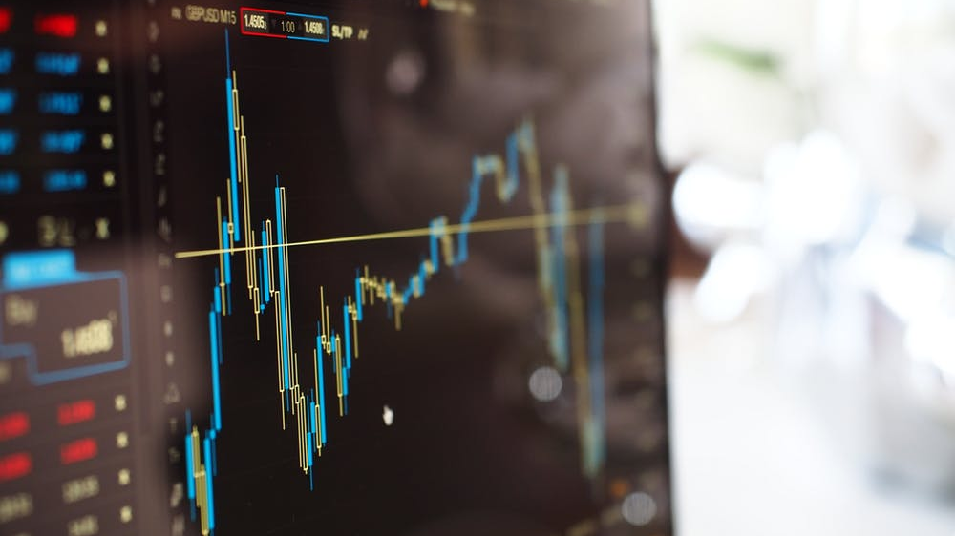
GETTING TO KNOW THE STOCK MARKET
Presented by Komron, Louis, Mark, and Mick

Slide 2

LEARNING FROM THE MARKET THROUGH ANALYSIS
Our project will attempt to uncover patterns and indicators in the stock market.
We will analyze a diverse group of publicly traded stocks after various major events.
Through data analysis and visualizations, we will examine each stock’s performance and search objectively for trends as the data permits.

Slide 3

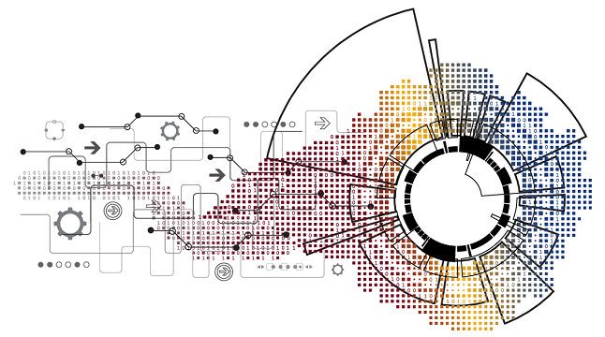
DATA CLEANUP & EXPLORATION
Data was obtained from a standardized historical stock library.
Data obtained in the format of open-high-low-close-volume.
Only cleanup required was the conversion of the date from string to datetime format. This was accomplished in Pandas.
One interesting problem we encountered was the price scale when plotting a stock versus the stock index such as the Dow Jones. The stock was in the <$100 range while the Dow may have been in the $11,000 range.
The insights that we discovered will be discussed with each event.

Slide 4

DOT-COM BUBBLE/BUST March 13th, 2000
DEFINITION of 'Bellwether Stock' A stock that is believed to be a leading indicator of the direction of a sector, industry or market as a whole. Bellwether stocks are often used to determine the direction in which an industry or market is headed in the short term.
The dotcom bubble occurred in the late 1990s and was characterized by a rapid rise in equity markets fueled by investments in Internet-based companies. During the dotcom bubble, the value of equity markets grew exponentially, with the technology-dominated NASDAQ index rising from under 1,000 to more than 5,000 between 1995 and 2000.

Slide 5
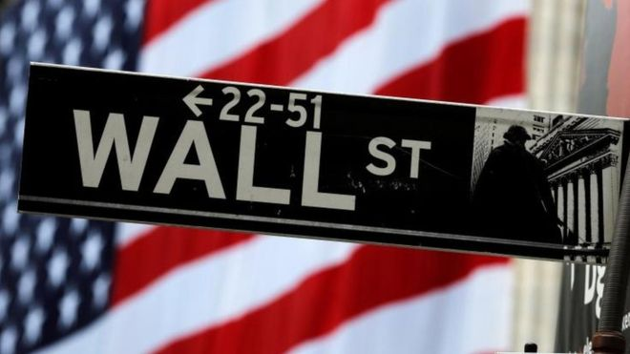
Wall Street’s Record Century
December 31, 1999: 6:33 p.m. ET Dow, Nasdaq, S&P cap phenomenal year, decade at all-time highs By Staff Writer Jill Bebar
Practically anything with a "dot.com” at the end of its name could expect to see its stock price double, triple or quadruple in a few months, profit or no profit. And investors, eager to cash in, joined the party by the thousands, thanks in large measure to discount brokerage firms, mutual funds and online trading accounts.
In taxis, restaurants and offices across America, people talk about stocks with the same passion as they talk about their favorite baseball team or the latest episode of a hot TV sitcom. Wall Street experts such as Abby Joseph Cohen, Ralph Acampora and Peter Lynch have become household names. And when Fed chairman Greenspan crosses a Washington street on the day of a crucial meeting on interest rates, all eyes turn to his briefcase for clues to the Fed’s next move.

Slide 6
THE TIMELINE
DATE | EVENT
1994 | Amazon Founded
1995 | EBay Founded
1998 | Pets.com Founded
1999 | Webvan Founded
January 10th, 2000 | AOL merged with Time Warner
January 14th, 2000 | Dow Jones peaks at $11,705.28
January, 30th, 2000 | 17 Dot-Com companies advertised in the Super Bowl
March 10th, 2000 | Nasdaq peaks $5132.52 (Monday)
March 13th, 2000 | Markets open 4% lower (Friday)
January 8th, 2001 | Three (3) Dot-Com companies advertise in the Super Bowl
April 2001 | Telecomm Crash

Slide 7
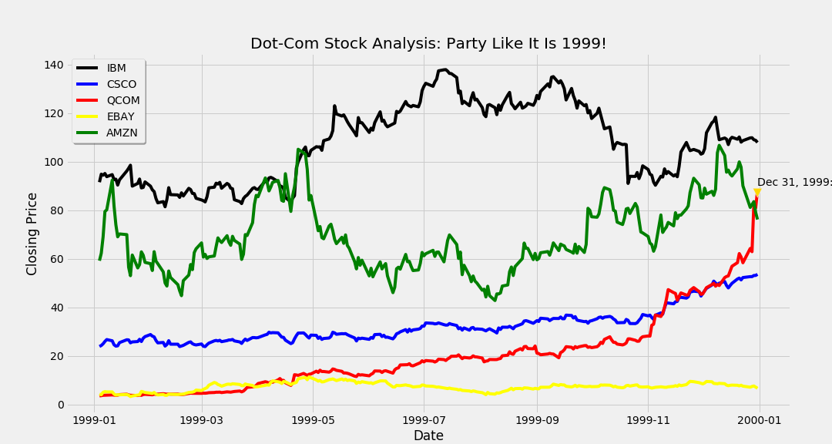

Slide 8
Dot-Com Bubble Has Burst; Will Things Worsen in 2001? By Kara Swisher Staff Reporter of The Wall Street Journal Updated Dec. 18, 2000 11:59 p.m. ET
Here's a rock-solid prediction for the Internet in 2001: Jeff Bezos will not be selected Time's Man of the Year.
Was it only a year ago that the founder of Amazon.com was beaming from the front of that magazine, an icon of the New Economy that had taken the world by storm? The choice of Bezos as a cover boy made complete sense at the time. He and other Young Turks on the Web had overturned the old order, sparked an electronic revolution and become impossibly rich.
Impossible, it turns out, was the operative word. Since then, the euphoria (and market capitalization) of the industry has been cut to shreds and some of its most prominent companies are in extreme distress. Few could have imagined that many of the brightest lights of Silicon Valley would lose most of their luster so suddenly.

Slide 9
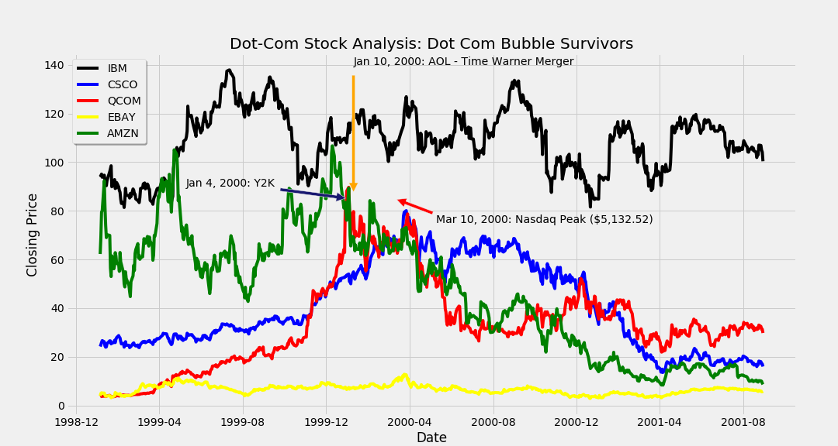

Slide 10

SUMMARY
Pets.com file bankruptcy in November 2000. The IPO launched with $300M in investment capital. The IPO to liquidation took 268 days.
Webvan shutdown in June of 2001.
Cisco stock price declined 86% during the crash.
EBay and Amazon survived and thrived. Amazon is currently one of the largest companies by market capitalization in the world.
By 2004 only 48% of the Dot-Com Companies survived.
IBM is a bellwether stock. As you can see, while other stocks had severe declines, IBM held its value. It did suffer through peaks and valleys but investors fled to stocks such as IBM.

Slide 11

BUT WHAT IF I HAD MORE TIME!?
We would have done a comparison analysis of today’s seeming bubble versus this and other bubbles. We would be searching for indicators that told us that the crash was imminent so that we could react appropriately.
We would use sentiment analysis to predict the rise and fall of markets and specific stocks, thus acting as a leading indicator.
Notes:
Last slide of Komron’s presentation.

Slide 12
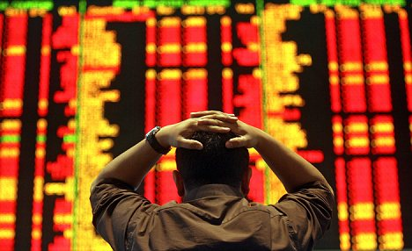
2008 STOCK MARKET CRASH
How did the 2008 stock market crash effect key stocks in each sector of the market?
Which stocks were most/least effected by the crash?
Which stock regained its pre-crash level first?

Slide 13
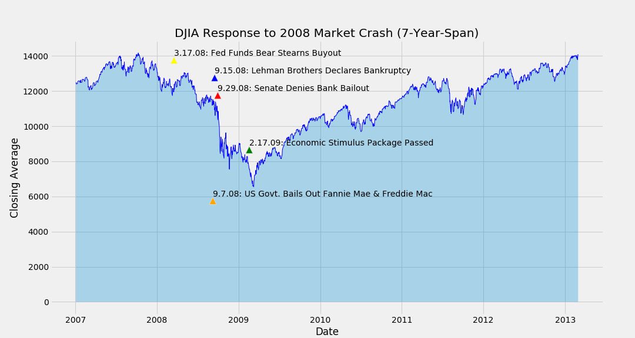

Slide 14
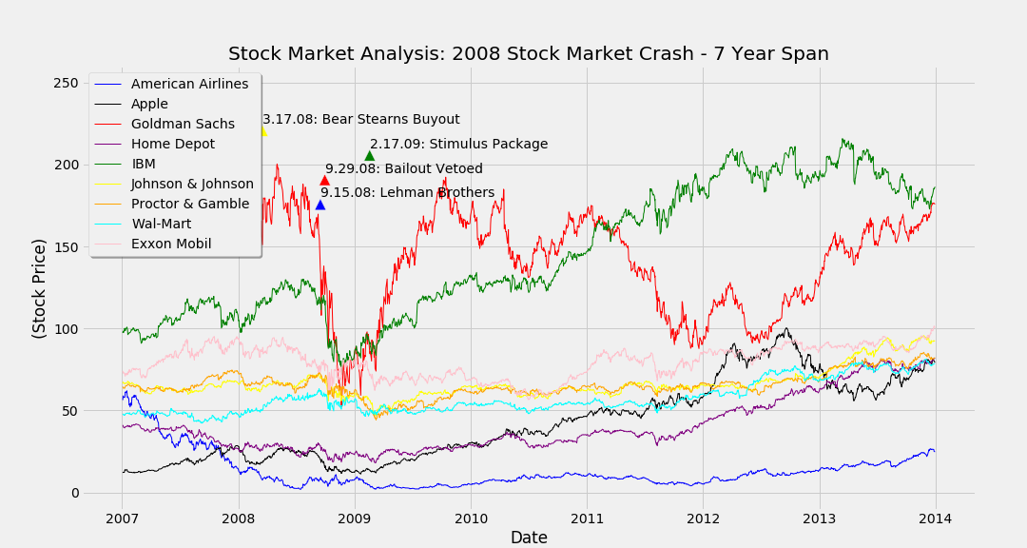

Slide 15
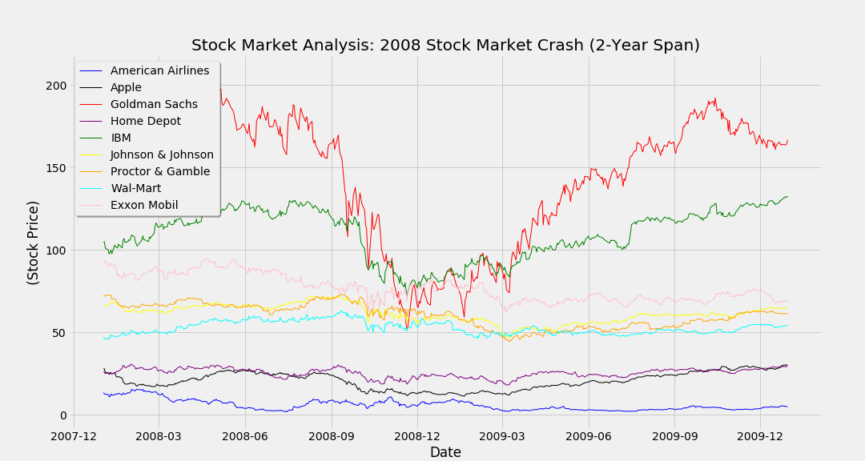

Slide 16
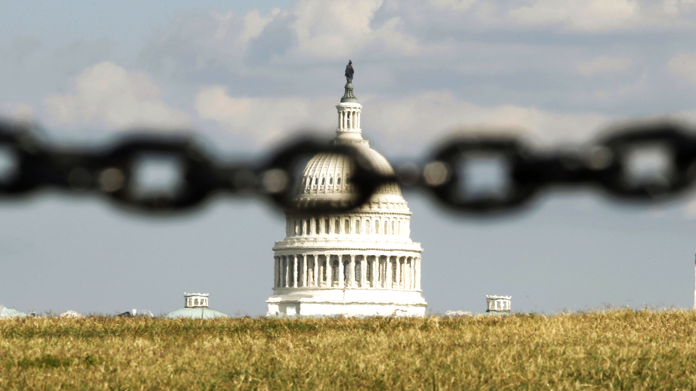
2013 GOVERNMENT SHUTDOWN
In 2013, the federal government shutdown from October 1st to October 17th.
During the shutdown, approximately 800,000 federal employees were indefinitely furloughed, and another 1.3 million were required to report to work without known payment dates.
The deadlock that shutdown the government was centered on the Continuing Appropriations Resolution which was passed by the House of Representatives on September 20, 2013.

Slide 17

IMMEDIATE QUESTIONS
Does a government shutdown shape the market?
Does it have a lasting impact?
Can we pinpoint specific dates that have a significant effect on the market?
Notes:
Komron’s presentation begins.

Slide 18
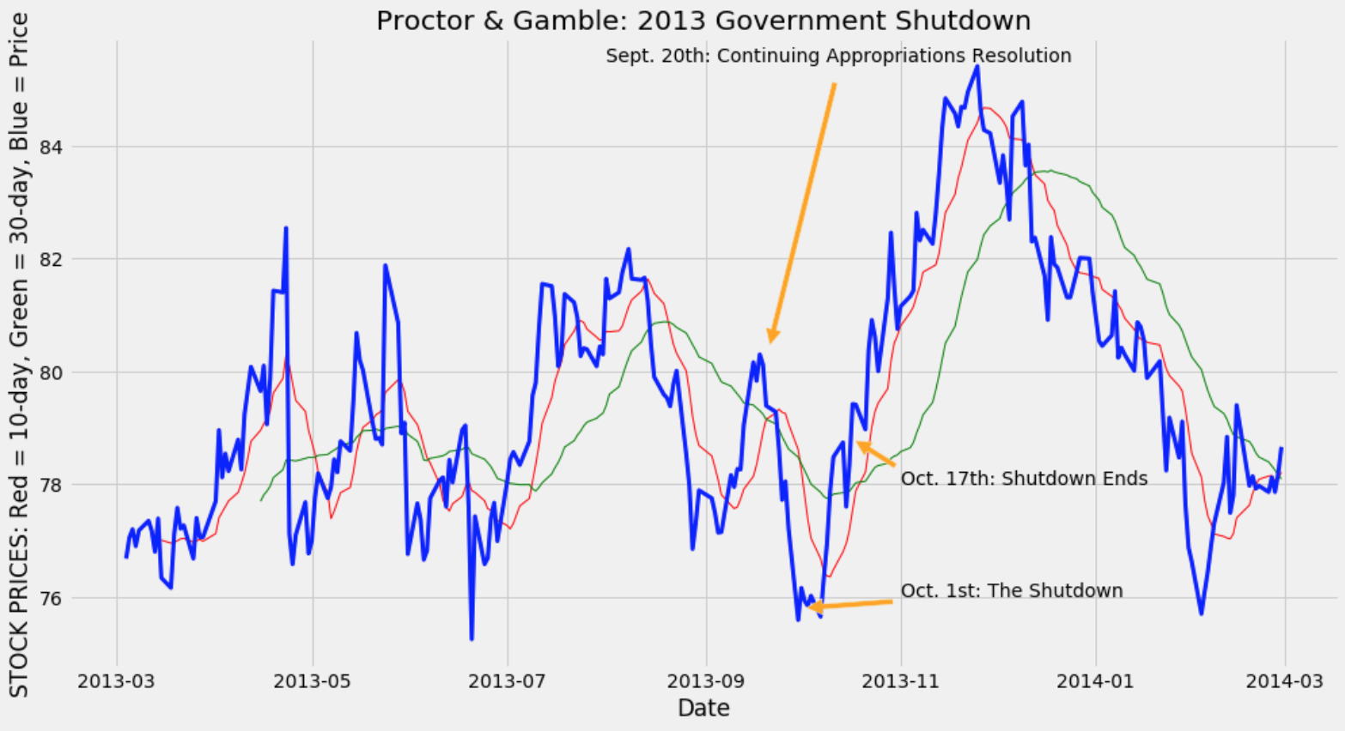

Slide 19
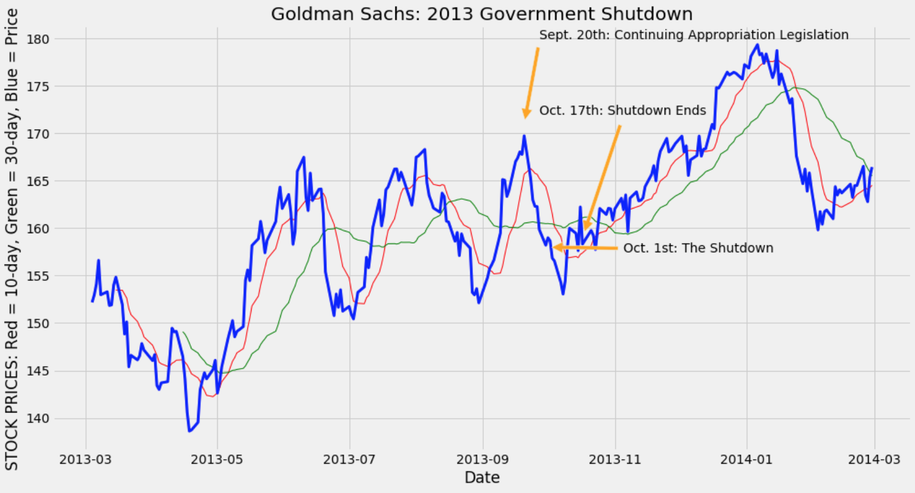

Slide 20
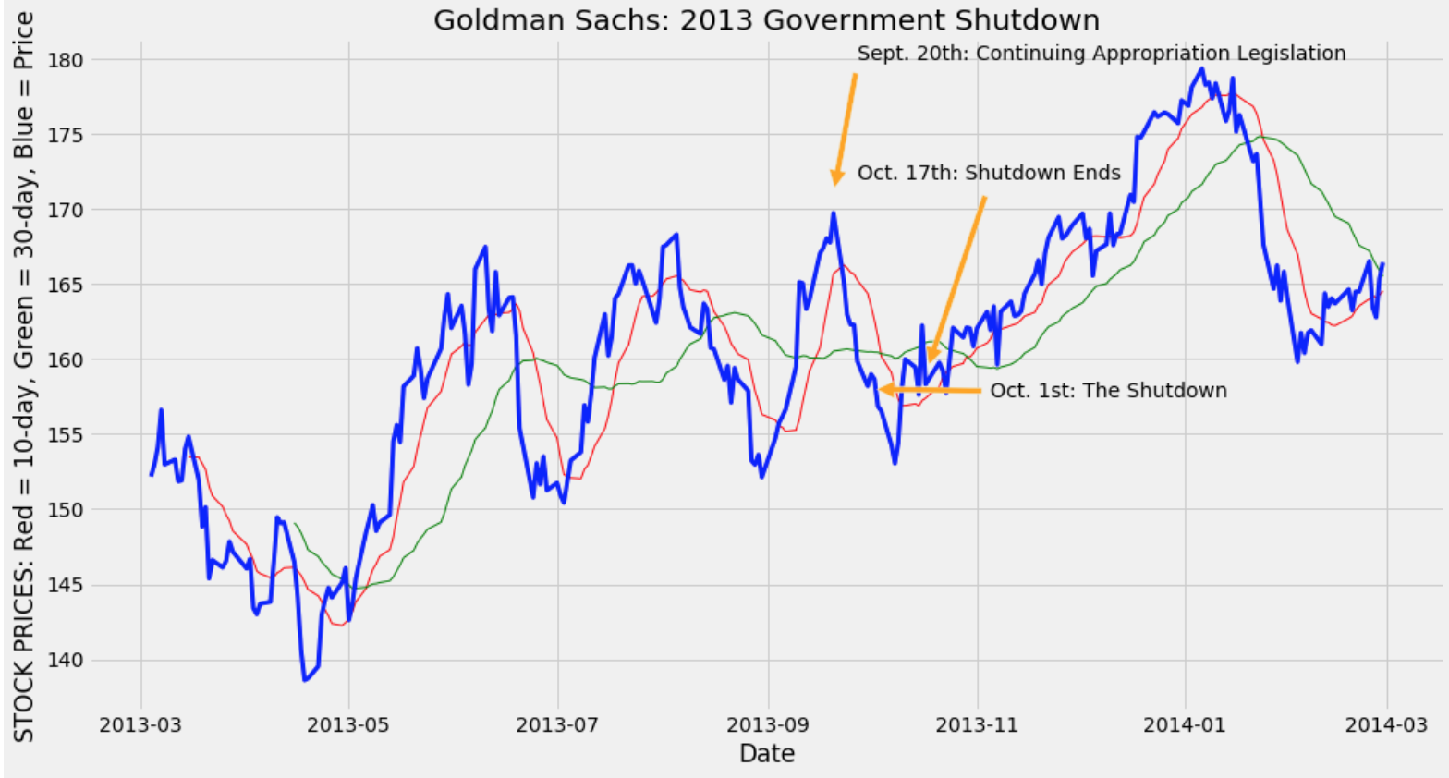

Slide 21

SUMMARY
With the limited amount of information shown, there does appears to be a connection between the 2013 government shutdown and the examined stocks.
But when you look at the scope of the year, it’s hard to differentiate the government shutdown with the other highs and lows.
The shutdown was followed by an abnormally large rebound, is this a result of the shutdown or a coincidence?
It would be good to look at other shutdowns or near-shutdowns and see how they shaped the market.
Sentient analysis could be an interesting tool to examine news articles, to see how the media connected the markets to the information coming out of the federal government.

Slide 22
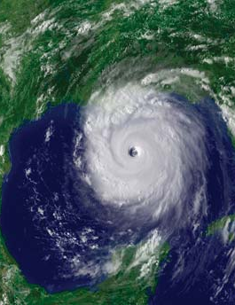
HURICANE KATRINA AUGUST 23rd, 2005
Can we measure the variance of an event’s effect across different stocks?
Is there a different pattern of recovery for each stock price in the time period following the event?

Slide 23

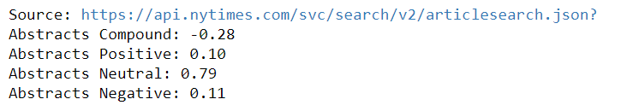
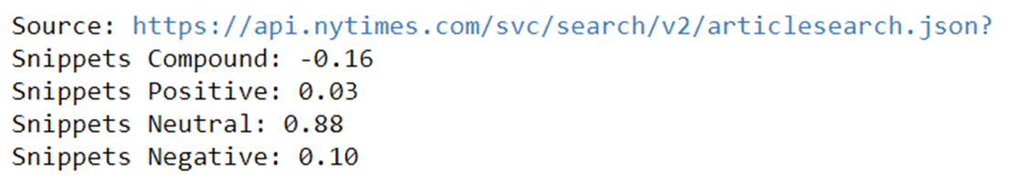
SENTIMENT ANALYSIS

Slide 24
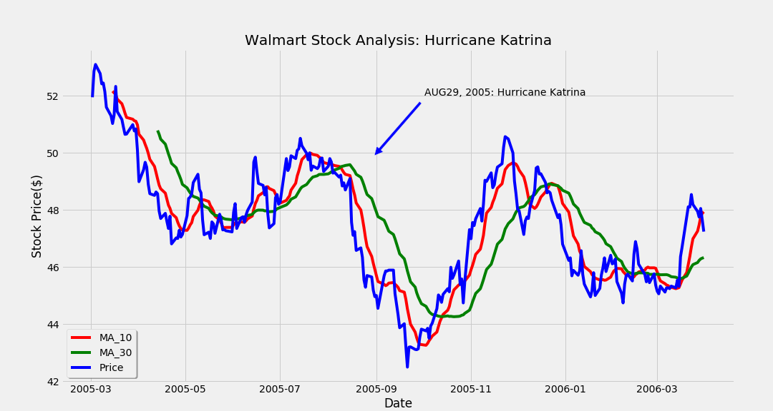

Slide 25
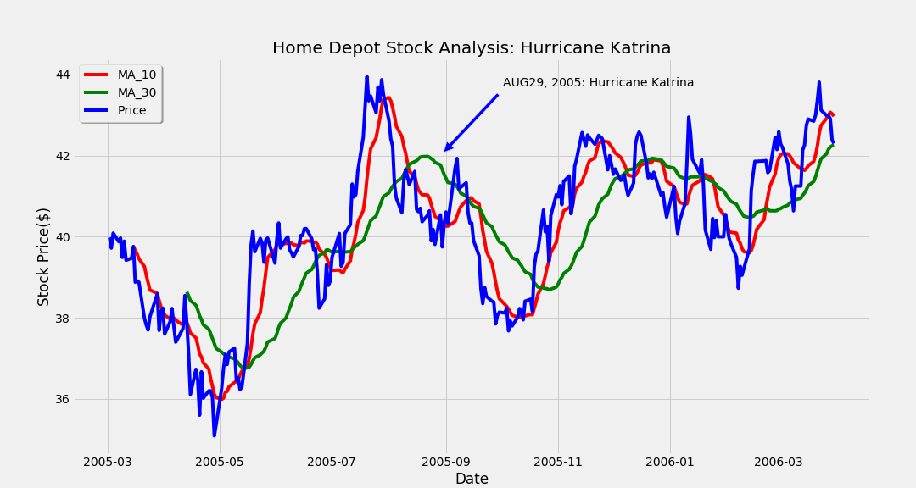

Slide 26
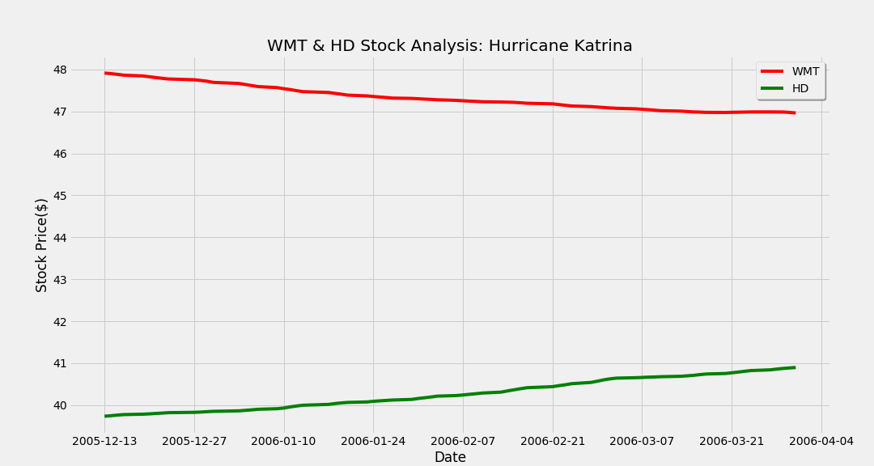

Slide 27
BUT WHAT IF I HAD MORE TIME!?
Analyze a similar event from a different time period. Comparable results would provide a degree of validation of current observations.
Notes:
Last slide of Komron’s presentation.

Slide 28


ANY QUESTIONS?

Slide 29

WHAT WE LEARNED
Teamwork makes the dream work.

