Slide 1

Natural Language Processing With Python
Chapter2-Accessing Text Corpora and Lexical Resources
Jianzhang Zhang
jianzhang.zhang@foxmail.com

Slide 2
Goals of This Chapter
What are some useful text corpora and lexical resources, and how can we access them with Python?
Which Python constructs are most helpful for this work?
How do we avoid repeating ourselves when writing Python code?

Slide 3
1 Accessing Text Corpora

Slide 4
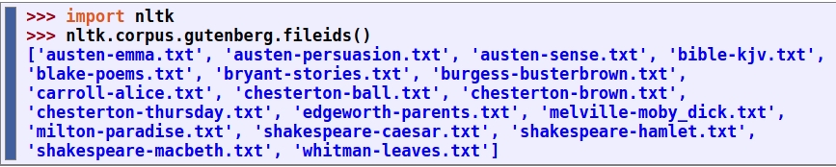
1.1 Gutenberg Corpus
NLTK includes a small selection of texts from the Project Gutenberg electronic text archive, which contains some 25,000 free electronic books, hosted at http://www.gutenberg.org/.

Slide 5
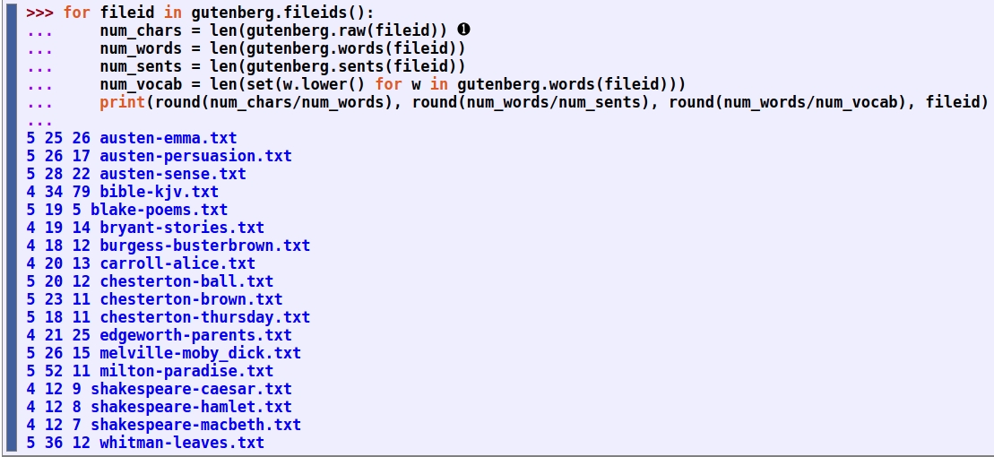
1.1 Gutenberg Corpus (contd.)
Observe that average word length appears to be a general property of English, since it has a recurrent value of 4. (In fact, the average word length is really 3 not 4, since the num_chars variable counts space characters.) By contrast average sentence length and lexical diversity appear to be characteristics of particular authors.

Slide 6
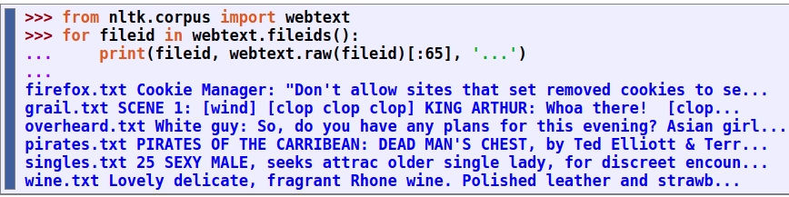
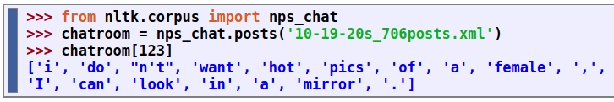
1.2 Web and Chat Text
It is important to consider less formal language as well. NLTK's small collection of web text includes content from a Firefox discussion forum, conversations overheard in New York, the movie script of Pirates of the Carribean, personal advertisements, and wine reviews

Slide 7
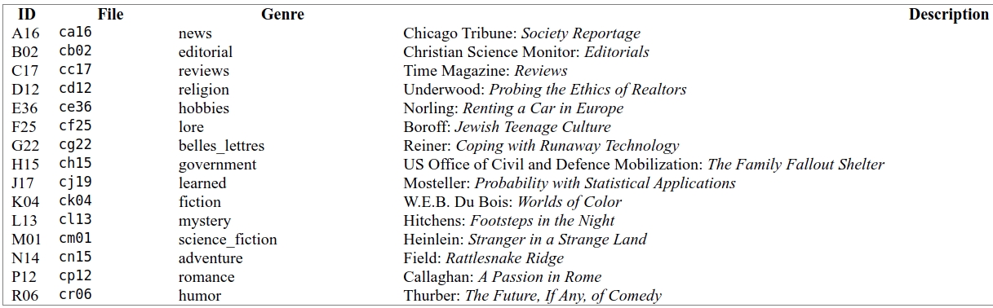
1.3 Brown Corpus
The Brown Corpus was the first million-word electronic corpus of English, created in 1961 at Brown University. This corpus contains text from 500 sources, and the sources have been categorized by genre, such as news, editorial, and so on.

Slide 8
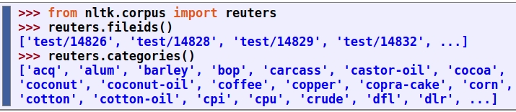
1.4 Reuters Corpus
The Reuters Corpus contains 10,788 news documents totaling 1.3 million words. The documents have been classified into 90 topics, and grouped into two sets, called "training" and "test"; thus, the text with fileid 'test/14826' is a document drawn from the test set. This split is for training and testing algorithms that automatically detect the topic of a document.

Slide 9
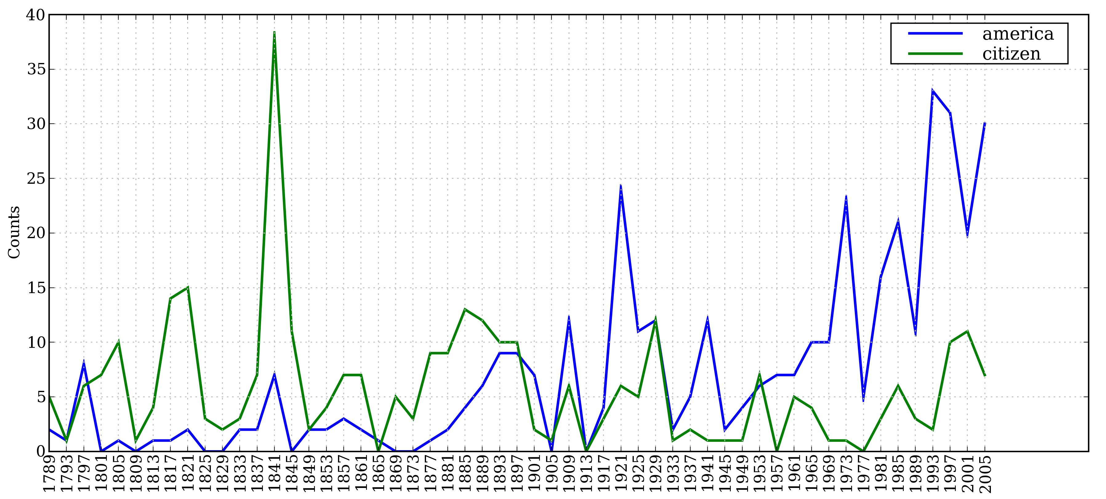
1.5 Inaugural Address Corpus
An interesting property of this collection is its time dimension.

Slide 10
1.6 Annotated Text Corpora
Many text corpora contain linguistic annotations, representing POS tags, named entities, syntactic structures, semantic roles, and so forth. NLTK provides convenient ways to access several of these corpora, and has data packages containing corpora and corpus samples, freely downloadable for use in teaching and research.
https://www.nltk.org/howto/corpus.html

Slide 11
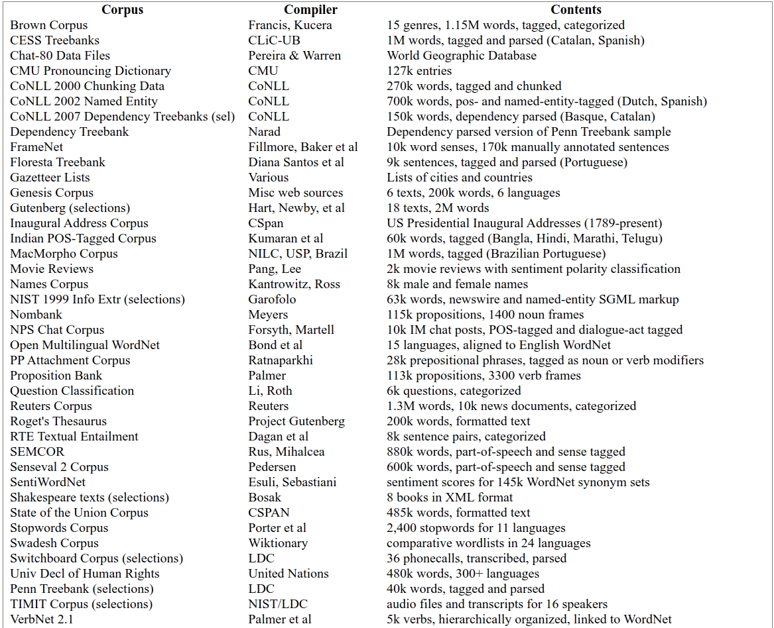

Slide 12
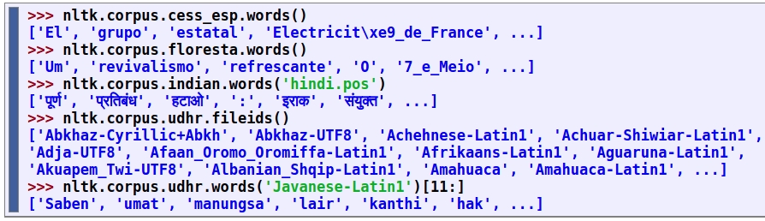
1.7 Corpora in Other Languages
NLTK comes with corpora for many languages, though in some cases you will need to learn how to manipulate character encodings in Python before using these corpora.

Slide 13
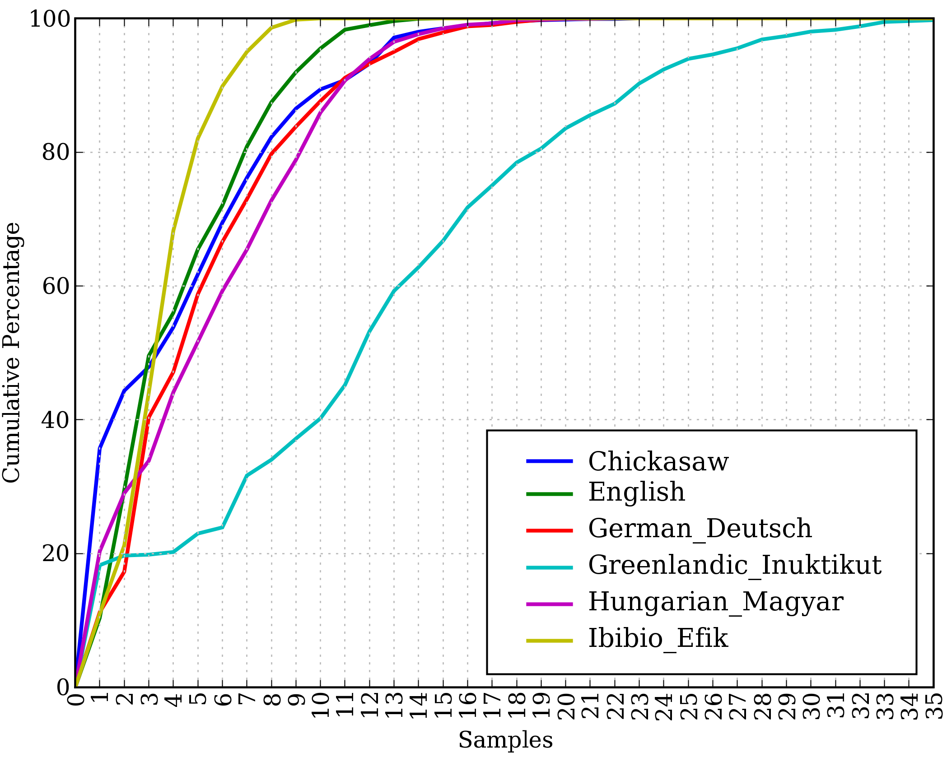
1.7 Corpora in Other Languages (contd.)
Cumulative Word Length Distributions: Six translations of the Universal Declaration of Human Rights are processed; this graph shows that words having 5 or fewer letters account for about 80% of Ibibio text, 60% of German text, and 25% of Inuktitut text.

Slide 14
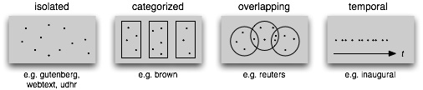
1.8 Text Corpus Structure
Common Structures for Text Corpora: The simplest kind of corpus is a collection of isolated texts with no particular organization; some corpora are structured into categories like genre (Brown Corpus); some categorizations overlap, such as topic categories (Reuters Corpus); other corpora represent language use over time (Inaugural Address Corpus).

Slide 15
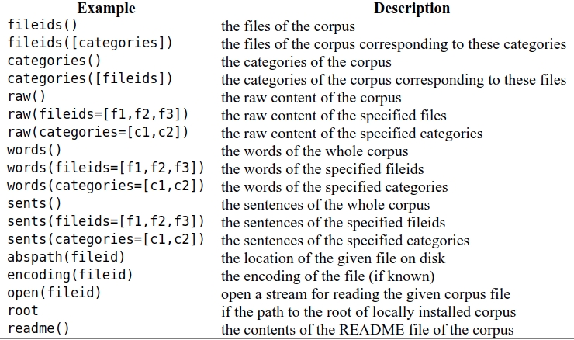
1.8 Text Corpus Structure (contd.)
Basic Corpus Functionality defined in NLTK

Slide 16
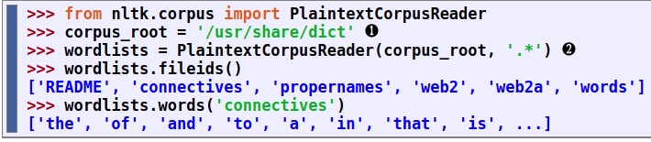
1.9 Loading your own Corpus
If you have your own collection of text files that you would like to access using the above methods, you can easily load them with the help of NLTK's PlaintextCorpusReader.

Slide 17
2 Conditional Frequency Distributions

Slide 18
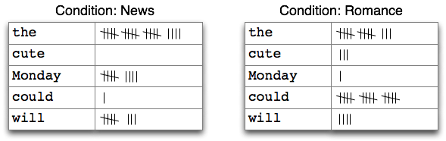
2.1 Conditions and Events
A conditional frequency distribution is a collection of frequency distributions, each one for a different "condition". The condition will often be the category of the text.
Counting Words Appearing in a Text Collection (a conditional frequency distribution)

Slide 19
2.1 Conditions and Events (contd.)
A frequency distribution counts observable events, such as the appearance of words in a text. A conditional frequency distribution needs to pair each event with a condition. So instead of processing a sequence of words, we have to process a sequence of pairs.
Each pair has the form (condition, event). If we were processing the entire Brown Corpus by genre there would be 15 conditions (one per genre), and 1,161,192 events (one per word).

Slide 20
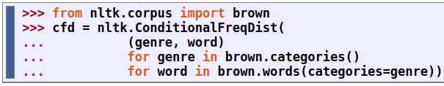
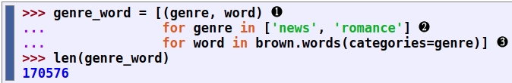
2.2 Counting Words by Genre
Whereas FreqDist() takes a simple list as input, ConditionalFreqDist() takes a list of pairs.
Let's break this down, and look at just two genres, news and romance. For each genre, we loop over every word in the genre, producing pairs consisting of the genre and the word:

Slide 21
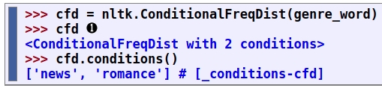
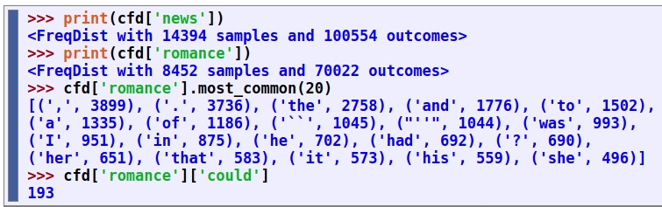
2.2 Counting Words by Genre (contd.)
Let's access the two conditions, and satisfy ourselves that each is just a frequency distribution:

Slide 22
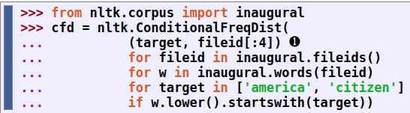
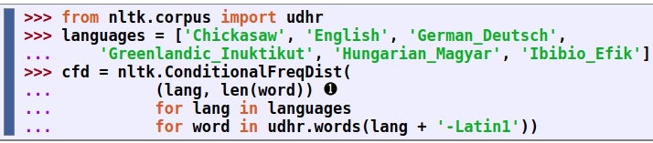
2.3 Plotting and Tabulating Distributions
Apart from combining two or more frequency distributions, and being easy to initialize, a ConditionalFreqDist provides some useful methods for tabulation and plotting.

Slide 23
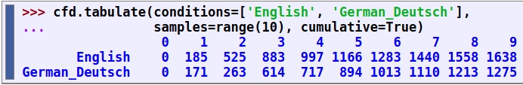
2.3 Plotting and Tabulating Distributions (contd.)
In the plot() and tabulate() methods, we can optionally specify which conditions to display with a conditions= parameter. Similarly, we can limit the samples to display with a samples= parameter.
It also gives us full control over the order of conditions and samples in any displays.

Slide 24
To be continued

