Slide 1
Sigmoid 实验结果

Slide 2
Summary
method | E_{max} | E_{avg} | Input format | Output format | LUT | FF | DSP | delay | power
16_16 | 5.72E-4 | 8.6E-5 | 16-bit FXP | 16-bit FXP | 305 | 180 | 6 | 100ns | 12mw
16_8 | 8.176E-3 | 4.637E-3 | 16-bit FXP | 8-bit FXP | 305 | 180 | 6 | 100ns
8_8 | 1.83E-2 | 5.42E-3 | 8-bit FXP | 8-bit FXP | 126 | 78 | 5 | 60ns | 8mw
PLAN8 | 2.35E-2 | 6.64E-3 | 8-bit FXP | 8-bit FXP | 97 | 55 | 0 | 20ns
16_16_200mhz | 5.72E-4 | 8.6E-5 | 16-bit FXP | 16-bit FXP | 351 | 325 | 6 | 85ns | 26mw
16_8_200mhz | 8.21E-3 | 4.641E-3 | 16-bit FXP | 8-bit FXP | 340 | 309 | 6 | 85ns | 24mw
8_8_200mhz | 1.8309E-2 | 4.717E-3 | 8-bit FXP | 8-bit FXP | 142 | 159 | 5 | 55ns | 19mw
16_16_200mhzPLAN | 1.8941E-2 | 5.869E-3 | 16-bit FXP | 16-bit FXP | 235 | 153 | 0 | 30ns | 9mw
16_8_200mhzPLAN | 2.5368E-2 | 7.194E-3 | 16-bit FXP | 8-bit FXP | 230 | 148 | 0 | 30ns | 9mw
8_8_200mhzPLAN | 2.3544E-2 | 6.64E-3 | 8-bit FXP | 8-bit FXP | 99 | 114 | 0 | 30ns | 5mw
16_16_200mhzHlsExpLib | 5.18E-4 | 1.16E-4 | 16-bit FXP | 16-bit FXP | 638 | 630 | 21 | 100ns

Slide 3
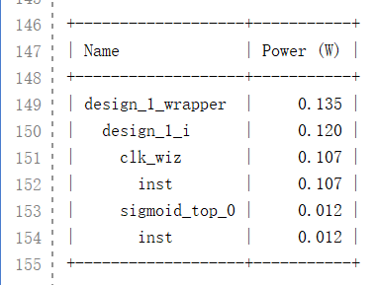

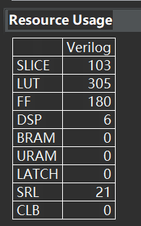
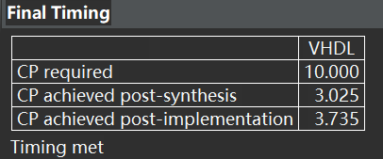
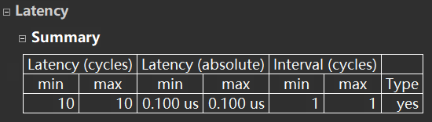
16bit input 16bit output

Slide 4

16bit input 8bit output

Slide 5
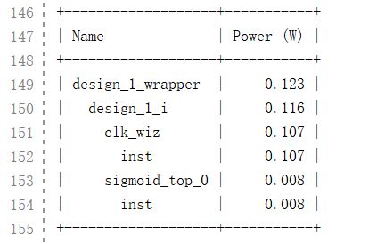
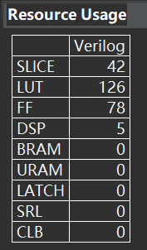

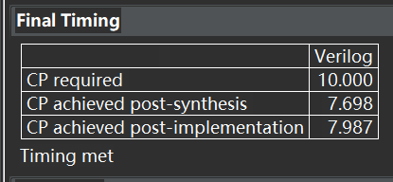
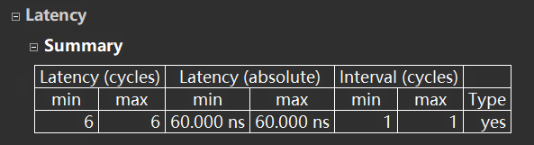
8bit input 8bit output

Slide 6
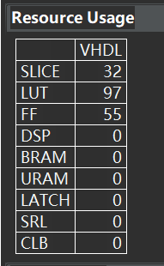

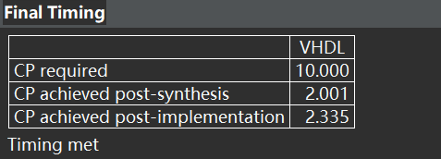
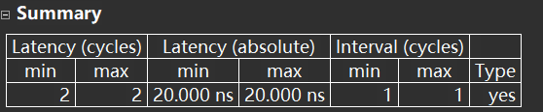
PLAN 8bit

Slide 7
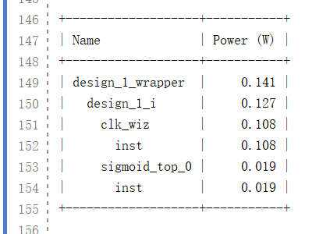

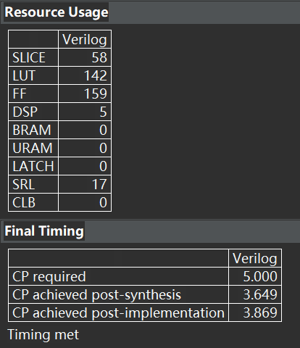
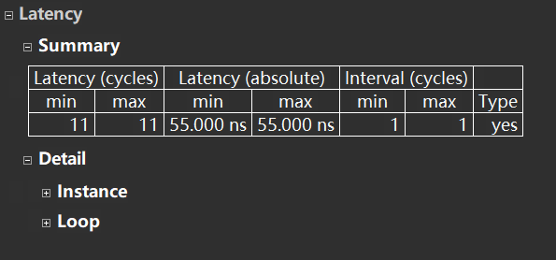
8bit input 8bit output 200mhz

Slide 8
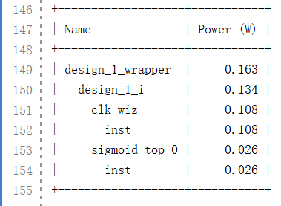
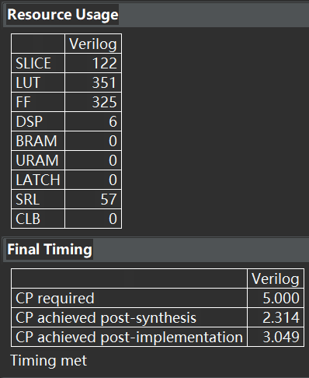
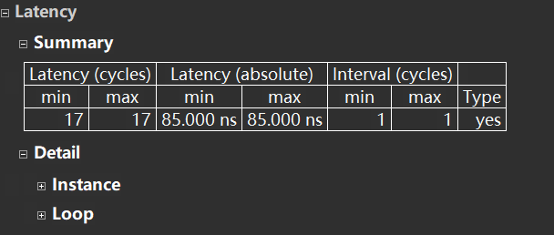
16bit input 16bit output 200mhz

Slide 9
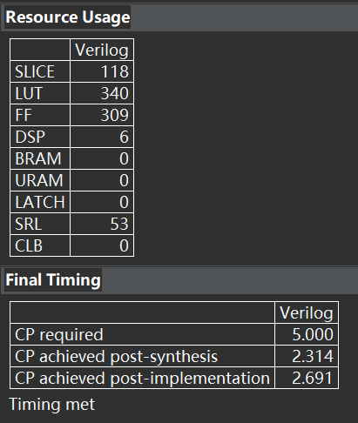

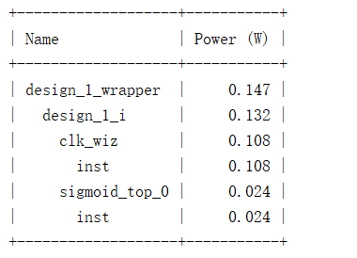
16bit input 8bit output 200mhz

Slide 10
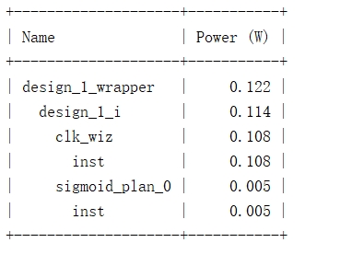
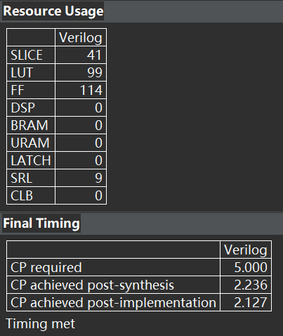

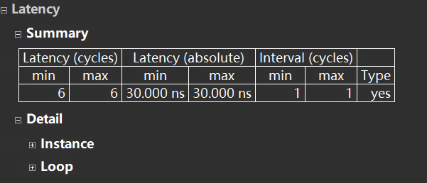
PLAN 8bit 200mhz

Slide 11
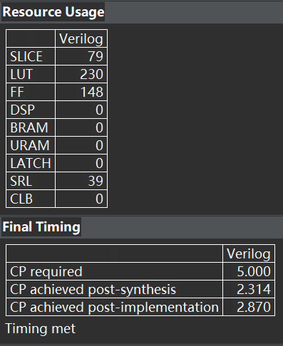
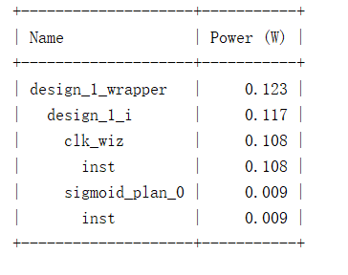

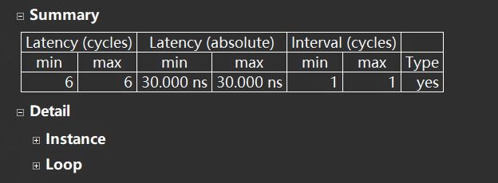
PLAN 16bit-8bit 200mhz

Slide 12
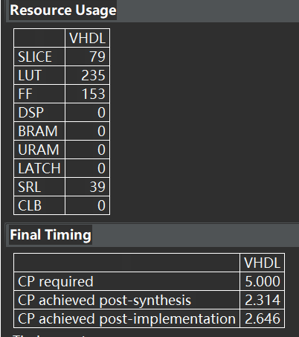

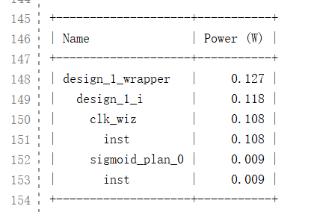
PLAN 16bit 200mhz

Slide 13
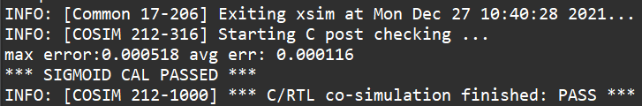
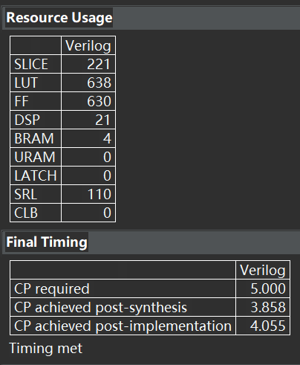
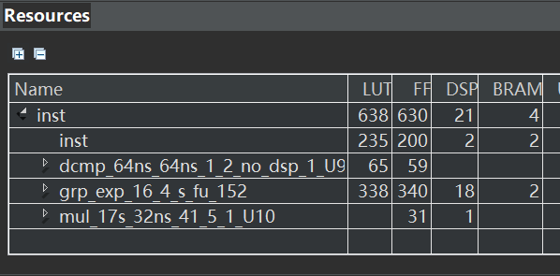
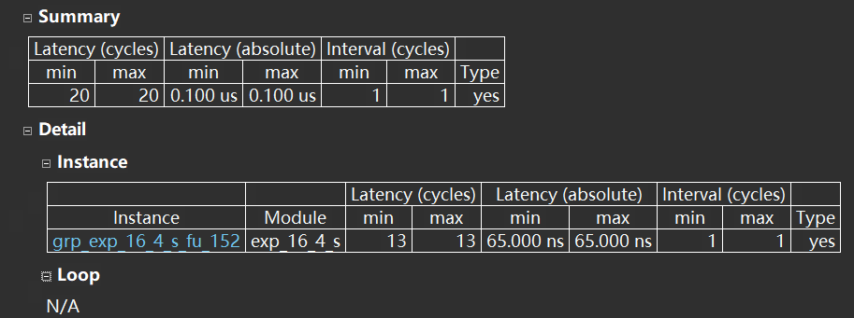
16bit input 16bit output HLS explib

Slide 14
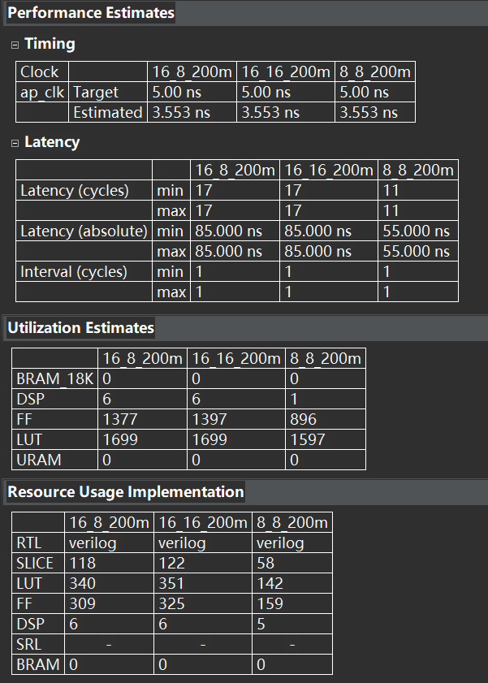
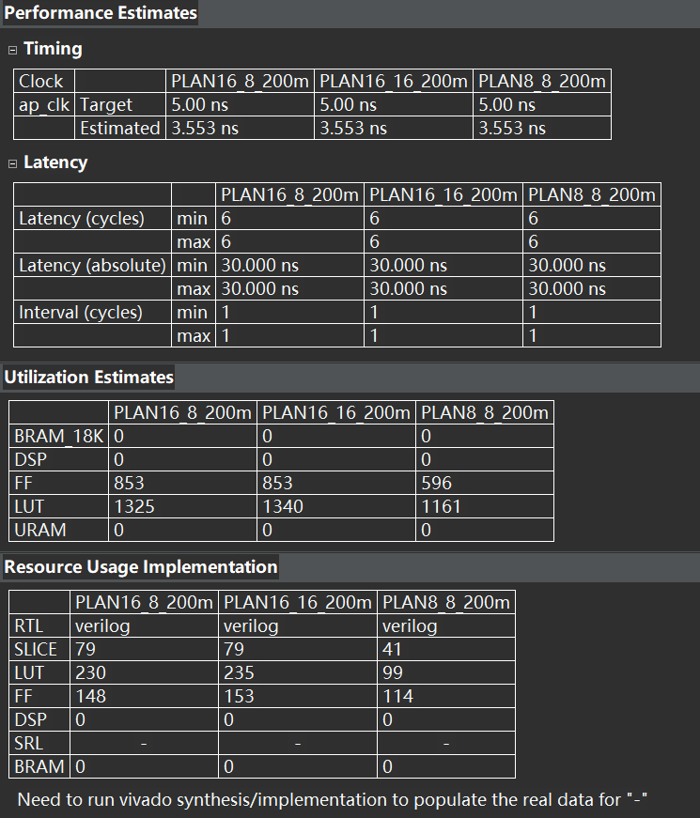
Report comparation

Slide 15
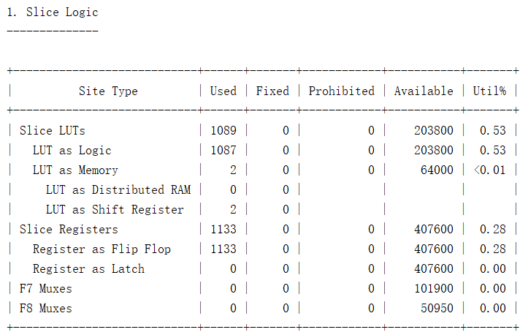
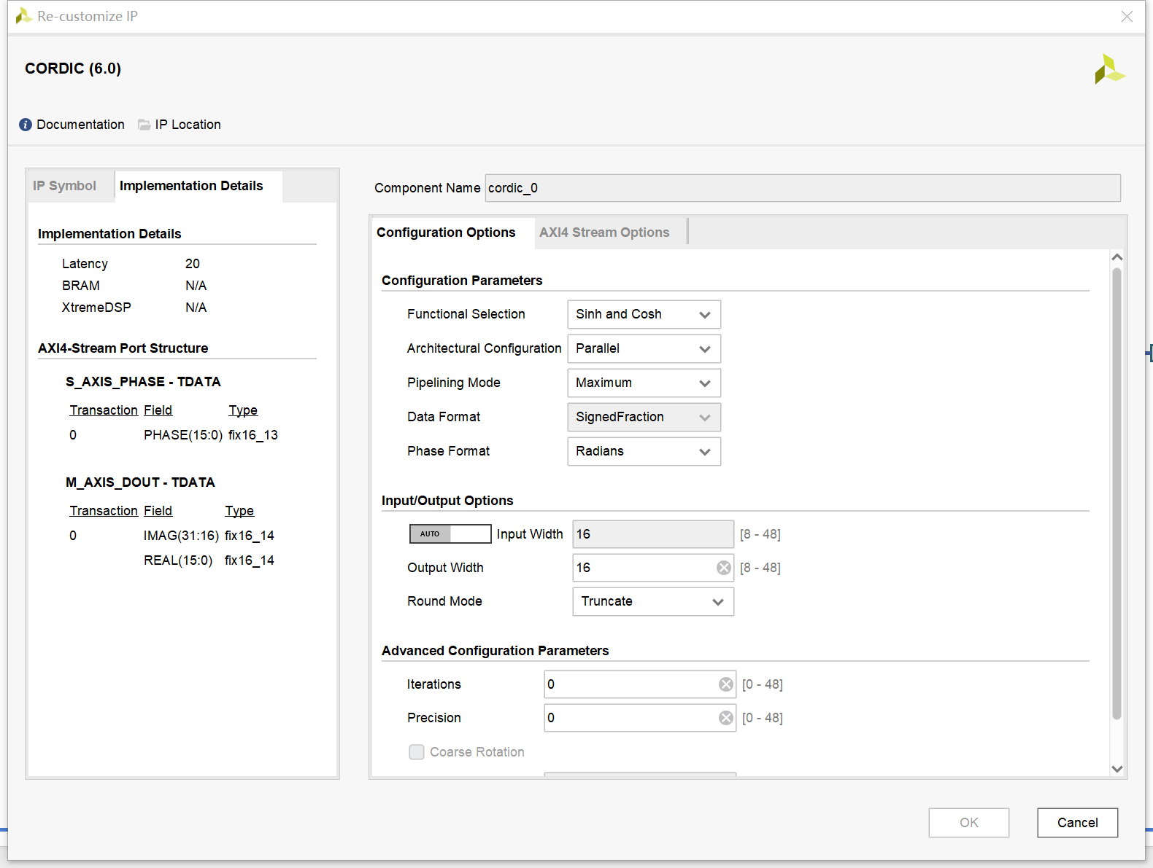
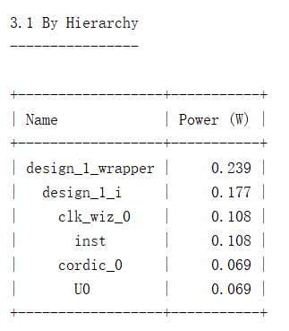
CORDIC parallel-maximum

Slide 16
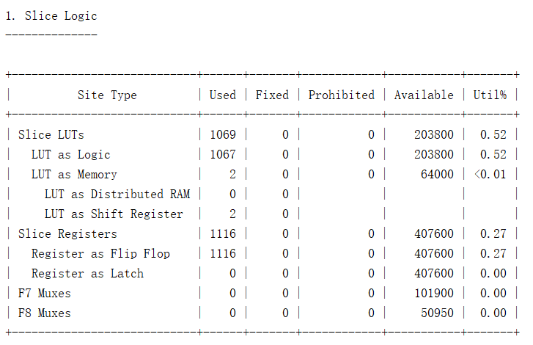
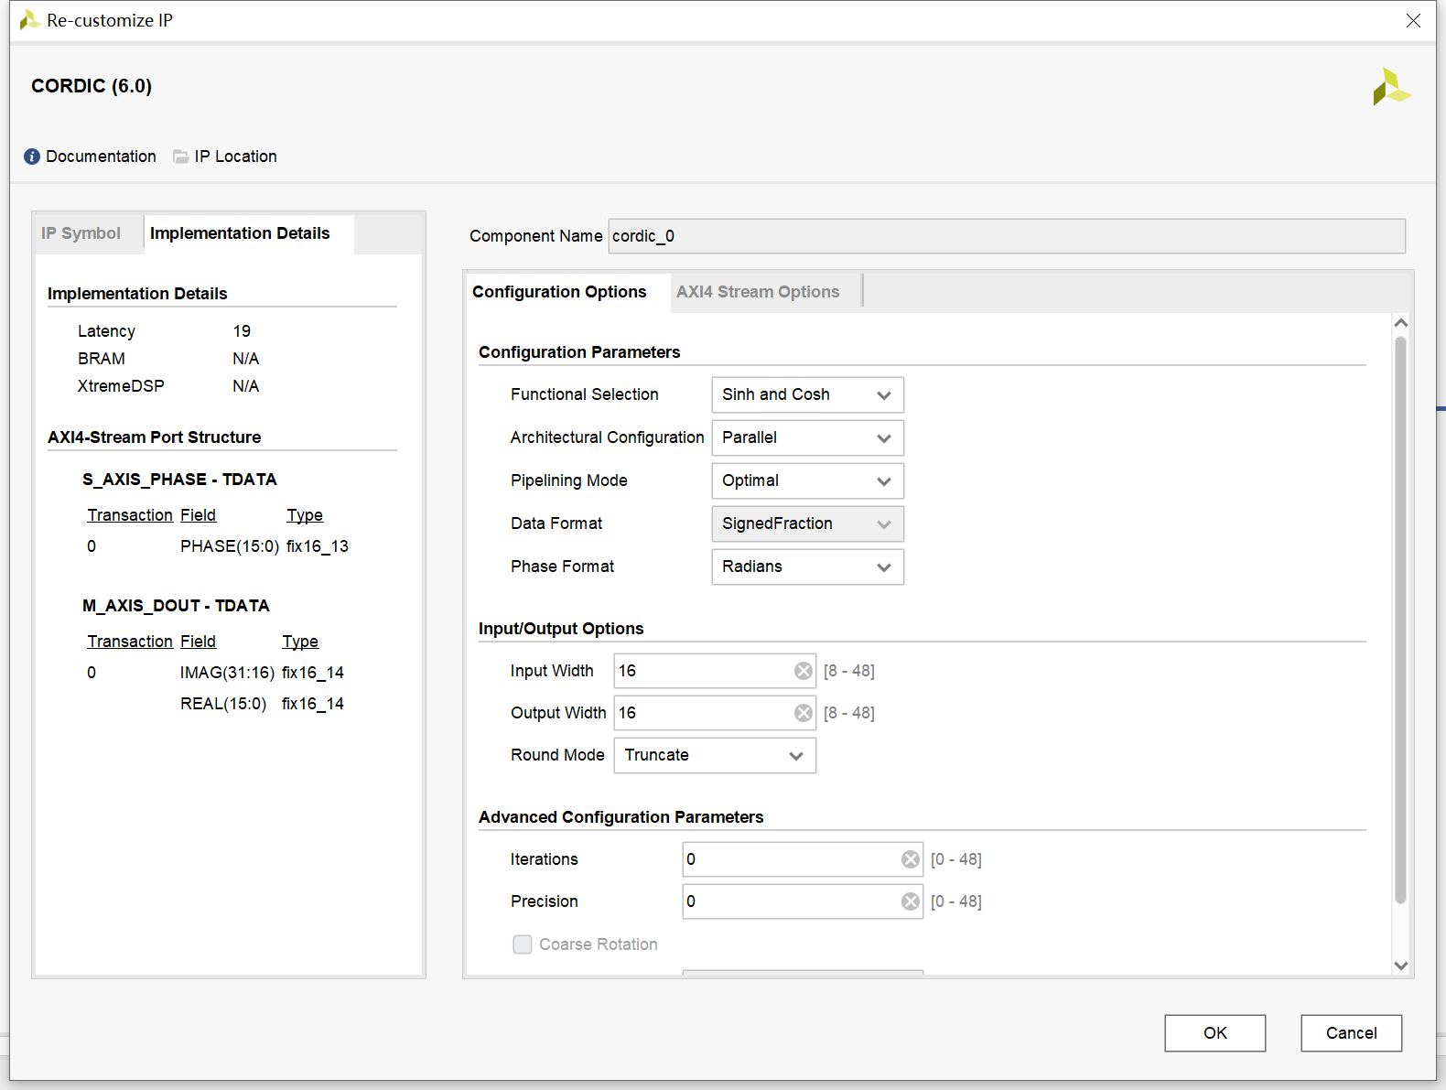
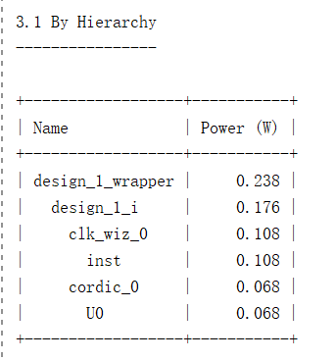
CORDIC parallel-optimal

Slide 17
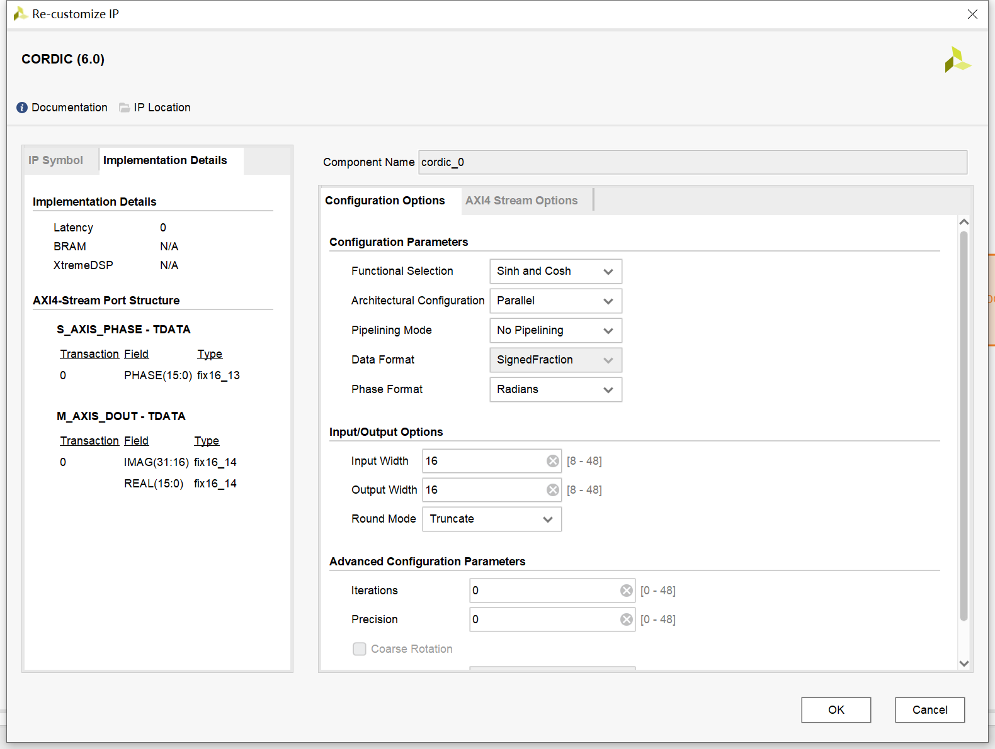
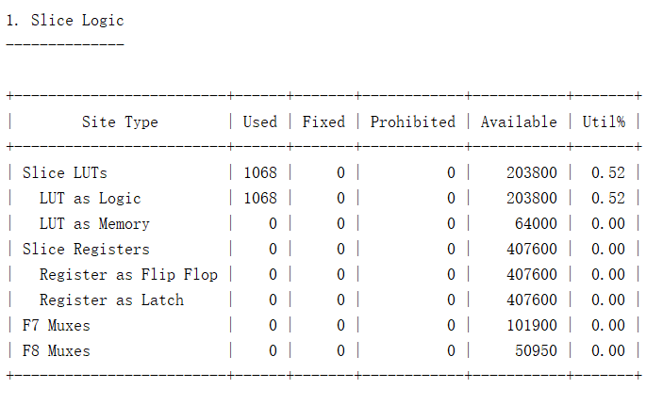
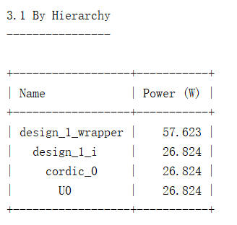
CORDIC parallel-no pipeline

Slide 18
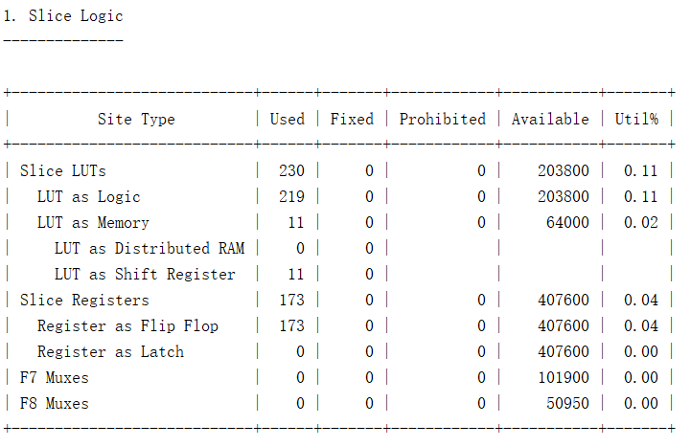

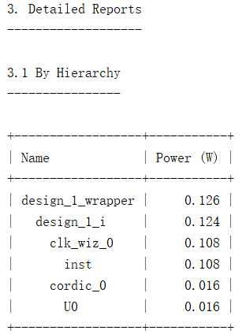
CORDIC word maximum

Slide 19
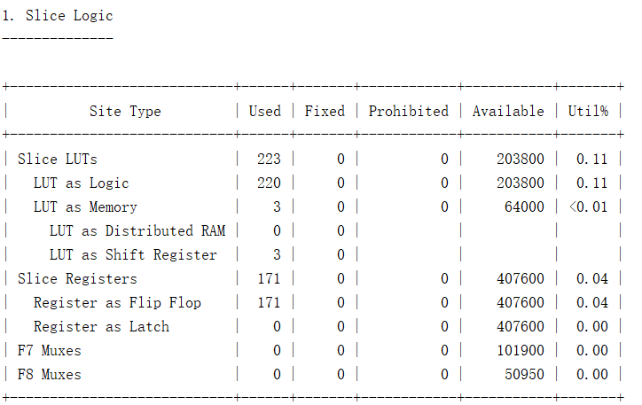
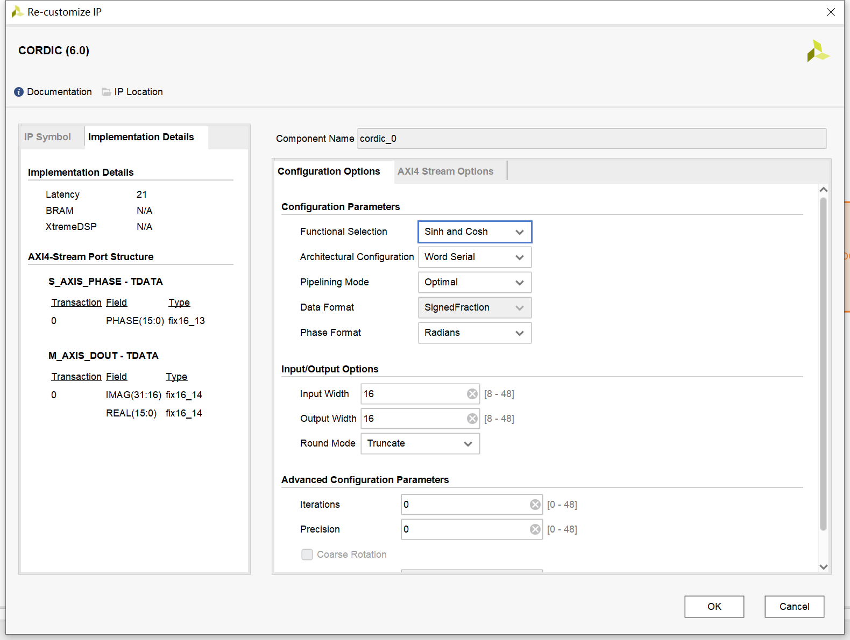
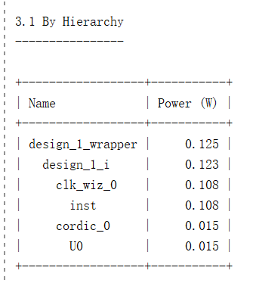
CORDIC word optimal

Slide 20
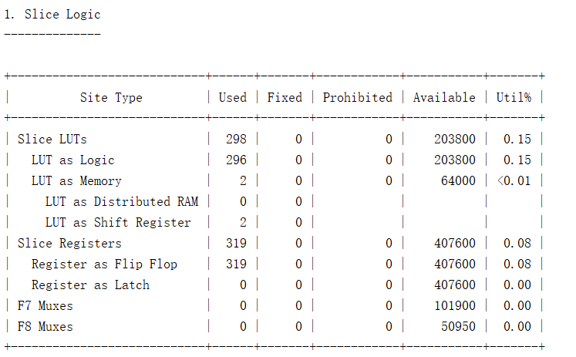
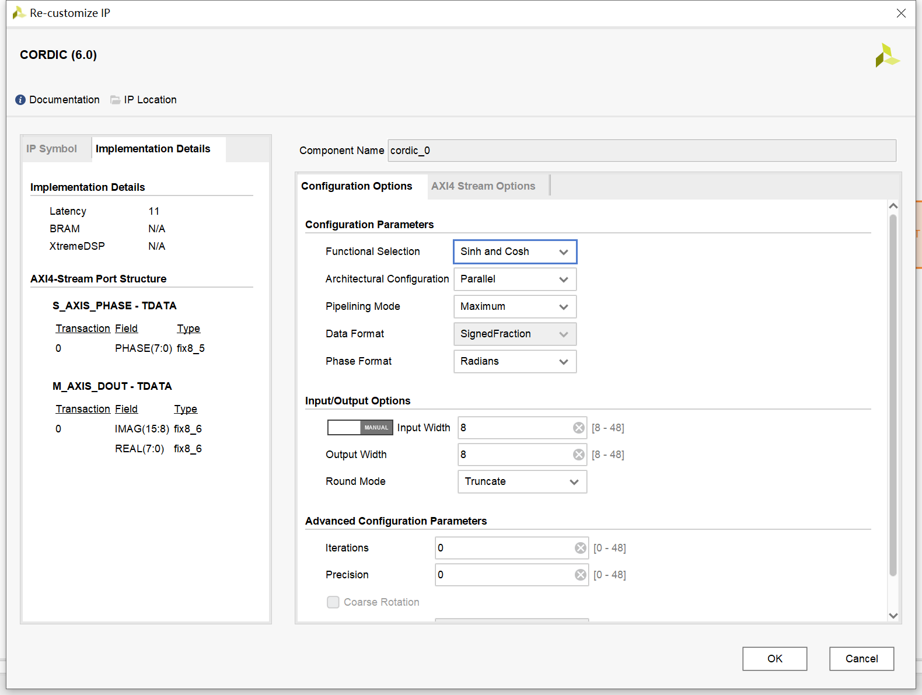
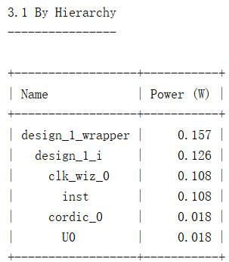
CORDIC parallel-maximum 88

Slide 21



CORDIC parallel-optimal 88

Slide 22



CORDIC word maximum 88

Slide 23



CORDIC word optimal 88

Slide 24



CORDIC parallel-maximum 16-8

Slide 25



CORDIC parallel-optimal 16-8

Slide 26



CORDIC word-maximum 16-8

Slide 27



CORDIC word-optimal 16-8

Slide 28

CORDIC table
method | Input format | Output format | LUT | FF | DSP | delay | power
Cordic_parallel_maximum_200mhz | 16-bit FXP | 16-bit FXP | 1089 | 1133 | 0 | 100ns | 69mw
Cordic_parallel_optimal_200mhz | 16-bit FXP | 16-bit FXP | 1069 | 1116 | 0 | 95ns | 68mw
Cordic_parallel_nopipeline | 16-bit FXP | 16-bit FXP | 1068 | 0 | 0 | 0ns | 26824mw
Cordic_wordseries_maximum_200mhz | 16-bit FXP | 16-bit FXP | 230 | 173 | 0 | 110ns | 16mw
Cordic_wordseries_optimal_200mhz | 16-bit FXP | 16-bit FXP | 223 | 171 | 0 | 105ns | 15mw
Cordic_parallel_maximum_200mhz | 16-bit FXP | 8-bit FXP | 300 | 323 | 0 | 55ns | 19mw
Cordic_parallel_optimal_200mhz | 16-bit FXP | 8-bit FXP | 290 | 310 | 0 | 50ns | 19mw
Cordic_wordseries_maximum_200mhz | 16-bit FXP | 8-bit FXP | 126 | 110 | 0 | 65ns | 8mw
Cordic_wordseries_optimal_200mhz | 16-bit FXP | 8-bit FXP | 114 | 108 | 0 | 60ns | 9mw
Cordic_parallel_maximum_200mhz | 8-bit FXP | 8-bit FXP | 298 | 319 | 0 | 55ns | 18mw
Cordic_parallel_optimal_200mhz | 8-bit FXP | 8-bit FXP | 288 | 310 | 0 | 50ns | 18mw
Cordic_wordseries_maximum_200mhz | 8-bit FXP | 8-bit FXP | 121 | 102 | 0 | 65ns | 8mw
Cordic_wordseries_optimal_200mhz | 8-bit FXP | 8-bit FXP | 115 | 100 | 0 | 60ns | 8mw

