Slide 1


Efficient Maximal Biclique Enumeration on GPUs
Zhe Pan, Shuibing He, Xu Li, Xuechen Zhang*, Rui Wang, Gang Chen
Zhejiang University, *Washington State University Vancouver

Slide 2
Outline
Introduction
Problem definition
MBE on CPUs
Related work comparison
Challenges of MBE on GPUs
Large memory requirement
Massive thread divergence
Load imbalance
GMBE : the first highly-efficient GPU solution for the MBE problem
Stack-based iteration with node reuse
Pruning using local neighborhood sizes
Load-aware task scheduling
Evaluation

Slide 3
Introduction
Problem definition
MBE on CPUs
Related work comparison

Slide 4
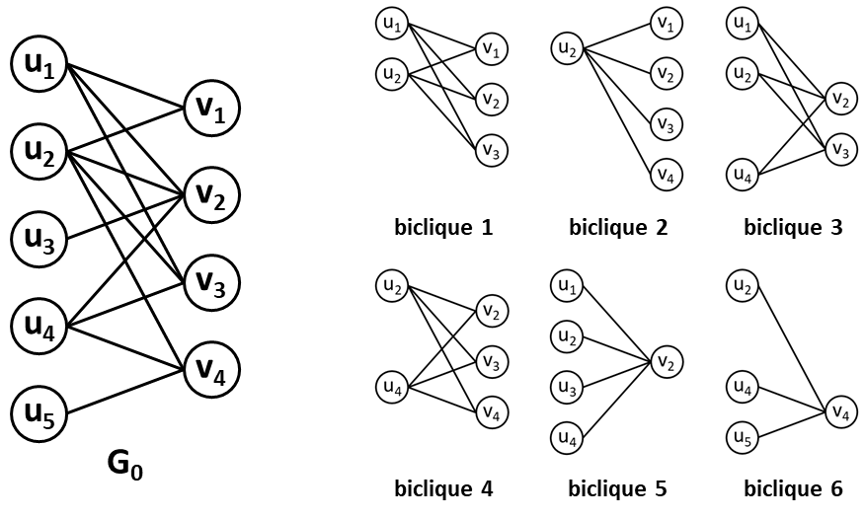
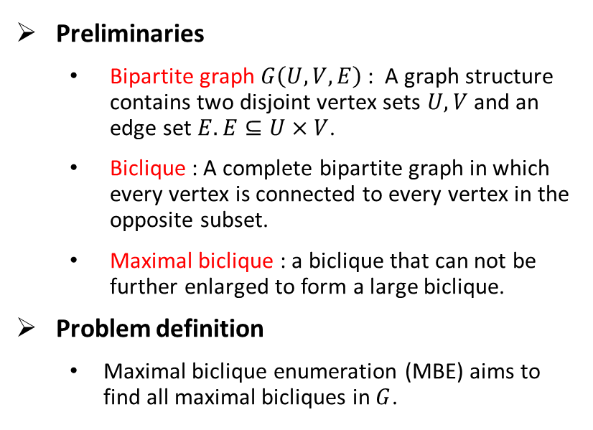
Introduction : Problem Definition
Preliminaries
Bipartite graph $G\left(U,V,E\right)$ : A graph structure contains two disjoint vertex sets $U,V$ and an edge set $E.E⊆U×V$.
Biclique : A complete bipartite graph in which every vertex is connected to every vertex in the opposite subset.
Maximal biclique : a biclique that can not be further enlarged to form a large biclique.
Problem definition
Maximal biclique enumeration (MBE) aims to find all maximal bicliques in $G$.
A bipartite graph $G_{0}$ containing 6 maximal bicliques.
Notes:
A bipartite graph $G\left(U,V,E\right)$ is a structure. $U$ and $V$ are two disjoint vertex sets in $G$. $E$ is the edge set in $G$ and $E⊆U×V$.
A biclique is a complete bipartite graph such that there exists an edge between two vertices if and only if the two vertices are in different vertex sets.
A maximal biclique in $G$ is a subgraph of $G$, which is a biclique and can not be further enlarged to form a large biclique.

Slide 5
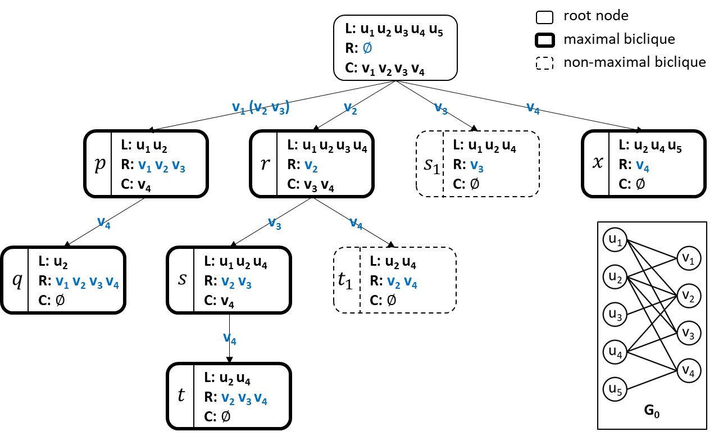
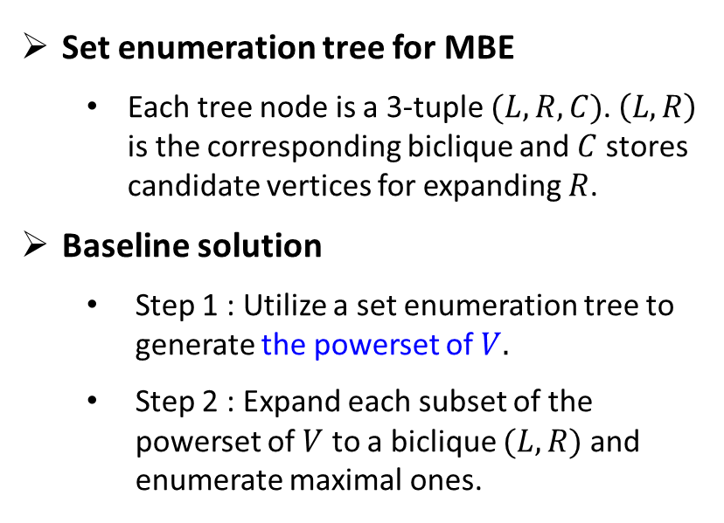
Introduction : MBE on CPUs
Set enumeration tree for MBE
Each tree node is a 3-tuple $(L,R,C)$. $\left(L,R\right)$ is the corresponding biclique and $C$ stores candidate vertices for expanding $R$.
Baseline solution
Step 1 : Utilize a set enumeration tree to generate the powerset of $V.$
Step 2 : Expand each subset of the powerset of $V$ to a biclique $(L,R)$ and enumerate maximal ones.
Notes:
Recent works utilized a set enumeration tree to generate the powerset of $V$ and then obtain all maximal bicliques correspondingly.
Each tree node is a 3-tuple $(L,R,C)$, where $L⊆U$ and $R,C⊆V$.$\left(L,R\right)$ is the corresponding biclique and $C$ stores candidate vertices for expanding $R$.

Slide 6
Introduction : MBE on CPUs
Recent optimizations
Vertex ordering ^{[1, 2, 5]}
Candidates pruning using pivots ^{[1, 2]}
Parallelization on multicore CPUs ^{[3]} or distributed architectures ^{[4]}
Existing solutions for MBE are insufficient because their performance speedup is constrained by the limited parallelism of CPUs.
[1] Lu Chen, Chengfei Liu, Rui Zhou, Jiajie Xu, and Jianxin Li. 2022. Efficient Maximal Biclique Enumeration for Large Sparse Bipartite Graphs. VLDB 2022. 1559-1571.
[2] Aman Abidi, Rui Zhou, Lu Chen, and Chengfei Liu. Pivot-Based Maximal Biclique Enumeration. IJCAI 2020. 3558–3564.
[3] Apurba Das and Srikanta Tirthapura. 2019. Shared-Memory Parallel Maximal Biclique Enumeration. HiPC 2019.
[4] Arko Provo Mukherjee and Srikanta Tirthapura. Enumerating Maximal Bicliques from a Large Graph Using MapReduce. IEEE Trans. Serv. Comput. 10, 5 (2017), 771–784.
[5] Yun Zhang, Charles A. Phillips, Gary L. Rogers, Erich J. Baker, Elissa J. Chesler, and Michael A. Langston. BMC bioinformatics 15, 1 (2014), 110.

Slide 7
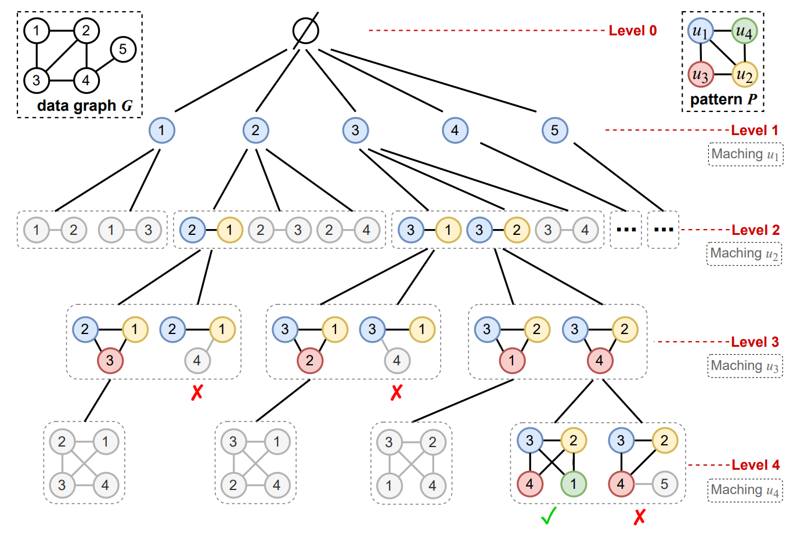
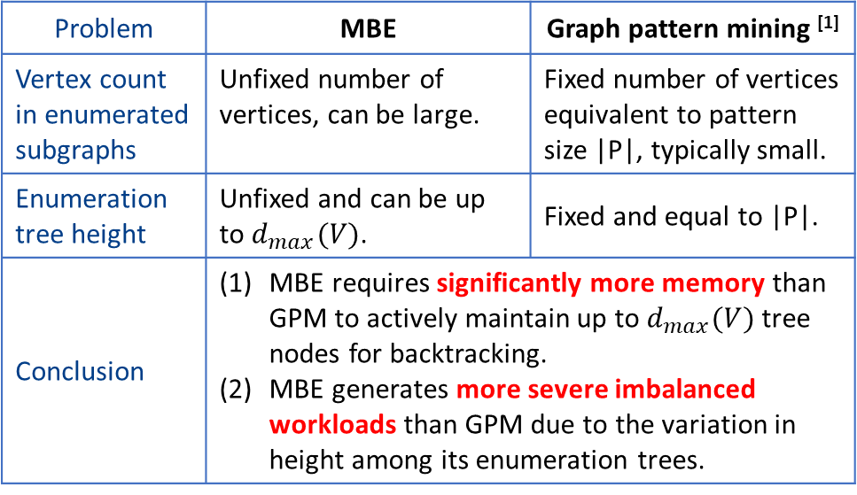
Introduction : Related Work Comparison
Problem | MBE | Graph pattern mining ^{[1]}
Vertex count in enumerated subgraphs | Unfixed number of vertices, can be large. | Fixed number of vertices equivalent to pattern size |P|, typically small.
Enumeration tree height | Unfixed and can be up to $d_{max}(V)$. | Fixed and equal to |P|.
Conclusion | MBE requires significantly more memory than GPM to actively maintain up to $d_{max}(V)$ tree nodes for backtracking. MBE generates more severe imbalanced workloads than GPM due to the variation in height among its enumeration trees.
An enumeration tree for mining pattern P in data graph G.
[1] Xuhao Chen and Arvind. Efficient and Scalable Graph Pattern Mining on GPUs. OSDI 2022. 857–877.

Slide 8
Challenges
Large memory requirement
Massive thread divergence
Load imbalance

Slide 9
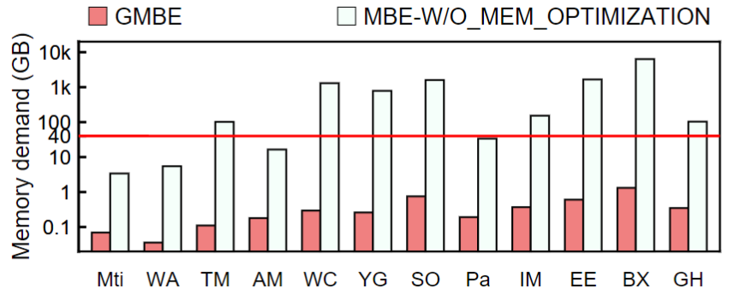
Challenge 1 : Large Memory Requirement
Dynamic memory allocations on GPUs are expensive
We need to execute multiple MBE procedures in parallel
Pre-allocate memory on GPUs before enumeration
Requires multiple blocks of memory
Exceeds the memory capacity
Directly parallelizing existing MBE procedures on an A100 GPU will exceed the memory capacity on multiple datasets.
Notes:
Since dynamic memory allocations on GPUs are expensive, we need to pre-allocate memory on GPUs before enumeration.
To fully utilize computational resources in GPUs, we need to execute multiple MBE procedures in parallel, which in turn requires multiple blocks of memory.
Our experimental results show that directly parallelizing existing MBE procedures on GPUs will lead to a memory requirement that exceeds the memory capacity
is impractical because its memory demands exceed the memory capacity of a 40GB A100 GPU on multiple datasets.

Slide 10
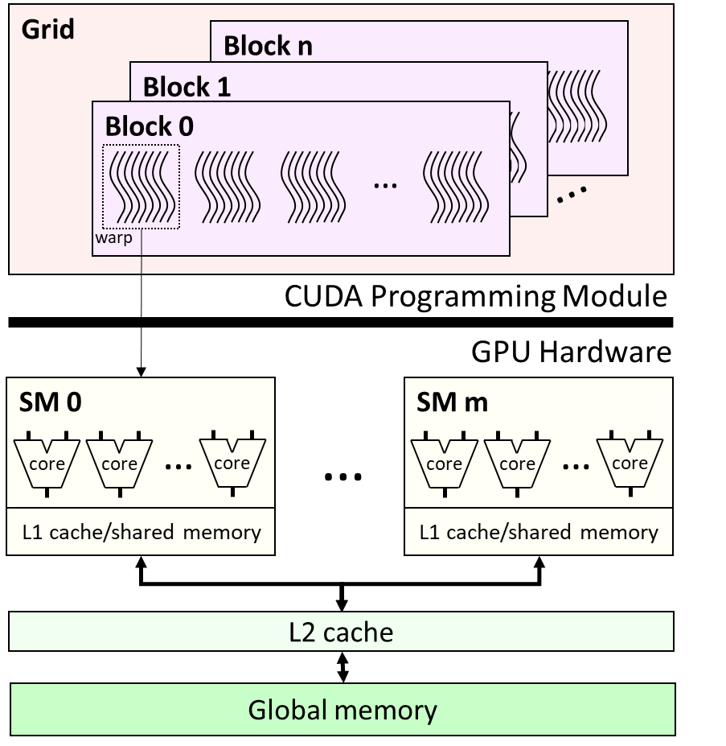
Challenge 2 : Massive Thread Divergence
CS 0 | if((threadIdx.x & 1) == 1){ code A; if((threadIdx.x & 2) == 2){ code B; } else{ code C; } }else{ code D; if((threadIdx.x & 2) == 2){ code E; } else{ code F; } }
CS 1 | code A; code A;
CS 0 and CS 1 are GPU code segments where threads with different routines execute 2 sets of codes each.
GPU architecture.
Notes:
The GPU groups 32 parallel threads into a warp and executes multiple warps concurrently. Thread divergence refers to threads in a warp take different execution paths on the GPU.
Thread divergence severely degrades the execution performance because the GPU has to serialize the different execution paths.
MBE algorithms require pruning approaches to reduce extensive enumeration space. However, existing pruning approaches generate more massive thread divergence because each thread works independently with different execution paths. It is desirable to design a GPU-friendly pruning approach.

Slide 11
Challenge 2 : Massive Thread Divergence
CS 0 | if((threadIdx.x & 1) == 1){ code A; if((threadIdx.x & 2) == 2){ code B; } else{ code C; } }else{ code D; if((threadIdx.x & 2) == 2){ code E; } else{ code F; } } | thread 0
 |  | thread 1
 |  | thread 2
 |  | thread 3
 |  | thread 4
 |  | thread 5
 |  | thread 6
 |  | thread 7
CS 1 | code A; code A; | thread 0
 |  | thread 1
 |  | thread 2
 |  | thread 3
 |  | thread 4
 |  | thread 5
 |  | thread 6
 |  | thread 7
Notes:
The GPU groups 32 parallel threads into a warp and executes multiple warps concurrently. Thread divergence refers to threads in a warp take different execution paths on the GPU.
Thread divergence severely degrades the execution performance because the GPU has to serialize the different execution paths.
MBE algorithms require pruning approaches to reduce extensive enumeration space. However, existing pruning approaches generate more massive thread divergence because each thread works independently with different execution paths. It is desirable to design a GPU-friendly pruning approach.

Slide 12
Challenge 2 : Massive Thread Divergence
CS 0 | if((threadIdx.x & 1) == 1){ code A; if((threadIdx.x & 2) == 2){ code B; } else{ code C; } }else{ code D; if((threadIdx.x & 2) == 2){ code E; } else{ code F; } } | thread 0
 |  | thread 1
 |  | thread 2
 |  | thread 3
 |  | thread 4
 |  | thread 5
 |  | thread 6
 |  | thread 7
CS 1 | code A; code A; | thread 0
 |  | thread 1
 |  | thread 2
 |  | thread 3
 |  | thread 4
 |  | thread 5
 |  | thread 6
 |  | thread 7
2 cycles
Notes:
The GPU groups 32 parallel threads into a warp and executes multiple warps concurrently. Thread divergence refers to threads in a warp take different execution paths on the GPU.
Thread divergence severely degrades the execution performance because the GPU has to serialize the different execution paths.
MBE algorithms require pruning approaches to reduce extensive enumeration space. However, existing pruning approaches generate more massive thread divergence because each thread works independently with different execution paths. It is desirable to design a GPU-friendly pruning approach.

Slide 13
Challenge 2 : Massive Thread Divergence
CS 0 | if((threadIdx.x & 1) == 1){ code A; if((threadIdx.x & 2) == 2){ code B; } else{ code C; } }else{ code D; if((threadIdx.x & 2) == 2){ code E; } else{ code F; } } | thread 0
 |  | thread 1
 |  | thread 2
 |  | thread 3
 |  | thread 4
 |  | thread 5
 |  | thread 6
 |  | thread 7
CS 1 | code A; code A; | thread 0
 |  | thread 1
 |  | thread 2
 |  | thread 3
 |  | thread 4
 |  | thread 5
 |  | thread 6
 |  | thread 7
2 cycles
Notes:
The GPU groups 32 parallel threads into a warp and executes multiple warps concurrently. Thread divergence refers to threads in a warp take different execution paths on the GPU.
Thread divergence severely degrades the execution performance because the GPU has to serialize the different execution paths.
MBE algorithms require pruning approaches to reduce extensive enumeration space. However, existing pruning approaches generate more massive thread divergence because each thread works independently with different execution paths. It is desirable to design a GPU-friendly pruning approach.

Slide 14
Challenge 2 : Massive Thread Divergence
CS 0 | if((threadIdx.x & 1) == 1){ code A; if((threadIdx.x & 2) == 2){ code B; } else{ code C; } }else{ code D; if((threadIdx.x & 2) == 2){ code E; } else{ code F; } } | thread 0
 |  | thread 1
 |  | thread 2
 |  | thread 3
 |  | thread 4
 |  | thread 5
 |  | thread 6
 |  | thread 7
CS 1 | code A; code A; | thread 0
 |  | thread 1
 |  | thread 2
 |  | thread 3
 |  | thread 4
 |  | thread 5
 |  | thread 6
 |  | thread 7
2 cycles
Notes:
The GPU groups 32 parallel threads into a warp and executes multiple warps concurrently. Thread divergence refers to threads in a warp take different execution paths on the GPU.
Thread divergence severely degrades the execution performance because the GPU has to serialize the different execution paths.
MBE algorithms require pruning approaches to reduce extensive enumeration space. However, existing pruning approaches generate more massive thread divergence because each thread works independently with different execution paths. It is desirable to design a GPU-friendly pruning approach.

Slide 15
Challenge 2 : Massive Thread Divergence
CS 0 | if((threadIdx.x & 1) == 1){ code A; if((threadIdx.x & 2) == 2){ code B; } else{ code C; } }else{ code D; if((threadIdx.x & 2) == 2){ code E; } else{ code F; } } | thread 0
 |  | thread 1
 |  | thread 2
 |  | thread 3
 |  | thread 4
 |  | thread 5
 |  | thread 6
 |  | thread 7
CS 1 | code A; code A; | thread 0
 |  | thread 1
 |  | thread 2
 |  | thread 3
 |  | thread 4
 |  | thread 5
 |  | thread 6
 |  | thread 7
2 cycles
Notes:
The GPU groups 32 parallel threads into a warp and executes multiple warps concurrently. Thread divergence refers to threads in a warp take different execution paths on the GPU.
Thread divergence severely degrades the execution performance because the GPU has to serialize the different execution paths.
MBE algorithms require pruning approaches to reduce extensive enumeration space. However, existing pruning approaches generate more massive thread divergence because each thread works independently with different execution paths. It is desirable to design a GPU-friendly pruning approach.

Slide 16
Challenge 2 : Massive Thread Divergence
CS 0 | if((threadIdx.x & 1) == 1){ code A; if((threadIdx.x & 2) == 2){ code B; } else{ code C; } }else{ code D; if((threadIdx.x & 2) == 2){ code E; } else{ code F; } } | thread 0
 |  | thread 1
 |  | thread 2
 |  | thread 3
 |  | thread 4
 |  | thread 5
 |  | thread 6
 |  | thread 7
6 cycles
CS 1 | code A; code A; | thread 0
 |  | thread 1
 |  | thread 2
 |  | thread 3
 |  | thread 4
 |  | thread 5
 |  | thread 6
 |  | thread 7
CS 0 requires more time because of the thread divergence.
2 cycles
Notes:
The GPU groups 32 parallel threads into a warp and executes multiple warps concurrently. Thread divergence refers to threads in a warp take different execution paths on the GPU.
Thread divergence severely degrades the execution performance because the GPU has to serialize the different execution paths.
MBE algorithms require pruning approaches to reduce extensive enumeration space. However, existing pruning approaches generate more massive thread divergence because each thread works independently with different execution paths. It is desirable to design a GPU-friendly pruning approach.

Slide 17
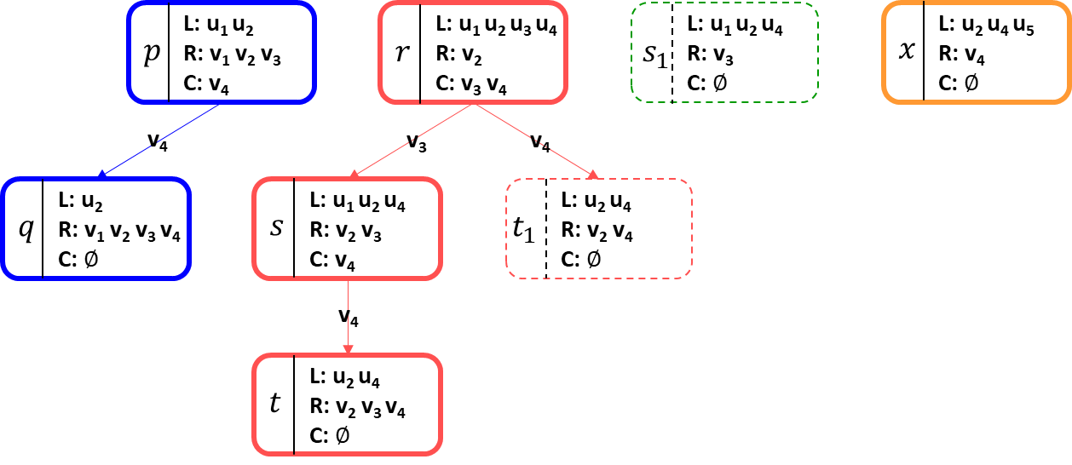
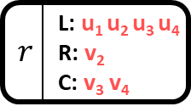
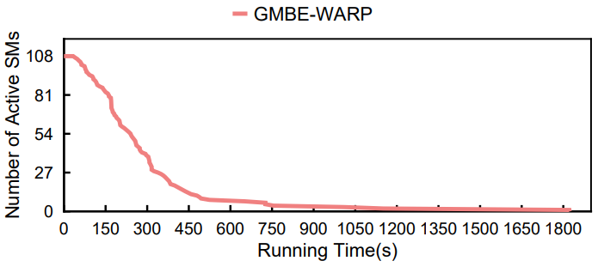
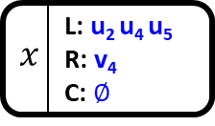
Challenge 3 : Load Imbalance
Subtrees have varying node counts
Nodes have varying vertex counts
Active SMs rapidly decline over time in a straightforward algorithm.
Severe load imbalance
Notes:
To parallelize MBE algorithm, each parallel MBE procedure processes a sub enumeration tree independently.
The parallel MBE suffers load imbalance problem mainly for two reasons:
The running time for processing each enumeration note $(L,R,C)$ varies greatly since nodes contain various numbers of candidate vertices.
The number of nodes in subtrees differs significantly because different maximal biclique $(L,R)$ contain various numbers of vertices in $R$.
The parallel MBE algorithm suffers from severe load imbalance problem. 86 streaming multiprocessors (SMs) waste over 1,458 seconds waiting for the slowest one on BookCrossing if we assign each sub enumeration tree to a warp based on our new algorithm GMBE.

Slide 18
GMBE
Stack-based iteration with node reuse
Pruning using local neighborhood sizes
Load-aware task scheduling

Slide 19
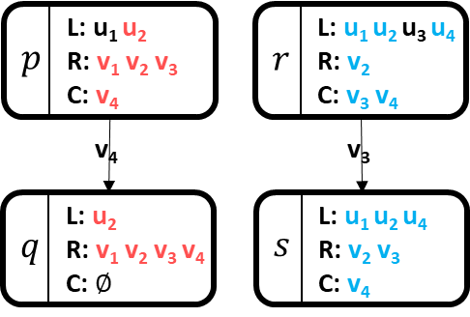
Idea 1 : Stack-based Iteration with Node Reuse
Key Observation
Vertices in the child node are always a subset of vertices in the parent node.
Main idea
We allocate memory for the root node and reuse this memory to derive all nodes within the subtree, resulting in a notable reduction in memory usage.
Notes:
To enhance memory efficiency when traversing the sub-enumeration tree rooted at node $x$, we reuse node $x$ to derive all nodes within the subtree instead of dynamically creating new nodes, resulting in a notable reduction in memory usage.

Slide 20
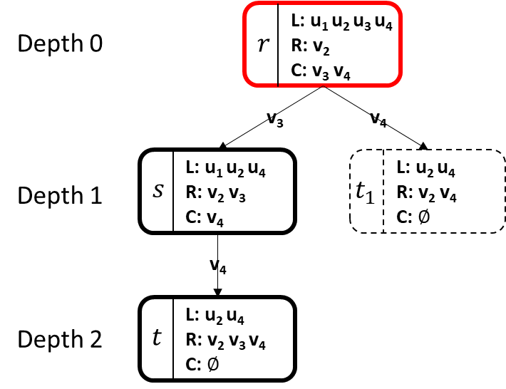
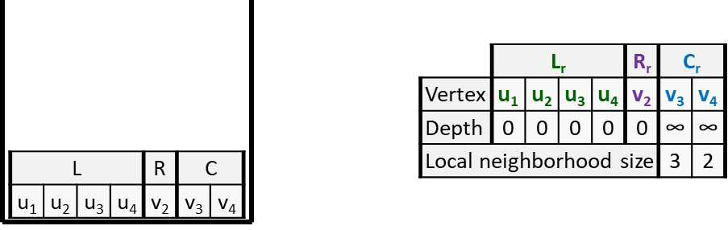
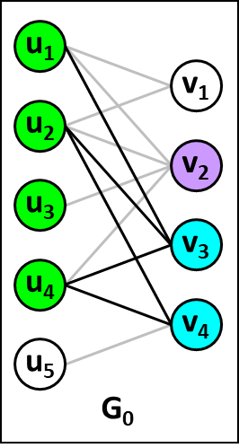
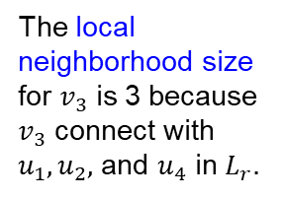
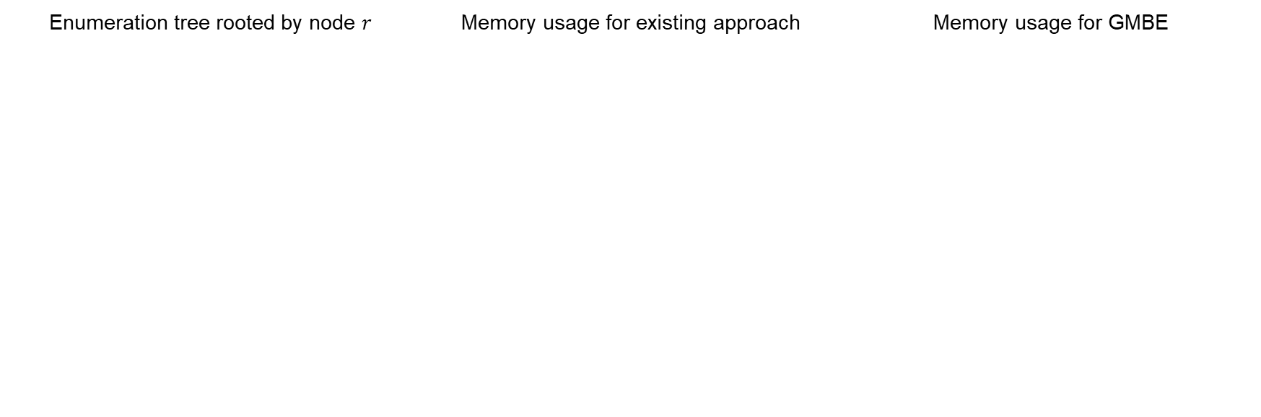
Idea 1 : Stack-based Iteration with Node Reuse
Step 1 : initialize node $r$
Enumeration tree rooted by node $r$ | Memory usage for existing approach | Memory usage for GMBE
The local neighborhood size for $v_{3}$ is 3 because $v_{3}$ connect with $u_{1}, u_{2},$ and $u_{4}$ in $L_{r}.$

Slide 21
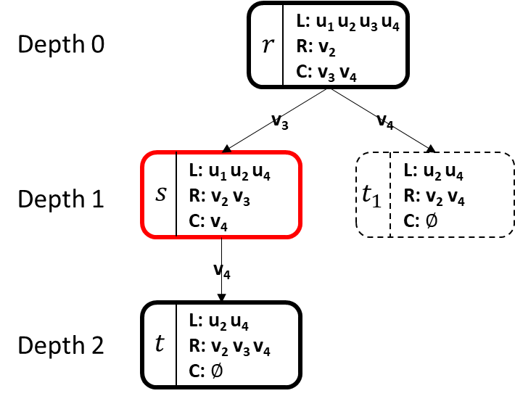
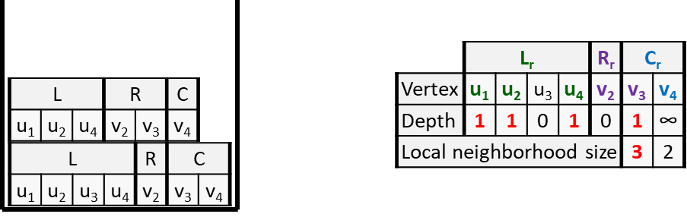
Idea 1 : Stack-based Iteration with Node Reuse
Step 2 : generate node s
Enumeration tree rooted by node $r$ | Memory usage for existing approach | Memory usage for GMBE

Slide 22
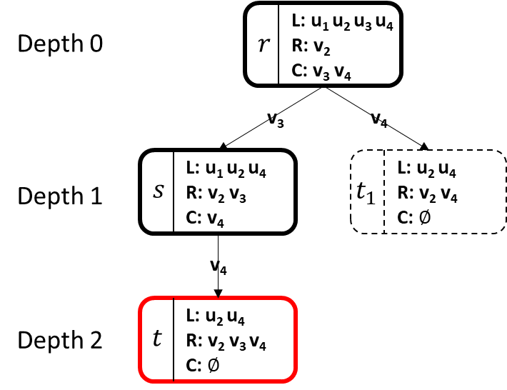
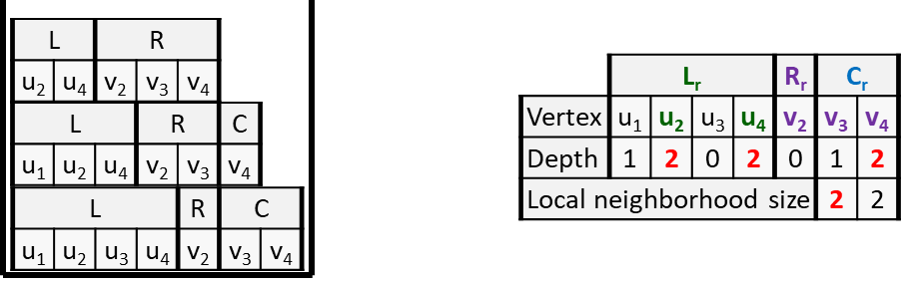
Idea 1 : Stack-based Iteration with Node Reuse
Step 3 : generate node t
Enumeration tree rooted by node $r$ | Memory usage for existing approach | Memory usage for GMBE
Memory size is increasing
Memory size is fixed
Notes:
Conclusion: Existing solutions for MBE often require significant memory usage as the depth of the node increases. In contrast, our proposed approach greatly reduces memory usage by efficiently reusing the memory of the root node.

Slide 23
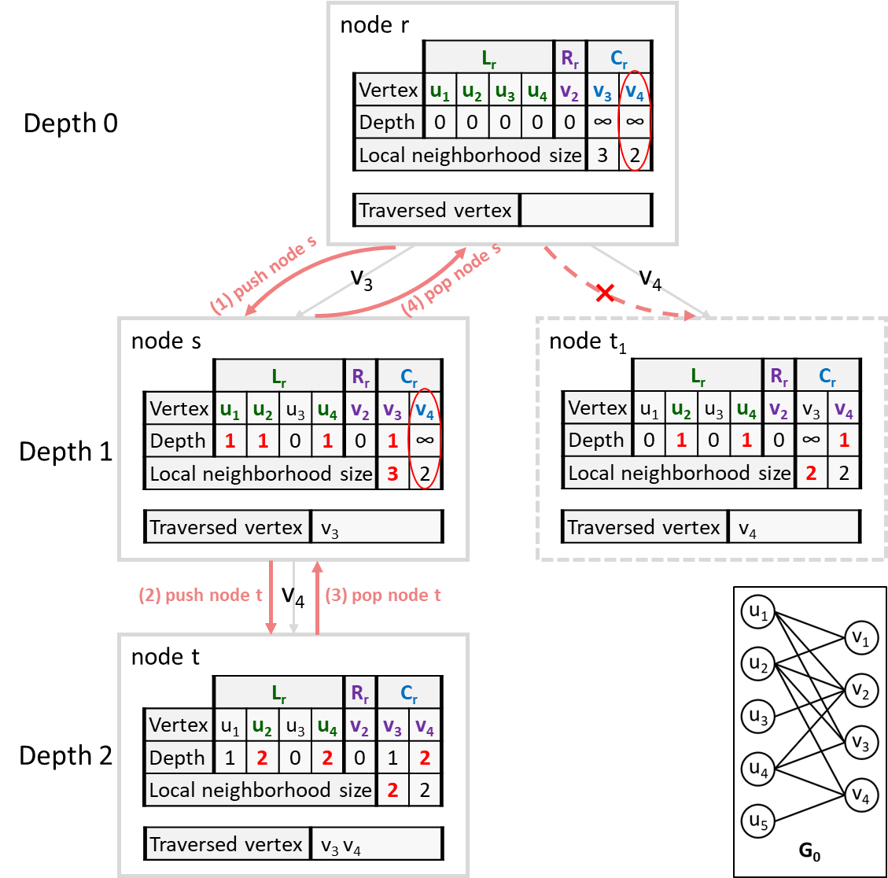
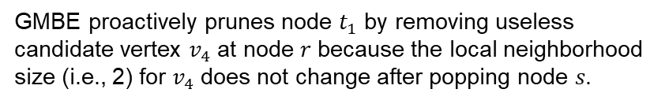
Idea 2 : Pruning Using Local Neighborhood Sizes
Key observation
Local neighborhood sizes, as a necessary intermediate result, can be utilized for pruning.
Main idea
We prune useless candidates if their local neighborhood sizes do not change after popping a traversed child node. This approach reduces thread divergence by checking multiple local neighborhood sizes simultaneously..
GMBE proactively prunes node $t_{1}$ by removing useless candidate vertex $v_{4}$ at node 𝑟 because the local neighborhood size (i.e., 2) for $v_{4}$ does not change after popping node 𝑠.

Slide 24
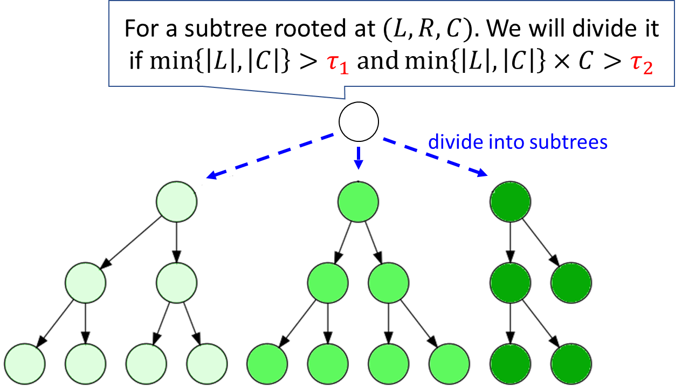
Idea 3: Load-aware Task Scheduling
Key observation
Due to the imbalance of subtrees in MBE problems, directly mapping subtrees to computational resources leads to significant load imbalance.
Main idea
Design two thresholds to detect large subtree.
Dynamically divide large trees into multiple subtrees to balance the workloads.
Notes:
Naïve approach
For exploring the massive parallelism of GPUs, a naive approach is assigning a task to manage each enumeration tree whose root node is $v_{s}$ ($v_{s}$∈ 𝑉 ). Then we map these tasks to warps^{[1]} or blocks^{[2]} in GPUs similar to the related work.
Key observation
The naive approach is insufficient to balance the loads among GPU SMs for the MBE problem because the parallel GPU tasks created are highly unbalanced and their loads are determined by the various size of the enumeration trees assigned to the tasks.
Main idea
Design two functions to detect tasks having heavy workloads at runtime.
Dynamically divide the task with heavy workload into multiple subtasks and balance the workloads using a concurrent queue.
[1] Xuhao Chen and Arvind. Efficient and Scalable Graph Pattern Mining on GPUs. OSDI 2022. 857–877.
[2] Mohammad Almasri, Izzat El Hajj, Rakesh Nagi, Jinjun Xiong, and Wen-Mei Hwu. Parallel K-clique counting on GPUs. ICS 2022. 21:1–21:14.

Slide 25
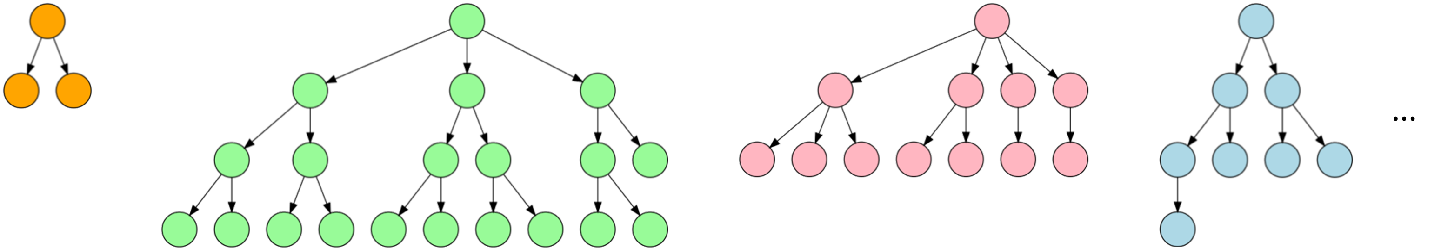
Idea 3: Load-aware Task Scheduling
Solution 1 : Map subtrees to warps.
Notes:
Naïve approach
For exploring the massive parallelism of GPUs, a naive approach is assigning a task to manage each enumeration tree whose root node is $v_{s}$ ($v_{s}$∈ 𝑉 ). Then we map these tasks to warps^{[1]} or blocks^{[2]} in GPUs similar to the related work.
Key observation
The naive approach is insufficient to balance the loads among GPU SMs for the MBE problem because the parallel GPU tasks created are highly unbalanced and their loads are determined by the various size of the enumeration trees assigned to the tasks.
Main idea
Design two functions to detect tasks having heavy workloads at runtime.
Dynamically divide the task with heavy workload into multiple subtasks and balance the workloads using a concurrent queue.

Slide 26
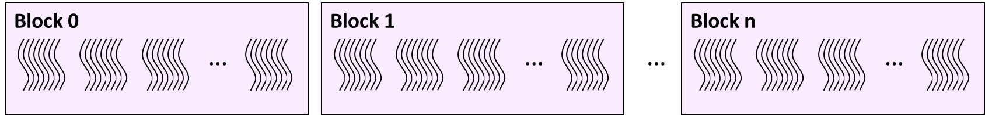
Idea 3: Load-aware Task Scheduling
Solution 2 : Map subtrees to blocks.
Notes:
Naïve approach
For exploring the massive parallelism of GPUs, a naive approach is assigning a task to manage each enumeration tree whose root node is $v_{s}$ ($v_{s}$∈ 𝑉 ). Then we map these tasks to warps^{[1]} or blocks^{[2]} in GPUs similar to the related work.
Key observation
The naive approach is insufficient to balance the loads among GPU SMs for the MBE problem because the parallel GPU tasks created are highly unbalanced and their loads are determined by the various size of the enumeration trees assigned to the tasks.
Main idea
Design two functions to detect tasks having heavy workloads at runtime.
Dynamically divide the task with heavy workload into multiple subtasks and balance the workloads using a concurrent queue.

Slide 27
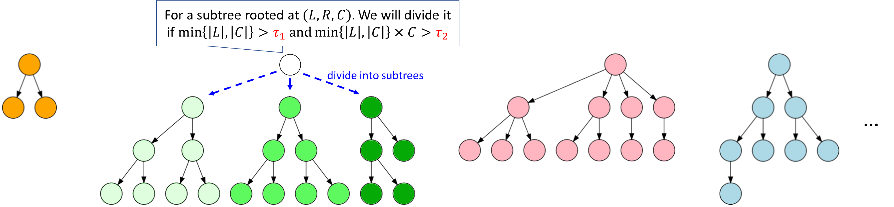
Idea 3: Load-aware Task Scheduling
Solution 3 : Dynamically divide large tree into multiple subtrees and map subtrees to warps.
Notes:
Naïve approach
For exploring the massive parallelism of GPUs, a naive approach is assigning a task to manage each enumeration tree whose root node is $v_{s}$ ($v_{s}$∈ 𝑉 ). Then we map these tasks to warps^{[1]} or blocks^{[2]} in GPUs similar to the related work.
Key observation
The naive approach is insufficient to balance the loads among GPU SMs for the MBE problem because the parallel GPU tasks created are highly unbalanced and their loads are determined by the various size of the enumeration trees assigned to the tasks.
Main idea
Design two functions to detect tasks having heavy workloads at runtime.
Dynamically divide the task with heavy workload into multiple subtasks and balance the workloads using a concurrent queue.

Slide 28
Evaluation
Overall evaluation
Effect of optimizations
Sensitivity Analysis

Slide 29
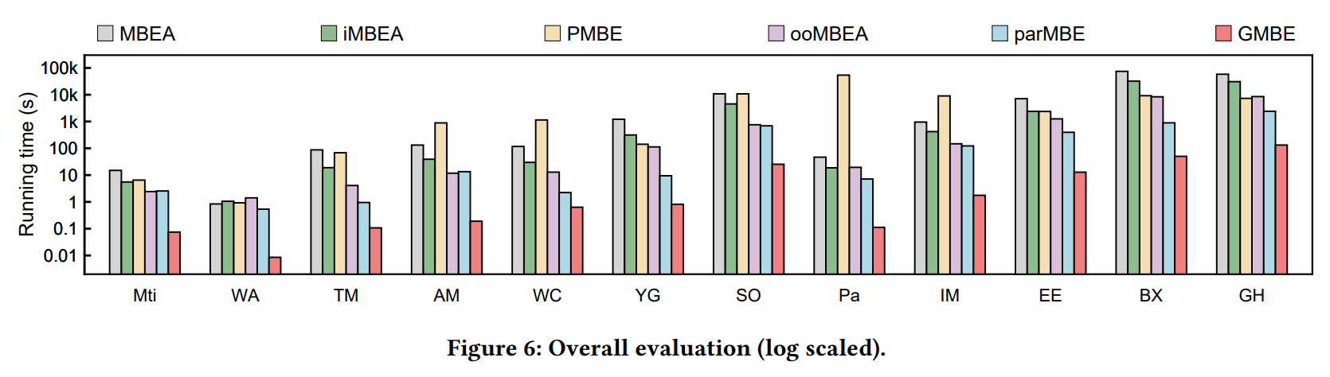
Evaluation : Overall Evaluation
GMBE is 3.5×–69.8× faster than any next-best competitor on CPUs on all testing datasets.

Slide 30
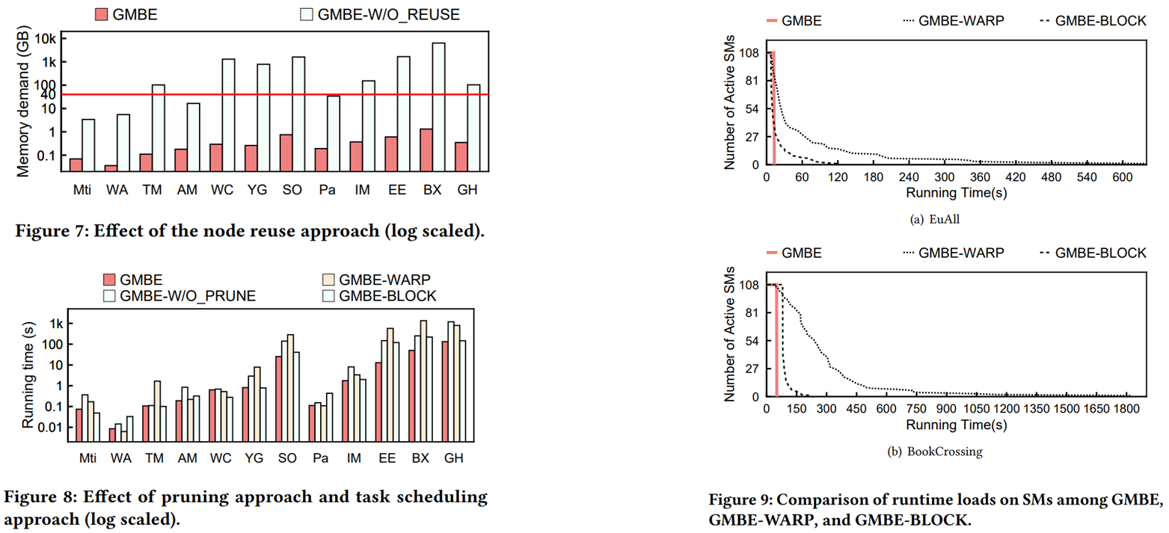
Evaluation : Effect of Optimizations
GMBE significantly reduces the memory usage, efficiently reduces the enumeration space, and successfully balance the workloads.

Slide 31
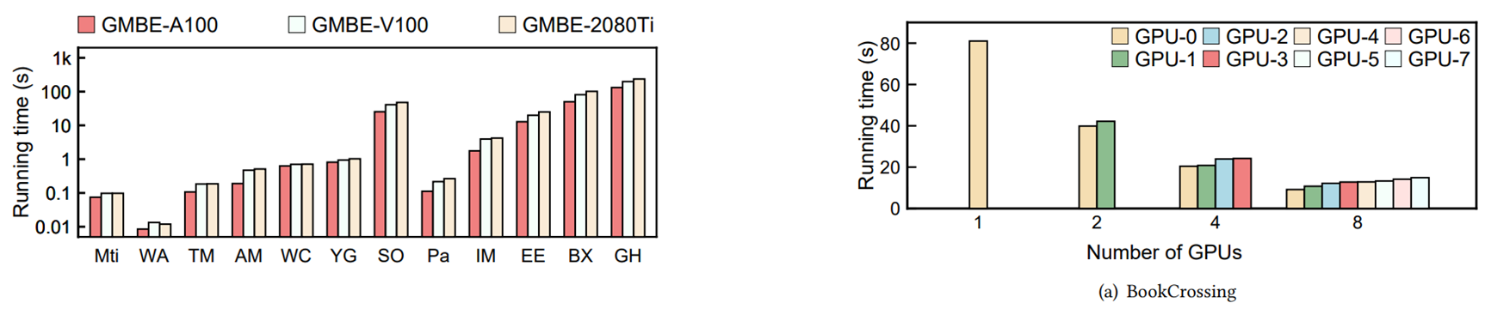
Evaluation : Sensitivity Analysis
Adaptability on different GPU (log scaled).
Scalability of GMBE on a machine with multi-GPU.

Slide 32
Q & A

