Slide 1
JaxLib Install Perlmutter

Slide 2
Conda environment
Creating the conda environment
  Conda create –p {PATH} python=3.12
Activate environment and get GPU Jaxlib
  Using conda pip: pip install –U “jax[cuda12]”
Clone Jax-ReaxFF repo:
  git clone https://github.com/cagrikymk/Jax-ReaxFF
  cd Jax-ReaxFF
  pip install .

Slide 3
Installing Cuda 12.5 on Perlmutter
Get Cuda 12.5 from NVIDIA (or other version compatible with JaxReaxFF)
  wget https://developer.download.nvidia.com/...
  Make sure the Linux distribution is compatible with your system (SLES for Perlmutter)
Install without sudo: ./cuda_12.5.1_555.42.06_linux.run
  Do not install the driver using the GUI (requires root privileges), only the toolkit. Specify a path that exists in the options, because you likely don’t have access to the default installation location

Slide 4
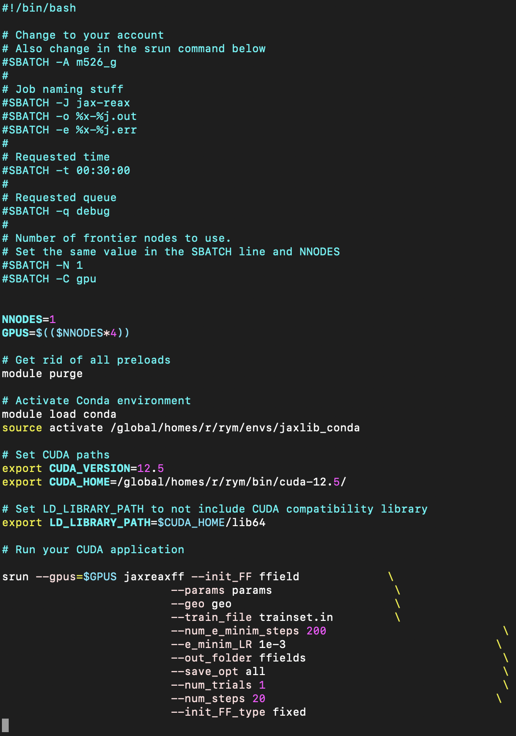
Example submission
Activate the conda environment within the script after purging the defaults (this gets rid CUDA natively loaded by the system)
Need to specify the CUDA version and where it is located with CUDA_HOME
Add the CUDA version’s library to the LD_LIBRARY_PATH variable

