Slide 1

Compass
A Smart Student‘s Roadmap
Team Epoch

Slide 2

Simon, 21
University student
High ambition
Lack of structure
Overwhelmed
Notes:
Meet simon
Highly ambitious fella

Slide 3
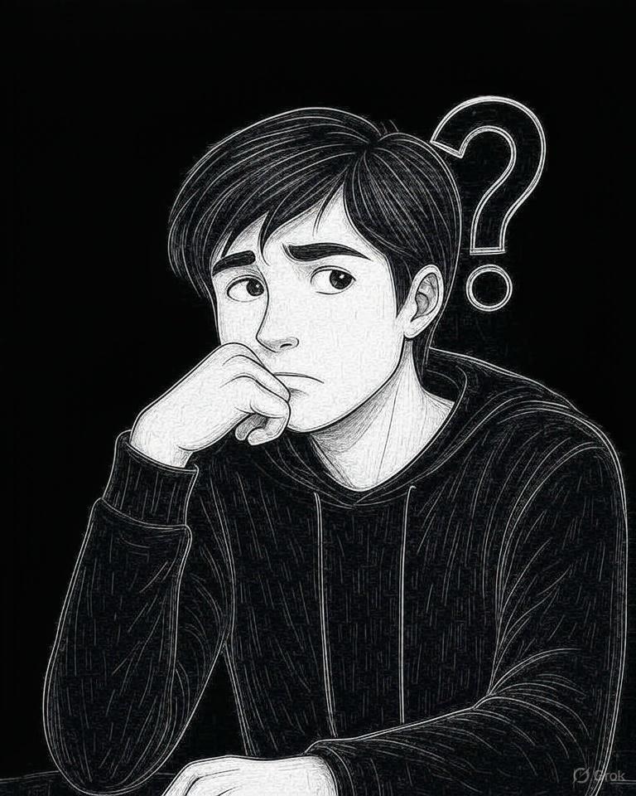
How can I structure my studies better?
How can I work as a PM at Microsoft?

Slide 4



Compass
A Smart Student‘s Roadmap
Plans and organises your semester
Recommends milestones
Personalised
job search and prep

Slide 5
Live Demo
:D

Slide 6
THANK YOU
Alexey Maxyuta, Andrei Filippov, Michelle Siegle, Siddharth Khattar, Vadim Spiro

Slide 7
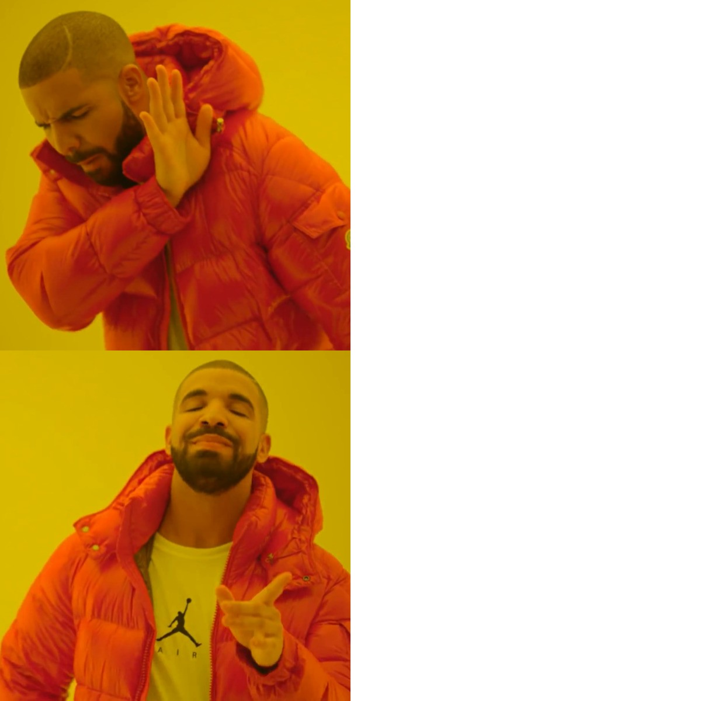
Go-to-market strategy
Students
Recruitment Agencies

