Slide 1
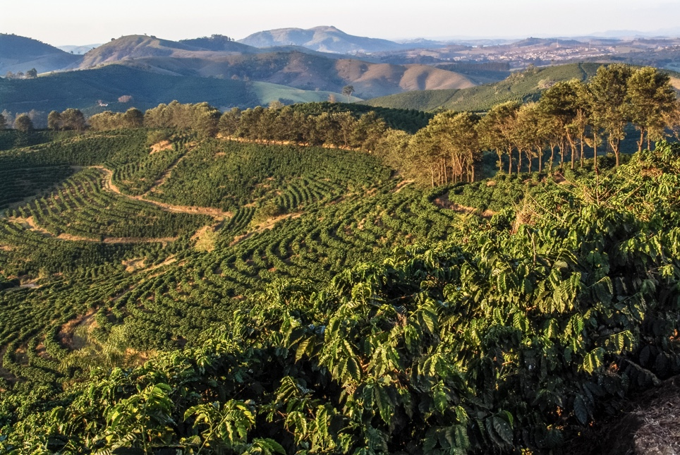
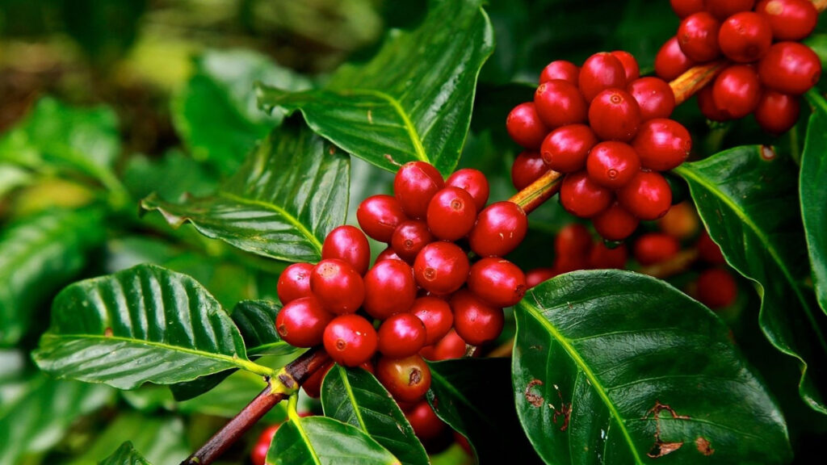
Q-SOLVE QUANTUM INNOVATION HACKATHON
Q-FertiRoute
Quantum–Classical Optimisation of Coffee Fertiliser Distribution in Kirinyaga County
TEAM Q-GEN
Mercy Amondi
Akram Ali
Peter Kimani
Ruth Ngotho
Evans nomo
Our Mentor : Dickson Owuor

Slide 2
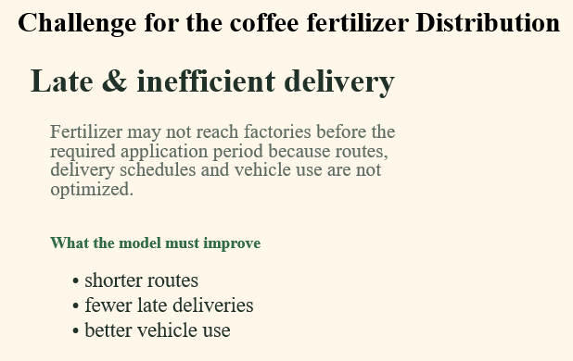
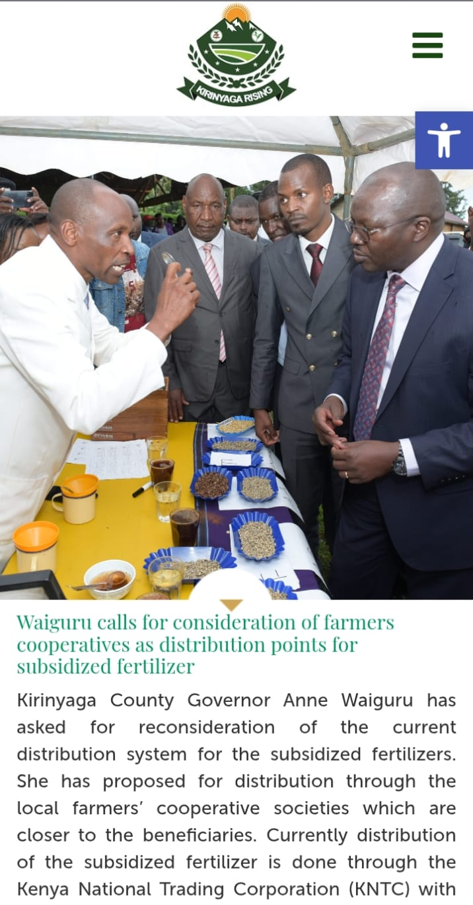

01 THE CHALLENGE
Factory A
Factory B
Factory C
NCPB Karatina
Depot
Factory D
The Challenge: How to determine the most efficient way to distribute fertilizer from NCPB Karatina to the 7 selected coffee factories, while minimizing distance, transport cost, and delivery time
Factory E
Factory f
02

Slide 3
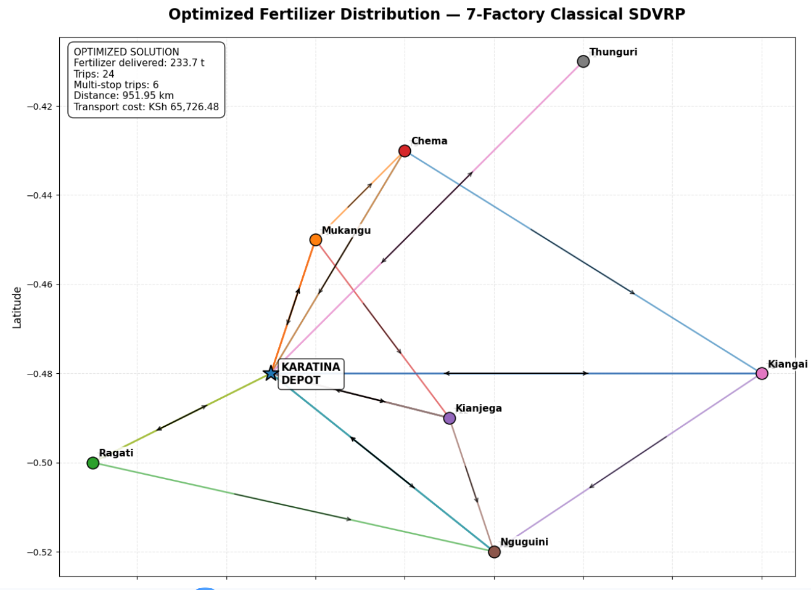
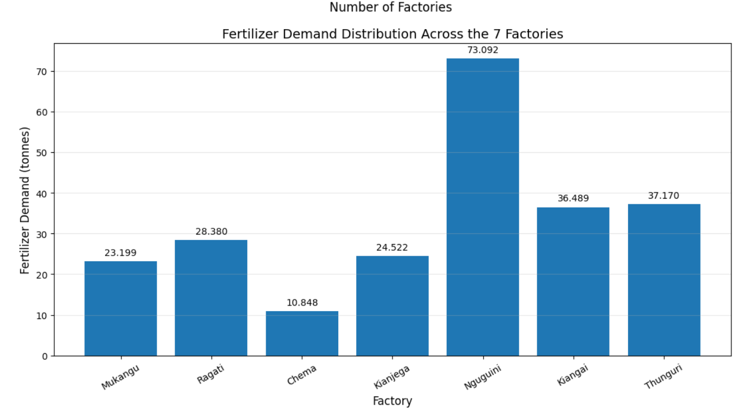
An Optimisation-Based Distribution Model
02 OUR APPROACH
We built a Mixed-Integer Linear Program (MILP) to minimise transport cost:
Min 16 × Σ (load × distance).
Key decisions: route selection (x), delivery quantities (q), and arc loads (l).
We enforced capacity (10 t/ truck), 100% demand satisfaction, ≤8-hour routes, and subtour elimination to guarantee feasible plans.
03

Slide 4
QUANTUM PART
Quantum slide 1
Searching smarter route options
Simple idea: score each route, then use QAOA to search for lower-cost choices.
Route choices grow fast
☕
▦
⚛
2
routes
with 2 factories
1 Prepare data
2 CUBO model
3 QAOA search
factory demand
road distance
travel time
gives each route
a cost score
makes low-cost
routes more likely
5,040
possible route orders with 7 factories
Key experiment settings
10 t
truck
8 h
route limit
KSh 16
per tonne-km
4,096
measurements
Takeaway: quantum does not replace the full logistics system — it helps test route-choice search, starting small and scaling step by step.
Notes:
Now I’ll explain the quantum part of our solution. We used QAOA, a quantum optimization method, to help search for efficient delivery routes. The main challenge is that as we add more factories, the number of possible routes increases very quickly. With two factories, there are only two route options, but with seven factories, there are 5,040 possible routes. To make this problem suitable for quantum computing, we first convert the routing choices and transport costs into a model called CUBO. In simple terms, this gives each possible route a cost score. We then use QAOA to search for routes with lower costs. We started with one truck and two factories, then increased the problem step by step up to seven factories. The main idea is simple: prepare the routing problem, let the quantum algorithm explore the route choices, and compare the result with the classical solution.

Slide 5
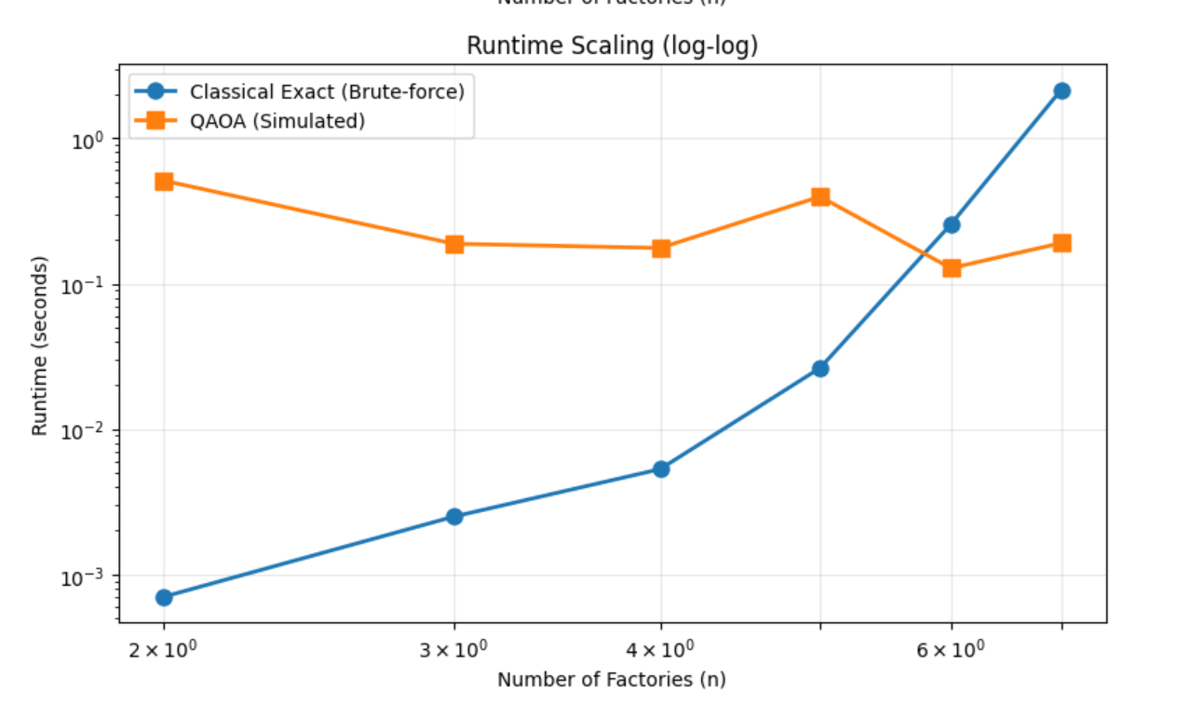
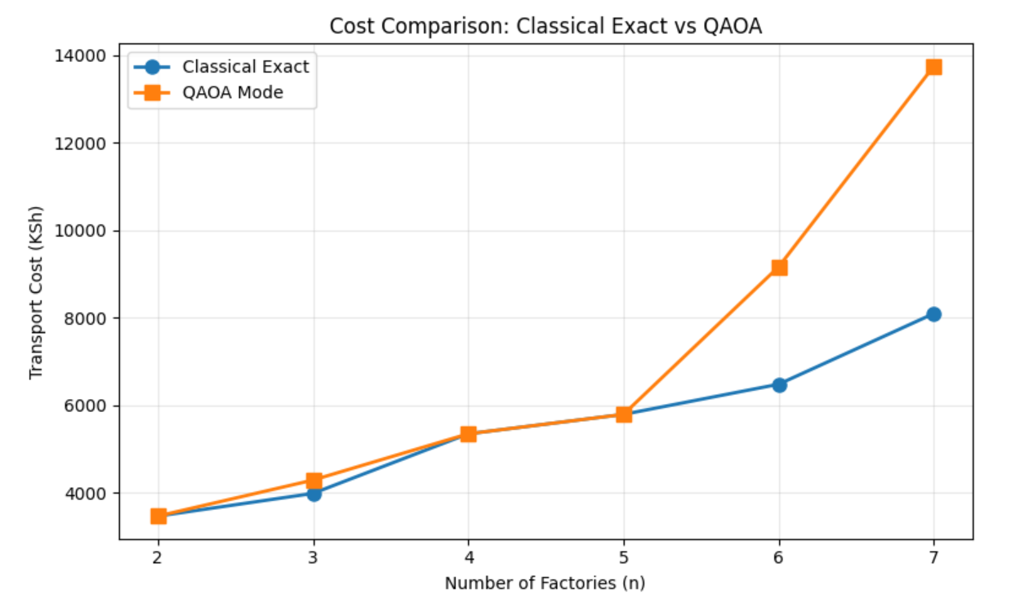
Classical vs Quantum
05 HEAD-TO-HEAD
06

Slide 6



Sustainable development Impact
👥 BENEFITS | 🚚 IMPROVES | 📊 MEASURES | 🌱 IMPACT
Farmers & Cooperatives | Routes & Delivery costs | Cost • Distance • Time | Efficient Agriculture
Distributors | Fertilizer allocation | Fuel Consumption | Lower Resource Use
⚠️ Risk: Data acquisition & completeness
🔄 Scalable: Other agricultural supply chains

Slide 7



Feasibility, Scalability & Adoption
09 WHAT'S NEXT
Feasibility
The classical model is deployable today. The quantum approach is testable now through cloud simulators and hardware access — D-Wave Leap and Cirq.
Scalability
Adoption
The framework extends naturally to more factories, more depots, and eventually county-wide distribution networks.
Requires buy-in from NCPB and Baragwi FCS, staff training, and integration with existing dispatch processes.
10

Slide 8
THANK YOU
Questions & Discussion
Q-FerliRoutes — Q-SOLVE Quantum Innovation Hackathon

