Slide 1
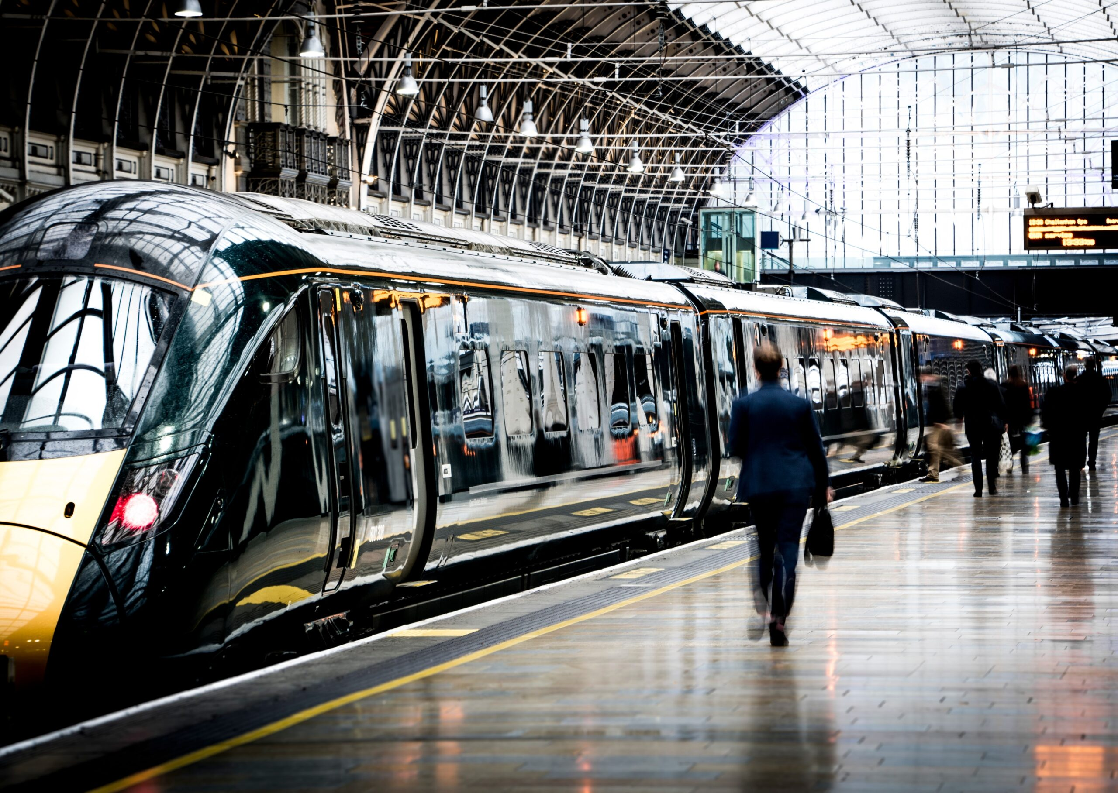

Slide 2
Introduction
Train reservation system project in C++ facilitates secure user authentication, real-time seat availability checks, online booking and cancellation of tickets, and admin controls for managing trains and user accounts. The system employs robust data storage, error handling, and security measures, using object-oriented programming principles for modular and maintainable code. The user interface may be console-based or graphical, with a focus on efficient data management and reporting features for administrators.

Slide 3
Project Functionality:
Our proposed system will replace the current Train reservation system. The system will have all of the standard features for using online applications in addition to the additional features mentioned below:
✓Efficient User Interface
✓Realtime Booking and Updates
✓Personalized Passenger Profiles
✓Enhanced Security Measures
✓Feedback
✓Improved Mechanism

Slide 4
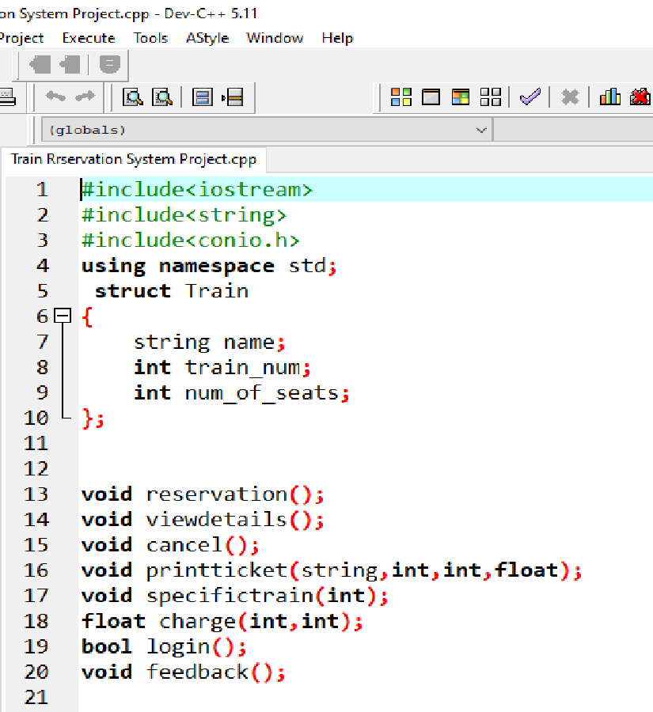
In this Train Reservation System we have a total of used 8 functions for:
Login
Reservation
View Details
Specific Train
Charges
Print Ticket
Cancel
Feedback

Slide 5
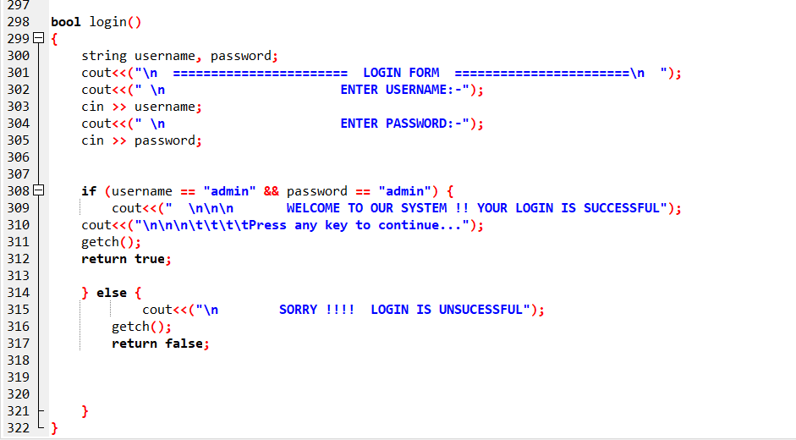
In the login functon the user is assigned with a username and a password which he only knows for security purposes. After a successful login the user moves towards the menu interface.

Slide 6
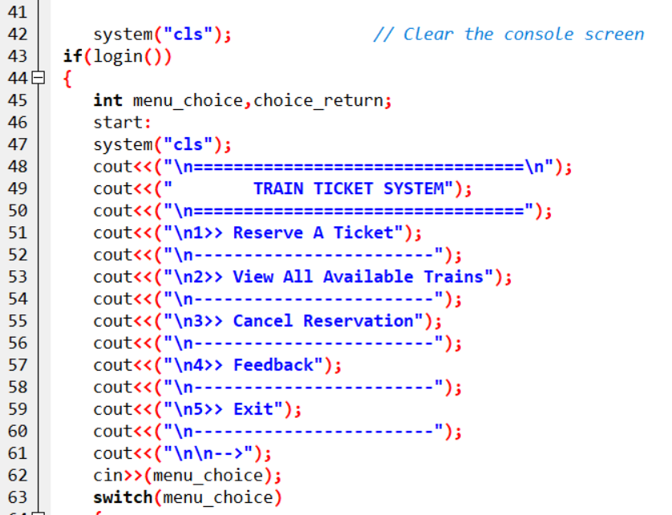
In the menu interface the user is presented with 5 opotions which are:
Reserve a Ticket
View All Available Trains
Cancle Reservation
Feedback
Exit

Slide 7
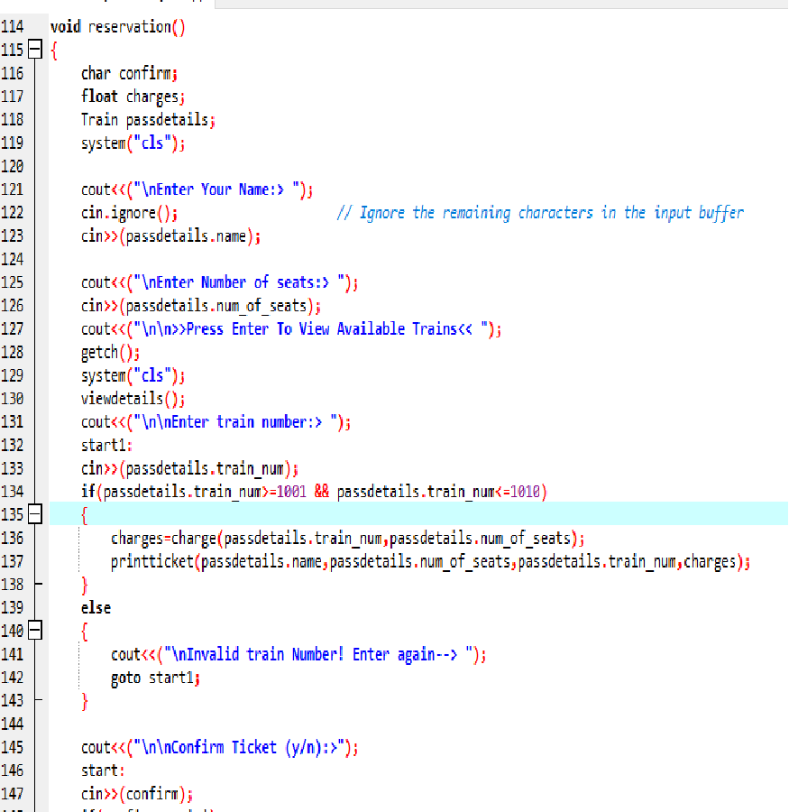
In the reservation function the user has to enter his name first.Then he checks for the train he want to use and enters the number of seats he needs. After this information is collected his profile is made with the net amount displayed. He is asked for confirmation of the ticket.

Slide 8
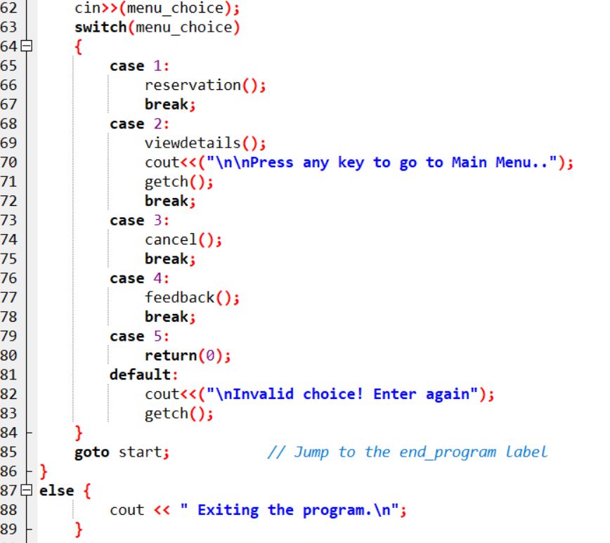
The switch case is used to call different functions depending upon the values assigned to them.

Slide 9
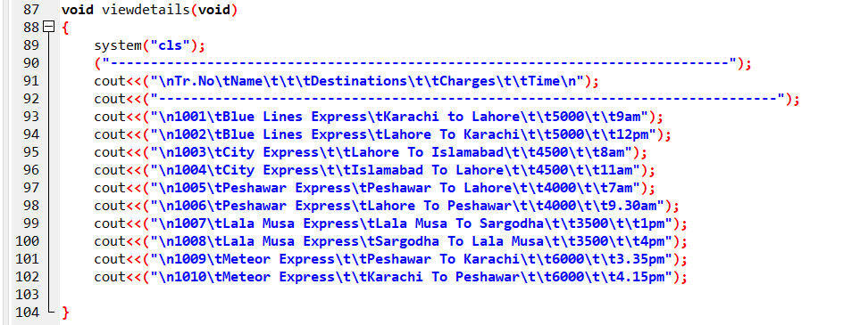
This function contains the train number, train name, destination, time and charges for the customer to view and decide. It also uses the switch to selection the specific train.

Slide 10
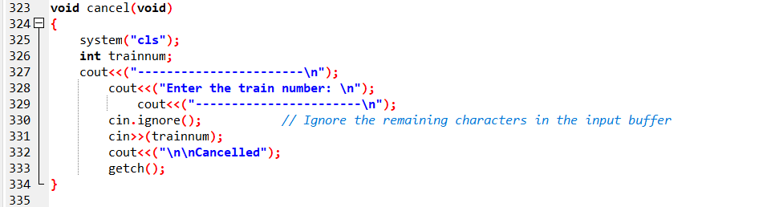
This function is used for the cancelation of a reserved ticket. The user enters the number of the train and the ticket gets cancelled.

Slide 11
Thank
Thank
You!!

