Slide 1
Object-Oriented JavaScript

Slide 2
Case Study: Xmas Light
Version 1
Properties
(Public) Name: ‘foo’ (default)
(private) Status: false (default); true (on)
Methods
Toggle
Check: return status

Slide 3
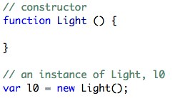
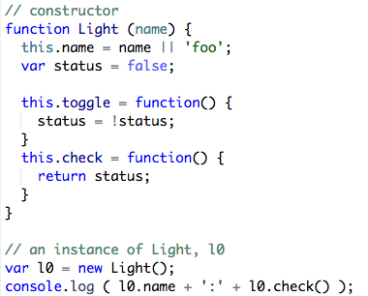
Basic Constructor setup
Version 1:

Slide 4
Version 2
Properties:
Name: ‘fxxx’ (default, ‘f’ with serial number, 流水號)
Methods:
Beef up toggle:
on/off realization by sending message to console
static variable的概念

Slide 5
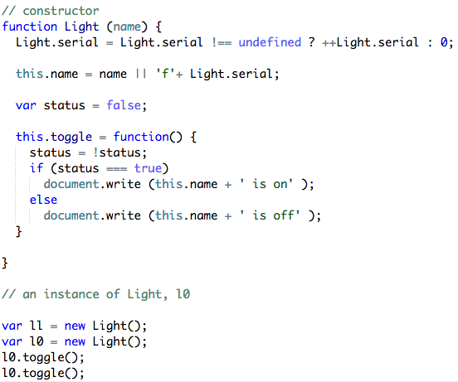

Slide 6
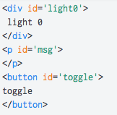
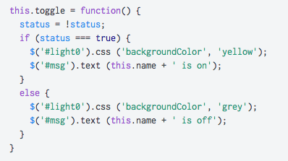
Version 3
Jsfiddle:
https://jsfiddle.net/georgeChen/q7kowc3c/
Html content:
<div> for light
<p> for message
<button> for on/off

Slide 7
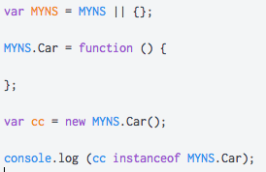
Version 3p Namespace
Compare C++ namespace
Light is such a‘菜市場名’
Use namespace …

Slide 8
Version 4 (homework 1)
Div: size and placement
Color specification by rgb or hsl
Varying blinking pattern and interval
Add button for on/off blink control
Change div parameters for size & positioning

Slide 9
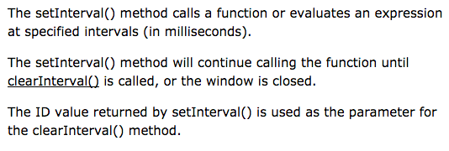
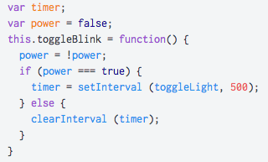
Blinking …setInterval & clearInterval
“all about time”

Slide 10
prototypes
What is it? (reference)
How is it different?
Why bother? More efficient (supporting data)

