Slide 1
Inventory Management System
By Ashley Ritchie

Slide 2
Specification
To create an application with utilisation of supporting tools, methodologies and technologies that encapsulate all fundamental modules covered during training.
The application needs to be an inventory management system and should interact with the end user via the CLI (Command Line Interface).

Slide 3
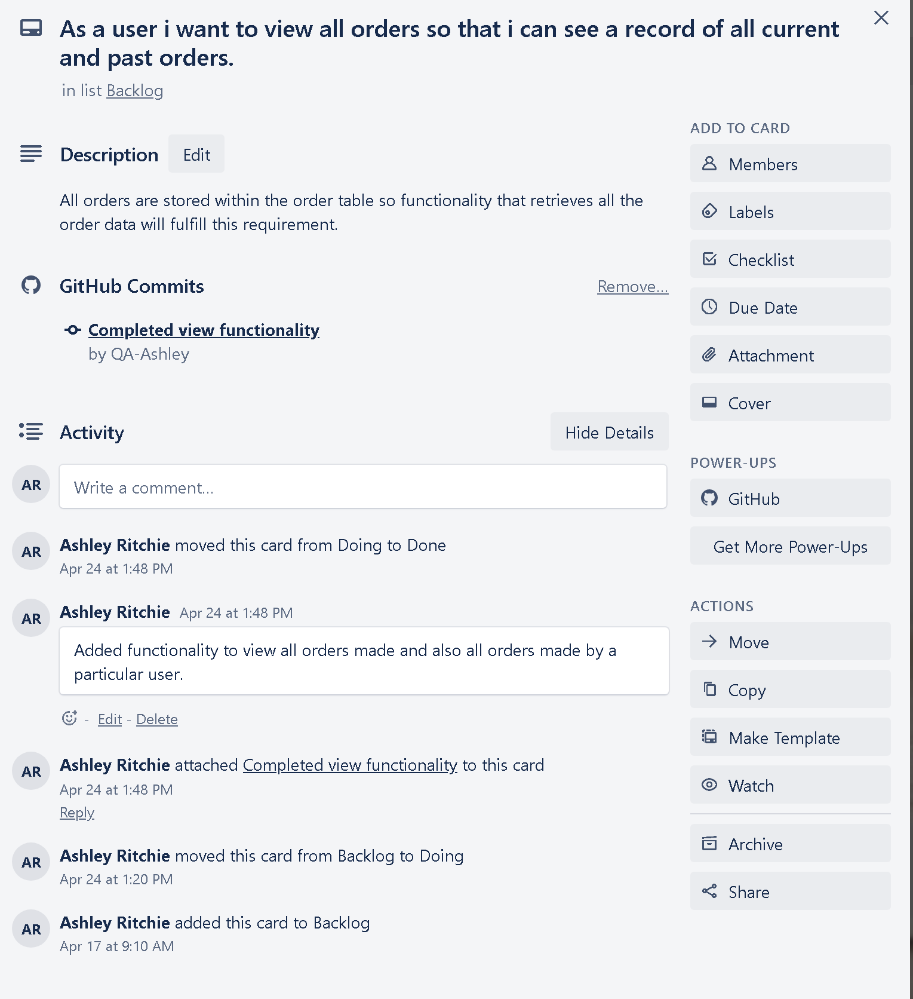
Planning
User stories created from the requirements.
Entity-Relationship Diagram created.
Set up a Kanban board with Trello
GitHub repository created

Slide 4
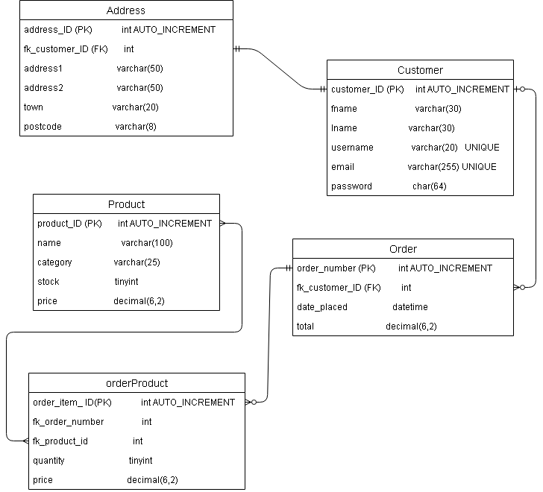

Slide 5

My journey
New skills
Using and managing instances on GCP
JAVA!
Testing frameworks
SQL
Working in an Agile environment

Slide 6
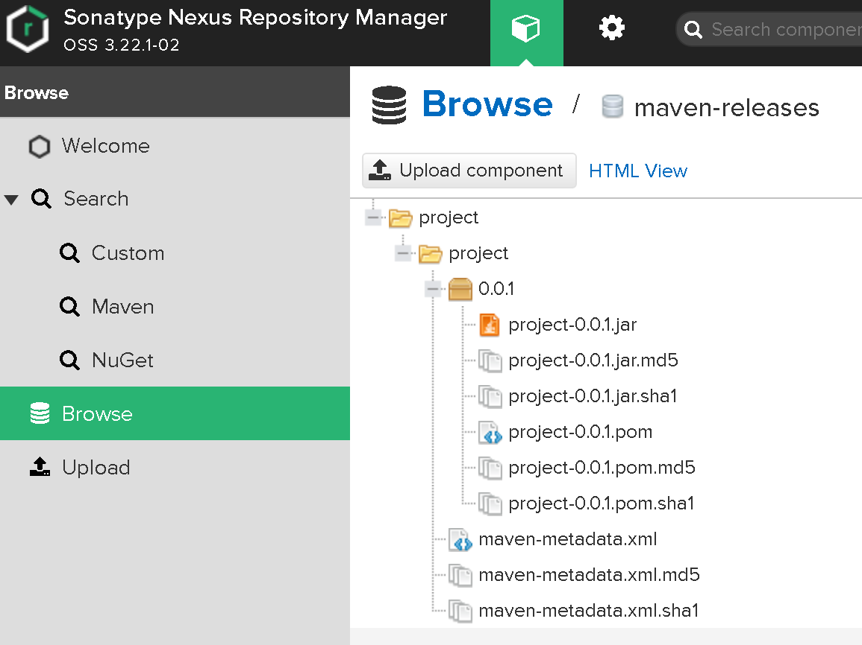
Nexus

Slide 7
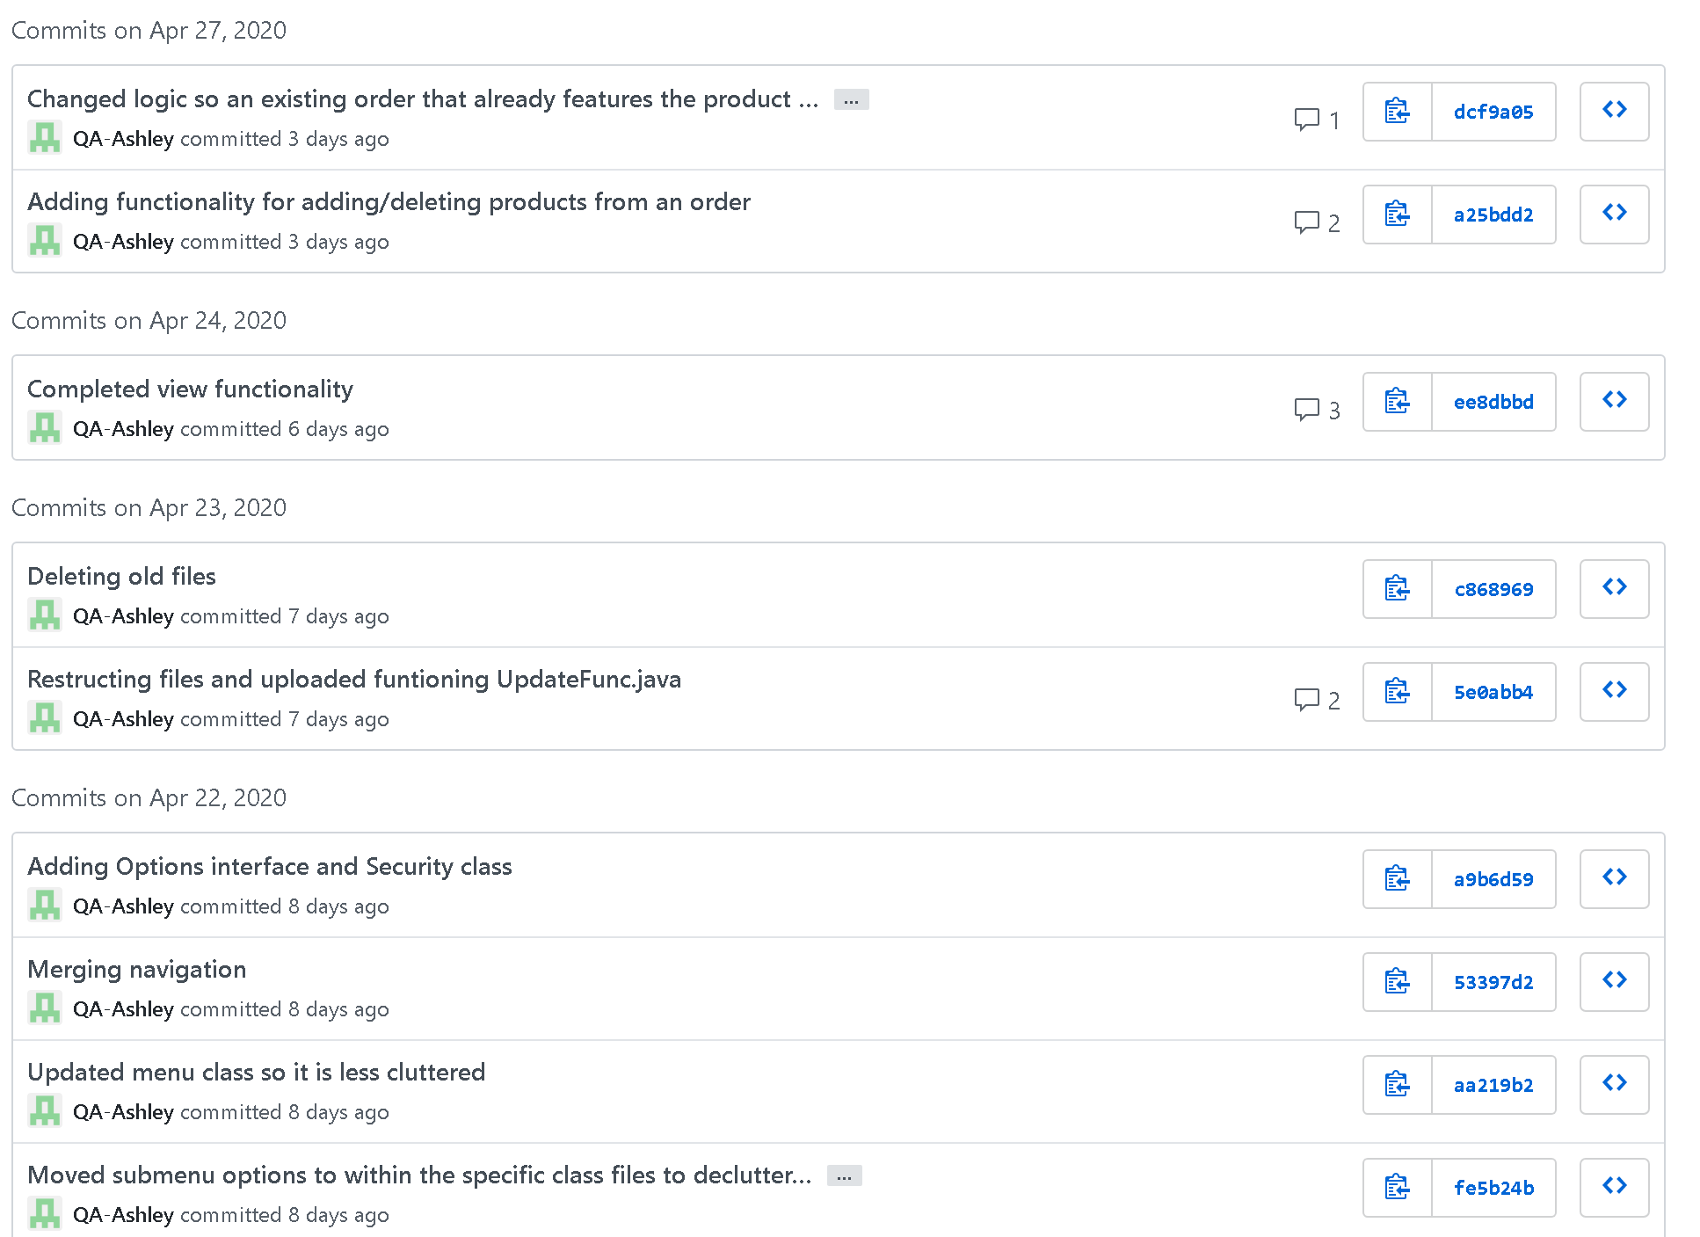
GitHub Commits
Regularly committed working code on to the GitHub repository and separated sections into branches which were merged once completed.

Slide 8

DEMO TIME

Slide 9
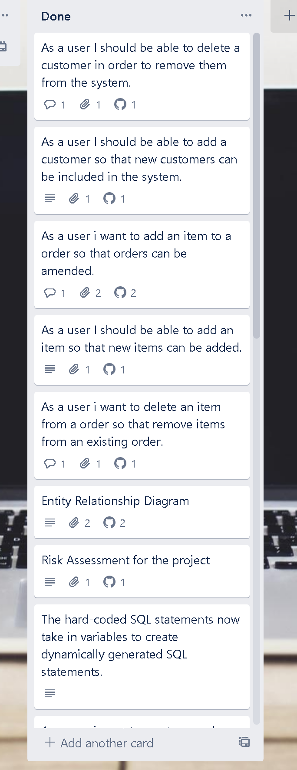
What did I accomplish?
Completed functionality that fulfilled all initial user stories created.
80.1% Testing coverage on the application.
Application supports connection to GCP database.
Built up a proficiency in various new technologies.

Slide 10
What would I have done different
Improve efficiency by utilising connection pooling (c3p0, HikariCP)
Use prepared statements (Using just Statements as a way to interact with the database is not only unsafe but is also a downgrade in performance)
Build testable code from the get go (Design patterns are there to help)
Better time management

Slide 11
Thanks for listening
Any questions?

