Slide 1
Stuff
Things All Developers (and Other People) Should Know

Slide 2
Chapter Information
## Learning Goals 1. Learn how to use GitHub 2. Learn how to install and use IntelliJ 3. Learn how to write an Hello World application in Java, run it from IntelliJ, from the command line and debug it 4. How to read from console using Scanner 5. How to do basic String operations 6. How to use variables and constants 7. Loops and Arrays 8. Learn some of the basics of computer design and architecture 9. Comments and when to use them (and when NOT to use them) 10. Java Packages, versions ## Final Project Animation: Show a single line animation on the console ## Tools to Install 1. Java SDK version 8 unless your team works with 11 2. IntelliJ (from JetBrains or local repository) 3. Create GitHub account 4. Git (from GitHub) 5. TortoiseGit (makes it easy to view repositories in Explorer) 6. Notepad++ (quick editor with syntax highlighting)

Slide 3
Computer Hardware
CPU
Assembly Language
Registers & Memory
Virtual Memory
Von Neumann Model
I/O and Interrupts
Disk I/O
Graphics
Networking

Slide 4
CPU
Central Processing Unit
Sits on Motherboard and controls most everything
Processes Machine Instructions
Recipes with predefined steps
Compare
Read and Write to memory
Jump around
Arithmetic

Slide 5
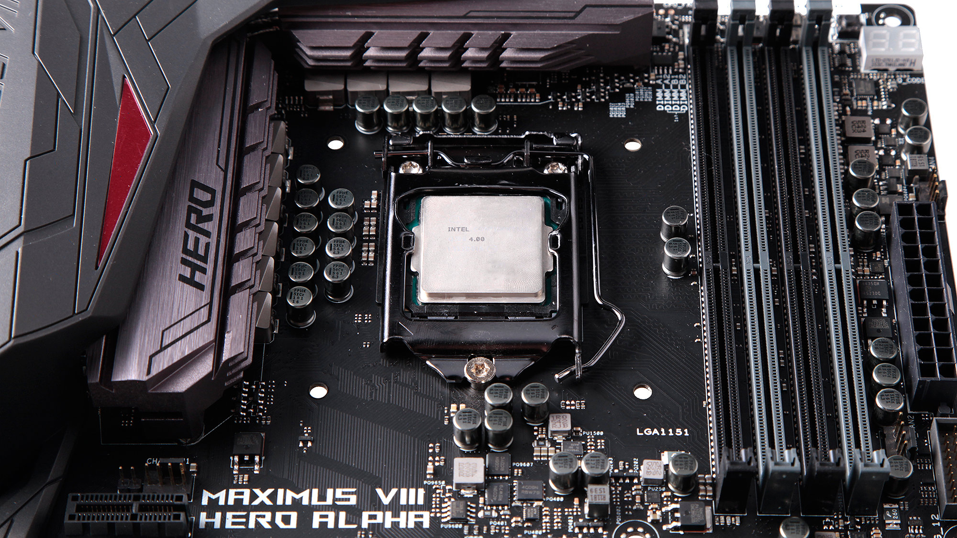

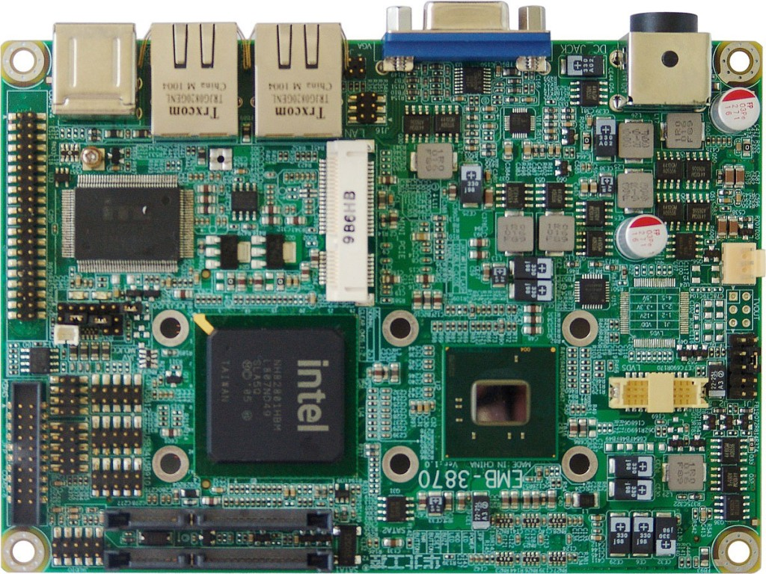

Slide 6
Assembly Language
A very primitive programming language
Instructions that directly translate to machine language
Macros
Very efficient
Very hard to write long meaningful programs
CPU specific
Assembler: Assembly -> Machine Code

Slide 7
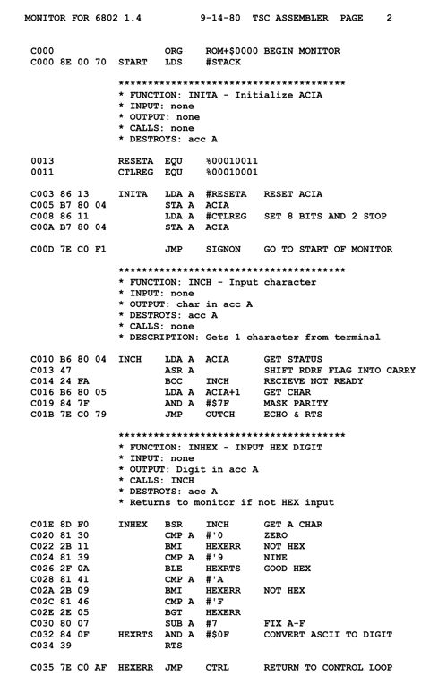
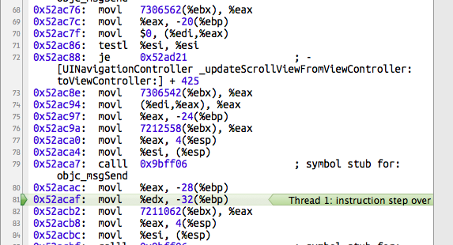

Slide 8
Registers & Memory
Memory – holds binary data
Manipulated by CPU
In Registers
Directly
Registers
How CPU manipulates data
Special
CPU Cache

Slide 9
Registers & Memory
Memory
IP
Registers
CPU
SP

Slide 10
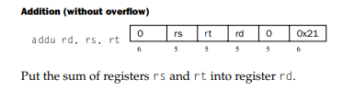
Word!
A word is the natural unit of data used by a particular processor design
A comprises a set number bits N (8,9,16,32,64) as dictated by the processor design
The word describes either
Data in the range 0..2^{N}-1
Memory addresses in the range 0..2^{N}-1
A representation of a machine code instruction

Slide 11
Refresher on Radix Systems
Radix is a Latin word for "root". Root can be considered a synonym for base in the arithmetical sense.
In a system with radix b (b > 1), a string of digits d₁…d_{n} denotes the number d₁b^{n−1}+d₂b^{n−2}+…+d_{n}b⁰, where 0≤d_{i}<b.^{[1]} In contrast to decimal, or radix 10, which has a ones' place, tens' place, hundreds' place, and so on, radix b would have a ones' place, then a b¹s' place, a b²s' place, etc.^{[2]}

Slide 12
2, 10, 16
Decimal {0..9} → d₁10^{n−1}+d₂10^{n−2}+…+d_{n}10⁰
77 = 77₁₀
= 7*10¹+7*10⁰
= 70+7 = 77₁₀
Binary {0..1} → d₁2^{n−1}+d₂2^{n−2}+…+d_{n}2⁰
0B01001101 = 010011012₂
= 0*2⁷+1*2⁶+0*2⁵+0*2⁴+1*2³+1*2²+0*2¹+1*1*2⁰
= 2⁶+2³+2²+1 = 77₁₀
Hexadecimal {0..9,A..F} →d₁16^{n−1}+d₂16^{n−2}+…+d_{n}16⁰
0X4D = 4d₁₆
= 4*16¹+13*16⁰
= 4*16+13 = 77₁₀

Slide 13
Significance in Radix R
d₁R^{n−1}+d₂R^{n−2}+…+d_{n}R⁰ ⁼
d₁d₂…d_{n R}
Most Significant
Least Significant
A digit of a binary number in the context of computer systems is called a Bit (Binary Digit)
We often talk about the most, and least significant bit, as indicated above…

Slide 14
Virtual Memory
Size of the address space
2³² = 4,294,967,296
(4 GigaGytes, 4 Billion Bytes)
2⁶⁴ = 18,446,744,073,709,551,616
(18 ExaBytes, 18 Quintillion Bytes)
Address spaces larger than 32 bit are impossible to maintain in physical memory.
OS and HW supports way less (2⁴⁰)
Cost would be prohibitive (@1$/GB)
18ExaBytes would cost $1,073,741,824
It would be huge, and draw a huge amount of power and cooling…
Virtual Memory allows maintaining a large address space with much smaller physical memory

Slide 15
Paging
Memory Space
Backing Store
IP
Registers
Physical Memory
CPU
SP

Slide 16
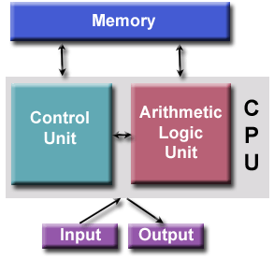
Von Neumann Model

Slide 17
I/O and Interrupts
Interrupts
Memory mapped I/O
Devices
Graphics
Disks
Network

Slide 18
Procedural Programming
Some History
What is Compiling
Creating Binaries
What is Linking
Putting things together
What is Loading
Putting things where CPU can get them
Executing code
Starting the program
Procedures and calling
Basic Procedural Programming Constructs

Slide 19
History
60’s (Algol, ForTran, BASIC)
70’s (Pascal, C)
80’s (Ada)

Slide 20
Compile
Turn text (code) to binary
Code
Binary
Code
Binary
Code
Binary

Slide 21
Lib
Expose common abilities through a library
Binary
Binary
Library
Binary

Slide 22
Link
Bring things together
Resolve IMPORTs through EXPORTs
IMPORTs
Library
Binary
EXPORTs
Binary
Executable binary
Binary

Slide 23
Load
Get the CPU to see stuff
Dynamic Load Library
Executable binary

Slide 24
Running – The IP
Memory
IP
Registers
CPU
SP

Slide 25
Notation
Memory
X = reference to X
Address
Register
(X) = content of X
E.g.
R1, 4544454
(R1), (4544454)
4544454
99AB
R1
33

Slide 26
Instruction Processing by the CPU
Fetch the next instruction
CPU ←((IP))
IP = (IP) + 8
CPU Processes the fetched instruction

Slide 27
Example
R1 = 4000016
IP = 4000000
Fetch the next instruction
CPU ←((IP))
(IP) = (IP) + 8
CPU processes the instruction
What are IP, R1 after FETCH?
4000000
Mov R1,IP
4000008
Mov, 3, R1
4000016
Mov, 2, R1

Slide 28
Running – The IP
Memory
IP
Registers
CPU
SP

Slide 29
Running – The IP
Memory
IP
Registers
CPU
SP

Slide 30
Running – The IP
Memory
IP
Registers
CPU
SP

Slide 31
Running – The IP
Memory
IP
Registers
CPU
SP

Slide 32
Calling a Procedure
Memory
IP
Registers
CPU
SP

Slide 33
Procedures
The Stack
The Stack pointer

Slide 34
Calling a Procedure
Memory
IP
Registers
CPU
SP

Slide 35
Calling a Procedure
Memory
IP
Registers
CPU
SP

Slide 36
Calling a Procedure
Memory
IP
Registers
CPU
SP

Slide 37
Calling a Procedure
Memory
IP
Registers
CPU
SP

Slide 38
Return from Procedure
Memory
IP
Registers
CPU
SP

Slide 39
Return from Procedure
Memory
IP
Registers
CPU
SP

Slide 40
Return from Procedure
Memory
IP
Registers
CPU
SP

Slide 41
Logic / Arithmetic
Usually executed by the CPU
On data in registers
Sometime on memory
Depends on CPU

Slide 42
Assignment
Move values from CPU registers into memory locations
Sometime can move data from memory to memory
Block transfers (BLOBs)
Specific capabilities depend on CPU

Slide 43
ALGOL
BEGIN
FILE F (KIND=REMOTE);
EBCDIC ARRAY E [0:11];
REPLACE E BY "HELLO WORLD!";
WRITE (F, *, E);
END.

Slide 44
Fortran
program hello
print *, "Hello, World"
end program hello

Slide 45
BASIC
10 PRINT "Hello, World"
20 END

Slide 46
ADA
with Ada.Text_IO;
procedure HelloWorld is
output_string : String(3..13);
begin
output_string := "hello, world";
Ada.Text_IO.Put (output_string);
end

Slide 47
C
#include <stdio.h>
int main (int argc, int argv)
{
printf("hello, world\n“);
return 0;
}

Slide 48
Pascal
Program Hello(output)
Begin
writeln("hello, world\n“);
End;

Slide 49
Conditionals
Conditionals
Simple (if)
Special comparison operators in the CPU
Work on registers or on memory
Complex (switch)
Works with jumps: IP assignments

Slide 50
Memory Allocation
Memory management subsystem
Allocate()
Free()
Memory leaks if something goes wrong
Most difficult part of “regular programming”
“Solved” through managed memory systems (later)

Slide 51
Arrays
Contiguous area of memory holding several entities of the same kind
Lookup is O(1)
E.g.,
Integers
Floats
Characters
Strings
See this overview for the big O notation

Slide 52
Finding Array Elements
Array Lookup = ArrayStart + (Index * elementSize)
0
1
2
3
4
5
6
7

Slide 53
Array Examples
Array Lookup = arrayStart + (index * elementSize)
Assuming arrayStart = 120000, and index = 3
int - elementSize = 4 bytes
Address of arrayStart[index] = 120000 + 12 = 120012
long - elementSize = 8 bytes
Address of arrayStart[index] = 120000 + 24 = 120024
char - elementSize = 2 bytes
Address of arrayStart[index] = 120000 + 6 = 120006
double - elementSize = 8 bytes
Address of arrayStart[index] = 120000 + 24 = 120024
byte - elementSize = 1 bytes
Address of arrayStart[index] = 120000 + 3 = 120003
String ?

Slide 54
Array of Strings
Strings have variable lengths and cannot be held contiguously
They all have addresses that have the same size
String Pointer - elementSize = 8 bytes
Address of string is → arrayStart[3] = 120000 + 24 = 120024
Value of string is (0xAABC4D00) = “नमस्ते”

Slide 55
Finding Array Elements
String Array Lookup = ArrayStart + (Index * 8) (64-bit)
0 …
Hello
1 …
Hola
2 0xAABE4D12
こんにちは
3 0xAABC4D00
नमस्ते
4 0x18BC4D00
Привет
5 …
مرحبا
6 …
你好
7 …
שלום

