Slide 1
Selenium Webdriver with Java
QAGuru
Quality Accelerated
Notes:
Welcome to selenium training session.
Selenium is a software test automation tool. Is it the only test automation tool in the market? No. There are many. Which are the others?UFT(QTP), TestComplete, RFT. Then, whats the importance of Selenium? Statistics from industry show that Selenium is the most widely used test automation tool in the market. What could be the reason? It’s the most stable and efficient test automation tool. What is the cost? Its free tool. It an open source tool too.

Slide 2
TestNG Framework

Slide 3
TestNG
TestNG is a testing framework that overcomes the limitations of another popular testing framework called JUnit
The "NG" means "Next Generation“
TestNG can generate the report in a readable format
Advantages of TestNG over JUnit:
Annotations are easier to understand
Test cases can be grouped more easily
Parallel testing is possible

Slide 4
TestNG Script
public class TestNGNewTest {
public String baseURL = " http://www.qaguru.ca”;
@Test
public void VerifyHomePageTitle() {
System.setProperty("webdriver.gecko.driver", "C:/geckodriver-v0.16.1-win64/geckodriver.exe");
public WebDriver driver = new FirefoxDriver();
driver.get(baseURL);
String expTitle = "QA Guru | Home“;
String actTitle = driver.getTitle();
Assert.assertEquals(expTitle,actTitle);
driver.quit();
}
}

Slide 5
Annotations

Slide 6
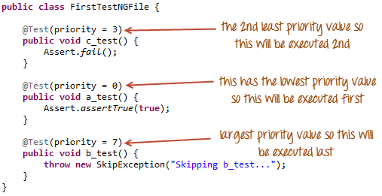
@Test(priority=n, enabled=true/false)
To execute tests
Tests are executed alphabetically
There is no need for your priority values to be consecutive
Enabled – to enable/disable the test

Slide 7
@BeforeTest and @AfterTest
@BeforeTest
methods under this annotation will be executed prior to the first test case in the TestNG file.
@AfterTest
methods under this annotation will be executed after all test cases in the TestNG file are executed.

Slide 8
@BeforeMethod
methods under this annotation will be executed prior to each method in each test case.
@AfterMethod
methods under this annotation will be executed after each method in each test case.

Slide 9
@BeforeSuite: The annotated method will be run before all tests in this suite have run
@AfterSuite: The annotated method will be run after all tests in this suite have run
@BeforeGroups: The list of groups that this configuration method will run before. This method is guaranteed to run shortly before the first test method that belongs to any of these groups is invoked.
@AfterGroups: The list of groups that this configuration method will run after. This method is guaranteed to run shortly after the last test method that belongs to any of these groups is invoked.
@BeforeClass: The annotated method will be run before the first test method in the current class is invoked.
@AfterClass: The annotated method will be run after all the test methods in the current class have been run.

Slide 10

Thank You
QAGuru
Quality Accelerated

