Slide 1
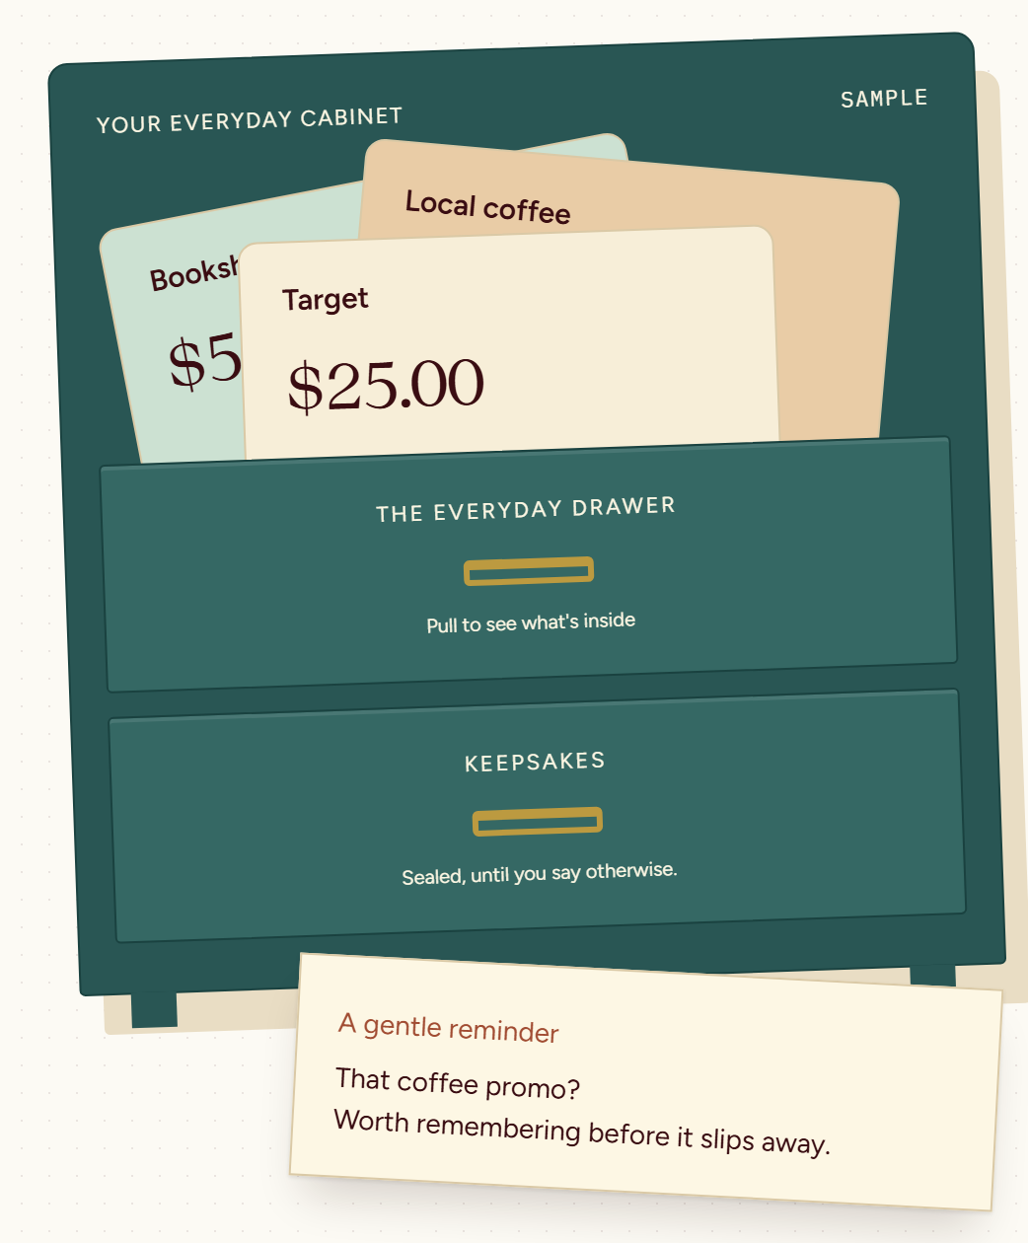
Meta Global AI Developer Hackathon · Build for Your World
Gift Cabinet 🎁
The gift cards you forgot, spent.
gift.dosa.dev · open source (MIT)
Notes:
Gift Cabinet. Americans leave about $20 billion of gift-card value unused. I built a cabinet that helps you spend yours.

Slide 2
Cards get a drawer. Then forgotten. Then expire.
$23B
43%
$244
Unused gift-card value Americans lose out on each year
American adults holding unused gift cards
Average unused total per person holding cards
Capital One Shopping, 2026
Capital One Shopping, 2026
Capital One Shopping, 2026
Trackers ask you to type the number and PIN — the one thing you shouldn't.
gift.dosa.dev
2
Notes:
Cards get a drawer, then get forgotten, then expire. Nothing tracks them, and the ones that do ask you to type the number — which is exactly the thing you shouldn't.

Slide 3
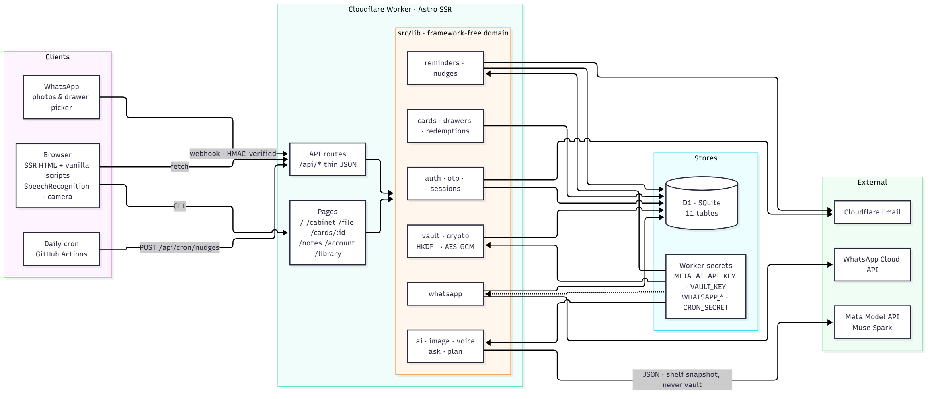
Four ways in. One cabinet.
Astro SSR on Cloudflare Workers · D1 · Muse Spark via the Meta Model API · WhatsApp as a second front door
gift.dosa.dev
3
Notes:
Photo, voice, typing, or a WhatsApp message all land in the same place. Muse Spark reads the card and understands what you want; my code holds the money.

Slide 4
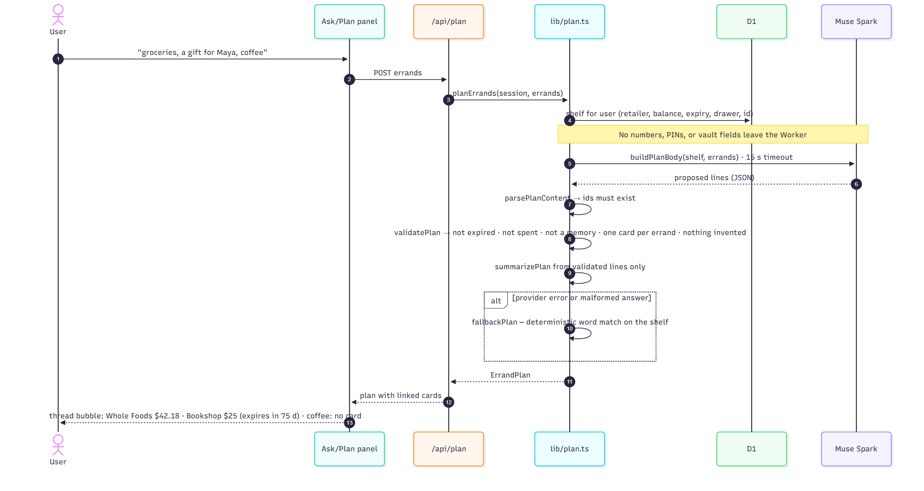
The model proposes. Code decides.
Model call | What code checks
Snap | Draft only; user confirms; number and PIN never extracted
Voice | Relative dates resolved; ambiguous currency or drawer flagged for review
Ask | Every claim must cite a card id, or a deterministic summary replaces it
Plan | Ids must exist; no expired, spent or memory cards; nothing invented
Provider down or malformed answer → deterministic fallback. The app never dead-ends.
gift.dosa.dev
4
Notes:
Four model calls, four validators. The model never touches a balance. If it's wrong or offline, a deterministic fallback takes over — the app never dead-ends.

Slide 5
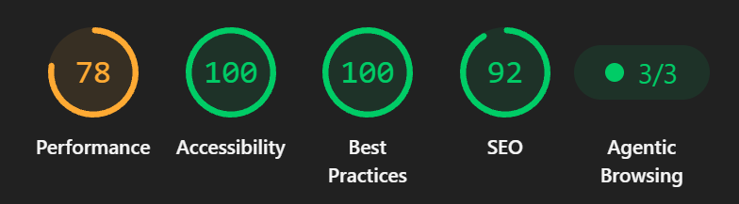
It holds up.
295
19
100 · 100
AES-GCM
unit tests
end-to-end specs
Accessibility · Best Practices
vault, per-user HKDF key
Live at gift.dosa.dev · MIT · github.com/QAInsights/gift.dosa.dev
gift.dosa.dev
5
Notes:
It's live, tested across every screen, accessible, and open source. Let me show you — two minutes.

