Slide 1
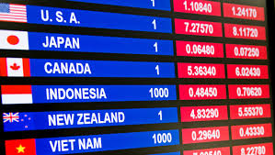
Fundamentals of Forex

Slide 2
Introducing the foreign exchange market
Market Structure
FX is a large, liquid and continuous transaction market
Operates 24 hours a day – From 20:15 GMT on Sunday (the “Asia Open”) until 22:00 GMT on Friday (the “New York Close”)
Lower transaction costs
Unlike equity markets, where traders pay commission of upwards of $20 per trade – OTC markets
No true price – each broker or market-maker gives their own prices which eliminate exchange and clearing fees
Perfect market for technical analysis
Currencies rarely spend time in tight trading ranges and have tendency to develop strong trends
Over 80% of market is speculative in nature (e.g. Hedge funds)
Market Structure | FX Drivers | Trading Strategies

Slide 3
Introducing the foreign exchange market
Over-the counter market
Over-the-counter market vs centralized exchange
Competition between market-makers prevents monopolistic pricing ranges
E.g. Amazon is listed on the NYSE – where their stock is traded – everyone can see the price of AMZN in NYSE
Decentralized markets (like OTC) - can have multiple market markets: all of whom have the right to quote different prices
Market Structure | FX Drivers | Trading Strategies

Slide 4
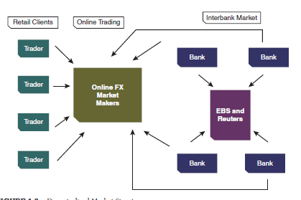
Introducing the foreign exchange market
How the foreign exchange market work
Market Structure | FX Drivers | Trading Strategies
Notes:
At the
top of the food chain is the interbank market, which trades the highest volume per
day in relatively few currencies. In the interbank market, the largest banks can deal
with each other directly, via interbank brokers, or through electronic brokering
systems like EBS or Reuters. The interbank market is a credit-approved system,
where banks trade based solely on the credit relationships they have established
with one another. The banks can see the rates everyone is dealing at, but each bank
must have a specific credit relationship with that bank in order to trade at the rates
being offered. Other institutions such as online FX market makers, hedge funds,
and corporations must trade FX through these banks, although some have created
their own liquidity pools through the years

Slide 5
FX Spot
What are Spot FX transactions?
A spot fx transaction is an exchange of one currency for another at an agreed rate
Settlement of spot trades typically* takes place two business days after the trade date (T+2)
For example, if you buy USDSGD at 1.3711 with 1 million SGD, you will receive 1.3711 USD only 2 business days after you enter the trade
Market Structure | FX Drivers | Trading Strategies

Slide 6
Spot Quotations
How are spot FX transactions quoted?
Spot rate is the price of currency against another, expressed as an ratio.
Market makers quote both the bid and offer prices in the market (2-way price). The difference between the two prices is known as the spread.
USDJPY 108.50/108.60
If you want buy usdjpy (exchange jpy for usd), you will need 108.60 yen for every dollar.
If you want to sell usdjpy (exchange usd for jpy), you will receive 108.50 yen for every dollar you sell.
Spread = 0.10
Pips is the smallest denomination of the FX quote: if AUDUSD increases from 0.6740 to 0.6750 – that is 10 pips.
Typically the 4th decimal point except for certain currency pairs where numbers are higher – eg USDJPY, USDINR
Market Structure | FX Drivers | Trading Strategies

Slide 7
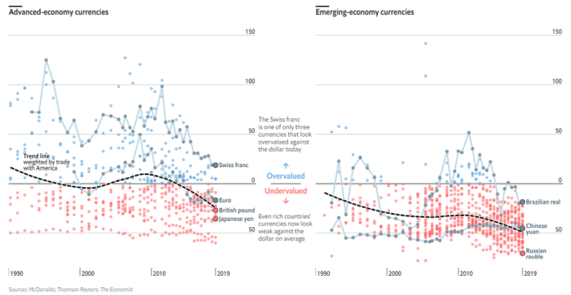
Longer-term drivers of FX
How do we know if FX is over-valued or undervalued
“Law of one price”
Big Mac Index
Big mac costs $1 in new York and 100 yen in Tokyo → then the fair value of USDJPY should be $1 = Y100
But if $1 = 50JPY, a Japanese person can buy American big mac for just 50 JPY
Japanese person will import American goods
Market Structure | FX Drivers | Trading Strategies

Slide 8
Longer-term drivers of FX
External Equilibrium
External balance: Persistent current account surplus → Currency is undervalued
However, does not take into account other factors that affect FX: like central bank intervention
For the longest time, PBOC adopt a fixed rate of yuan against the USD (1=8.28)
Singapore also manages currency strength against a basket of other currencies (NEER) – only allowed to trade within +- 2% of the NEER basket
Market Structure | FX Drivers | Trading Strategies

Slide 9
Other factors affecting foreign exchange
Fundamental factors affecting FX
FX is like trading a stock, except instead of a company, you are analysing a country.
Portfolio Flows
Intervention Risk
Political Climate
Interest Rates
Economic Data
Market Structure | FX Drivers | Trading Strategies

Slide 10
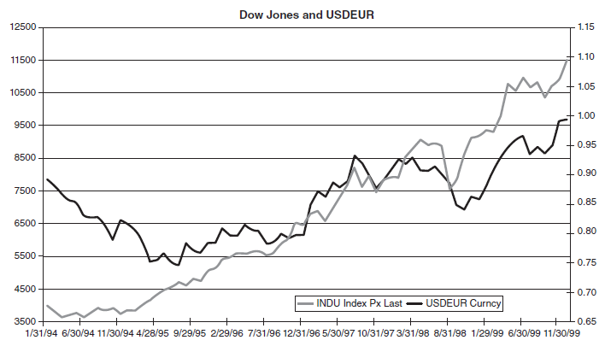
Fundamental factors affecting FX
Portfolio Flows
Strong correlation between a country’s equity markets and its currency
Market Structure | FX Drivers | Trading Strategies

Slide 11
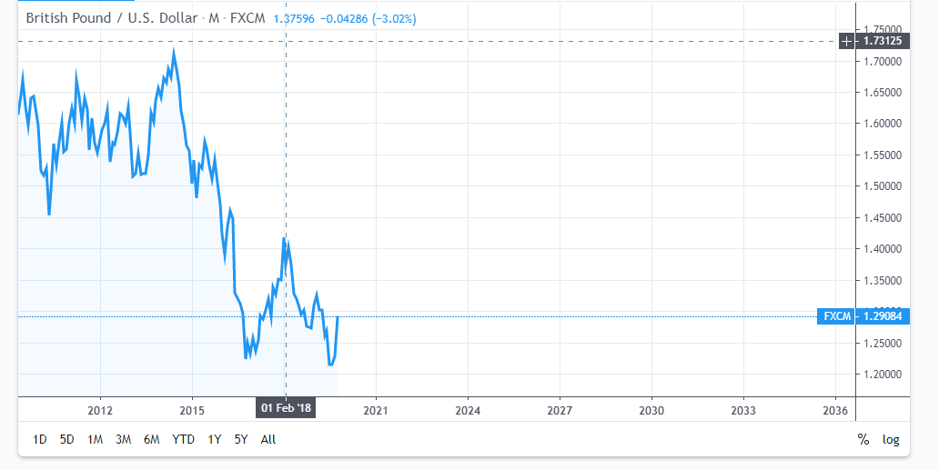
Fundamental factors of FX
Political Climate
Uncertain political climate in a certain country does not bode well for its currency
Why? Investors and businesses do not want to invest more money in the country due to uncertainty → Capital flight → Depreciation of currency
Case in point: GBPUSD and USDTRY
Market Structure | FX Drivers | Trading Strategies

Slide 12
Fundamental factors of FX
Economic Data
Economic data shows the health of the nation’s economy
Some important data include:
Inventories
Auto Sales
GDP
Mortgage Applications
Consumer Confidence
ISM
Unemployment
ADP National Employment Report
In practice, market discounts most reports before they are released based on estimates. However, if actual statistics are significantly different from that which has been expected, will have pronounced response.
Market Structure | FX Drivers | Trading Strategies

Slide 13
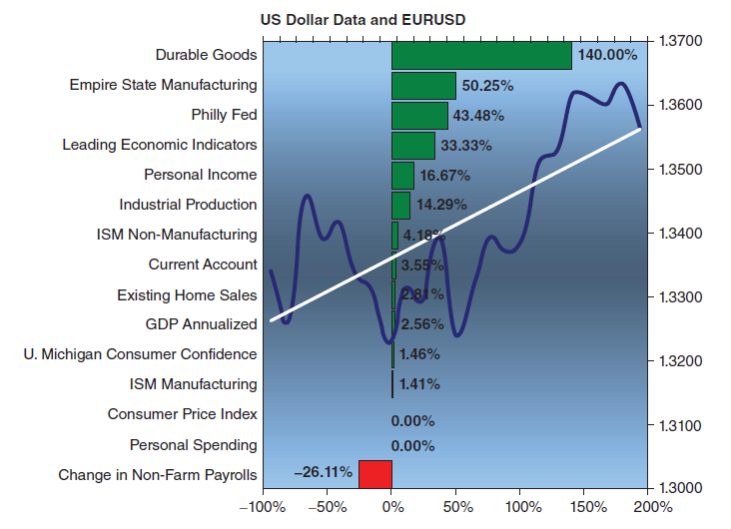
Fundamental factors of FX
Economic Data surprise
Trading strategy: chart economic surprise against FX
Market Structure | FX Drivers | Trading Strategies

Slide 14
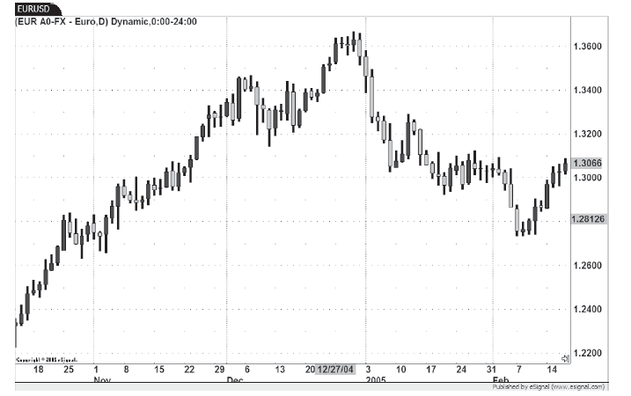
Fundamental factors of FX
Charting Economic Surprise
Market Structure | FX Drivers | Trading Strategies

Slide 15
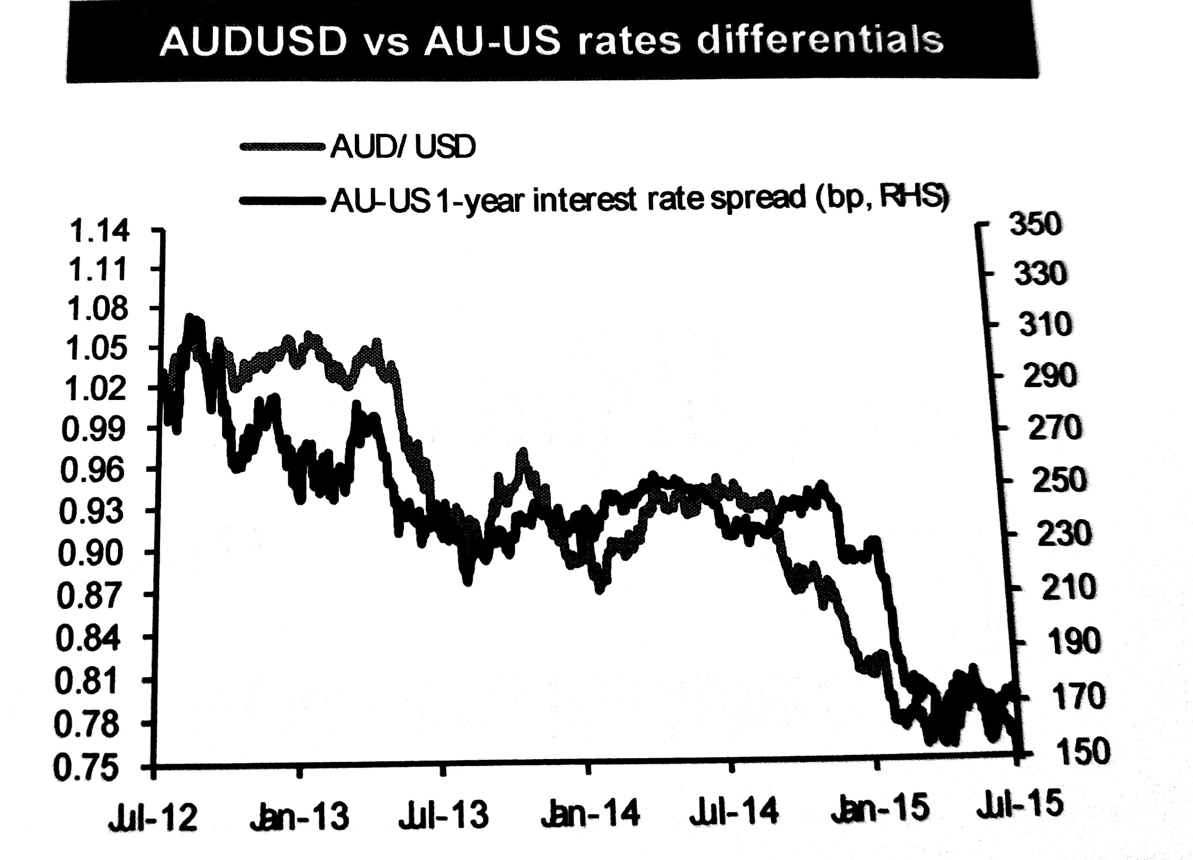
Fundamental factors of FX
Interest Rate differential
If a currency interest rates is high, more demand for ccy
Imagine USD 2yr bond at 1.5% vs AUD 2yr bond at 5.5% (theoretical) – which one will u want to buy?
Higher rates are not aways good, higher risk premium or high inflation.
Currencies usually track interest rate spread (difference in interest rates between two countries):
Market Structure | FX Drivers | Trading Strategies

Slide 16
Fundamentals of FX
Interest Rate Differential
Interest rates are one of the most important factors affecting FX – to the extent FX strategists in hedge funds and banks typically forecast when central bank is going to cut rates
Cutting rates does not necessarily mean lower FX strength on the day – depends on how much and the expectation heading into the meeting
Can use Bloomberg for banks estimates to determine what is market thinking
More sophisticated where is through Fed Fund futures – whereby traders bet on which direction of policy rates: will give you the market-implied probability of a central bank cutting or raising rates
Market Structure | FX Drivers | Trading Strategies

Slide 17
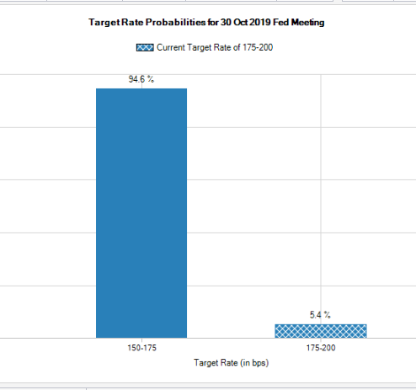
Fundamentals of FX
Using fed fund futures to determine interest rates
https://www.cmegroup.com/trading/interest-rates/countdown-to-fomc.html
Market Structure | FX Drivers | Trading Strategies

Slide 18
Fundamentals of FX
Central bank Intervention
Direct FX intervention in Spot FX market
Indirect FX intervention via derivatives, capital control measures, interest rate policy
During volatility / at key prescribed levels
Market Structure | FX Drivers | Trading Strategies

Slide 19
FX is also driven by risk sentiment
Some currencies rally during “risk-off” environment, some during “risk-on”
“Risk-off” vs “Risk-on”
Safe-haven currencies: JPY/CHF
“Risk-on” currencies: AUD / EM currencies
EM Currencies: TRY, BRL, CNH, CNY, INR etc
Oil currencies: CAD
Market Structure | FX Drivers | Trading Strategies

Slide 20
FX Products
FX is more than just spot….
Forwards
Buying a currency at a stipulated time in the future
Forward price = Spot price + forward points
FX Swaps
Vanilla Options
Exotic Options
Multi-currency options
Market Structure | FX Drivers | Trading Strategies

Slide 21
FX Trading Strategies
Potential Strategies to look into
Technical Analysis
2 Bollinger trading
Channel trading
Carry Trade
Seasonal Trading
Many more… will share more if interested in future sessions to avoid overload of information
Market Structure | FX Drivers | Trading Strategies

