Slide 1

Git Workflow
Ang Jun Liang

Slide 2
What’s a workflow
Use Git efficiently
Consistent
Productive
There’s no one or best way
Key – Everyone must agree

Slide 3
What is ‘good’ workflow?
Goal is to boost productivity
Depends on your needs
How large is your team? How well does it scale?
How easy is this workflow?
Is it easy to undo mistakes?

Slide 4
Our requirements
Team of 3-5?
Small team => No scaling needed
We want an easy workflow… nothing too fancy

Slide 5
Centralized Workflow
Most simple but it works well.
Only one entry point – a central repository
Brief summary of required steps:
Create an organization then a team on GitHub
Create a central repository for that team
Each member clones the central repository to their local computer
They work on it as usual
When ready, push code to central repository
Others should pull from central repository
Manage conflicts..

Slide 6
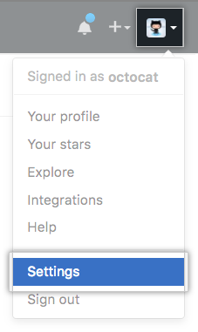

1. Create Organization
In the upper-right corner of any page, click your profile photo, then click Settings.
In your user settings sidebar, click Organizations.

Slide 7
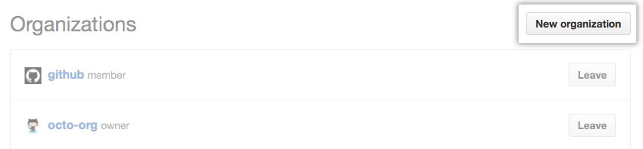
1. Create Organization
In the "Organizations" section, click New organization.

Slide 8
1. Create Organization
Under "Organization name", give the organization a name.
Fill in the necessary details then click Create Organization.

Slide 9
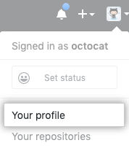
2. Create a team
In the top right corner of GitHub, click your profile photo, then click Your profile.

Slide 10
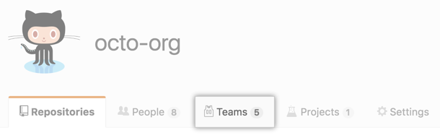
2. Create a team
Under your organization name, click Teams.

Slide 11
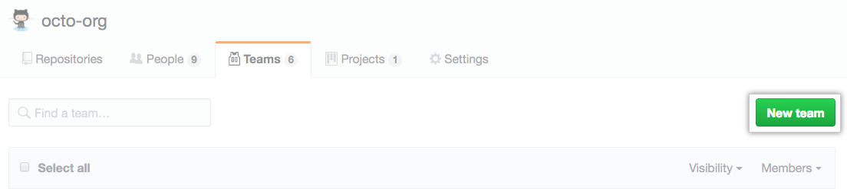
2. Create a team
On the right side of the Teams tab, click New team.

Slide 12
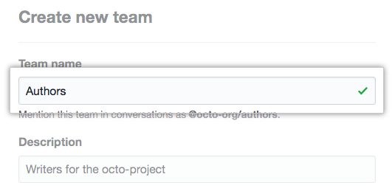
2. Create a team
Under "Create new team", type the name for your new team.

Slide 13
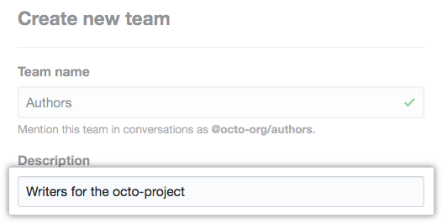
2. Create a team
Optionally, in the "Description" field, type a description of the team.
Fill the rest accordingly and Click Create team.

Slide 14
How it works (organization/team)
Create organization -> add people in.
Repositories are created organization-level.
Then you create team.
Team can add members/repos from the organization.
https://github.com/collab-uniba/socialcde4eclipse/wiki/How-to-setup-a-GitHub-organization,-project-and-team

Slide 15
3. Clone the central repo locally
git clone ….

Slide 16
4. Each member works on as usual
Make changes/commits
git add <some-file> # Stage a file
git commit # Commit a file</some-file>
This is safe!! Why?
These commands create local commits
Can be repeated as many times without worrying what is going on in the central repository.

Slide 17
5. Pushing to central repository
Once the local repository has new changes committed, they will need to be pushed to share with other developers on the project.
git push origin master
This command will push the new committed changes to the central repository.
When pushing changes to the central repository, it is possible that updates from another developer have been previously pushed that contain code which conflict with the intended push updates.

Slide 18
6. Managing Conflicts
Fetch the updated central commits (from other person) and rebase changes on top of them.
git pull --rebase origin master
The --rebase option tells Git to move all of Mary’s commits to the tip of the master branch after synchronizing it with the changes from the central repository.
Without rebase also can… just that it will become a merge commit.

Slide 19
6. Managing Conflicts
git status # Tell you where is the error
Edit the file
git add <some-file>
git rebase –continue
…
If mess up, git rebase –abort
Git will return you to your branch's state as it was before git rebase was called.

