Slide 1
AWS

Slide 2
Root User → User who created the account. It will be defaultly created.
IAM User → Identity and Access Management. Always Use IAM, It is a Best practice. It is better and safe to use than root user.
IAM: [steps to Create a IAM User]
Sign in to Console.
Type IAM in Search Box.
User → Add Users → name, pwd → we can autogenerate or create custom pwd.
Permission is defined through policies.
If you created a autogenerated pwd. Please click the Download.csv
IAM Users and Group: [steps to Create]
1. In Users Group → click Create Group → add User in that group → apply policy for the user to access the group.
IAM password policy: [steps to Create]
Click Account Setting in (IAM management Console) → click change pwd policy.
Select the checkbox whatever type of validation policy you want for your pwd.

Slide 3
MFA Multi Factor Authentication:
1.It is a must and its very recommended to use it.
2. Main reason to create: if a password is stolen or hacked, the account is not compromised.
[steps to Create]:
Click your account [ It is in Top right corner ]
Click Security Credential
Click MFA → Click Activate MFA
Click Virtual MFA Device → select Authy, Authy is the best one
Note: If you activate MFA then you have to keep your MFA device [like mobile or any devices] safely once the device is lost then you cannot user your account.
How to generate Access Key for Aws Cli:
Click Users → click user name → Click Security Credentials → Click Create Access Key → Click Download.Csv file.
Note: Always Create Access key with IAM User. Don’t Create Access Key with Root User.

Slide 4
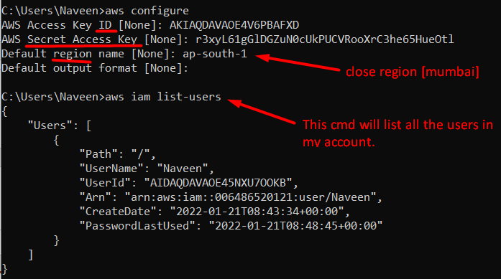
How to use Access Key in Cli:
Download Aws Cli for windows machine and then install it.
Go to Cmd prompt and do this.

Slide 5
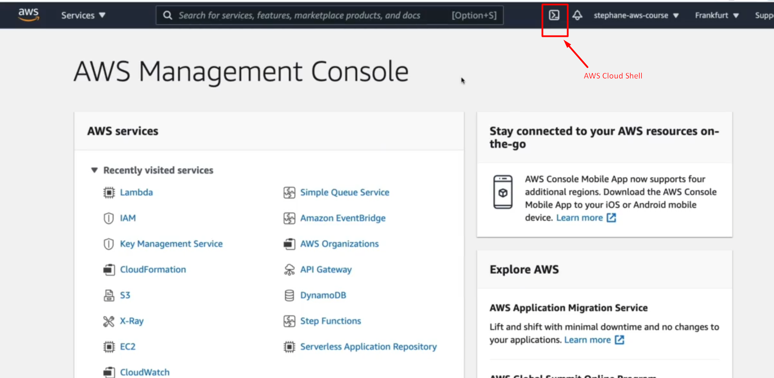
Aws Cloud shell:
Cloud Shell is Basically a terminal in the cloud of Aws. It is an alternative to Cli.
It will be available for some region not for all region.
Check video in Udemy → Section 4 [video 24] for more detail.

Slide 6
IAM Security Tools:
Credential report: [account level]
IAM Management Console → Credential report → Download the csv file and see the credentials for the user.
2. IAM Access Advisor: [User level]
It shows the services permission and when they are lastly used that service.
IAM Management Console → Users → click any user name → Access Advisor

Slide 7
How to Configure alert for the budget Usage:
Basically the IAM User has no Access to the billing account.
To resolve this Issue First login as a root user → click your Account → Click IAM User and role access to billing information → Edit → Select the check box and Click Update.
Now login as IAM User → Go to Billing Dashboard → Check Bills [It gives info about the bills and which services is creating more expenses.]
Create a Budget and then set a Alert for that Budget:
Billing Dashboard → Budget → Create Budget → Cost Budget → Enter Budget amount → Budget name → click next.
Configure Alert → Add alert threshold → Email recipient.

Slide 8
Launching an Ec2 Instance:
Type Ec2 in Search box → Choose a region.
Instance → Launch instance’s.
Choose AMI [For now select Quick Start] → Select Amazon Linux 2 AMI which is a free tier then choose Instance [t2 micro]
Config Instance details → Add Storage → Add Tags like [ Name : My first Instance].
Config Security group [click add rule and choose HTTP] → Create key pair [ Key pair is something that will be using to SSH ] select RSA and then give a key pair name and download the key pair [.pem file].
Ec2 Instance Type: Overview
There are few types of instance in Aws we will look some instances:
General purpose → balance between compute, network, memory.
Compute optimized → high performance processor [ Instance name mostly start’s with c. like c5, c6 etc.
Memory optimized → Ram [ Instance name mostly start’s with r and some will be x and z].
Storage optimized → local storage.

Slide 9
How to create Security Groups: [ creating inbound and outbound rules]
IAM → On the left hand side we have Security Groups.
We have launch wizard 1 which we created while we launched our Ec2 Instance.
Default group which is one that is created by default when you have your alias account created as well.
How to configure Security Groups and see the impact of inbound rule:
Go to Instance → Create a new instance [or] select a already created instance.
Copy the public ipv4 address and paste it in a new tab.
If it show time out error message then the firewall is protected your ec2 instance.
To resolve this go to → security groups → select the latest launch wizard and then edit the inbound rule.
For ex: for this scenario Add HTTP and select allow anywhere in inbound rule.
Now go to a new tab paste the ipv4 address. It will work fine.

Slide 10
Note:
Putty →It is a tool which is used to access a remote machine from our local machine. Using putty You can do anything in your remote machine like Edit, Delete and run any files etc.
WinSCP [windows secure copy] → It is a tool used to transfer Something [like files etc] from our local machine to the remote machine. Putty cannot do that. So that we are using WinSCP.
For reference [watch]:https://www.youtube.com/watch?v=A290NMZHSlI
Puttygen → It is a tool which is used to convert private key [.pem file] to [.ppk format] which putty can understand.

Slide 11
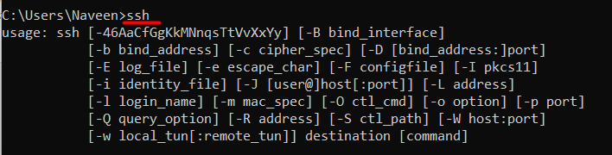
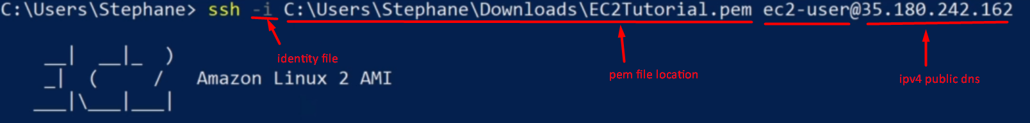
How to use SSH using Windows:
SSH is one of the most important function. It allows you to control a remote machine, all using the command line.
1. Convert private key [.pem file] to [.ppk format] Using putty gen.
2. Open putty → paste ipv4 Dns address, port 22.
3. Then add keypair[.ppk format file] to the putty.
Go to → In category[putty] → expand SSh → click Auth → Browse for the private key.
4. Go to session in putty → In saved session → just type the instance name and click save → click ok.
5. Cmd will Open and ask
login as : ec2-user
How to use SSH using windows 10 or any windows latest version :
If you are using windows 10 or above version then you may be able to use SSH command instead of using putty.
Go to → windows PowerShell [or] Cmd prompt.
Just Type ssh and if you see this below command means that you have access to SSH.
Note: watch Udemy video
For better clarification on config.
Section 5 : video 41

Slide 12
How to use SSH using Linux or mac:
It is similar to using windows 10. for better clarification on config watch Udemy video section 5 : video 39
Ec2 instance connect:
We can connect Ec2 instance using putty or SSH. There is one more way that is by using Ec2 instance connect.
Select the Instance → Click Connect [Top navigation] → Username [ec2-user] → Click Connect.
Note:
Ec2 Instance Connect may only work with Amazon Linux 2 or Ubuntu So far. It doesn’t work with every type of AMI’s in AWS.
Ec2 Instance Connect it is still run on SSH.
Ec2 instance connect with IAM Role for using AWS cli:
We can perform any Linux command in Ec2 Instance Connect. We can also Perform Aws cli [Run IAM command] in Aws Linux 2 Instance.
In the Ec2 Instance terminal if you type aws iam list-users it will ask for credentials. Because here Ec2 service is accessing or performing other services. we can directly configure the credentials Using aws configure in the Ec2 instance connect but it is a bad idea other user can easily see or retrieve your credentials.
For this we need permission that means we have to create a role in IAM for accessing some services in EC2.
Steps for using Ec2 Instance Connect with IAM role:
We must have to Create a IAM role.
Go to Ec2 → select Linux Instance → Click Action dropdown[Top navigation] → Click Security → click Modify IAM role → select the IAM role .
Select the Instance → Click Connect [Top navigation] → Username [ec2-user] → Click Connect → Type aws iam list-users in the Ec2 Instance Connect.
The list users will be displayed in the Json format.

Slide 13
Elastic IP address:
If you want your public ipv4 address not to change when terminate or stop. You have to use Elastic Ip address.
1. In the EC2 Go to → Elastic Ip’s [left navigation] →click Allocate Elastic Ip address → select Amazon’s pool ipv4 address → Click Allocate
After Allocate the Elastic Ip address
2. Go to → Elastic Ip’s → Click Action [Top Navigation] → click Associate Elastic Ip address
3. Then go to Instance and now your ipv4 address will not change when terminate or stopped.
If you want to remove the Elastic Ip address from your Instance.
4. Go to → Elastic Ip’s → Click Action [Top Navigation] → click Disassociate Elastic Ip address → click Release Elastic Ip address.
Note:
Elastic Ip address is allocate to an Specific Instance.
With elastic Ip address you are charged as long as you don’t use them. So we need to attach it ASAP. Otherwise we will be charged.
Ec2 Placement Group:
click Placement group[left hand side] → Create Placement Group → Choose any placement like [ cluster or spread or partition].
After Config the placement group
Go to → Instance → Create an Instance → In step:3 [ Config Instance Details] → Select (Add Instance to placement group) and then choose the placement group.
Elastic Network Interface:
Create two Ec2 Instance. [By Default Every Instance there will be an ENI [primary ENI]].
To Create an Secondary ENI:
Go to → Network Interface [left hand side] → Click Create Network Interface → In the Subnet Choose the AZ, In which you have Create the Instance → Create Network Interface.
→ Click Action [Top Navigation] →Attach.
After that Go to Instance → Select the Instance in which you have Config ENI → In the bottom Select network [ In Network Interface you can the Secondary ENI]
Note: You can create ENI independently and attach them on the fly (move them) on EC2 instances for failover

