Slide 1
What is Gas Buddy?

Slide 2
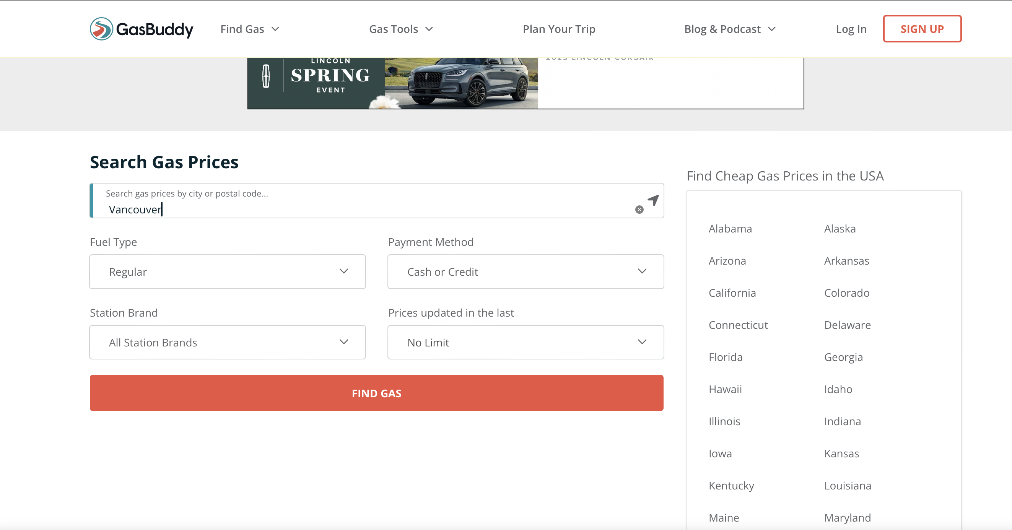
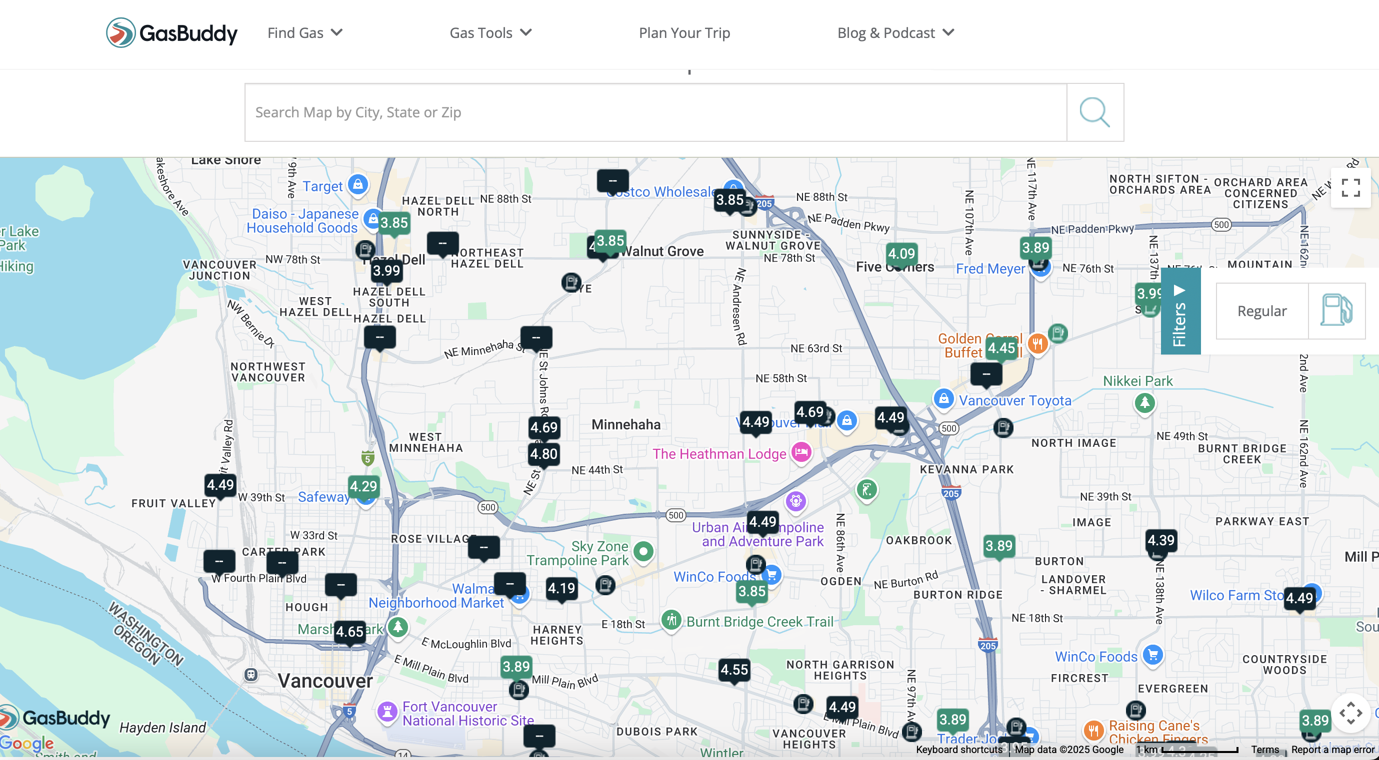
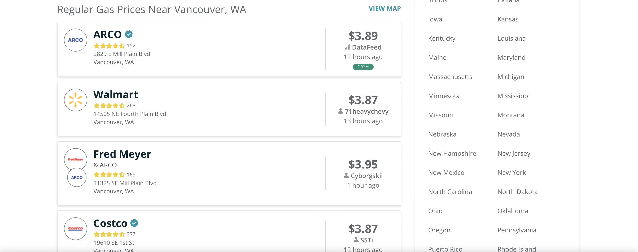

Slide 3
Project Overview
Gas Price Analysis Pipeline
Three Python scripts:
  scrape_gasprice.py
  clean_data.py
  visualization.py
Two Shell scripts:
  autorun.sh
  check_time.sh
Automation:
  Shortcut (MacOS)+ shell scripts
Dependencies:
  asyncio, logging, pandas, datetime, time
  gasbuddy, matplotlib, folium, branca, plotly

Slide 4
Visualization Output
Time Series Plot
Scatter Plot
Heatmap

Slide 5
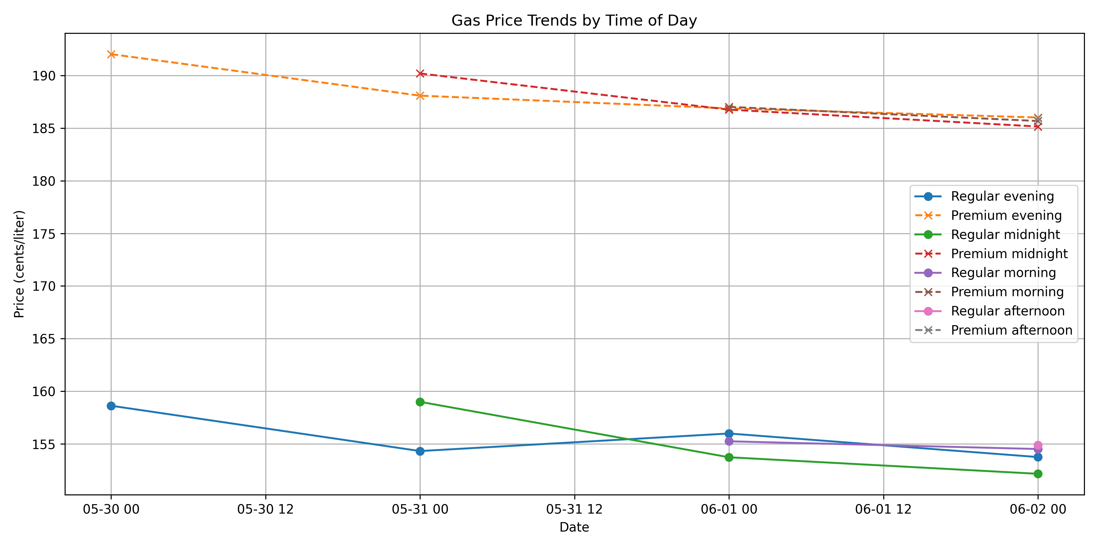

Slide 6
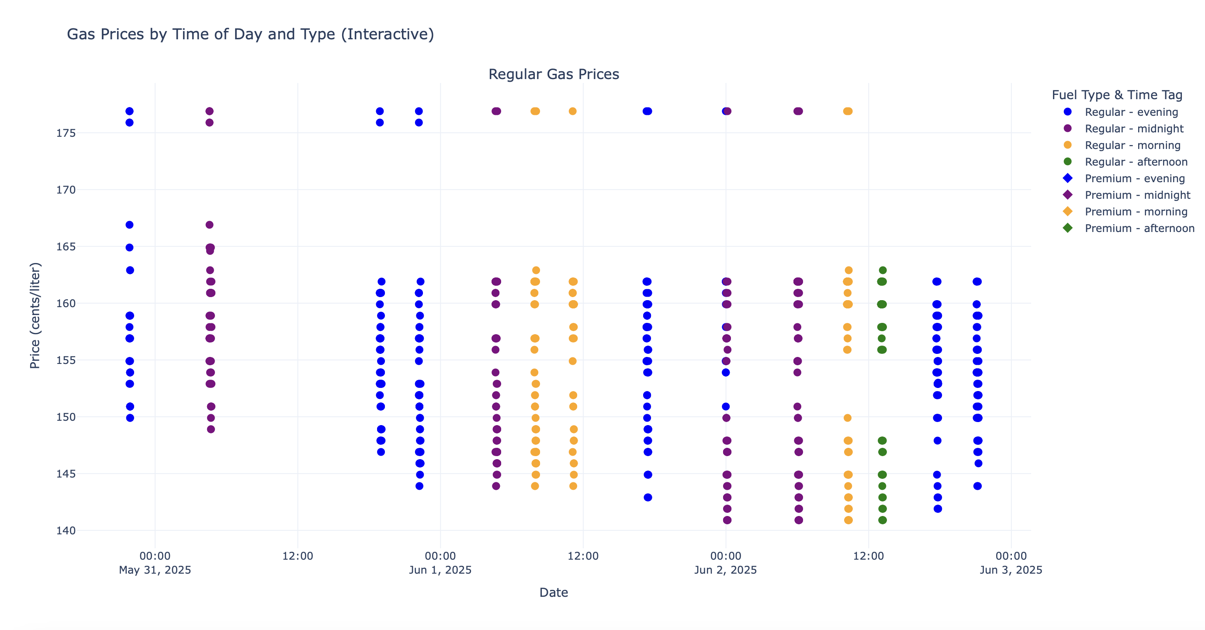
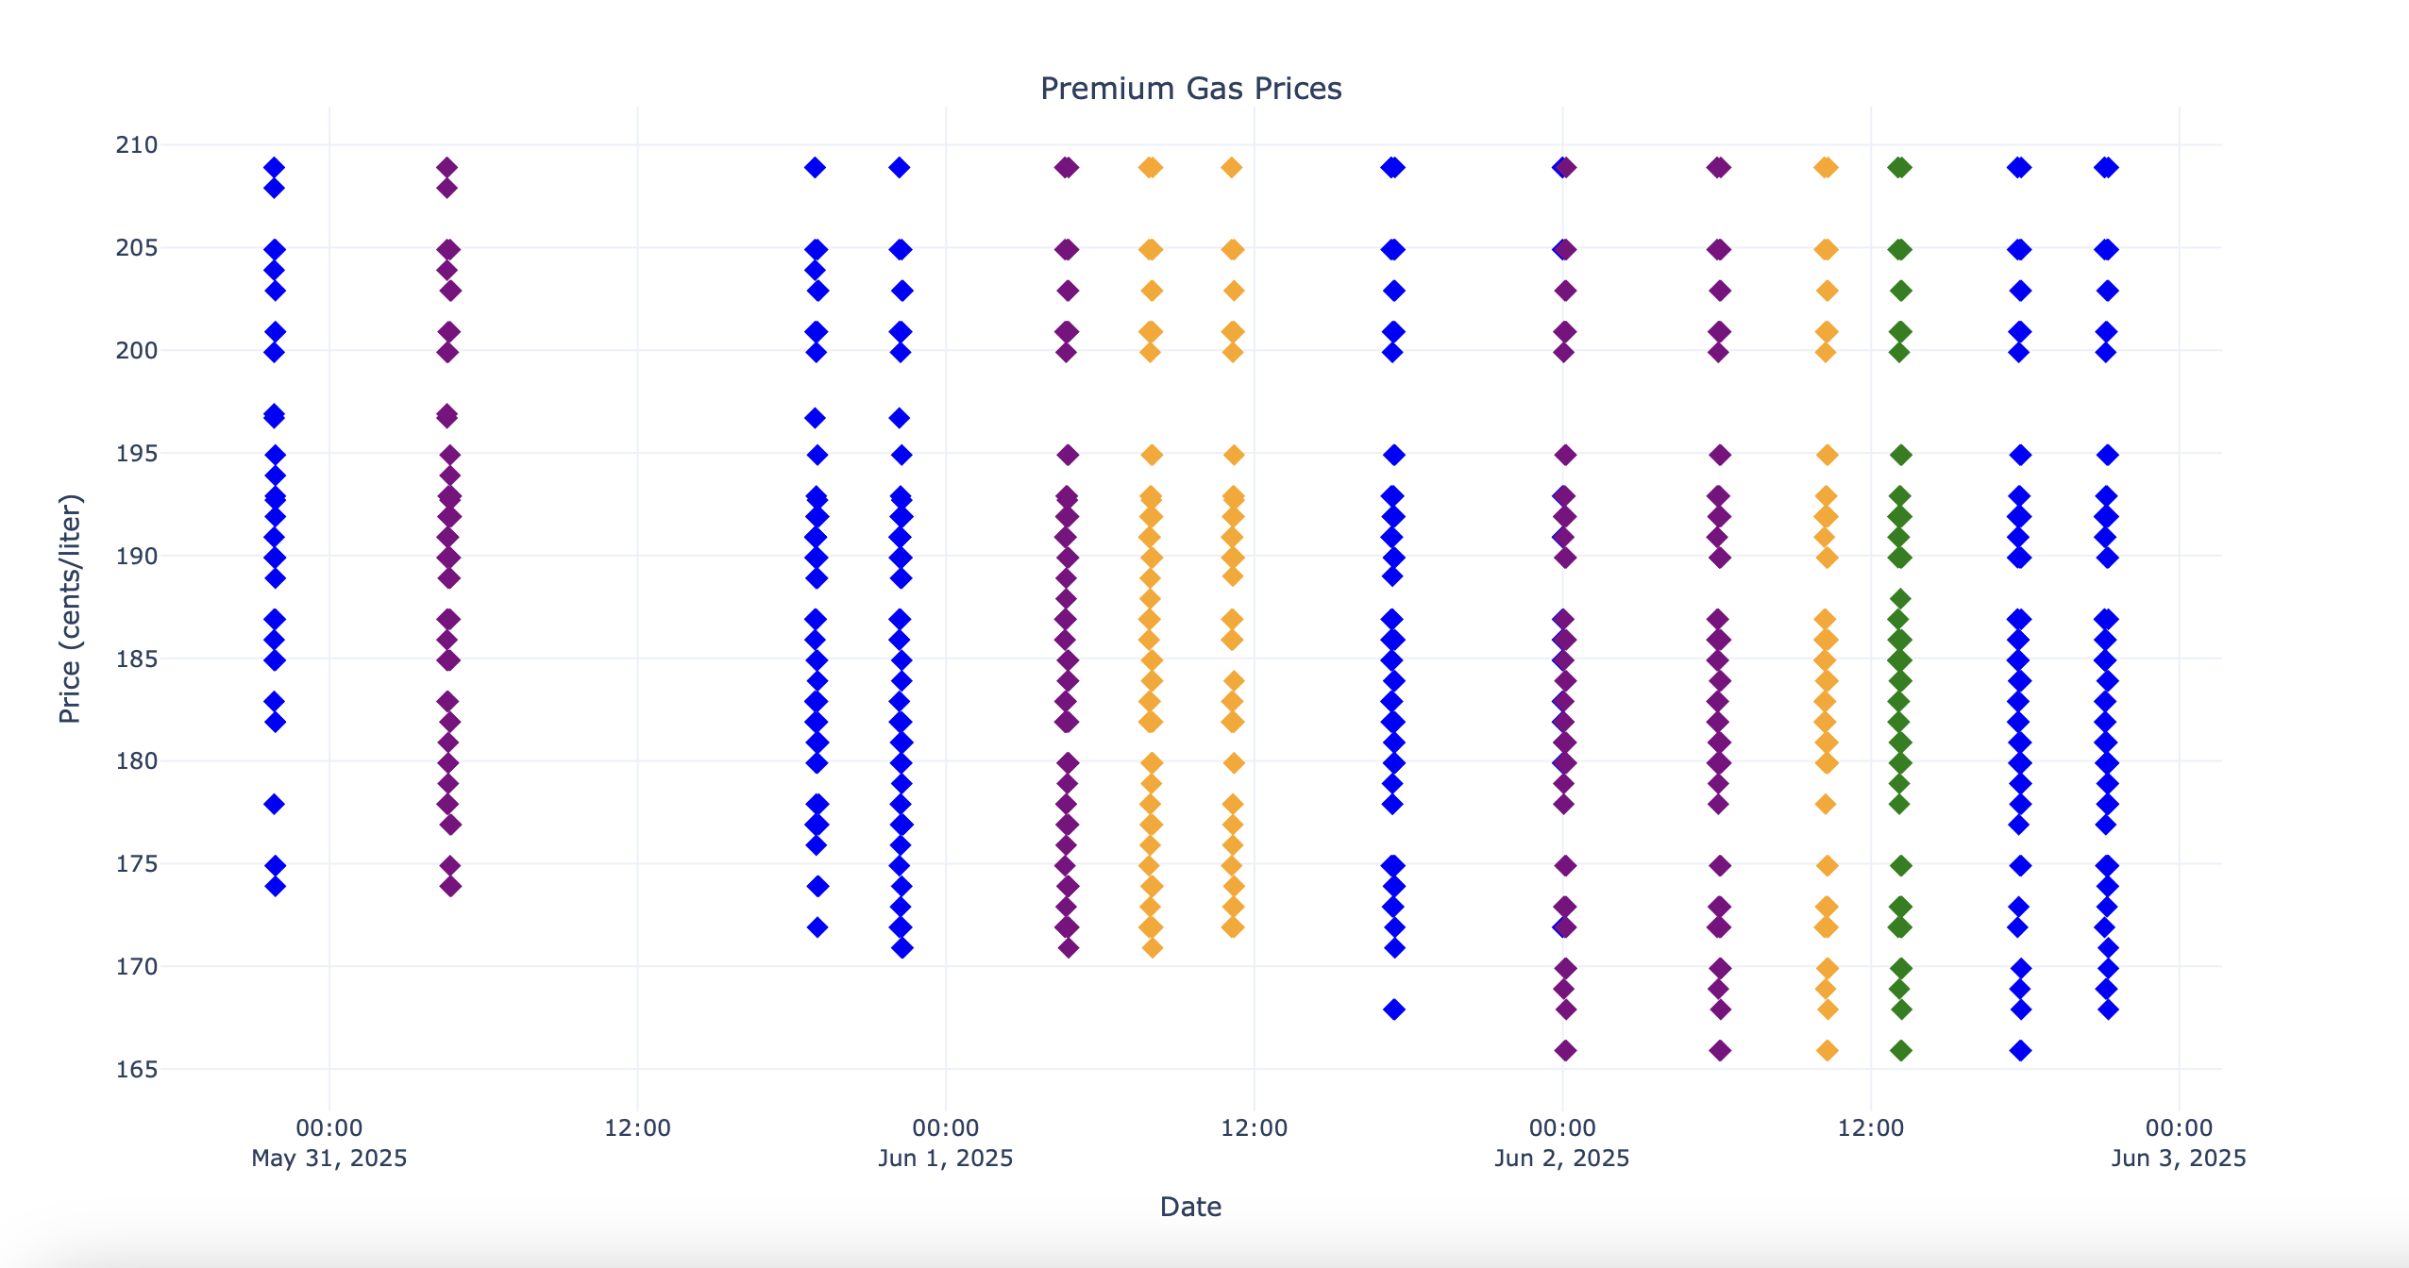

Slide 7
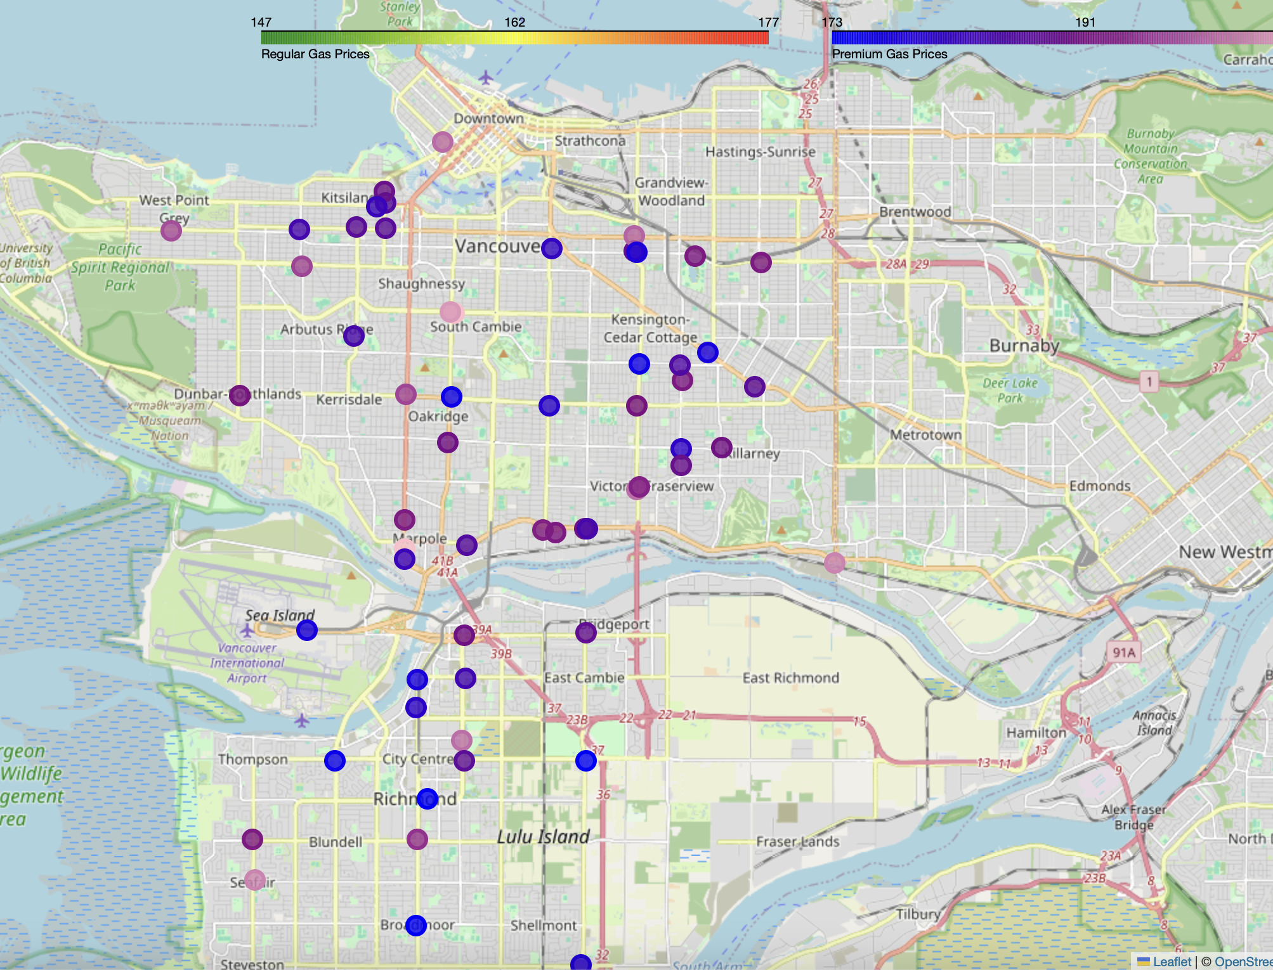
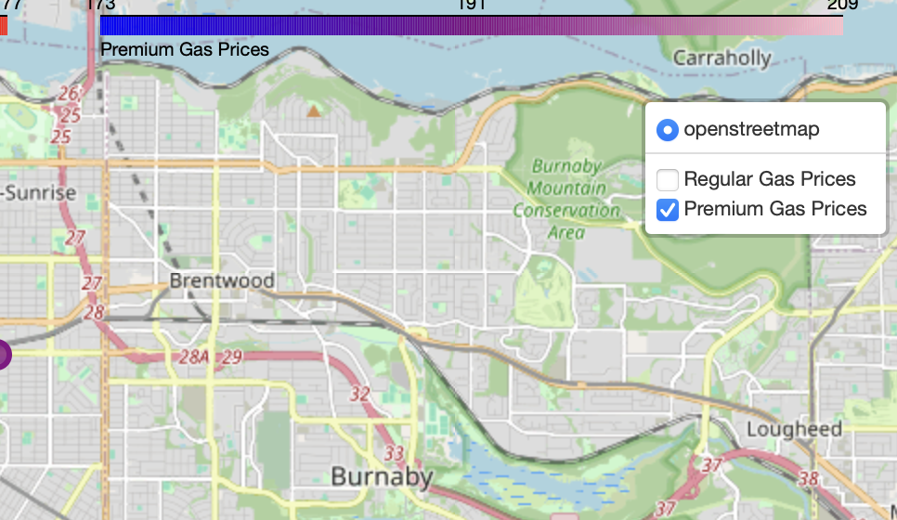
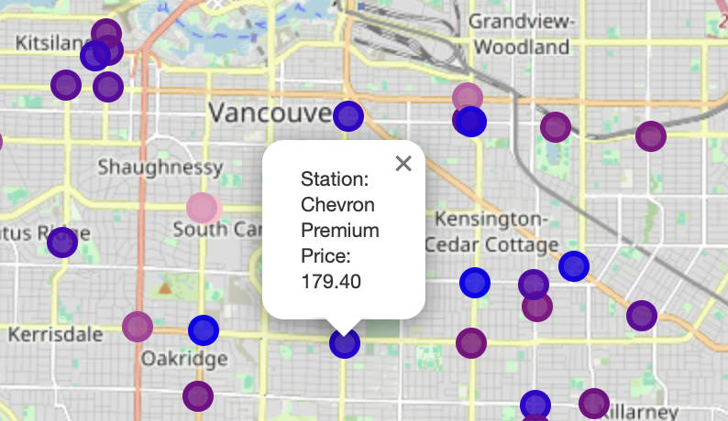
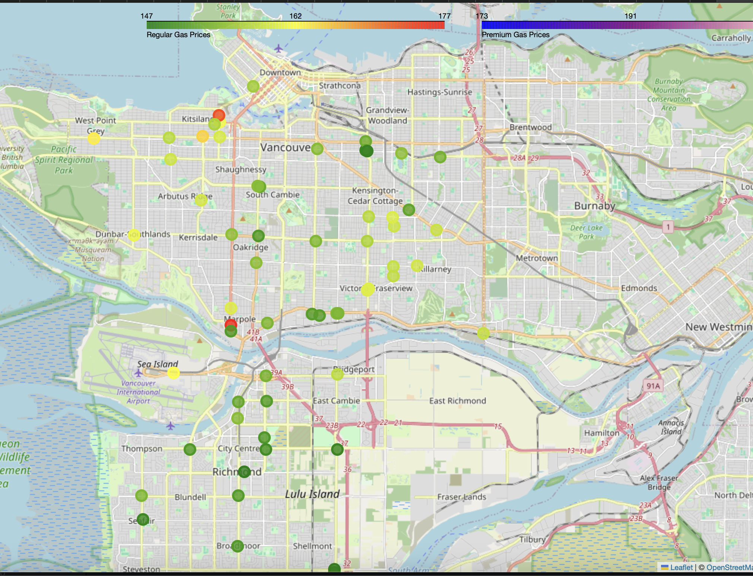

Slide 8
Pipeline Overview
Overview:
  1. scrape_gasprice.py: Collects gas price data.
  2. clean_data.py: Cleans and deduplicates the data.
  3. visualization.py: Produces visual insights.
Note:
  Logs at ./log/debug_log.txt
  gas_prices.xlsx grows over time — archive regularly
  Time Tags: morning, afternoon, evening, midnight
  Heatmap clips extreme values
Challenges:
  API rate limits

Slide 9
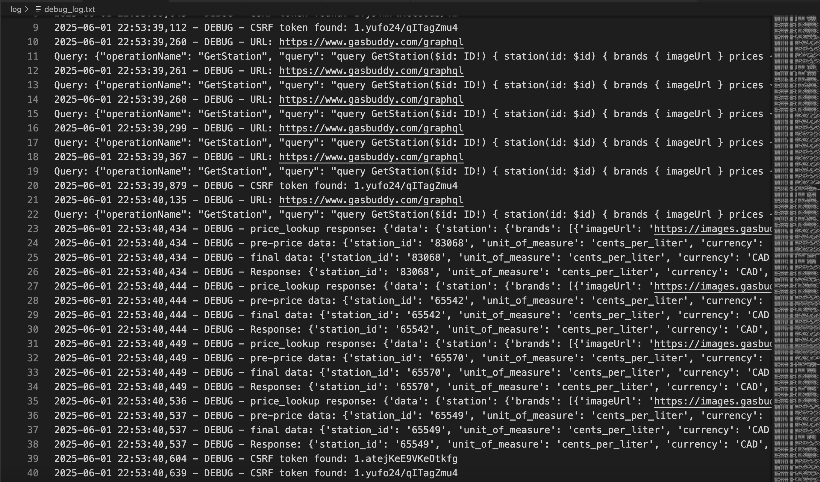
scrape_gasprice.py
Retrieves gas station data using GasBuddy API.
Saves data to gas_prices.xlsx.
Uses asyncio for async API calls.
Extracts station data.
Logs operations.
Rate-limit friendly: 60s delay between queries for each location.

Slide 10
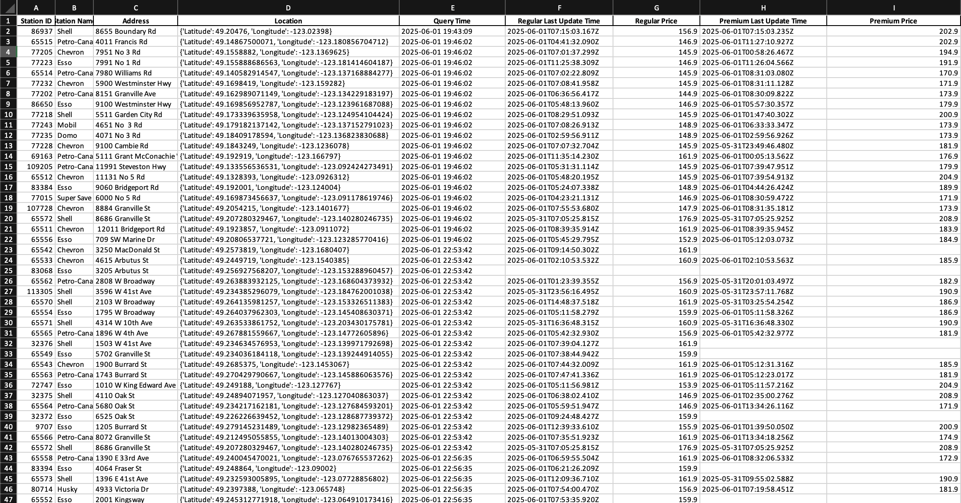
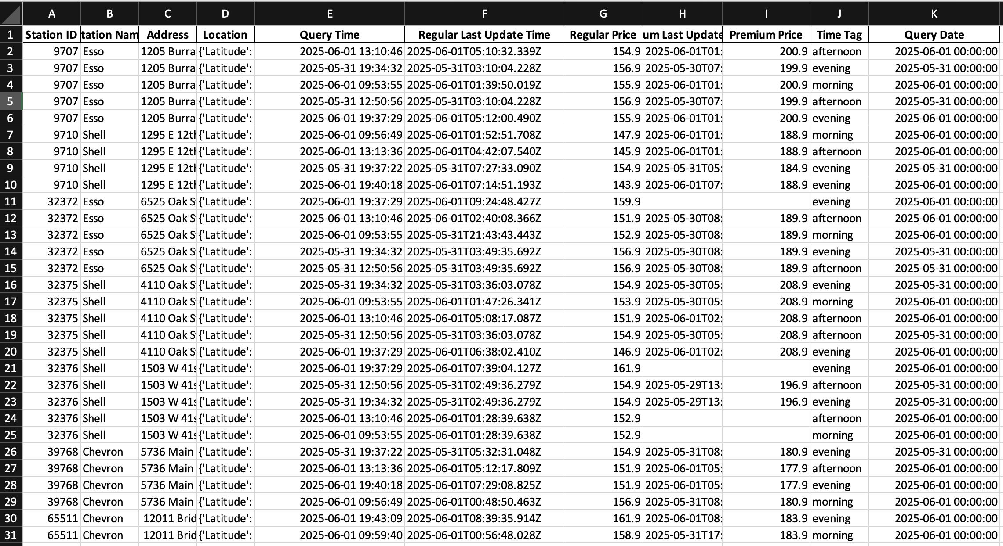
clean_data.py
Cleans raw data from gas_prices.xlsx.
  Filters invalid records.
  Tags by time-of-day.
  Removes duplicates.

Slide 11
visualization.py
Time-Series Plot:
  Price trends over time on Average
Interactive Time Plot:
  Scatter plot of all data points
Geographic Heatmap:
  Interactive map of gas stations
  Colour codes the average price of all recorded gas stations
Outputs: time_plot.png and heatmap.html, interactive_graph.html

Slide 12
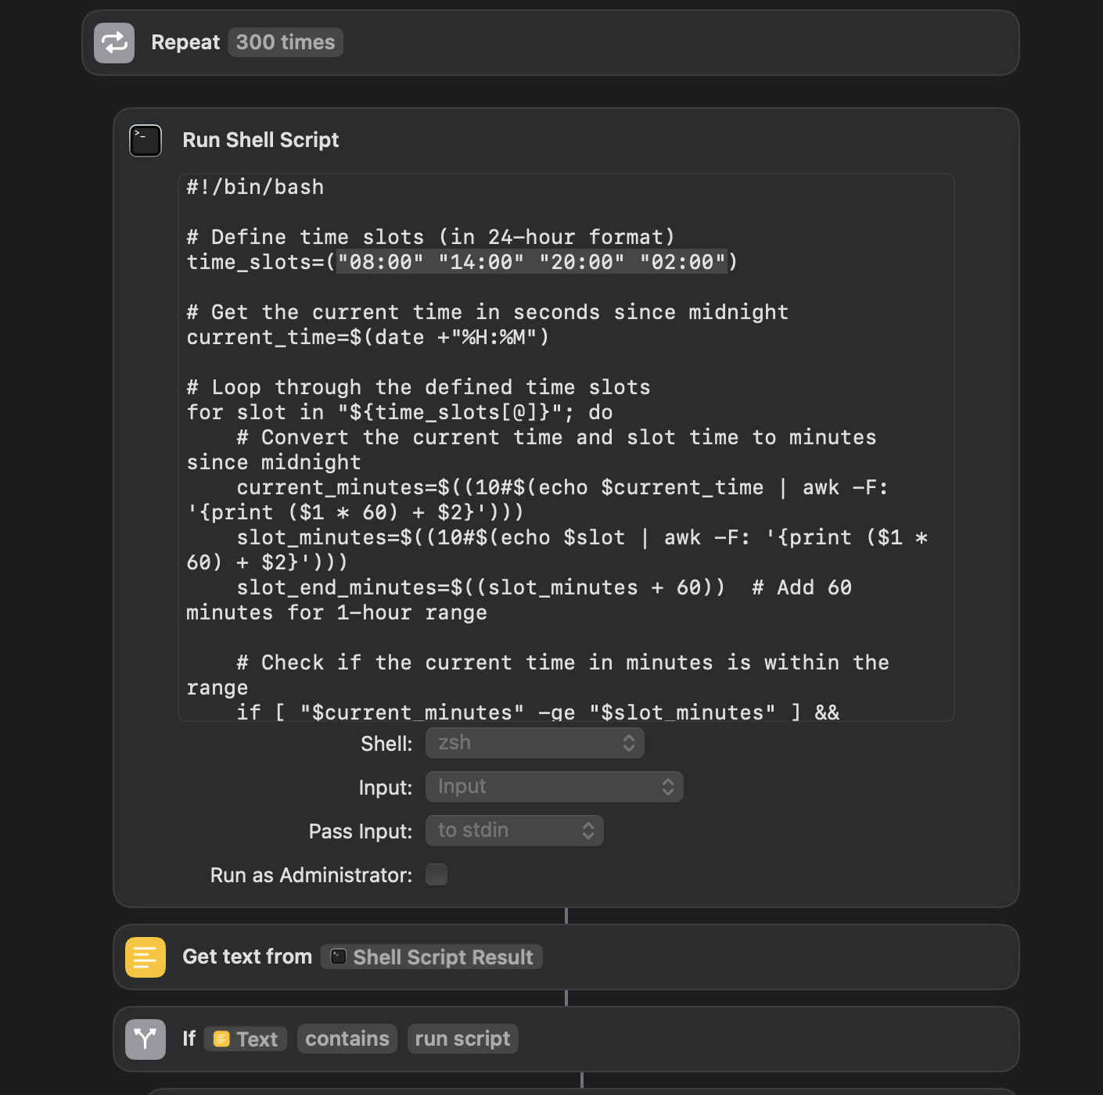
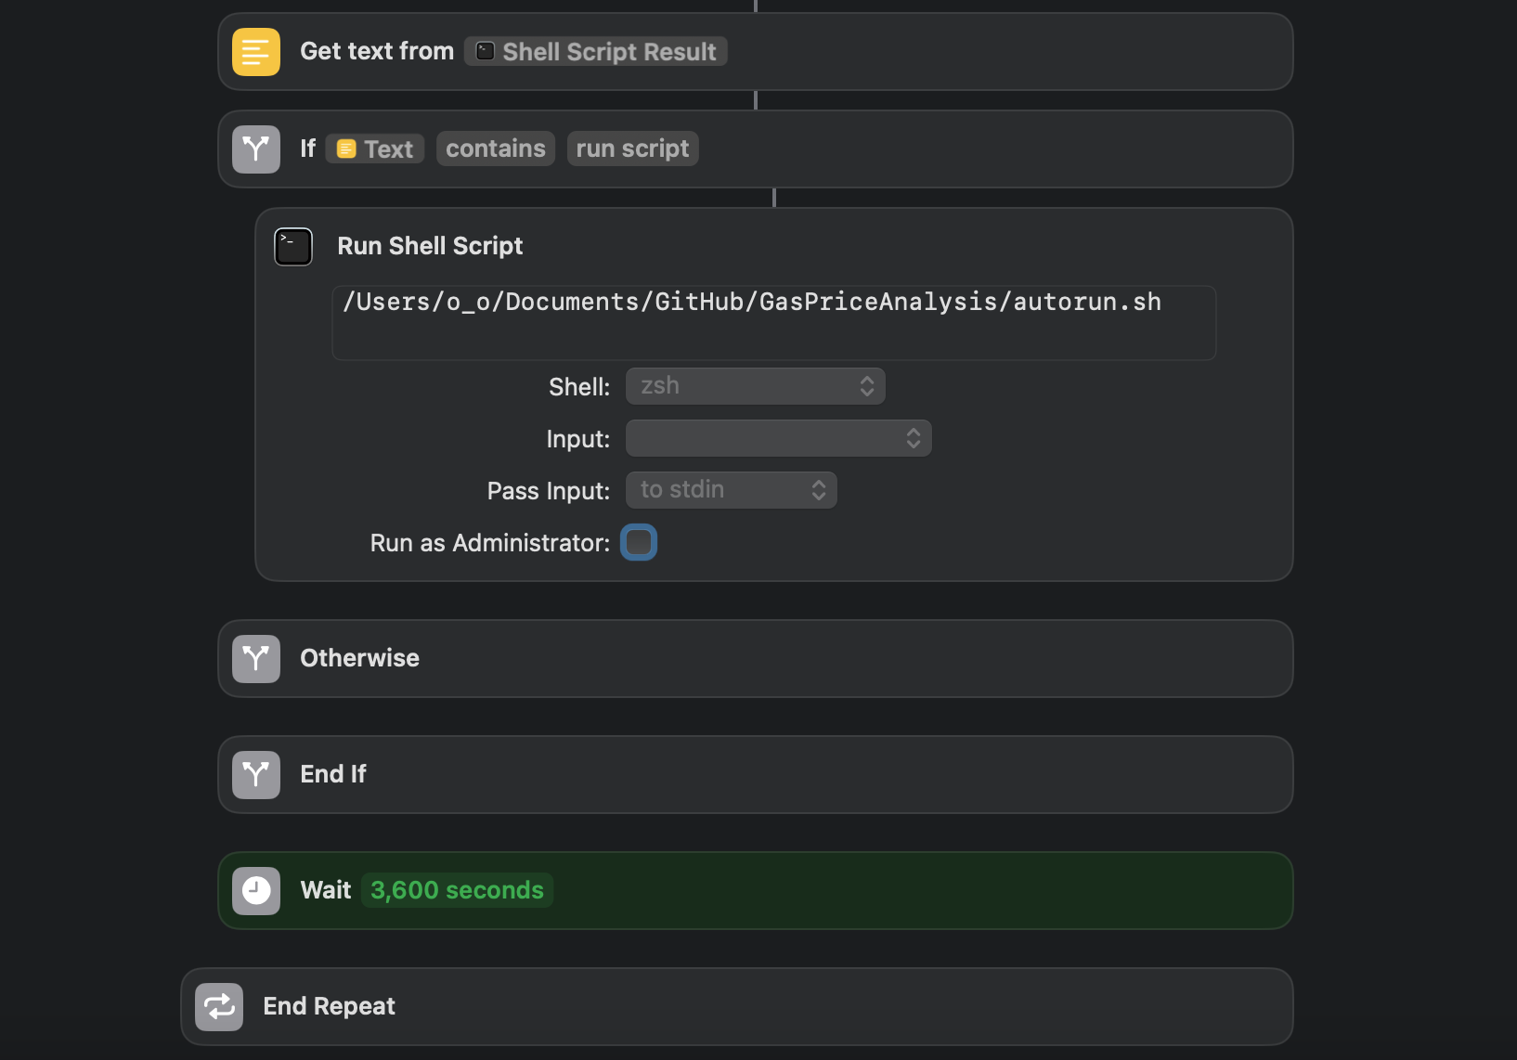
Automatin the Pipeline
check_time.sh + shortcut triggers autorun when in time slot
  Shortcut keeps script running in background even when laptop is asleep
autorun.sh handles scheduling for morning, afternoon, evening, and midnight
  Run scrape_gasprice.py
  Run clean_data.py
  Run visualization.py
Shortcut functions are very limited,
but easy get system permission to run while sleep

Slide 13
Thank You

