Slide 1
C1-B 一元多项式计算器讲解
20241029 徐天行

Slide 2
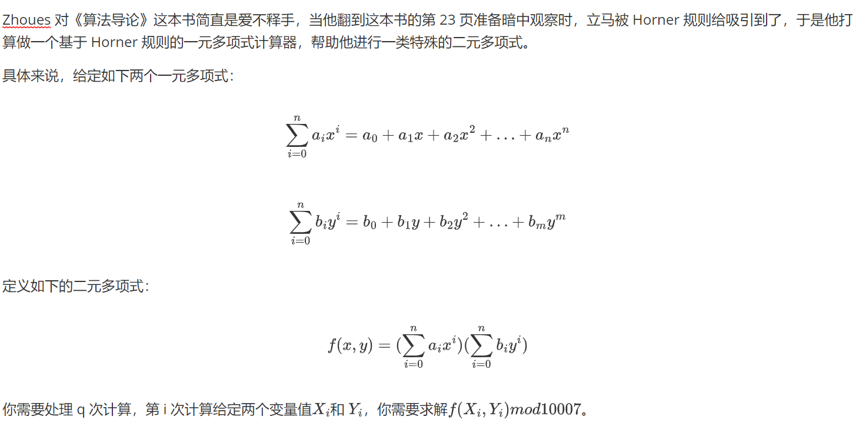
C1-B
题目描述

Slide 3
C1-B
题解思路
要求两个多项式在给定自变量值下的乘积，只需先分别算出两个多项式在对应自变量值下的值，相乘即为答案。
题目关键在于多项式求值。

Slide 4

C1-B
题解思路
$$\sum_{i=0}^{n}{a_{i}x^{i}} =a_{0}+a_{1}x+a_{2}x^{2}+...+a_{n}x^{n} \\ =a_{0}+x\left(a_{1}+a_{2}x+...+a_{n}x^{n−1}\right) \\ =a_{0}+x\left(a_{1}+x\left(a_{2}+a_{3}x+...+a_{n}x^{n−2}\right)\right) \\ =… \\ =a_{0}+x(a_{1}+x(...+x(a_{n−2}+x(a_{n−1}+a_{n}x))..)$$

Slide 5
C1-B
题解思路
计算多项式的过程：
result = 0;
for (j = n; j >= 0; j--)
result = result * x + a[j]; //a为多项式的系数数组

Slide 6
C1-B
for (int i = 0; i <= m; i++)
scanf("%d", &bn[i]);
scanf("%d", &q);
for (int i = 0; i < q; i++)
{
scanf("%d%d", &x, &y);
result1 = result2 = 0;
for (int j = n; j >= 0; j--)
result1 = ((result1 * x) % MOD + an[j]) % MOD;
for (int j = m; j >= 0; j--)
result2 = (((result2 * y) % MOD) + bn[j]) % MOD;
printf("%lld\n", result1 * result2 % MOD);
}
return 0;
}
代码
#include <stdio.h>
#define MOD 10007
int an[30010], bn[30010]; //用于存储多项式系数
int main(void)
{
int n, m, q, x, y;
long long result1, result2;
scanf("%d", &n);
for (int i = 0; i <= n; i++)
scanf("%d", &an[i]);
scanf("%d", &m);

