Slide 1
E3-B-DNA配对
21371112-刘奕哲

Slide 2
题目描述
Zhoues 沉迷于医学实验，尤其是 DNA 配对。由于他最近一直在为北航校庆切钢条，因此 DNA 配对实验也停滞不前。他现在遇到了一个实验难题，希望大家可以帮他一下。具体来说，给定两个由 A,T,C,G组成的字符串，请你求出它们的最长公共子序列。
输入样例
AGCTTCGA
AGTTCAGC
最长公共子序列(LCS)问题
输出样例
AGCTTCGA
AGTTCAGC
AGTTCA

Slide 3
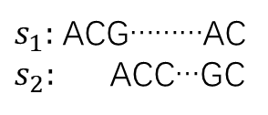
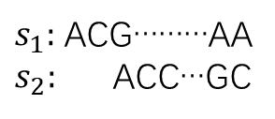
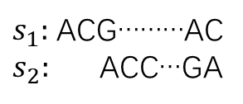
动态规划：
记dp[i][j]为第一个字符串前 i 个字符与第二个字符串前 j 个字符的最长公共子序列的长度
(i) i = 0 或 j = 0 时其中一个为空串，则dp[0][j] = dp[i][0] = 0
(ii) 若$s_{1}\left(i\right)=$ $s_{2}\left(j\right)$，显然去掉$s_{1}\left(i\right)和$ $s_{2}\left(j\right)$对前面无影响，此时dp[i][j] = dp[i - 1][j - 1] + 1
i-1
i-1
i-1
$s_{1}:$ ACG………AC
$s_{2}:$ ACC…GC
$s_{1}:$ ACG………AC
$s_{2}:$ ACC…GA
$s_{1}:$ ACG………AA
$s_{2}:$ ACC…GC
j-1
j-1
j-1
若$s_{1}\left(i\right)≠$ $s_{2}\left(j\right)$，则$s_{1}\left(i\right)和$ $s_{2}\left(j\right)不同时$在最长公共子串中，去掉$s_{1}\left(i\right)或$ $s_{2}\left(j\right)$都可，取其中较大者，此时dp[i][j] =max(dp[i - 1][j], dp[i][j - 1])

Slide 4
 | A | G | C | T | T | C | G | A
A | 1 | 1 | 1 | 1 | 1 | 1 | 1 | 1
G | 1 | 2 | 2 | 2 | 2 | 2 | 2 | 2
T | 1 | 2 | 2 | 3 | 3 | 3 | 3 | 3
T | 1 | 2 | 2 | 3 | 4 | 4 | 4 | 4
C | 1 | 2 | 3 | 3 | 4 | 5 | 5 | 5
A | 1 | 2 | 3 | 3 | 4 | 5 | 5 | 6
G | 1 | 2 | 3 | 3 | 4 | 5 | 6 | 6
C | 1 | 2 | 3 | 3 | 4 | 6 | 6 | 6

Slide 5
 | A | G | C | T | T | C | G | A
A | 1 | 1 | 1 | 1 | 1 | 1 | 1 | 1
G | 1 | 2 | 2 | 2 | 2 | 2 | 2 | 2
T | 1 | 2 | 2 | 3 | 3 | 3 | 3 | 3
T | 1 | 2 | 2 | 3 | 4 | 4 | 4 | 4
C | 1 | 2 | 3 | 3 | 4 | 5 | 5 | 5
A | 1 | 2 | 3 | 3 | 4 | 5 | 5 | 6
G | 1 | 2 | 3 | 3 | 4 | 5 | 6 | 6
C | 1 | 2 | 3 | 3 | 4 | 6 | 6 | 6

Slide 6
 | A | G | C | T | T | C | G | A
A | 1 | 1 | 1 | 1 | 1 | 1 | 1 | 1
G | 1 | 2 | 2 | 2 | 2 | 2 | 2 | 2
T | 1 | 2 | 2 | 3 | 3 | 3 | 3 | 3
T | 1 | 2 | 2 | 3 | 4 | 4 | 4 | 4
C | 1 | 2 | 3 | 3 | 4 | 5 | 5 | 5
A | 1 | 2 | 3 | 3 | 4 | 5 | 5 | 6
G | 1 | 2 | 3 | 3 | 4 | 5 | 6 | 6
C | 1 | 2 | 3 | 3 | 4 | 6 | 6 | 6

Slide 7
 | A | G | C | T | T | C | G | A
A | 1 | 1 | 1 | 1 | 1 | 1 | 1 | 1
G | 1 | 2 | 2 | 2 | 2 | 2 | 2 | 2
T | 1 | 2 | 2 | 3 | 3 | 3 | 3 | 3
T | 1 | 2 | 2 | 3 | 4 | 4 | 4 | 4
C | 1 | 2 | 3 | 3 | 4 | 5 | 5 | 5
A | 1 | 2 | 3 | 3 | 4 | 5 | 5 | 6
G | 1 | 2 | 3 | 3 | 4 | 5 | 6 | 6
C | 1 | 2 | 3 | 3 | 4 | 6 | 6 | 6

Slide 8
 | A | G | C | T | T | C | G | A
A | 1 | 1 | 1 | 1 | 1 | 1 | 1 | 1
G | 1 | 2 | 2 | 2 | 2 | 2 | 2 | 2
T | 1 | 2 | 2 | 3 | 3 | 3 | 3 | 3
T | 1 | 2 | 2 | 3 | 4 | 4 | 4 | 4
C | 1 | 2 | 3 | 3 | 4 | 5 | 5 | 5
A | 1 | 2 | 3 | 3 | 4 | 5 | 5 | 6
G | 1 | 2 | 3 | 3 | 4 | 5 | 6 | 6
C | 1 | 2 | 3 | 3 | 4 | 6 | 6 | 6

Slide 9
 | A | G | C | T | T | C | G | A
A | 1 | 1 | 1 | 1 | 1 | 1 | 1 | 1
G | 1 | 2 | 2 | 2 | 2 | 2 | 2 | 2
T | 1 | 2 | 2 | 3 | 3 | 3 | 3 | 3
T | 1 | 2 | 2 | 3 | 4 | 4 | 4 | 4
C | 1 | 2 | 3 | 3 | 4 | 5 | 5 | 5
A | 1 | 2 | 3 | 3 | 4 | 5 | 5 | 6
G | 1 | 2 | 3 | 3 | 4 | 5 | 6 | 6
C | 1 | 2 | 3 | 3 | 4 | 6 | 6 | 6

Slide 10
 | A | G | C | T | T | C | G | A
A | 1 | 1 | 1 | 1 | 1 | 1 | 1 | 1
G | 1 | 2 | 2 | 2 | 2 | 2 | 2 | 2
T | 1 | 2 | 2 | 3 | 3 | 3 | 3 | 3
T | 1 | 2 | 2 | 3 | 4 | 4 | 4 | 4
C | 1 | 2 | 3 | 3 | 4 | 5 | 5 | 5
A | 1 | 2 | 3 | 3 | 4 | 5 | 5 | 6
G | 1 | 2 | 3 | 3 | 4 | 5 | 6 | 6
C | 1 | 2 | 3 | 3 | 4 | 6 | 6 | 6

Slide 11
 | A | G | C | T | T | C | G | A
A | 1 | 1 | 1 | 1 | 1 | 1 | 1 | 1
G | 1 | 2 | 2 | 2 | 2 | 2 | 2 | 2
T | 1 | 2 | 2 | 3 | 3 | 3 | 3 | 3
T | 1 | 2 | 2 | 3 | 4 | 4 | 4 | 4
C | 1 | 2 | 3 | 3 | 4 | 5 | 5 | 5
A | 1 | 2 | 3 | 3 | 4 | 5 | 5 | 6
G | 1 | 2 | 3 | 3 | 4 | 5 | 6 | 6
C | 1 | 2 | 3 | 3 | 4 | 6 | 6 | 6

Slide 12

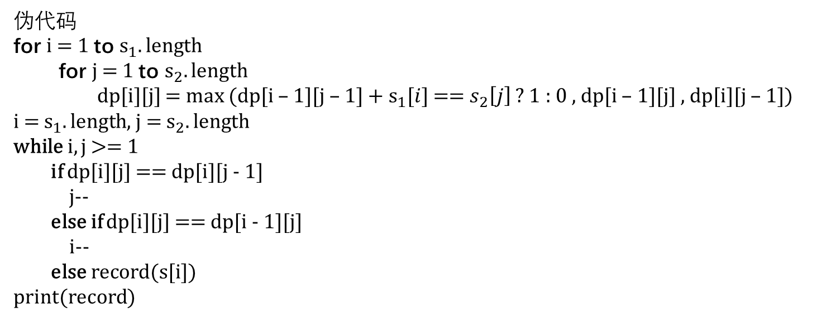
伪代码
for i = 1 to $s_{1}.length$
for j = 1 to $s_{2}.length$
dp[i][j] = max (dp[i – 1][j – 1] + $s_{1}[i]$ == $s_{2}\left[j\right]$ ? 1 : 0 , dp[i – 1][j] , dp[i][j – 1])
i = $s_{1}.length$, j = $s_{2}.length$
while i, j >= 1
if dp[i][j] == dp[i][j - 1]
j--
else if dp[i][j] == dp[i - 1][j]
i--
else record(s[i])
print(record)
时间和空间复杂度均为$O(mn)$

Slide 13
void solve() { scanf("%s %s", c1 + 1, c2 + 1); int len = strlen(c1 + 1); int len2 = strlen(c2 + 1); for (int i = 1; i <= len; ++i) { for (int j = 1; j <= len2; ++j) { dp[i][j] = max(max(dp[i - 1][j - 1] + c1[i] == c2[j] ? 1 : 0, dp[i - 1][j]), dp[i][j - 1]); } } int i = len; int j = len2; recordLen = dp[len][len2]; while (i >= 1 && j >= 1){ if (dp[i][j] == dp[i][j - 1]){ j--; } else if (dp[i][j] == dp[i - 1][j]){ i--; } else { record[--recordLen] = c1[i]; i--, j--; } } printf("%s", record); }

