Slide 1
Game Management
By Eric Gaspar

Slide 2
The System
In this presentation I will be going through
Initial Thoughts / Plans / Ideas
ERD
Desirable Out-Comes, Must Haves
The Database

Slide 3
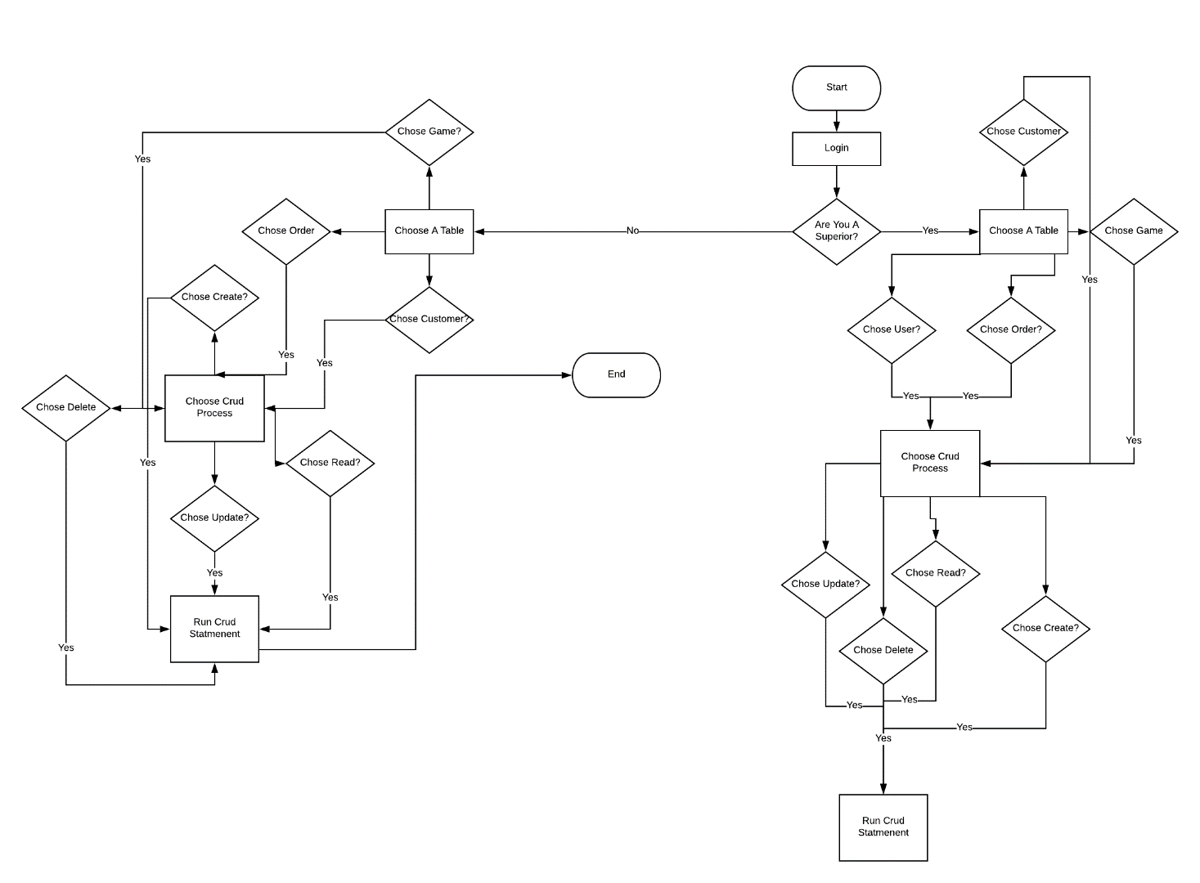
The Flow of the app

Slide 4
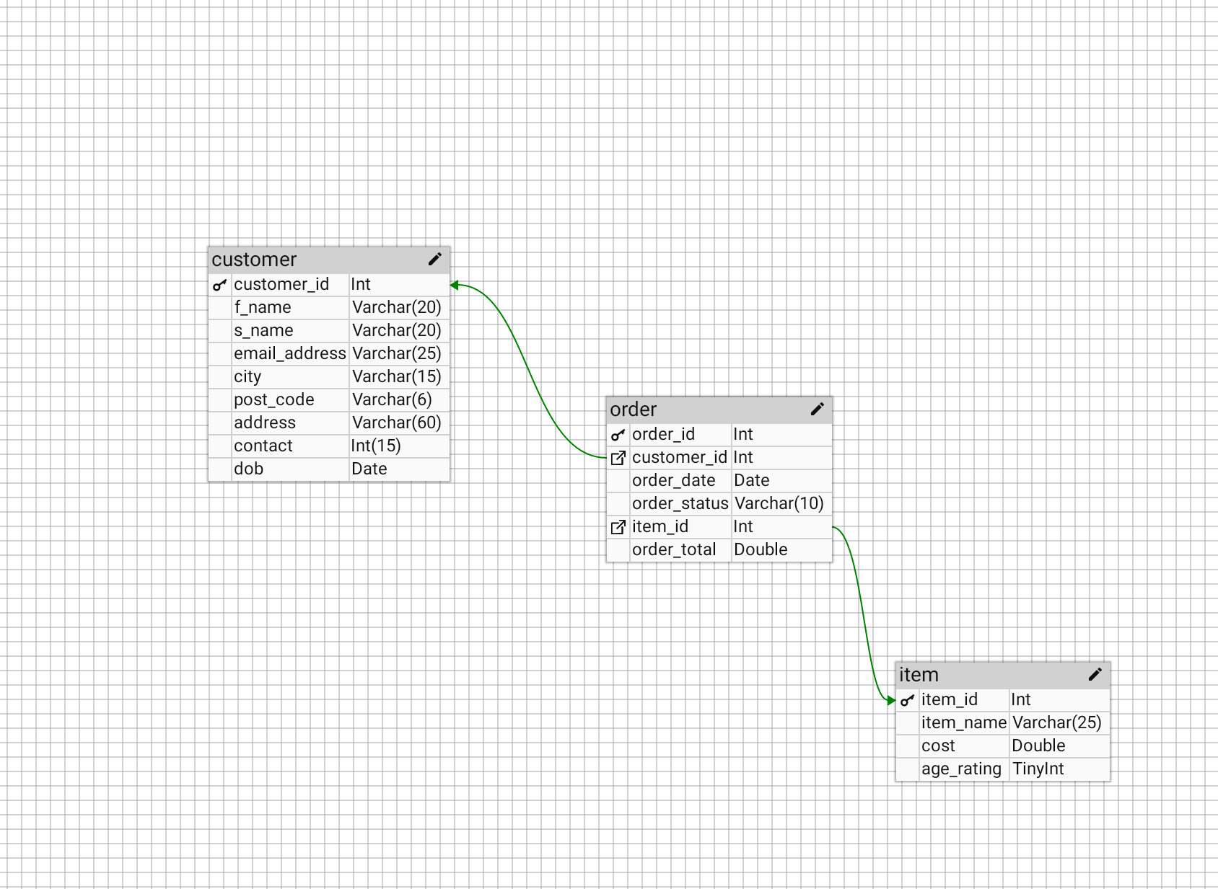
Relationship diagram

Slide 5
User Stories
User Stories 1
User Stories 2
As A Receptionist
As A Receptionist
As A Customer
User Stories 3
I Want To be able to add a customer to the system
So I Can deliver their goods to the right place
I Want To Access customer information So I
Can see if they are age appropriate for the item
I Want To save my information
So I Can order anytime i want without having to constantly put in my details
User Stories 4
User Stories 5
As A head user
I Want To access users in the system
So I Can keep up regular maintenance
As A head user
I Want To access the users in the system
So I Can add , delete or update other users

Slide 6
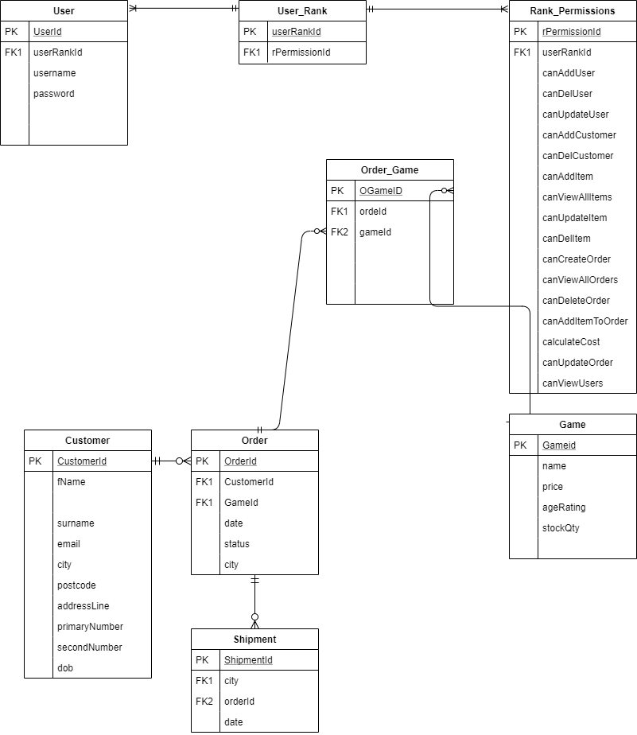
E.R.D

Slide 7
Add a Slide Title - 2

Slide 8
Add a Slide Title - 3

Slide 9
Add a Slide Title - 4

Slide 10
Add a Slide Title - 5

