Slide 1


QA Teamwork “Team Ilizing” Automation and manual testing of “Supertoys.bg”
QA
Fundamentals
QA team:
Nevena Tshoncheva
Alexander Stefanov
Ivan Atanasov

Slide 2

Table of Contents
SRS – Software requirements specification
Overall description
Functional requirements specification
Non-functional requirements
Use cases
Test cases
Automation testing

Slide 3
Software Requirements Specification
The purpose of this document is to present a detailed description of the Super Toys E-store System. It will explain the purpose and features of the system, the interfaces of the system, what the system will do, the constraints under which it must operate and how the system will react to external stimuli. It will serve as a guide to everyone, who is responsible to the project.
Scope of project
In scope
Out of scope

Slide 4
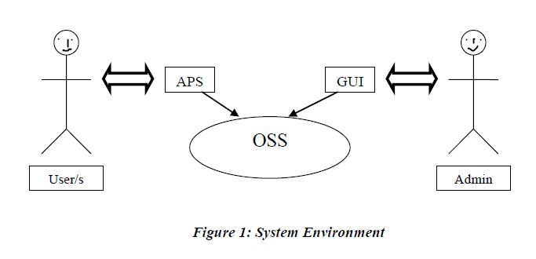
Overall description
Supertoys.bg system roles – User/s and admin/s. Any User/Admin communicates with the system through GUI/APS. Both of them access the entire system directly

Slide 5
Functional Requirements Specification
Describing login/logout functionality
By user
By admin

Slide 6
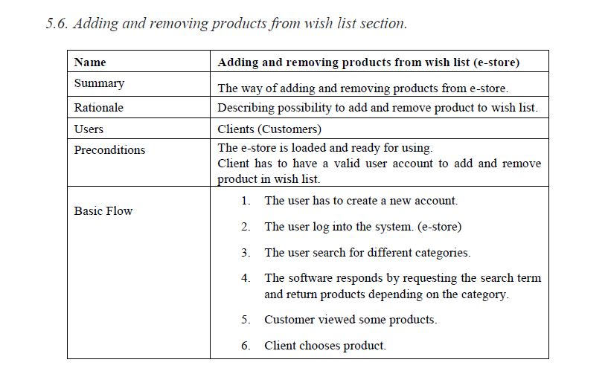
Use Cases

Slide 7
Use Cases in “Ilizing team”
Use Cases in Ilizyng team are:
Login system in GUI section
Discovering items in GUI section
Add and remove products from “My basket” section
Delivery in GUI section
Ways of payment
Add/remove products from wishlist section
Login and logout from APS
Accessing APS

Slide 8
Test Cases in “Ilizing team”
Manual Test Cases :
Login/out in APS
Invalid username/password in APS
Forgotten password in APS
Shopping products from GUI section without account
Delivery in GUI section
Add product from wishlist from GUI section
Login system in GUI section
Adding/removing products from “My basket” section
Discovering items in GUI section

Slide 9
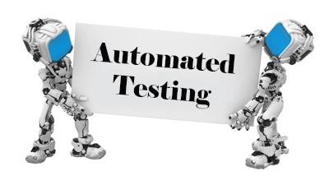
Automation testing…
Automation Test Cases :
Login/out in APS
Invalid username/password in APS
Forgotten password in APS
Login/out in GUI
Discovering items in GUI section
Surfing in catalogue in APS section

Slide 10
Goodbye and…
If (you learn to code)
{
Console.WriteLine (“Grab a beer”)
}
Else
{
Console.WriteLine (“Beer is still an option”)
}

