Slide 1
Performing Arithmetic&Logic Operations on Quantum Computer
Ali Hakim Taşkiran
Department of Electrical&Electronics Engineering

Slide 2
What is Logic?
“The science of thinking about or explaining the reason for something using formal methods.”[1]
Logic enables us to relate and link statements.

Slide 3
Statement
“Something that you say or write that gives information or an opinion.”[1]
“Ankara is capital of Turkey”(True)
“Books are printed on paper”(True)
“Inconsistent behaviour is consistent”(False)

Slide 4
Role of Statements in Logic
Reality may be unreal and it may .

Slide 5
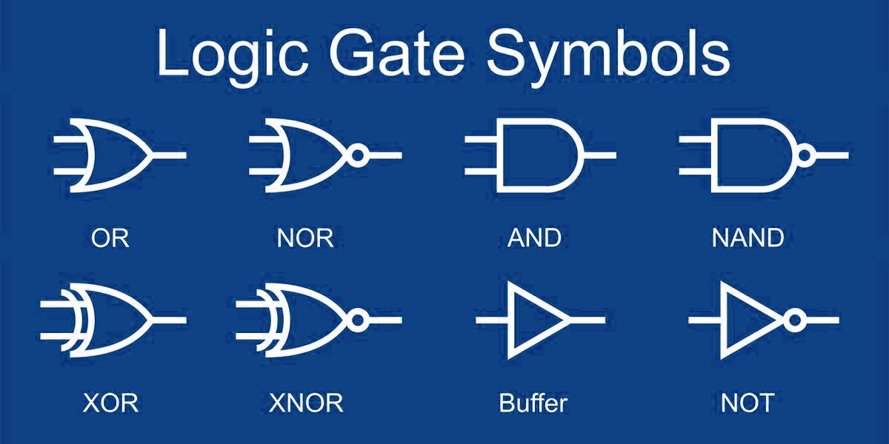
Logic Gate

Slide 6
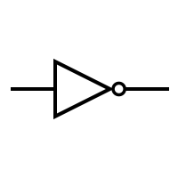
NOT
“used to give the following word or phrase a negative meaning”[1]
I did not buy apple
A | A’
1 | 0
0 | 1

Slide 7
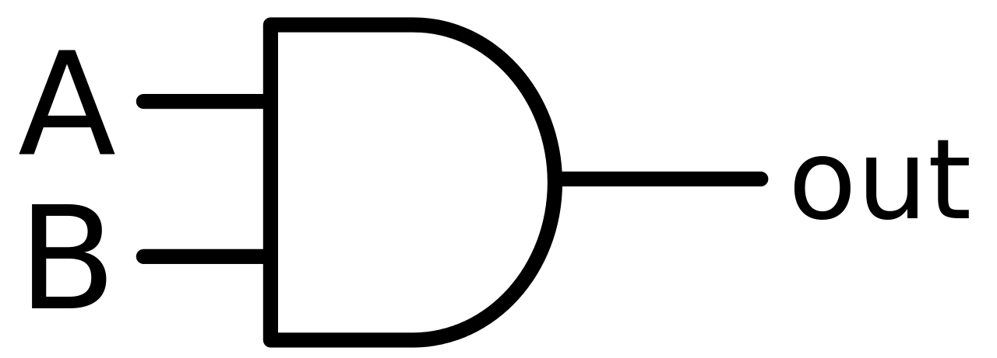
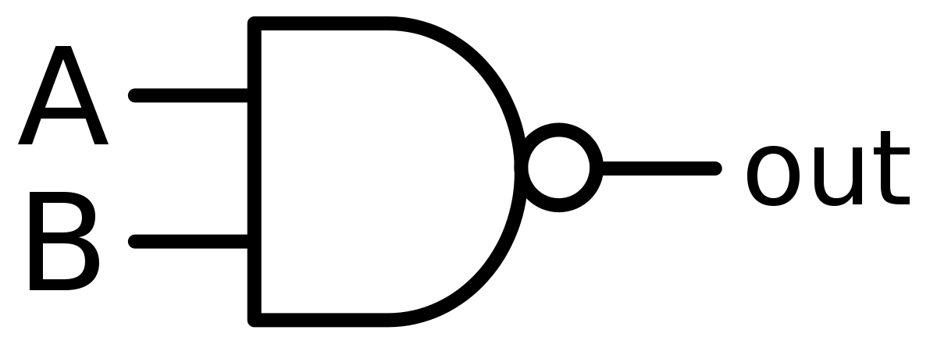
AND
“Used to connect words or parts of sentences”[1]
I bought apple and banana from market
*Both of them
A | B | A&B
1 | 1 | 1
1 | 0 | 0
0 | 1 | 0
0 | 0 | 0

Slide 8
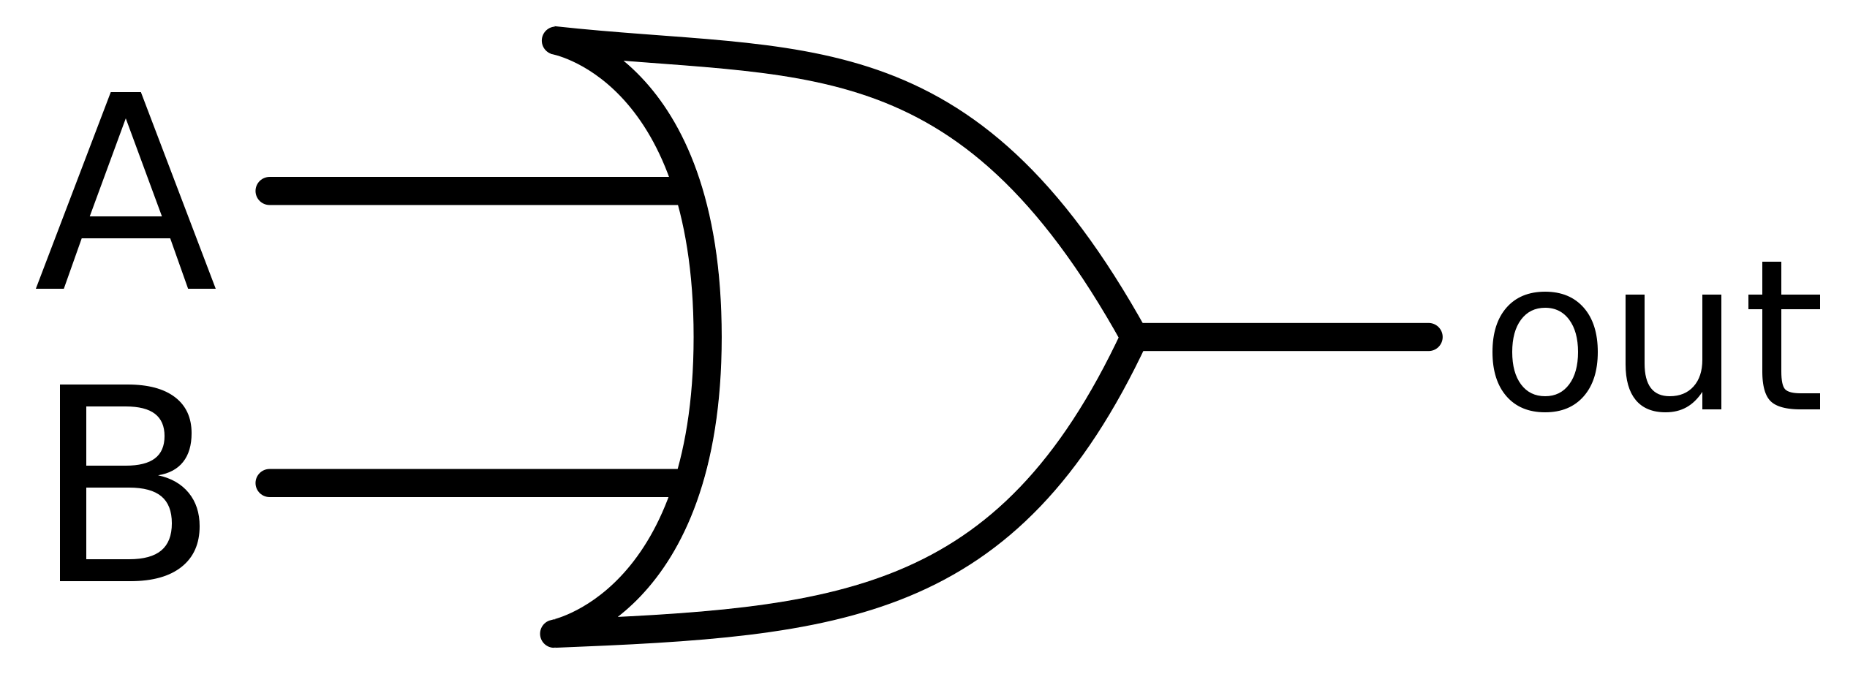
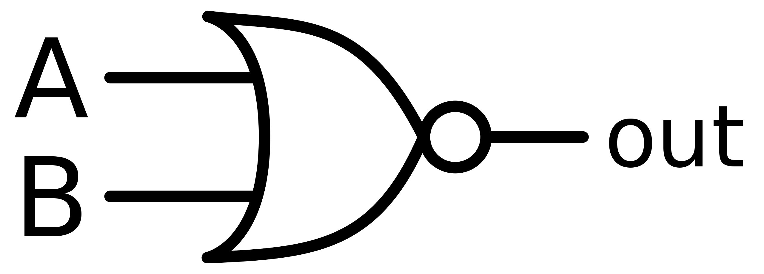
OR
“Used to introduce another possibility”[1]
I bought apple or banana from market
A | B | A || B
1 | 1 | 1
1 | 0 | 1
0 | 1 | 1
0 | 0 | 0

Slide 9


XOR(Either)
“One or the other of two; it does not matter which”[1]
I bought either apple or banana from market
*Not both and not none of them
A | B | A⊕B
1 | 1 | 0
1 | 0 | 1
0 | 1 | 1
0 | 0 | 0

Slide 10
What Is Arithmetic?
“The type of mathematics that deals with the adding, multiplying, etc. of numbers.”[1]

Slide 11
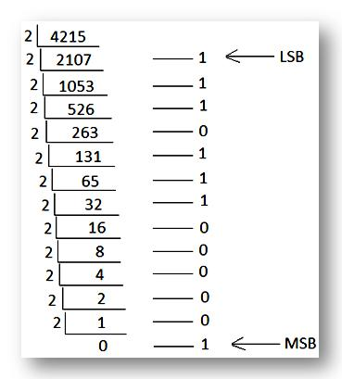
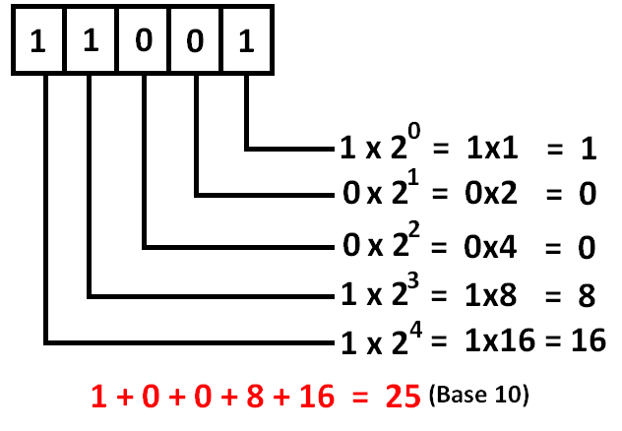
Expressing Numbers in Binary

Slide 12
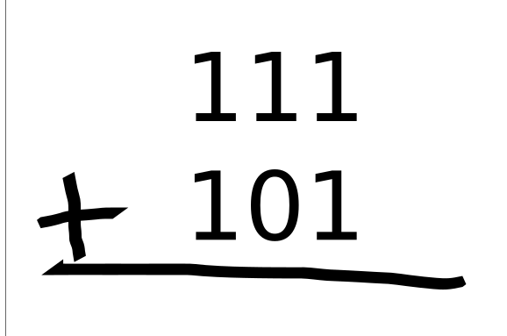
Addition

Slide 13
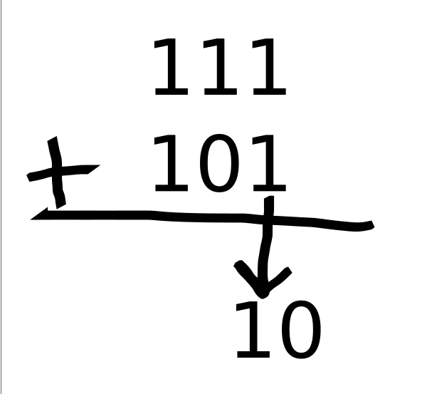
Addition

Slide 14
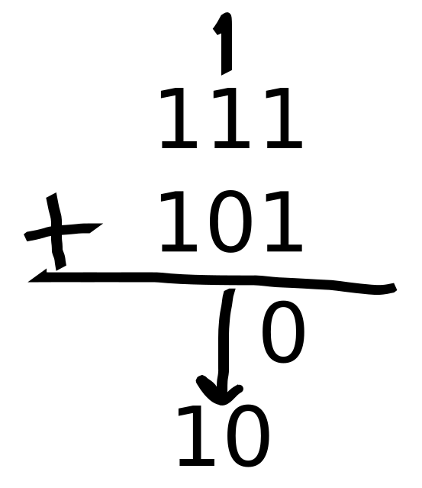
Addition

Slide 15
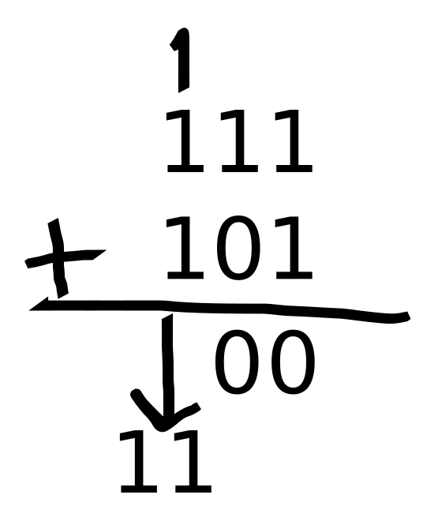
Addition

Slide 16
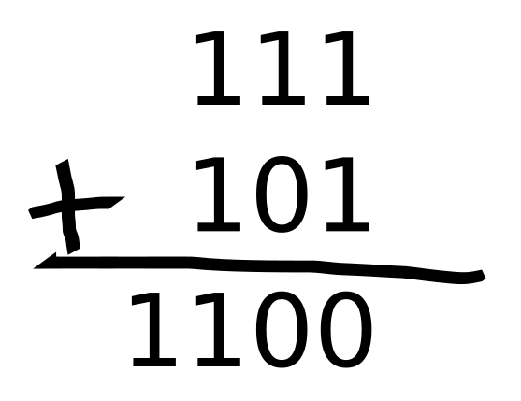
Addition

Slide 17
Addition
A | B | Carry | Sum
1 | 1 | 1 | 0
1 | 0 | 0 | 1
0 | 1 | 0 | 1
0 | 0 | 0 | 0

Slide 18
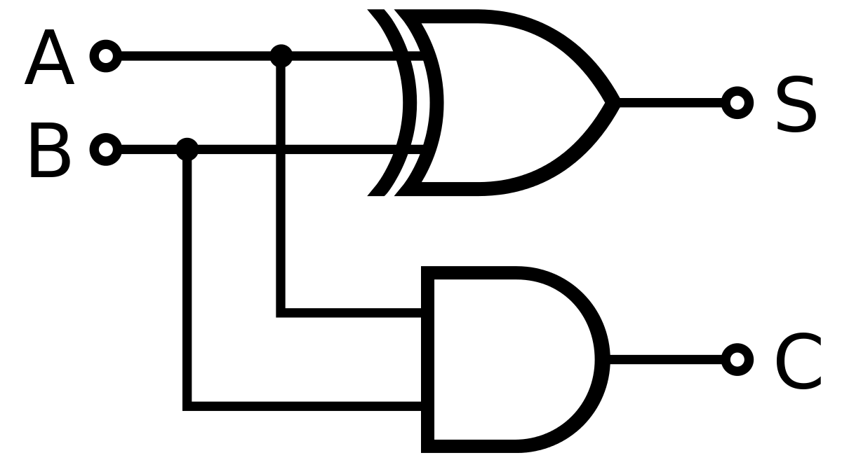
Half Adder

Slide 19
What If We Add Carry?
We will no longer perform A+B+Carry operation with 2 inputs.
We need a new circuit for adding three addend

Slide 20
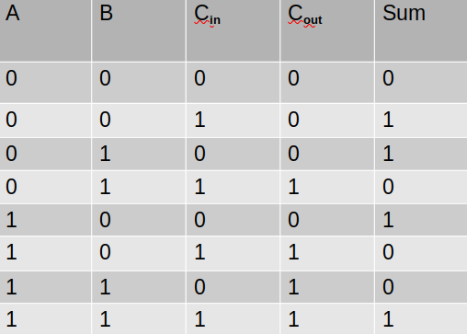
Full Adder
A | B | C_{in} | C_{out} | Sum
0 | 0 | 0 | 0 | 0
0 | 0 | 1 | 0 | 1
0 | 1 | 0 | 0 | 1
0 | 1 | 1 | 1 | 0
1 | 0 | 0 | 0 | 1
1 | 0 | 1 | 1 | 0
1 | 1 | 0 | 1 | 0
1 | 1 | 1 | 1 | 1

Slide 21
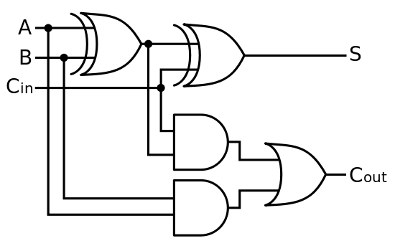
Full Adder

Slide 22
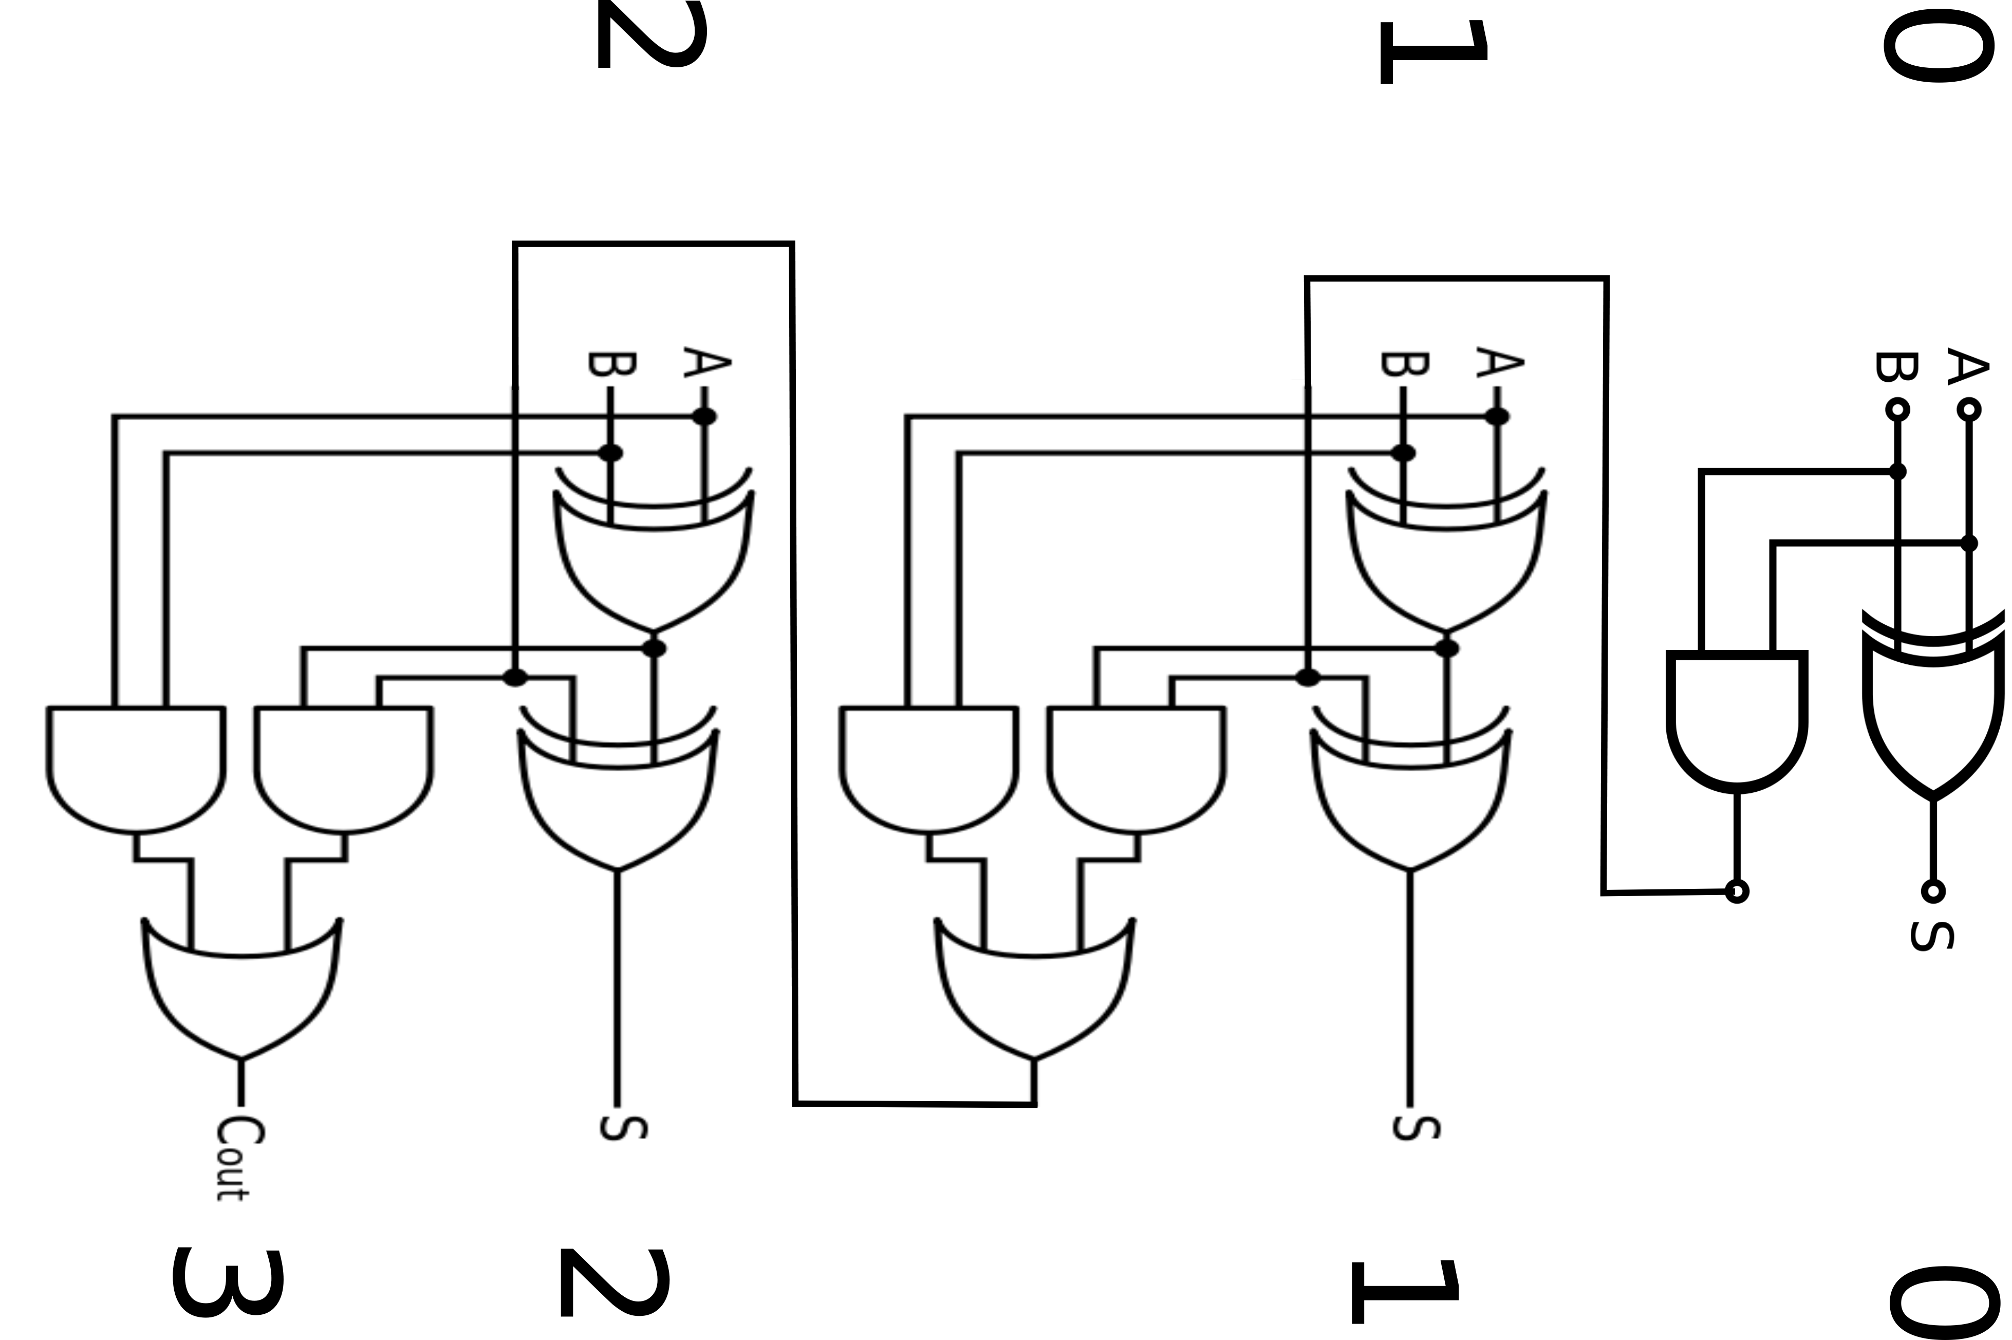

Slide 23
Using Quantum Mechanics
Quantum mechanics accelerates addition insanely.
We are able to perform 64 summing operations in the same instance if we use previous adder circuit .

Slide 24
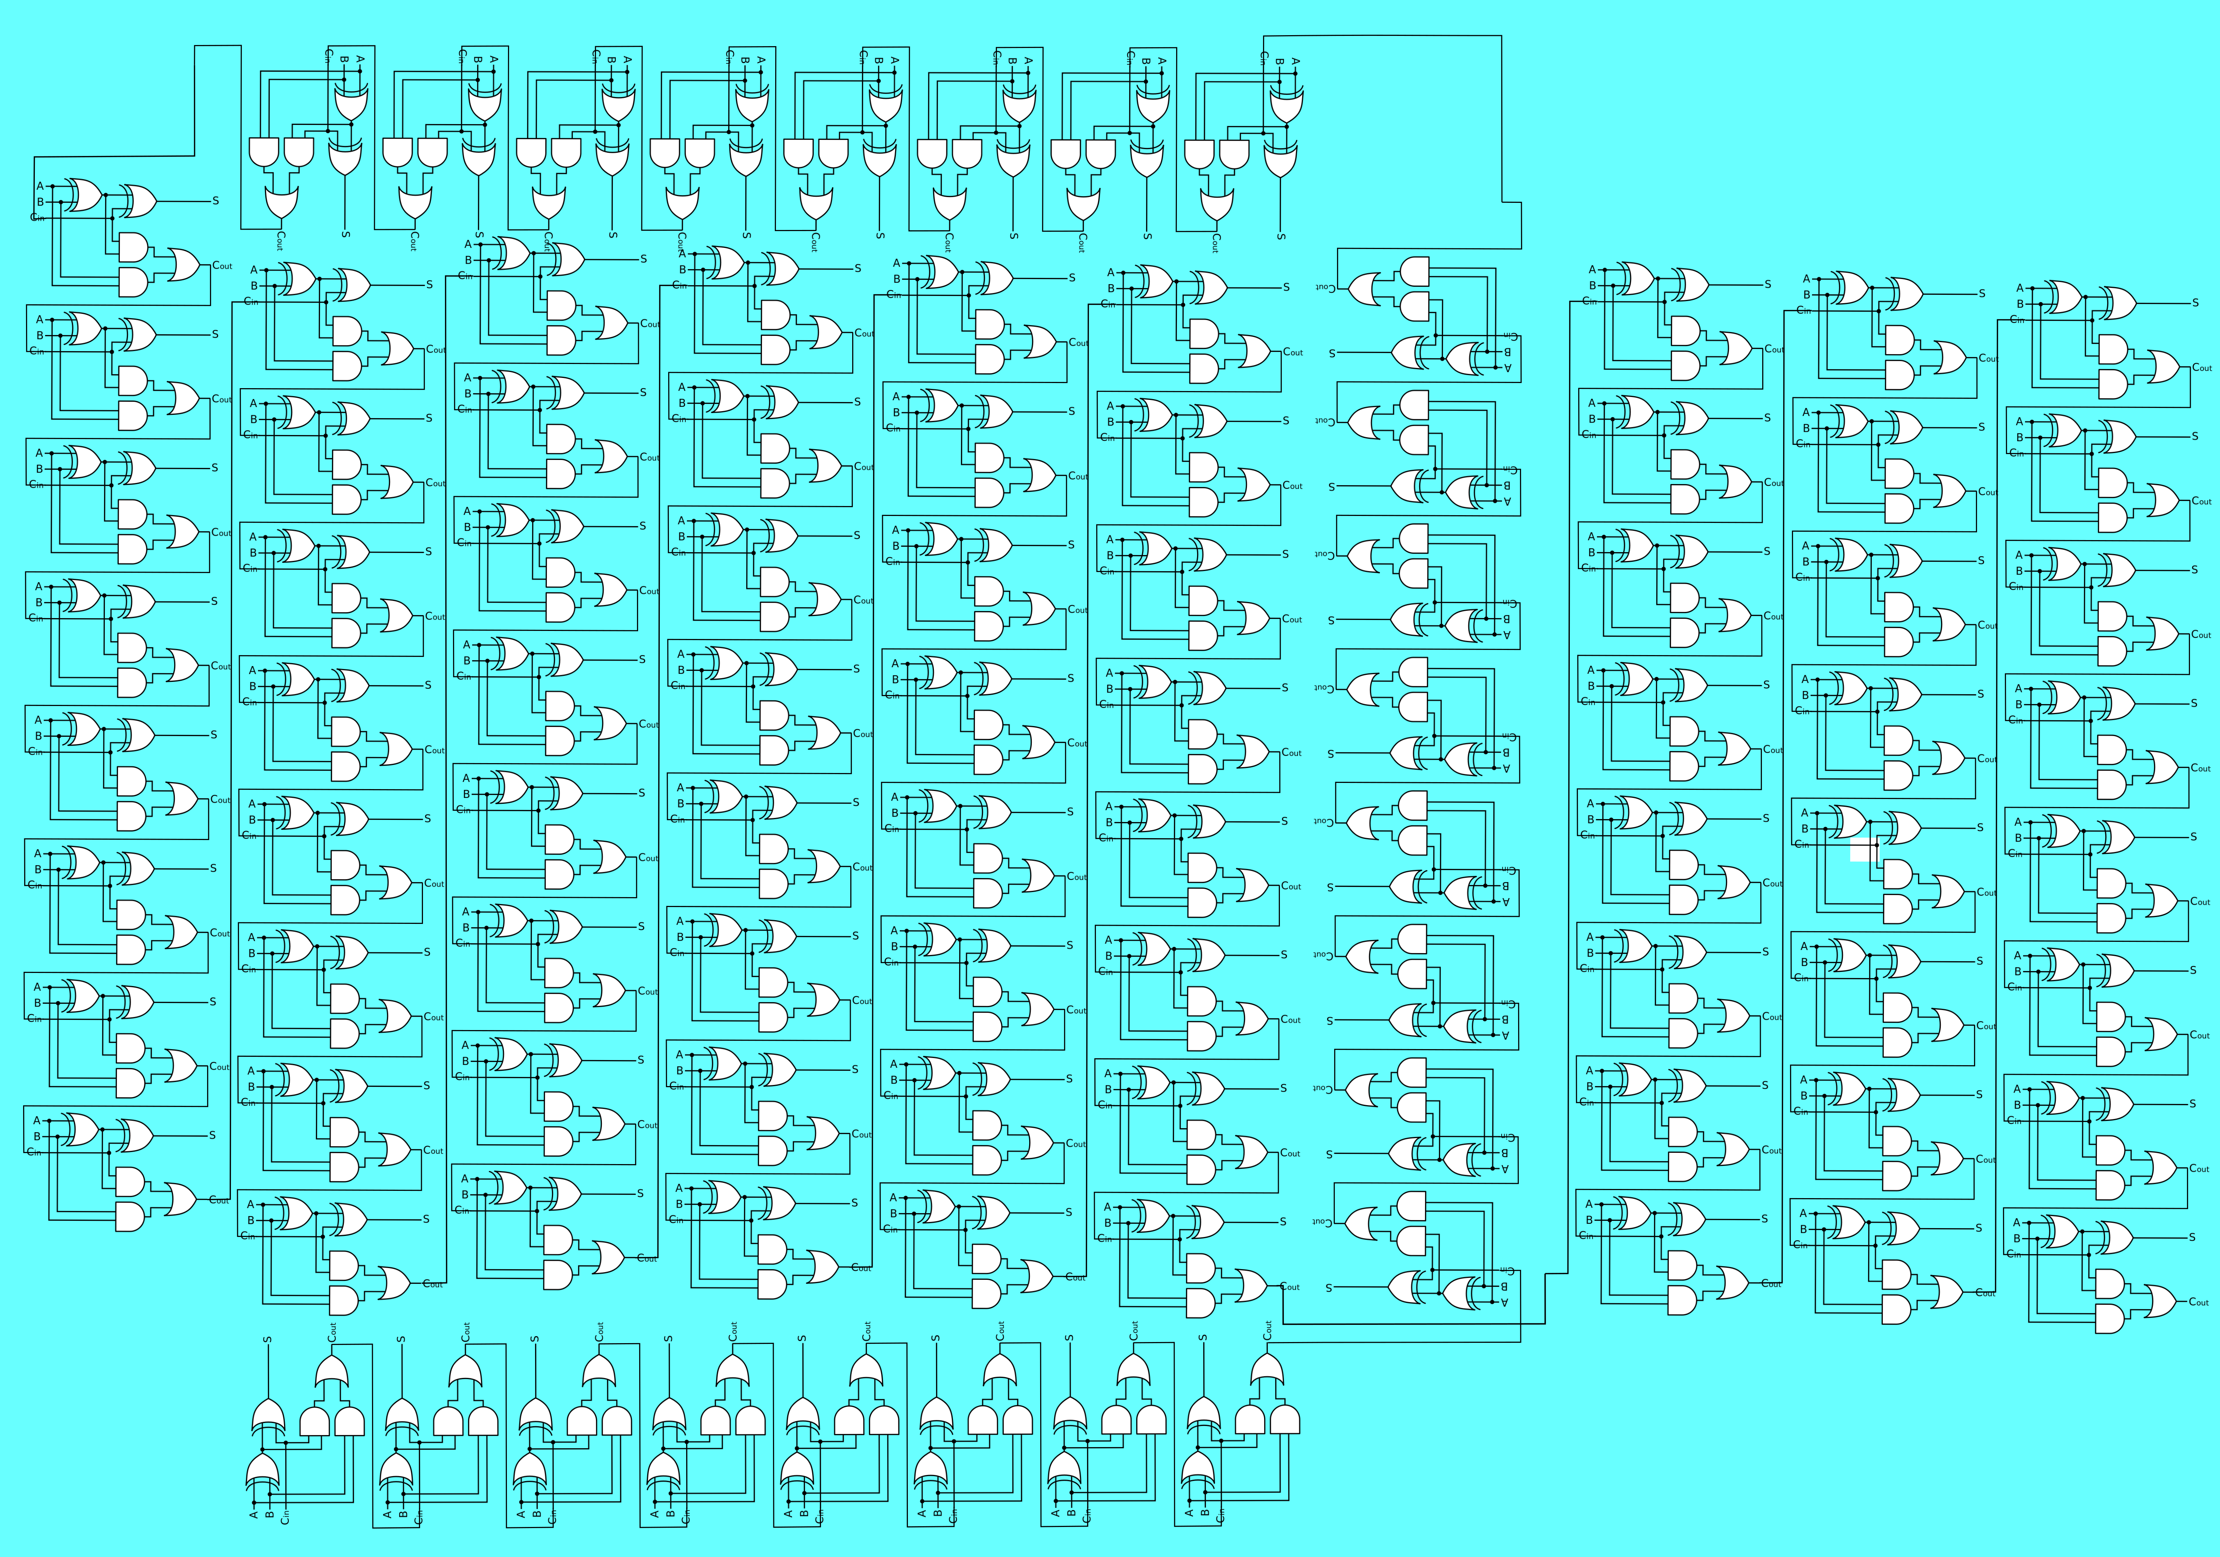

Slide 25
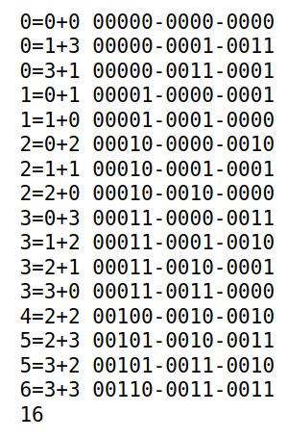
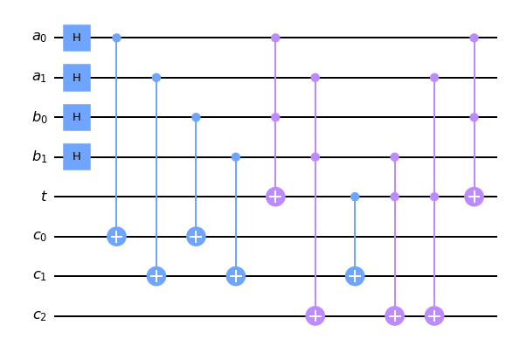
Quantum Adder

Slide 26
References
[1] OxfordLearningDictionaries,viewed 21 Oct 2021 ,<https://www.oxfordlearnersdictionaries.com/ >

Slide 27
Thank you for your time

