Slide 1
DSS Overview (Display Sub system)
9th March 2017
Version 1.0

Slide 2
Agenda
DSS Hardware Overview
Display Controller
Pipelines
Overlay Manager
Interfaces
DSS Capabilities
Scaling Capabilities
Overlaying capabilities
DSS Software
FVID2 Driver Architecture

Slide 3
What is DSS?
DSS – Display Sub System for TDA2xx/AM572x/DRA72x/TDA3xx/DRA78x
Displays video frames from memory to LCD1 or TV (HDMI)
Composition of graphics and video sources
Scaling, Color Space Conversion, Blending, Color Keying

Slide 4
DSS Hardware Overview

Slide 5
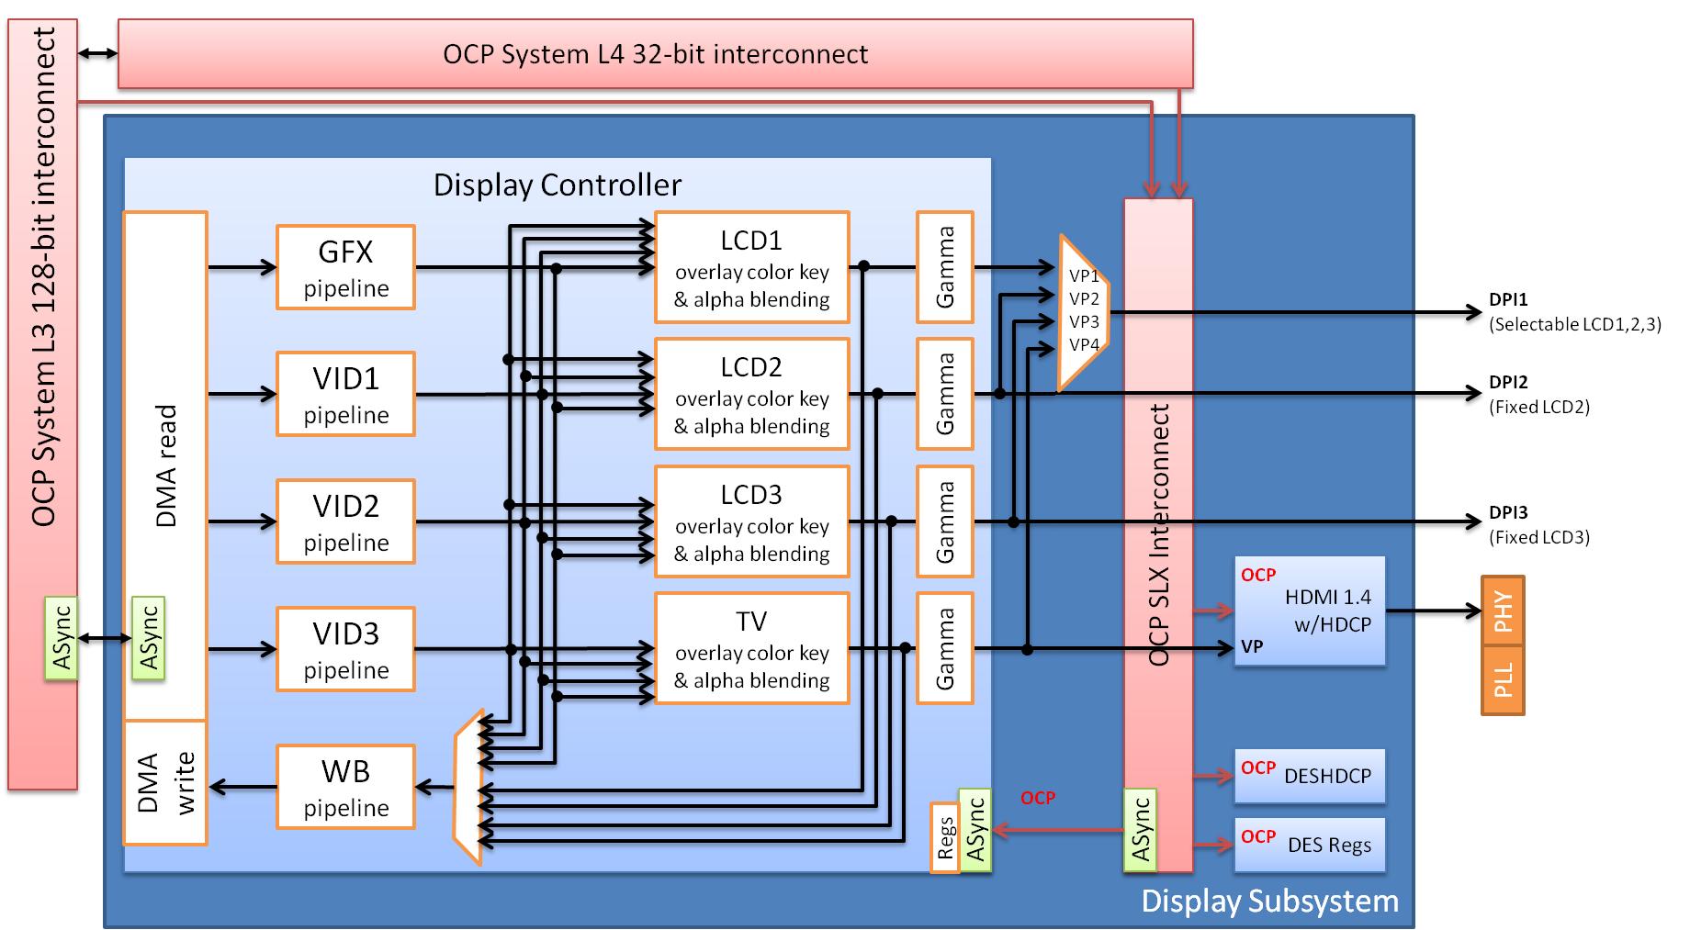
DSS Hardware for TDA2xx/AM572x/DRA72x

Slide 6
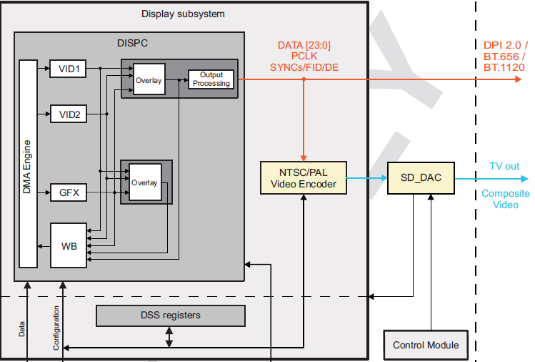
DSS Hardware for TDA3xx/DRA78x

Slide 7
DSS Hardware TDA2xx/AM572x/DRA72x
Display Controller
4 Pipelines (3 Video and 1 Graphics)
4 Overlay managers
Write Back pipeline
Direct Memory Access
4 Interfaces (3 DPI, 1 HDMI)

Slide 8
DSS Hardware TDA3xx/DRA78x
Display Controller
3 Pipelines (2 Video and 1 Graphics)
2 Overlay managers
Write Back pipeline with region based WB support
Direct Memory Access
2 Interfaces (1 DPI, 1 SD-DAC)

Slide 9
Display Controller
Processes on-the-fly video streams and graphics
No extra memory needed for processing
Fetches pipeline data through DMA transfers
4 Overlay managers
3 LCD & 1 TV output
Can process maximum at 192Mpix/sec
1920x1200 @60fps OR 2048x1536 @59fps

Slide 10
Video Pipeline
Three Video Pipelines, all are identical
Fetch data from frame buffers using DMA
VID – RGB, YUV422, YUV420 NV12 up to 1920x2048
Each pipeline has a scalar ,color space converter, VC1 Range mapping

Slide 11
Video Pipeline
VC-1 Range Mapping is to remap the Y, Cb and Cr components (mainly used when the video frame picture is decoded using a VC-1 codec).
Shadow
registers
Video pipeline
Line
buffer
Replication
logic
ARGB32
From
DMA buffer
VC-1
range
mapping
ARGB32
Color space
conversion
YUV→RGB
Scalar
polyphase filter
10
To
overlay
manager
ARGB40
YUV
Bypass
Bypass
Bypass

Slide 12
CSC Unit: YUV to RGB
CSC Unit will convert Video encoded pixels from YUV4:4:4 format into RGB24 or RGB30 format.
In case of YUV4:2:0 or YUV4:2:2 formats chrominance resampling is required before converting to RGB format.

Slide 13
Scalar Unit
Works on RGB and YUV data formats
Filter used is FIR filter
Filter can be used for
Upscaling, Downscaling
Antiflicker Reduction
Spatial De-Interlacing using BOB algorithm
Chrominance resampling for YUV formats
Max Upscaling ratio is 8x
Downscaling Using 3-tap configuration is x0.5 and using 5-tap its x0.25

Slide 14
Graphics pipeline
The replication logic is used to convert the RGB pixel formats into an ARGB40-based format
The antiflicker filter processes the graphics data in RGB format to remove some of the vertical flicker
The 256-entry palette is used to convert bitmap formats into RGB
There is no scalar block in Graphics pipeline
Supports only RGB and BITMAP Formats
Graphics pipeline
To
R-color
Component
CLUT
Index R[7:0]
G-color
Component
CLUT
Index G[7:0]
B-color
Component
CLUT
Index B[7:0]
Primary LCD
From
MA buffer
Replication Logic
Antiflicker filter
Index RGB[23:0]
Palette
ARGB EXPANSION
32→40
To
Overlay
manager
ARGB40
Bypass
Bypass
Bypass

Slide 15
Write Back Pipeline
Used to store in the system memory the capture of Overlay output or the output of one of the pipeline
Supports WB memory-to-memory Mode and WB capture Mode.
Truncation Logic is used to convert ARGB32 bit formats into lower color depth : 12 bit or 16 bit formats.
CSC used to convert RGB to YUV formats.
Shadow
registers
Write-back pipeline
Line
buffer
ARGB32 OR
YUV
From Pipelines or Overlay
Color space
conversion
RGB->YUV
Scalar
polyphase filter
RGB
truncation
To
DMA Buffer
ARGB32 OR
YUV
Bypass
Bypass
Bypass

Slide 16
Overlay Manager
LCD output
Timing
Generator
Active
Matrix
dithering
CLUT
TDM
Overlay
Manager
Color Key
And
Alpha blending
DISPC_LCD_DATA[23:0]
DISPC_LCD_VSYNC
DISPC_LCD_HYSNC
DISPC_LCD_FID
DISPC_LCD_DE
From GFX pipeline
Sync
buffer
From VID1 pipeline
Color
Phase
rotation
Gamma
From VID2 pipeline
From VID3 pipeline
To WB pipeline

Slide 17
Overlay Manger Capabilities
Z-Order: App can set the Ordering of layers
Transparency color keys: Source and destination (can only be used with RGB and BITMAP formats)
Alpha Blending: Global alpha blending and pixel level alpha blending
Gamma Correction, temporal dithering and phase rotation
Configurable output size and position of pipeline
Color Phase rotation unit is used to correct the LCD output colorimetry in case of non pure white backlight, it can also be used to convert RGB to YUV.

Slide 18
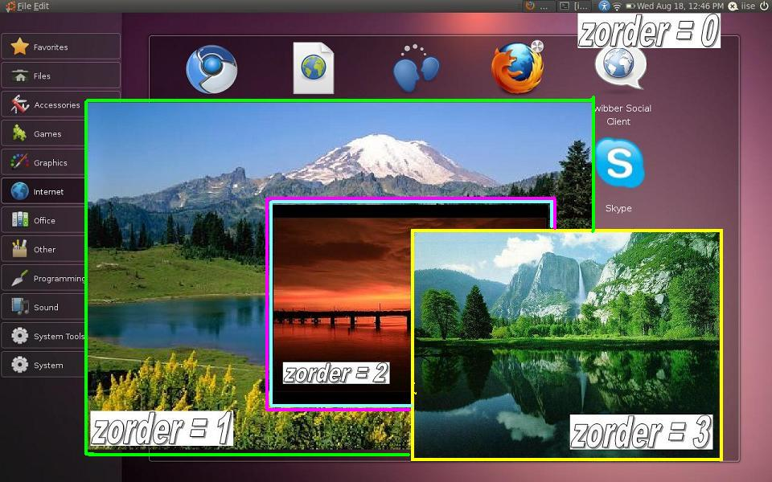
Z-Order Example

Slide 19
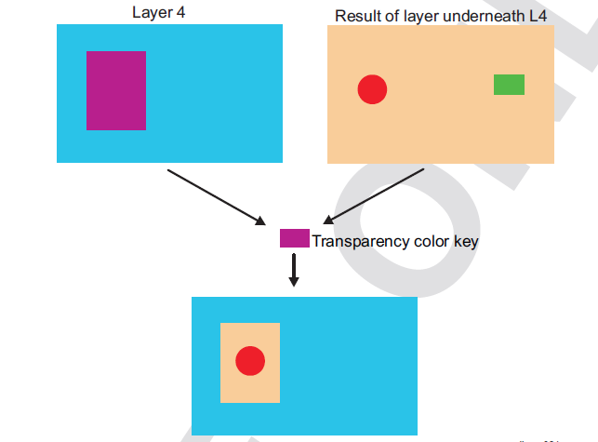
Color Keying Examples
Source Transparency

Slide 20
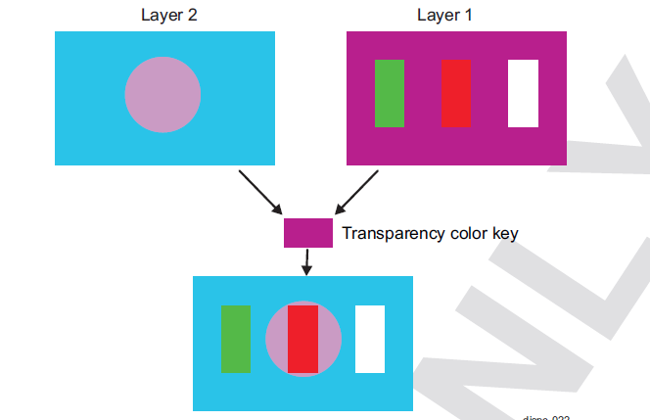
Color keying Examples cont..
Destination Transparency

Slide 21
DSS Driver Overview (based on FVID2 Interface)

Slide 22
FVID2 Introduction
What is FVID2?
Next version of FVID and it addresses the different limitations of FVID
Provides interface to streaming operations like queuing of buffers to driver and getting back a buffer from the driver
Abstracts the underlying hardware for the video application with a standard set of interface
Gives a same look and feel for video applications across different SOC
Interface is independent of OS/Hardware/Driver
FVID2 is currently supported on BIOS6
What is not FVID2?
Not the actual driver
Does not define hardware specific APIs and structures

Slide 23
Understanding FVID2 - Interfaces
FVID2_init
Initializes the drivers and the hardware. Should be called before calling any of the FVID2 functions
FVID2_deInit
Un-initializes the drivers and the hardware
FVID2_create
Opens a instance/channel video driver
FVID2_delete
Closes a instance/channel of a video driver
FVID2_control
To send standard (set/get format, alloc/free buffers etc..) or device/driver specific control commands to video driver
FVID2_queue
Submit a video buffer to video driver. Used in display/capture drivers
FVID2_dequeue
Get back a video buffer from the video driver. Used in display/capture drivers

Slide 24
Understanding FVID2 – Interfaces Contd.
FVID2_processFrames
Submit video buffers to video driver for processing. Used only in M2M drivers
FVID2_getProcessedFrames
Get back the processed video buffers from video driver. Used only in M2M drivers
FVID2_start
Start video capture or display operation. Not used in M2M drivers
FVID2_stop
Stop video capture or display operation. Not used in M2M drivers

Slide 25
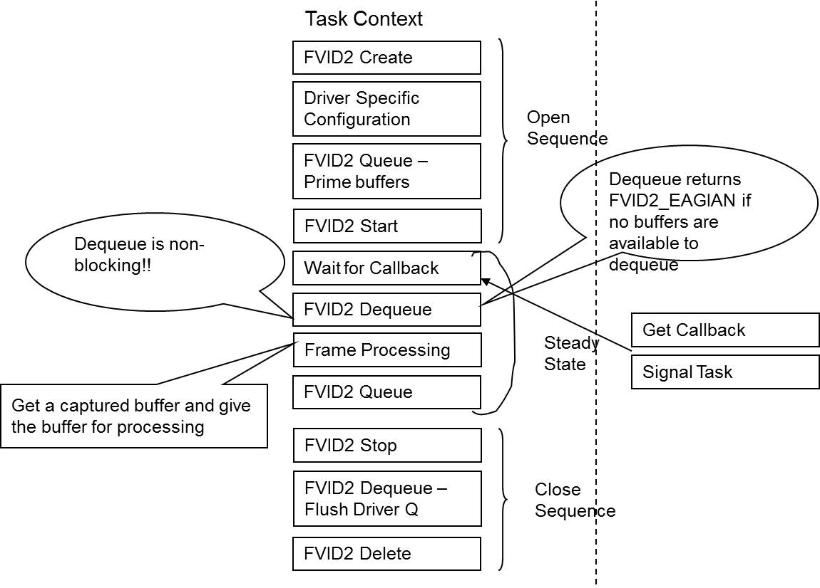
Typical Application Flow

Slide 26
Design
FVID2_Queue
This will put the buffer into Input Queue.
FVID2_DeQueue
This will take out the buffer from the output Queue
Vsync ISR
Call back will be given to application if there is any frame in the output Queue or if periodic callback is enabled.
It will program the base address of the frame present in the input queue in shadow registers and the frame is put in the current Queue.
Checks
If application queues from the task context and the previous buffer is repeated then driver checks if its safe to program the buffer, if its safe then it will updated the registers and put it in the current queue, else it will put the buffer in the input queue.

Slide 27
Flow chart of Queue
FIVID2_Queue from task context
Is Previous Buf Repeated(No Buf Queued in Prev Vsync)
No
Yes
No
Is it safe to
Program the
Buffer?
Yes
Put the Buffer in the Input Queue
Put the Buffer in the Input Queue
Program the Buffer in register and put it in current Queue

Slide 28
Buffer Queue latency
Driver latency to program the buffer to DSS = Code execution time from APP queue to programming Registers (T1) + 5 line of display rate (T2).
With Vayu EVM, T1 is measured to be around 20 micro seconds.
The total latency comes around 180 us for 800x480 @ 60 FPS display. So if any buffer is queued 180 us before the Vsync then the buffer will be displayed in the next frame period.
T2 in micro seconds for different resolution
- 800x480@60fps -→ 158.25 us
- 1280x720@60fps --→ 107.74 us
- 1920x1080@60fps -→ 74.07 us
(Reason for 5 lines check) This check is required so that the driver won't program the buffer address around the display VSYNC period. Doing so would result in DSS HW not accepting the programmed buffer resulting in frame drop.
Note - This measurement is done with the stand alone display application. In fully loaded system the interrupt latency will add to it.

Slide 29
Background
Some DISPC registers are termed shadow registers. A shadow register change has no direct effect on the configuration of the DISPC
The registers are shadow registers let software change the values of the registers at any time
When all the registers for a given configuration are into the registers, software must set 1 bit (GoBit) only to validate the configuration
When hardware reaches the end of the current frame and sees that the bit field has been set by software, the new configuration is now the configuration used by the hardware.
In some corner cases, even though application has queued a new buffer before Vsync event, due to software overhead the new frame address might be programmed after the actual VSYNC event. In such cases previous frame is repeated.

Slide 30
Display Sequence: Timing Diagram, Three Buffers (Two priming)
Display Start
VSYNC1
VSYNC2
VSYNC3
VSYNC4
Current Display
B1
B2
B3
Input Queue
Actual Registers
B1
B2
B3
Current Queue
Shadow Registers
B1
B2
B3
B1
Output Queue
Fvid2_Queue
B1,B2
B2
B1
Program
Shadow Registers,
InVsync ISR
Fvid2_Start
B2
B1
Program
Shadow Registers,
InVsync ISR
B2
B1
Program
Shadow Registers,
InVsync ISR
Fvid2_Queue
B3
B3
B2
B1
Call Back
B3
B2
Fvid2_DeQueue
B1
B1
B3
B2
Process B1
B1
Fvid2_Queue
B1
B3
B2
Call Back
B1
B3
Fvid2_DeQueue
B2
B2
B1
B3
Process B2
B2
Fvid2_Queue
B2
B1
B3
TI Confidential

Slide 31
Display Sequence: Timing Diagram, Two Buffers (only one priming) – No frame Repeat case
Display Start
VSYNC1
VSYNC2
VSYNC3
VSYNC4
Current Display
B1
B2
B1
Input Queue
Actual Registers
B1
B2
B1
Current Queue
Shadow Registers
B1
B2
B1
B2
Output Queue
Fvid2_Queue
B1
B1
Program
Shadow Registers
Fvid2_Start
B1
Program
Shadow Registers
B2
Fvid2_Queue
B2
B1
B2
B1
Program
Shadow Registers,
B2
Call Back
B1
Fvid2_DeQueue
B1
B2
Process B1
Fvid2_Queue
B1
B1
B2
Call Back
B1
B2
Fvid2_DeQueue
B2
B1
Process B2
B2
B1
Fvid2_Queue
B2
TI Confidential

Slide 32
Display Sequence: Timing Diagram, Two Buffers (only one priming) – Frame Repeat UseCase
Frame Repeat as B3 is Queued after Vsync
Display Start
VSYNC1
VSYNC2
VSYNC3
VSYNC4
VSYNC5
Current Display
B1
B2
B2
B1
Input Queue
Actual Registers
B1
B2
B2
B1
Current Queue
Shadow Registers
B1
B2
B1
B2
Output Queue
Fvid2_Queue
B1
B1
Program
Shadow Registers
Fvid2_Start
B1
B2
Fvid2_Queue
B2
B1
B2
B1
Program
Shadow Registers,
B2
B1 is Programmed after Vsync
Call Back
B1
Fvid2_DeQueue
B1
B2
Process B1
Fvid2_Queue
B1
B1
B2
Call Back
B1
B2
Fvid2_DeQueue
B2
B1
Process B2
B2
B1
Fvid2_Queue
B2
TI Confidential

Slide 33
Corner Case, where frame is queued Near Vsync Boundary
Actual Vsync
Event
Vsync ISR
The decision to program the
The registers with updated buffer
Is done by checking the current
Line number of LCD1 Overlay, if the
Diff is more than 5 lines,it will program
Else it will repeat the buffer
If its safe it will updates the buffer
And programmed buffer will be displayed in next frame period
Few Micro Sec
Application Queues
The Buffer
Driver checks if its
Safe to program
The buffer

Slide 34

Questions? Thank You

