Slide 1
VIP Overview (Video Input Port)
9th March 2017
Version 1.0

Slide 2
Agenda
VIP Introduction
Features
SC
CSC
CHR_DS
VIP Capture data flows
VIP Driver Overview
FVID2 Interface
Driver Design
2

Slide 3
VIP Sub-sytem Block
8/16/24
8/16/24
Repacker
Repacker
8/16/24
8
8/16/24
8
OCP Slave Port
CPU Host Port
A
B
A
B
Slice 0
Slice 1
Config Regs
Interrupts
System Clock Domain
L4 Clock Domain
VPDMA
OCP Master Port 0
OCP Master Port 1
L3 Clock Domain
3

Slide 4
VIP Slice Block
VIP Parser
Port A and B
CSC
SC
CHR_DS0
CHR_DS1
Output 0
Output 1
4

Slide 5
VIP Block
TDA2xx/AM572x/DRA72x Supports 3 VIP Block with two ports Port A and Port B per slice
VIP1/ VIP2 parser can operate as one 8/16/24 bit input port (Port A) or two 8-bit ports (Port A, Port B).
VIP3 parser can operate as 16 bit input port (Port A)
Separate pixel clock and framing signals for each port
Each VIP block has two slices : VIPx S0, VIPx S1
VIP Block is used to capture video data from external video sources like video decoders or sensors
5

Slide 6
VIP Features
Format conversion
Inputs: YUV422I, YUV444, RGB888
Outputs: YUV422I, YUV420SP (Uses CHR_DS), YUV422SP, RGB888 (Uses CSC)
Supports optional scaling from 1/8x to 2048 pixels, only down scaling supported
Supports optional color space conversion
YUV to RGB color space conversion using CSC block
Supports optional chroma downsampler
YUV422I to YUV420SP conversion using CHR_DS
Supports up to 165 MHz clock (includes blanking)
Video Interface width
8/16/24 bit mode
Combination: PortA 8-bit and PortB 8-bit or PortA 16 or 24-bit
6

Slide 7
Contd..
Supports Embedded (BT.656/BT.1120 16/24b, BT.656 8b) or discrete (BT.601 style) sync
Video Interface Mode
Discrete Sync
Single Channel non multiplexed mode with HSYNC and VBLK as control signals
Single Channel non multiplexed mode with HSYNC and VSYNC as control signals
Single Channel non multiplexed mode with AVID and VBLK as control signals
Single Channel non multiplexed mode with AVID and VSYNC as control signals
Embedded Sync
Single Channel non multiplexed mode
Multi-Channel pixel or line multiplexed mode
7

Slide 8
VIP Interface modes
Active lines captured
All pixels in line captured
Frame Start: VBLK high to low
Line start: HSYNC low to high
DS : Single Channel non multiplexed mode with HSYNC and VBLK as control signals
All lines captured
All pixels in line captured
Frame Start: VSYNC low to high
Line start: HSYNC low to high
DS :Single Channel non multiplexed mode with HSYNC and VSYNC as control signals
8

Slide 9
Contd..
Active lines captured
Active pixels in line captured
Frame Start: VBLK high to low
Line start: ACTVID low to high
DS : Single Channel non multiplexed mode with AVID and VBLK as control signals
All lines captured which has ACTVID high
Active pixels in line captured
Frame Start: VSYNC low to high
Line start: ACTVID low to high
DS : Single Channel non multiplexed mode with AVID and VSYNC as control signals
9

Slide 10
Contd
ES : Single Channel non multiplexed mode
10

Slide 11
SC Features
Vertical and horizontal up and down scaling
Polyphase filter upscaling
Running average vertical down scaling
Decimation and polyphase filtering for horizontal scaling
Non-linear scaling for stretched/compressed left and right sides
Input image trimmer for pan/scan support
Pre-scaling peaking filter for enhanced sharpness
Scale field as frame
Interlacing of scaled output
Full 1080p input and output support
Scaling filter Coefficient memory download
11

Slide 12
SC Block
Line Memory
(5 line)
YCbCr
422
YCbCr
422
Trimmer
Peaking
Vertical Scaler
Horizontal Scaler
FIFO
VS Ver Coef Mem
32 phase x 5tap
(Polyphase filter)
HS Coef Mem
32 phase x 7tap
12

Slide 13
CSC Features
A fully programmable color space converter. With the programmability, input video data in any color space can be converted to another color space.
It could convert YCbCr to RGB and vice versa.
This module could be put by pass as well if no conversion is required.
13

Slide 14
CHR_DS Features
It is used to downsample picture input in the format 4:2:2 to 4:2:0
This downsampling is required because typical video encoders expects input in 4:2:0 format before compression
Down sampling is performed using averaging filter.
14

Slide 15
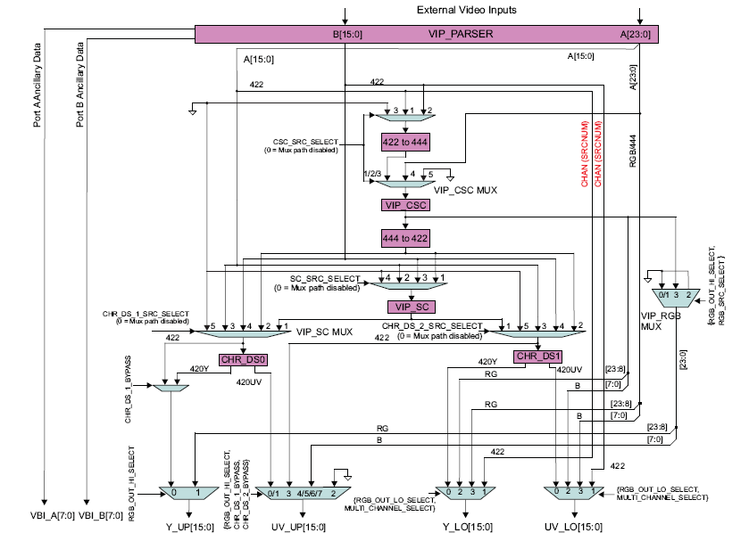
VIP Slice Detailed Block Diagram
15

Slide 16
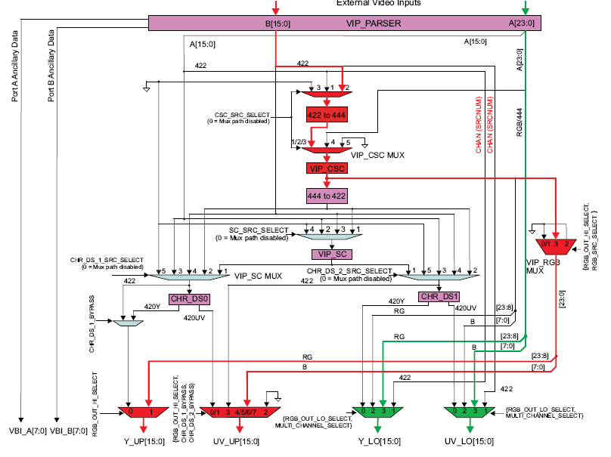
Example Single Channel RGB / YUV422 Capture
16

Slide 17
VIP Driver Overview (based on FVID2 Interface)
17

Slide 18
FVID2 Interface
FVID2_create | Init and prepare a VIP port for capture. Buffer allocation and priming must be done outside driver.
FVID2_start | Start the VIP port for capture
FVID2_dequeue | Get captured frames. Possible to dequeue all channels in a handle using single dequeue call. Need separate dequeue calls for each stream
FVID2_queue | After processing captured frames return them back to the driver. Also used for priming buffers to driver. Possible to queue from different channels in a handle using single queue call. Need separate queue call for different streams
FVID2_control | IOCTL like control to change frame drop sequence per channel, scaling ratio per stream, get channel status like captured width x height
FVID2_stop | Stop the VIP port
FVID2_delete | Release resources allocated during capture
18

Slide 19
Typical Application Flow
Task Context
FVID2 Create
Driver Specific Configuration
Open Sequence
FVID2 Queue – Prime buffers
Dequeue returns FVID2_EAGIAN if no buffers are available to dequeue
Dequeue is non-blocking!!
FVID2 Start
Wait for Callback
FVID2 Dequeue
Steady State
Get Callback
Frame Processing
Signal Task
Get a captured buffer and give the buffer for processing
FVID2 Queue
FVID2 Stop
FVID2 Dequeue – Flush Driver Q
Close Sequence
FVID2 Delete
19

Slide 20
Queue Element Flow Diagram
Queue Request from application
Request Submitted to core
Fvid2_queue
R3
R2
R1
Request Queue
C3
Current Queue
C2
C1
Done Queue
(One per instance)
Dequeue Request from application
Request completion
Fvid2_dequeue
D1
D2
20

Slide 21
Buffer Capture Modes
Frame Drop Mode
VIP Capture driver will stop capturing data when there are no more buffers at the input queue
It will not hold any buffer with it and the last buffer will be returned to the application through dequeue call
It makes use of the VPDMA drop data feature
Last Frame Repeat Mode
VIP Capture driver will keep capturing the data to the last buffer when there are no more buffers at the input queue
It will hold the last buffer with it till the applications queues any new buffer or the capture is stopped
Used for on-the-fly capture to single OCMC-CBUF use case (without ping-pong buffers)
21

Slide 22
Contd..
Circular Frame Repeat Mode
VIP Capture driver will keep reusing all the sets of buffer with it in a circular fashion
Application cannot get back any buffer from the driver when streaming is on and dequeue call will result in error
Used for on-the-fly capture to OCMC-CBUF use case with ping-pong buffers
22

Slide 23
Frame Drop Mode Buffer Flow
Application
Driver
Core
F6
F5
F4
F3
F2
F1
Fvid2_queue
(Priming of 4 buffers)
F6
F5
B4
B3
B2
B1
Fvid2_start
F6
F5
B4
B3
Buffer requests from core
B1
B2
Frame Complete Callback
F6
F5
B4
Buffer completion from core (a buffer request usually follow this)
B1
B2
B3
F1
F6
F5
B4
Fvid2_dequeue
B2
B3
Fvid2_dequeue
(Only dequeue again and again will flush the driver queue)
F4
F3
F2
F1
F6
F5
23

Slide 24
Last Frame Repeat Mode Buffer Flow
Application
Driver
Core
F6
F5
F4
F3
F2
F1
Fvid2_queue
(Priming of 4 buffers)
F6
F5
B4
B3
B2
B1
Fvid2_start
F6
F5
B4
B3
Buffer requests from core
B1
B2
Frame Complete Callback
F6
F5
B4
Buffer completion from core (a buffer request usually follow this)
B1
B2
B3
F1
F6
F5
B4
Fvid2_dequeue
B2
B3
F3
F2
F1
F6
F5
Fvid2_dequeue
B4
(Only dequeue again and again will flush the driver queue except last buffer)
24

Slide 25
Circular Frame Repeat Mode Buffer Flow
Application
Driver
Core
F6
F5
F4
F3
F2
F1
Fvid2_queue
(Priming of 4 buffers)
F6
F5
B4
B3
B2
B1
Fvid2_start
F6
F5
B4
B3
Buffer requests from core
B1
B2
Frame Complete Callback
F6
F5
B1
B4
Buffer completion from core (a buffer request usually follow this)
B2
B3
F1
F6
F5
B1
B4
Fvid2_dequeue
Returns Error!!
B2
B3
Fvid2_stop
F3
F2
F1
F6
F5
B1
B4
Fvid2_dequeue
Returns all buffers
B2
B3
25

Slide 26
VIP Driver List Management
26

Slide 27
Single Channel List Layout
Program descriptors every LC interrupt received
Since post is based on VPDMA LC interrupt, the shadow descriptor gets filled in case of startup, short frames or emulation break points
From 3rd LC interrupt, this could be considered as VSYNC
Buffer Set 1 (Ping)
Stream 1 B1 Luma
Data Descriptor (Y)
Stream 1 B1 Chroma
Data Descriptor (UV)
Stream 2 B1 Luma
Data Descriptor (Y)
Stream 2 B1 Chroma
Data Descriptor (UV)
27

Slide 28
Contd..
Use List Complete (LC) Interrupt
Acts like VSYNC interrupt since this happens after blocking descriptors are loaded except for the first two interrupts (which happens immediately)
Driver programs the next set of buffers and move the buffer programmed two LC interrupt earlier to output buffer
First two LC interrupts: Both descriptors gets accepted as shadow descriptor is not present for the startup
28

Slide 29
Single Channel: Timing Diagram
LC2
Start-up sequence, back-to-back LC interrupt occurs!!
LC1
VSYNC1
VSYNC2/LC3
VSYNC3/LC4
VSYNC4/LC5
VSYNC5/LC6
Current Descriptor
B1
B2
B3
B4
B5
Shadow Descriptor
B2
B3
B4
B5
B6
Blocked Descriptor
B3
B4
B5
B6
B7
B1
Input Queue
B2
B2
B3
B3
B3
B4
B4
B4
B4
B5
B5
B5
B5
B5
B6
B6
B6
B6
B6
B6
B7
B7
B7
B7
B7
B7
B7
Current Queue
B1
B1
B1
B2
B3
B4
B5
B2
B2
B3
B4
B5
B6
B3
B4
B5
B6
B7
Output Queue
B1
B1
B1
B1
B2
B2
B2
B3
B3
B4
29

Slide 30

Questions? Thank You
30

