Slide 1
VPE Overview (Video Processing Engine)
9th March 2017
Version 1.0

Slide 2
Agenda
VPE Introduction
Features
SC
DEI
VPDMA
VPE Driver Overview
FVID2 Interface
Driver Design

Slide 3
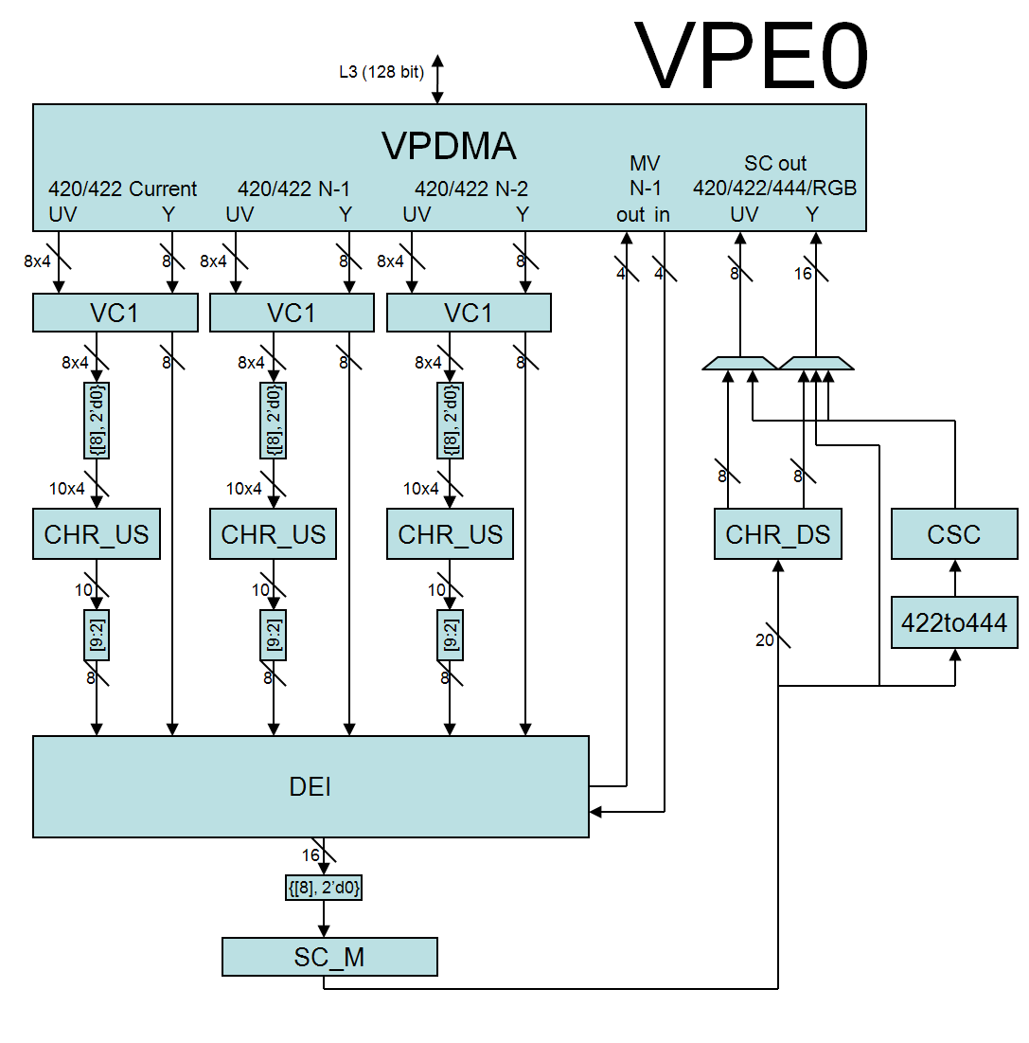
VPE Block Diagram

Slide 4
VPE Features
Format conversion
Inputs: YUV422I, YUV420SP (Uses CHR_US), YUV422SP
Outputs: YUV422I, YUV420SP (Uses CHR_DS), YUV422SP, RGB888 (Uses CSC), YUV444I
Deinterlacing (interlaced to progressive)
4 field motion based algorithm
up to two 1080i video sources
DEI can be bypassed in case of progressive input
Scaling from 1/8x to 2048 pixels
Color space conversion
YUV to RGB color space conversion using CSC block
VC-1 Range Mapping and Range Reduction
Supports up to 304 MHz clock
Tiled (2D) input/output

Slide 5
SC Block
Line Memory
(5 line)
YCbCr
422
YCbCr
422
Trimmer
Peaking
Vertical Scaler
Horizontal Scaler
FIFO
VS Ver Coef Mem
32 phase x 5tap
(Polyphase filter)
HS Coef Mem
32 phase x 7tap

Slide 6
SC Features
Vertical and horizontal up and down scaling
Polyphase filter upscaling
Running average vertical down scaling
Decimation and polyphase filtering for horizontal scaling
Non-linear scaling for stretched/compressed left and right sides
Input image trimmer for pan/scan support
Pre-scaling peaking filter for enhanced sharpness
Scale field as frame
Interlacing of scaled output
Full 1080p input and output support
Scaling filter Coefficient memory download

Slide 7
Motion-Adaptive Deinterlacer Block

Slide 8
DEI Features
Motion-adaptive deinterlacing
Motion detection is based on Luma only
4-field data is used
Motion Detection (MDT)
Examines 3 fields of input video data (luma only) and calculates a 4 bit motion vector to drive the Edge Directed Interpolation Block
Edge-Directed Interpolation (EDI)
Edge detection using luma pixels in a 2x7 window
Soft-switch between edge directed interpolation and vertical interpolation depending on the confidence factor
Film Mode Detection (FMD)
3-2 pull down detection (NTSC style)
2-2 pull down detection (PAL style)
Bad Edit Detection (BED)
Progressive or interlaced bypass mode

Slide 9
VPDMA
The VPDMA’s primary function is to move data between external memory and internal processing modules that source or sink data.
Clients
The modules that source or sink data are referred to as clients. i.e. the physical interface between the processing module and external memory is called a client
Each client can be configured to have specific start event which allows for the channel data to start flowing to or from the external client
Channel
A channel is setup/mechanism inside the VPDMA to connect a specific memory buffer/transfer to a specific client

Slide 10
Descriptors/List
Crux of VPDMA programming is descriptors.
Descriptors defines how data will be transferred through different channel. In other words, channel is described through a Data Transfer descriptor.
The client that the channel is mapped to interprets the information in the descriptor to perform the requested data transfer.
List is a group of descriptors that makes up a set of DMA transfers that need to be completed.
List can contain any kind of descriptor without limitation and be of any size
Descriptor 1
Descriptor 1
Descriptor 2
Descriptor 3
List
Descriptor 4
Descriptor 5
Descriptor 6
10

Slide 11
How VPDMA operates
The VPDMA Controller works on lists of descriptors.
CPU creates the lists of descriptors in DDR in the order it wants them executed
CPU then writes the location of the list to the LIST_ADDR register, followed by writing the size, type of list and list number to the LIST_ATTR register and post list
The List Manager module of VPDMA (manages different lists) will then schedule a DMA transfer to pull in the portion of the list that it can store in internal VPDMA memory
List Manager will sequentially process descriptors in the list and does data transfer
11

Slide 12
List Contd..
Data transfer could be initiated by list. Each List represents data descriptors.
VPE supports maximum up to 8 lists but there is no restriction on the size of each list.
A Data Transfer Descriptor will be removed from the list when the resource specified by the Channel field is free. If the Channel is not free when the list reaches a data transfer descriptor then the list will stall until the current transfer on the channel has completed
List will stall at 2nd
data descriptor till
First Frame 1Data
descriptor (DD) is
completed.
DD DEI Frame 1
DD DEI Frame 2
DD DEI Frame 3
DD DEI Frame 4
DD DEI – Data Descriptor for De-interlacer
12

Slide 13
Descriptors Contd..
There three kinds of descriptors which could be programmed in the list.
Data Transfer Descriptor – describes video data transfer
Configurations Descriptor – Used for set up client configuration like scalar configuration for scaling ratio, crop window etc
Control Descriptor – Used in list to give control commands to list manager like wait till transfer is complete before initiating next transfer etc
13

Slide 14
Driver Programming Difference with VPDMA
Register based programming
Program hardware parameters in the registers
Program destination buff address
Program source buff address
Enable interrupt generation after completion of operation
Trigger h/w
Wait for interrupt
Descriptor based programming
Program config Descriptor for scalar parameters
Program DD for destination
Program DD for source
Program SI control descriptor for interrupt
Post list
Wait for interrupt
The main advantage with descriptor based programming is that reconfiguring the hardware register (say for another context) takes very minimal CPU cycles as these are already pre-programmed and kept in the memory per context
14

Slide 15
Typical Descriptor Layout
Three frames from different channel has to be scaled to different ratio and application needs intimation after resizing of all three frames
Descriptor based programming
Program config Descriptor for scalar parameters
Program DD for destination
Program DD for source
Program SI control descriptor for interrupt
Post list
Wait for interrupt
Program descriptor in DDR
These set of descriptor creates list in DDR
Write address of this list in LIST_ADDR and LIST_ATTRIB register which posts list
Wait for interrupt from SI which indicates completion
Ch1 config desc
DD Ch1 Out
DD Ch1 In
Sync on Channel
Control Descriptor
Send Interrupt
15

Slide 16
Typical Descriptor Layout Contd..
Why do need “Sync on channel control descriptor for output client”
NF (new frame signal) flows from output to input client
It is possible that because of the pipeline delay, nf signal for the channel-1 will arrive at the inbound client after vpdma parses config descriptor for channel-2.
This will cause problem for channel 1 and it means that channel 2 config has been applied to channel 1.
Using Sync on Channel, it has been tried to delay parsing of config descriptor for channel 2
Config Descriptor
Config Descriptor
Config Descriptor
N Out Bound
Data Descriptors
N Out Bound
Data Descriptors
N Out Bound
Data Descriptors
M In Bound
Data Descriptors
M In Bound
Data Descriptors
M In Bound
Data Descriptors
Sync on channel
Control Descriptor
Sync on channel
Control Descriptor
Sync on channel
Control Descriptor
Reload
Control Descriptor
Reload
Control Descriptor
Reload
Control Descriptor
Channel-1
Channel-2
Channel-3
16

Slide 17
VPE Driver Overview (based on FVID2 Interface)

Slide 18
FVID2 Introduction
What is FVID2?
Next version of FVID and it addresses the different limitations of FVID
Provides interface to streaming operations like queuing of buffers to driver and getting back a buffer from the driver
Abstracts the underlying hardware for the video application with a standard set of interface
Gives a same look and feel for video applications across different SOC
Interface is independent of OS/Hardware/Driver
FVID2 is currently supported on BIOS6
What is not FVID2?
Not the actual driver
Does not define hardware specific APIs and structures

Slide 19
Understanding FVID2 - Interfaces
FVID2_init
Initializes the drivers and the hardware. Should be called before calling any of the FVID2 functions
FVID2_deInit
Un-initializes the drivers and the hardware
FVID2_create
Opens a instance/channel video driver
FVID2_delete
Closes a instance/channel of a video driver
FVID2_control
To send standard (set/get format, alloc/free buffers etc..) or device/driver specific control commands to video driver
FVID2_queue
Submit a video buffer to video driver. Used in display/capture drivers
FVID2_dequeue
Get back a video buffer from the video driver. Used in display/capture drivers

Slide 20
Understanding FVID2 – Interfaces Contd.
FVID2_processFrames
Submit video buffers to video driver for processing. Used only in M2M drivers
FVID2_getProcessedFrames
Get back the processed video buffers from video driver. Used only in M2M drivers
FVID2_start
Start video capture or display operation. Not used in M2M drivers
FVID2_stop
Stop video capture or display operation. Not used in M2M drivers

Slide 21
Understanding FVID2 – M2M Application Flow
ISR Context
Typical M2M Application Flow
Task Context
FVID2 Create
Driver Specific Configuration
Open Sequence
FVID2 Process Frames
Dequeue is non-blocking!!
Wait for Callback
Steady State
Get Callback
FVID2 Get Processed Frames
Signal Task
Note:
1. Start/stop not needed as the operation starts as soon as a buffer is queued for processing and is returned as soon as a buffer is processed
2. Priming of buffers is not a must in a typical M2M driver as most M2M driver can start processing with one buffer
App Process Frames
Close Sequence
FVID2 Delete

Slide 22
Understanding FVID2 – M2M Interface
Key M2M Driver Requirements | Covered already by FVID2
Non-blocking | Callbacks supported
Support multiple request per call | Frame List supports this
Support multiple inputs and multiple outputs | Is covered now!!
Hypothetical
M2M
Hardware
N Inputs
M Outputs

Slide 23
Understanding FVID2 – M2M Interface Contd…
FVID2 FrameList -> Multiple buffers/requests per input/output
FVID2_ProcessList -> Multiple input and multiple output which in turn could contain multiple requests
FVID2_ProcessList contains an array of FVID2_FrameList pointers for both input streams and output streams separately
Two more new APIs – FVID2_processFrames(), FVID2_getProcessedFrames() instead of FVID2_queue(), FVID2_dequeue() which are used for stream drivers (display/capture)
R1 I1
R1 Ptr
R2 Ptr
R2 I1
typedef struct FVID2_Frame_t
{
Ptr addr[2][3];
UInt32 channelNum;
/* Other members not shown */
} FVID2_Frame;
typedef struct FVID2_FrameList_t
{
FVID2_Frame *frames[64];
UInt32 numFrames;
/* Other members not shown */
} FVID2_FrameList;
typedef struct FVID2_ProcessList_t
{
FVID2_FrameList *inFrameList[FVID2_MAX_IN_OUT_PROCESS_LISTS];
FVID2_FrameList *outFrameList[FVID2_MAX_IN_OUT_PROCESS_LISTS];
UInt32 numInLists;
UInt32 numOutLists;
} FVID2_ProcessList;
I1 RPtr
R3 Ptr
1
R3 I1
R1 Ptr
R1 O1
O1 RPtr
R2 Ptr
2
R2 O1
O2 RPtr
R3 Ptr
R1 Ptr
R3 O1
Process List
R2 Ptr
R1 O2
R3 Ptr
R2 O2
Frame Lists
R3 O2
Frames

Slide 24
Understanding FVID2 – M2M Interface
Similar to queue/dequeue calls, only frame lists are queued/dequeued in/from the driver
Process list is not queued/dequeued
Now Process list acts like a container
Hence application can’t reuse the submitted frame lists till it gets them back from driver
Process List - Filled
Driver InQ
Frame List 1
Frames
Frames
Pend Frames
Frame List 2
Frames
Frames
Pend Frames
FVID2 Process Frames
Completion
Callback
Process List - Empty
Driver OutQ
Process List - Empty
Done Frames
Done Frames
FVID2 Get Processed Frames
Done Frames
Done Frames
Process List - Completed

Slide 25
Generic M2M Driver Requirements Summary…
All Memory to Memory (M2M) drivers are non-blocking i.e. asynchronous drivers. Blocking calls not supported!!
Unlike display and capture drivers, it could be opened multiple times – supports multiple handles (N) for the same driver
Each call/request can consist of set of buffers
M (no of picture or frame in each request) is fixed per handle at time of the time of driver open
Callback will be generated after processing all requests in a given set
Each handle/channel can have different configuration

Slide 26
VPE Driver Flow
Request Stored in form of process list
Request submitted to MLM in form of descriptor layout
Request in form of process list
Process up to
N Request
R21
R61
R31
MLM
R22
R62
Hardware
Queue up to N Buffer
for Processing
R71
R51
R41
R23
R72
R63
R52
R64
Active queue
Driver
Input Queue
Processing
Done
Driver
Output Queue
Note: Process list is the container for the memory drivers
R11
R01
R12
R02
R13
Driver
H/W
Application

Slide 27
Handling of context fields
VPE driver
Takes one field (F1), de-interlaces, provides output (OF1).
F1 is held back by the driver, as context field. Apps SHOULD NOT re-use F1.
On input field (F2), uses context field (F1), de-interlaces F2 and provides output (OF2).
F2 is held back by the driver, as context field. (context fields are F1 & F2) Apps SHOULD NOT re-use F1 & F2.
On input field (F3), uses context field (F1 & F2), de-interlaces F3 and provides (OF3).
F3 is held back by the driver, as context field. (context fields are F1, F2 & F3) Apps SHOULD NOT re-use F1, F2 & F3.
On input field (F4), uses context field (F1, F2 & F3), de-interlaces F4 and provides (OF4).
F4 is held back by the driver, as context field. (context fields are F2, F3 & F4) Apps SHOULD NOT re-use F2, F3 & F4, Apps could re-use F1

Slide 28
Handling of context fields (Queuing)
Application
Driver
H/W
Queue One Buffer
Driver Input Queue
DEI/VPDMA
Hardware
Driver Maintained
Buffers (Context)
F(-3)
Frame Time 0
F(-2)
F(-1)
De-Queue One Buffer
Pipe delay – 3 frames
Driver Output Queue
Driver Instance 0 (Only one)
Queue One Buffer
Driver Input Queue
DEI/VPDMA
Hardware
Driver Maintained
Buffers (Context)
F(-3)
Frame Time 0
F(-2)
F(-1)
De-Queue One Buffer
Pipe delay – 3 frames
Driver Output Queue

Slide 29

Questions? Thank You

