Slide 1
GCC INSURANCE MARKET ANALYSIS
Market Entry Strategy & UAE Product-Line Deep Dive

Slide 2
OVERVIEW
Business Task & Methodology
BUSINESS TASK
PROCESS FOLLOWED
Which GCC country should a hypothetical insurer prioritize for expansion, and — having identified the UAE as a focus market — what product-line trends should shape their UAE entry strategy?
A
Ask
Defined the business task, stakeholders, and metrics (penetration, density, GWP, CAGR)
P
Prepare
Sourced GCC-specific and macroeconomic data; evaluated and rejected weaker alternatives
P
Process
DATA SOURCES
Standardized country names, fixed data types, validated internal consistency
Alpen Capital — GCC Insurance Industry Report (May 2026)
World Bank Open Data — World Development Indicators, 2010–2025
Central Bank of the UAE — Annual Statistical Reports, 2021–2025 editions
Analyze
A
Built 11 visualizations across cross-country and UAE-specific views
GCC Insurance Market Analysis
2

Slide 3
PART ONE
Cross-GCC Comparison
Which country should an insurer prioritize for expansion?

Slide 4
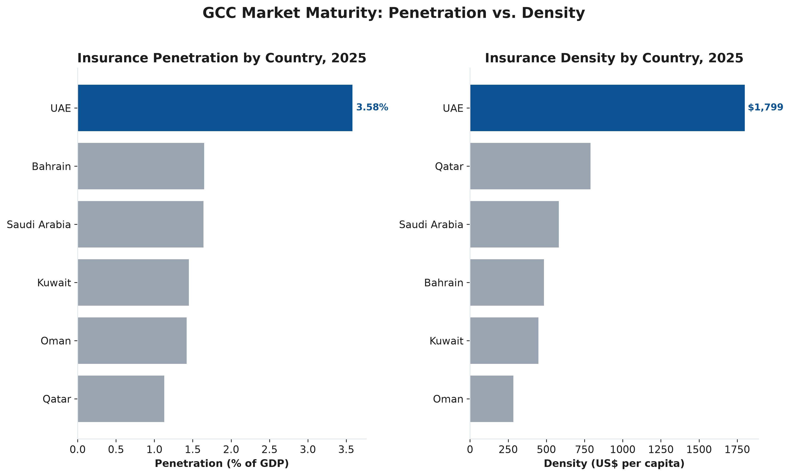
CROSS-GCC COMPARISON
Market Maturity: Penetration vs. Density
KEY FINDING
UAE leads the GCC on both insurance penetration (3.58%) and density ($1,799) — roughly double the next-highest country on each metric, indicating a mature, well-established market.
GCC Insurance Market Analysis
4

Slide 5
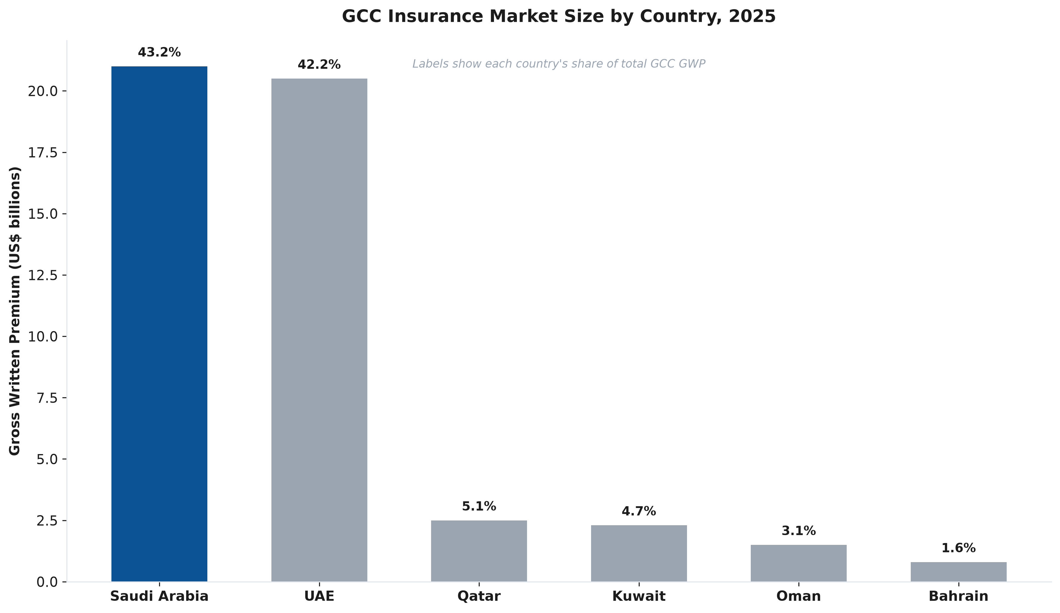
CROSS-GCC COMPARISON
Market Size by Country
KEY FINDING
Saudi Arabia and UAE together account for 85.4% of total GCC insurance premium. Saudi Arabia is the largest single market — a still-developing market with more room to expand than UAE.
GCC Insurance Market Analysis
5

Slide 6
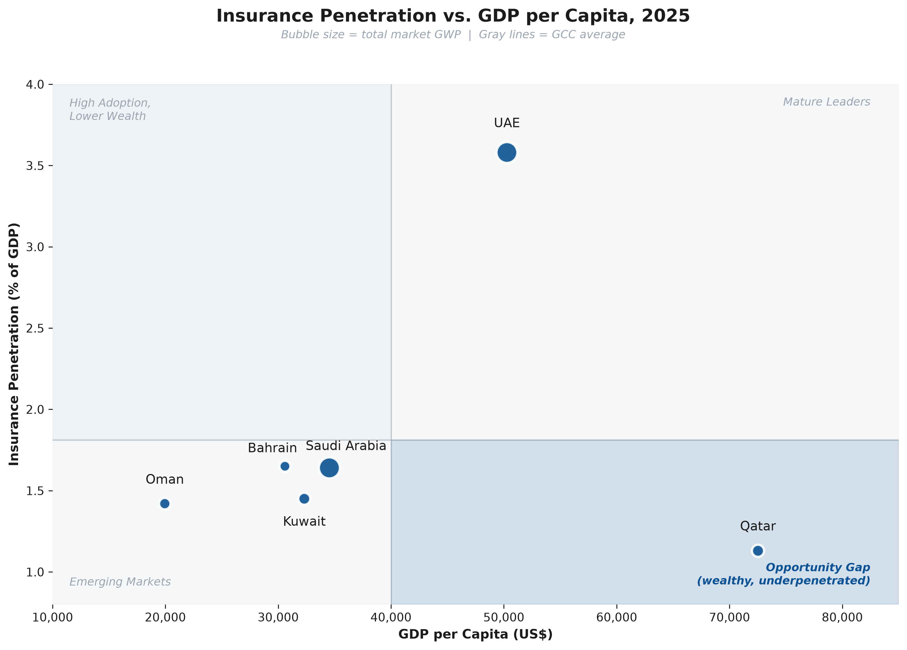
CROSS-GCC COMPARISON
Wealth vs. Insurance Adoption
KEY FINDING
Qatar combines the GCC's highest GDP per capita with its lowest penetration — a wealth/adoption gap likely explained by structural factors (small population, free public healthcare, smaller expat base) rather than an immediately addressable opportunity.
GCC Insurance Market Analysis
6

Slide 7
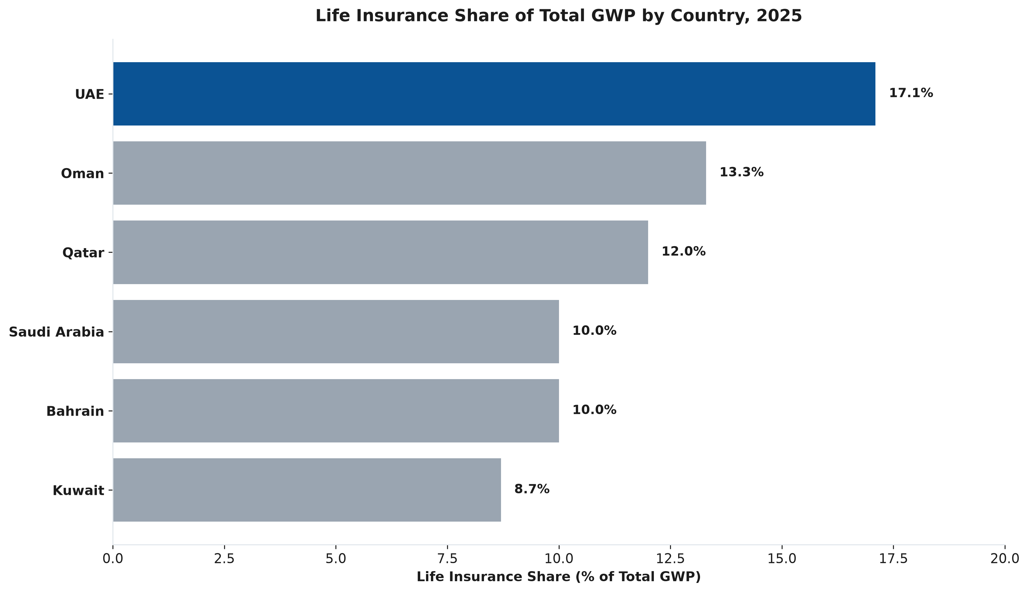
CROSS-GCC COMPARISON
Life Insurance Share by Country
KEY FINDING
UAE has the highest life insurance share of any GCC market on regional data (17.1%), nearly double Kuwait's (8.7%) — though UAE-specific regulator data suggests a lower figure (~11.2%), an unreconciled source discrepancy (see Appendix).
GCC Insurance Market Analysis
7

Slide 8
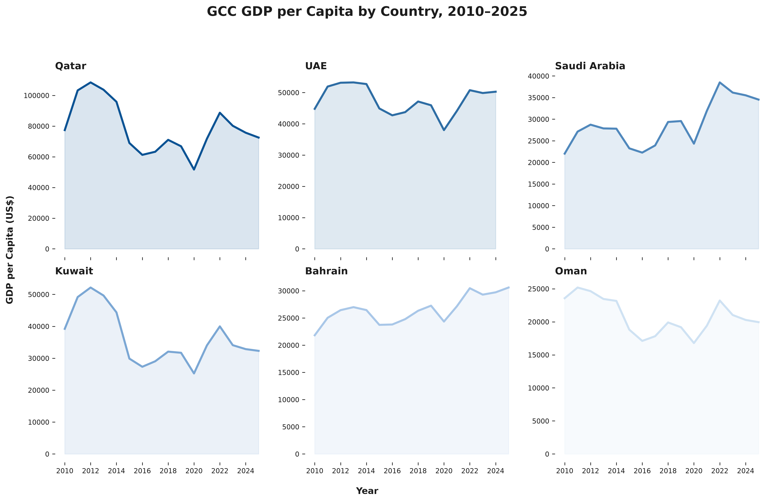
CROSS-GCC COMPARISON
GDP per Capita Trends, 2010–2025
KEY FINDING
Qatar and Kuwait show pronounced boom-bust volatility tied to hydrocarbon cycles. UAE and Saudi Arabia show more stable, gradually recovering paths — UAE's current high penetration sits on a comparatively stable wealth foundation.
GCC Insurance Market Analysis
8

Slide 9
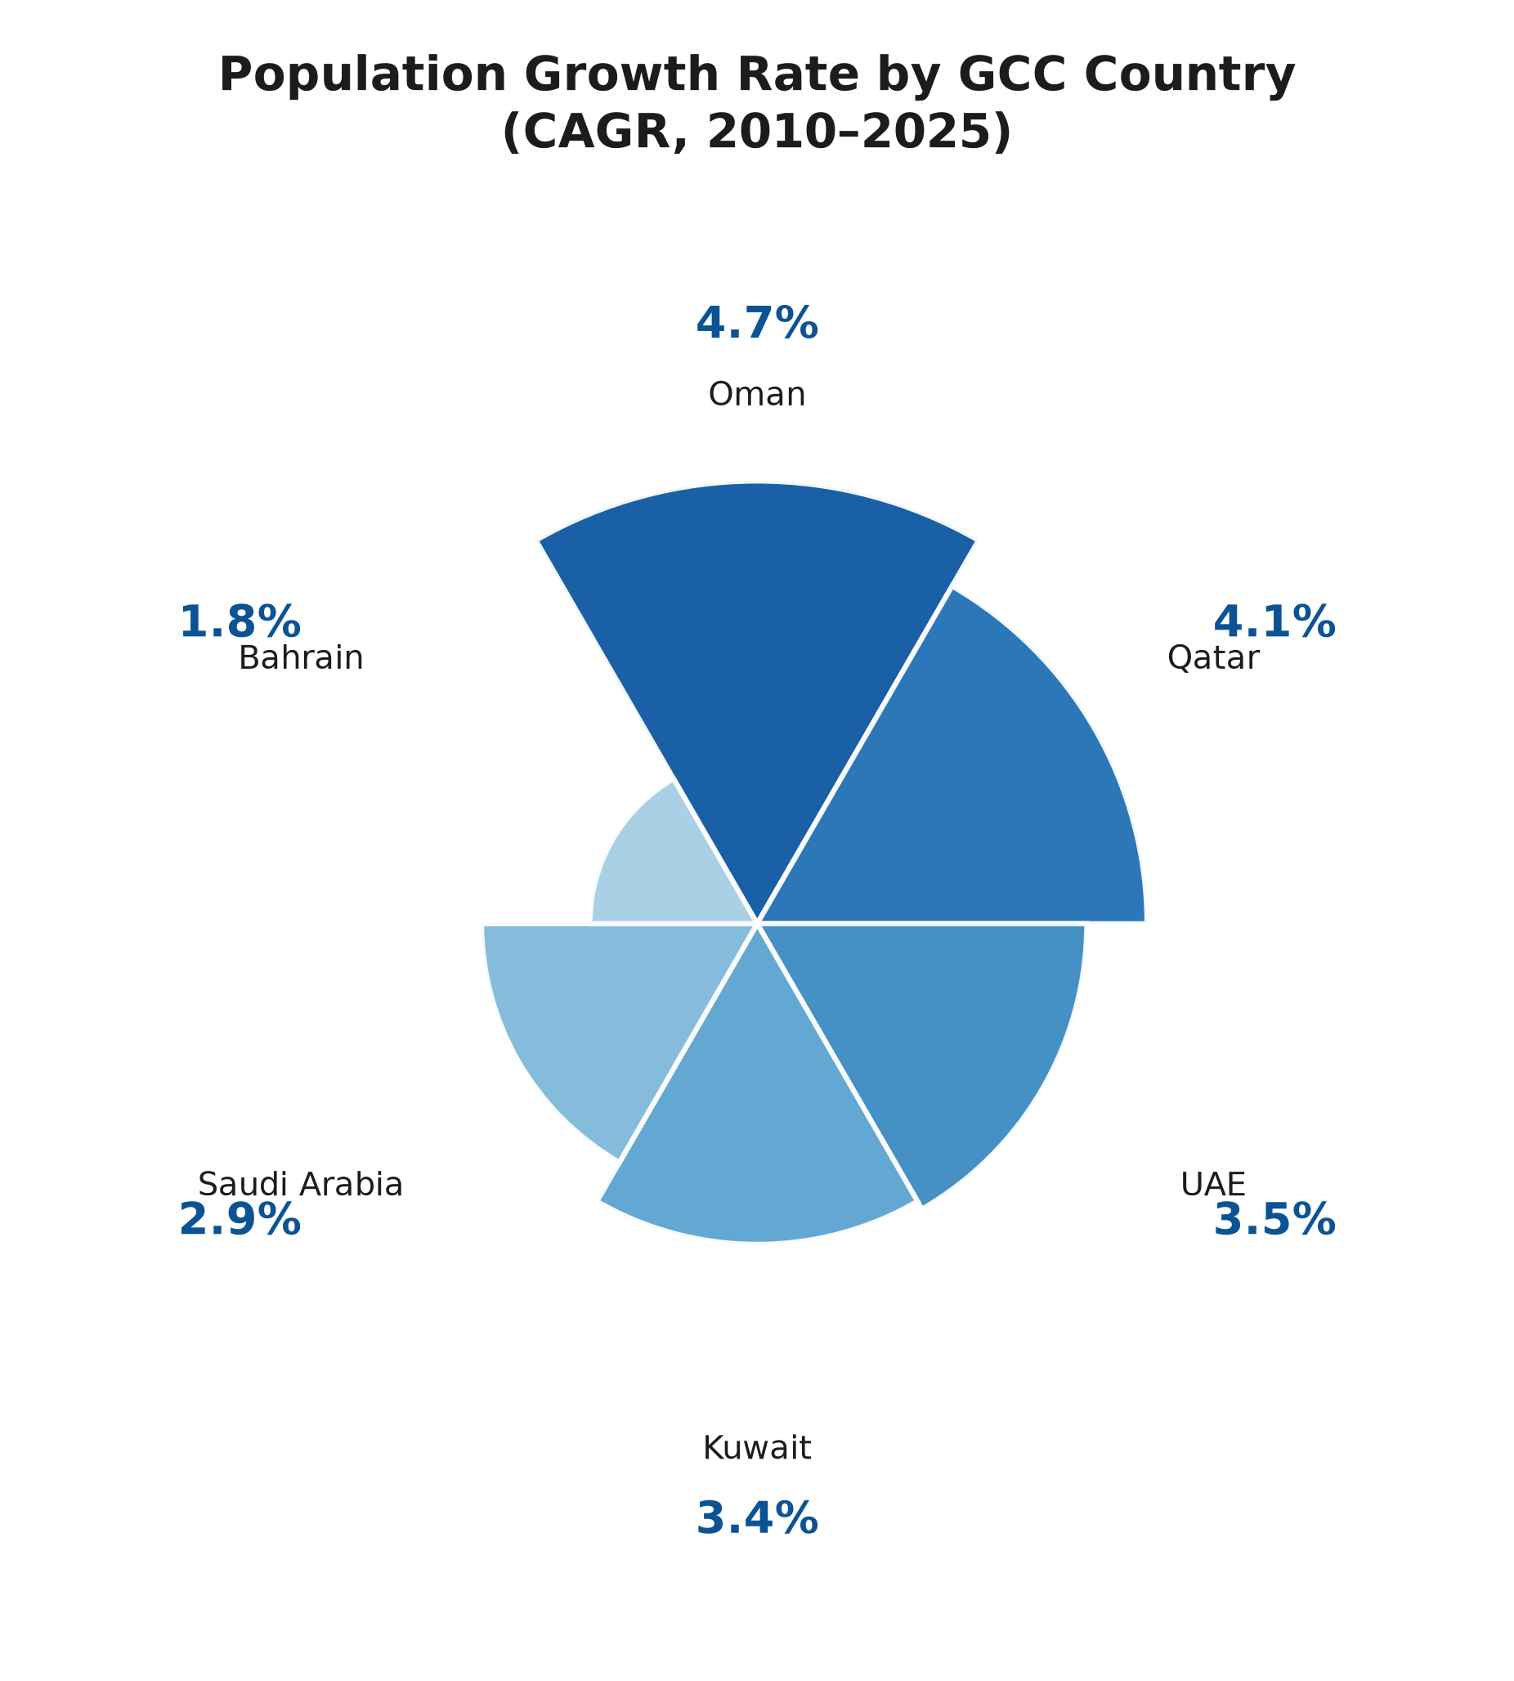
CROSS-GCC COMPARISON
Population Growth Rate, 2010–2025
KEY FINDING
Oman shows the GCC's fastest population growth (4.7% CAGR) despite ranking lowest on wealth and penetration — a growing customer base not yet reflected in current insurance metrics, distinct from Qatar's wealth-adoption gap.
GCC Insurance Market Analysis
9

Slide 10
PART TWO
UAE Deep Dive
What product-line trends should shape UAE entry strategy?

Slide 11
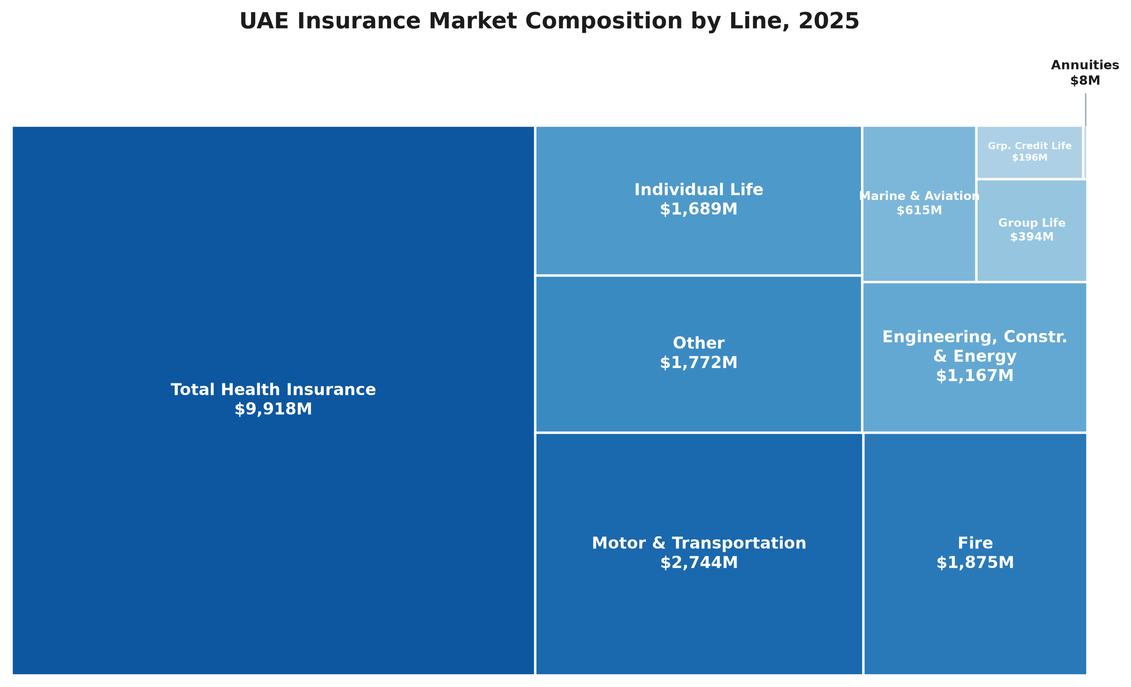
UAE DEEP DIVE
Market Composition by Line, 2025
KEY FINDING
Health insurance alone accounts for $9,918M — nearly half (48.7%) of UAE's total 2025 market. Motor & Transportation ($2,744M) is the second-largest line, ahead of Fire, Other, and Individual Life.
GCC Insurance Market Analysis
11

Slide 12
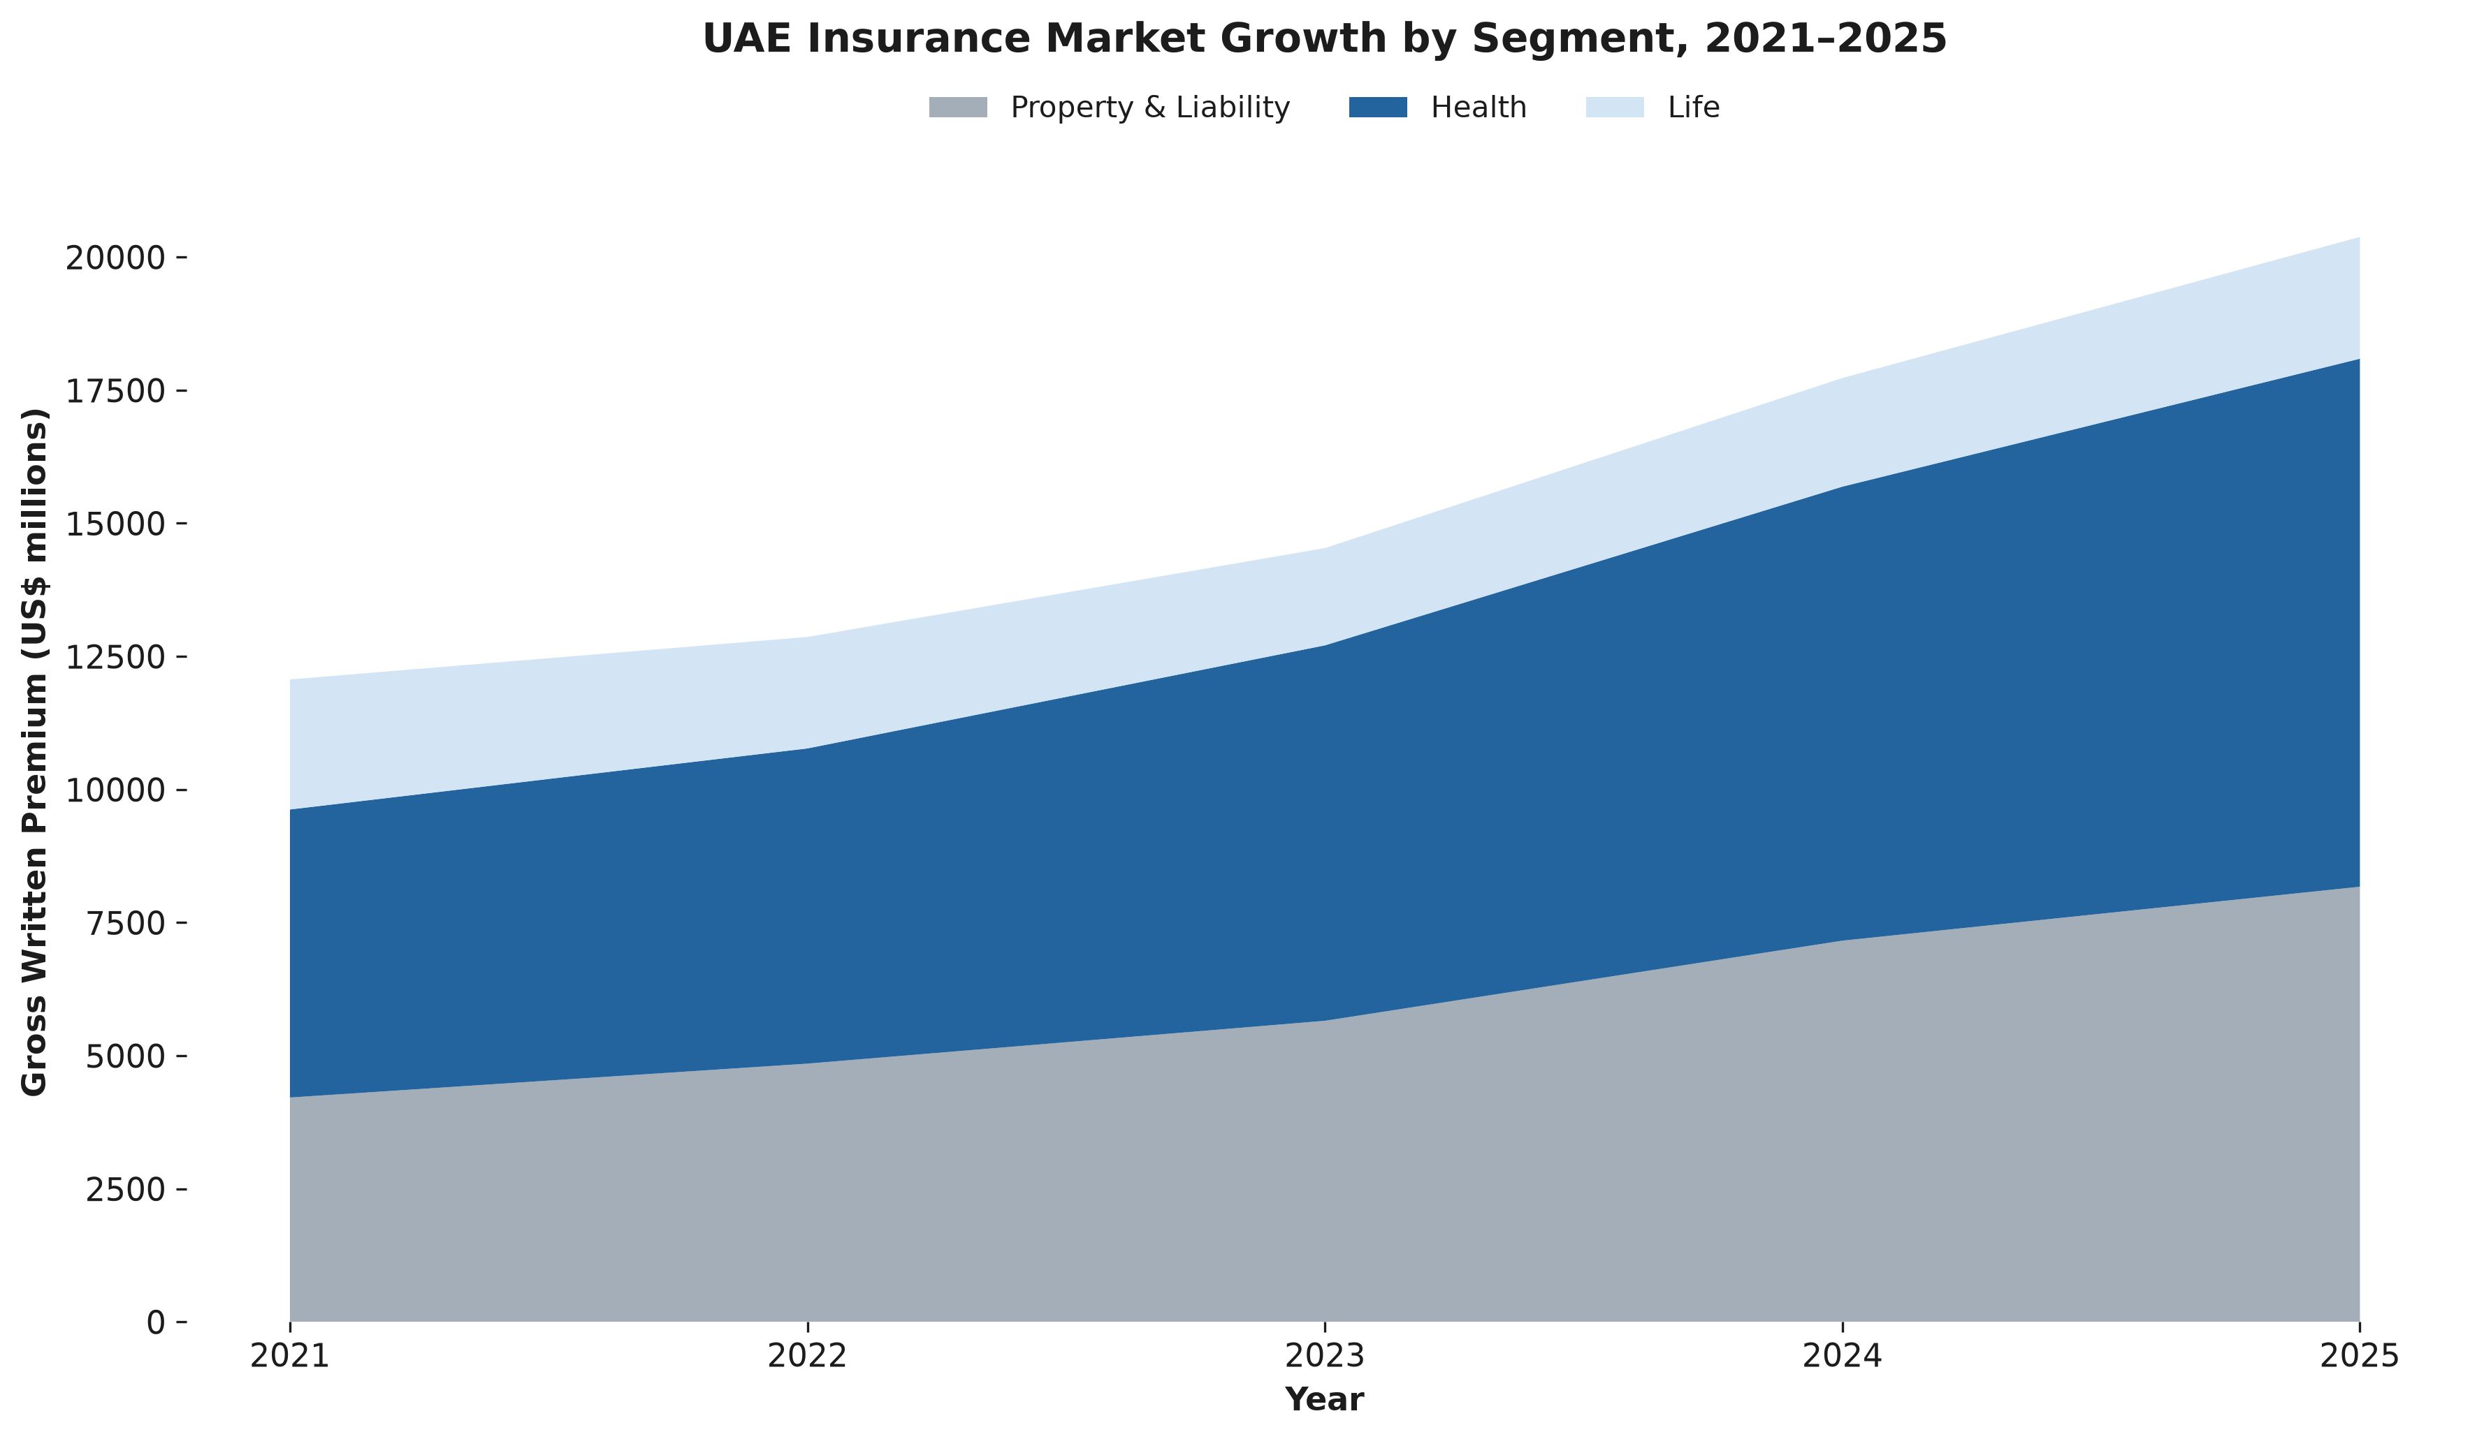
UAE DEEP DIVE
Market Growth by Segment, 2021–2025
KEY FINDING
UAE's total market grew 69% from 2021–2025 ($12.1B → $20.4B). Health insurance is the single largest and fastest-growing segment, now representing nearly half of total GWP.
GCC Insurance Market Analysis
12

Slide 13
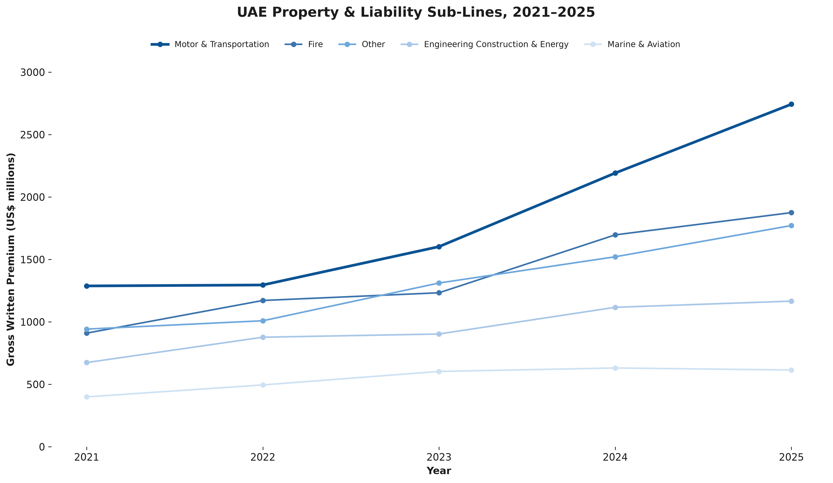
UAE DEEP DIVE
Property & Liability Sub-Lines
KEY FINDING
Motor & Transportation grew 113% over the period — the fastest-growing line by both growth rate and CAGR, and the largest non-life line throughout the period.
GCC Insurance Market Analysis
13

Slide 14
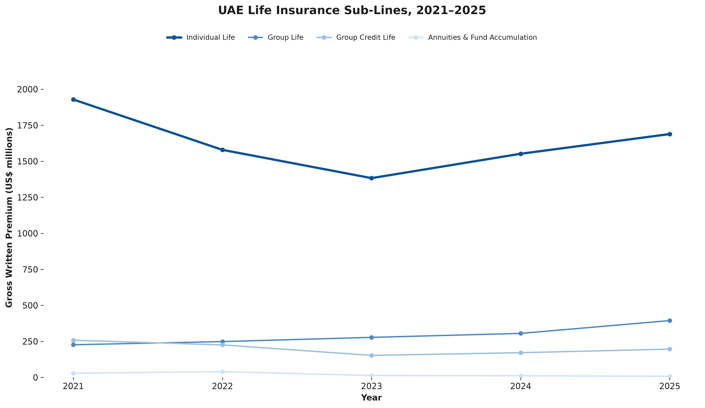
UAE DEEP DIVE
Life Insurance Sub-Lines
KEY FINDING
Individual Life declined 28% from 2021–2023 before recovering. Group Life grew steadily throughout — group products show more resilience than individual/retail life demand.
GCC Insurance Market Analysis
14

Slide 15
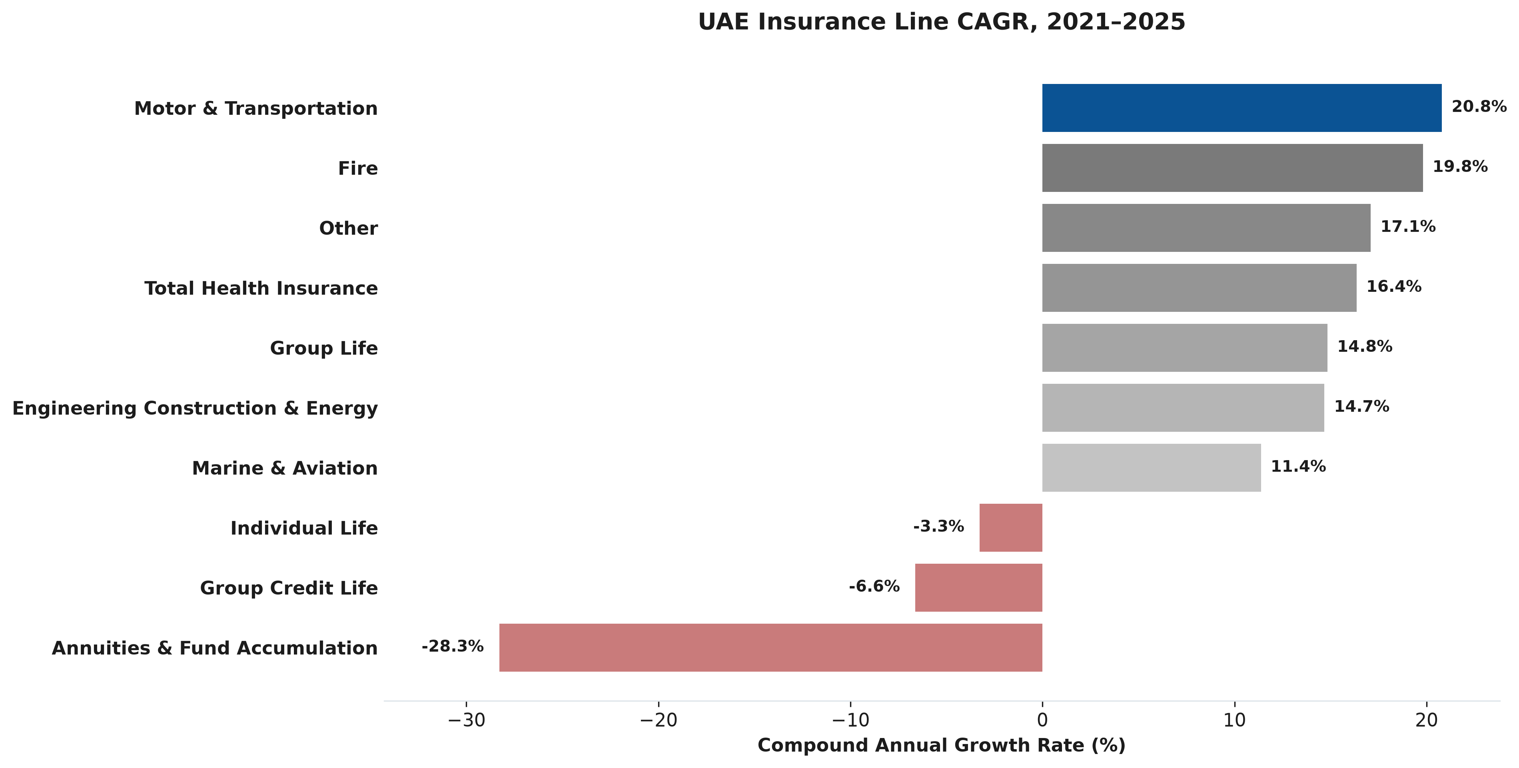
UAE DEEP DIVE
Insurance Line CAGR, 2021–2025
KEY FINDING
Motor confirmed as top performer on both measures: 20.8% CAGR, not just an artifact of a small base. Annuities, Group Credit Life, and Individual Life were the only declining lines.
GCC Insurance Market Analysis
15

Slide 16
SYNTHESIS
Key Findings
CROSS-GCC COMPARISON
UAE DEEP DIVE
UAE leads on penetration (3.58%) and density ($1,799) — roughly double the next country
Saudi Arabia + UAE = 85.4% of total GCC premium
UAE has the most diversified product mix on regional data (17.1% life share; see Appendix)
Qatar: high wealth, low penetration — likely structural, not an accessible gap
Oman: fastest population growth (4.7% CAGR), but weakest on wealth/penetration
Total market grew 69% (2021–2025): $12.1B → $20.4B
Health is the largest segment: $9.9B, 48.7% of total GWP
Motor grew fastest by both growth rate (+113%) and CAGR (20.8%)
Individual Life, Group Credit Life, and Annuities all declined
Group Life grew steadily throughout — more resilient than individual products
GCC Insurance Market Analysis
16

Slide 17
RECOMMENDATION
Prioritize the UAE, Lead with Health & Motor
MARKET
PRODUCT LINES
LIFE STRATEGY
Enter the UAE first — proven scale, highest penetration and density, a more diversified product mix than the rest of the GCC (see Appendix), and a stable (not volatile) wealth trajectory.
Lead with Health and Motor insurance — Health leads by absolute size, Motor leads by growth rate and CAGR, both likely aided by regulatory tailwinds.
Within life insurance, prioritize Group products over individual/retail life, credit life, and annuities — more consistent growth, less disruption sensitivity.
Secondary markets to monitor: Qatar (wealth/adoption gap) and Oman (population growth) — both distinct signals, neither an immediate priority.

Slide 18
APPENDIX
Limitations & Further Exploration
LIMITATIONS
FURTHER EXPLORATION
Cross-GCC comparison relies on a single-year (2025) snapshot for 5 of 6 countries
Qatar's structural explanation is based on industry knowledge, not a cited source
Sub-line detail (motor, health) available only for the UAE
Population CAGR reflects a 15-year average, not current momentum
UAE life insurance share differs by source (17.1% Alpen vs. ~11.2% CBUAE) — not fully reconciled
A comparable line-of-business breakdown for Saudi Arabia
Regulatory calendar research on mandatory health/motor coverage rollout
A dedicated investigation into Qatar's insurance market structure
Tracking Oman's penetration alongside its population growth over time
GCC Insurance Market Analysis
18

