Slide 1
Identifying Patterns of Biodiversity in Indiana Ponds
Joy O’Brien & Erica Nadolski
QB 2023

Slide 2
Presentation Outline
Study system background
Research questions
Hypotheses
Alpha & beta diversity analyses & results
Summary & conclusion

Slide 3
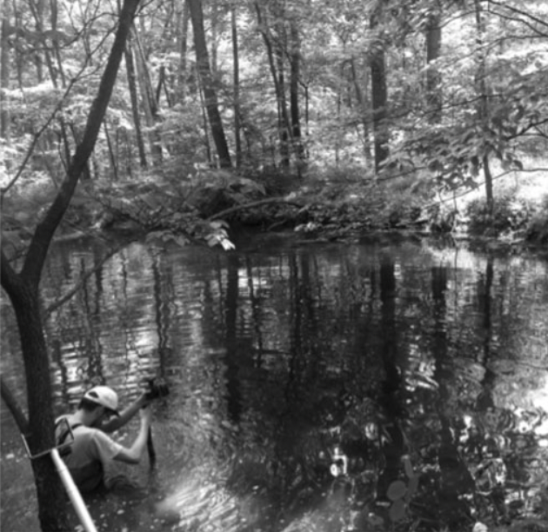
Background
58 ponds
Brown County SP (BCSP)
Yellowwood State Forest (YSF)
Hoosier Natl. Forest (HNF)
Samples include active and total libraries
Environmental & geographic data
Total of ~30,000 OTUs across all ponds
Image: Locey et al., 2020

Slide 4
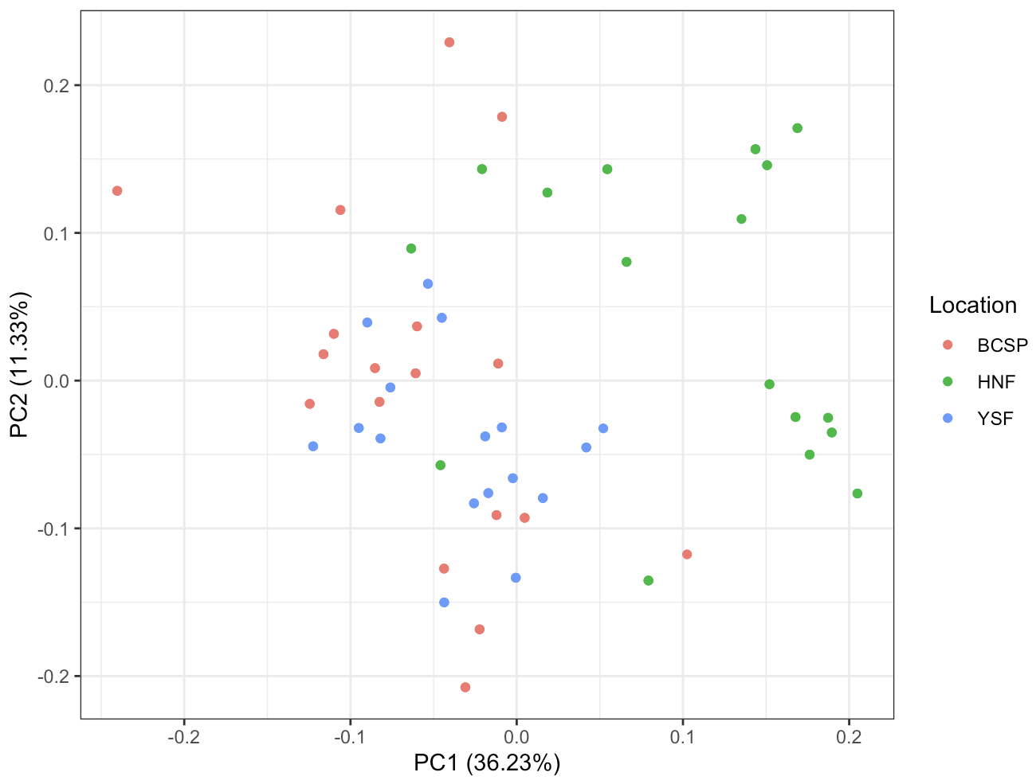
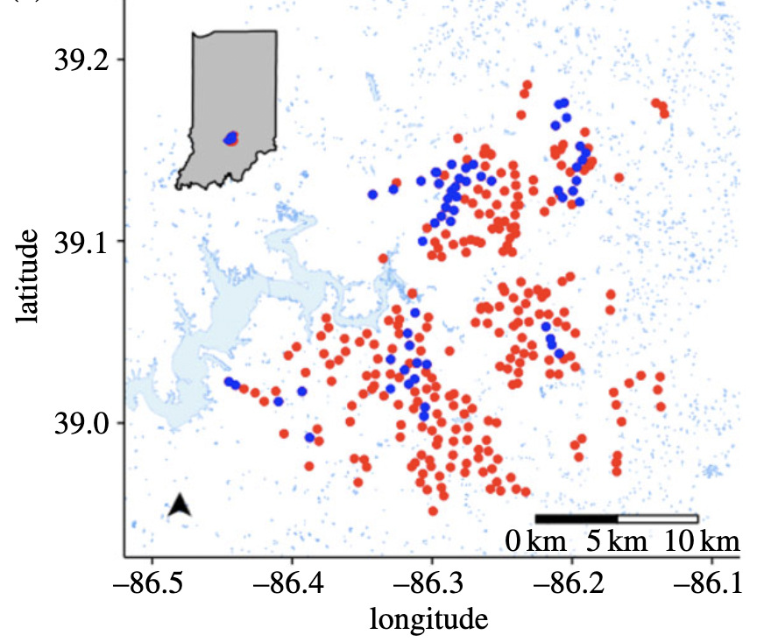
Environmental and Geographic Data
PCA of scaled pond environmental data
Lat.
Long.
Elevation
Diameter
Depth
Canopy
Salinity
pH
Color
Temp
Cal_Volume
chla algal biomass
TP, total phosphorus
ORP, redox potential
DO dissolved oxygen
SpC, specific conductivity
TDS total dissolved solids
DOC, dissolved org. carbon
DON, dissolved org. nitrogen
figure: Locey et al., 2020
Notes:
"lat" "long" "Elevation" "Diameter" "Depth" "Cal_Volume" "ORP" redox potential "Temp" "SpC"specific conductivity "DO" dissolved oxygen "TDS"total dissolved solids "Salinity" "pH" "Color" "chla" algal biomass (chlorophyll quantification) "DOC" dissolved organic carbon "DON"dissolved organic nitrogen "canopy" "TP" total phosphorus

Slide 5
Research questions
Are the microbial communities within ponds similar in their biodiversity across watersheds?
Hypothesis: Microbial community composition will differ among watershed locations.
Are active & total community compositions similar to each other?
Hypothesis: Active and total community composition will be similar due to the storage effect.
Are pond assemblages correlated with environmental variables?
Hypothesis: Bacterial assemblage similarity across ponds is correlated with the similarity of pond environmental variables across ponds.

Slide 6
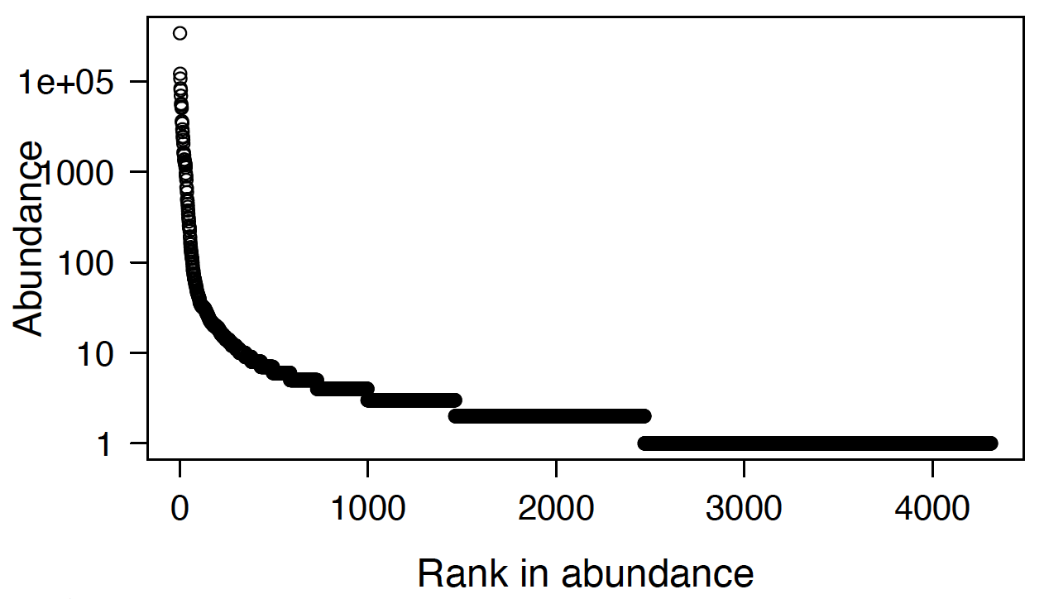
Are microbial communities within ponds similar in biodiversity?
BCSP Pond 001

Slide 7
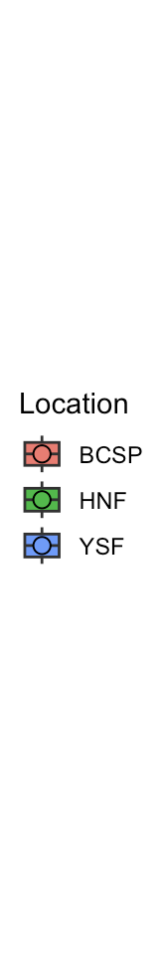
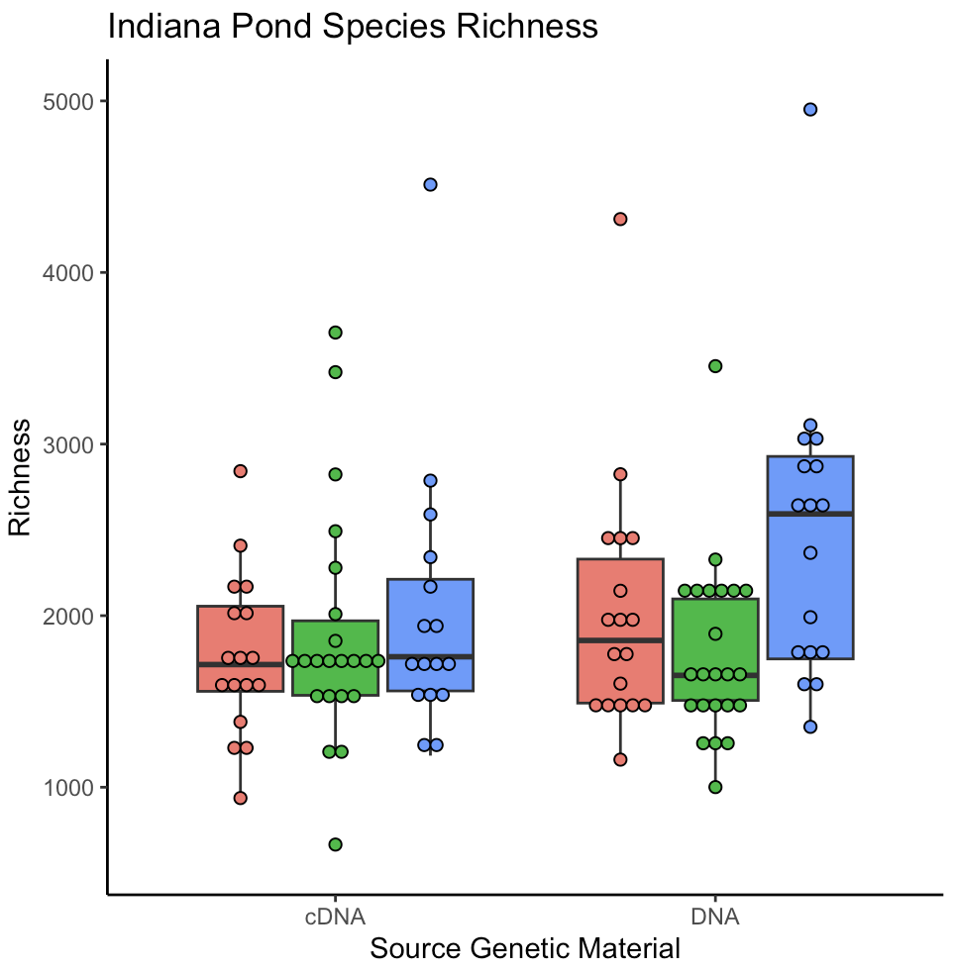
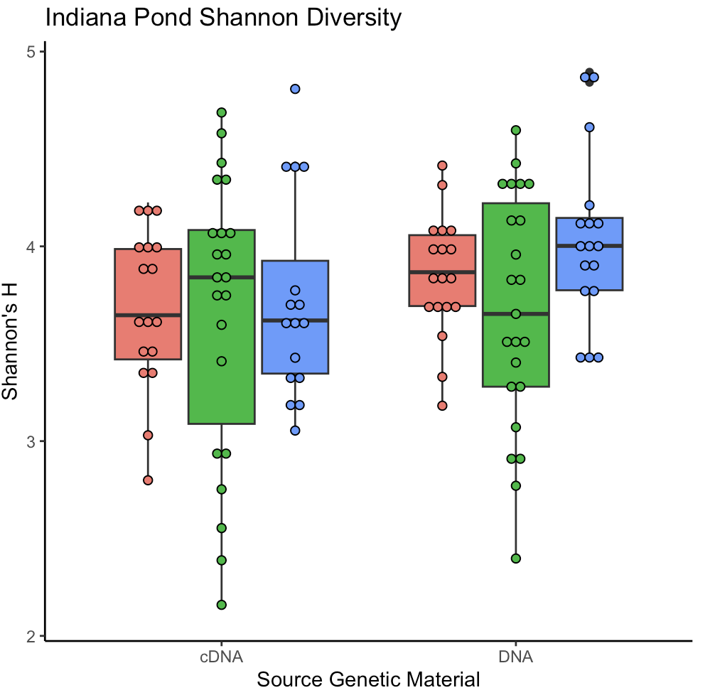
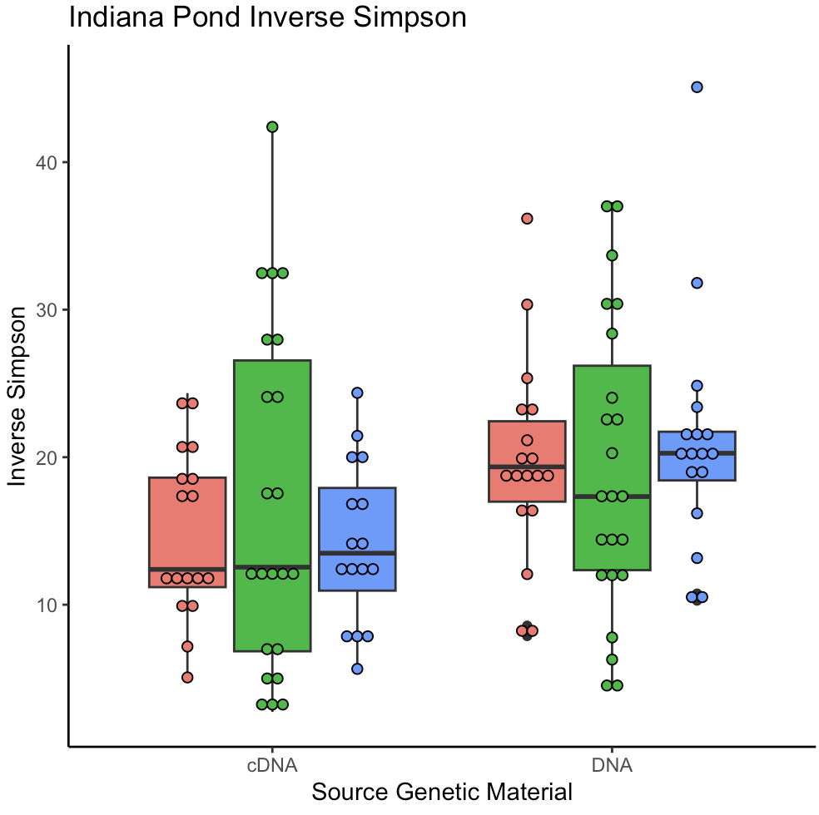
Are microbial communities within ponds similar in biodiversity?
mean | 1975 | 3.758241 | 17.75242

Slide 8
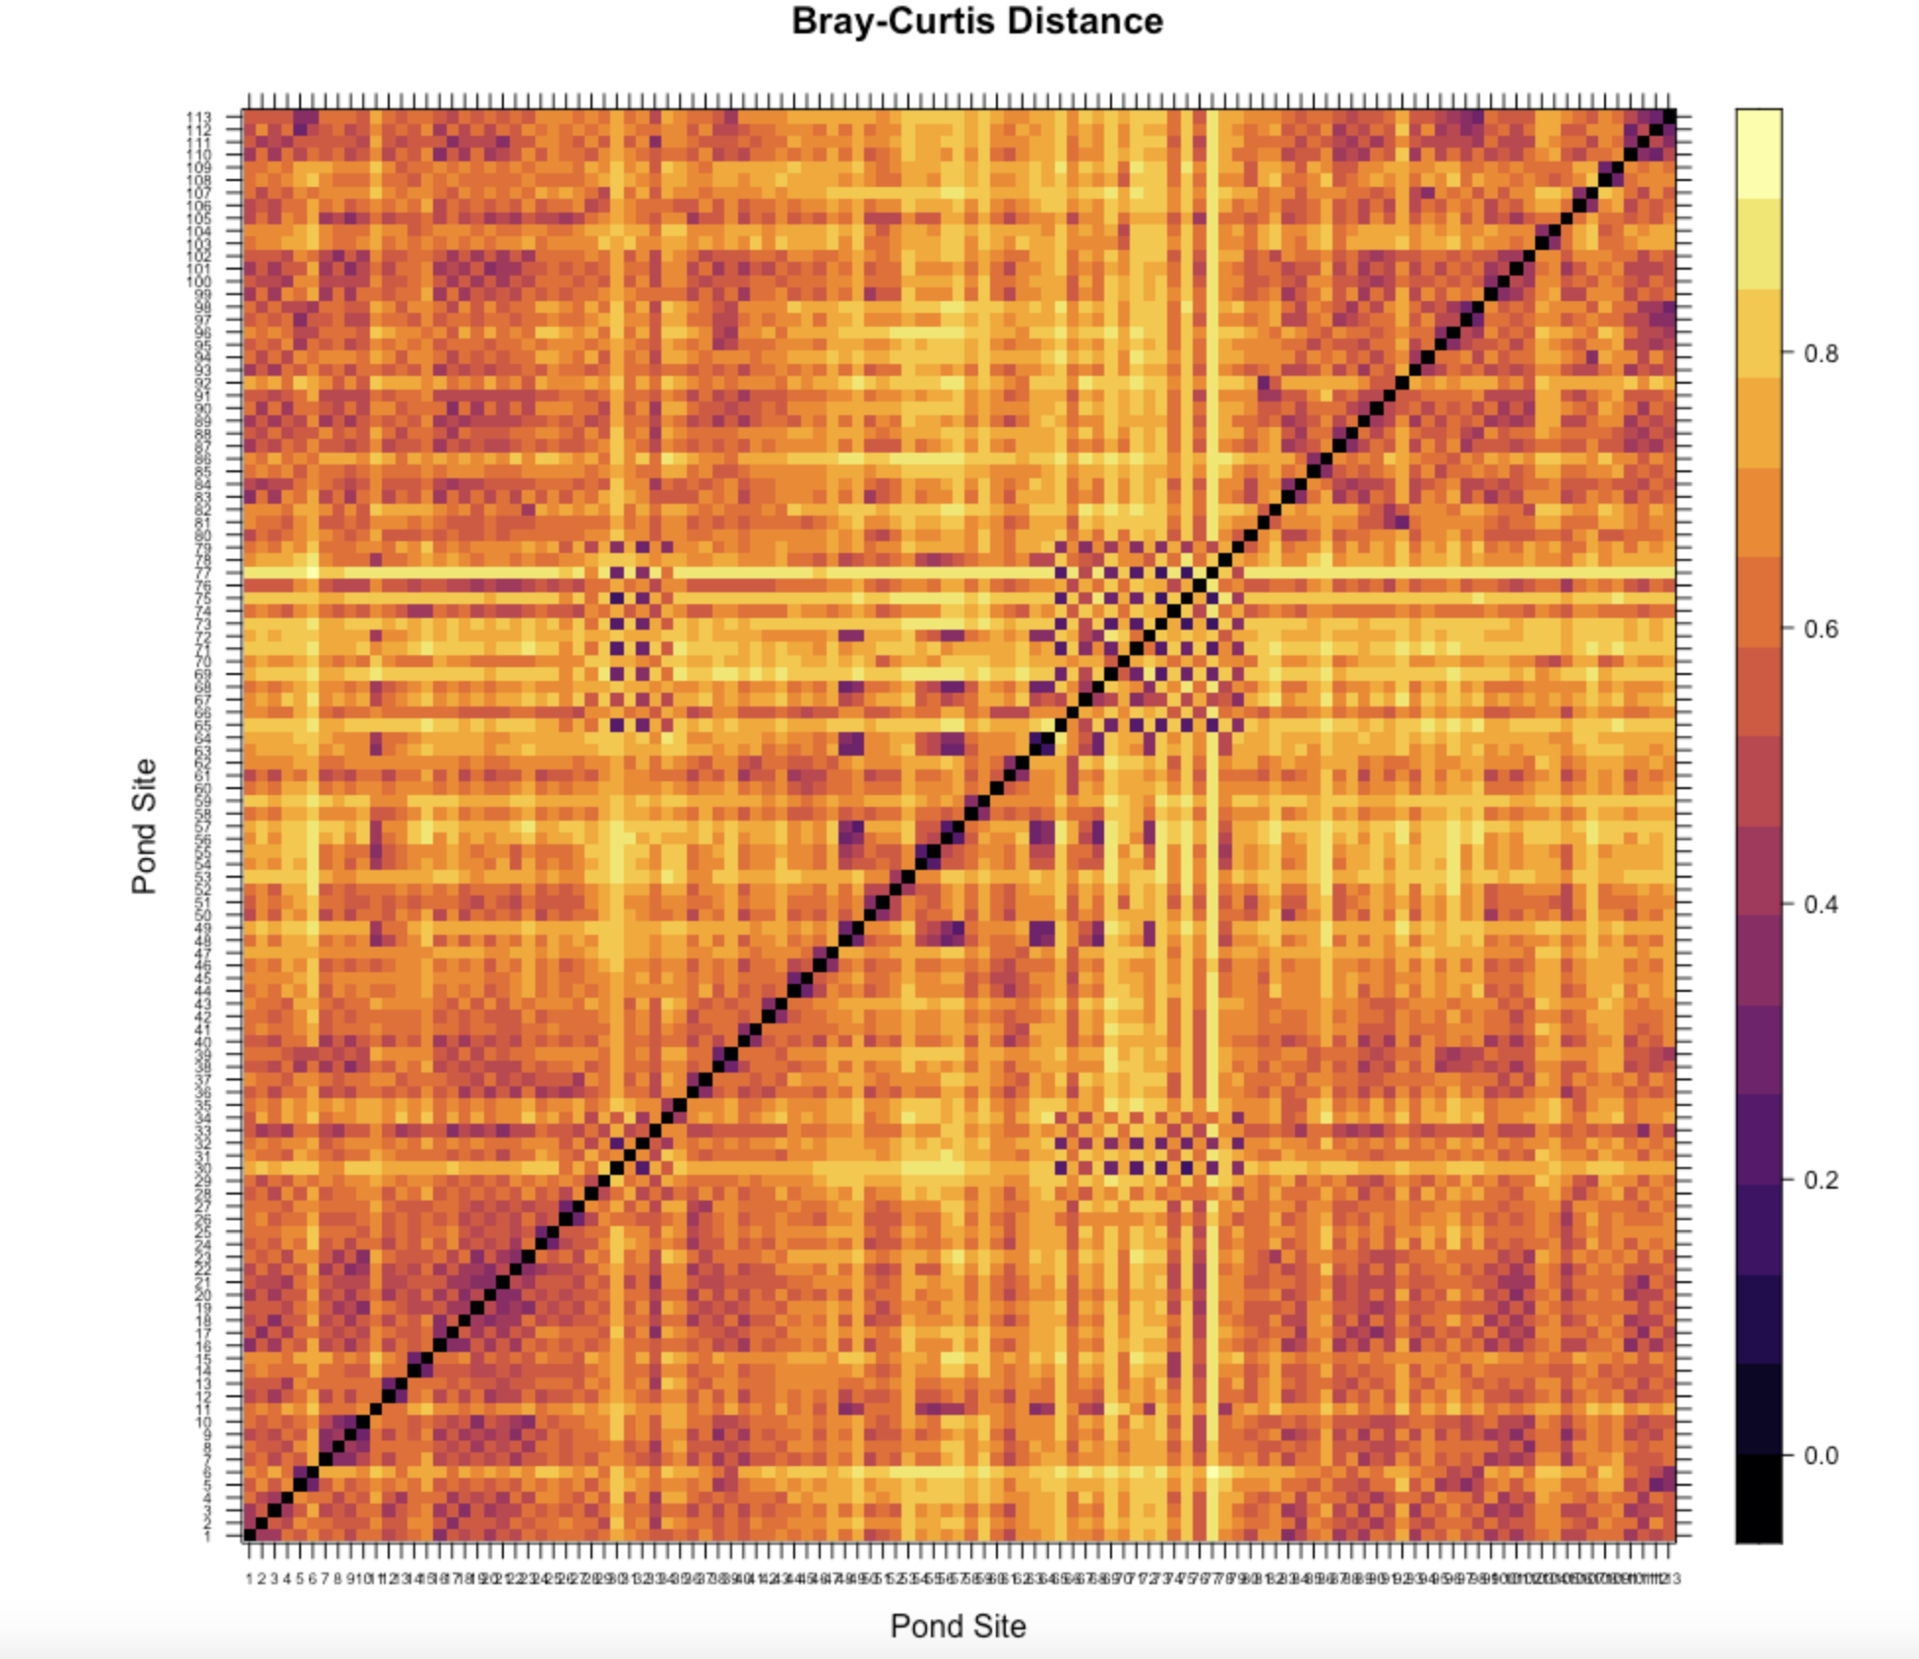
Are microbial communities within ponds similar in biodiversity?
BCSP
HNF
YSF
Notes:
In other words, ponds within each state park will be more similar than ponds between state parks.

Slide 9
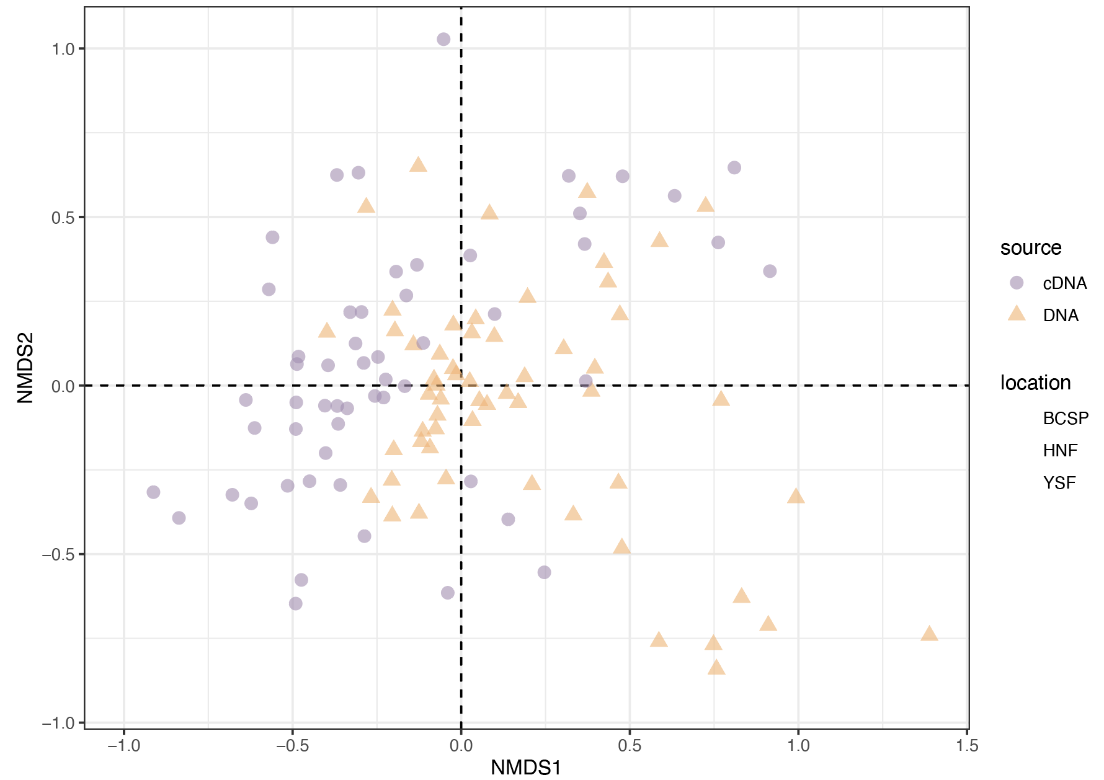
How similar are active and total community composition?

Slide 10
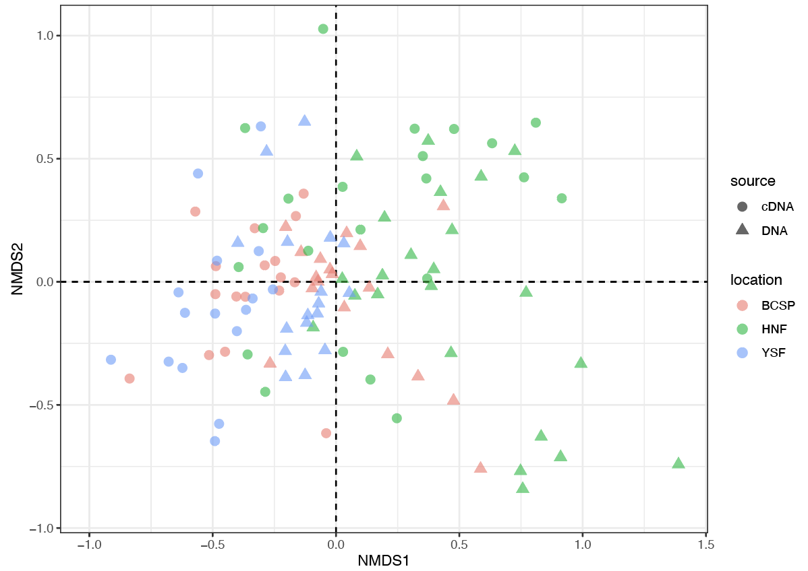
Does watershed location affect pond microbial community diversity?

Slide 11
PERMANOVA
How similar are active and total community composition?
Does watershed location affect pond microbial community diversity?
 | Df | Sum of Sqs | R2 | F | Pr(>F)
Source (active vs. total) | 1 | 1.74 | 0.0685 | 8.988 | 0.001
Location (watershed) | 2 | 2.53 | 0.0999 | 6.547 | 0.001
Residual | 109 | 21.05 | 0.8315
Total | 112 | 25.32 | 1.0000

Slide 12
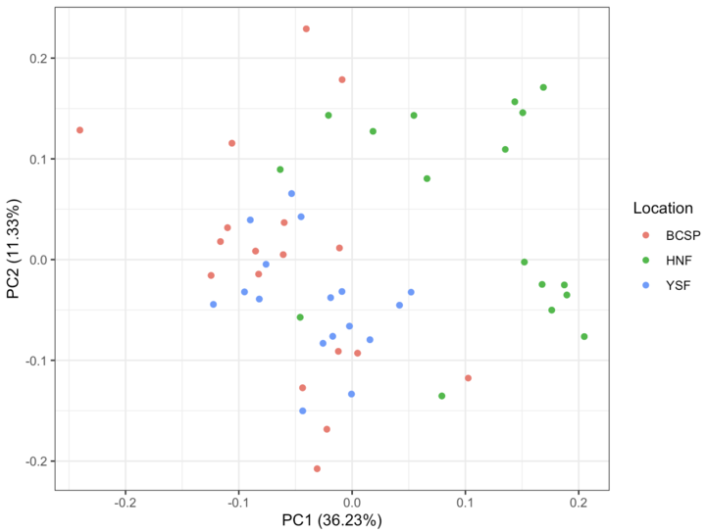
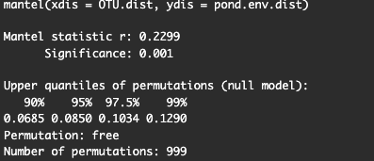
Are pond assemblages correlated with environmental variables?
There is a significant relationship between pond community assemblages similarity and environmental variable similarity

Slide 13
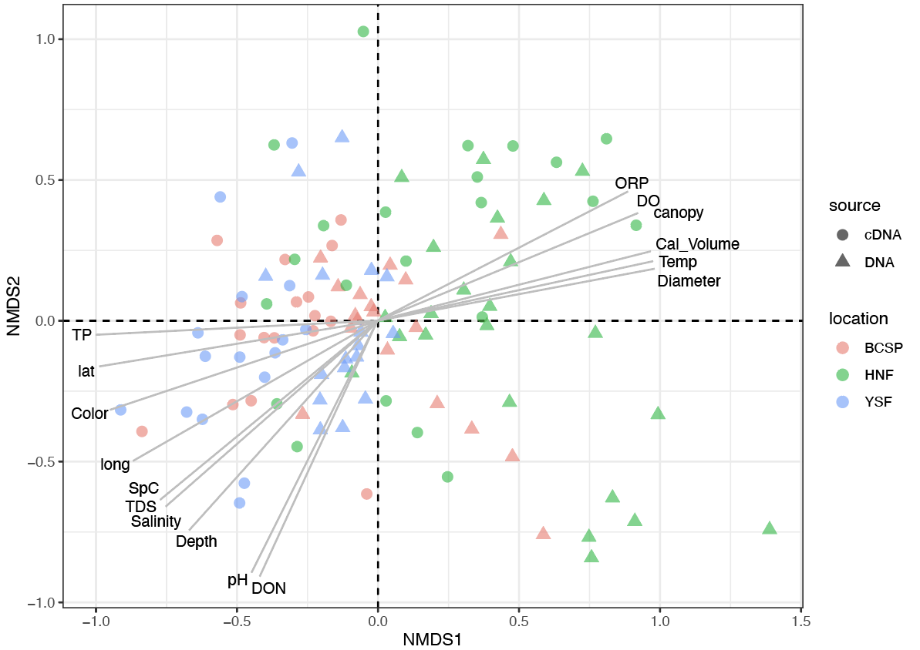
Are pond assemblages correlated with environmental variables?

Slide 14
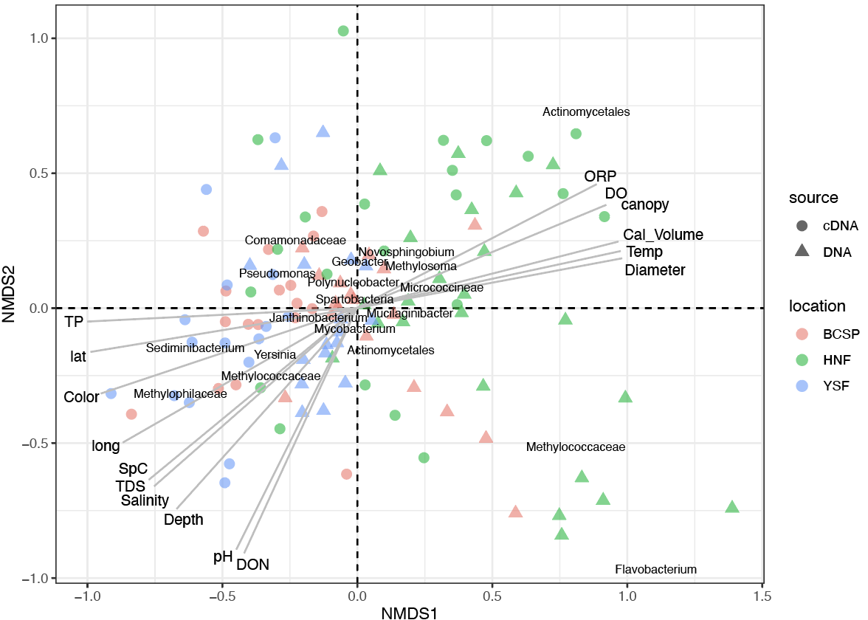
Are there indicator species that correlate with specific signatures of pond microbial community diversity?
Notes:
Trying to come up with correlations between what we know about these taxa and the environmental variables of those ponds,
Actinomycetales is anaerobic??
Sediniminibacterium - correlates with pond color, total dissolved solids

Slide 15
Summary & Concluding Points
Hypothesis 1: Microbial community composition will differ among watershed location.
Alpha and beta diversity differ between active and total bacterial communities.
Diversity is significantly affected by pond watershed location (p-value = 0.001).
HNF: Actinomycetales, Methylococcaceae & Flavobacterium
BCSP: Pseudomonas, Spartobacteria
YSF: Sediminibacterium, Mycobacterium

Slide 16
Summary & Concluding Points
Hypothesis 2: Active and total community composition will be similar.
Variation in Shannon & Simpson diversity metrics and distinct clustering in ordination in NMDS
Permanova indicated they are significantly different!
This could be due to dormancy or turnover

Slide 17
Summary & Concluding Points
Hypothesis 3: Bacterial assemblage similarity across ponds is correlated with similarity of pond environmental variables.
Supported (Mantel = 0.2299, p-value = 0.001)
HNF microbial communities are correlated with ORP, DO, and temp while YSF and BCSP are correlated with salinity, depth, and pH (among others)
Future research
Compare the phylogenetic diversity of active and total communities
Test for an interaction effect between genetic material and watershed

Slide 18
References
Locey, K. J., Muscarella, M. E., Larsen, M. L., Bray, S. R., Jones, S. E., & Lennon, J. T. (2020). Dormancy dampens the microbial distance-decay relationship. Philosophical transactions of the Royal Society of London. Series B, Biological sciences, 375(1798), 20190243. https://doi.org/10.1098/rstb.2019.0243

