Slide 1

Python Hackathon
Thiago Mosqueiro
Renaud Dessalles
Simon Mitchell

Slide 2
Our goal for today
Use this time to code together and exchange ideas and experiences among the participants
Learn more about how Python is used in real-life projects applied to bio-related fields
Collectively solve a set of projects of interest to the QCBio community
Collaboratory fellows will be available to help during the development of the projects

Slide 3
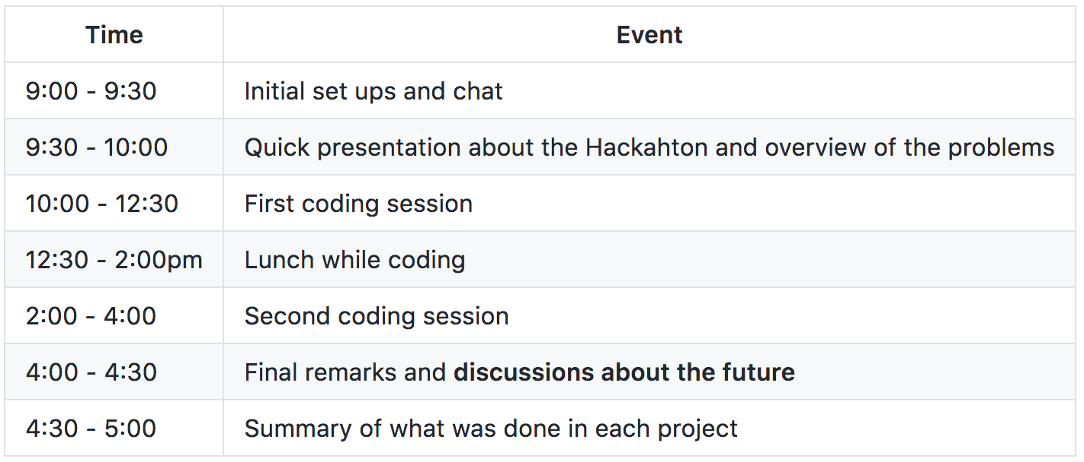
Schedule for today

Slide 4
Schedule for today

Slide 5
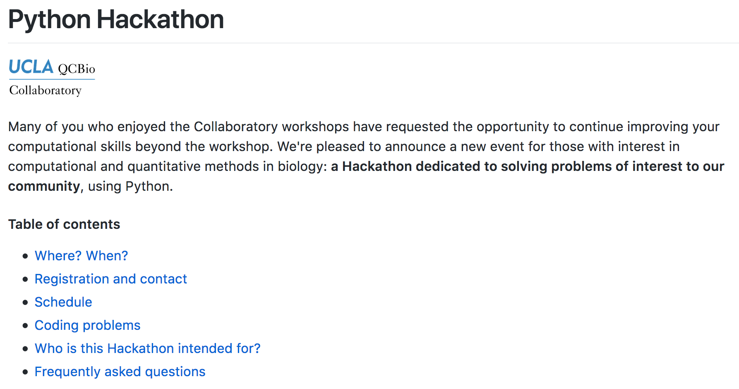
The material is currently available on
https://github.com/thmosqueiro/UCLA-Collaboratory_Hackathon/
or https://goo.gl/c4LtW6

Slide 6
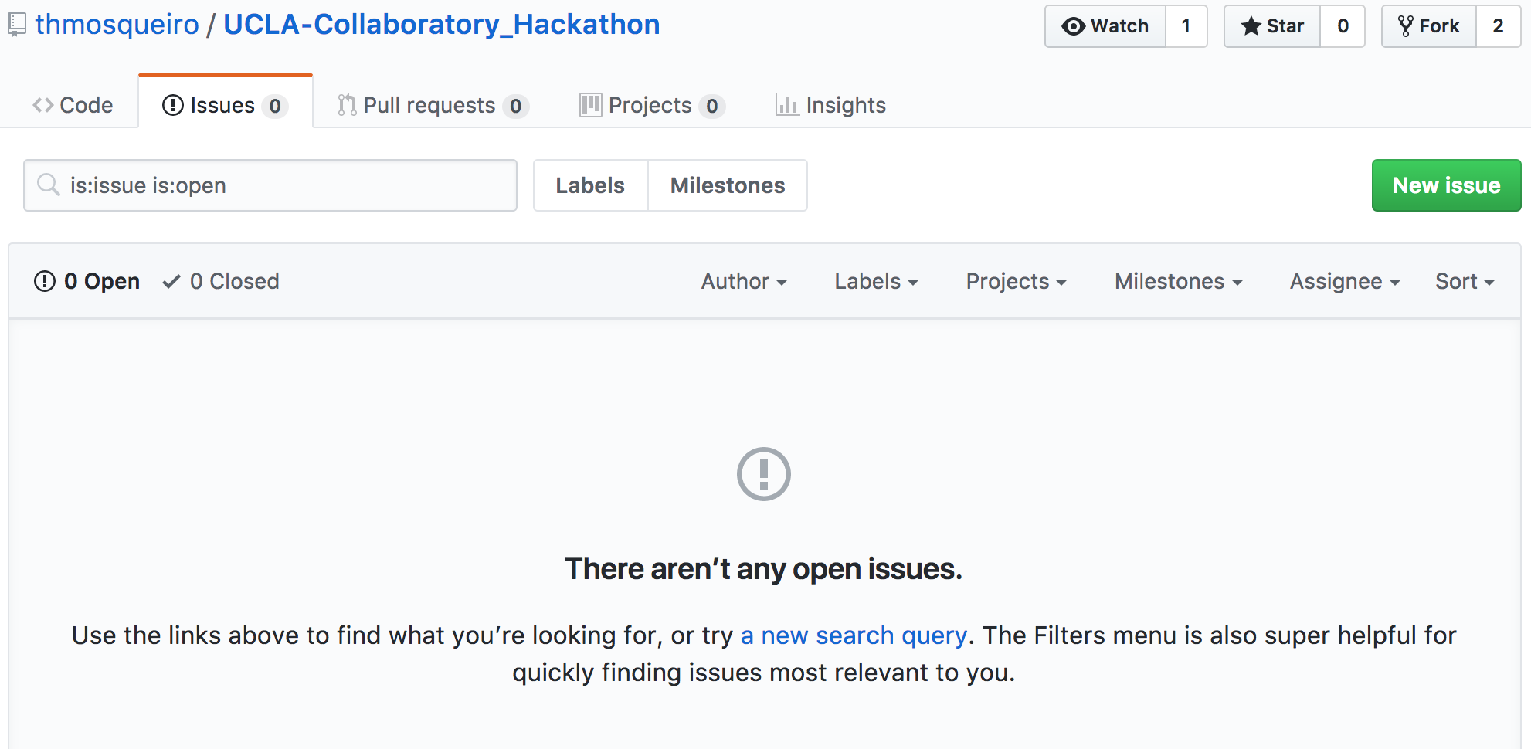
If you have some material you want to share with everyone else, use the Issues page on the GitHub.

Slide 7
Projects

Slide 8
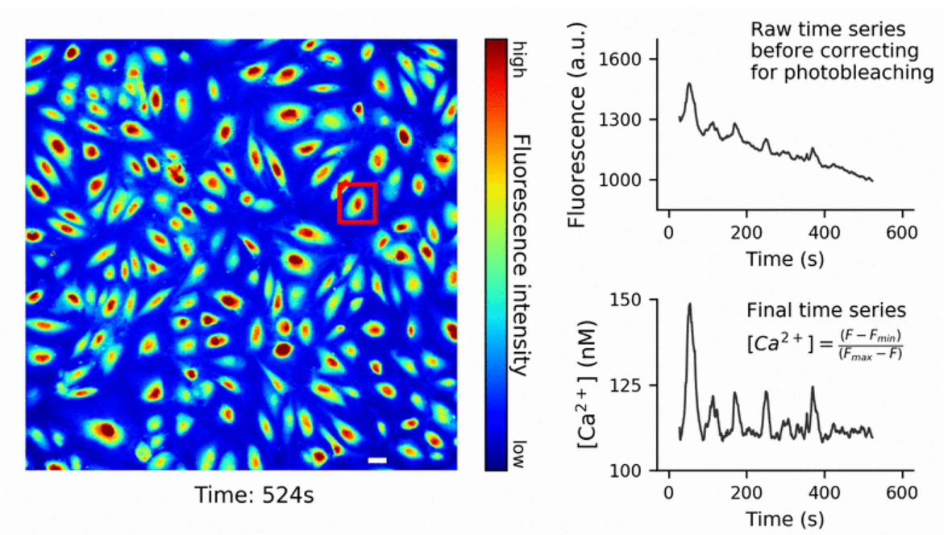
1- Analysis of calcium imaging
Goal: A Jupyter notebook that summarizes how we extracted calcium time series
Technical Challenges:
Handling images and videos with python
Dealing with photobleaching and estimating calcium concentration
Applying regression on a set of time series
Extracting statistics based on a set of cells
Dataset:
We will use a dataset used in a recent publication by Julia Mack @ Arispe Lab

Slide 9
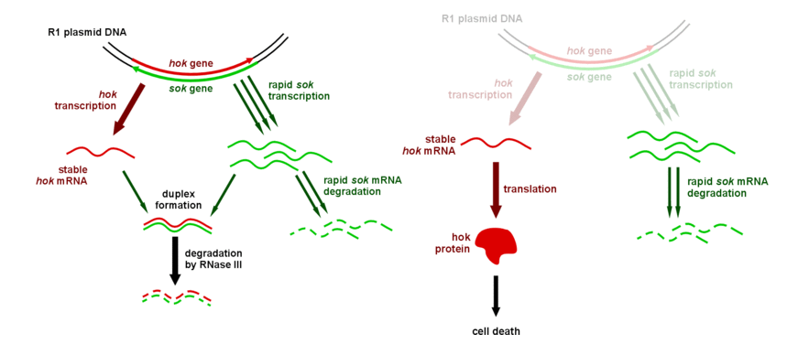
2- Gene expression with Gillespie algorithm
Goal: Using the Hok/Sok system as an example, we will explore the Gillespie algorithm
Technical Challenges:
Create a model that represents a real biological system.
Learn how to implement the Gillespie algorithm
Determine the parameters for the simulation

Slide 10
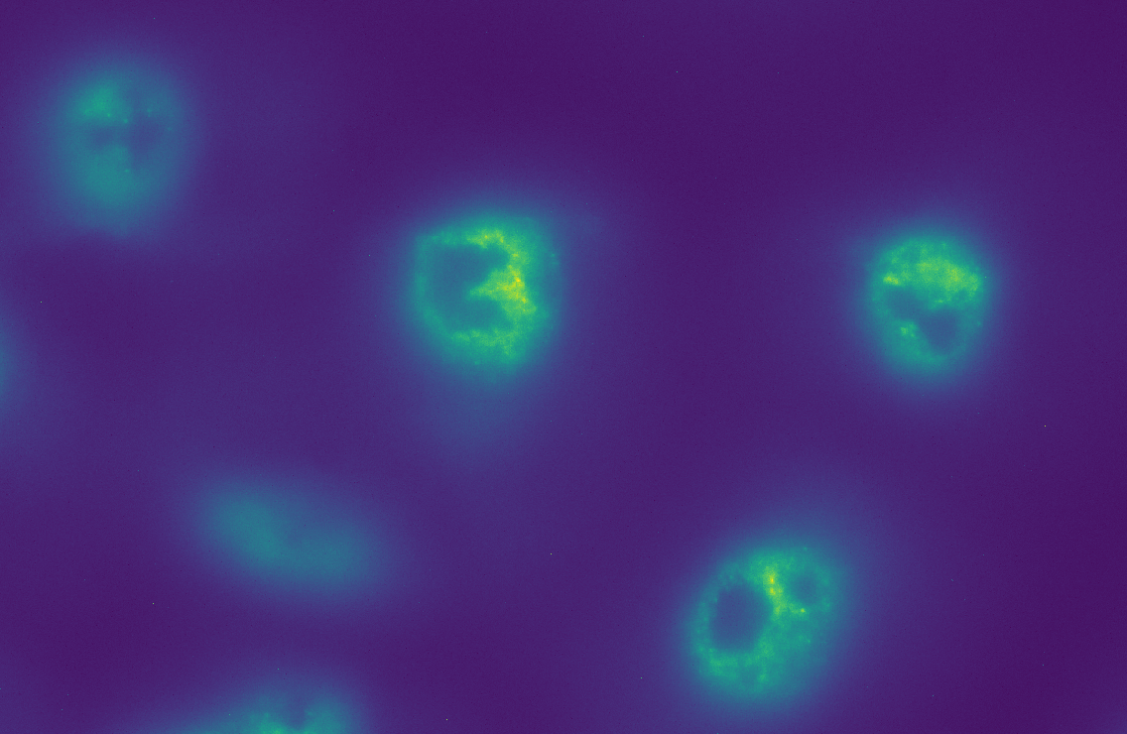
3- Automation of pipeline
Goal: Automate a pipeline for image processing using efficient use of parallel resources and memory management.
Technical Challenges:
Basics of parallel processing in Python
Automating the analysis of batches of large images
Good practices for a memory efficient implementation of parallel processing in Python
Dataset:
We will use a dataset currently being developed by Rob Foreman @ Wollman Lab

Slide 11
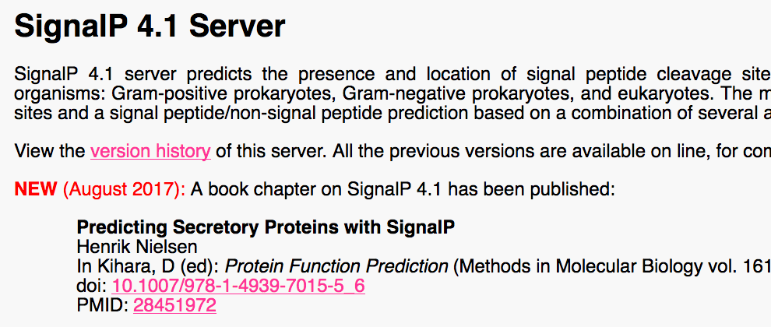
4- Automated job submissions
Goal: Write a script that prepares and sends sequences to SignalP server, an online service that predicts cleavage sites of signal peptides.
Technical Challenges:
Automating genomics analyses based on online applications
Dealing with a bottleneck when analyzing a large dataset
Learning how to construct web crawlers
Dataset:
Chlamydomonas reinhardtii's
proteome, availablne on the Genome Portal hosted by the Joint Genome Institute

Slide 12
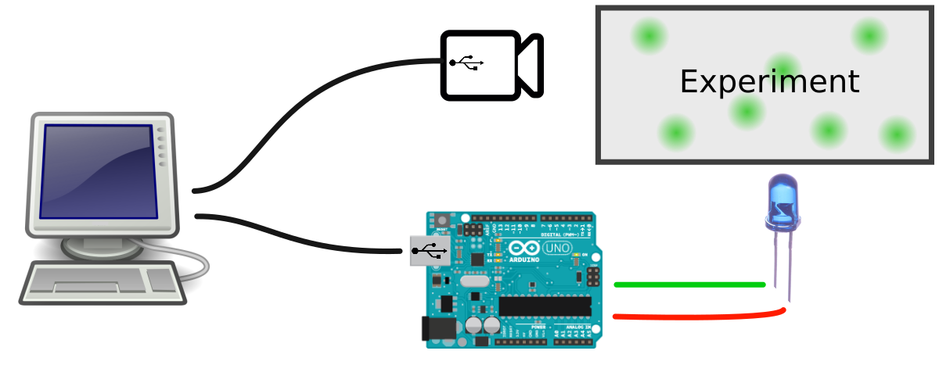
5- Integrating camera and arduino
Goal: Construct an acquisition system that integrates a camera with an LED array controled by an arduino.
Technical Challenges:
Use Python to synchronize an LED array and a camera
Writing very simple code for arduino
Control a camera from Python
Dataset:
We will use the camera and arduino to capture data during the Hackathon

Slide 13
Let’s get started!

