Slide 1
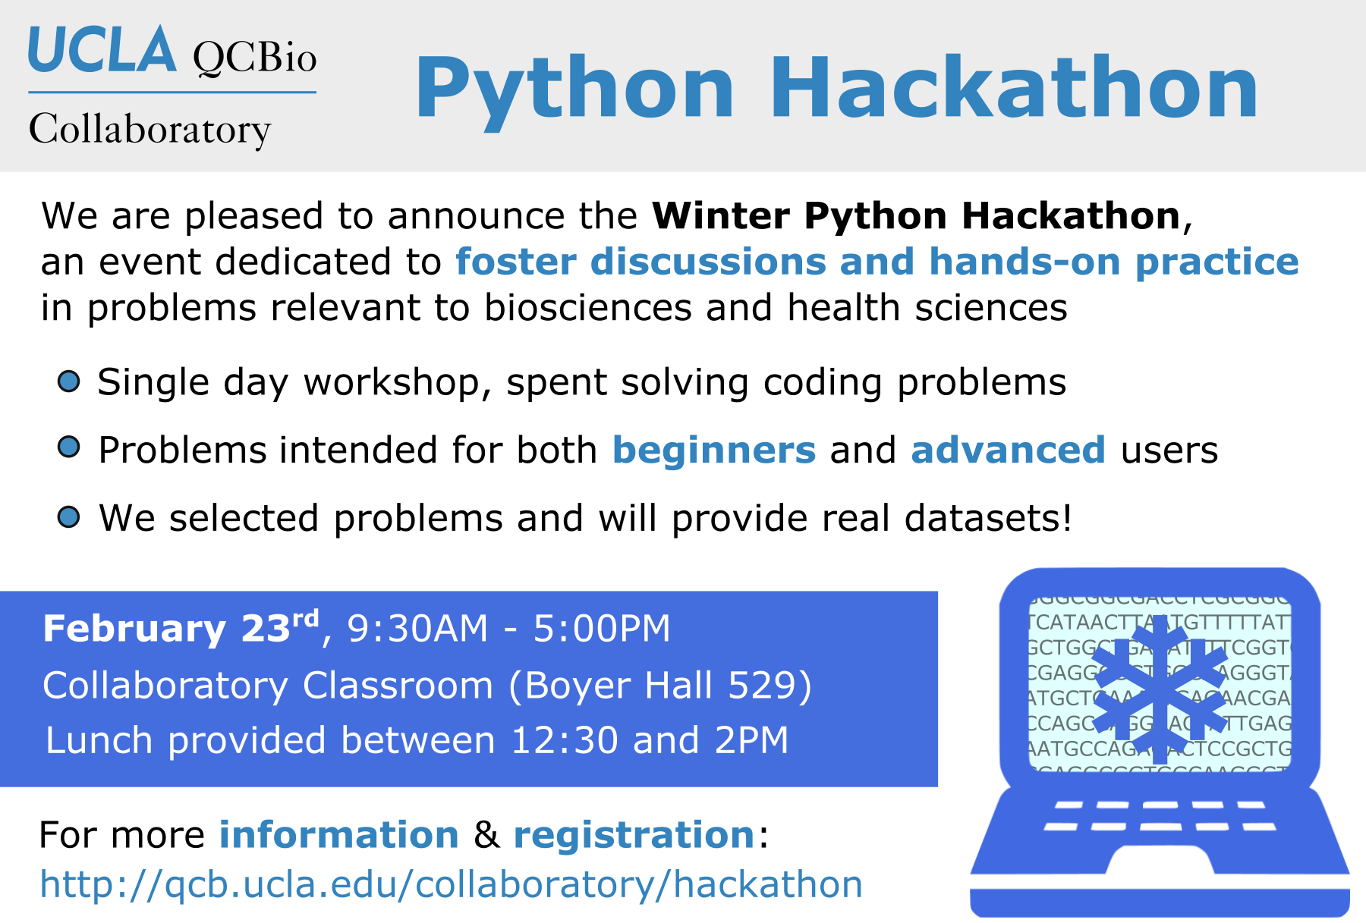

Slide 2

Our goal for today
Use this time to code together and exchange ideas and experiences among the participants
Learn more about how Python is used in real-life projects applied to bio-related fields
Collaboratory fellows will be available to help during the development of the projects

Slide 3
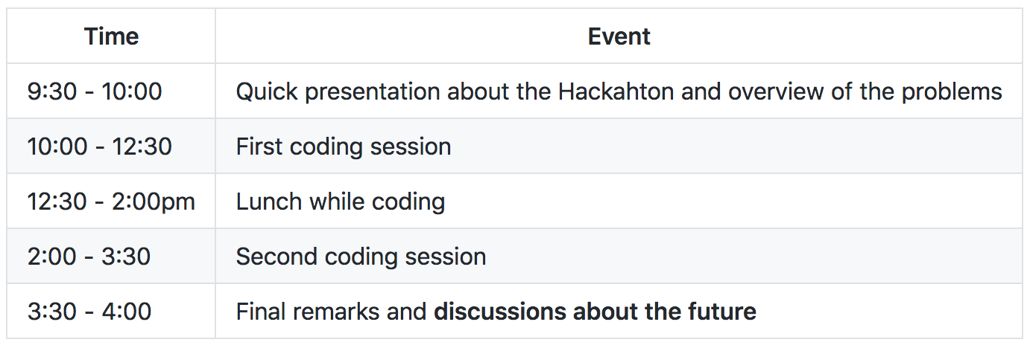
Schedule for today

Slide 4
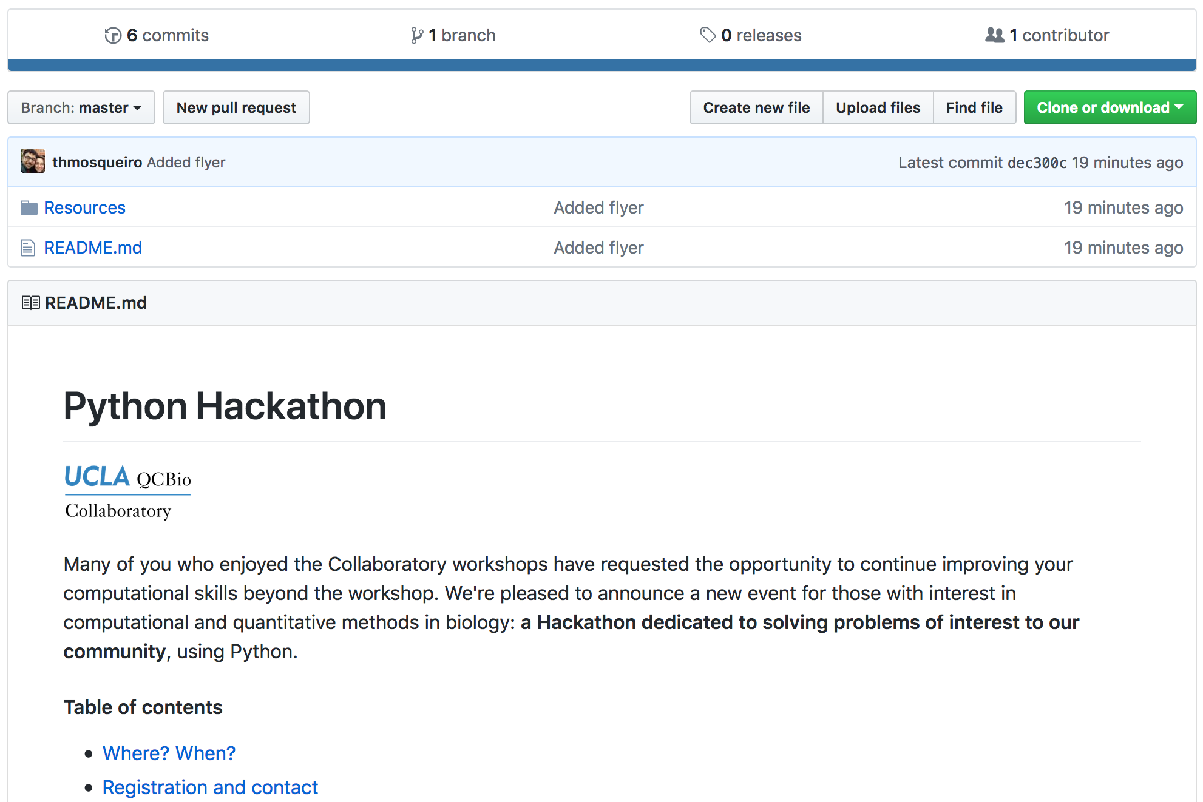
The material is currently available on
http://github.com/QCB-Collaboratory/Python-Hackathon-Winter2018

Slide 5
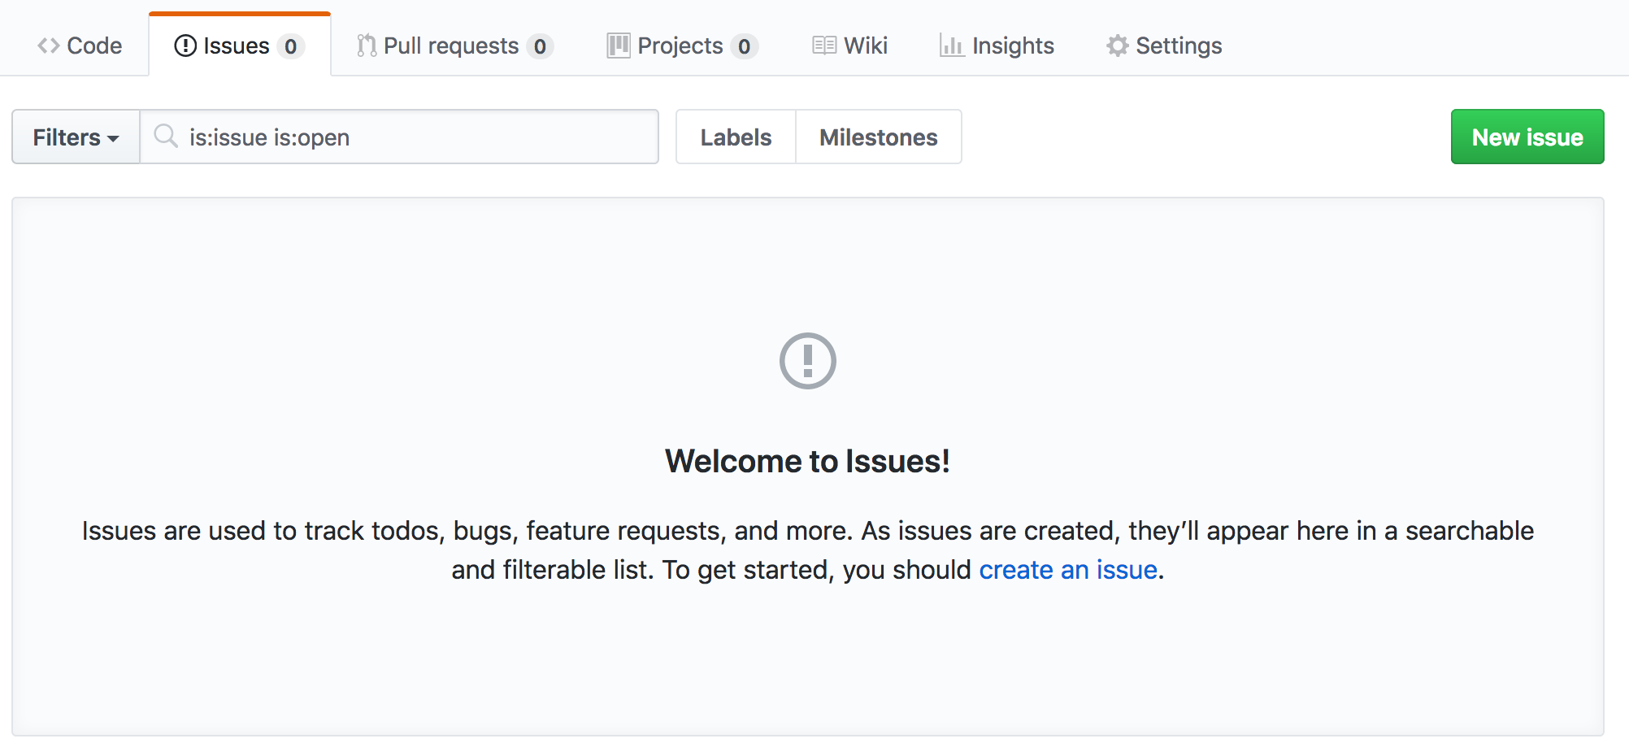
If you have some material you want to share with everyone else, use the Issues page on the GitHub.

Slide 6
Projects

Slide 7
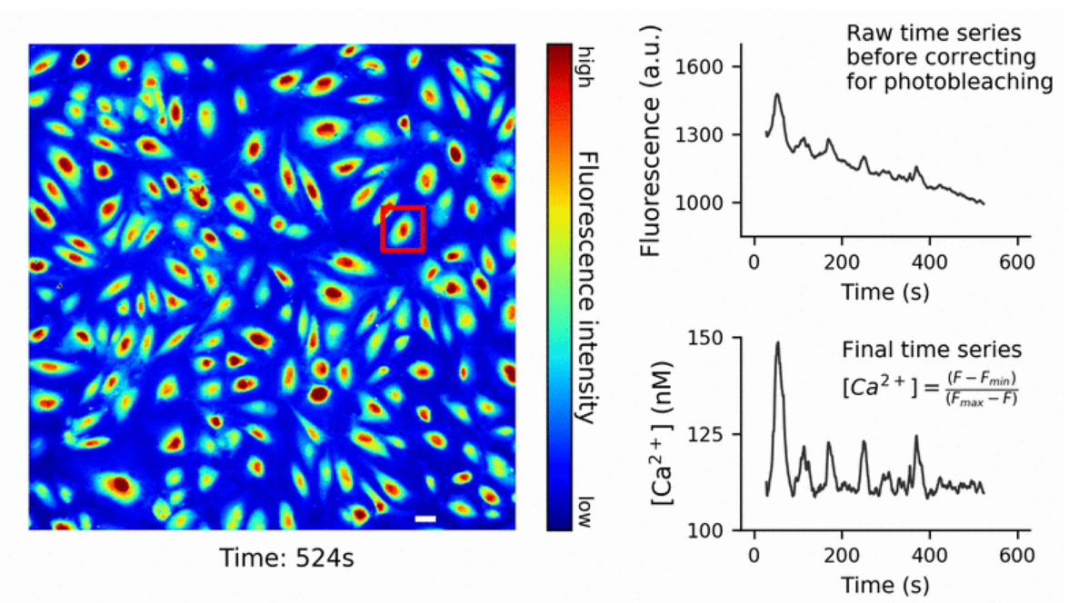
1- Analysis of calcium imaging
Goal: A Jupyter notebook that summarizes how we extracted calcium time series
Technical Challenges:
Handling images and videos with python
Dealing with photobleaching and estimating calcium concentration
Applying regression on a set of time series
Extracting statistics based on a set of cells
Dataset:
We will use a dataset used in a recent publication by Julia Mack @ Arispe Lab

Slide 8
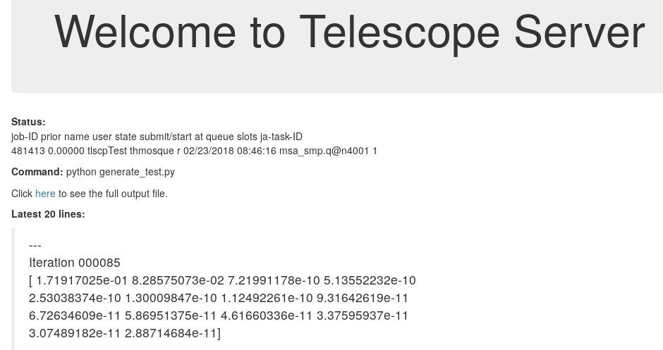
2- Work together to create Telescope
Goal: We are creating this system that keeps track of jobs submitted to remove severs such as Hoffman2
In exchange: a co-author in a future paper on this server
Technical Challenges:
Python programming for mixed with Unix
A bit of Web Development

Slide 9
Let’s get started!

