Slide 1

Workshop 1: Introduction to UNIX command-line
Day 3
Serghei Mangul, PhD | smangul@ucla.edu
CBI Fellow
“Swiss Army knife” set of tools

Slide 2
Summary of Day 2
file permissions
pipeline
ln –s
grep
regex
cat
wc
>, >>, <
sed

Slide 3

awk
awk is both a
programming language
text processor
parsing and manipulating tabular data
iterates through the entire file line-by-line
whitespace (spaces, tabs, etc.)
to separate fields
awk ‘{action_to_take}’ <file_to_parse>

Slide 4
awk : Simple Uses
action_to_take
awk '{print}’ <file_to_parse>
awk '{print $1}’ <file_to_parse>
column number
awk '{print $1”\t”$3}’ <file_to_parse>
delimiter

Slide 5

Let’s practice
awk '{print}' hg19.gtf
awk '{print $1}’ hg19.gtf
awk '{print $4}' hg19.gtf
awk '{print $1"\t"$4} hg19.gtf
awk '{print $1"\t"$4*$5}' hg19.gtf

Slide 6
awk : If statement
condition
if(age>18) then
print("Beer Please")
TRUE
age>18
FALSE
Beer
Coke

Slide 7

awk : If statement
Beth 4.00 0
Dan 3.75 0
Kathy 4.00 10
Mark 5.00 20
Mary 5.50 22
Susie 4.25 18
Print those employees who actually worked
tabular data
awk ‘{if($3>0) print}’ emp.data

Slide 8
Data type
1 clothing 3141
1 computers 9161
1 textbooks 21312
2 clothing 3252
2 computers 12321
2 supplies 2242
2 textbooks 15462
Numbers
Text
Print information about computers only
awk '{if($2=="computers") print}' sales.dat
use double quote
Text

Slide 9
Let’s practice!
awk '{if($3>0) print}' emp.data
awk '{if($3>0) print $1"\t"$2*$3}' emp.data
Beth 4.00 0
Dan 3.75 0
Kathy 4.00 10
Mark 5.00 20
Mary 5.50 22
Susie 4.25 18

Slide 10
Let’s practice!
awk '{if($4>50) print}’ hg19.gtf
awk '{if($1=="chr2") print}’ hg19.gtf
awk '{if($1=="chr2") print $1"\t"$3}’ hg19.gtf
chr2 hg18_knownGene_GnfAtlas2 exon 237538 237602 0.000000 - . gene_id "204019_s_at"; transcript_id "uc002qvu.1";
chr2 hg18_knownGene_GnfAtlas2 exon 239731 239852 0.000000 - . gene_id "204019_s_at"; transcript_id "uc002qvu.1";

Slide 11

awk : sum
Calculate sum of a particular column
awk '{sum+=$2} END { print sum}' emp.data
New variable
“+=” means to add the value to the variable sum
Do it until the end of the file
A variable is like a box where we can store a value and reuse this same value multiple times in our program.

Slide 12



Variable is like a box
awk '{sum+=$2} END { print sum}' emp.data
Beth 4.00 0
Dan 3.75 0
Kathy 4.00 10
Mark 5.00 20
Mary 5.50 22
Susie 4.25 18
4
3.75
4
5
5.5
4.25
sum

Slide 13
Variable is like a box
awk '{sum+=$2} END { print sum}' emp.data
Beth 4.00 0
Dan 3.75 0
Kathy 4.00 10
Mark 5.00 20
Mary 5.50 22
Susie 4.25 18
sum

Slide 14
Variable is like a box
awk '{sum+=$2} END { print sum}' emp.data
Beth 4.00 0
Dan 3.75 0
Kathy 4.00 10
Mark 5.00 20
Mary 5.50 22
Susie 4.25 18
26.5
sum

Slide 15
Let’s practice!
awk '{sum+=$4} END {print sum}’ hg19.gtf
awk ' END {print NR}' hg19.gtf
wc –l hg19.gtf
awk '{sum+=$4} END {print sum/3000}’ hg19.gtf
awk '{sum+=$4} END {print sum/NR}’ hg19.gtf
awk '{if($1=="chr2") sum+=$4} END {print sum}’ hg19.gtf
chr2 hg18_knownGene_GnfAtlas2 exon 237538 237602 0.000000 - . gene_id "204019_s_at"; transcript_id "uc002qvu.1";
chr2 hg18_knownGene_GnfAtlas2 exon 239731 239852 0.000000 - . gene_id "204019_s_at"; transcript_id "uc002qvu.1";

Slide 16
Sort
will rearrange the lines in a text file so that they are sorted, numerically and alphabetically.
sort [OPTION]... [FILE]...
Options :
-n - numerical ordering
-k - sort by a particular column

Slide 17

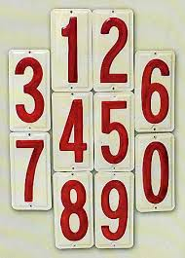
Sort a file
regex.txt
beat
brat
boat
bat
banana
sort regex.txt
Sort a text file
sort –n regex.txt
Sort a file with numbers

Slide 18
Sort by column
sort –k 2 sales.dat
Column number
sort –k 3n sales.dat
sales.dat
1 clothing 3141
1 computers 9161
1 textbooks 21312
clothing 3252
…

Slide 19
Uniq
Removes duplicate lines from a file*
uniq [OPTION]... [INPUT]
Options :
-c - how many times each line occurred
-d - print only duplicated lines
*assumes that the file is sorted

Slide 20
Let’s practice
$ sort –n numbers.txt >numbers_sort.txt
$ uniq numbers_sort.txt
$ sort numbers.txt | uniq
$ uniq -d numbers_sort.txt
$ uniq -c numbers_sort.txt
2 7
numbers.txt
3
4
5
7
2
1
6
7
a line of the file
How many times it occurs

Slide 21
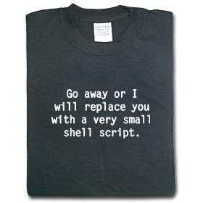
Shell scripts
If you have a bunch of commands you’d like to automate, you can put them on separate lines of a file.

Slide 22
My first shell script!
Following steps are required to write shell script:
Use any vi editor like to write shell script.
After writing shell script set execute permission for your script

Slide 23

My first shell script!
vi script.sh
#!/bin/bash
echo "My first script”
chmod u+x script.sh
./script.sh
How to run the script :

Slide 24
More scripting
Let’s create a bash script which will split <gtf> into files corresponding to every chr (2,3,21), save every file in separate directory called chr${i}_gtf.

Slide 25
More scripting
vi script.sh
#!/bin/bash
echo "My first script"
mkdir chr2_gtf
mkdir chr3_gtf
mkdir chr21_gtf
grep "chr2\s" $1 >chr2_gtf/chr2.gtf
grep "chr3\s" $1 >chr3_gtf/chr3.gtf
grep "chr21\s" $1 >chr21_gtf/chr21.gtf
How to run the script :
./script.sh hg19.gtf

Slide 26

Environmental modules
set you environment to be able to run bioinformatics tools
module load <modulefile>
bowtie
BWA
samtools
tophat

Slide 27
Let’s practice
[serghei@login1 test]$ tophat
-bash: tophat: command not found
[serghei@login1 test]$ module load tophat
[serghei@login1 test]$ tophat

Slide 28

How to use qsub
qsub is the command used for job submission to the cluster. It takes several command line arguments and can also use special directives found in the submission scripts or command file.
qsub -cwd -V –N <name of the proccess> -l h_data=<MEM_NEEDED>,time=24:00:00 run.sh
amount of memory (in megabytes M, or gigabytes G) that your job will require
4GB-32GB
command to be run

Slide 29

Let’s practice!
echo “My first qsub”
sleep 36000
vi run.sh
qsub -cwd -V –N test -l h_data=1G,time=1:00:00 run.sh
qstat | grep serghei
Displays all the jobs which are running on hoffman2

Slide 30

History
history | grep awk
history >history_w1.txt
All UNIX commands from the workshop in one file

Slide 31
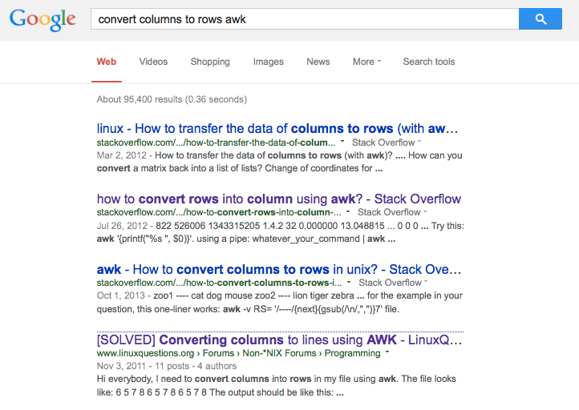
http://www.linuxquestions.org/questions/programming-9/converting-columns-to-lines-using-awk-911677/

Slide 32





Do Biologists have to become Programmers?
*provided in the class
*free and easy to use

Slide 33
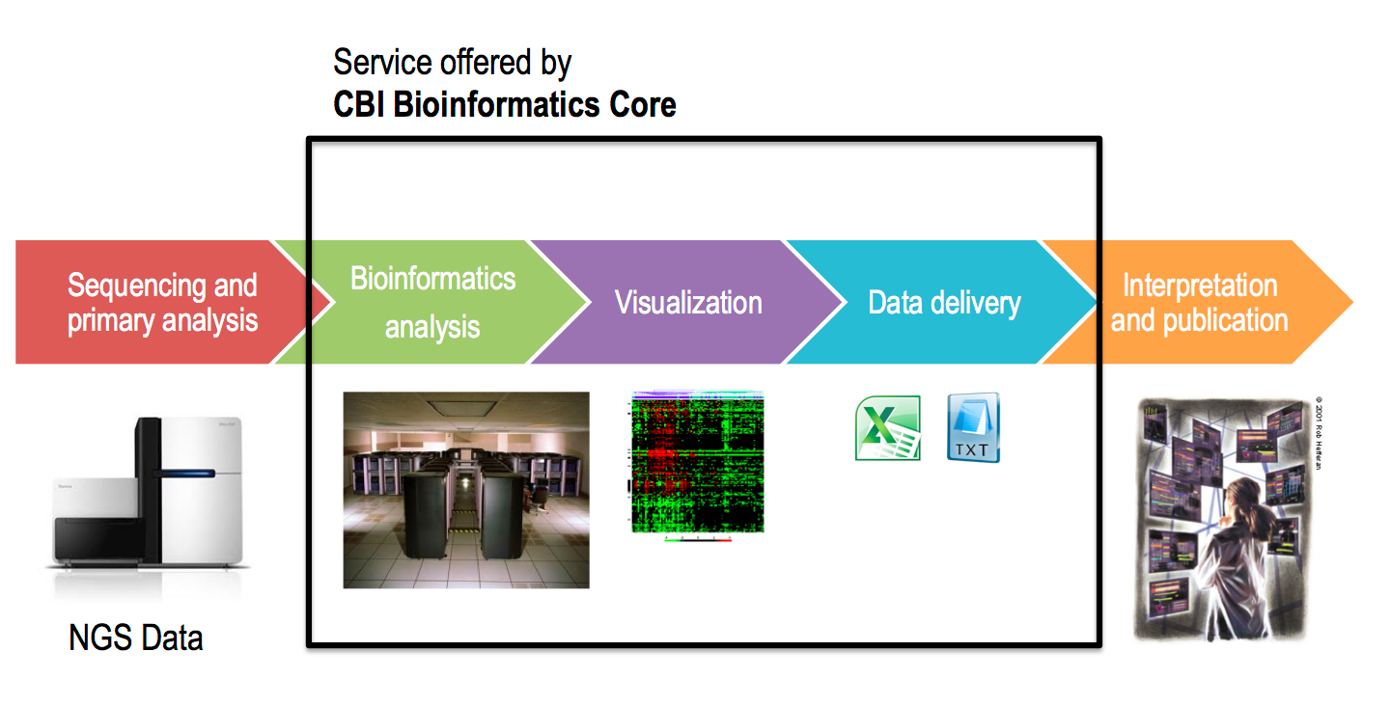
QCB Bioinformatics Core
offers next-generation sequencing data processing and analysis service (pilot stage)
RNA-Seq
http://qcb.ucla.edu/collaboratory/services/

Slide 34



Junk reads
ROP
repeat elements
B/T repertoire diversity
circular RNA
microbial communities
https://sergheimangul.wordpress.com/rop/

Slide 35
Thanks!
Please take a few minutes to fill the survey

