Slide 1
Protein-Protein Interactions
Introduction to
Interaction Data Processing
February 2020
Lukasz Salwinski
lukasz@mbi.ucla.edu
Boyer Hall 205
Notes:
Title

Slide 2
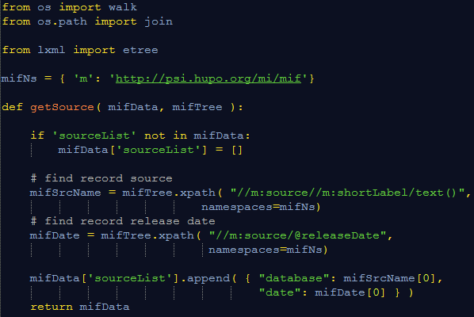
MIF File Parsing
Merging Interaction Data (I)
<entrySet>
<entry>
<source>...</source>
<experimentList>
<experimentDescription id="1">
...
</experimentList>
<interactorList>
<interactor id="7">...</interaction>
...
</interactorList>
<interactionList>
<interaction id="57">...</interaction>
...
</interactionList>
</entry>
</entrySet>
<entrySet>
<entry>
<source>...</source>
<experimentList>
<experimentDescription id="1">
...
</experimentList>
<interactorList>
<interactor id="7">...</interaction>
...
</interactorList>
<interactionList>
<interaction id="57">...</interaction>
...
</interactionList>
</entry>
</entrySet>
<entrySet>
<entry>
<source>...</source>
<experimentList>
<experimentDescription id="1">
...
</experimentList>
<interactorList>
<interactor id="7">...</interaction>
...
</interactorList>
<interactionList>
<interaction id="57">...</interaction>
...
</interactionList>
</entry>
</entrySet>
<entrySet>
<entry>
<source>...</source>
<experimentList>
<experimentDescription id="1">
...
</experimentList>
<interactorList>
<interactor id="7">...</interaction>
...
</interactorList>
<interactionList>
<interaction id="57">...</interaction>
...
</interactionList>
</entry>
</entrySet>
mifFileMerge.py
dictionary

Slide 3
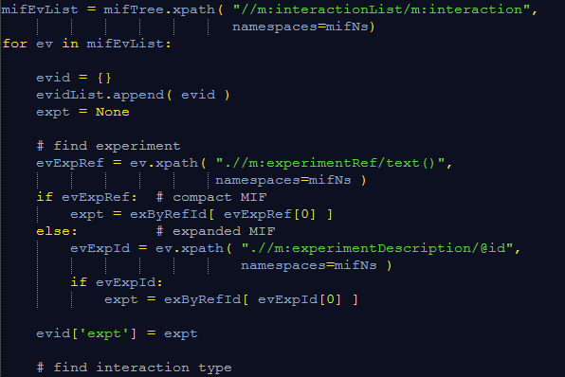
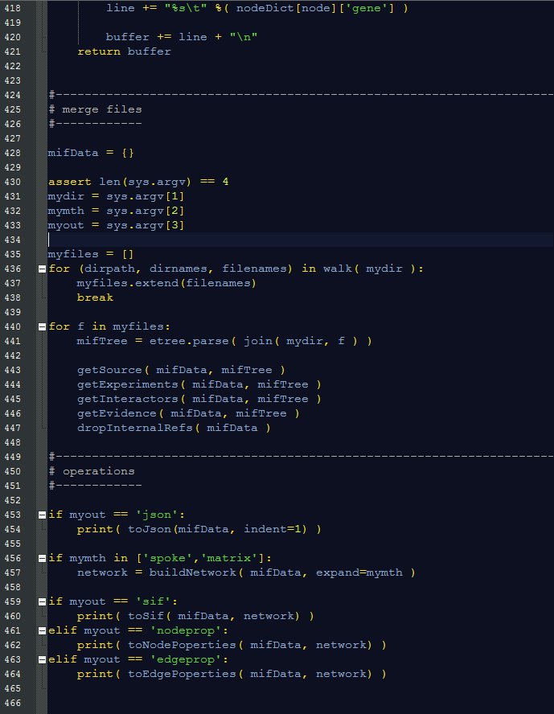
MIF File Parsing
Merging Interaction Data (I)
<interactorList>
<interactor id="7">
...
<experimentRef>33</experimentRef>
or
<experiment id="57">
...
</experiment>
...
</interaction>
...
</interactorList>
Alternate
versions

Slide 4
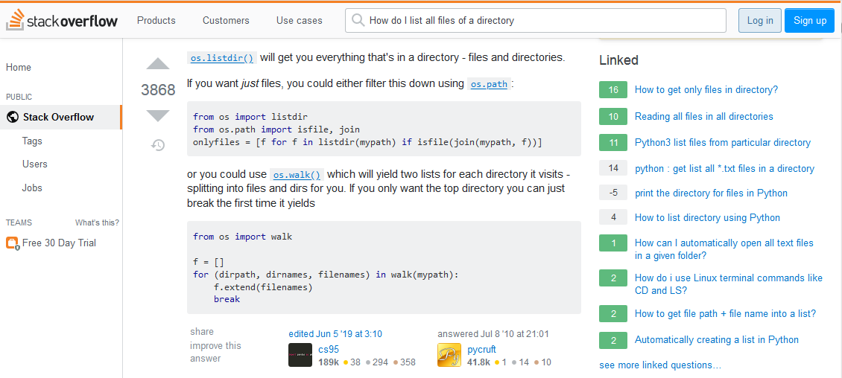
MIF File Parsing
Merging Interaction Data (II)

Slide 5
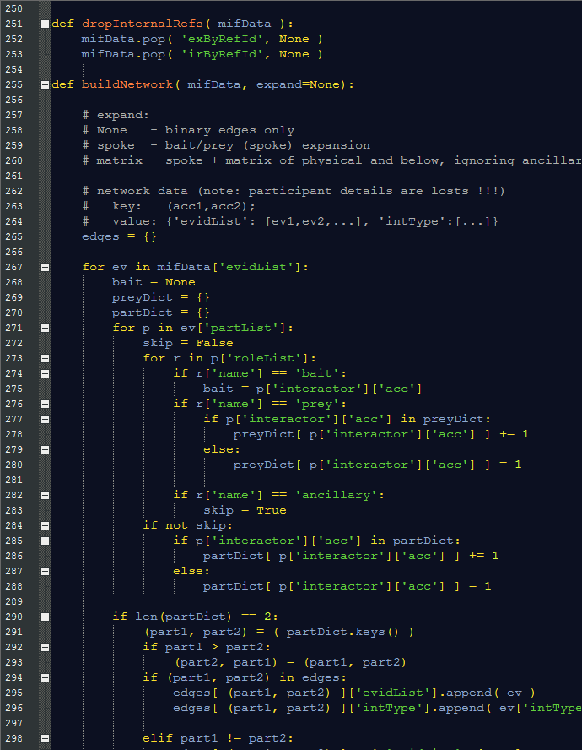
MIF File Parsing
Network/Graph
Node
Merging Interaction Data
Edge
Physical
Association
P4
B
Ancillary
P1
P3
P2
Association

Slide 6
MIF File Parsing
Network/Graph
Merging Interaction Data
Is ancillary ?
Physical
Association
P4
B
P1
P3
P2
Association

Slide 7
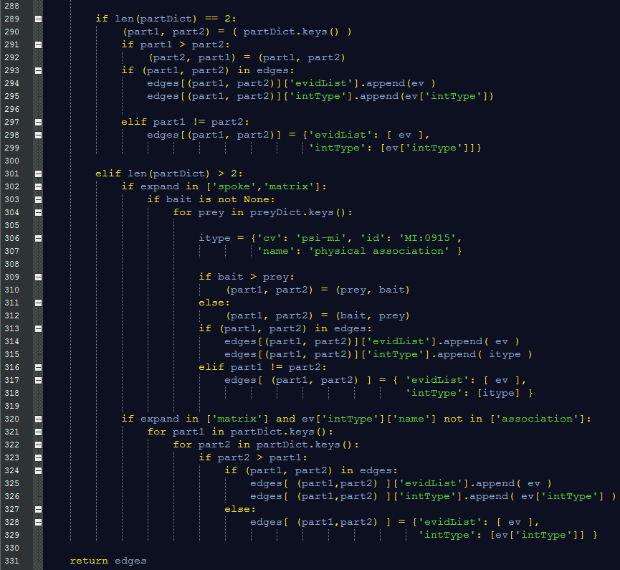
MIF File Parsing
Network/Graph
Merging Interaction Data
‘Binary’ Experiments
Physical
Association
P4
B
P1
P3
P2
Association

Slide 8
MIF File Parsing
Network/Graph
Merging Interaction Data
Spoke expansion
Physical
Association
P4
B
P1
P3
P2
Association

Slide 9
MIF File Parsing
Network/Graph
Merging Interaction Data
Physical
Association
P4
B
P1
P3
P2
Association
Matrix expansion

Slide 10
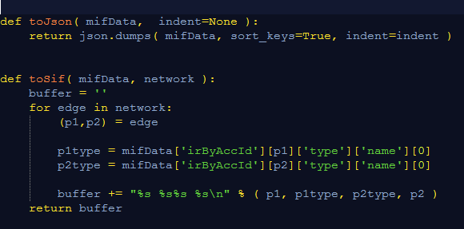
MIF File Parsing
Network/Graph
Merging Interaction Data
JSON
SIF
Dictionary key !!!
Physical
Association
P4
B
P1
P3
P2
Association

Slide 11
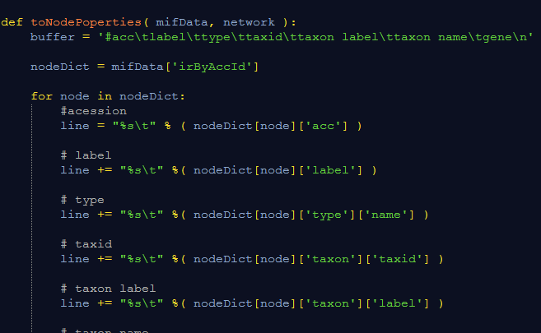
MIF File Parsing
Network/Graph
Merging Interaction Data
Node
Identifier
Physical
Association
P4
B
P1
P3
P2
Association
Node
Properties

Slide 12
Interaction Data Processing
Take Home Message(s)
XML parsing is not that hard !!!
In many cases it is much easier that parsing text files
Use example scripts as a starting point for your own
To read UniprotKB records
To read PSI-MI XML interaction files
To read any other XML (or HTML) files
Be careful when dealing with
Potentially ambiguous and/or inconsistent protein identifiers
Interaction types
Multi-protein interactions (spoke/matrix expansion, changing interaction types)

Slide 13
Interaction Data Processing
XML file parsing
Simple (and less simple but somewhat useful) project ideas
List UniprotKB (gene names, Entrez gene identifiers, GO terms, etc) identifiers for each protein in a given MIF file
Generate a FASTA file listing sequences all the bait proteins reported in a given MIF file
Count interactions of a given protein (or a set of proteins) that are reported in a given MIF file
Find all direct interactions of a given protein that are reported in a given MIF file
List all proteins for each interaction reported in a given MIF file excluding proteins annotated (experimental role) as ‘ancillary’
Retrieve GO annotation from XML-formatted UniprotKB record – e.g.
https://www.uniprot.org/uniprot/P60010.xml
Notes:
Title

Slide 14
Interaction Data Processing
References
XML Parsing
lxml library: https://lxml.de
XPath: https://en.wikipedia.org/wiki/XPath (and references therein)
MIF (miXML) format specification
XSD: https://github.com/HUPO-PSI/miXML (2.5/src, 3.0/src directories)
Publications
Hermjakob H et al. The HUPO PSI's molecular interaction format--a community standard for the representation of protein interaction data.
Nat Biotechnol. 22:177-83 (2004). PMID: 14755292
Kerrien S et al. Broadening the horizon--level 2.5 of the HUPO-PSI format for molecular interactions.
BMC Biol. 5:44 (2007). PMID: 17925023
Sivade Dumousseau M et al. Encompassing new use cases - level 3.0 of the HUPO-PSI format for molecular interactions.
BMC Bioinformatics. 19:134. doi: 10.1186/s12859-018-2118-1 (2018). PMID: 29642841
Notes:
Title

