Slide 1
Protein-Protein Interactions
Introduction to
Interaction Data Processing
February 2020
Lukasz Salwinski
lukasz@mbi.ucla.edu
Boyer Hall 205
Notes:
Title

Slide 2
Interaction Experiment Flow
Make proteins
Get them together
Test which ones interact
Identify proteins that interact
Where: native vs heterologous host vs in vitro translation vs chemical synthesis
How much: native level vs overexpressed
Modifications: isoforms, fragments, mutations, PTMs present/absent
Where: native organism/cell type/tissue/compartment vs something else
When: cell cycle phase/cell state
Diverse methods can be used to determine that that proteins interact
Information that can be inferred from each experiment depends on the method and experimental setup
?
Identity of some proteins might be known a priori (eg purified, cloned/ tagged bait, etc)
Identity and/or state of some proteins might be ambiguous (eg unknown splice form, PTMs)
Some molecules participating in the interaction might remain unidentified
C
B
D
F
Notes:
Experiments demonstrating interactions between proteins (or any other type of molecules) are very diverse. However, no matter how different are, they follow the same generic steps. Interaction records provide information about each step although not always grouped according to the experiment flow. A large number of fields within interaction record might describe details of the experimental procedure. These might be not related to and do not describe biology but might be helpful for quality control.

Slide 3
Interaction Experiment Record
Interaction Record
Interaction Experiment
Interaction Detection Method: Pull down (MI:0096)
Experiment Host/Cell Line: in vitro
Interaction Type: Direct (MI:0407)
Make Proteins
Participant List
1
2
Molecule Type: Protein (MI:0326)
Molecule Name: Cellular tumor antigen p53
Molecule Symbol: p53
Species of Origin: Human (Taxid:9606)
Cross-reference(s): P04637-1 (UniProtKB), NP_00537, (RefSeq), …
…
Get the Proteins Together
N
Experimental Role: Bait (MI:0496)
Experimental Source: E.coli K12 (Taxid: 83333)
Identification method(s): Predetermined (MI:0396)
Features:
Test Which Proteins Interact
1
2
Feature Type: Sufficient binding region (MI:0442)
Feature Range: 1-73
Identification Method: Deletion analysis (MI:0033)
…
M
Identify/Re-identify Proteins
That Interacted
Notes:
The list of proteins listed for a particular experiment is ultimately determined after testing which proteins were interacting. Apart from information about identity, each protein will be annotated with information about the organism/cell line the protein was produced in (in vitro translation & chemical synthesis is also possible). Additional information might include expression level (native/overexpressed) & purification state.

Slide 4
Interaction Database Records
Formats
Notes:
OLS is not the original source of the CVs – different CV were created and are (or not) maintained by individual people, groups of volunteers, consortia, etc. In some cases, like in case of interaction records, they are components of a two-part solution : record format (typically a file format but it could be also a database schema) specifies how different fields of the record are arranged within a record, CVs provide values to use for some/all fields within a record (Side issue – what is the format for CVs ? OBO - Open Biomedical Ontology; OWL – Web Ontology Language; the split reflects overlap between biomedical informatics and computer science/artificial intelligence/automated reasoning)

Slide 5
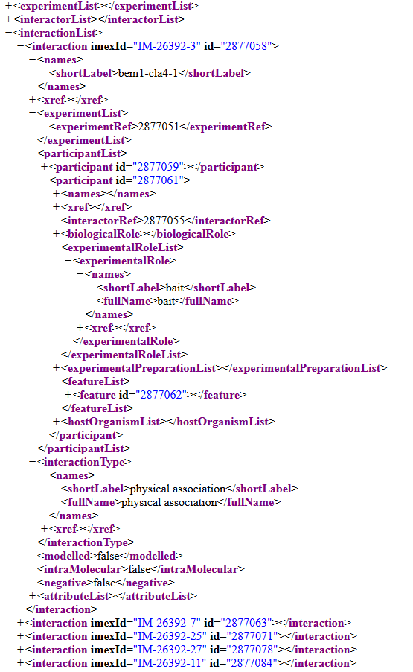
Interaction Record Formats
PSI-MI XML (MIF) format
Interaction Record
Interaction Experiment
Interaction Detection Method: Pull down (MI:0096)
Experiment Host/Cell Line: in vitro
Interaction Type: Direct (MI:0407)
Participant List
1
2
Molecule Type: Protein (MI:0326)
Molecule Name: Cellular tumor antigen p53
Molecule Symbol: p53
Species of Origin: Human (Taxid:9606)
Cross-reference(s): P04637-1 (UniProtKB), NP_00537, (RefSeq), …
…
N
Experimental Role: Bait (MI:0496)
Experimental Source: E.coli K12 (Taxid: 83333)
Identification method(s): Predetermined (MI:0396)
Features:
1
2
Feature Type: Sufficient binding region (MI:0442)
Feature Range: 1-73
Identification Method: Deletion analysis (MI:0033)
…
M
Notes:
Title

Slide 6
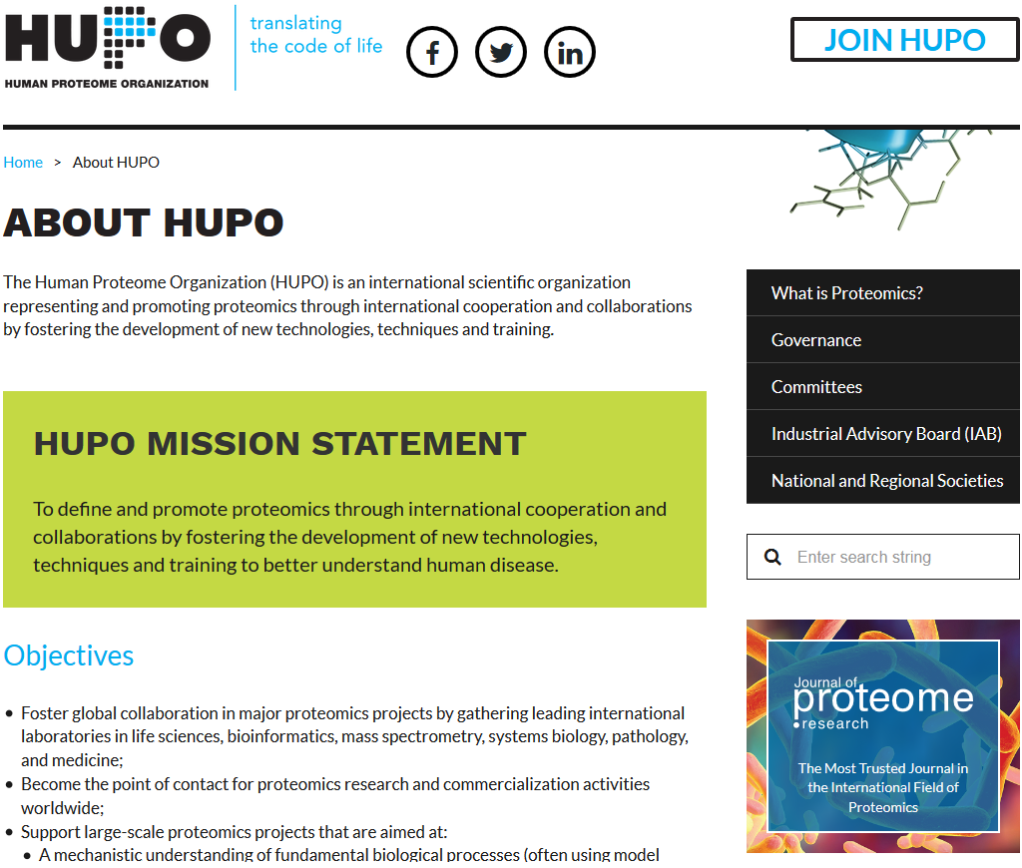
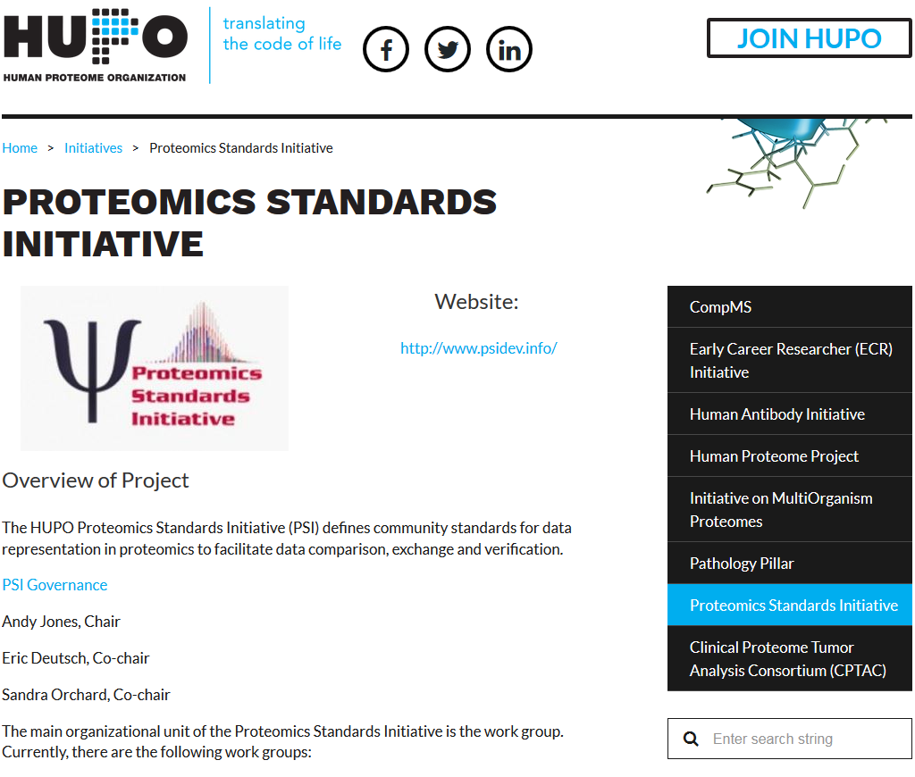
MIF/MI Definitions
Notes:
Title

Slide 7
Interaction Record Formats
PSI-MI XML (MIF) format
Good
Bad
Stable
MIF 2.5 (2007)
MIF 3.0 (2018; mostly backward-compatible)
Database-neutral
Developed by HUPO-PSI
Widely used by data providers
IMEx Consortium (DIP, IntAct, MINT,...) – native
BioGRID – export
Expressive enough to describe most of the interaction experiments
Multi-protein interactions
Protein features (PTMs, mutations, ...)
Multiple experimental methods/protein
Not limited to proteins
Nucleic Acids
Small Molecules
Overly verbose
Redundant open/close tags
Several levels of nested elements
But compresses quite well – 20x is not that rare
Does not fit ‘Excel spreadsheet’ paradigm
Not too surprising – interaction data is NOT tabular
Limited set of good quality user-side tools
Java JAMI is very versatile but complicated
Limited support for reporting experiment ambiguities
MIF 3.0 provides some support but curation lags
No support for oligo-/poly-saccharides
Limited by the current state of nomenclature
No active curation (to my knowledge)
XML is considered to be hard to work with
Notes:
Title

Slide 8
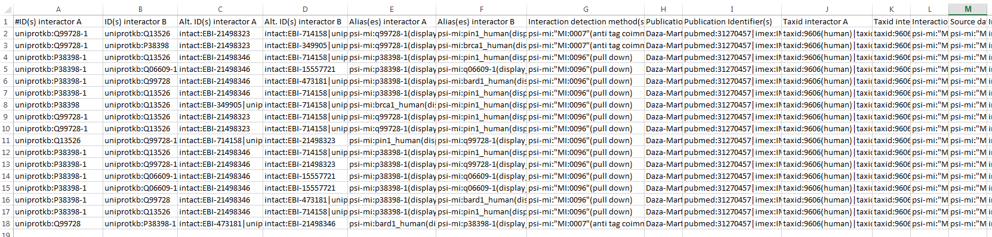
Interaction Record Formats
PSI-MI tab-delimited (MITAB) format
MITAB 2.5
ID(s) interactor A
ID(s) interactor B
Alt. ID(s) interactor A
Alt. ID(s) interactor B
Alias(es) interactor A
Alias(es) interactor B
Interaction detection method(s)
Publication 1st author(s)
Publication Identifier(s)
Taxid interactor A
Taxid interactor B
Interaction type(s)
Source database(s)
Interaction identifier(s)
Confidence value(s)
MITAB 2.6
Expansion method(s)
Biological role(s) interactor A
Biological role(s) interactor B
Experimental role(s) interactor A
Experimental role(s) interactor B
Type(s) interactor A
Type(s) interactor B
Xref(s) interactor A
Xref(s) interactor B
Interaction Xref(s)
MITAB 2.7
Feature(s) interactor A
Feature(s) interactor B
Stoichiometry(s) interactor A
Stoichiometry(s) interactor B
Identification method participant A
Identification method participant B
Annotation(s) interactor A
Annotation(s) interactor B
Interaction annotation(s)
Host organism(s)
Interaction parameter(s)
Creation date
Update date
Checksum(s) interactor A
Checksum(s) interactor B
Interaction Checksum(s)
Negative
Column values
uniprotkb:P12345(very important protein)
wwpdb:1COL|wwpdb:3COL
psi-mi:”MI:0096”(pull-down)
psi-mi:”MI:0097”(“\”super\” tag”)
XREF
VALUE
DESCRIPTION
MITAB 2.6

Slide 9
Interaction Record Formats
PSI-MI tab-delimited (MITAB) format
Good
Bad
Applicable only to binary interactions
Cannot handle multi-protein complexes
Many columns can be multi-valued
Requires custom parsing routines
Some information originally available in MIF format cannot be stored as MITAB
The format is lossy – is, essentially, impossible, to restore fully-featured MIF record from its MITAB representation
Less stable than MIF
MITAB 2.5, 2.7, 2.8 (MIF 2.5 derivatives)
MITAB 3.0 (3.0 derivative)
Easy to read into a spreadsheet
Supported by third-party libraries
Notes:
Title

Slide 10
Interaction Record Formats
BioGRID tab & complex tab formats
Good
Bad
Separate format for binary and multi-protein complexes
Supports only protein-protein interactions
Identifies proteins by gene identifies
It works only for organisms that do not splice
Provides less information than PSI-MI MIF
This is because BioGRID extracts less information about interactions that IMEx Consortium databases
Uses simplified, non-standard CV terms
See also MITAB deficiencies
Easy to read into a spreadsheet
Notes:
Title

Slide 11
Interaction Record Formats
Cytoscape SIF format
Good
Bad
Native Cytoscape format
Simple/easy to prepare (spreadsheet will work)
Not limited to biological data
Only binary interactions
Must be combined with information from additional files in order to provide more detailed information
SIF
Interaction Type (arbitrary)
Molecule name (arbitrary)
Molecule Property File
Molecule Name
Property
MoleculeA pp MoleculeB
MoleculeA pp MoleculeB1 MoleculeB2 MoleculeB3
...
Interaction Property File
Interaction Name
Property
MoleculeA = Value1
MoleculeB = Value2
...
MoleculeA (pp) MoleculeB1 = Value1
MoleculeA (pp) MoleculeB2 = Value2
...

Slide 12
Interaction Data Processing
Topics
XML parsing
Lxml library
Xpath
Parsing UniprotKB XML files
MIF file structure
‘compact vs ‘expanded’ variants
Binary expansion of multi-protein interactions
‘spoke’ vs ‘matrix’ expansion
Extracting data from MIF files
Access relevant/useful information
Prepare files ready to import into Cytoscape
Notes:
Title

Slide 13
XML File Anatomy
Namespace
<?xml version="1.0" encoding="UTF-8"?>
<mif:entrySet xmlns:mif="http://psi.hupo.org/mi/mif"
level="2" version="5" minorVersion="4">
<mif:entry>
<mif:source releaseDate="2019-05-13">
<mif:names>
<mif:shortLabel>DIP</mif:shortLabel>
<mif:fullName>Database of Interacting Proteins</mif:fullName>
</mif:names>
<mif:xref>
<mif:primaryRef db="psi-mi" dbAc="MI:0488" id="MI:0465"
refType="identity" refTypeAc="MI:0356"/>
...
</mif:xref>
</mif:source>
...
</mif:entry>
</mif:entrySet>
Text
Element
Opening tag
Closing tag
Attribute (name = “value”)
Namespace
Prefix
<element attribute=“value”/>
is equivalent to
<element attribute=“value”></element>
<ROOT ELEMENT>...</ROOT ELEMENT>
Notes:
Title

Slide 14
XML File Parsing
Lxml library (https://lxml.de/)
from lxml import etree
from io import StringIO
xml = '<protein acc="P60010"><seq>MKYDDEW...</seq></protein>'
strDom = etree.fromstring( xml )
or
strDom = etree.fromstring( StringIO(xml) )
fileDom = etree.parse("doc/test.xml")
or
fileDom = etree.parse( open("doc/test.xml") )
print( etree.tostring( strDom ).decode())
Only if needed...
Parse String
Parse File/URL
.gz files OK
... and back to String
See lxml web site for more options
Notes:
Title

Slide 15
XML File Parsing
lxml library (https://lxml.de/)
from lxml import etree
xml = '<protein acc="P60010"><seq format="fasta">MKYDDEW...</seq></protein>'
xmlDom = etree.fromstring( xml )
for child in xmlDom:
print( child.tag.decode() )
print( child.get("format").decode() )
print( child.text.decode() )
print( etree.tostring(child).decode() )
Get element tag
Get attribute
Get text
Get element as XML
See lxml web site for more options
Notes:
Title

Slide 16
XML File Parsing
lxml Xpath support (https://lxml.de/xpathxslt.html)
from lxml import etree
xml = '<protein acc="P60010"><seq>MKYDDEW...</seq></protein>'
xmlDom = etree.fromstring( xml )
root = xmlDom.xpath('/protein')
for child in root[0]:
print( child.tag.decode() )
print( child.get("format").decode() )
print( etree.tostring(child).decode() )
Get top-level ‘protein’ element
NOTE: Returns a list !!!
Get element tag
Get attribute
Get element as XML
See lxml web site for more options
Notes:
Title

Slide 17
XML File Parsing
lxml Xpath support (https://lxml.de/xpathxslt.html)
from lxml import etree
xml = '<protein acc="P60010"><seq>MKYDDEW...</seq></protein>'
xmlDom = etree.fromstring( xml )
t1 = xmlDom.xpath('/protein/seq/text()')
t2 = xmlDom.xpath('//seq/text()')
e3 = xmlDom.xpath('//protein[@acc="P60010"]/seq')
e4 = e3[0].xpath(‘./text()’)
Get the text of ‘seq’ elements that are children of the top-level ‘protein’ element
Get the text of ANY ‘seq’ element
LIST!!!
Get ‘seq’ elements that are children of ‘protein’ element with ‘acc’ attribute equals to ’P60010’
Get the text of the current element
See https://en.wikipedia.org/wiki/XPath and
https://www.w3.org/TR/xpath-10 for more details
Notes:
Title

Slide 18
XML File Parsing
lxml Xpath namespace support (https://lxml.de/xpathxslt.html)
from lxml import etree
xml = '''<mif:protein xmlns:mif="http://psi.hupo.org/mi/mif" acc="P60010">
<mif:seq>MKYDDEW...</mif:seq>
</mif:protein>'''
xmlDom = etree.fromstring( xml )
e = xmlDom.xpath('/m:protein/m:seq',
namespaces={'m': 'http://psi.hupo.org/mi/mif'})
print( e[0].tag.decode())
qname = etree.QName(e[0])
print( qname.localname.decode() )
print( qname.namespace.decode() )
Get qualified (i.e. with namespace) tag
Split qualified tag into namespace and local name
Notes:
Title

Slide 19
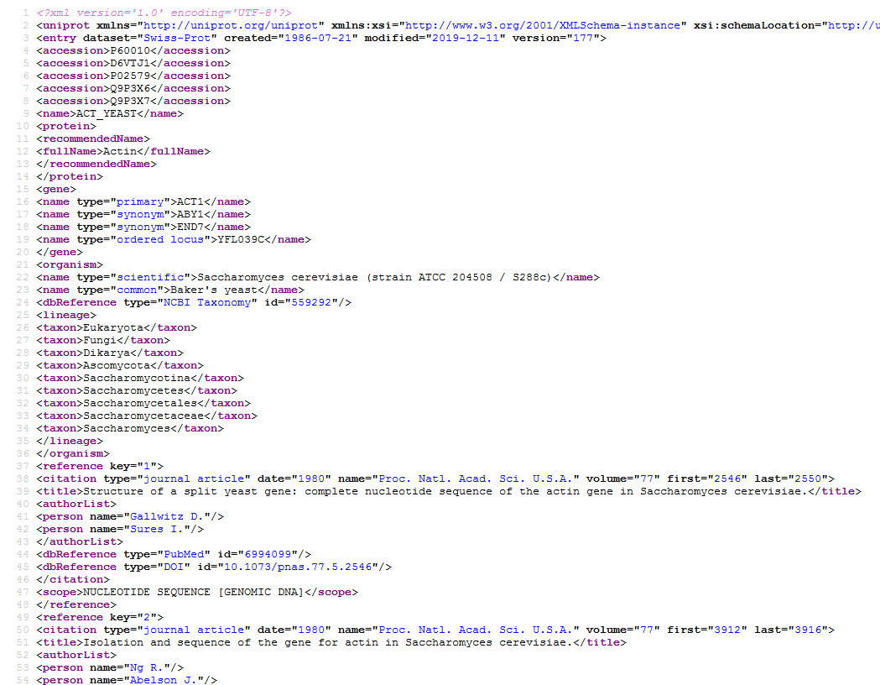
XML File Parsing
Lots and lots of stuff !!!
Example: Parsing UniprotKB records
https://www.uniprot.org/uniprot/P60010.xml
Primary/secondary (aka past) accessions
Names
Protein Names (including aliases)
Gene Names (including aliases)
Taxonomy
Species of origin (possibly strain)
Linage
Sequence (possibly isoforms)
Molecular weight
Cross-references
Articles
Gene Ontology Terms
Domains (InterPro, Pfam Prosite)
Structures (PDB)
Interactions
And more....

Slide 20
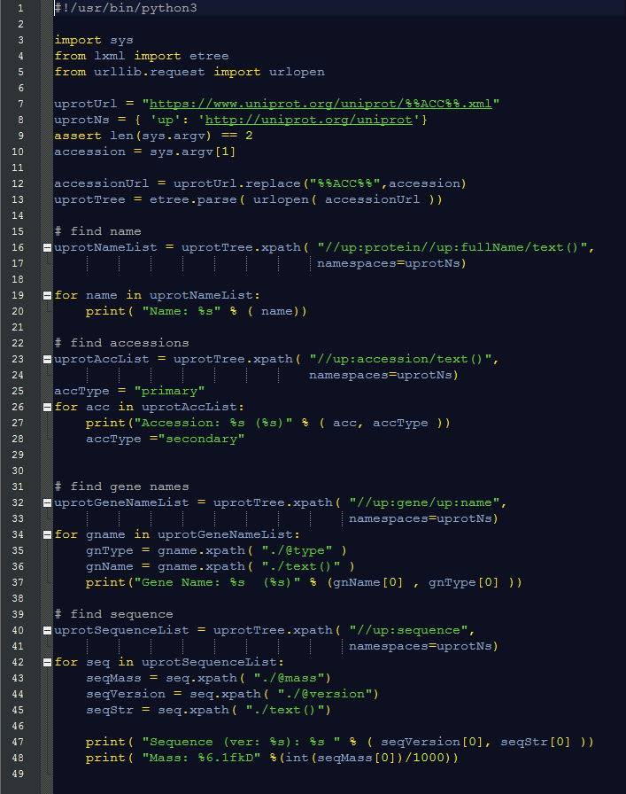
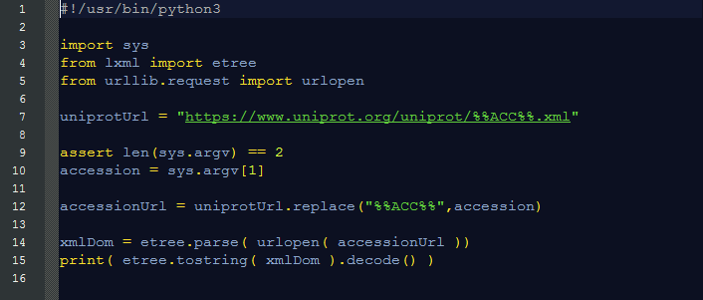
XML File Parsing
uniprotRead.py
Example: Parsing UniprotKB records
uniprotPrint.py
Needed for https only
Program flow
Specify UniprotKB Identifier
Read Corresponding File
Find interesting element(s)
Print results

Slide 21
Interaction Record Formats
PSI-MI XML (MIF) format
Interaction Record
Interaction Experiment
Interaction Detection Method: Pull down (MI:0096)
Experiment Host/Cell Line: in vitro
Interaction Type: Direct (MI:0407)
Participant List
1
2
Molecule Type: Protein (MI:0326)
Molecule Name: Cellular tumor antigen p53
Molecule Symbol: p53
Species of Origin: Human (Taxid:9606)
Cross-reference(s): P04637-1 (UniProtKB), NP_00537, (RefSeq), …
…
N
Experimental Role: Bait (MI:0496)
Experimental Source: E.coli K12 (Taxid: 83333)
Identification method(s): Predetermined (MI:0396)
Features:
1
2
Feature Type: Sufficient binding region (MI:0442)
Feature Range: 1-73
Identification Method: Deletion analysis (MI:0033)
…
M
Notes:
Title

Slide 22
Interaction Data Processing
Compact MIFs use references to interactors and/or experiments
PSI-MI XML (MIF) file anatomy
<entry Set>
<entry>
<source releaseDate=‘2019-05-22’>...</source>
<interactorList>
<interactor id=‘1’>...</interactor>
<interactor id=‘2’>...</interactor>
...
</interactorList>
<experimentList>
<experiment id=‘1’>...</experiment>
<experiment id=‘2’>...</experiment>
...
</experimentList>
<interactionList>
<interaction id=‘1’ imexId=‘IM-123456-1’>
<experimentList>
<experimentRef id=‘1’/>
</experimentList>
<participantList>
<participant id=‘1’>
<interactorRef id=‘2’/>
<biologicalRole>...</biologicalRole>
<experiemntalRole>...</experimentalRole>
....
</participant>
<participant id=‘2’>...</participant>
....
</participantList>
</interaction>
<interaction id=‘2’ imexId=‘IM-123456-12’>...</interaction>
...
</interactionList>
</entry>
...
</entrySet>
Record source (database)
List of interactors
List of experimental methods/protocols
List of interactions
Reference to experimental method/protocol
Reference to interactor
Participant (e.g. protein)
Describes the state of the molecule as used in the experiment
Refers to ‘interactor’ – the reference description of the molecule (e.g. UniprotKB)
Notes:
Title

Slide 23
Interaction Data Processing
Expanded MIFs describe interactors and experiments within each interaction
PSI-MI XML (MIF) file anatomy
<entry Set>
<entry>
<source releaseDate=‘2019-05-22’>...</source>
<interactionList>
<interaction id=‘1’ imexId=‘IM-123456-1’>
<experimentList>
<experiment id=‘1’/>...</experiment>
</experimentList>
<participantList>
<participant id=‘1’>
<interactor id=‘2’>...</interactor>
<biologicalRole>...</biologicalRole>
<experiemntalRole>...</experimentalRole>
....
</participant>
<participant id=‘2’>...</participant>
....
</participantList>
</interaction>
<interaction id=‘2’ imexId=‘IM-123456-12’>...</interaction>
...
</interactionList>
</entry>
...
</entrySet>
Record source (database)
List of interactions
Experimental method/protocol description
Interactor description
Conversion between
Compact & Expanded
MIF is lossless !!!
Participant (e.g. protein)
Describes the state of the molecule as used in the experiment
Refers to ‘interactor’ – the reference description of the molecule (e.g. UniprotKB)
Notes:
Title

Slide 24
Interaction Data Processing
Binary Expansion is
is lossy !!!
Binary Expansion
Association
Physical Associations
B
Physical Association
Physical Associations
Direct
Direct
Notes:
Title

Slide 25
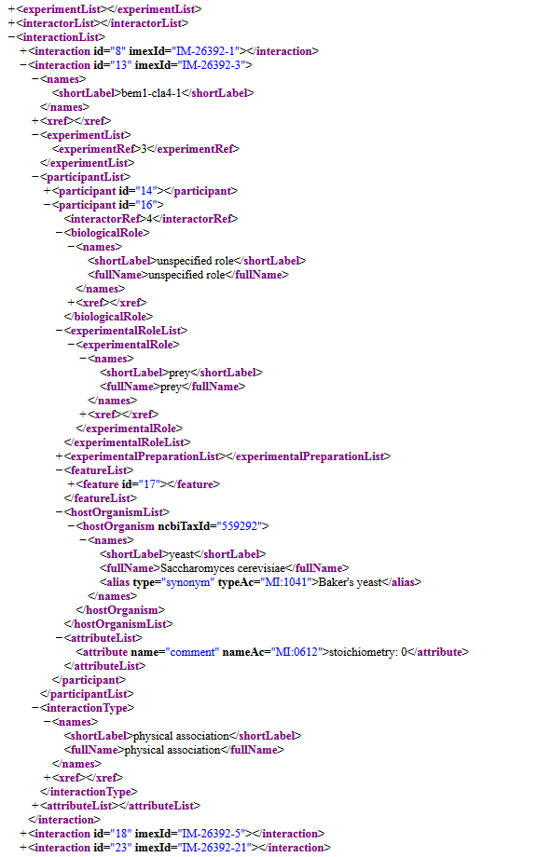
Interaction Data Processing
Compact MIFs use references to interactors and/or experiments
PSI-MI XML (MIF) file anatomy
Description of the experimental method (explicit or a reference)
Description of the interactor (explicit or a reference)
Participant (e.g. protein)
Describes the state of the molecule as used in the experiment
Refers to ‘interactor’ – the reference description of the molecule (e.g. UniprotKB)
Features (e.g. mutations)
Modifications of the molecule relative to the reference state
Interaction
Notes:
Title

Slide 26
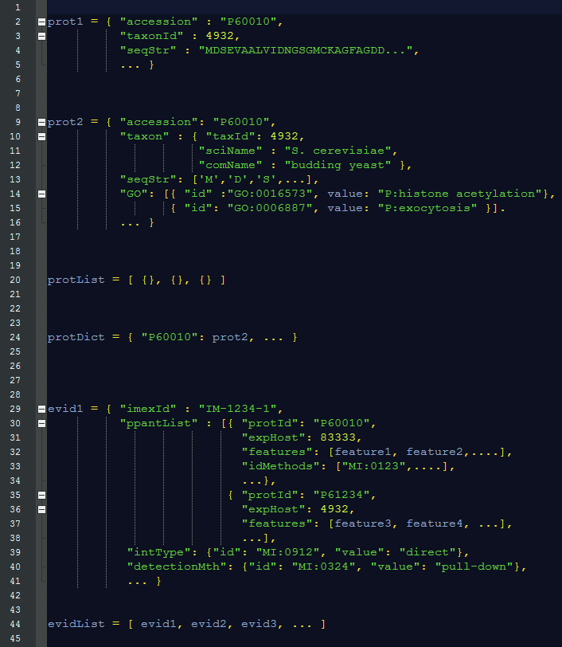
Interaction Data Processing
Data structures
Protein (reference state/interactor)
Nested dictionary
Protein collection
Dictionary, using unique id as key
Interaction evidence
or
Nested dictionary
Participants as list
Each refers to interactor through its unique id
Most often easier to work with
Interaction evidence collection
List
or
Dictionary, using IMEx id as key

Slide 27
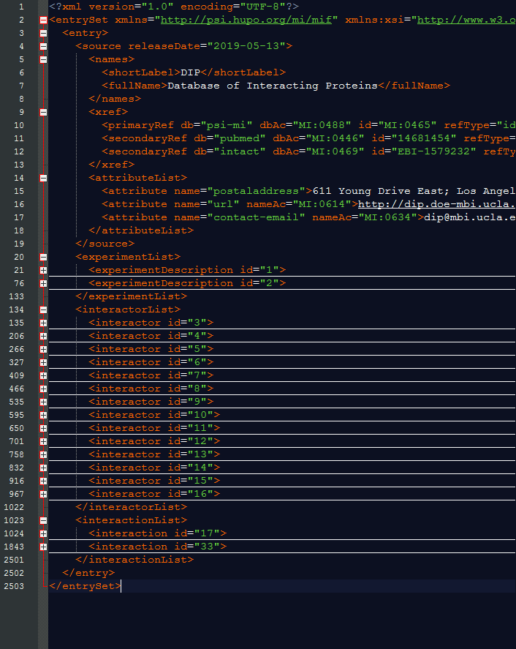
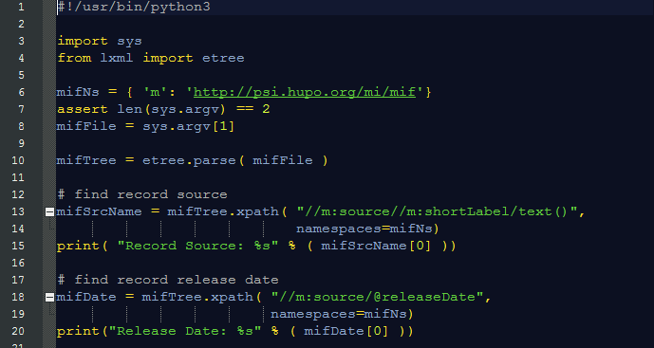
MIF File Parsing
uniprotRead.py
Preliminaries/Record Source Information
mifReadFile.py
Program flow
Specify input file location
Read and parse the input file
Find interesting element(s)
Print out/save results

Slide 28
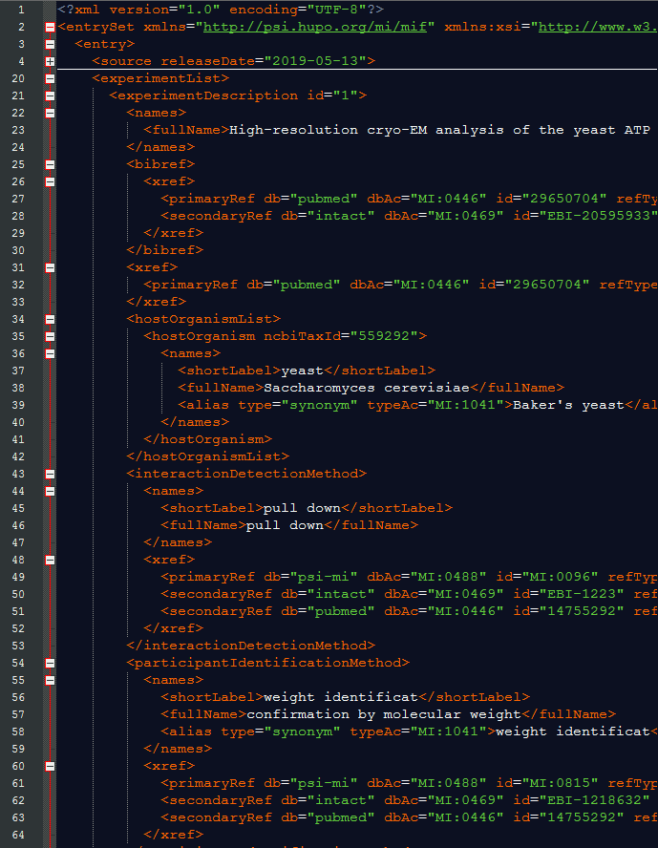
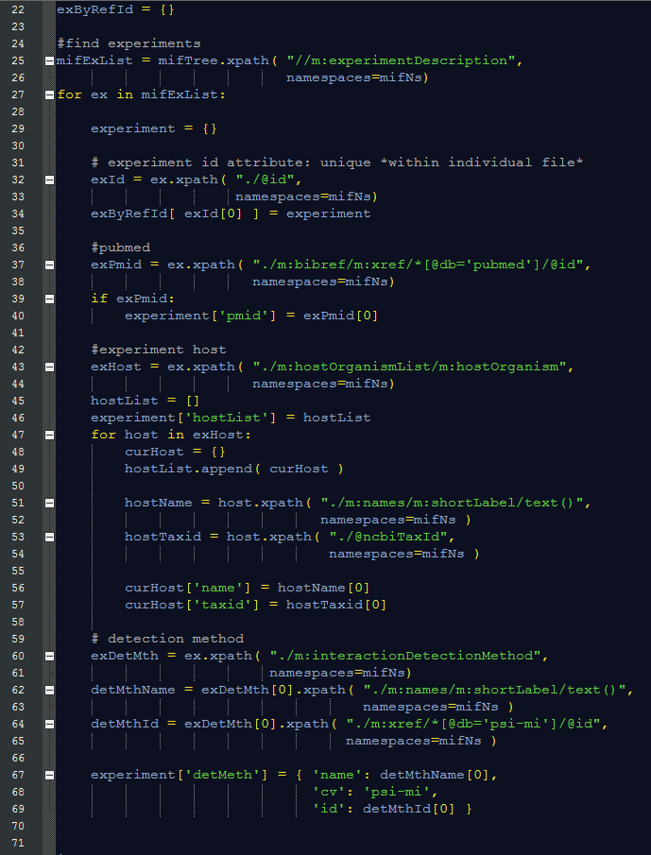
MIF File Parsing
Experimental Method Information

Slide 29
MIF File Parsing
Experimental Method Information

Slide 30
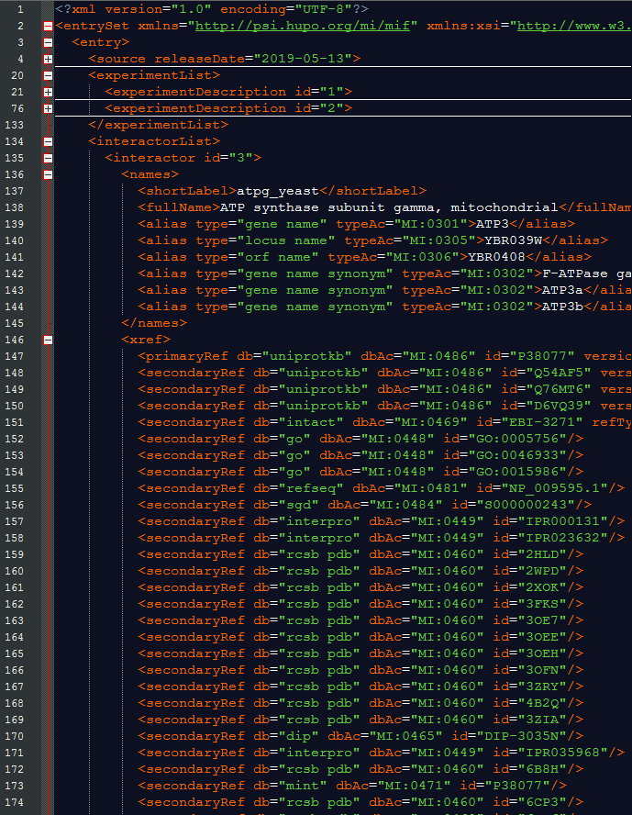
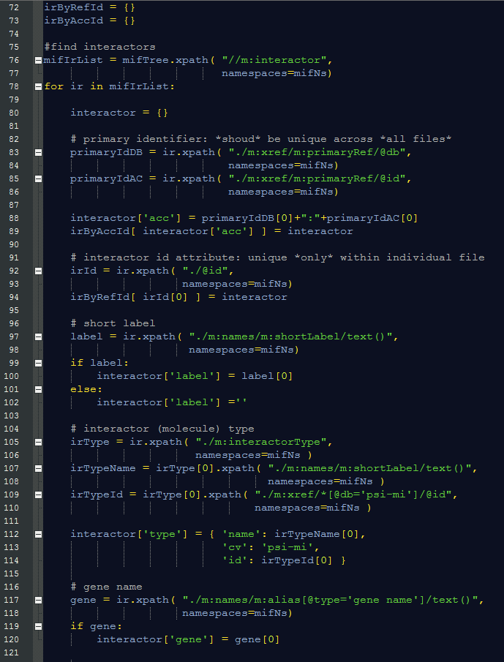
MIF File Parsing
Interactor (Reference Molecule) Information (I)

Slide 31
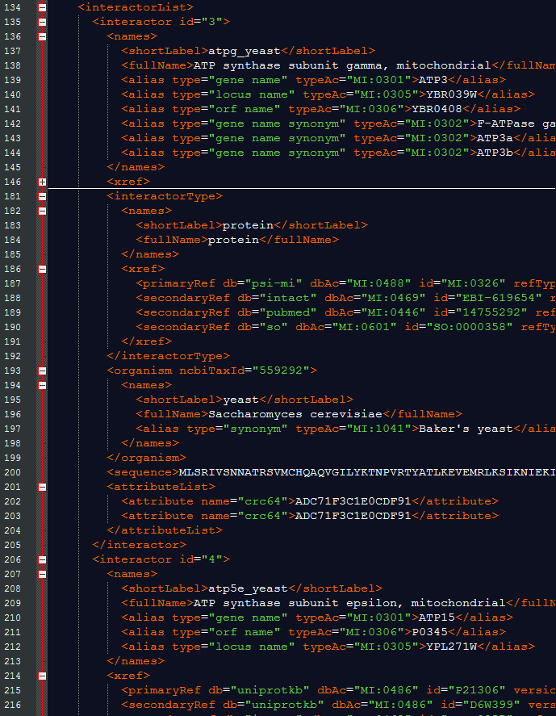
MIF File Parsing
Interactor (Reference Molecule) Information (II)

Slide 32
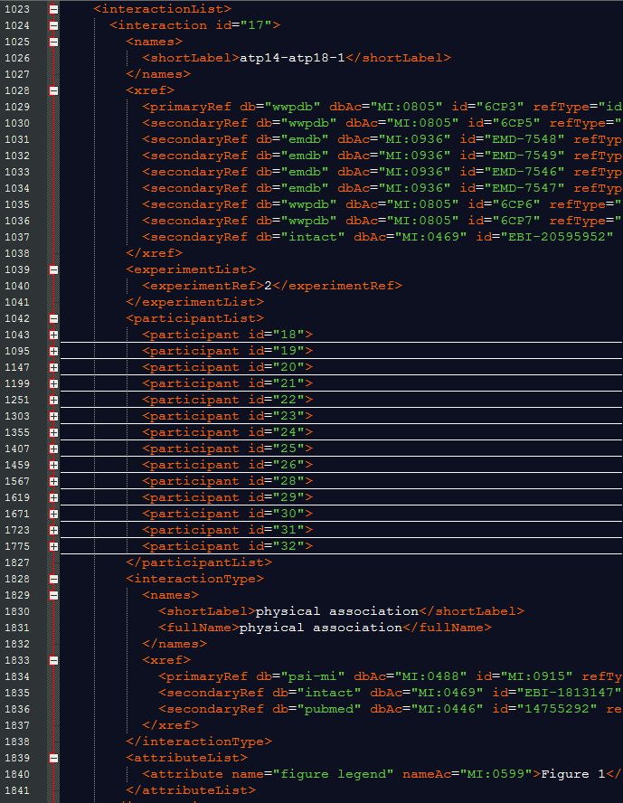
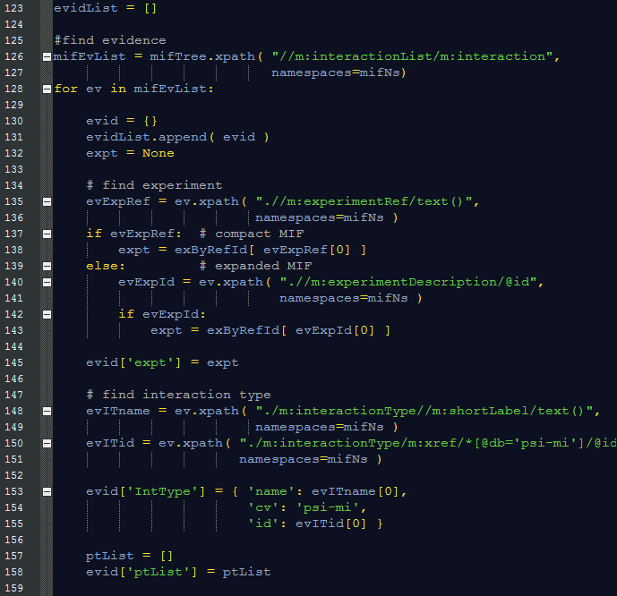
MIF File Parsing
Interaction Evidence Information (I)

Slide 33
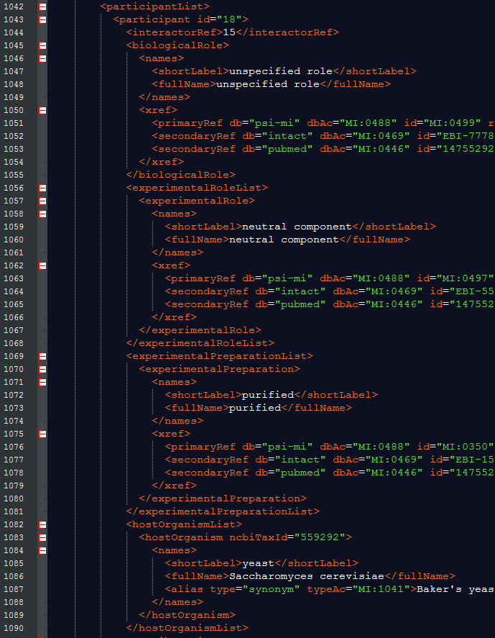
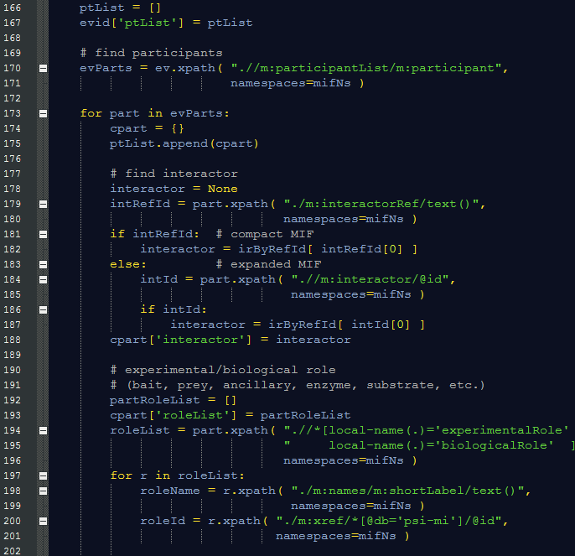
MIF File Parsing
Interaction Evidence Information (II)

Slide 34
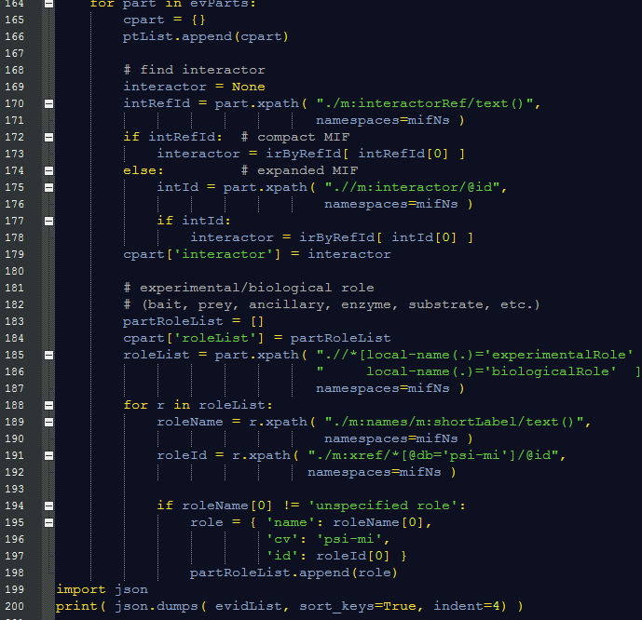
MIF File Parsing
Interaction Evidence Information (III)
mifFileRead.py

Slide 35
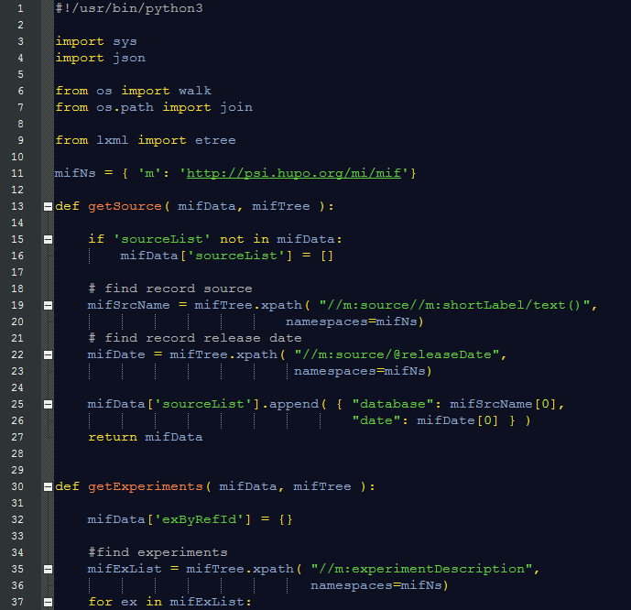
MIF File Parsing
Merging Interaction Data (I)
mifFileMerge.py

Slide 36
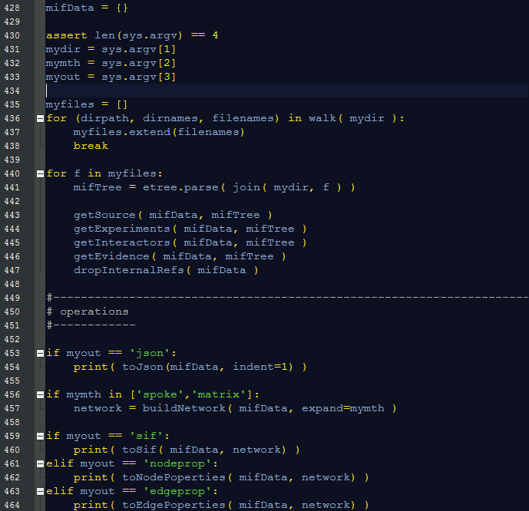
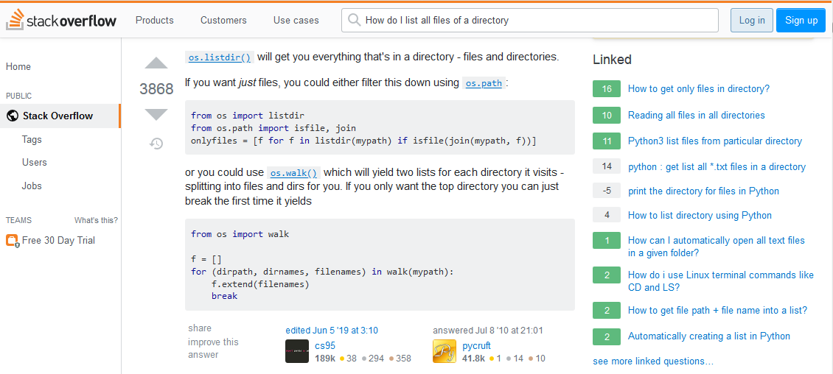
MIF File Parsing
Merging Interaction Data (II)
mifFileMerge.py

Slide 37
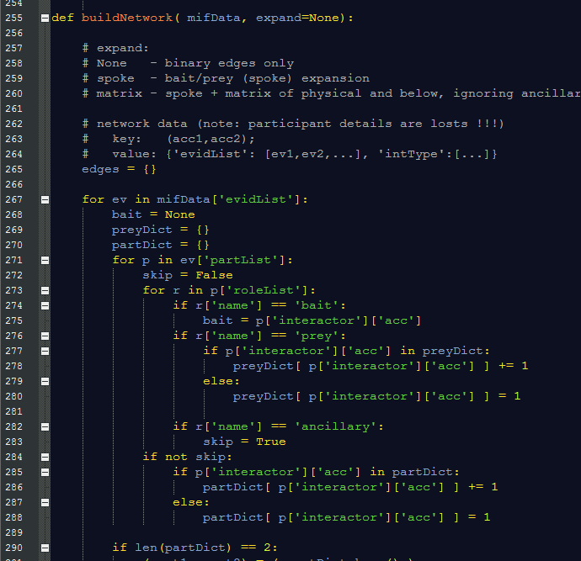
MIF File Parsing
Network/Graph
Node
Merging Interaction Data
Edge
Physical
Association
P4
B
Ancillary
P1
P3
P2
Association

Slide 38
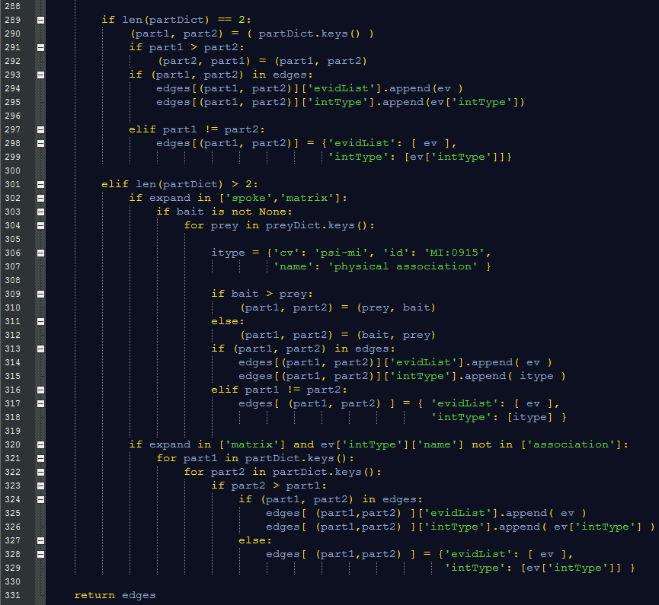
MIF File Parsing
Network/Graph
Merging Interaction Data
Physical
Association
P4
B
‘Binary’ Experiments
P1
P3
P2
Association

Slide 39
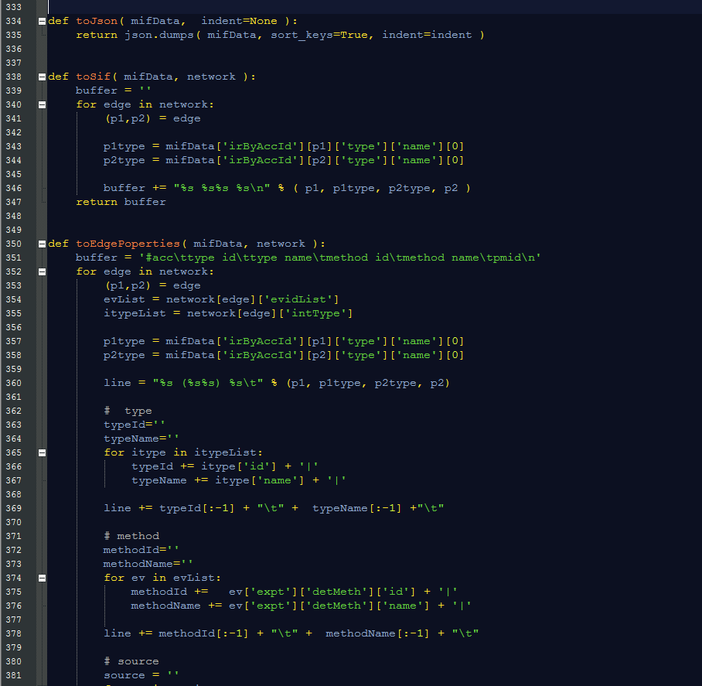
MIF File Parsing
Network/Graph
Merging Interaction Data
JSON
SIF
Physical
Association
P4
B
P1
P3
P2
Association

Slide 40
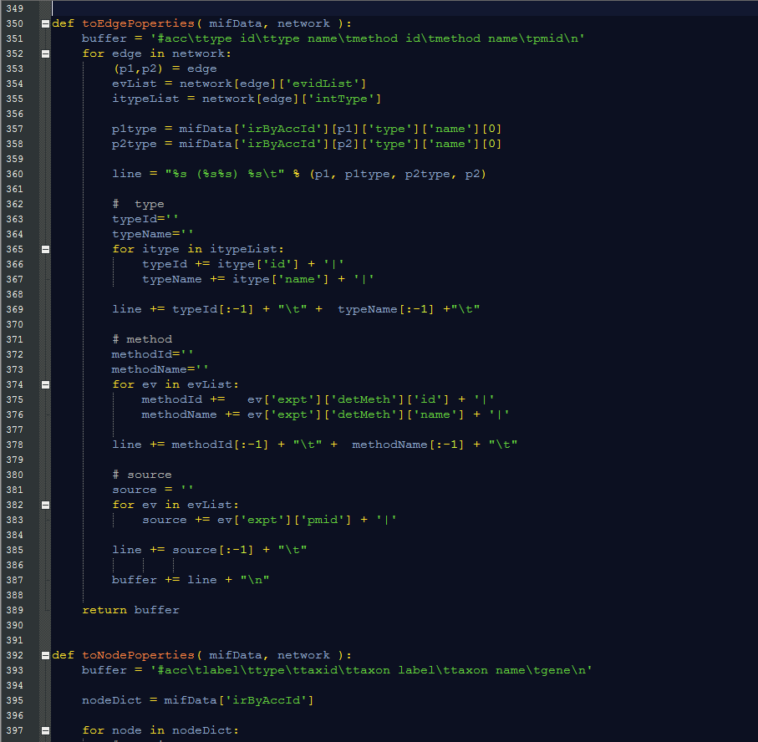
MIF File Parsing
Network/Graph
Merging Interaction Data
Edge
Identifier
Physical
Association
P4
B
P1
Edge
Properties
P3
P2
Association

Slide 41
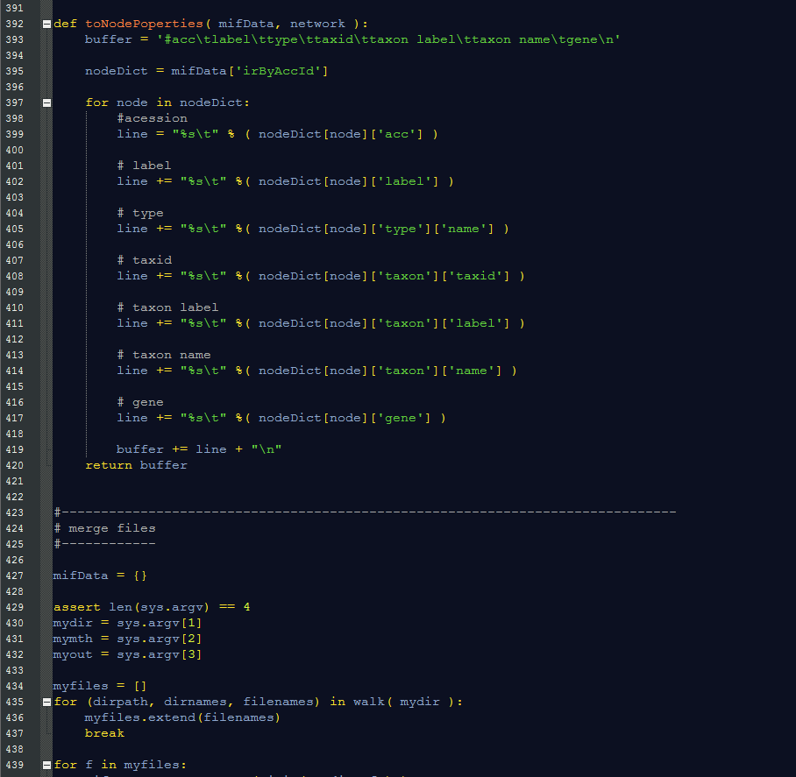
MIF File Parsing
Network/Graph
Merging Interaction Data
Node
Identifier
Physical
Association
P4
Node
Properties
B
P1
P3
P2
Association

Slide 42
Interaction Data Processing
Take Home Message(s)
XML parsing is not that hard !!!
In many cases it is much easier that parsing text files
Use example scripts as a starting point for your own
To read UniprotKB records
To read PSI-MI XML interaction files
To read any other XML (or HTML) files
Be careful when dealing with
Potentially ambiguous and/or inconsistent protein identifiers
Interaction types
Multi-protein interactions (spoke/matrix expansion, changing interaction types)

Slide 43
Interaction Data Processing
XML file parsing
Simple (and less simple but somewhat useful) project ideas
List UniprotKB (gene names, Entrez gene identifiers, GO terms, etc) identifiers for each protein in a given MIF file
Generate a FASTA file listing sequences all the bait proteins reported in a given MIF file
Count interactions of a given protein (or a set of proteins) that are reported in a given MIF file
Find all direct interactions of a given protein that are reported in a given MIF file
List all proteins for each interaction reported in a given MIF file excluding proteins annotated (experimental role) as ‘ancillary’
Retrieve GO annotation from XML-formatted UniprotKB record – e.g.
https://www.uniprot.org/uniprot/P60010.xml
Notes:
Title

Slide 44
Interaction Data Processing
References
XML Parsing
lxml library: https://lxml.de
XPath: https://en.wikipedia.org/wiki/XPath (and references therein)
MIF (miXML) format specification
XSD: https://github.com/HUPO-PSI/miXML (2.5/src, 3.0/src directories)
Publications
Hermjakob H et al. The HUPO PSI's molecular interaction format--a community standard for the representation of protein interaction data.
Nat Biotechnol. 22:177-83 (2004). PMID: 14755292
Kerrien S et al. Broadening the horizon--level 2.5 of the HUPO-PSI format for molecular interactions.
BMC Biol. 5:44 (2007). PMID: 17925023
Sivade Dumousseau M et al. Encompassing new use cases - level 3.0 of the HUPO-PSI format for molecular interactions.
BMC Bioinformatics. 19:134. doi: 10.1186/s12859-018-2118-1 (2018). PMID: 29642841
Notes:
Title

