Slide 1
Protein-Protein Interactions
Introduction to Cytoscape
Feb 2020
Lukasz Salwinski
lukasz@mbi.ucla.edu
Boyer Hall 205
Notes:
Title

Slide 2
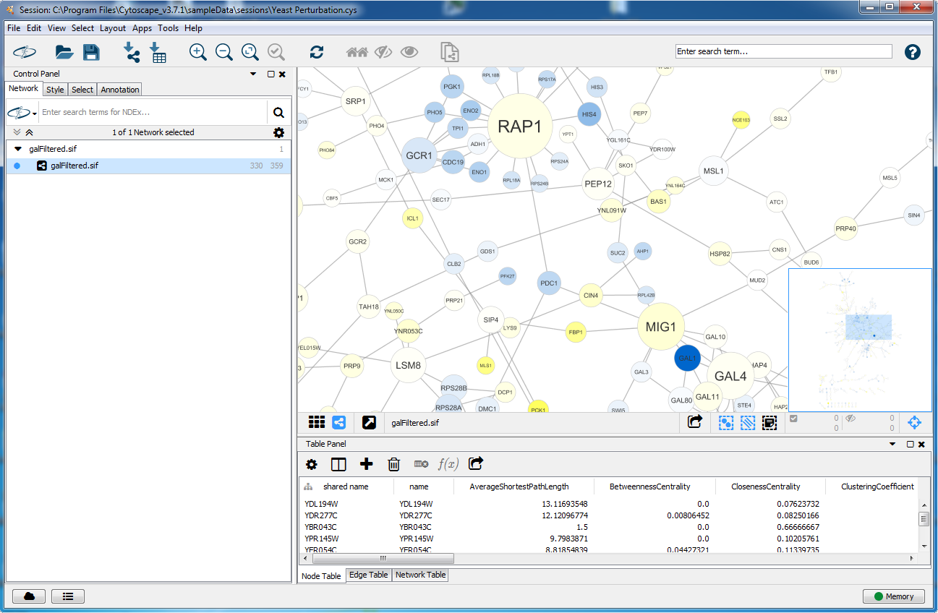
Cytoscape
https://cytoscape.org/
Topics
Graph/network models
Cytoscape GUI overview
Data sources
Data integration
Apps overview
Notes:
Title

Slide 3
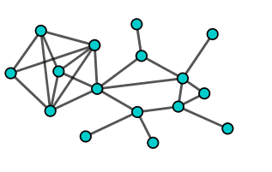
Cytoscape: Data model
Anatomy of a Graph
Graph Theory
Might be directed
Béla Bollobás. Modern Graph Theory.
Springer. ISBN 978-0-387-98488-9 (https://link.springer.com)
Edges
Richard J. Trudeau Introduction to Graph Theory.
Dover. ISBN: 978-0-486-67870-2
Gary Chartrand. Introductory Graph Theory. Dover. ISBN: 978-0-486-24775-5
Béla Bollobás. Random Graphs.
Cambridge University Press. ISBN: 978-0-521-80920-7
Vertices
(aka Nodes)
Popular Science
Albert-László Barabási. Linked: The New Science of Networks. Perseus Books Group. ISBN 978-0-738-20667-7.
Network = Graph + Attributes
Notes:
Title

Slide 4
Cytoscape: Data model
Interaction Networks
Anatomy of a Graph
Graph is just an abstract model...
All interactions are binary
No time dependence
No spatial information
Might be directed
Edges
Vertices/Nodes represent genes or molecules with varying level of detail
One node – one gene
One node – one protein
One node – one protein state
One node – one protein domain
Edges represent interactions
Molecular interactions
Genetic interactions
Functional relationships
Vertices
(aka Nodes)
Network = Graph + Attributes
Notes:
Title

Slide 5
Cytoscape: Data model
Interaction Networks
Anatomy of a Graph
Graph is just an abstract model...
All interactions are binary
No time dependence
No spatial information
Vertices/Nodes represent genes or molecules with varying level of detail
One node – one gene
One node – one protein
One node – one protein state
One node – one protein domain
Physical
Association
P4
B
Edges represent interactions
Molecular interactions
Genetic interactions
Functional relationships
P1
P3
P2
Association
Notes:
Title

Slide 6
Cytoscape: Data model
Anatomy of a Graph
Interaction Networks
Common node attributes
Graph theory-based properties (node degree, centrality, etc)
Gene/protein name
UniprotKB/RefSeq/GeneBank identifier
GO annotation
Cellular localization
Expression/methylation/phosphorylation level
Enzymatic activity
...
Might be directed
Edges
Common edge attributes
Graph theory-based properties
Interaction type
Experimental method
Number of supporting experiments
Expression level correlation
Quality score
....
Vertices
(aka Nodes)
Network = Graph + Attributes
Notes:
Title

Slide 7
Cytoscape
https://cytoscape.org/
Key features
Open source, written in Java
Windows/Mac/Linux
Network visualization
Data integration
Expandable through Apps (aka plugins)
Scripting interface
NOTE: Recent issues with
Java JDK license
Notes:
Title

Slide 8
Cytoscape
https://cytoscape.org/
Topics
Graph/network models
Cytoscape GUI overview
Data sources
Data integration
Apps overview
Notes:
Title

Slide 9
Cytoscape: GUI
GUI Anatomy
Zoom In/Out
Online Help
Network Panel
View/edit current view of the network
Switch between different views of the network
Control Panel
Select network view
Select/edit network view style
Annotate network view
Filter network
Table Panel
View/edit node and edge attributes
View network table
Notes:
Title

Slide 10
Cytoscape: GUI
Layout modifications
Individual nodes
Select (LBM) and drag
Groups of nodes
Select (shift-LBM)
Drag (LBM) to translate
Use Tool Panel to translate and scale
Entire network
Use layout menu
Some algorithms work on node selections
Notes:
Title

Slide 11
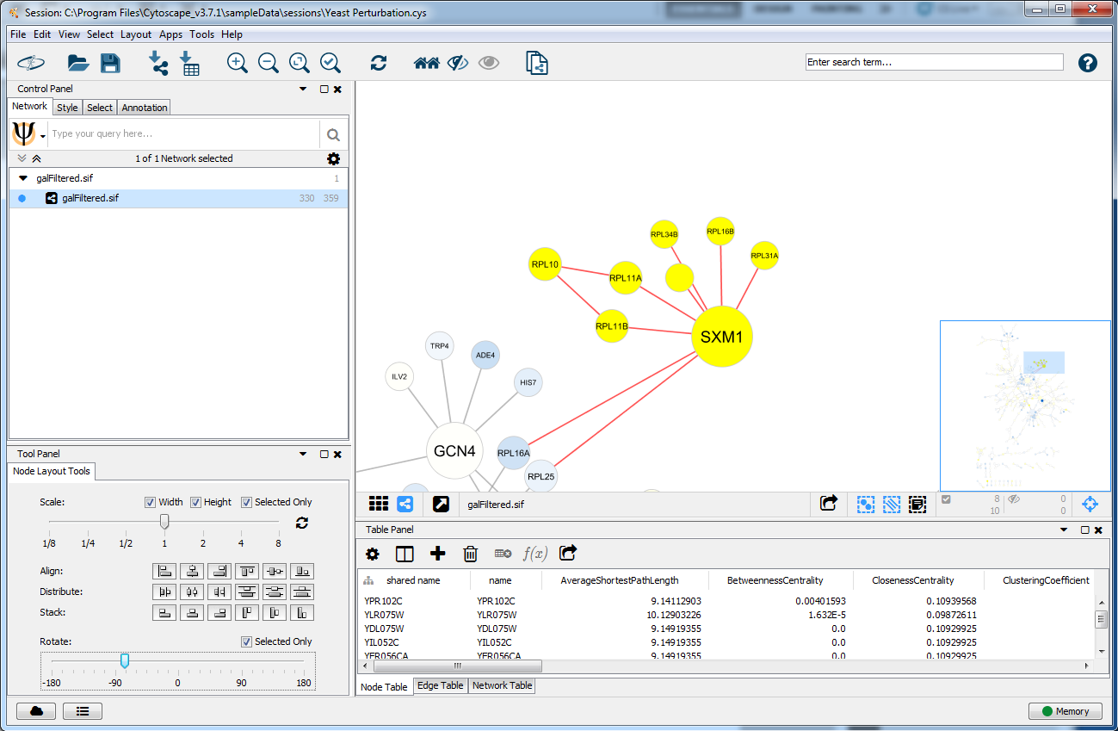
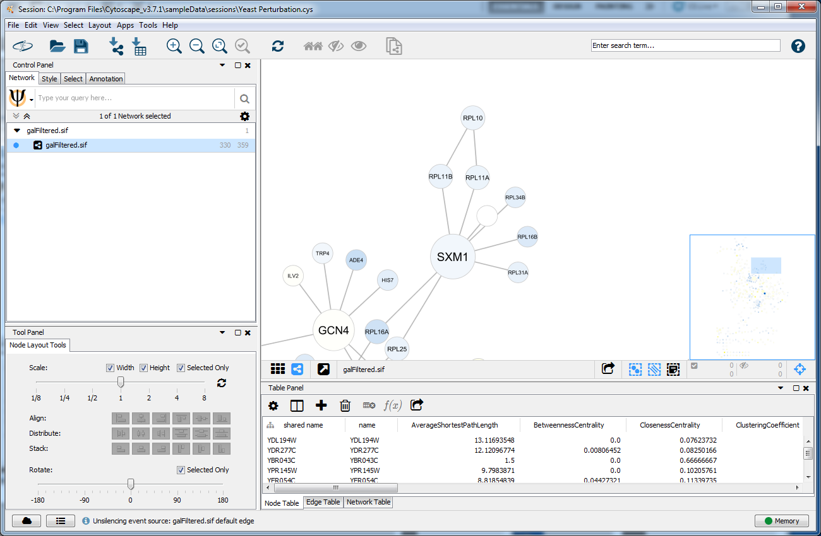
Cytoscape: GUI
Layout modifications
Individual nodes
Select (LBM) and drag
Groups of nodes
Select (shift-LBM)
Drag (LBM) to translate
Use Tool Panel to translate and scale
Entire network
Use layout menu
Some algorithms work on node selections
Notes:
Title

Slide 12
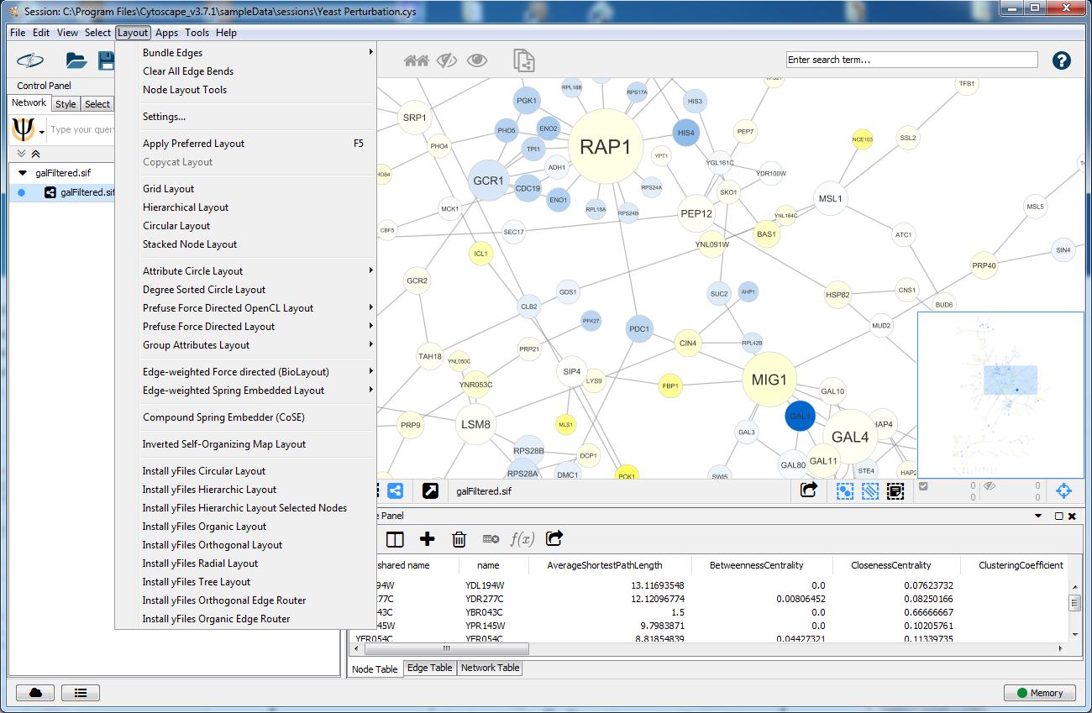
Cytoscape: GUI
Layout modifications
Individual nodes
Select (LBM) and drag
Groups of nodes
Select (shift-LBM)
Drag (LBM) to translate
Use Tool Panel to translate and scale
Entire network
Use layout menu
Some algorithms work on node selections
Notes:
Title

Slide 13
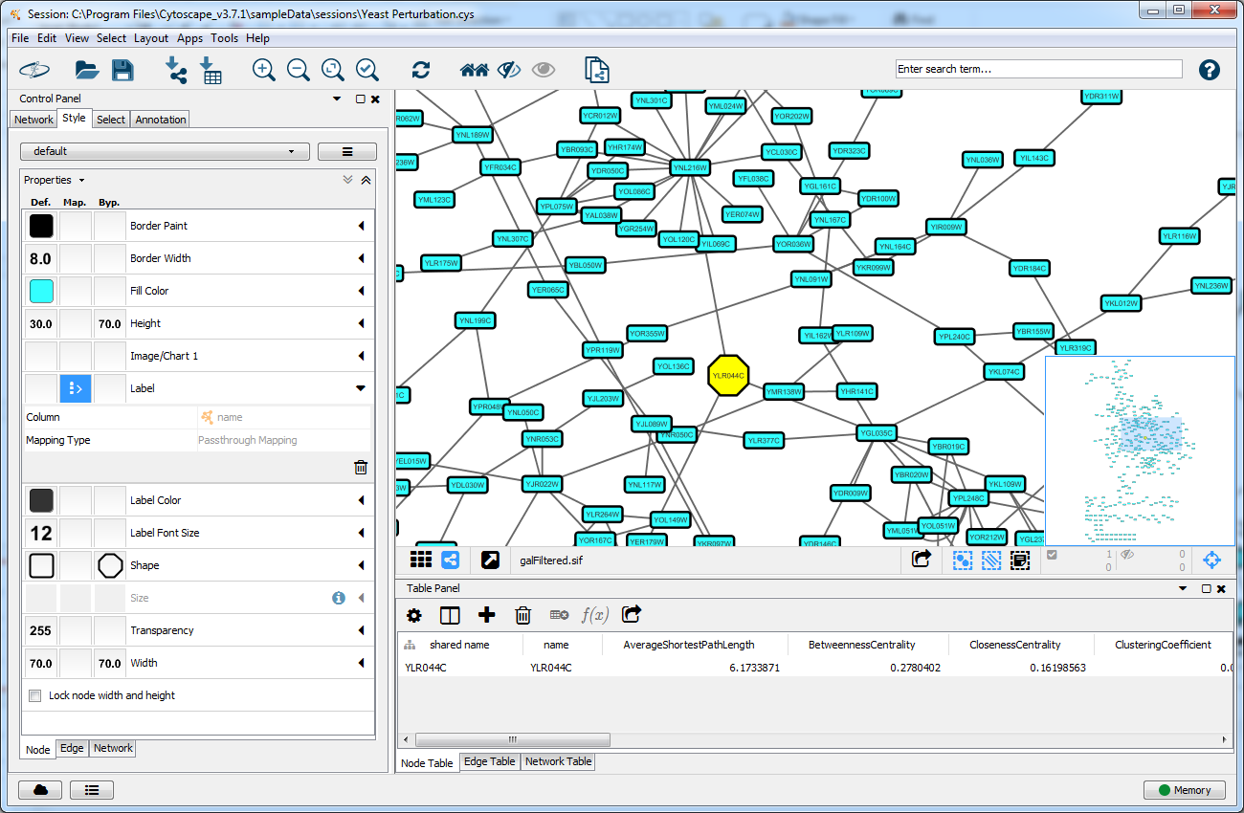
Cytoscape: GUI
Style modifications
Default
Mapped
Passthrough Mappers
Directly uses column values (e.g. name column values shown as node labels)
Continuous Mappers
Scales column values (numbers)
Converts column values (numbers) into color scale
Discrete Mappers
Converts discrete values (numbers or text) into numbers
Converts discrete values (text or numbers) into colors
Bypass
Bypass
Custom style for a specific node/edge
Notes:
Title

Slide 14
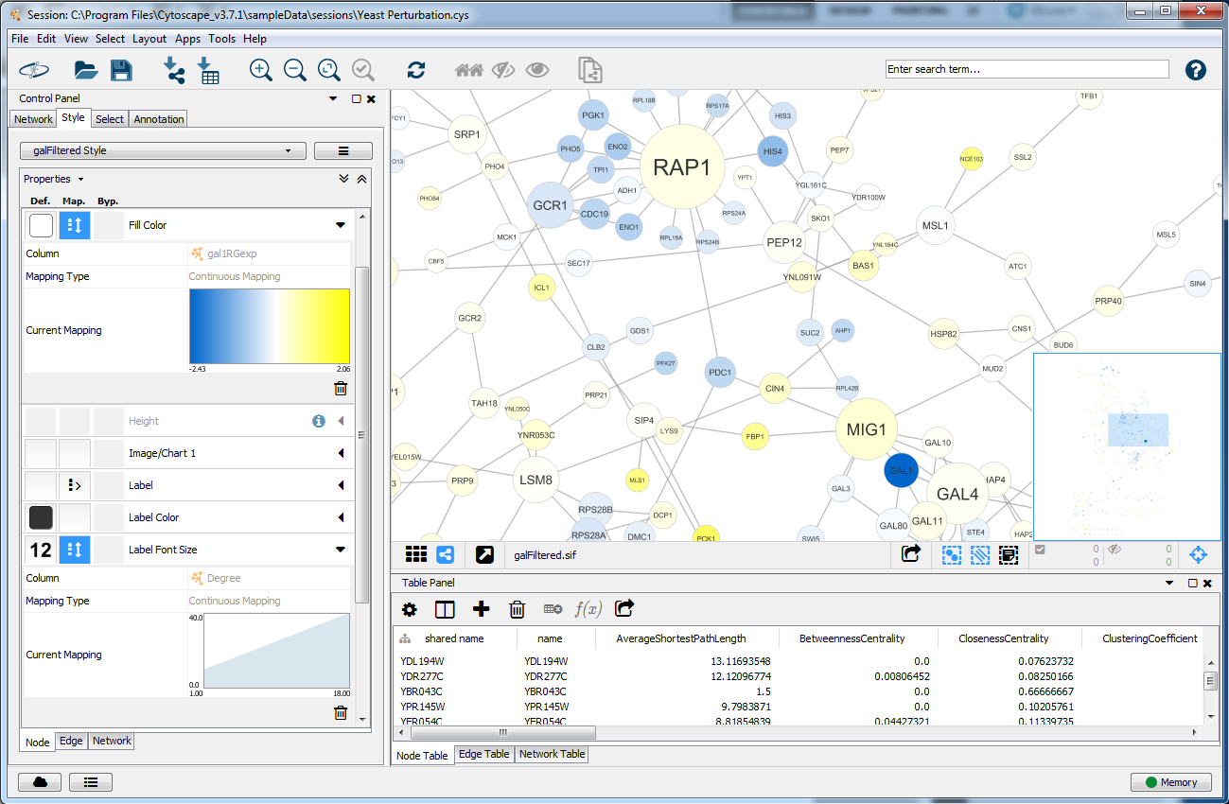
Cytoscape: GUI
Style modifications
Mapped
Passthrough Mappers
Directly uses column values (e.g. name column values shown as node labels)
Continuous Mappers
Scales column values (numbers)
Converts column values (numbers) into color scale
Discrete Mappers
Converts discrete values (numbers or text) into numbers
Converts discrete values (text or numbers) into colors
Bypass
Custom style for a specific node/edge
Notes:
Title

Slide 15
Cytoscape: GUI
Style modifications
Image/Chart
Node Paint
Display node as an image
Display node as a chart
Notes:
Title

Slide 16
Cytoscape
https://cytoscape.org/
Topics
Graph/network models
Cytoscape GUI overview
Data sources
Data integration
Apps overview
Notes:
Title

Slide 17
Cytoscape: Data Sources
SIF format
SIF
Common Edge Types
-----------------
pp .. protein - protein
pd .. protein - DNA
gl .. genetic lethal
pm .. protein-metabolite
mp .. metabolite-protein
Interaction Type (arbitrary)
Molecule name (arbitrary)
MoleculeA pp MoleculeB
MoleculeA pp MoleculeB1 MoleculeB2 MoleculeB3
...
Molecule Property File
Interaction Property File
Molecule Name
Property
Interaction Name
Property
MoleculeA = Value1
MoleculeB = Value2
...
MoleculeA (pp) MoleculeB1 = Value1
MoleculeA (pp) MoleculeB2 = Value2
...

Slide 18
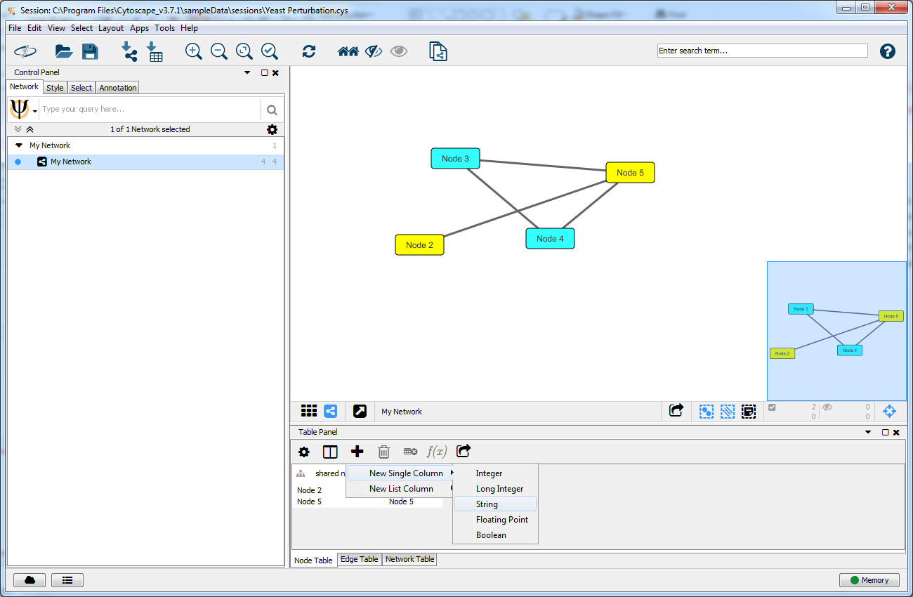
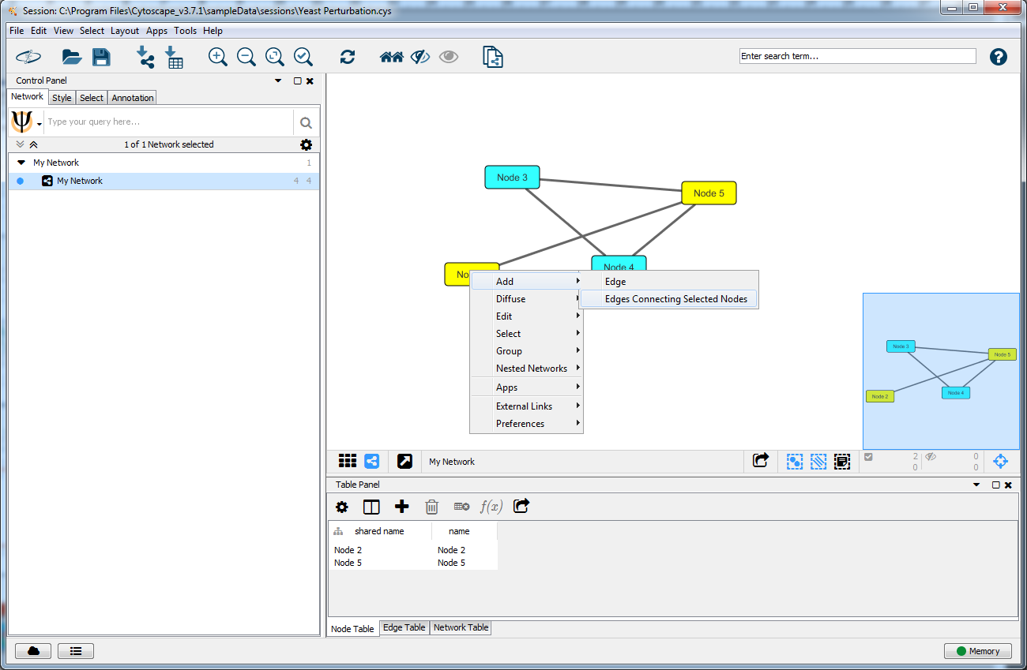
Cytoscape: Data Sources
Manual Entry
Data entry modes
SIF (native) file format
By hand
File import
Built-in Web services
Apps
Notes:
Title

Slide 19
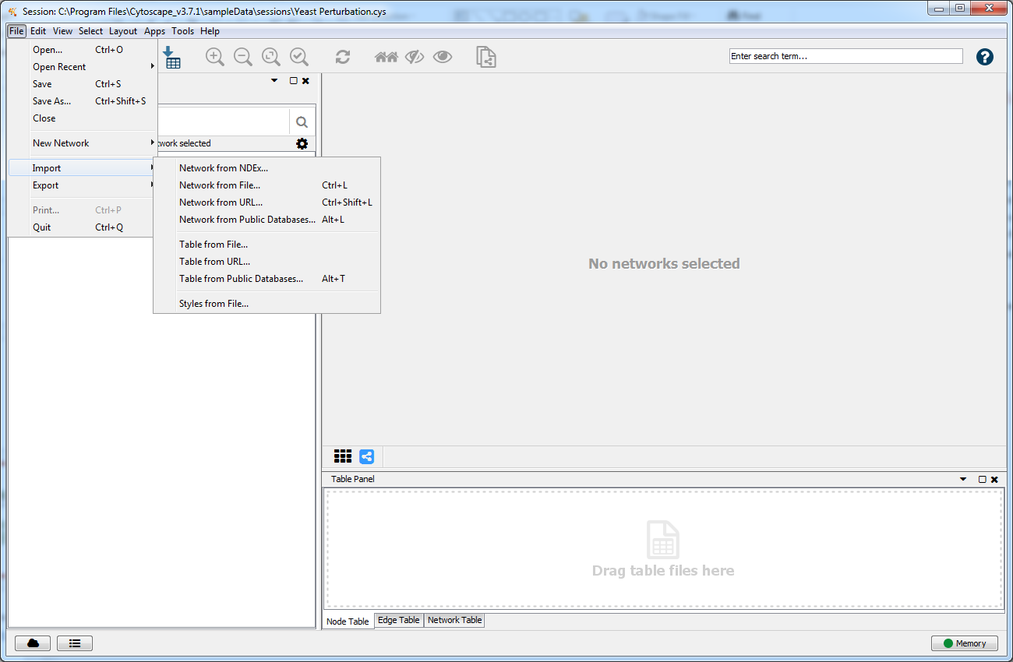
Cytoscape: Data Sources
File Import
Data entry modes
SIF (native) file format
By hand
File import
Delimited text
Excel Workbooks
PSI-MI Level 1 and 2.5
Graph Markup Language (GML)
XGMML
GraphML
SBML
BioPAX
Nested network format (NNF)
Cytoscape.js JSON
Cytoscape CX
Notes:
Title

Slide 20
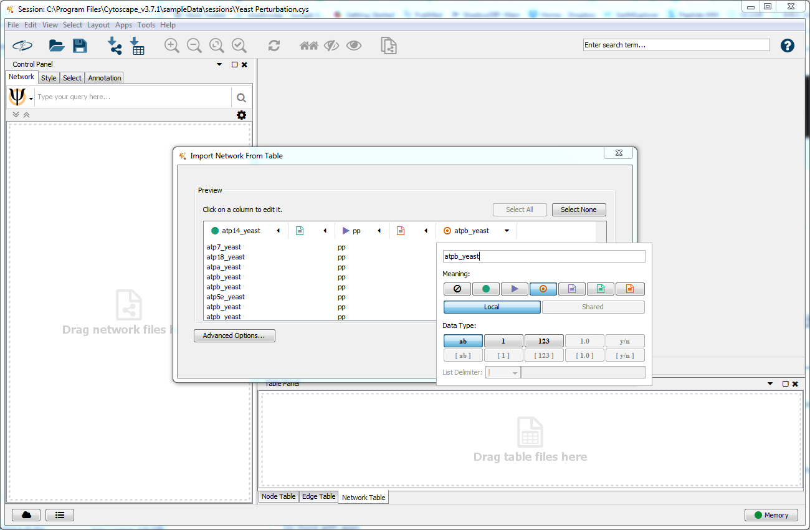
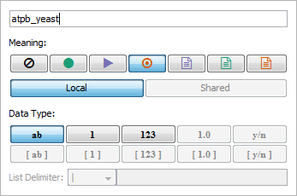
Cytoscape: Data Sources
Tabular data
File types
Text flies (arbitrary delimiter)
Excel files (.xls, .xlsl)
Network
and/or
Annotation

Slide 21
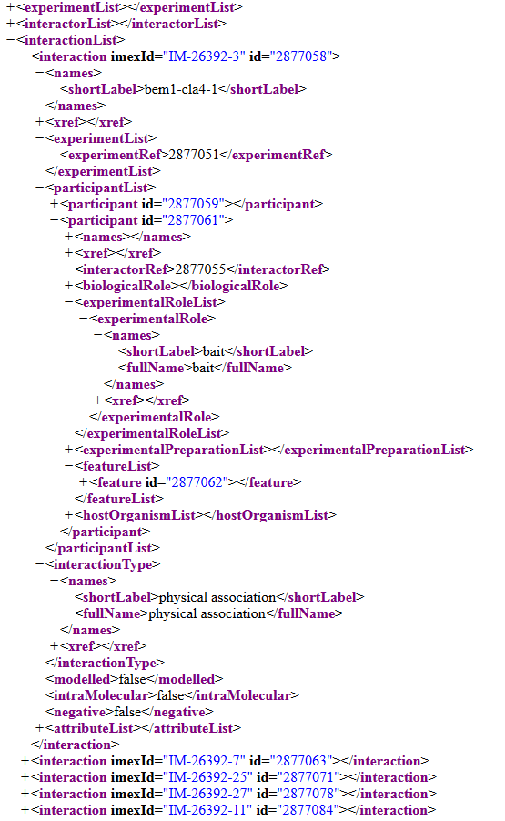
Cytoscape: Data Sources
PSI-MI XML (MIF) Files
Interaction Record
Interaction Experiment
Interaction Detection Method: Pull down (MI:0096)
Experiment Host/Cell Line: in vitro
Interaction Type: Direct (MI:0407)
Participant List
1
2
Molecule Type: Protein (MI:0326)
Molecule Name: Cellular tumor antigen p53
Molecule Symbol: p53
Species of Origin: Human (Taxid:9606)
Cross-reference(s): P04637-1 (UniProtKB), NP_00537, (RefSeq), …
…
N
Experimental Role: Bait (MI:0496)
Experimental Source: E.coli K12 (Taxid: 83333)
Identification method(s): Predetermined (MI:0396)
Features:
1
2
Feature Type: Sufficient binding region (MI:0442)
Feature Range: 1-73
Identification Method: Deletion analysis (MI:0033)
…
M
Notes:
Title

Slide 22
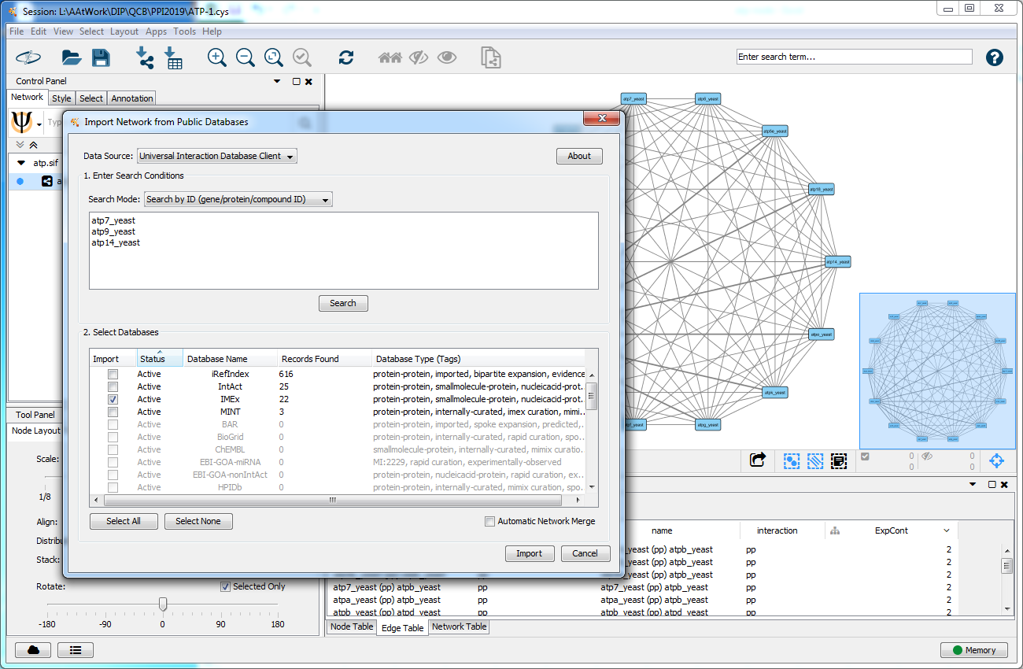
Cytoscape: Data Sources
PSICQIUC Client
Data entry modes
SIF (native) file format
By hand
File import
Universal DB Client (PSICQUIC)
Notes:
Title

Slide 23
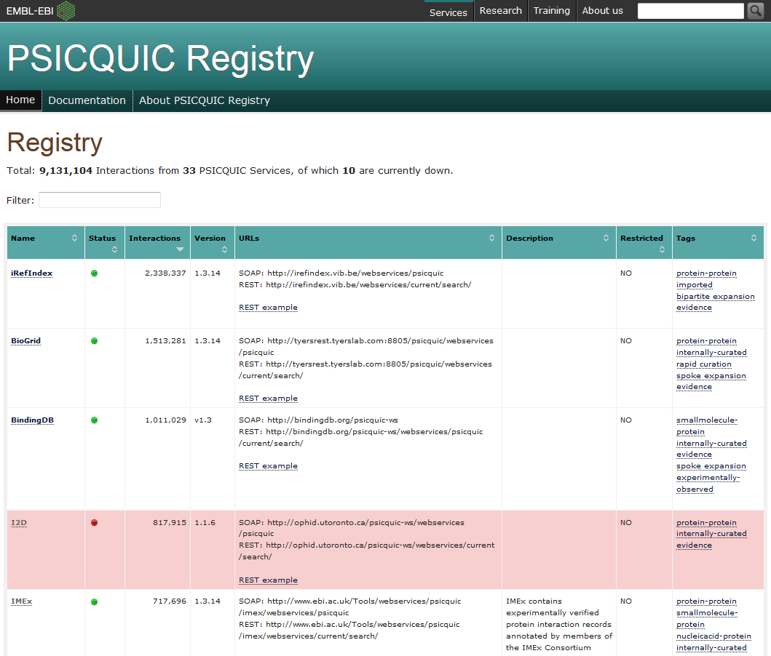
Interaction Data Sources
Registry: https://www.ebi.ac.uk/Tools/webservices/psicquic/registry/registry?action=STATUS
Programmatic access to interaction data
SOAP & REST APIs
Results returned as PSI-MI, MITAB, etc
MIQL Queries
(brca1 or brca2) and species:human
(atpa_yeast or atpb_yeast) and type:”physical association”
References
https://psicquic.github.io/MiqlDefinition.html
Aranda et al. PSICQUIC and PSISCORE: accessing and scoring molecular interactions.
Nat Methods. 8:528-9 (2011) PMID:21716279
Nucleic Acids Res. del-Toro et al. A new reference implementation of the PSICQUIC web service.
NAR 41:W601-606 (2013) PMID:2367134
Notes:
Title

Slide 24
Cytoscape: Data Sources
Data Cleanup
Data entry modes
By hand
File import
Universal DB Client (PSICQUIC)
Caveats
Different providers might use different protein identifiers
One edge per experiment
Directed edges
Possible cross-species interactions
A lot of attributes
Often requires cleanup !!!
Notes:
Title

Slide 25
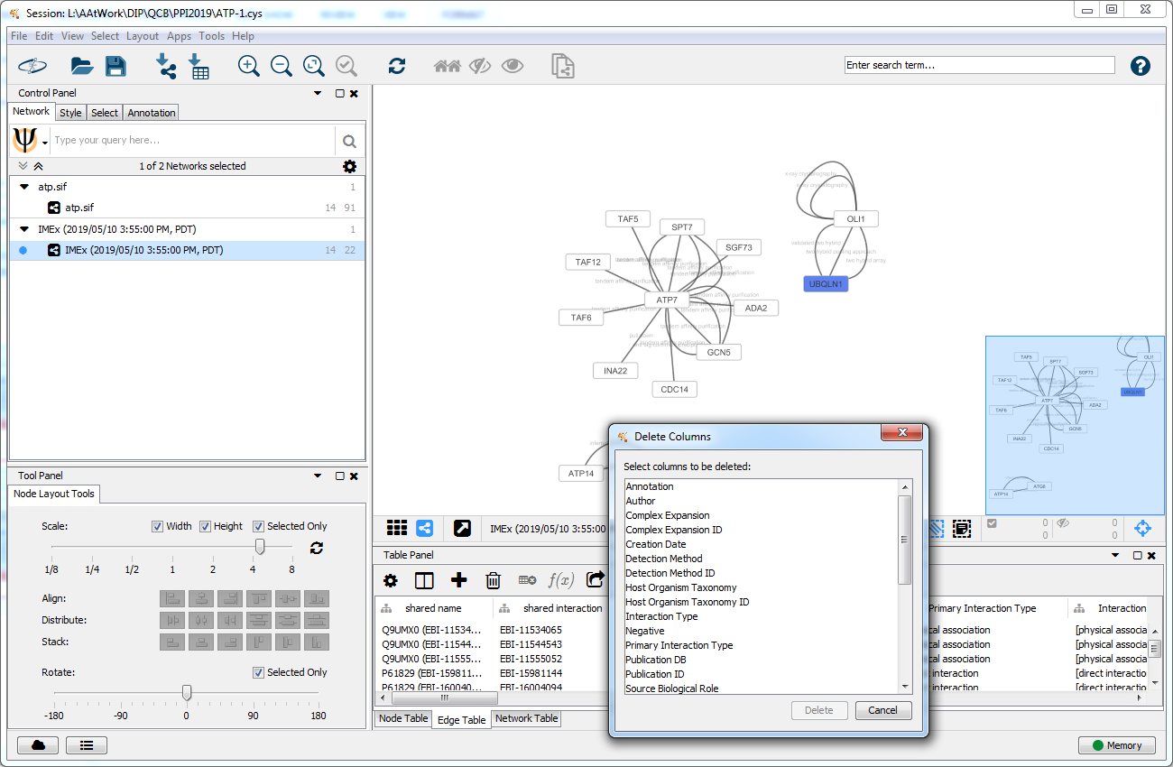
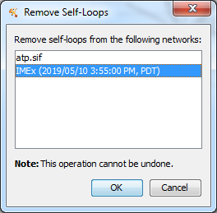
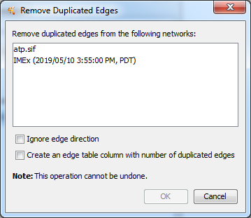
Cytoscape: Data Sources
Data Cleanup
Data entry modes
By hand
File import
Universal DB Client (PSICQUIC)
Caveats
Different providers might use different protein identifiers
One edge per experiment
Directed edges
Possible cross-species interactions
A lot of attributes
Often requires cleanup !!!
Notes:
Title

Slide 26
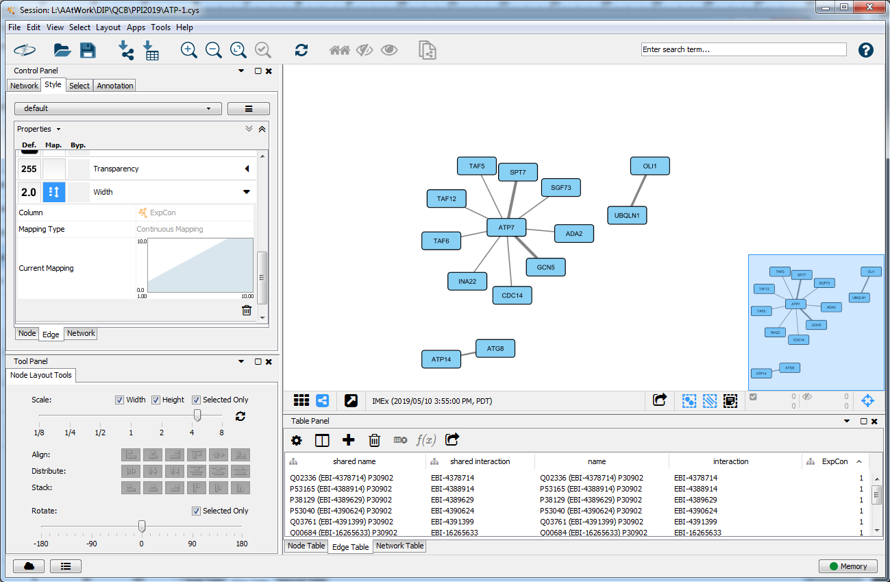
Cytoscape: Data Sources
Data Cleanup
Data entry modes
By hand
File import
Universal DB Client (PSICQUIC)
Caveats
Different providers might use different protein identifiers
One edge per experiment
Directed edges
Possible cross-species interactions
A lot of attributes
Often requires cleanup !!!
Notes:
Title

Slide 27
Notes:
Title

Slide 28
Notes:
Title

Slide 29
Cytoscape: Data Sources
Data entry modes
Manual
File import
Built-in Web services
Apps
Notes:
Title

Slide 30
Notes:
Title

Slide 31
Notes:
Title

Slide 32
Cytoscape: GUI
Style modifications
Node Paint
Mapped
Directly uses column values (e.g. name column values shown as node labels)
Node labels
Scales column values (numbers)
Converts column values (numbers) into color scale
Notes:
Title

Slide 33
Cytoscape: GUI
Style modifications
Node Paint
Mapped
Directly uses column values (e.g. name column values shown as node labels)
Node labels
Scales column values (numbers)
Converts column values (numbers) into color scale
Notes:
Title

Slide 34
Cytoscape: GUI
Editing style
Individual nodes
Select (LBM) and drag
Groups of nodes
Select (shift-LBM)
Drag (LBM) to translate
Use Tool Panel to translate and scale
Entire network
Use layout menu
Some algorithms work on node selections
Notes:
Title

Slide 35
Notes:
Title

Slide 36
Notes:
Title

Slide 37
Notes:
Title

Slide 38
Notes:
Title

Slide 39
Notes:
Title

Slide 40
Notes:
Title

