Slide 1
An Introduction to Python
Day 3
Renaud Dessalles
_{dessalles@ucla.edu}

Slide 2
Writing Modules

Slide 3
Combining what we’ve learnt
Yesterday we learnt a lot of different bits of Python.
Let’s summarize that knowledge by writing a module of functions to do various analysis on values in a list.
Notes:
Advanced features: object orientated

Slide 4
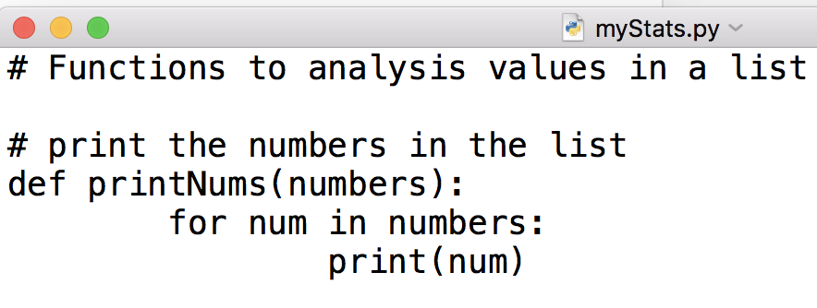
myStats.py
In a text editor:
Comment your code well so you remember what it does when you look at it again.
Notes:
Advanced features: object orientated

Slide 5
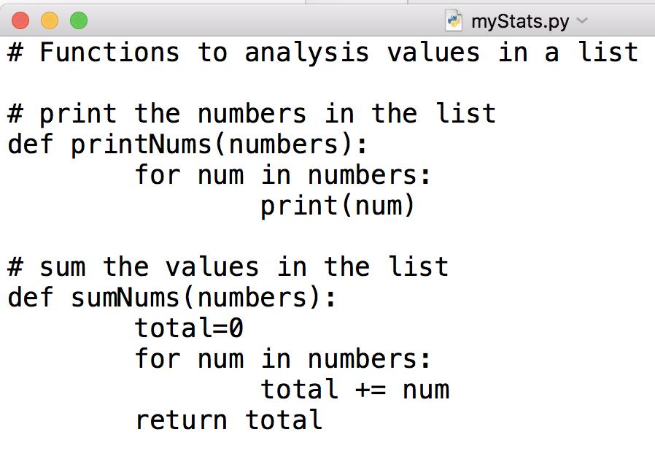
myStats.py
A function to sum values:
Notes:
Advanced features: object orientated

Slide 6
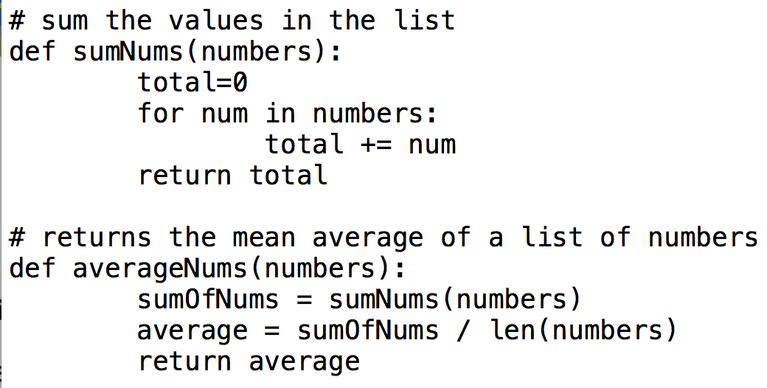
myStats.py
A function to average numbers:
Reminder: in Python2, should put a float somewhere
Notes:
Advanced features: object orientated

Slide 7
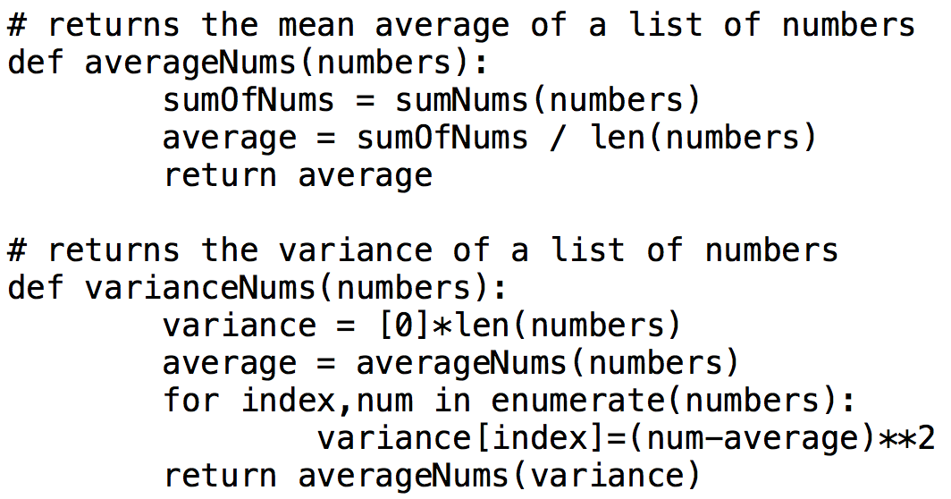
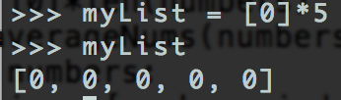
myStats.py
A function to calculate the variance:
Notes:
Advanced features: object orientated

Slide 8
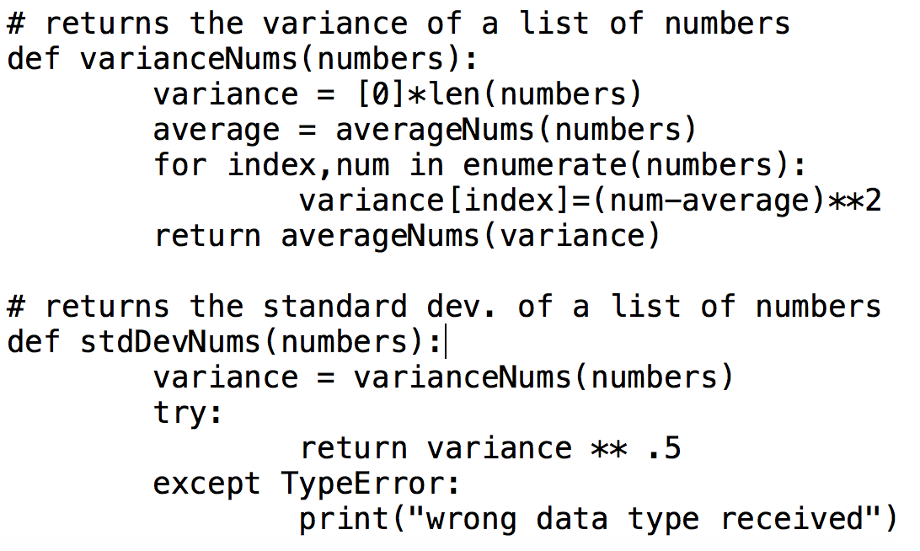
myStats.py
A function to calculate the population standard deviation using the variance
Notes:
Advanced features: object orientated

Slide 9
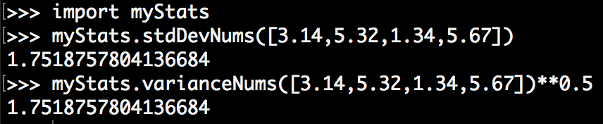
myStats.py
Test it
Notes:
Advanced features: object orientated

Slide 10
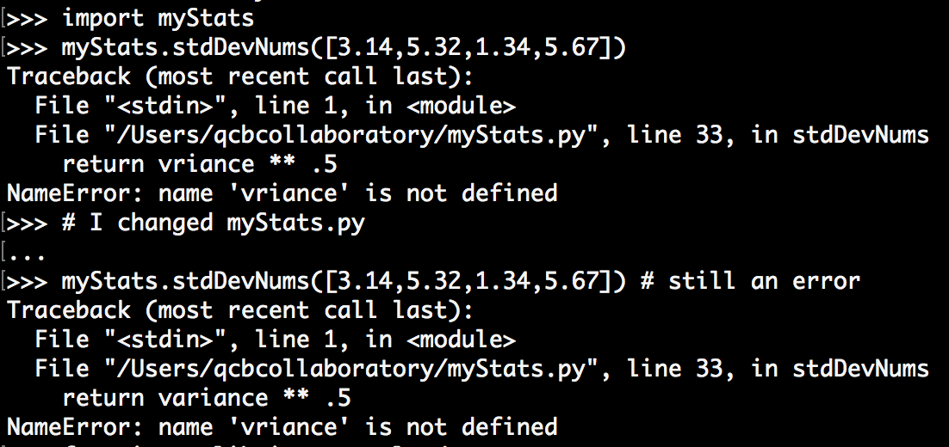
Reload modules
Problem when debugging a module:
Solution 1 : Exit python, re-open python and import again
Solution 2 : reload the module
An error
Have edited myStat.py
The error
still occurs

Slide 11
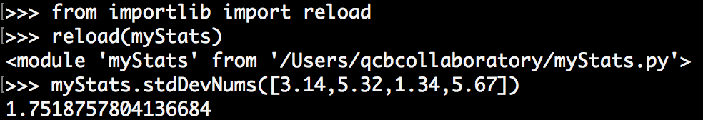
Python 2 vs 3: Reload modules
Python2
reload is directly available
Python3
Need to import reload via importlib

Slide 12
Other features

Slide 13
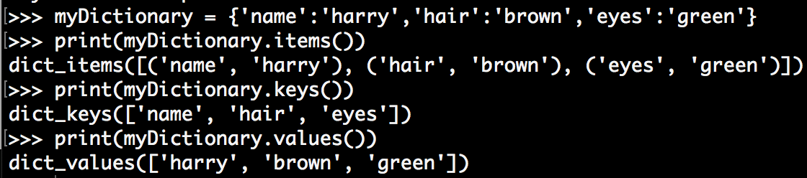
More Dictionary Methods
.items() returns key value pairs
.keys() returns just the keys
.values() returns just the value
This is useful so we can iterate over dictionaries more easily…
Note: in Python2, they returns simple lists
Notes:
Advanced features: object orientated

Slide 14
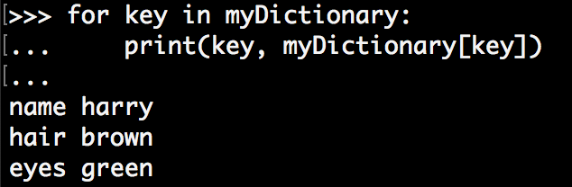
Iterating over dictionaries
Let’s iterate over the keys:
Notes:
Advanced features: object orientated

Slide 15
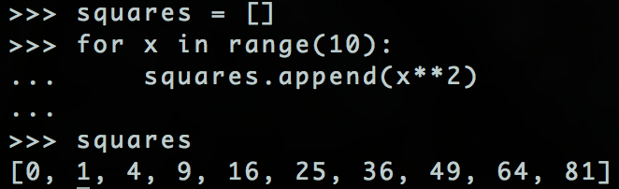
List Comprehension
If we want to create a list that is a modified version of an existing list we usually do something like this:
Python offers an easy alternative!
Notes:
Advanced features: object orientated

Slide 16
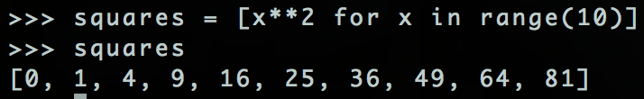
List Comprehension
Notes:
Advanced features: object orientated

Slide 17
List Comprehension
To create a list this way:
newList = [expression for value in oldList]
Notes:
Advanced features: object orientated

Slide 18
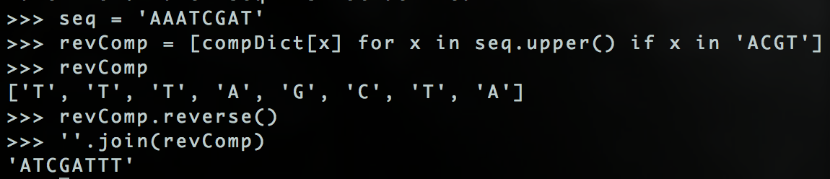
List Comprehension
Reverse complement function we wrote previous in much less code!
Have to reverse() the list and then use a string method (join) to turn the list of characters into a string.
Notes:
Advanced features: object orientated

Slide 19
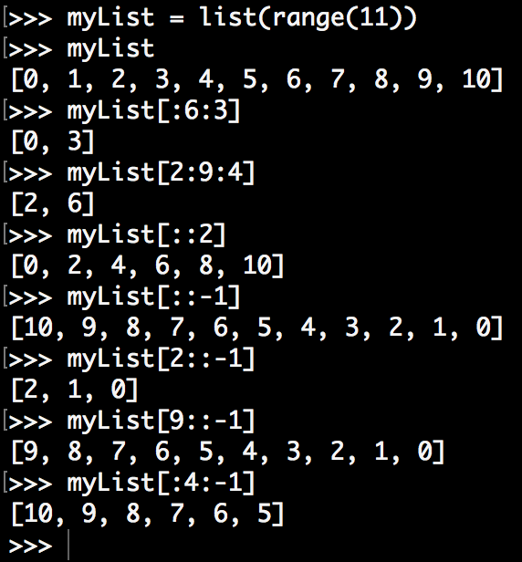
Slicing Up a List (with step)
listName[start:end:step]
From 1st value to 6th, choosing every 3rd value.
From 2nd value to 9th value, choosing every 4th
List with values with only pairwise index
Entire list, every value, in reverse
2nd value down to the beginning
9th value down to the beginning
From beginning of list to 4th value, in reverse
Notes:
Advanced features: object orientated

Slide 20
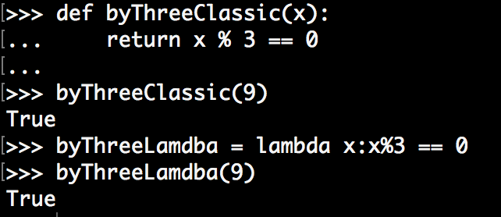
Lambda functions
An alternative way to define a function.
More compact, but also useful in conjunction with other functions.
Notes:
Advanced features: object orientated

Slide 21
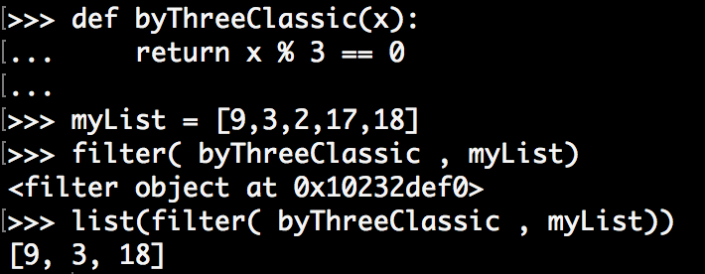
Filters
The function filter(function, list)
Like for range, in Python2, filter would directly returns a list
Notes:
Advanced features: object orientated

Slide 22
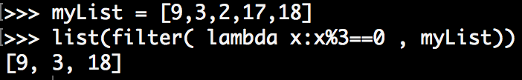
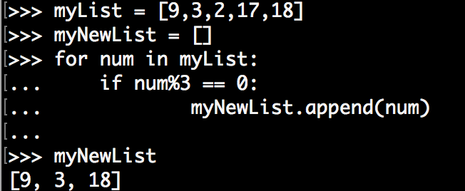
Let’s combine lambda and filter
Only 1 line !
To compare with the old fashioned way :
4 lines

Slide 23
File Input/Output

Slide 24
File Input.
Reading from a file is the main way of getting biological data into Python.
fileVariable = open(“fileName.txt” , “w”)
fileVariable.read(size)
size is optional and specifies how many bytes to read
fileVariable.readLine()
reads and returns a single line of the file
Notes:
Advanced features: object orientated

Slide 25
File Output
Writing results to a file is useful for large data sets and for exporting to other programs to create graphs etc.
fileVariable.write(string)
writes the contents of string to the file.
fileVariable.tell()
returns an integer value representing how far through the file you currently are, in bytes.
fileVariable.seek(offset,0)
change current position in file to offset bytes from the beginning. To offset from current position or end do seek(offset,1) or seek(offset,2) respectively.

Slide 26
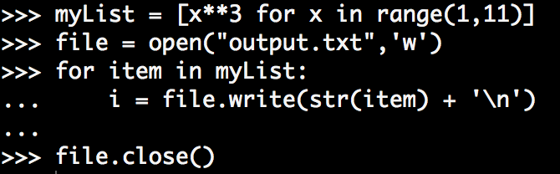
File Input/Output Example.
Write in a file:
Notes:
Advanced features: object orientated

Slide 27
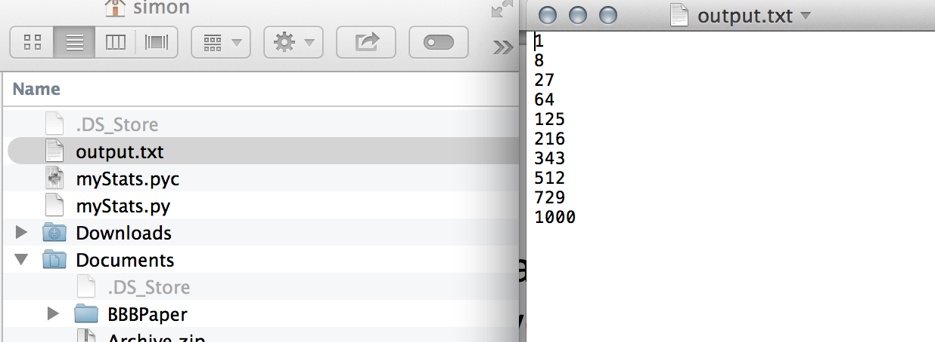
File Output.
Notes:
Advanced features: object orientated

Slide 28
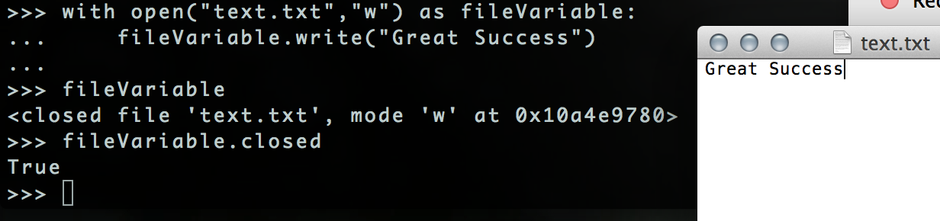
Always close() Files
It’s important to close() a file when you have finished writing or reading from it.
Alternatively use with open() as variable: to automatically close the file after the code is executed.

Slide 29
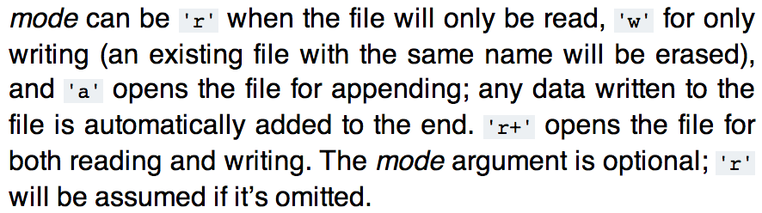
File Mode
What does the “w” do in: Open(“fileName.txt”, “w”)

Slide 30
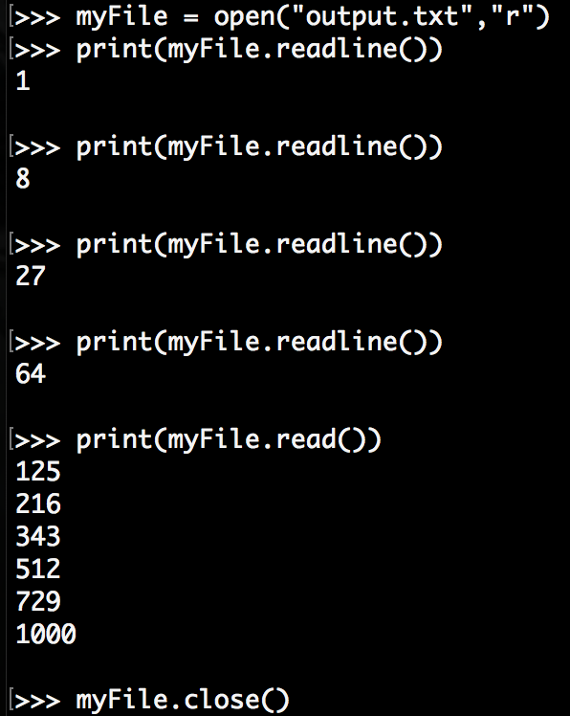
File Mode

Slide 31
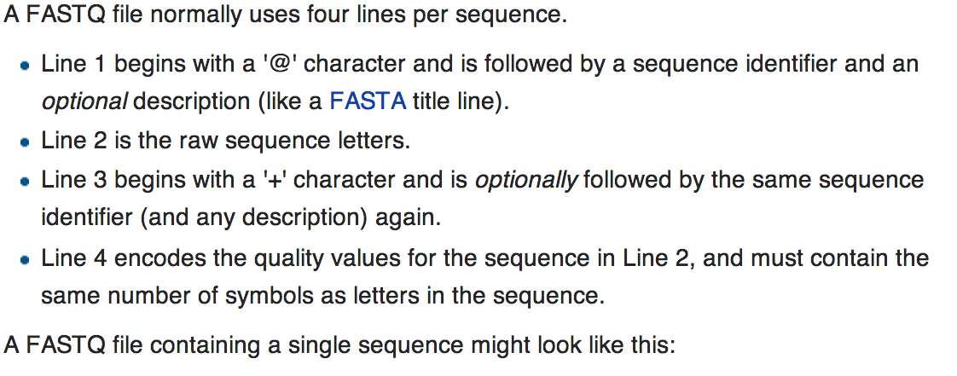
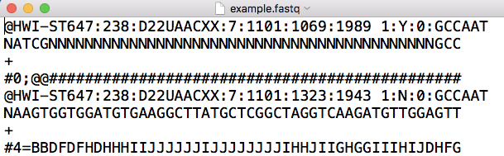
fastQ file
Contain reads for sequencing analysis.

Slide 32
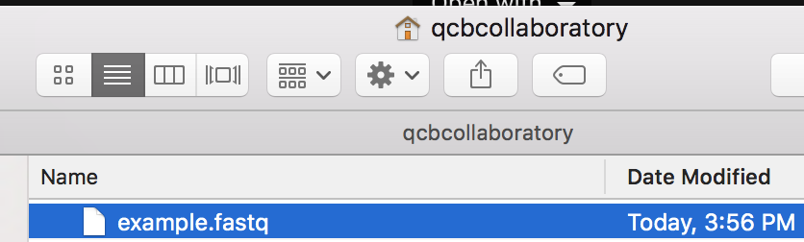
fastQ file
Download the fastQ file at : https://goo.gl/tYYftm
In home directory
.fastq extension

Slide 33
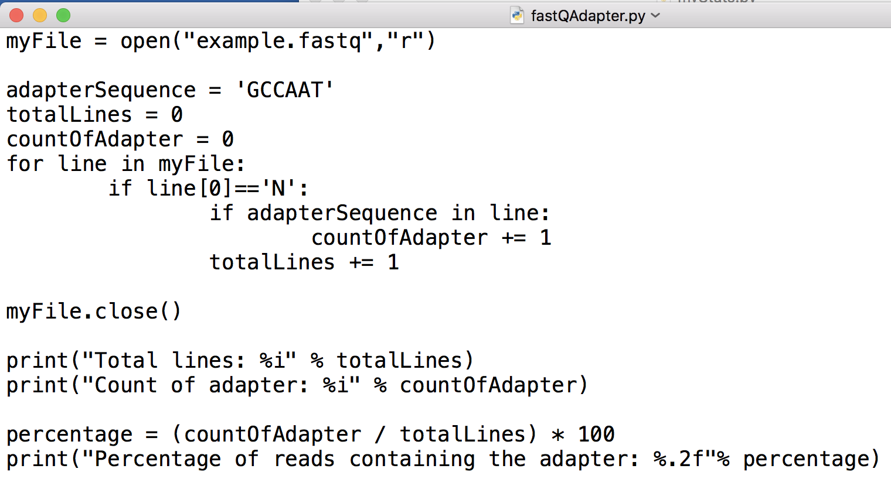
fastQ Example
Code to find which reads contain an adapter sequence
Reminder: in Python2, should put a float somewhere

Slide 34
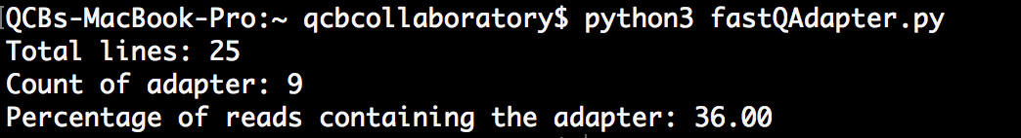
fastQ Example
Let’s test it!

Slide 35

To continue with Python:
Other workshops
http://www.codecademy.com/en/tracks/python

Slide 36
Thanks!
Before you leave please fill out the survey, it really helps us and only has a few tick-boxes:
Surveymonkey.com/r/PythonJun2016
you leave please

