Slide 1
Stock Price Prediction
Using QLSTM
17th May 2025
Kshitij Saxena
Nitesh Deedwania
Nandan Singh
Anita Maurya

Slide 2
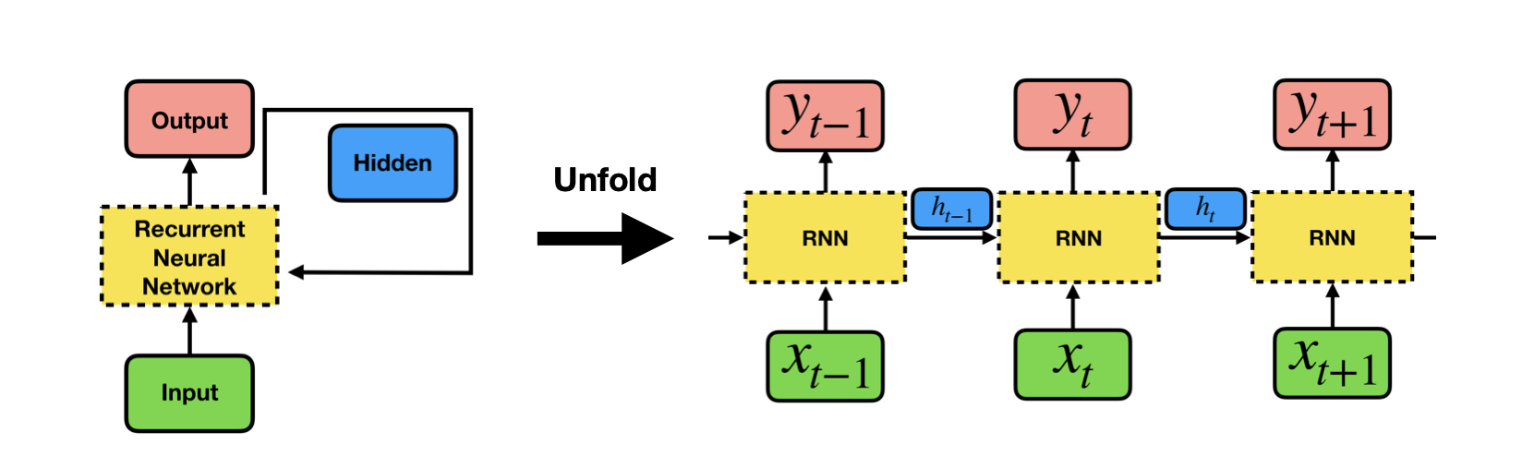
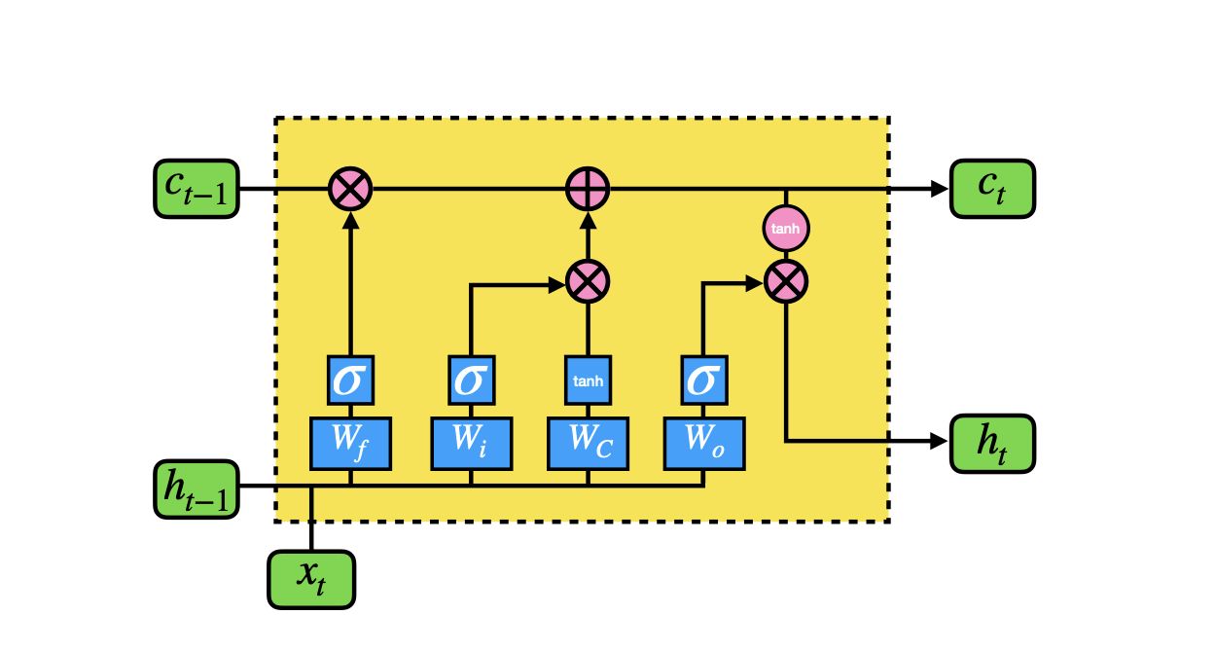
LSTM (Classical)
For Learning most from recent in Time Series Data
Recurring Neural Network are used for time series data.
Cause diminishing gradient as long past reduce effectiveness
Long Short Term Memory model are more promising to learn recent past

Slide 3
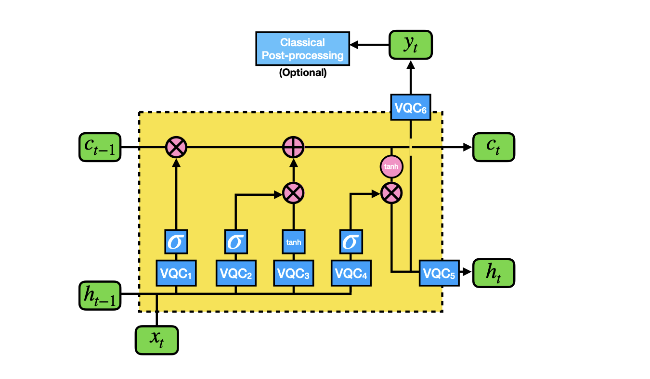
QLSTM (Quantum)
For Learning most from recent in Time Series Data
VQC use in core to implement QLSTM
Xt Input vector
Ct Cell state : Main player to keep the recent state
Ht Hidden: Keeps the all previous memory in series.
Yt Output: Prediction/Label

Slide 4
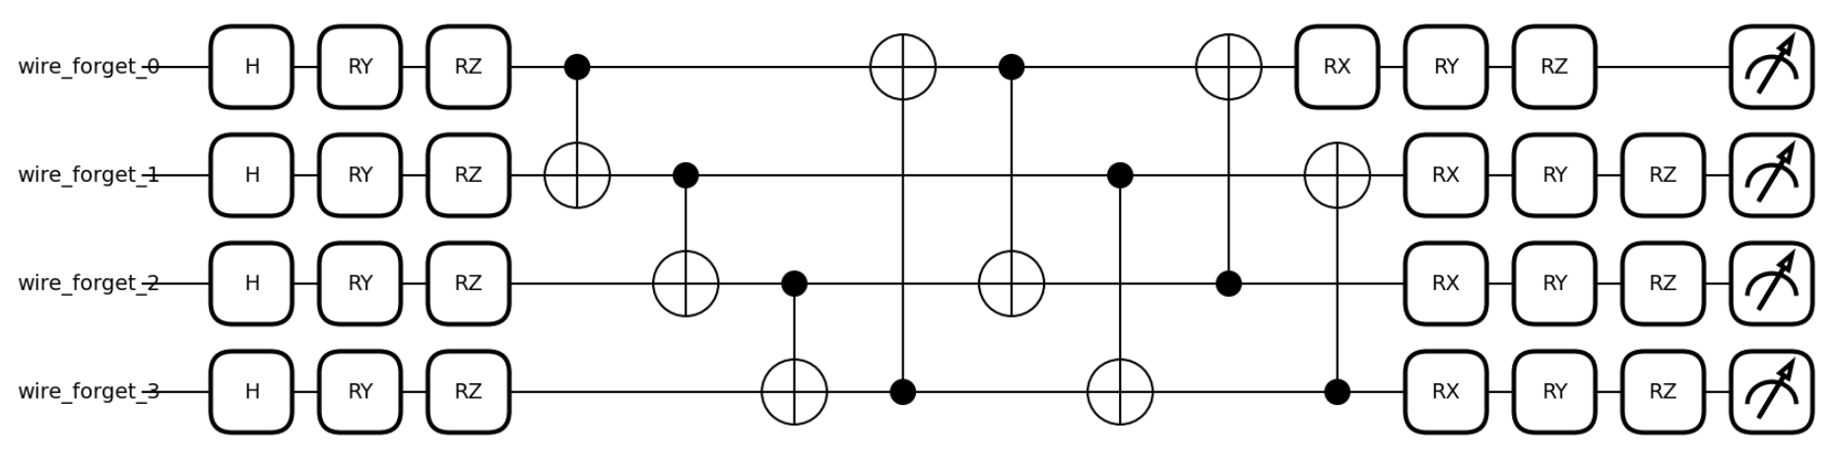
VQC
Core Quantum tool
Data Encoding Layer
We generate 2N rotation angles from the N-dimensional input vector ⃗v= (x1,x2,···,xN) by taking θi,1 = arctan(xi) and θi,2 = arctan(x2i) for each element xi
Taking x2 is for creating higher-order terms after the entanglement operations
Variational Layer
The 3 rotation angles {αi,βi,γi}along the axes x,y,and z, respectively, in the single-qubit rotation gates {Ri = R(αi,βi,γi)}are not fixed in advance; rather, they are to be updated in the iterative optimization process based on a gradient descent method.
Quantum Measurement Layer
The end of every VQC block is a quantum measurement layer. Here we consider the
expectation values of every qubit by measuring in the computational basis

Slide 5
QLTSM
The Neuron gives superior weights to recent activities
ft = σ(VQC1(vt))
it = σ(VQC2(vt))
˜Ct=tanh(VQC3(vt))
ct=ft∗ct−1+it∗˜Ct
ot = σ(VQC4(vt))
ht=VQC5(ot∗tanh(ct))
yt=VQC6(ot∗tanh(ct))

Slide 6
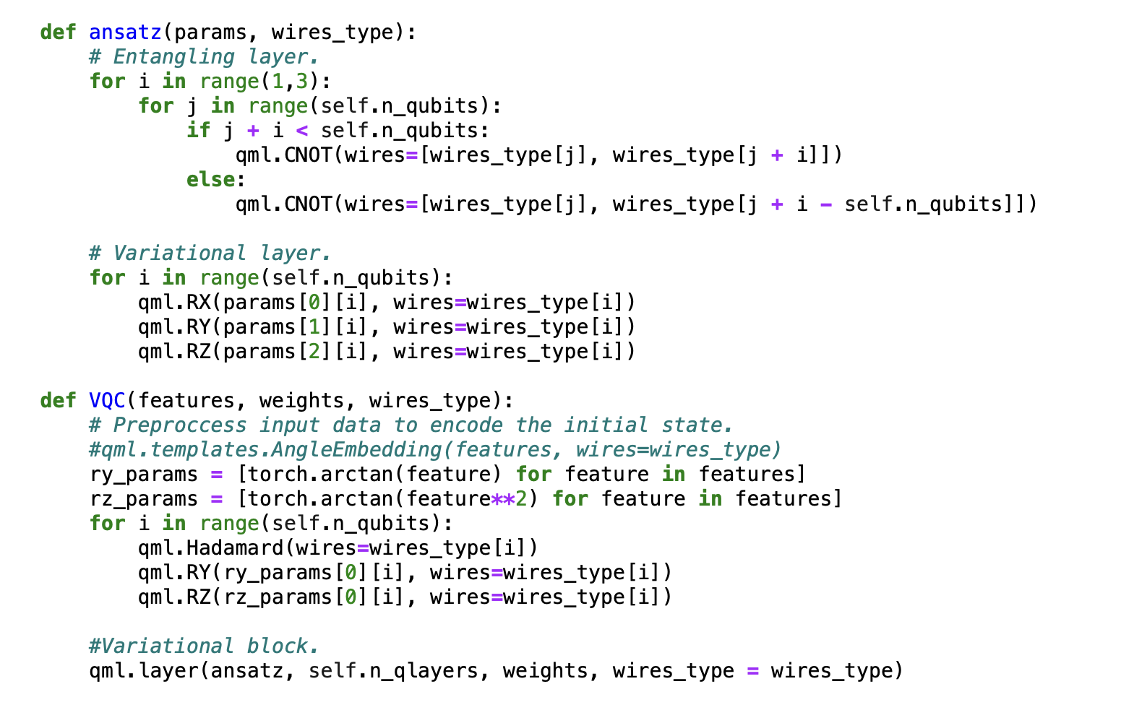
VQC (Code)

Slide 7
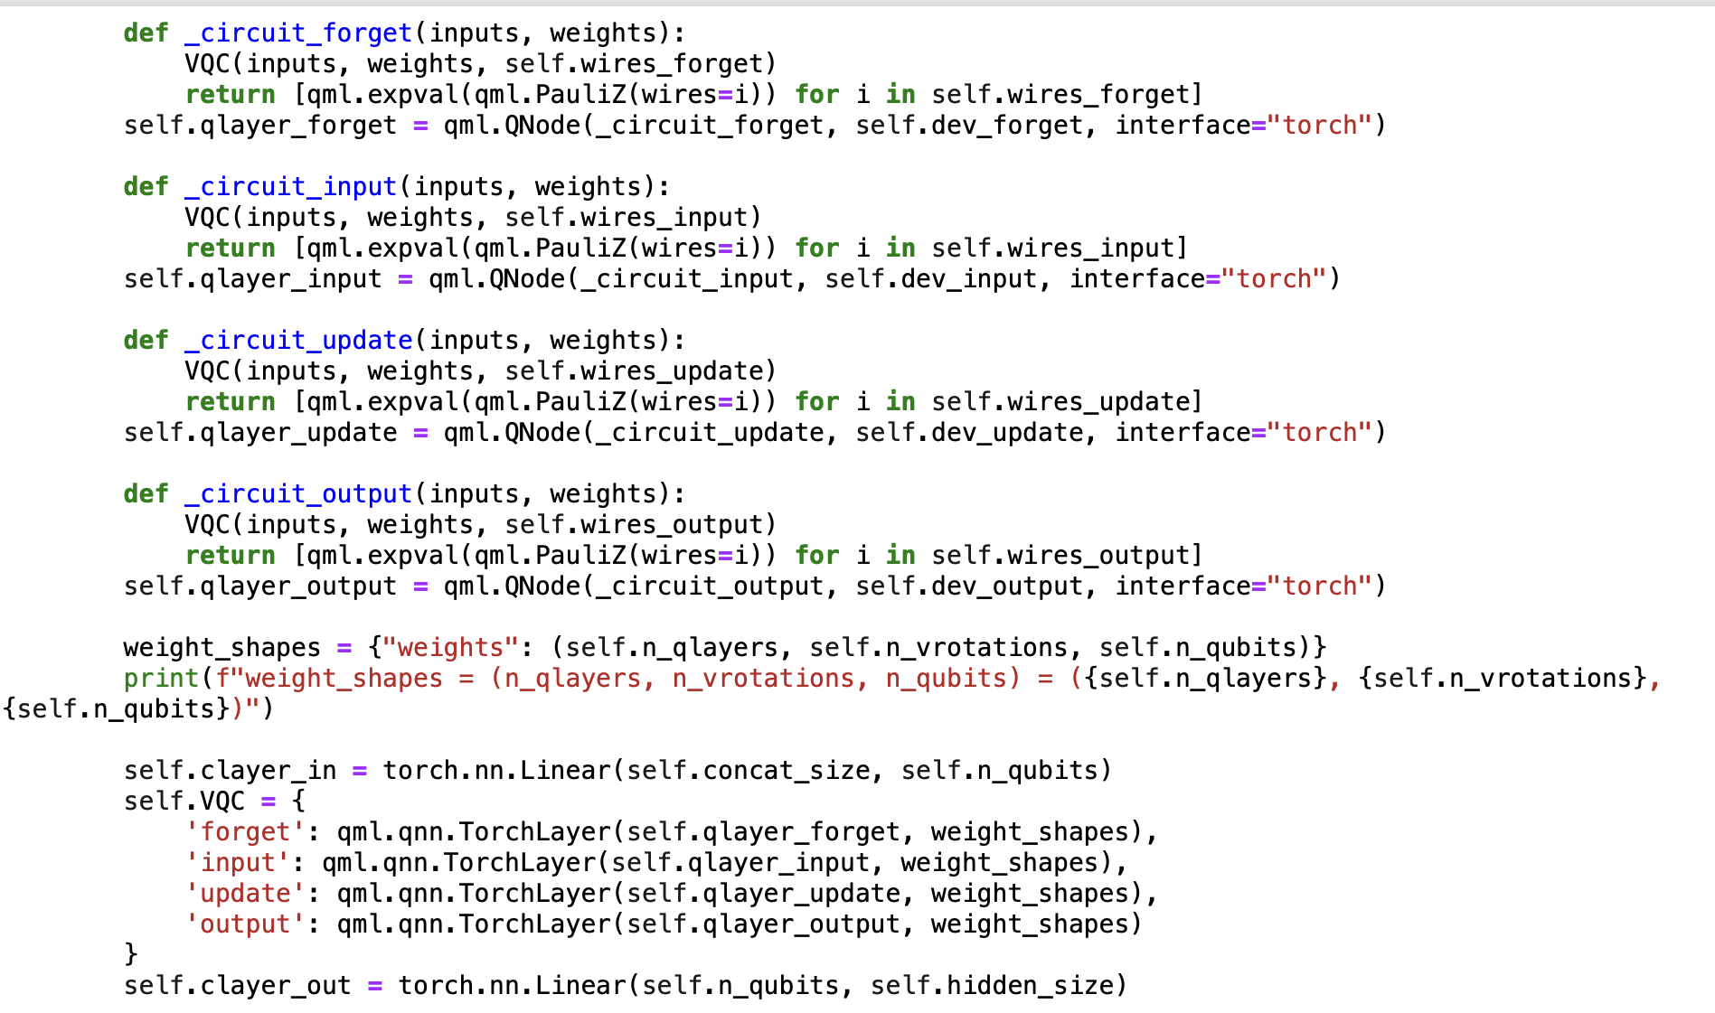
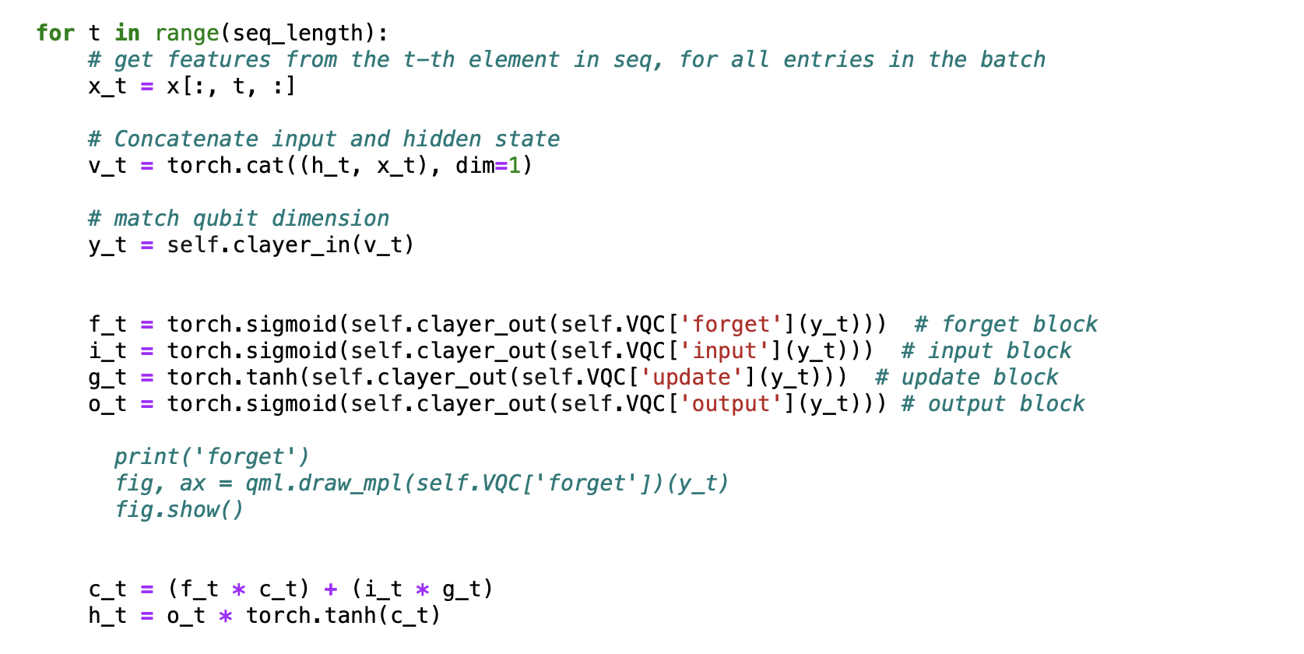
QLSTM Cell (Code)

Slide 8
Comparison Prices
QLSTM/LSTM/Real

Slide 9
Comparison Loss
QLSTM/LSTM/Real

