Slide 1



Programming in Python,
without messing it up
Toon Verstraelen
Center for Molecular Modeling (CMM), Ghent University, Belgium
Universidad de Concepción, Chile
January, 2019

Slide 2

You know Python. Great!
Now the real fun begins...
¿Reliable software?
¿Managing complexity?
¿Sustainable software development?

Slide 3

¿How to debug?
¿How to avoid bugs?

Slide 4
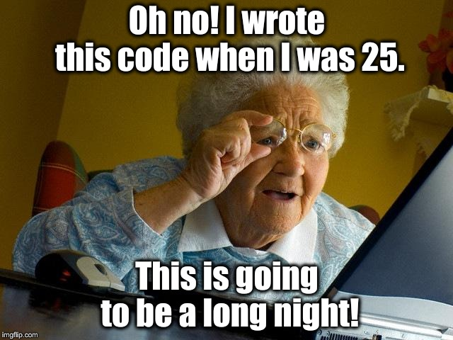

Slide 5
Write code in style
= rules for readability
In general, adhere to PEP8
https://www.python.org/dev/peps/pep-0008/
Tools:
  pip install --user pycodestyle
  Checks a subset of PEP8 rules
  pip install --user pydocstyle
  Checks a subset of PEP257 (docstrings)
  pip install --user pylint
  Checks subset of PEP8 and other things.
  Cardboardlint => our wrapper for many checkers

Slide 6
Write transparent code
Single line of code = self-explaining
  Give variables, functions, ... sensible names.
  Not too much stuff in one line. No crazy one-liners.
Comments explain code (implementation)
  English, please.
  Comment on groups of lines, rarely individual lines.
Docstrings explain usage of code (API)
  Document a function, class, module, ...
  Describe parameters, return values, exceptions & behavior

Slide 7
def fire_in_the_disco(msg):
"""Contributed by https://pythondev.slack.com/team/staticmethod
This code was written for obfuscation contest.
"""
reconstitute(msg,wwpd)
try:
f=type((lambda:(lambda:None for n in range(len(((((),(((),())))))))))().next())
u=(lambda:type((lambda:(lambda:None for n in range(len(zip((((((((())))))))))))).func_code))()
n=f(u(int(wwpd[4][1]),int(wwpd[7][1]),int(wwpd[6][1]),int(wwpd[9][1]),wwpd[2][1],
(None,wwpd[10][1],wwpd[13][1],wwpd[11][1],wwpd[15][1]),(wwpd[20][1],wwpd[21][1]),
(wwpd[16][1],wwpd[17][1],wwpd[18][1],wwpd[11][1],wwpd[19][1]),wwpd[22][1],wwpd[25][1],int(wwpd[4][1]),wwpd[0][1]),
{wwpd[27][1]:__builtins__,wwpd[28][1]:wwpd[29][1]})
c=partial(n, [x for x in map(lambda i:n(i),range(int(0xbeef)))])
FIGHT = f(u(int(wwpd[4][1]),int(wwpd[4][1]),int(wwpd[5][1]),int(wwpd[9][1]),wwpd[3][1],
(None, wwpd[23][1]), (wwpd[14][1],wwpd[24][1]),(wwpd[12][1],),wwpd[22][1],wwpd[26][1],int(wwpd[8][1]),wwpd[1][1]),
{wwpd[14][1]:c,wwpd[24][1]:urlopen,wwpd[27][1]:__builtins__,wwpd[28][1]:wwpd[29][1]})
FIGHT(msg)
except:
pass

Slide 8
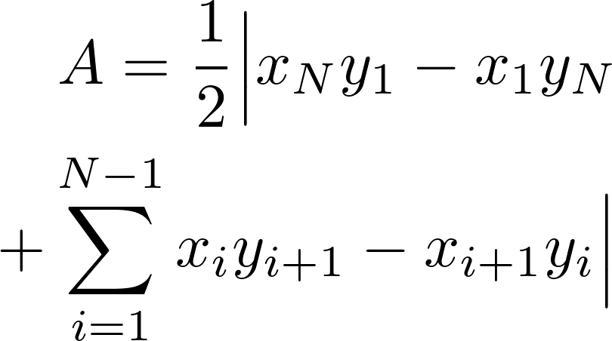
def compute_surface_polygon(x, y):
"""Compute the surface area of a 2D polygon.
Parameters
----------
x : np.array
X-coordinates of the polygon's corners.
y : np.array
Y-coordinates of the polygon's corners.
Returns
-------
area : type of x and y
The surface area of the polygon.
"""
# Shoelace algorithm, Meister, 1769
if len(x) != len(y):
raise TypeError("Arguments x and y must have the same length.")
if len(x) <= 2:
return 0.0
else:
return abs( x[-1]*y[0] + np.dot(x[:-1], y[1:])
-x[0]*y[-1] - np.dot(x[1:], y[:-1]))/2

Slide 9
Write unit tests
= function to validate another function
Runs fast, easy to start
Write tests first, certainly not months later.
Write many!
Think of corner cases
Coverage analysis = check if code is tested

Slide 10
def check_single(x, y, area):
np.testing.assert_almost_equal(compute_area_polygon(x, y), area)
def check_variants(x, y, area):
x = np.asarray(x)
y = np.asarray(y)
check_single(x, y, area)
check_single(x[::-1], y[::-1], area)
check_single(x + 0.3, y - 0.5478, area)
check_single(-2*x, 0.8*y, 1.6*area)
xp = np.cos(0.3)*x - np.sin(0.3)*y
yp = np.sin(0.3)*x + np.cos(0.3)*y
check_single(xp, yp, area)
def test_compute_area_polygon():
# Simple geometries
check_single([0, 0, 1, 1], [0, 1, 1, 0], 1.0)
check_single([0.0, 0.0, 2.0], [0.0, 1.0, 1.0], 1.0)
check_single([-0.5, 2.5, 1.0, 0.0], [0.0, 0.0, 0.5, 0.5], 1.0)
# Corner cases: flat, coinciding points, too short vectors
check_single([0.0, 2.0, -1.0], [0.0, 2.0, -1.0], 0.0)
check_single([0.0, 0.0, 2.0, 2.0], [0.0, 1.0, 1.0, 1.0], 1.0)
check_single([], [], 0.0)
check_single([1], [2], 0.0)
check_single([2.0, 1.0], [0.0, 0.0], 0.0)

Slide 11
Live demo
# Plain, without coverage
nosetests -v meister.py
# With coverage analysis
nosetests -v meister.py \
--with-coverage \
--cover-html \
--cover-package=meister

Slide 12
Write regression tests
= tests for entire program
Slower than unit tests
Test whether program changes behavior.
Pairs of input and output
for every feature of your program
test1.in
test1.out
test2.in
test2.out
test3.in
test3.out
test4.in
test4.out
...
...

Slide 13
Regression test workflow
After changing source code:
run regression tests
Outputs unchanged.
No action needed.
Outputs changed
...
... because of bugfix.
Update outputs.
... because of a new bug.
Fix the bug.

Slide 14
Hands-on: the Kabsch algorithm
Write the function signature & docstring.
Write one unit test.
Implement the Kabsch algorithm.
Write more unit tests.
Perform coverage analysis.
Corner cases?
Review your neighbour’s code.

Slide 15

¿How to write complex software?
¿How to hide complexity?

Slide 16
Use built-in packages
Ideal for reducing code:
argparse
command-line argument parser
collections (namedtuple)
beyond lists and dicts
glob & fnmatch
UNIX-style pattern matching: "foo*_???.txt"
JSON
simple data representation, very widely used.
YAML
JSON generalization,
better suited for humans

Slide 17
Live demo
from collections import namedtuple
Point = namedtuple('Point', ['x', 'y'])
p = Point(11, y=22)
p[0] + p[1]
x, y = p
x, y
p.x + p.y
p
p._replace(x=100)
Point = namedtuple('Point', ['x', 'y'], verbose=True)

Slide 18
Use third-party packages
Scientific computing, besides the usual (NumPy, SciPy, MatplotLib, pandas):
H5Py: binary cross-platform array file format
Cython: Python C++ interface
Scikit-learn: (old-school) machine learning & statistics
RDkit: cheminformatics
Sympy: symbolic calculus
Dask: parallel workflows
AutoGrad: algorithmic differentiation
Numba: just-in-time compiler for Python
Mars: parallel Numpy

Slide 19
Split code into modules
# foo.py
def add(a, b):
return a+b
# bar.py
import foo
print(foo.add(1, 2))
from foo import add
print(add(1, 2))
from foo import *

Slide 20
Python package = group of modules
### Directory layout:
# bar.py
# pack/__init__.py
# pack/foo.py
# Content of pack/__init__.py
def subtract(a, b):
return a-b
# Content of pack/foo.py
def add(a, b):
return a+b
# bar.py
import pack.foo
print(pack.foo.add(1, 2))
import pack
print(pack.subtract(1, 2))

Slide 21
Installing & distributing packages
### Directory layout:
# setup.py
# pack/__init__.py
# pack/foo.py
# Content of setup.py
from distutils.core import setup
setup(name='Your package name',
version='1.0',
description='Bla bla bla',
author='Your name',
author_email='your.email@server.com',
url='https://website.com',
packages=['pack'])
# Run as folows:
python setup.py install

Slide 22
Make modular modules
No cyclic dependencies between modules.
You use a module ⇒ module does not use you.
Modules should have a minimal API.
Modules should have a well-defined purpose, which can be summarized in 1 sentence.
A
A
C
C
B
BAD
B
GOOD

Slide 23
Idiomatic Python
# Pythonic code, use context manager ("with") and enumerate:
with open("somefile.txt") as fh:
for counter, line in enumerate(fh):
print(counter, " ", line[: -1])
# C++ish code:
fh = None
try:
fh = open("somefile.txt")
counter = 0
line = fh.readline()
while len(line) > 0:
print(counter, " ", line[:-1])
counter += 1
line = fh.readline()
finally:
if fh is not None:
fh.close()
See also: https://docs.python.org/3.0/howto/doanddont.html

Slide 24
Object-oriented programming (OOP)
Before going into detail:
OOP is sometimes over-rated. (Java)
OOP does not solve all your problems.
Keep it simple.
Python does not support all OOP concepts. Hooray!

Slide 25
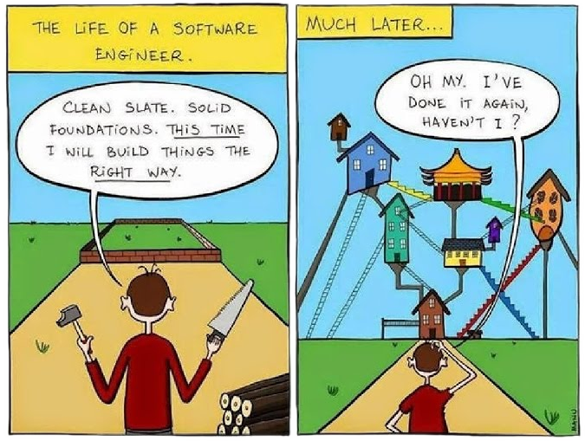

Slide 26
Next to built-in types (int, list, str, ...), you can define more general "objects" with attributes and a behavior.
Live demo
Classes can "inherit" from other classes, and add & override attributes & methods.
Live demo
"Polymorphism" justifies inheritance.
= Difference in behavior with the same API

Slide 27
Object-oriented programming (OOP)
Benefits
Related elements (data and code) are also nearby in source.
Higher-level programming, in terms of objects
Polymorphism can reduce many "if" statements.
Limitations
Methods are essentially unary operators.
Pitfalls
Too many classes.
Too complex inheritance diagrams. Use composition where possible.
Too many methods.

Slide 28
Free functions
= method “degraded” to a function.
See https://www.youtube.com/watch?v=nWJHhtmWYcY
Goal: keep classes simple & easy to understand
When to write a free function?
  Attributes are not modified (directly).
  Algorithms that "work with" objects
  Binary (or higher) operators.
  When a class becomes too complicated.

Slide 29
Hands-on: polygon & regular polygon
1. Write polygon class and add features:
compute_area and compute_perimeter
rotate, scale and translate
regular polygon
Select the “best” patterns: inheritance or composition, method or function.
2. Minimization of perimeter/area ratio
Implement function for ratio with 1 argument: x & y arrays concatenated.
Add regularization term, 1e-6*(1−area)**2.
Implement gradient with autograd.
Minimize with scipy.optimize.fmin_lbfgs_b.

Slide 30
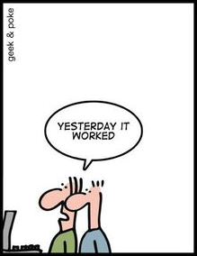

Slide 31
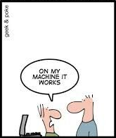

Slide 32
Even if you don't collaborate...
Long-term maintenance
≈
Collaboration with your future self
More than avoiding bugs & hiding complexity.

Slide 33
Semantic versioning
https://semver.org/
Given a version number MAJOR.MINOR.PATCH, increment the:
MAJOR version when you make incompatible API changes,
MINOR version when you add functionality in a backwards-compatible manner, and
PATCH version when you make backwards-compatible bug fixes.

Slide 34
Version Control System (VCS)
= records history of all changes in source code
Why?
Collaboration
  Merging: combine changes from different persons.
  Review code before merging.
  When was a bug introduced (bisection)
  Blame people for their ugly code. :)
Access to all versions
Backup

Slide 35
A patch (file)
diff --git a/horton/grid/cext.pyx b/horton/grid/cext.pyx
index e4615275..47c607fc 100644
--- a/horton/grid/cext.pyx
+++ b/horton/grid/cext.pyx
@@ -55,7 +55,7 @@
'PowerExtrapolation', 'PotentialExtrapolation', 'tridiagsym_solve',
'CubicSpline', 'compute_cubic_spline_int_weights',
# evaluate
- 'index_wrap', 'eval_spline_grid', 'eval_decomposition_grid',
+ 'eval_spline_grid', 'eval_decomposition_grid',
# ode2
'hermite_overlap2', 'hermite_overlap3', 'hermite_node',
'hermite_product2', 'build_ode2',
@@ -477,10 +477,6 @@
-def index_wrap(long i, long high):
- return evaluate.index_wrap(i, high)
-
-
def eval_spline_grid(CubicSpline spline not None,
np.ndarray[double, ndim=1] center not None,
np.ndarray[double, ndim=1] output not None,

Slide 36
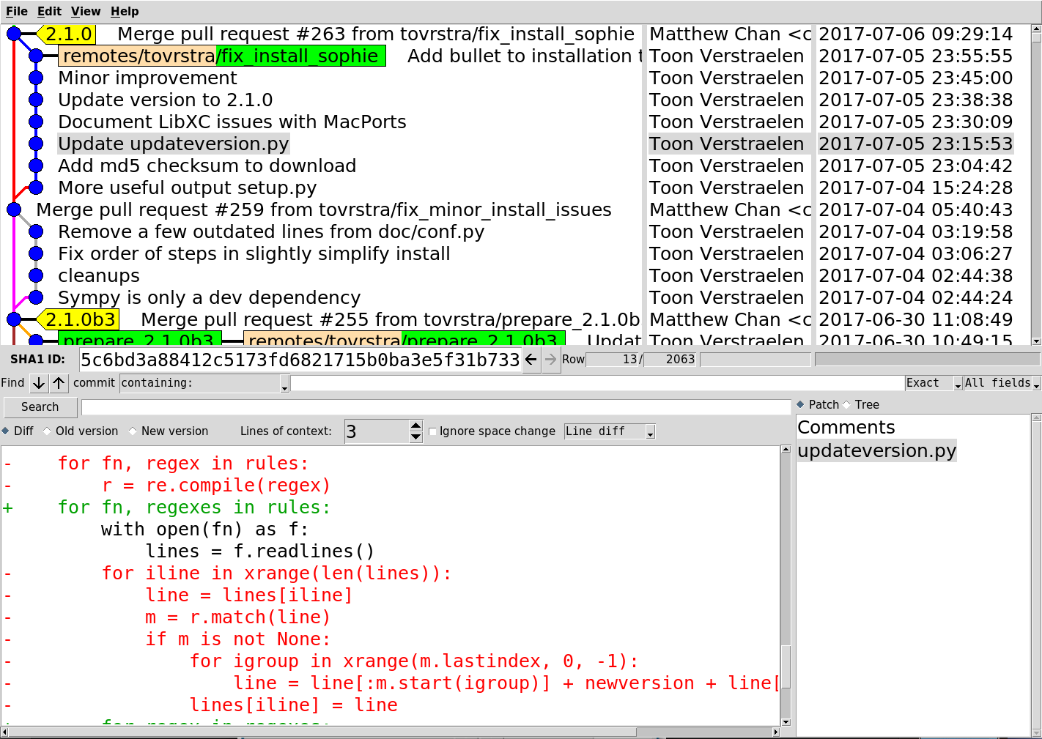
Patch, Commit, Branch, Review, Merge, Release

Slide 37


Git & Github
Git = probably the best VCS software
https://git-scm.com/
Steep learning curve, but worth it.
Lots of online tutorials.
Github = Git hosting
https://github.com/
Hosts git repositories
Extra's: issue tracker, pull requests, web hosting

Slide 38
Continuous integration (CI)
= automatically analyze every commit on Github:
Unit tests + coverage analysis
Coding style (pylint, pycodestyle, ...)
Test package build & install
...
Very neat, involved setup, use cookiecutter.
https://travis-ci.org/
Example: https://github.com/theochem/grid/pull/4

Slide 39
Write user documentation
README.md
Links to other documentation
Quick install instructions
Contact & License information
Website (use Sphinx; http://www.sphinx-doc.org)
Background
Tutorials
API reference

Slide 40
Assignment: fix a simple bug
Fix Scipy documentation:
https://github.com/scipy/scipy/issues/7168

Slide 41
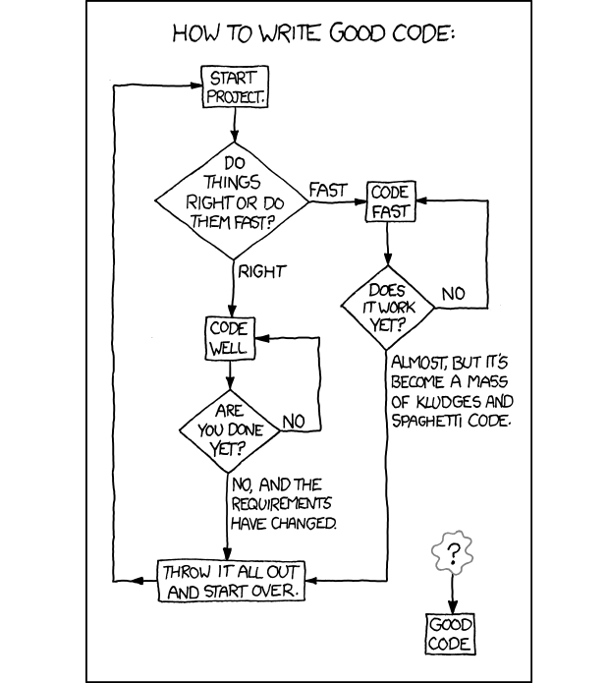
SCRUM
Keep it
simple.

