Slide 1








Secure device-independent quantum key distribution with causally independent measurement devices
Lluis Masanes¹, Stefano Pironio² and Antonio Acín ^{1,3}
¹ ICFO-Institut de Ciencies Fotoniques, Barcelona
² Université Libre de Bruxelles, Brussels
³ ICREA-Insititució Catalana de Recerca i Estudis Avançats, Barcelona
QCRYPT 2011, Zurich, September 2011

Slide 2
References
Quantum Correlations
M. Navascués, S. Pironio and A. Acín, Phys. Rev. Lett. 98, 010401 (2007)
M. Navascués, S. Pironio and A . Acín, New J. Phys. 10, 073013 (2008)
S. Pironio, M. Navascués and A . Acín, SIAM J. Optim. 20, 2157 (2010)
Device-Independent Quantum Key Distribution
Antonio Acín, N. Brunner, N. Gisin, S. Massar, S. Pironio and V. Scarani, Phys. Rev. Lett. 98, 230501 (2007)
S. Pironio, Antonio Acín, N. Brunner, N. Gisin, S. Massar and V. Scarani, New J. Phys. 11, 045021 (2009)
L. Masanes, S. Pironio and Antonio Acín, Nature Communications 2, 238 (2011)

Slide 3


Device-independent scenario
Goal: to construct information protocols where the parties can see their devices as quantum black-boxes → no assumption on the devices.
x=1,…,m
y=1,…,m
Alice
a=1,…,r
b=1,…,r
Bob

Slide 4
Characterization of Quantum Correlations

Slide 5
Motivation
Given p(a,b|x,y), does it have a quantum realization?
Example:
Previous work by Tsirelson

Slide 6
Hierarchy of necessary conditions
Given a probability distribution p(a,b|x,y), we have defined a hierarchy consisting of a series of tests based on semi-definite programming techniques allowing the detection of supra-quantum correlations.
YES
YES
YES
YES
NO
NO
NO
The hierarchy is asymptotically convergent.
Related work by Doherty, Liang, Toner and Wehner

Slide 7
Convergence of the hierarchy
If some correlations satisfy all the steps in the hierarchy, then:
with
?

Slide 8
Device-Independent Quantum Key Distribution

Slide 9
Device-Independent QKD
Standard QKD protocols based their security on:
Quantum Mechanics: any eavesdropper, however powerful, must obey the laws of quantum physics.
No information leakage: no unwanted classical information must leak out of Alice's and Bob's laboratories.
Trusted Randomness: Alice and Bob have access to local random number generators.
Knowledge of the devices: Alice and Bob require some control (model) of the devices.
Is there a protocol for secure QKD based on without requiring any assumption on the devices?

Slide 10
Motivation
The fewer the assumptions for a cryptographic protocol → the stronger the security.
Useful when considering practical implementations. If some correlations are observed → secure key distribution. No security loopholes related to technological issues.

Slide 11
Bell inequality violation
Bell inequality violation is a necessary condition for security.
If the correlations are local:
A perfect copy of the local instructions can go to Eve.
Barrett, Hardy, Kent, PRL 95; Ekert PRL 91
Any protocol should be built from non-local correlations. Standard QKD is not device-independent.

Slide 12
Secure device-independent quantum key distribution with causally independent measurement devices

Slide 13


The model
We require that the generation of raw key elements define causally independent events.
Masanes PRL09; Hänggi, Renner, arXiv:1009.1833
All raw-key elements
General quantum state
Measurements by Alice and Bob

Slide 14
The model
This requirement can be satisfied by performing space-like separated measurements. Secure DIQKD is, in principle, possible.
The requirement can just be assumed, either by assuming memoryless devices or some shielding ability by the honest parties (which is always necessary).
This requirement is always one of the assumptions (among many more) needed for security in standard QKD.
...

Slide 15


Bounding the key rate
Privacy amplification:
Error correction:
König, Renner, Schaffner
Our goal is to bound Eve’s guessing probability on Alice’s raw-key symbols.

Slide 16

Local predictability vs Bell violation
x
y
a
b
For any Bell inequality, it is possible to derive bounds on the randomness, or predictability, of Alice’s symbols from the observed Bell violation.
Pironio et al., Nature 2010

Slide 17
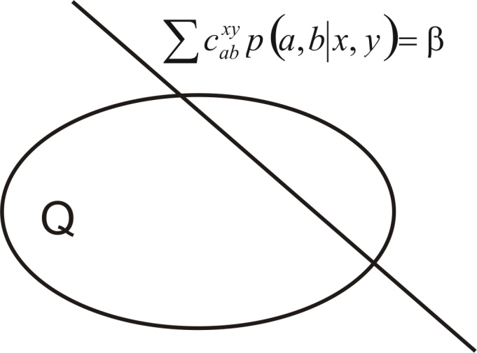
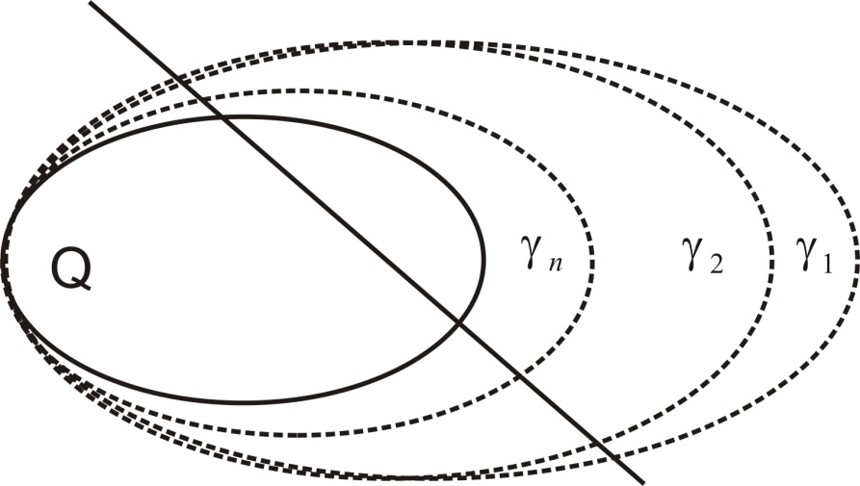
Local predictability vs Bell violation
We have developed an asymptotically convergent series of sets approximating the quantum set.

Slide 18
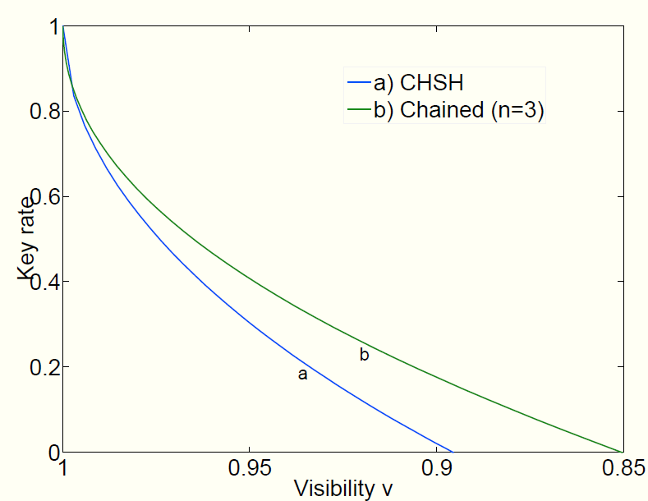
Bound on the key rate
The critical error for the CHSH inequality is of approx 5%. For the chained inequality with 3 settings, one has 7.5%. The protocols are competitive in terms of error rate.

Slide 19
Concluding remarks
How to make these proposals practical? Detection efficiency? Losses in the channel can be solved by QND measurements. Gisin’s Talk: Experimental DIQKD is a great challenge for Quantum Communication.
Secure DIQKD is a great challenge of Quantum Information Theory.
The techniques presented here provide a general proof valid under a “reasonable” requirement: no memory in the devices (extracted from the report: “detection devices involving photo-detectors typically are prone to show memory effects, so that using the same detectors at different times will be in general a bad approximation to independent measurements”).
This proof requires fewer assumption than standard QKD.
How to include memory effects?
Privacy amplification is impossible if no structure is imposed on the measurements by Alice and Bob.
What happens in a sequential scenario? No signalling from the future: measurement at a given step do not depend on future steps.
Hänggi, Renner and Wolf, arXiv:0906.4760

Slide 20
Concluding remarks
No-signalling QKD
Device-independent QKD
Hybrid models: semi device-independent, measurement device independent, steering based protocols,…
Assumptions
Standard QKD
Bounded models QKD

Slide 21
Post-doc positions
DIQIP: Device-Independent Quantum Information Processing (Chist-ERA project). www.icfo.es
ICFOnest post-doctoral program: it aims at providing high-level training and support for outstanding international researchers in the early stages of their careers. Deadline: September 30 2011, see http://nestpostdocs.icfo.es/

