Slide 1





Dual universality of hash functions and its applications to classical and quantum cryptography
arXiv: 1101.0064
Toyohiro Tsurumaru (Mitsubishi Electric Corporation)
Masahito Hayashi (Graduate School of Information Sciences, Tohoku University /
CQT National University of Singapore)

Slide 2
Outline
We introduce the concept of (dual) universal₂ hash function family，and (dual) universal₂ code family
  By analogy and as an extension of universal₂ hash functions.
ε-almost universal₂ codes are a good classical error correcting code
  They achieve the Shannon limit.
Extension of hash functions used for QKD
  QKD systems using universal hash functions can be shown secure even in Shor-Prekill argument, or in Koashi’s argument.
  More generally, ε-almost dual universal₂ hash functions can be used.
We also show applications to the classical wiretap channel and the classical randomness extraction

Slide 3
(Dual) Universal₂ Hash Functions and
(Dual) Universal₂ Codes

Slide 4

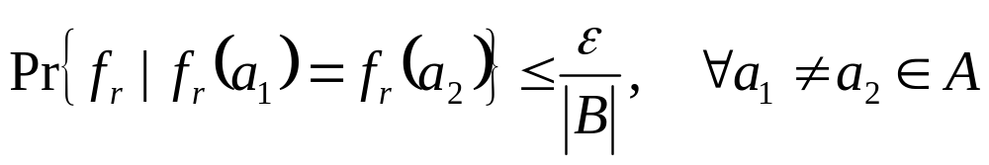
Universal₂ Hash Functions
（Carter-Wegman 1979）
A family of functions f_{r} : A → B is
ε-almost universal₂
def
Probability Pr : the uniform distribution over index r
“1-almost universal₂” is often simply called “universal₂”
Weaker condition than the completely random functions． ex：the Toeplitz matrix multiplication（described later）
Still a sufficient condition for many applications; information theoretically-secure authentication,
and PA for QKD

Slide 5




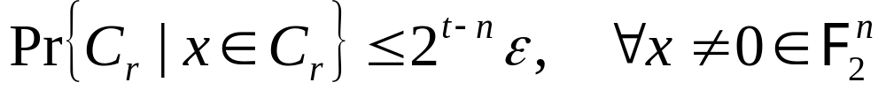
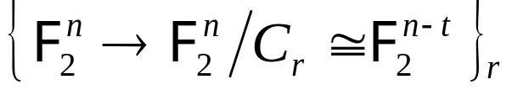
Universal₂ Code Family
(TT&MH, arXiv: 1101.0064)
Considerε-almost universal₂ functions which are linear over F₂
A set of linear functions isε-almost universal₂
…，the kernel Ker f_{r} of a linear map f_{r}
Since Ker f_{r} vector subspace V_{r} linear code C_{r} ，
the universality₂ can be defined for linear codes {C_{r}}_{r} ．
Linear codes areε-almost universal₂
def
A function family isε-almost universal₂

Slide 6

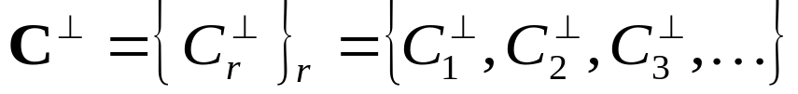

The Universality₂ of Dual Codes
― The Main Theorem ―
Further，given a code family
The Dual Code Family C⊥ of C is the set of their dual codes
where
Our Main Theorem
A linear code family C = {C_{r}}_{r} is ε-almost universal₂
The dual code family C⊥ of C is
2(1-2^{t-n})+(-1)2^{t}-almost universal₂

Slide 7




Dual Universality₂ of a Code Family
A Code family is universal₂
Linear hash functions are universal₂
def
Our Main Theorem
Not true in general
The dual code family is 2-almost universal₂
Hash functions are
2-almost universal₂
Code family is 2-almost DUAL universal₂
def
Hash functions f_{r} are 2-almost DUAL universal₂

Slide 8
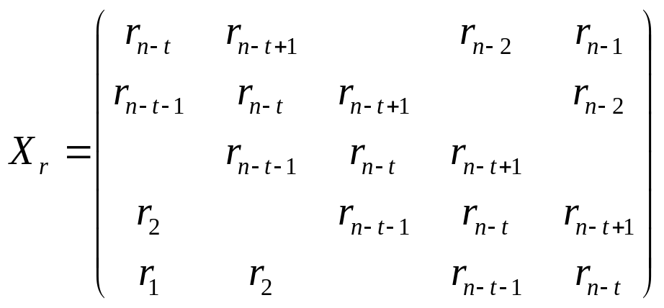


Examples of (Dual) Universal₂ Hash Functions
Ex.1：
the Toeplitz matrices
（All diagonals are the same）
The multiplication of X_{r} and a vector v yields a universal₂ hash family
⇔ The code family {C_{r}}_{r} having parity check matrices X_{r} is universal₂
⇒ The dual code family {C_{r}⊥}_{r} is 2-almost universal₂
(Hayashi PRA 2009,
Hayashi arXiv:0904.0308)
Ex. 2： modified Toeplitz matrices
A concatenation of Toeplitz matrix X_{r} and the identity I_{n-t}
gives a code family which is both universal₂ and dual universal₂

Slide 9
Universal₂ Codes Are
Good Error Correcting Codes

Slide 10
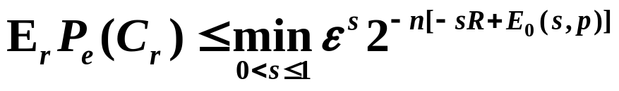
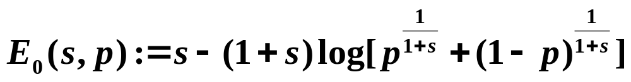
ε-Almost Universal₂ Code Family is a
Good Classical Error Correcting Code
Error correction using an ε-almost universal₂ code family
achieves the Shannon limit.
  The syndrome functions are ε-almost
  universal₂ functions, with a small collision probability.
  Errors are mapped to syndromes uniquely.
Lemma （Gallager bound）
For an n-tiple use of (i.i.d.) BSC with crossover probability p,
if one uses an ε-almost universal₂ code family {C_{r} ⊂F₂^{n}}_{r}
of nR dimension, the ML decoding fails with error prob. P_{e} (C_{r}) , where

Slide 11



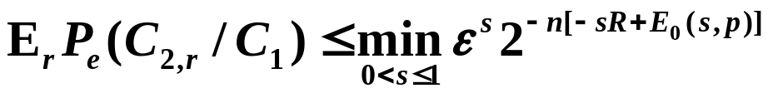
Extension to the Classical CSS Code
The same properties hold for a (fixed) m-dimensional code C₁,
and the family of its extended codes (subcodes) {C_{2,r}}_{r} .
（C₁⊂C_{2,r} ⊂F₂^{n}, dimC_{2,r} = t）
Projections are ε-almost universal₂ functions
{C_{2,r}}_{r} is an ε-almost universal₂ extended code family of C₁
is an ε’-almost universal₂ subcode family of C₁⊥
def.
Main Theorem
Lemma （Gallager bound）
If one uses an ε-almost universal₂ extended code family {C_{2,r}}_{r} of C₁ in BSC(p), the decoding error prob. of phase error correction is

Slide 12
Security of QKD and the Quantum Wiretap Channel

Slide 13




Security of QKD
PA using ε-almost dual universal₂ functions
⇒ Good CSS codes for phase error correction
PA using anε-almost DUAL univesal₂ function family
PA by projection C₁ → C₁/C_{2,r}
with anε-almost DUAL univesal₂ code family {C_{2,r}}_{r}
Phase error correction using code family
with the syndrome functions
ε-almost univesal₂ functions
Equiv. by def.
Equiv. by def.
Instead, becomes ε-almost universal₂
The Holevo informationχ of Eve under collective attacks
where nR bits are consumed in PA.
The security under coherent attacks can be shown similarly.
Gallager bound

Slide 14
Security of QKD
PA using ε-almost dual universal₂ functions
⇒ Good CSS codes for phase error correction
PA using anε-almost DUAL univesal₂ function family
PA by projection C₁ → C₁/C_{2,r}
with anε-almost DUAL univesal₂ code family {C_{2,r}}_{r}
Phase error correction using code family
with the syndrome functions
ε-almost univesal₂ code family
Equiv. by def.
Equiv. by def.
The Holevo informationχ of Eve under collective attacks
where nR bits are consumed in PA.
The security under coherent attacks can be shown similarly.
Gallager bound

Slide 15
Extension of Secure Hash Functions for QKD (and the Quantum Wiretap Channel)
According to our main theorem,
Universal₂ Hash Functions
⊂ ε-Almost Dual Universal₂ Hash Functions
Previous Work （e.g., Renner-König 2004; Hayashi 2009）
Alice and Bob perform privacy amplification using universal₂ hash functions {f_{r}}_{r}
Present Work
A much larger class
Alice and Bob perform privacy amplification using an
ε-almost dual universal₂ hash functions {f_{r}}_{r}.

Slide 16

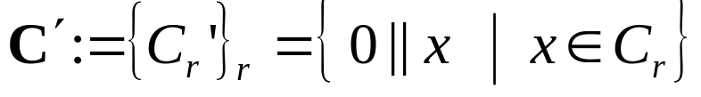
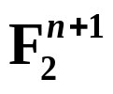
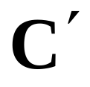
An ε-almost universal₂ code family that is
NOT ε-almost dual universal₂
Counterexample of a Secure
ε-Almost (Non-Dual) Universal₂
Hash Function Family with ε≧2
Given a t -dimensional universal₂ code family C = {C_{r}}_{r}
over , one can construct another code family
that is a 2-almost universal₂ code family over
One cannot attain strong security by performing privacy amplification using
is NOT ε-almost dual universal₂.

Slide 17
Classes of (Dual) Universal₂ Code Families and the Security of QKD
ε-Almost
Universal₂
Our Counterexample
(Codes with the MSB=0)
Renner and König
2005
Strongly Secure Hash Functions
ε-Almost Dual
Universal₂
Universal₂
Modified Toeplitz
Dual Universal₂
?
Permutation Code Family
Hayashi 2009
Present Work

Slide 18
Applications to
Classical Cryptography

Slide 19
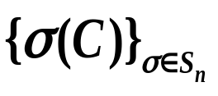
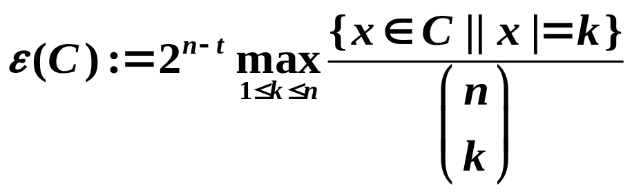
Permutation Code Family
Another example of ε-almost universal2 codes
There exists a fixed (deterministic) code C, such that its bit-
permutations generate anε-almost universal₂ code family.
Since i.i.d. channels are invariant under bit perm.
The fixed code C works asε-almost universal₂ codes.
Lemma
∃C : t dimensional code over F₂^{n}
s.t. the codes obtained by bit-permuting C
is an (n+1)-almost universal₂ code family．
Proof： Apply Markov inequality to

Slide 20
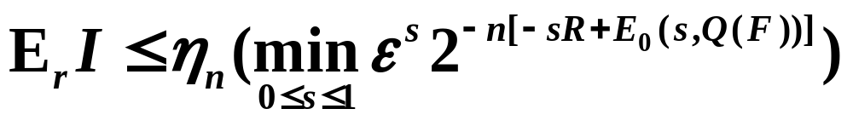
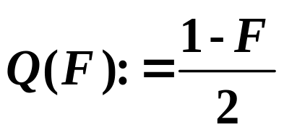
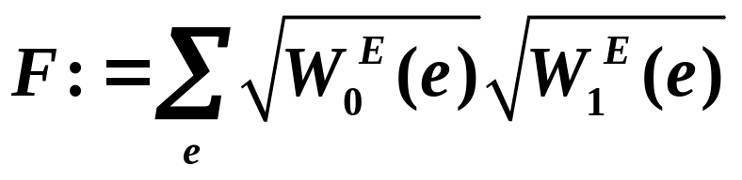
Classical Wiretap Channel (1/2)
Alice, Bob, and Eve are connected by i.i.d. channels.
On Alice’s input i，Eve obtains data obeying prob. dist. W_{i}^{E}
Alice
Bob
i
W_{i}^{E}
Eve
How many secret bits can Alice and Bob extract?
We simulate this system with a quantum wiretap channel.
The mutual information I of Alice and Eve can be bounded:

Slide 21
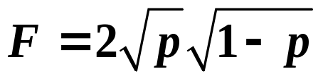
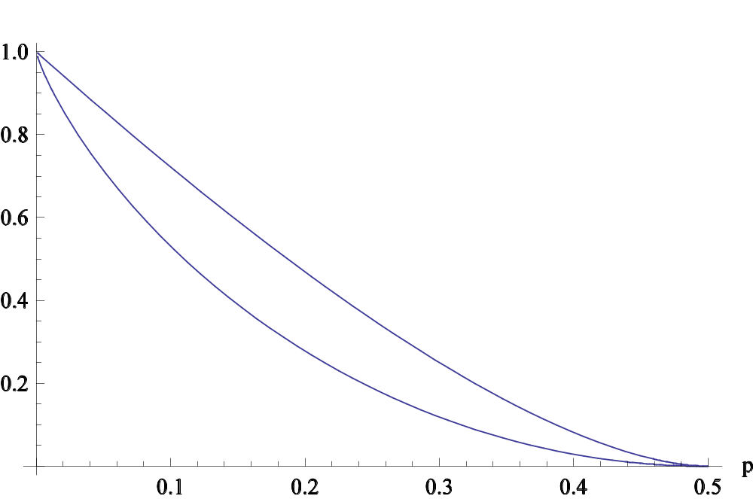
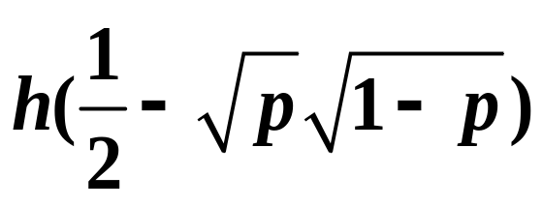
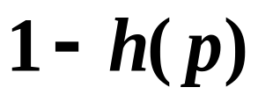
Classical Wiretap Channel (2/2)
If Eve’s channel is a BSC with crossover probability p,
the amount of leaked Information can be measured by fidelity
For S := The sacrifice bit rate of privacy amplification,
S
Our Result (deterministic)
Previous Results
(random)

Slide 22
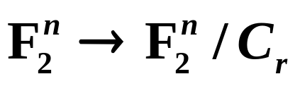
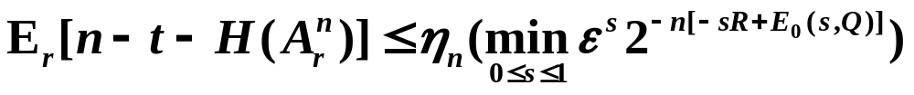
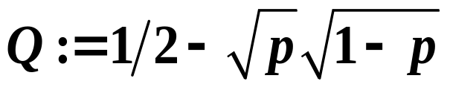
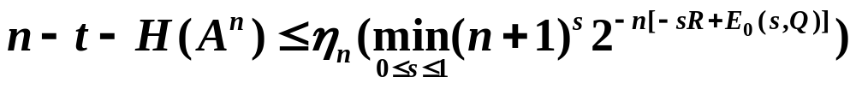
（Classical）Randomness Extraction (1/2)
Goal: Extracting a uniformly distributed random bits from a partially random bits.
From an n-bit string obeying a binomial dist. with parameter p .
We extract random number A_{r}^{n} by a projection
C_{r} : chosen randomly from a t-dimensional ε-almost dual universal code family {C_{r}}_{r}
Using the argument of permutation code, we can show the existence of a deterministic and universal protocol

Slide 23
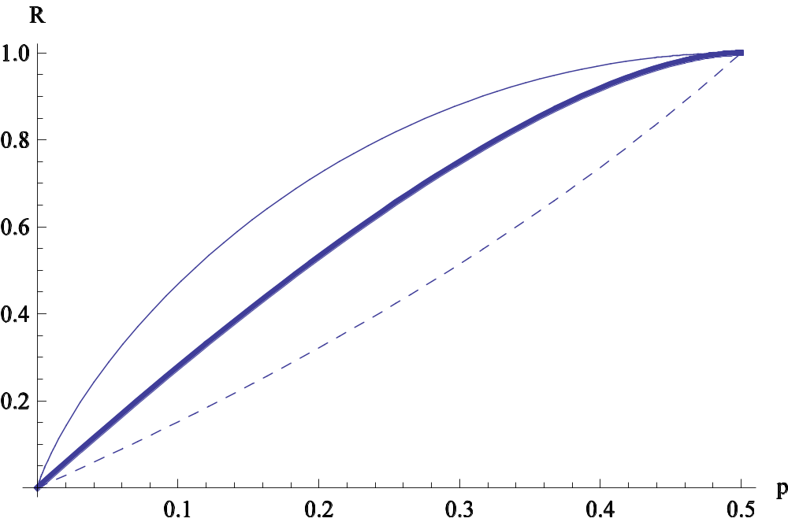
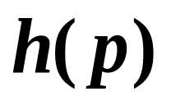
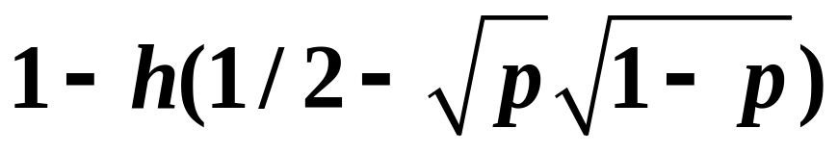
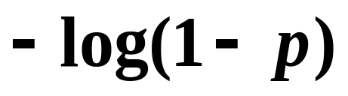
（Classical）Randomness Extraction (2/2)
We generate a uniformly distributed random bits from an
n-bit string obeying binomial distribution with parameter p
Generation Rate R
Previous work
(probabilistic protocol)
Our Result
（deterministic protocol）
Previous work (deterministic protocol)
p

Slide 24
Summary
We introduce the concept of (dual) universal₂ hash function family，and (dual) universal₂ code family
  By analogy and as an extension of universal₂ hash functions.
(Dual) universal₂ code is a good classical error correction code
  As good as truly random codes (Gallager bound)
Extension of hash functions used for QKD
  QKD systems using universal hash functions can be shown secure even in Shor-Prekill argument, or in Koashi’s argument.
  More generally, ε-almost dual universal₂ hash functions can be used.
Applications to the classical wiretap channel and the classical randomness extraction
  We simulate a classical system by using a quantum system, and analyze it as a quantum wiretap channel.
  We show the existence of a deterministic hash function that works universally under variable information leakage.

Slide 25
References
1. R. Renner, “Security of Quantum Key Distribution,” PhD thesis, Dipl. Phys. ETH, Switzerland, 2005; arXiv:quantph/0512258.
2. M. Hayashi, “Upper bounds of eavesdropper’s performances in finite-length code with the decoy method,” Phys. Rev. A 76, 012329 (2007); Phys. Rev. A 79, 019901(E) (2009).
3. M. Hayashi, “Exponential decreasing rate of leaked information in universal random privacy amplification,” arXiv:0904.0308, to be published in IEEE Trans. Inform. Theory.
4.D. R. Stinson, “Universal hashing and authentication codes,” in J. Feigenbaum (Ed.): Advances in Cryptology - CRYPTO ’91, LNCS 576, pp.62-73 (1992).
5.M. N. Wegman and J. L. Carter, “New Hash Functions and Their Use in Authentication and Set Inequality,” J. Comput. System Sci. 22, pp.265-279 (1981).

