Slide 1
Randomness Extraction and Privacy Amplification with quantum eavesdroppers
Thomas Vidick
UC Berkeley
Based on joint work with Christopher Portmann, Anindya De, and Renato Renner

Slide 2
Outline
Privacy amplification and randomness extraction
A one-bit extractor
Trevisan’s construction

Slide 3
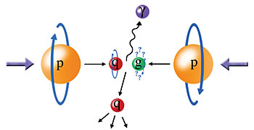
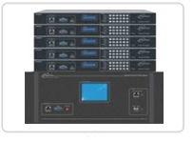
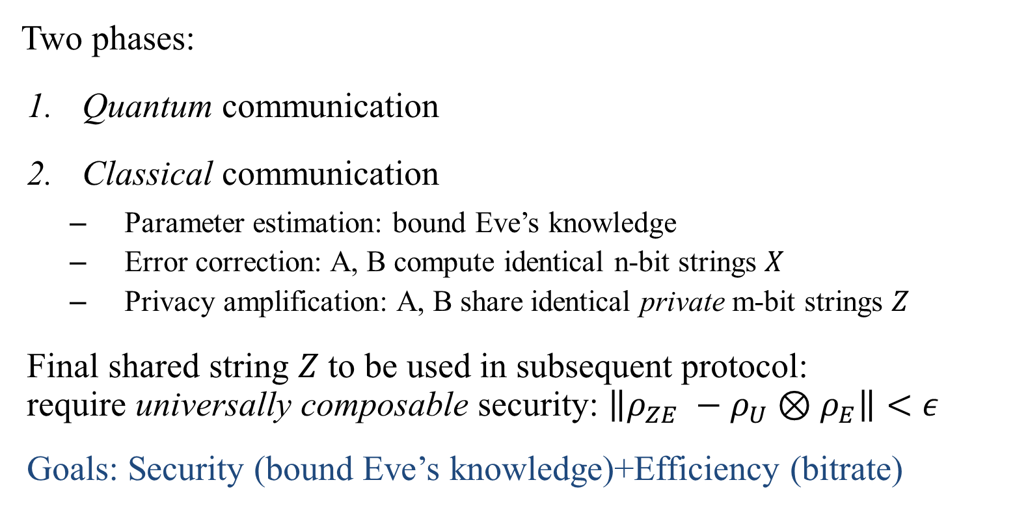
Quantum Key Distribution
quantum channel
classical channel
Two phases:
Quantum communication
Classical communication
  Parameter estimation: bound Eve’s knowledge
  Error correction: A, B compute identical n-bit strings $X$
  Privacy amplification: A, B share identical private m-bit strings $Z$
Final shared string $Z$ to be used in subsequent protocol:
require universally composable security: $\left\|ρ_{ZE} −ρ_{U}⊗ρ_{E}\right\|<ε$
Goals: Security (bound Eve’s knowledge)+Efficiency (bitrate)
Eve

Slide 4




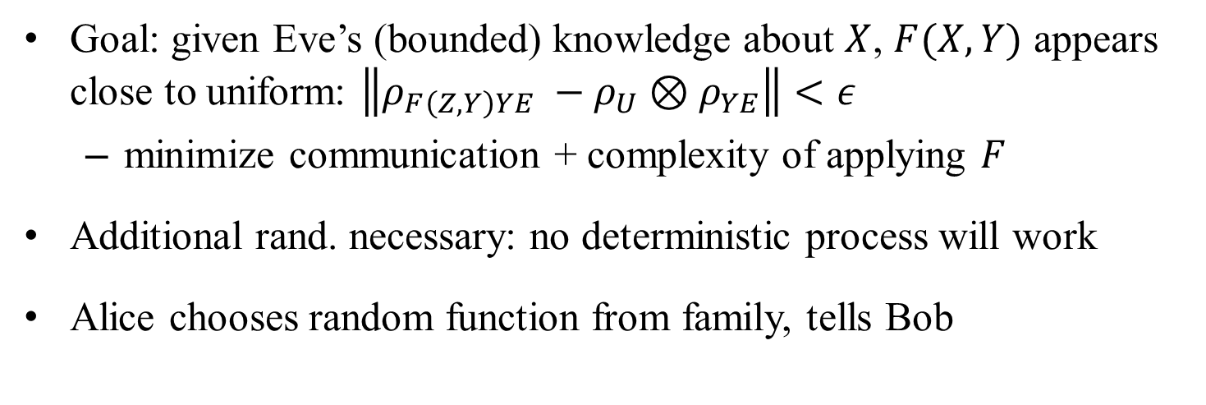
Privacy amplification [BBR’88]
$X: n$bits
Classical communication $Y$
F
Eve
$F(X,Y): m<n$bits
Goal: given Eve’s (bounded) knowledge about $X$, $F(X,Y)$ appears close to uniform: $\left\|ρ_{F\left(Z,Y\right)YE} −ρ_{U}⊗ρ_{YE}\right\|<ε$
  minimize communication + complexity of applying $F$
Additional rand. necessary: no deterministic process will work
Alice chooses random function from family, tells Bob
Notes:
Mention examples: Eve knows first few bits; overall parity; etc
Minimize, for target security eps.

Slide 5
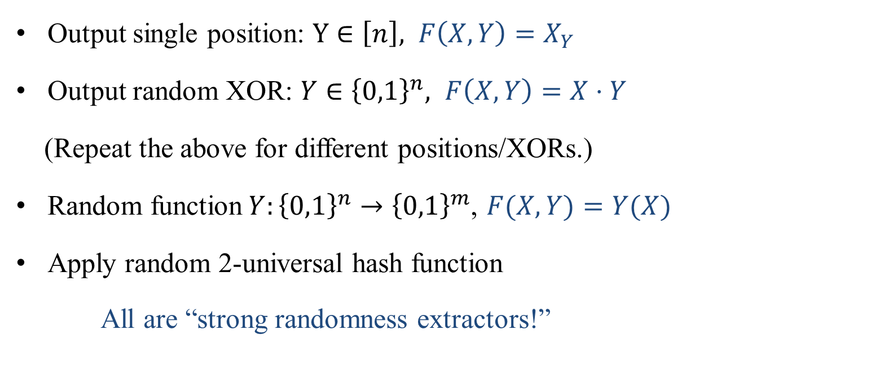



Examples
$X: n$bits
Classical communication $Y$
F
$F(X,Y): m<n$bits
Output single position: $Y∈\left[n\right], F\left(X,Y\right)=X_{Y}$
Output random XOR: $Y∈{\left\{0,1\right\}}^{n}, F\left(X,Y\right)=X⋅Y$
(Repeat the above for different positions/XORs.)
Random function$Y:{\left\{0,1\right\}}^{n}→{\left\{0,1\right\}}^{m}$, $F(X,Y)=Y(X)$
Apply random 2-universal hash function
All are “strong randomness extractors!”
Notes:
General idea is Eve’s information must be localized somewhere: first 10 bits, parities, value of some function. So by mixing everything up there is a small chance she still has information. Say XOR, probability of success goes down. Difficult when Eve quantum, as “localization” of information harder to pinpoint. Give example later.
2 much more secure than 1, but also requires very large seed.

Slide 6

Aside: randomness extraction (1)
Fundamental concept from TCS [NZ’96]
Weak randomness is “readily” available
Many applications require “perfect” randomness
Can we convert one to the other?
P_{X}(x)
Public source X:
x
P_{X}(x)
Ideal uniform
source:
Randomized
algorithms
Crypto
Modeling
x
P_{X}(x)
P_{U}(x)
Ext?
x
x

Slide 7
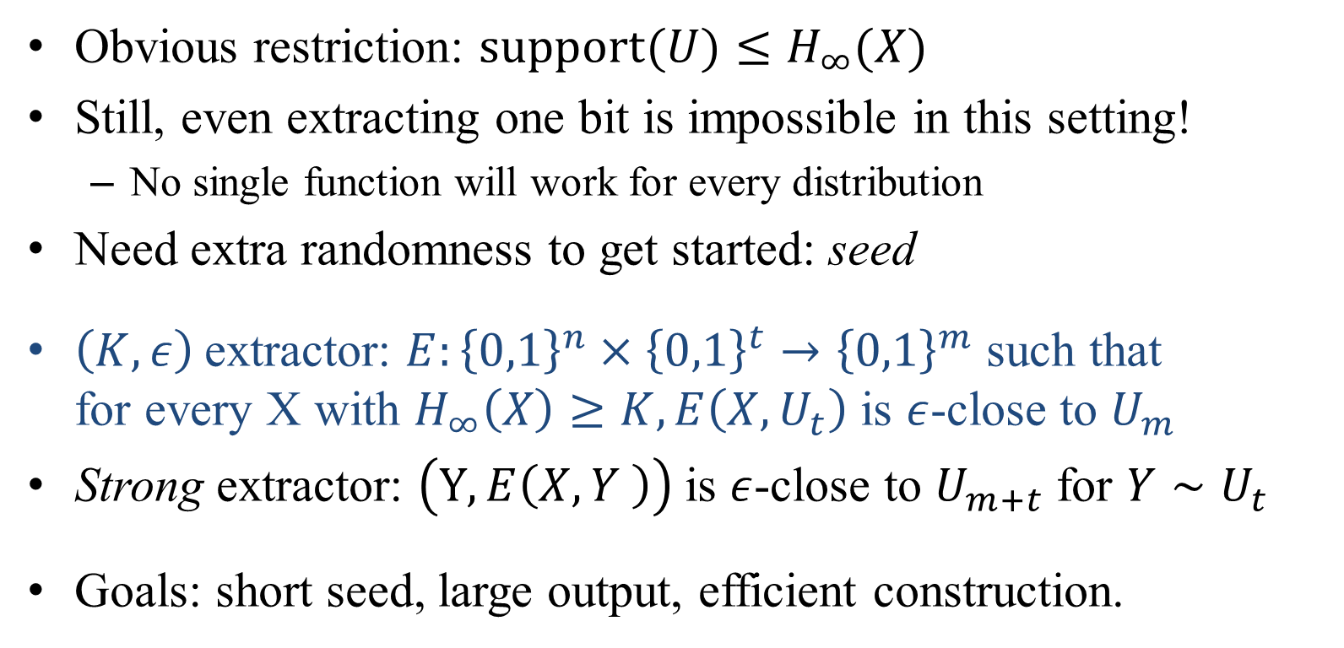
Aside: randomness extraction (2)
P_{X}(x)
P_{Y}(x)
P_{U}(x)
Ext?
+
x
x
x
Obvious restriction: $\text{support}(U)≤H_{∞}(X)$
Still, even extracting one bit is impossible in this setting!
  No single function will work for every distribution
Need extra randomness to get started: seed
$\left(K,ε\right)$extractor: $E:{\left\{0,1\right\}}^{n}×{\left\{0,1\right\}}^{t}→{\left\{0,1\right\}}^{m}$ such that
for every X with $H_{∞}\left(X\right)≥K, E\left(X,U_{t}\right)$ is $ε$-close to $U_{m}$
Strong extractor: $\left(Y,E\left(X,Y \right)\right)$is $ε$-close to $U_{m+t}$ for $Y∼U_{t}$
Goals: short seed, large output, efficient construction.
Notes:
Min-entropy is upper bound on extractable randomness, even if shannon entropy is large.
Parameters in this order of importance: goal is to get short seed for derandomization.

Slide 8
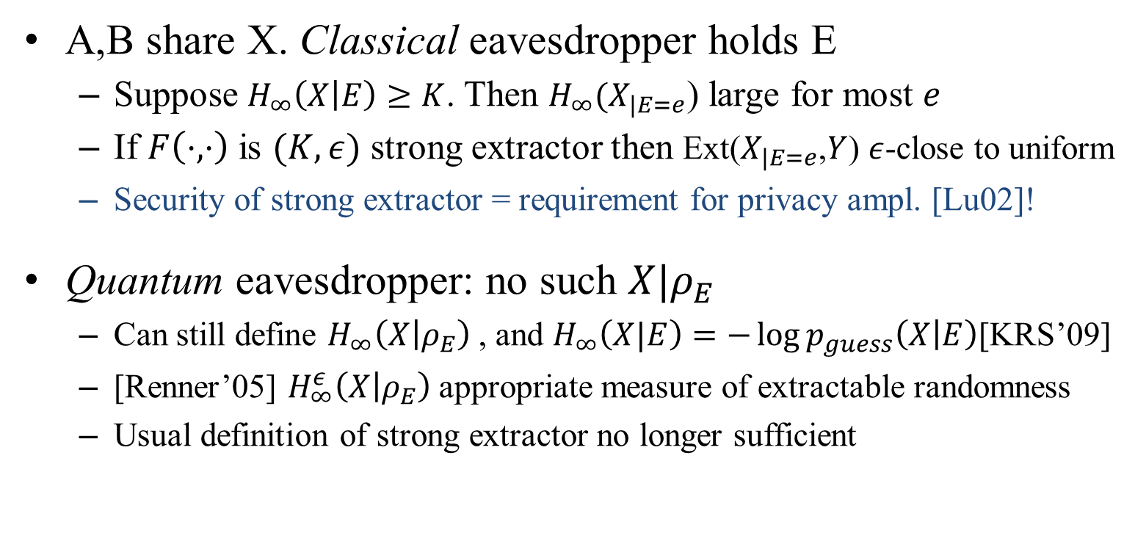



Extractors for privacy amplification
$X: n$bits
Classical communication $Y$
F
$F(X,Y): m<n$bits
  A,B share X. Classical eavesdropper holds E
  Suppose $H_{∞}\left(X | E\right)≥K$. Then $H_{∞}(X_{|E=e}$) large for most $e$
  If $F\left(⋅,⋅\right)$ is $(K,ε)$ strong extractor then Ext($X_{|E=e}$,$Y$) $ε$-close to uniform
  Security of strong extractor = requirement for privacy ampl. [Lu02]!
Quantum eavesdropper: no such $X|ρ_{E}$
  Can still define $H_{∞}^{}\left(X | ρ_{E}\right)$, and $H_{∞}^{}\left(X|E\right)=−\log{p_{guess}\left(X | E\right)}$[KRS’09]
  [Renner’05] $H_{∞}^{ε}\left(X | ρ_{E}\right)$appropriate measure of extractable randomness
  Usual definition of strong extractor no longer sufficient
Notes:
Classically, can treat adversary by conditioning on his knowledge (fix it) and then proceed with analysis. Quantum, there is no “conditional” state, but we can still define the min-entropy.
Check epsilon in min-entropy with respect to pguess?
Appropriate in the sense that Can extract that much; no more no less
Many constructions known; are they secure against quantum?

Slide 9
Example: the perfect matching extractor
[GKKRW’07]
Ext: {0,1}^{n} x {0,1}^{2log n} → {0,1}^{n/2}
X: n-bit string
Y: perfect
matching
chosen
among n²
x₁
x₂
x₃
x₄
Ext
Output is uniformly random
x_{n-1}
x_{n}
Classical adversary: cannot do better than birthday paradox
  → need ≈ √n bits of information about x
Quantum adversary:
  on seeing x, store
  when matching revealed, measure in
  → only need ≈ log n qubits!
Notes:
First see why extractor, then why strong extractor
Only log n qubits
here is an example where quantum storage does much more for you. Task of designing good extractor = understanding when such a situation can happen

Slide 10
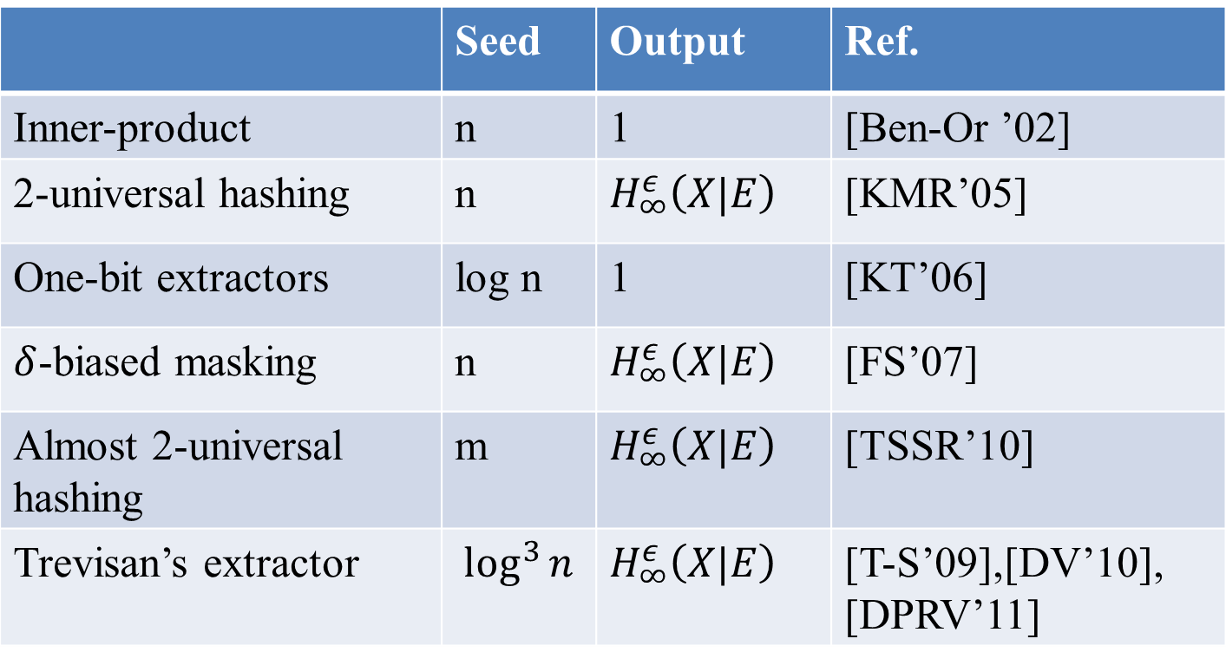
Summary of known constructions
 | Seed | Output | Ref.
Inner-product | n | 1 | [Ben-Or ’02]
2-universal hashing | n | $$H_{∞}^{ε}\left(X|E\right)$$ | [KMR’05]
One-bit extractors | log n | 1 | [KT’06]
$δ$-biased masking | n | $$H_{∞}^{ε}\left(X|E\right)$$ | [FS’07]
Almost 2-universal hashing | m | $$H_{∞}^{ε}\left(X|E\right)$$ | [TSSR’10]
Trevisan’s extractor | $$\log^{3}{n}$$ | $$H_{∞}^{ε}\left(X|E\right)$$ | [T-S’09],[DV’10], [DPRV’11]

Slide 11
Outline
Privacy amplification and randomness extraction
A one-bit extractor
Trevisan’s construction

Slide 12
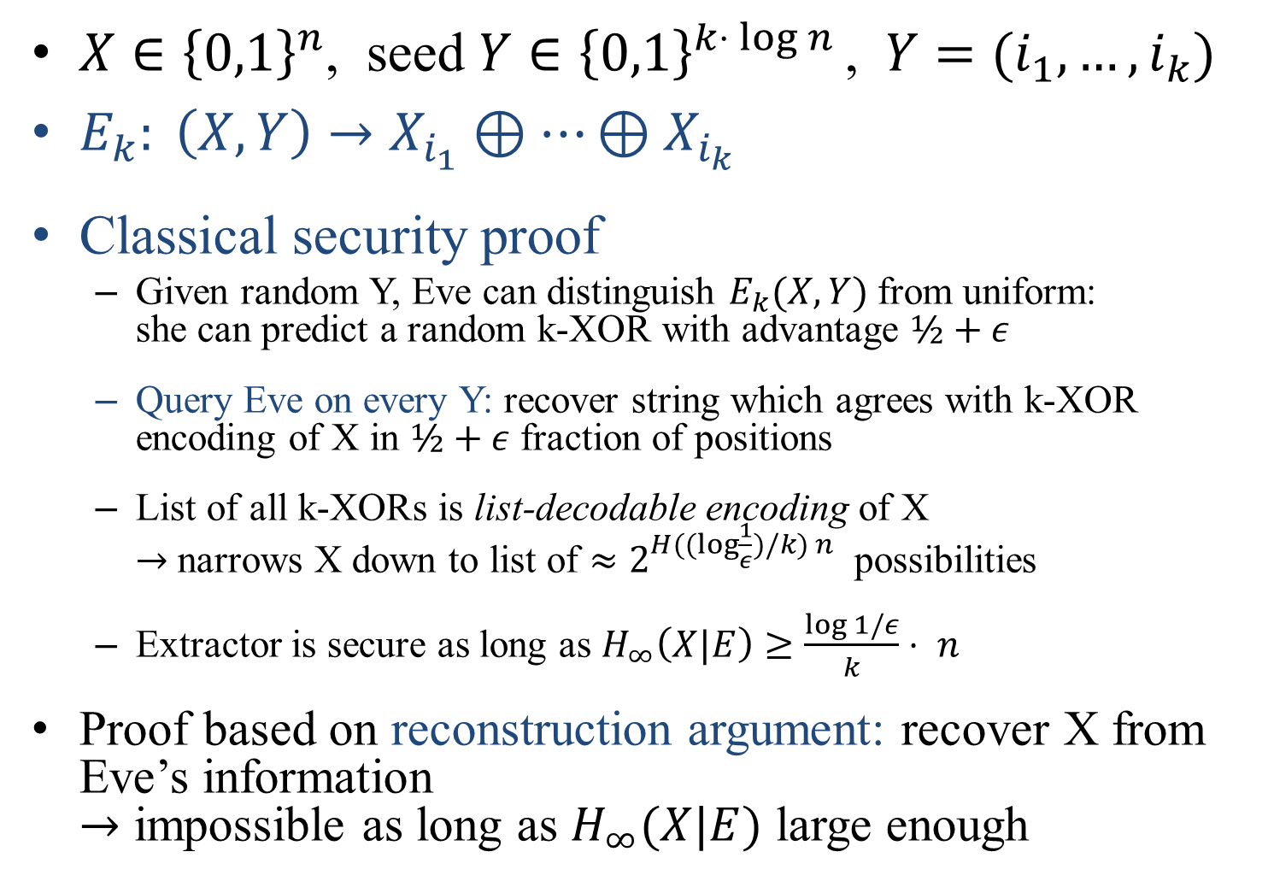
A one-bit extractor
$X∈{\left\{0,1\right\}}^{n}$, seed $Y∈{\left\{0,1\right\}}^{k⋅ log n }$, $Y=(i_{1},…,i_{k})$
$E_{k}: \left(X,Y\right)→X_{i_{1}}⊕⋯⊕X_{i_{k}}$
Classical security proof
  Given random Y, Eve can distinguish $E_{k}(X,Y)$from uniform:
  she can predict a random k-XOR with advantage $½+ε$
  Query Eve on every Y: recover string which agrees with k-XOR encoding of X in $½+ε$ fraction of positions
  List of all k-XORs is list-decodable encoding of X
  $→$ narrows X down to list of $≈2^{H((log{\frac{1}{ε}})/k) n }$ possibilities
  Extractor is secure as long as $H_{∞}\left(X|E\right)≥\frac{\log{1/ε}}{k}⋅ n$
Proof based on reconstruction argument: recover X from Eve’s information
$→$ impossible as long as $H_{∞}(X|E)$ large enough
Notes:
Explain that in general predicting random positions of X with small advantage is not so hard (just keep random subset of bits). Here, crucial use of error-correcting code: makes task much harder.

Slide 13
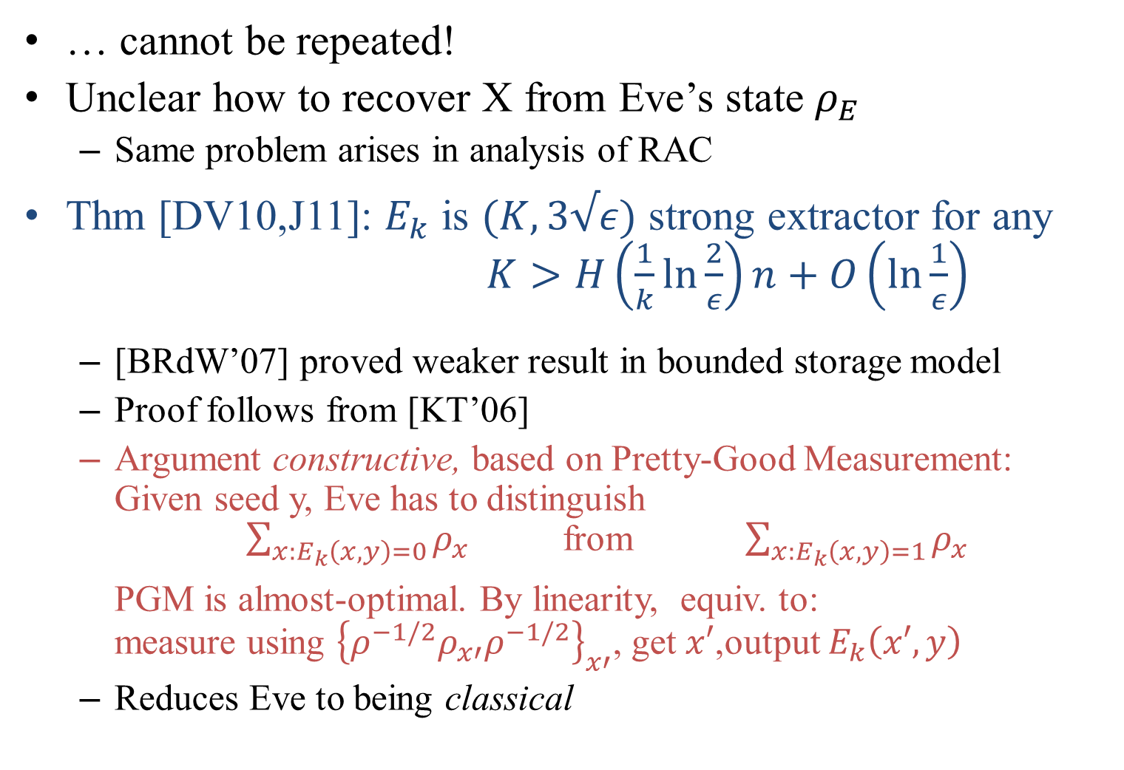
Quantum eavesdroppers
… cannot be repeated!
Unclear how to recover X from Eve’s state $ρ_{E}$
  Same problem arises in analysis of RAC
Thm [DV10,J11]: $E_{k}$ is $(K,3√ε)$ strong extractor for any $K>H\left(\frac{1}{k}\ln{\frac{2}{ε}}\right)n+O\left(\ln{\frac{1}{ε}}\right)$
  [BRdW’07] proved weaker result in bounded storage model
  Proof follows from [KT’06]
  Argument constructive, based on Pretty-Good Measurement:
  Given seed y, Eve has to distinguish
  $\sum_{x:E_{k}\left(x,y\right)=0}{ρ_{x}}$ from $\sum_{x:E_{k}\left(x,y\right)=1}{ρ_{x}}$
  PGM is almost-optimal. By linearity, equiv. to:
  measure using ${\left\{{ρ^{−1/2}ρ}_{x′}ρ^{−1/2}\right\}}_{x′}$, get $x′$,output $E_{k}\left(x′,y\right)$
  Reduces Eve to being classical
Notes:
Hidden matching extractor suggests something tricky may happen. 2 pfs: KT + generalization of RAC bound

Slide 14
Outline
Privacy amplification and randomness extraction
A one-bit extractor
Trevisan’s construction

Slide 15



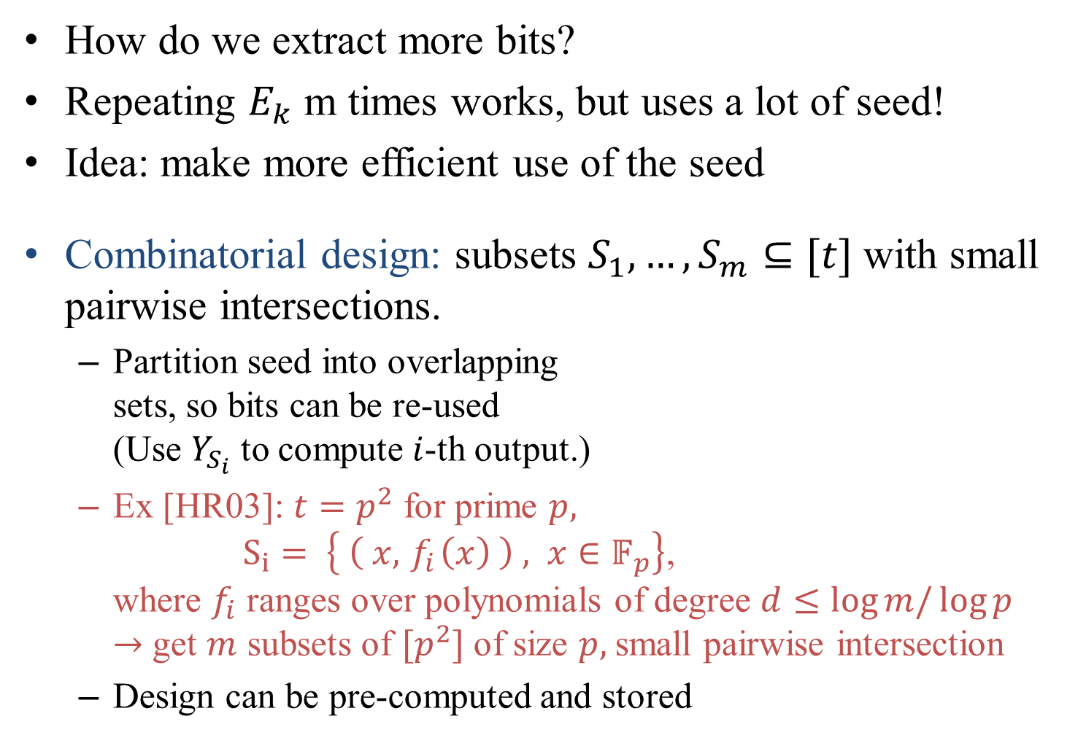
Trevisan’s construction (1)
How do we extract more bits?
Repeating $E_{k}$ m times works, but uses a lot of seed!
Idea: make more efficient use of the seed
Combinatorial design: subsets $S_{1},…,S_{m}⊆[t]$ with small pairwise intersections.
  Partition seed into overlapping
  sets, so bits can be re-used
  (Use $Y_{S_{i}}$ to compute $i$-th output.)
  Ex [HR03]: $t=p^{2}$ for prime $p,$
  $S_{i}= \left\{ \left( x,{ f}_{i}\left(x\right) \right) , x∈𝔽_{p}\right\}$,
  where $f_{i}$ ranges over polynomials of degree $d≤\log{m/\log{p}}$
  $→$ get $m$ subsets of $[p^{2}]$ of size $p,$small pairwise intersection
  Design can be pre-computed and stored
y
0
1
0
0
1
0
1
$$S_{1}$$
$$S_{2}$$
$$S_{3}$$
Notes:
Part of seed corresponding to each subset used to compute one of the bits of the output
Can be pre-computed, but computation on the fly also very easy: select a poly, and evaluate at all points
Many other constructions known

Slide 16
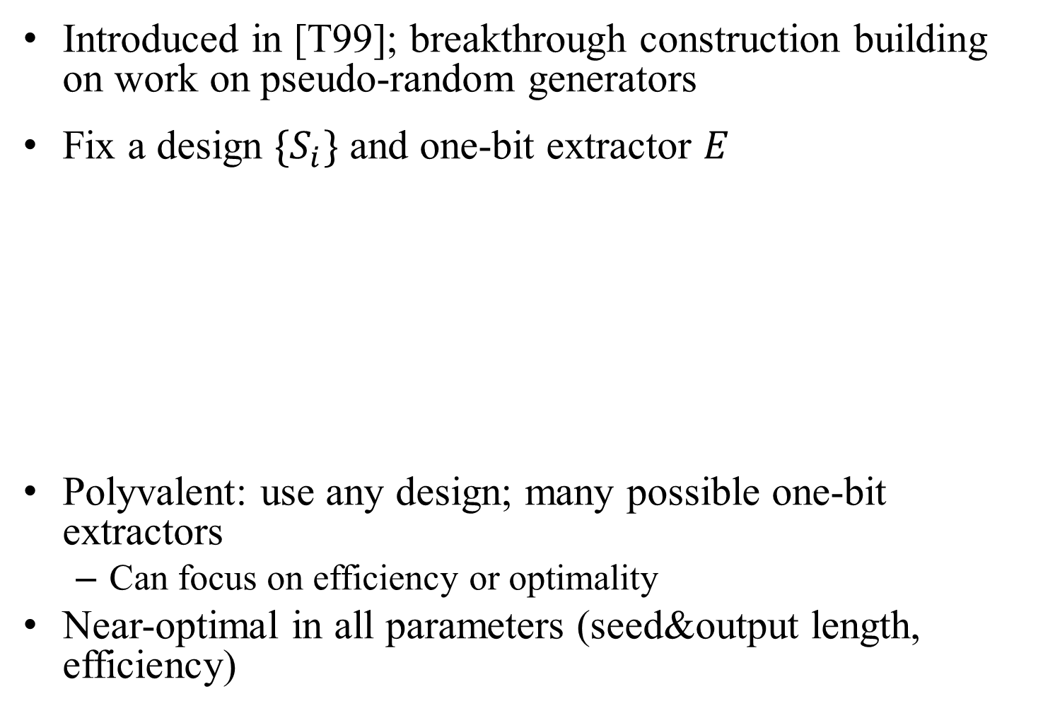



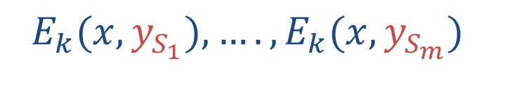
Trevisan’s construction (2)
Introduced in [T99]; breakthrough construction building on work on pseudo-random generators
Fix a design $\{S_{i}\}$ and one-bit extractor $E$
Polyvalent: use any design; many possible one-bit extractors
  Can focus on efficiency or optimality
Near-optimal in all parameters (seed&output length, efficiency)
x
+
y
0
1
0
0
1
0
1
  $$E_{k}(x,y_{S_{1}}),….,E_{k}(x,y_{S_{m}})$$
$$S_{1}$$
$$S_{2}$$
$$S_{3}$$
Notes:
Emphasize simple, efficient construction. Not more complex than pairwise hash.

Slide 17
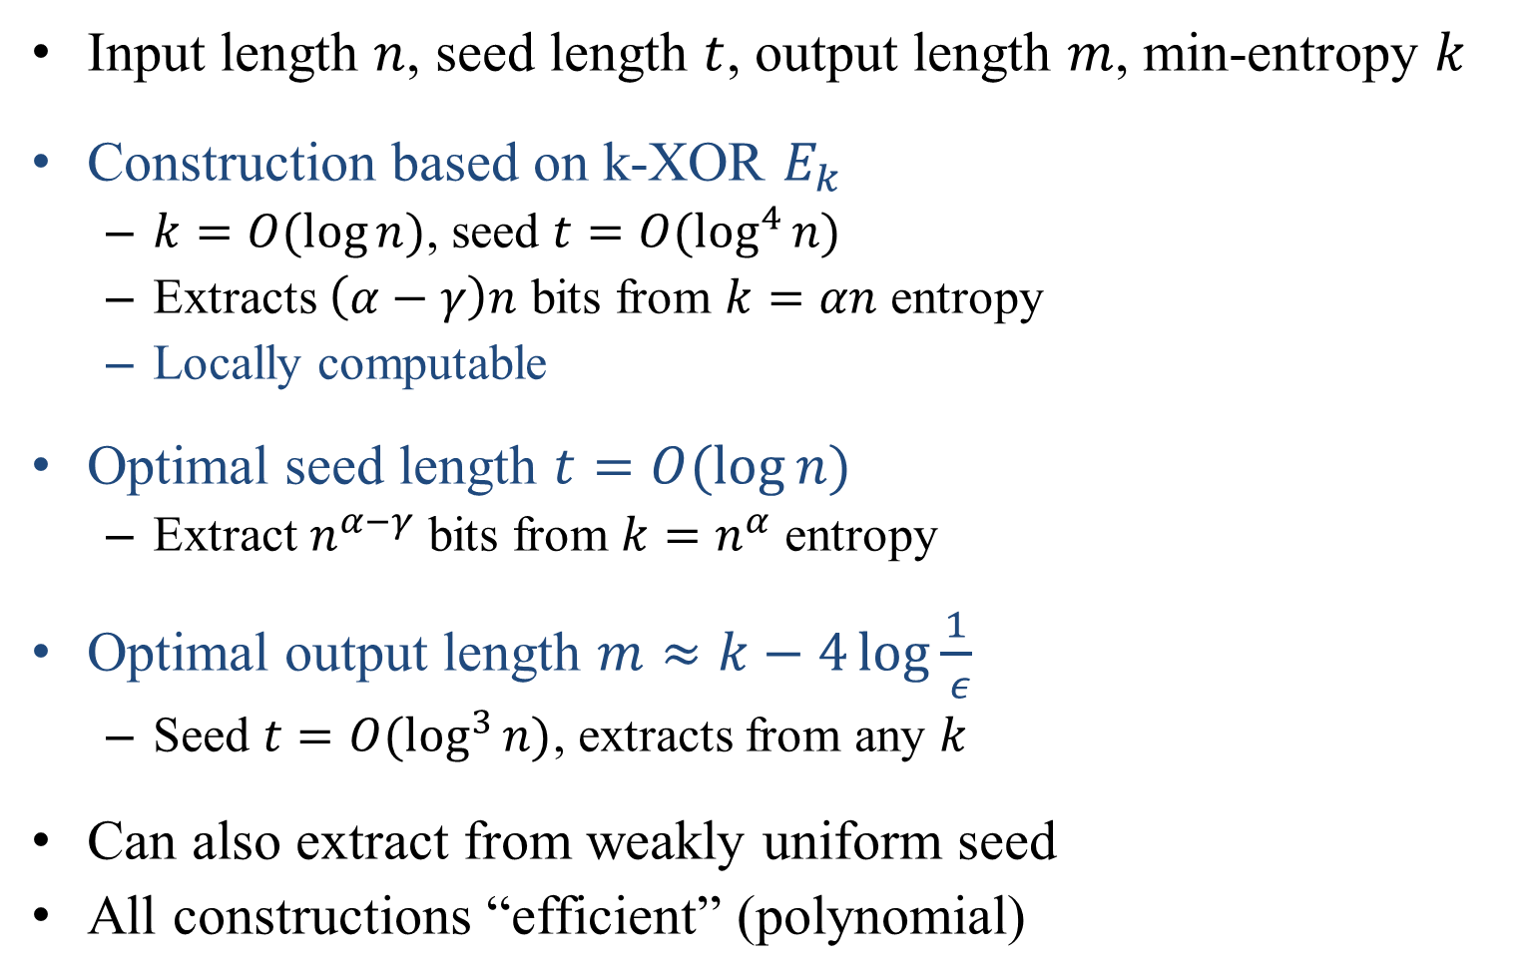
Some parameters
Input length $n$, seed length $t$, output length $m$, min-entropy $k$
Construction based on k-XOR $E_{k}$
  $k=O(\log{n)}$, seed $t=O(\log^{4}{n)}$
  Extracts $\left(α−γ\right)n$ bits from $k=αn$ entropy
  Locally computable
Optimal seed length $t=O(\log{n)}$
  Extract $n^{α−γ}$ bits from $k=n^{α}$ entropy
Optimal output length $m≈k−4\log{\frac{1}{ ε}}$
  Seed $t=O(\log^{3}{n)}$, extracts from any $k$
Can also extract from weakly uniform seed
All constructions “efficient” (polynomial)

Slide 18


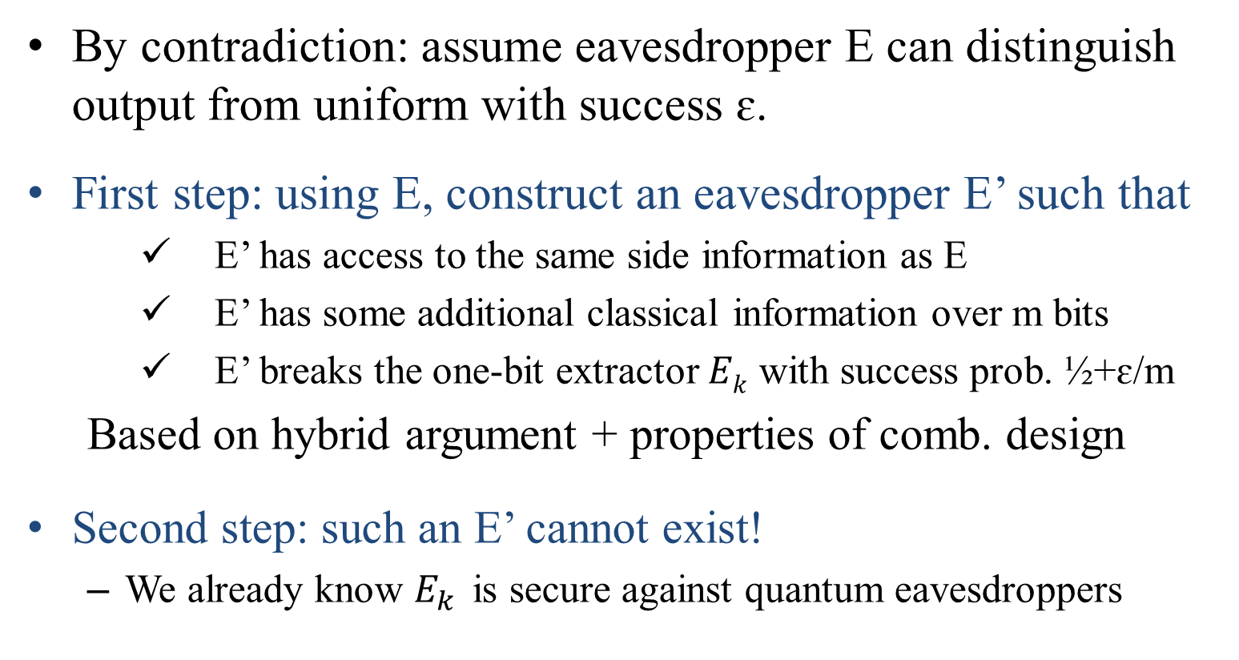
Overview of security proof
x: n bits
+
y: t bits
0
1
0
0
1
0
1
  $$E_{k}(x,y_{S_{1}}),….,E_{k}(x,y_{S_{m}})$$
$S_{i}$: log n bits
By contradiction: assume eavesdropper E can distinguish output from uniform with success ɛ.
First step: using E, construct an eavesdropper E’ such that
    E’ has access to the same side information as E
    E’ has some additional classical information over m bits
    E’ breaks the one-bit extractor $Ek$ with success prob. ½+ɛ/m
  Based on hybrid argument + properties of comb. design
Second step: such an E’ cannot exist!
  We already know $E_{k}$ is secure against quantum eavesdroppers

Slide 19
Summary
Privacy amplification is an important step in QKD
Well-understood classically, but quantum eavesdropper is a challenge
Some constructions proved to carry over
  2-universal hashing most often used: efficient (matrix multiplication), extracts most key.
  All previous const. require as many “fresh” random bits as length of key
Trevisan’s construction has many advantages
  Efficient (local XOR computation)
  Extracts longest possible key, only polylog random bits required
Proof of security based on reconstruction argument + [KT’06]

Slide 20
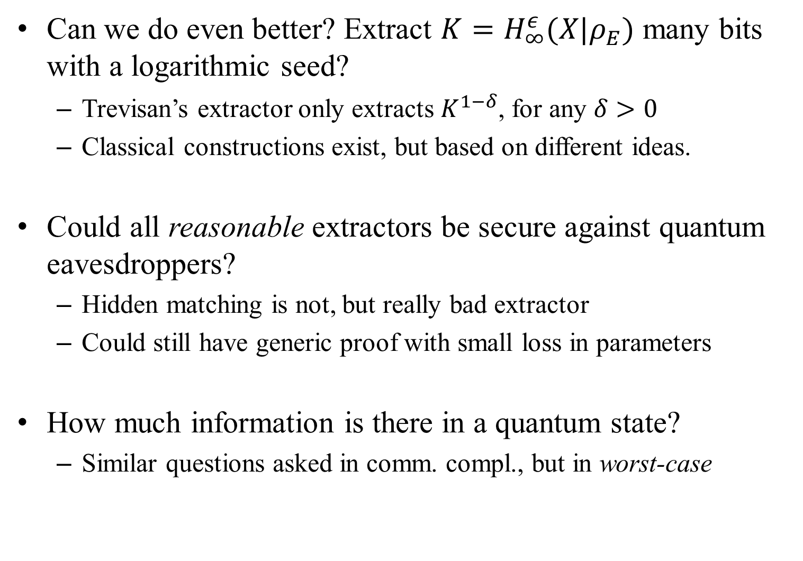
Open problems
Can we do even better? Extract ${K=H}_{∞}^{ε}(X|ρ_{E})$ many bits with a logarithmic seed?
  Trevisan’s extractor only extracts $K^{1−δ}$, for any $δ>0$
  Classical constructions exist, but based on different ideas.
Could all reasonable extractors be secure against quantum eavesdroppers?
  Hidden matching is not, but really bad extractor
  Could still have generic proof with small loss in parameters
How much information is there in a quantum state?
  Similar questions asked in comm. compl., but in worst-case

Slide 21
Thank you!

