Slide 1

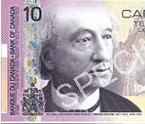
Private-Key Quantum Money
Scott Aaronson (MIT)

Slide 2
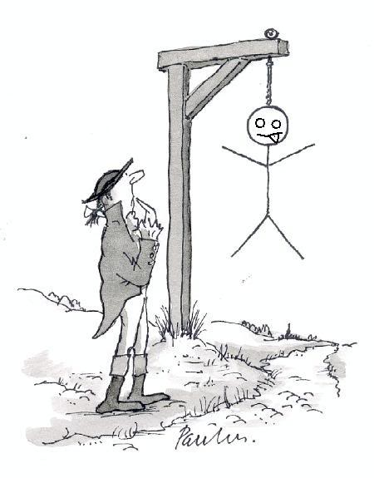
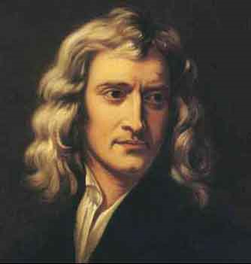
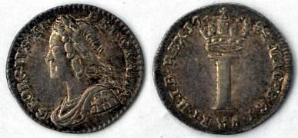
Ever since there’s been money, there’ve been people trying to counterfeit it
Previous work on the physics of money:
In his capacity as Master of the Mint, Isaac Newton worked on making English coins harder to counterfeit
(He also personally oversaw hangings of counterfeiters)

Slide 3
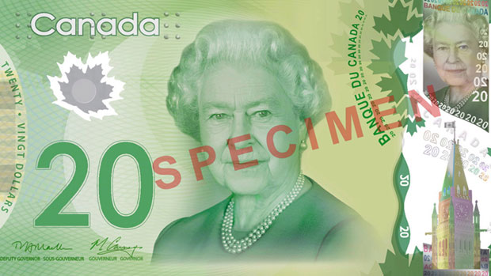
Today: Holograms, embedded strips, “microprinting,” special inks…
Leads to an arms race with no obvious winner
Problem: From a CS perspective, uncopyable cash seems impossible for trivial reasons
Any printing device a good guy can build, a determined bad guy can also build
x → (x,x) is an easy computation

Slide 4
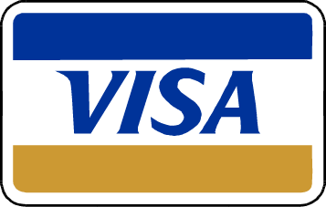
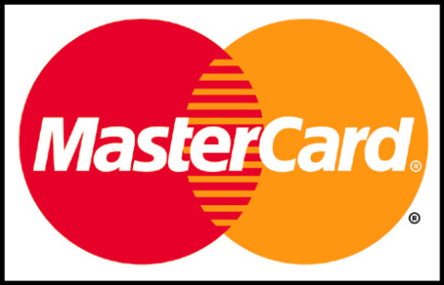

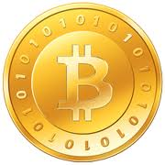
What’s done in practice: Have a trusted third party authorize every transaction
(BitCoin: “Trusted third party” is distributed over the Internet)
OK, but sometimes you want cash, and that seems impossible to secure, at least in classical physics…

Slide 5

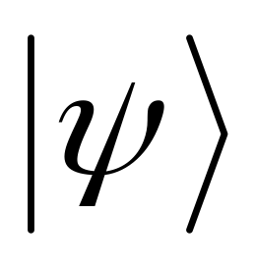
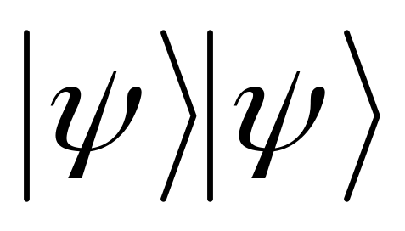
The No-Cloning Theorem

Slide 6
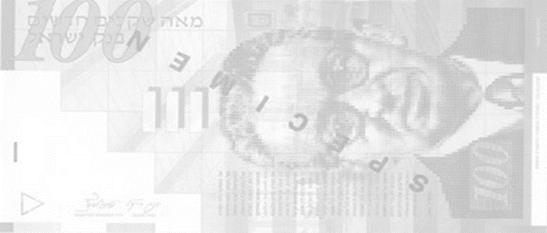
First Idea in the History of Quantum Info
Wiesner ~1969: Private-key quantum money
Besides a classical serial number s, each bill has n qubits, secretly prepared in one of the four BB84 states |0⟩,|1⟩,|+⟩,|-⟩
Serial number: 011000010110
At least at a handwaving level, seems impossible to copy |ψ_{f(s)}⟩ if you don’t know the right bases!
In a giant database, the bank stores f(s), a description of the quantum state |ψ_{f(s)}⟩ corresponding to serial number s
Want to verify a bill? Take it to the bank. Bank uses knowledge of f(s) to measure each qubit of |ψ_{f(s)}⟩ in the correct basis:
OR

Slide 7
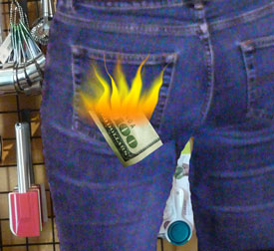
The Decohering Money Problem
There’s a reason why quantum money is not yet practical… Need a quantum memory (cf. Fernando Pastawski’s talk)!
More fundamentally: won’t verifying a bill necessarily destroy it?
Answer: No!
“Gentle Measurement / Almost As Good As New Lemma”
Accept w.p. ≥1-ε ⇒ damage by ≤√ε

Slide 8
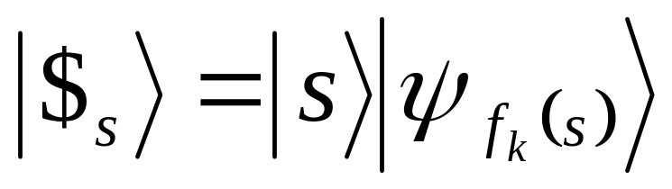
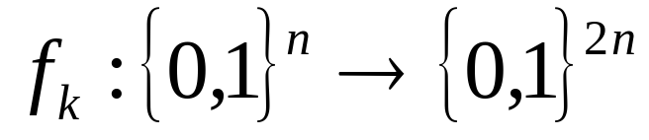
The Giant Database Problem
Isn’t it cumbersome for the bank to remember a classical description f(s) of every bill in circulation?
Reinterpretation of Wiesner’s original scheme: It’s just the BBBW scheme, but where f_{k}(s)=A(k,s) for a random oracle A!
Solution (Bennett, Brassard, Breidbart, Wiesner 1982): Pseudorandom functions! Bank remembers just a single n-bit secret key k. Then each bill has the form
Cryptographic PRF
Handwavy security argument for BBBW scheme: Suppose we could copy |$_{s}⟩. Then either we could also copy the bills in Wiesner’s original scheme, or else we’d be distinguishing f_{k} from a truly random function f

Slide 9

Still, if only the bank can verify the bills, doesn’t that sort of defeat the purpose of cash?
Indeed! That’s why lots of recent work has been on public-key quantum money (A. 2009), which anyone could verify
This inherently requires a computational assumption—not just
quantum mechanics! (Why?)
Main Proposals:
Farhi et al. 2011: Quantum money from knots
A.-Christiano 2012: Quantum money from hidden subspaces
| ⟩
Provable black-box security! And non-black-box security under a plausible crypto assumption
A⊥
A

Slide 10
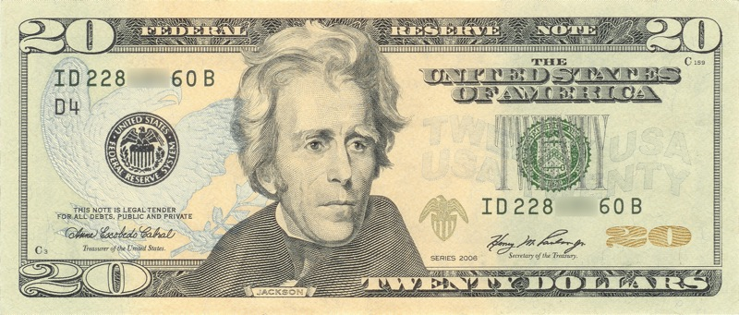
Goal of This Talk: Use our new understanding of public-key quantum money, to go back and solve open problems about private-key quantum money
“Open problems? About private-key quantum money?”
Are the Wiesner and BBBW schemes really secure?
Does every private-key money scheme require either a giant database, or else a computational assumption?
The “interactive attack problem”:

Slide 11
Our Results
(paper still in preparation)
Rigorous, unified security proof for Wiesner and BBBW schemes (building on Werner, Molina-Vidick-Watrous, Gavinsky, Pastawski et al…)
Information-theoretic break of any BBBW-like scheme (most technically-novel part)
First private-key quantum money scheme provably secure against interactive attack (building on A.-Christiano)
First we need some formal definitions…

Slide 12
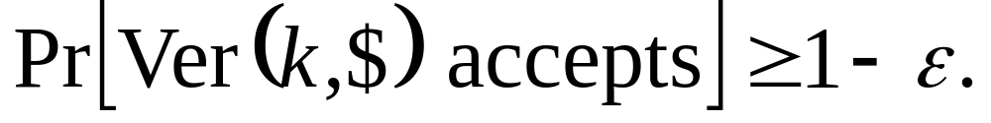
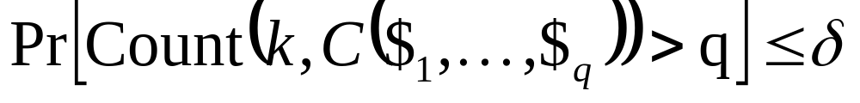
Private-Key Quantum Money Scheme
Consists of two polynomial-time quantum algorithms:
Bank(k): Generates quantum banknote $
Ver(k, ¢): Accepts or rejects claimed banknote ¢
“Mini-Scheme”: Only needs to be secure in the special case q=1 and r=2
We’ll use as a crucial building block, as A.-Christiano did for public-key schemes
S has completeness error ε if for all k and valid $,
S has soundness error δ if for all polynomial-time counterfeiters C,
where Count returns the number of C’s r>q output registers ¢₁,…,¢_{r} that Ver(k,⋅) accepts

Slide 13
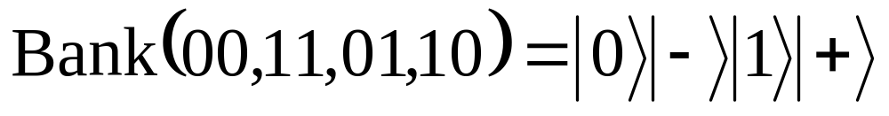

Wiesner Mini-Scheme
(with no serial numbers)
Theorem (Molina-Vidick-Watrous 2012):
The Wiesner mini-scheme has soundness error ≤ (3/4)^{n}
(And this is tight, by a non-obvious counterfeiting strategy!)
Proof uses SDP / quantum games formalism
Gavinsky 2011: Can even make all communication between verifier and bank classical
Pastawski et al. 2012: Can even tolerate noise

Slide 14
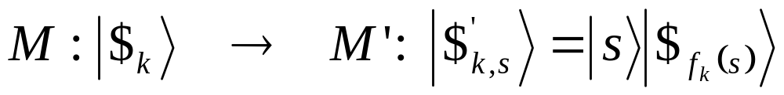
“Standard Construction” of a Money Scheme M’ from a Mini-Scheme M
Theorem: Suppose M’ is insecure. Then either the underlying mini-scheme M was insecure, or else f_{k} wasn’t really a pseudorandom function
“Intuitively obvious,” but still need to prove it!
Note: Wiesner and BBBW schemes handled in unified way!

Slide 15
Proof Sketch
Break M as a mini-scheme
Break M’ as a mini-scheme
OR
Break M’ as a money scheme
OR
Distinguish f_{k} from random
Intuition: If you can copy bills with the same serial numbers, you can break the mini-scheme M.
If you can create bills with new serial numbers, then a “hybrid argument” / simulating the bank’s verification yourself lets you distinguish f_{k} from a random function

Slide 16
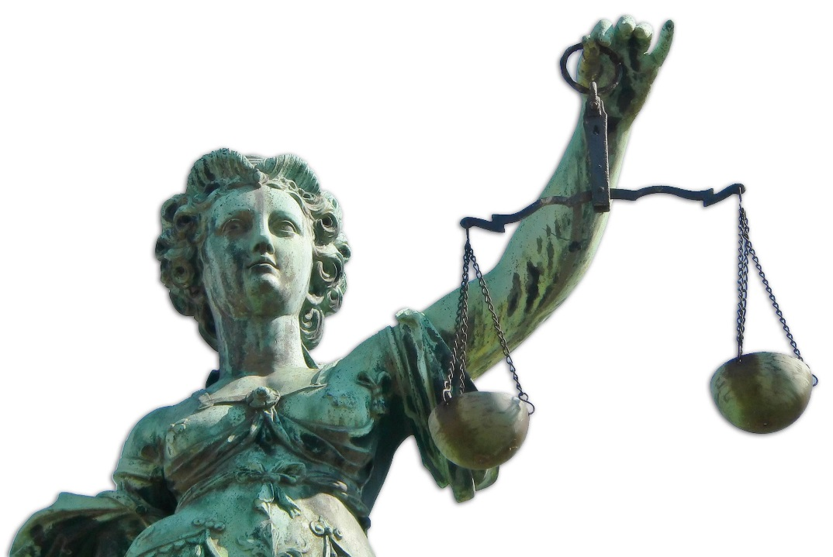
The Tradeoff Theorem
Let M be any money scheme where the bank has an n-bit secret key k*. Then M can be broken using O(n⁵) legitimate money states |$_{k*}⟩, O(n) trial verifications, and 2^{n}poly(n) quantum computation time.
BBBW
WIESNER
Why isn’t this obvious?
Because essentially the only way to learn about k* is using the states |$_{k*}⟩—but measuring |$_{k*}⟩ could destroy it! Also, |$_{k*}⟩ might happen to be accepted by many keys k other than “true” one

Slide 17
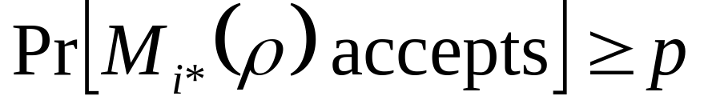
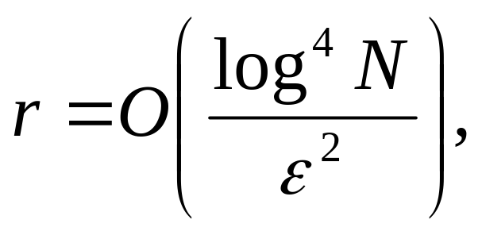
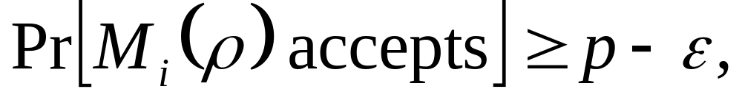
“Secret Acceptor Lemma”
Let M₁,…,M_{N} be known 2-outcome POVMs
Let ρ be an unknown state
Suppose we’re promised there exists an i*∈[N] such that
Then given ρ^{⊗r}, where
there’s a measurement strategy to find an i∈[N] such that
with success probability ≥1-1/N.

Slide 18
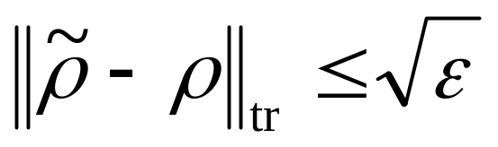
Proof Sketch
Amplification / Chernoff Bound
ρ → ρ^{⊗k}
Almost As Good As New Lemma
Quantum OR Bound (A. 2006)
If some M_{i} accepts ρ with Ω(1) probability, then applying M₁,…,M_{N} to ρ in succession also accepts with Ω(1) probability
M₁
M₂
M₃
M₄
M₅
M₆
M₇
M₈
The Strategy:
Do a binary search for M_{i}, decreasing the acceptance threshold by ε/(logN) at each level, and using fresh copies of ρ
Is there an M_{i} in this half that accepts ρ with ≥p-ε/(logN) probability?
What about in this half?

Slide 19
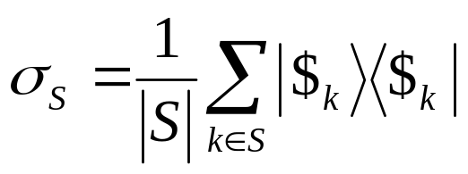
The Counterfeiting Strategy
Let S be the set of keys “still in the running.” Initially S={0,1}^{n}
Repeat O(n) times:
Submit for trial verification
(if σ_{S} is accepted, then halt!)
If σ_{S} is rejected, then let U be the set of all keys k such that Ver(k,σ_{S}) rejects with high probability
(at least one such k must exist, namely k*)
Use Secret Acceptor Lemma, and O(n⁴) copies of |$_{k*}⟩, to find a key k’∈U such that Ver(k’,|$_{k*}⟩) accepts with high probability
(again, at least one such k’ must exist, namely k*)
Eliminate from S every key k∈S such that Ver(k’,|$_{k}⟩) rejects with high probability
(k* itself must survive this)
Crucial observation: S shrinks by a constant factor at each iteration

Slide 20
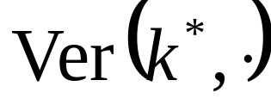
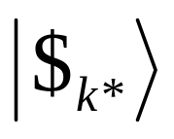
All 2^{n} possible verifiers
U = “Rejects a random state in S w.h.p.”
All 2^{n} possible quantum money states
U
Throw out everything in S that Ver(k,⋅) rejects w.h.p.
S
S = “Still in the running”
Find some verifier k∈U (not necessarily k*) that nevertheless accepts |$_{k*}⟩ w.h.p.

Slide 21
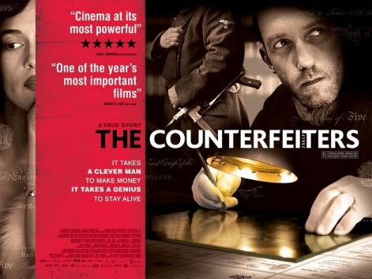
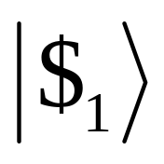
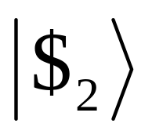
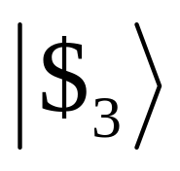
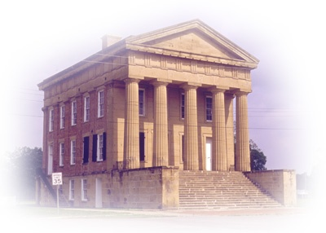
Interactive Security
We want a private-key quantum money scheme that remains secure, even if the counterfeiter can start with poly(n) legitimate bills, then repeatedly modify them and submit for verification
Gavinsky did this, but in his scheme, the bill gets destroyed after ~n verifications
Farhi et al. showed that, if the verification is just a projection, then we can’t have interactive security with unentangled bills
Observation: Such a scheme follows from my previous work with Christiano on public-key quantum money

Slide 22
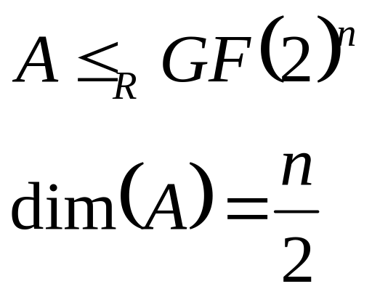
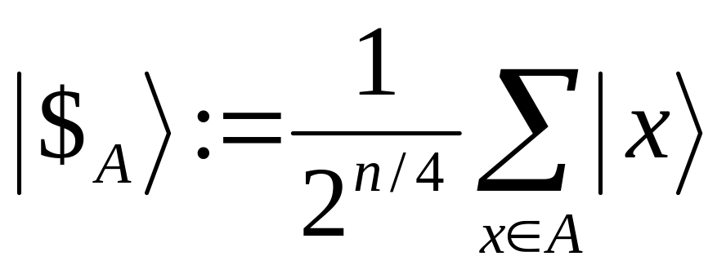
The Hidden Subspace Mini-Scheme
Quantum money state:
|$_{A}⟩ is easy to prepare, given a basis for A. It’s also easy to verify, given only membership oracles for A and A⊥
A.-Christiano proposed a cryptographic way to “instantiate” such membership oracles, without revealing A—but not directly relevant here
Theorem (A.-Christiano 2012): Even given membership oracles for A and A⊥, any counterfeiter needs Ω(√ε 2^{n/4}) quantum queries to copy |$_{A}⟩ with ε success probability
Proof uses modification of Ambainis’s quantum adversary method

Slide 23
Corollary: Considered as a private-key mini-scheme, the hidden subspace scheme must be secure against interactive attacks!
(With no computational or oracle assumptions)
Proof: Suppose an interactive attack existed. Then a public-key counterfeiter could simulate that attack, using membership oracles for A and A⊥ to simulate the bank’s verification. He’d thereby break the public-key scheme, which we already proved to be secure against such counterfeiters.

Slide 24
Open Problems
Improve the n⁵ from our Tradeoff Theorem?
Does private-key quantum money without a giant database require one-way functions?
We know it requires some computational assumption
Can we have private-key quantum money secure against interactive attack, without highly-entangled bills?
Farhi et al. show that if so, verification will need to be non-projective
Can we have unconditionally-secure public-key quantum money, relative to a random oracle?
If we remove the word “public-key” or the word “random,” then yes
Private-key quantum copy-protection?

Slide 25
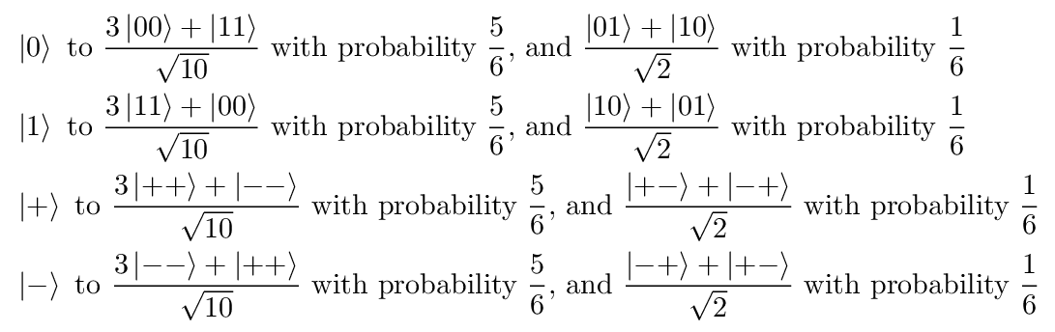
The (3/4)^{n} Counterfeiting Strategy
For each qubit in the money state, map
(Note: “Obvious” strategy only succeeds with (5/8)^{n} probability!)

