Slide 1
Secure Multi-Party Quantum Computation
Michael Ben-Or
QCrypt 2013 Tutorial
M. Ben-Or, C. Crépeau, D. Gottesman, A.Hassidim, A. Smith, arxiv.org/abs/0801.1544

Slide 2
Talk Structure
Definitions and a bit of history
Classical “top down” scheme
Quantum building blocks
Verifiable Quantum Secret Sharing (VQSS)
Multi Party Quantum Computation (MPQC)

Slide 3
Talk Structure
Definitions and a bit of history
Classical “top down” scheme
Quantum building blocks
Verifiable Quantum Secret Sharing (VQSS)
Multi Party Quantum Computation (MPQC)

Slide 4
Problem Settings
Multi Party Computation - A group of n players wants to perform a computation but t of them form a coalition of cheaters
  Player i’s input (called x_{i}) should remain secret.
  P_{i}’s output is g_{i}(x₁,…,x_{n})
  Cheaters can input what they like, but can not otherwise disrupt the computation.
  We assume that there is a private authenticated channel between any two players, and a classical broadcast channel.
Verifiable Secret Sharing – In the first stage a dealer is sharing a secret among n players. At a later stage a receiver learns the secret.
  Cheaters do not learn any information about the secret.
  Even if the dealer is faulty, after the sharing is done the secret is set.
VSS is usually an important building block in MPC.

Slide 5
Abbreviated History
Optimal classical results:
  t < n/2 for classical computation with broadcast (RB89)
  t<n/3 without broadcast (zero error prob.)
Quantum preliminary results:
  MPQC is possible for t < n/6 (CGS02)
  VQSS is possible for t < n/4 (CGS02)
  Impossible to succeed with no error probability for t ≥ n/4.

Slide 6
Quantum Upper Bound On t
According to the “no cloning” theorem, quantum error correcting codes (QECC) can correct less than n/4 changes (or less than n/2 erasures)
This gives an upper bound for t for VQSS, as any VQSS can be considered as a QECC in which we code one qudit to n, and protect it from t changes (CGS02)
Fortunately, Barnum, Crépeau, Gottesman, Smith and Tapp found “Approximate Quantum Error Correcting Codes” which can fix up to t < n/2 changes, with high probability [BCGST02,CGS05]
  So there’s hope …

Slide 7
Main Result
Assuming pairwise quantum channels and a classical broadcast channel between n players,
There exists a universally composable statistically secure multiparty computation protocol, that tolerates an adaptive adversary controlling t < n/2 faulty players
The complexity of the protocol is polynomial in the security parameter, the number of players and the size of the circuit
Notes:
להסביר שזה בעצם טריביאלי (במובן המתמטי) אבל יש קצת פרטים קטנים לפני שזה נעשה טריביאלי...

Slide 8
Universal Composiblity
The protocol is secure iff the real protocol is statistically indistinguishable from the ideal protocol + simulator [Can01, PW01, BM04, Un10, MR11]
Simulator
Bob (x_{B})
Charlie (x_{C})
Alice (x_{A})
Trusted Third
Party
(TTP)
g_{i}(x₁,…,x_{n})
Harriet (x_{H})
Cheaters
Diane (x_{D})
George (x_{G})
Eve (x_{E})
Fred (x_{F})

Slide 9
Talk Structure
Definitions and a bit of history
Classical “top down” scheme
Quantum building blocks
Verifiable Quantum Secret Sharing (VQSS)
Multi Party Quantum Computation (MPQC)

Slide 10
Top Down Description of VSS
Sharing - The dealer begins with a secret s. She encodes it to n shares, authenticates each share, and sends one share to each player
  Some tests are being run…
Recovery - At a later stage all shares are sent to the same player, who uses authenticated shares to build the secret
Security is based on error correcting codes and authentication
This will not work for a faulty dealer…

Slide 11
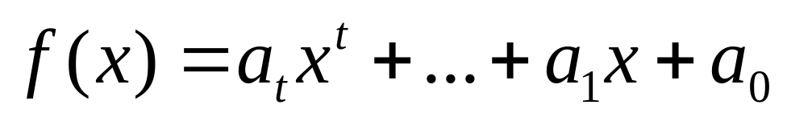
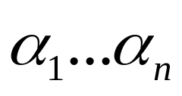
secret=a₀
s
f(α₁)
e
f(α₂)
c
f(α₃)
r
f(α₄)
e
f(α₅)
t
f(α₆)
b
f`(α₆)

Slide 12
Weak Secret Sharing
Assume a faulty dealer does the sharing correctly
After the sharing phase a single faulty player changes her state to another authenticated state
  At the recovery stage no state will be recovered
The faulty players can’t change the secret
  It’s protected by the t+1 shares of the honest players
We call this Weak Secret Sharing

Slide 13
Trusted Third Party Definition for WSS
The dealer D sends TTP a secret ρ (the secret will later be quantum) or no state at all. If D did not send a secret, the TTP notifies all the players that this is the case and the protocol ends.
Otherwise, at the reconstruction phase, a reconstructor R is chosen
If D is honest, the TTP sends the secret ρ to R.
If D is faulty, she can tell the TTP not to send the secret. In this case the TTP tells the reconstructor that D is faulty.

Slide 14
From WSS to VSS
After the sharing phase, every player will distribute the share she got from the dealer
The recovering player will work with n² shares
As the only “bad” thing faulty players can do is destroy their share, the t+1 shares of the good players will be opened and determine the secret

Slide 15
secret
s
e
c
r
e
t
WSS(S)
WSS(e)
WSS(c)
WSS(e)
WSS(t)
WSS(r)
VQSS = 2WQSS
Acting on secrets is done by acting on shares transversally

Slide 16
Two Levels of Security
The receiver gets n² shares and builds the secret out of them
So after the sharing phase of the second WSS, top level authentication is no longer needed (as all data is already authenticated)
WSS(S)
WSS(S)
WSS(S)
WSS(e)
WSS(e)
WSS(e)
WSS(e)
WSS(e)
WSS(c)
WSS(e)
WSS(c)
WSS(c)
WSS(t)
WSS(t)
WSS(t)
WSS(r)
WSS(r)
WSS(r)

Slide 17
Talk Structure
Definitions and previous results
Classical “top down” scheme
Quantum building blocks
Verifiable Quantum Secret Sharing (VQSS)
Multi Party Quantum Computation (MPQC)

Slide 18
Turning VSS to VQSS
How do we authenticate data?
  We will also need to manipulate authenticated data
How do we make sure the dealer sent any data at all?
How do we make transversal operations on encoded states?

Slide 19
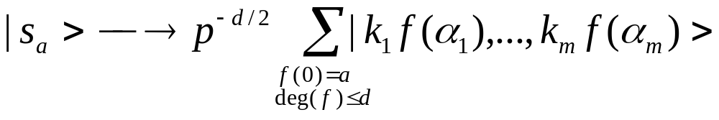
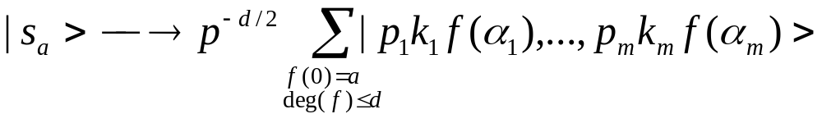
Quantum authentication
Arithmetic is done modulu p. α₁… α_{m} ∈Z_{p}
Uses two types of keys:
  Authentication key denoted k₁…k_{m} ∈_{R}{-1,1}
  Secrecy key denoted x⁰₁, x¹₁ , …x⁰_{m}, x¹_{m} ∈_{R}{0,…,p-1}
  x⁰_{i} and x¹_{i} will be used to encrypt the i’th part of the state using a random Pauli operation

Slide 20
Why is this Secure?
Enough to prove that any Pauli operation will be caught with high probability (BCGST02,HLM)
If the operation effects less than d places it will be caught (the code can fix it)
Assume the operation effected α_{r}… α_{m} , r ≤ d.
α₁… α_{d+1} fix a polynomial. The probability that the new points sit on it is at most 2^{-d}, as if k_{i}=1 sits on it, than k_{i}=-1 doesn’t

Slide 21
Managing the Keys
All keys in the protocol will be managed by a classical [UC-] MPC
We use an ideal classical Trusted Third Party (TTP) [Un10]
TTP will also take care of other classical data (measurement results, etc.)

Slide 22
Use TTP for Authentication
TTP
Receiver can verify that either he got A_{key}(ψ) or the adversary tampered with the information
key
key
Dealer
Receiver
A_{key}(ψ)
Adversary
?

Slide 23
Operations on encoded data
TTP
We want P to operate on the quantum data according to the protocol, with the help of the TTP
If P should operate on the data but doesn’t do it correctly – the receiver will notice that the data is not authenticated
key
key`
Dealer
Receiver
A_{key}(ψ)
Player P
A_{key`}(Uψ)

Slide 24
Goal – Clifford Group Operations
Pauli operations are trivial – just change the encryption key x.
Multiplying with a scalar – P multiplies each part of the code, the TTP multiplies the key x.
Fourier: k_{i} → 1/k_{i} , (x⁰_{i}, x¹_{i})→ (x¹_{i}, x⁰_{i}), transversal operation
Measurement according to the computational basis: measure transversally. We are left with
k₁f(α₁)+p₁,…,k_{m}f(α_{m})+p_{m}
where f is a random polynomial, such that f(0) is the measurement result. Note that the results of the transversal measurement give no information without the keys (the p_{i} are random)

Slide 25
The CNOT operation
Only possible for states with the same authentication key k
Transversal CNOT on A_{k}⊗A_{k} maps to a CNOT on the data.
Assuming x = (x₀,x₁), y = (y₀,y₁)
  CNOT on E_{x}A_{k} ⊗ E_{y}A_{k} maps to E_{x’}A_{k} ⊗ E_{y’}A_{k}
with x’ = (x₀,x₁-y₀), y’ = (x₀+y₀,y₁)
Assuming that the keys (k, x, y) are shared via the classical MPC we can perform the transformation
(k, x, y) → (k, x’, y’)
via the MPC.
All Clifford groups operations are possible. Furthermore, they leak no information regarding the state or the keys.

Slide 26
What Do We Have?
We know to authenticate data
But how do we make sure the dealer sent any data at all?
We will begin by forcing the dealer to distribute authenticated zeroes, and than manipulate them…

Slide 27
Dealer
At least one honest player sent correctly authenticated zeroes
In the end of this phase, every honest player has zeroes authenticated by the dealer
0
0
More than t complaints
0
0
0
0
0
0
0
Yes
No
Dealer is faulty
Fix the situation
P₁
P₂
P_{n}
P_{n} complains
0
0
0
0

Slide 28
Testing the Zeroes
Assume P holds φ₁,…, φ_{m}, where each φ_{i}, is a zero state which was sent by the dealer
P chooses random numbers a₁,…,a_{m} ∈_{R}{0,…,p}, and computes into φ_{m} the sum φ_{m} = ∑a_{i} φ_{i}.
P measures φ_{m}. The result should be 0.
P repeats this s times, applies the Fourier transform and does this another s times
The fidelity to authenticated zeroes is exponential in s
As x is not revealed, the secrecy of the authentication key k is not jeopardized

Slide 29
Passing information
Dealer
P_{i}
ρ
0
0
EPR-pair
ϕ ₂
entanglement
ϕ ₁
Teleport
ρ
TTP
Measurement result
P_{i} Holds an authenticated state

Slide 30
Talk Structure
Definitions and a bit of history
Classical “top down” scheme
Quantum building blocks
Verifiable Quantum Secret Sharing (VQSS)
Multi Party Quantum Computation (MPQC)

Slide 31
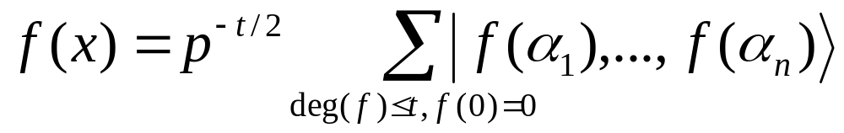
Weak Quantum Secret Sharing
Assume n=2t+1.
The dealer uses a degree t-polynomial quantum erasure code to share many joint zeros (protects against t erasures). The n shares are transmitted to the players.
The players test the joint zero shares they have, with the help of the Classic TTP
The players Generate joint EPR pairs and send a half back to the dealer. The dealer decodes and use the half he hold to teleport any qudit to the players.

Slide 32
WQSS
n shares
Dealer:
Original
qudit
Polynomial code
Auth
Auth
Auth
Faulty dealer can’t change the opened state, but can make sure that no state is reconstructed
S qudits
1 share
S qudits
1 share
S qudits
1 share
All sent by one joint telleportation

Slide 33
The VQSS protocol
Preparation – Each player P_{i} chooses a constant authentication key k_{i} and distributes many zeroes which were authenticated by k_{i} to all players. k_{i} will be kept secret at all times
The dealer chooses a temporary authentication key and distributes the secret using WQSS and the temporary key
Each player distributes her share using WQSS and the constant key k_{i}.
The top level authentication is removed using Clifford operations

Slide 34
VQSS is similar to a two level WQSS:
n shares
Original
qudit
Polynomial code
Every player has her own authentication key for the second level
S qudits
1 share
Auth
n shares
VQSS = 2WQSS

Slide 35
Recovering the Data
A simple scheme could be to send all data and keys to the recovering player R.
But this will reveal k_{i}.
Instead, R will share half an EPR pair with the group using VQSS.
The secret shared by D will be teleported to R using this pair
(as always – with the help of the TTP)

Slide 36
Talk Structure
Definitions and a bit of history
Classical “top down” scheme
Quantum building blocks
Verifiable Quantum Secret Sharing (VQSS)
Multi Party Quantum Computation (MPQC)

Slide 37

Multi Party Computation
Clifford group operations and measurements are easy
  Even between states shared by different players
Toffoli can be done with the help of the Toffoli state:

Slide 38
Sharing the Toffoli State
All players share Toffoli states
Using “state tomography” the players purify the shared states and verify that the shared states have polynomial fidelity to a Toffoli state
Using error correction techniques a high fidelity Toffoli state is generated from the low fidelity states
Toffoli, measurement and Clifford are enough for universal quantum computation

Slide 39
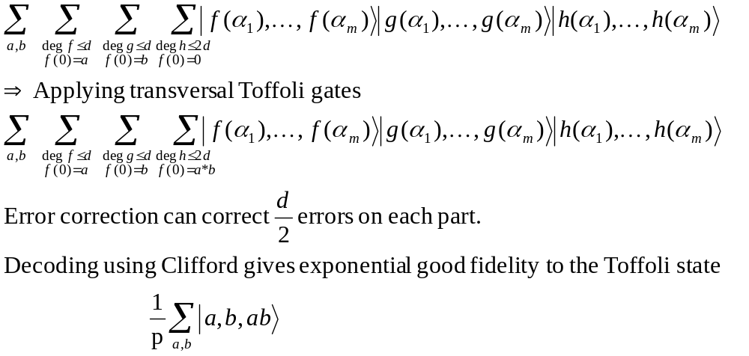
Purifying Toffoli States
Let m=3d+1. Using Clifford op generate

Slide 40
Simulation
Protocols are tricky, but the simulation is quite trivial
  Until all the checks are done, only known data is being manipulated
  The ideal classical MPC can be used to control the protocol

Slide 41
What happens for t ≥ n/2 faulty players
No statistically secure Bit Commitment and no strong coin flip,
but Leader Election is possible [Mo07].
Assuming quantum computationally secure UC-Bit Commitment we get UC 2-party, and general UC-secure classical multiparty against quantum adversaries [Un10].
Similar results in the noisy quantum memory model with statistical security but weaker composability.
What can be done for quantum computation?
Asynchronous networks:
A similar scheme works for t < n/4.
What can be done for n/4 ≤ t < n/3 ?

Slide 42
Thank
You

