Slide 1
Universal Uncertainty Relations
Gilad Gour
University of Calgary
Department of Mathematics and Statistics
Based on joint work with Shmuel Friedland and Vlad Gheorghiu
arXiv:1304.6351
QCrypt2013, August 5–9, 2013 in Waterloo, Canada

Slide 2
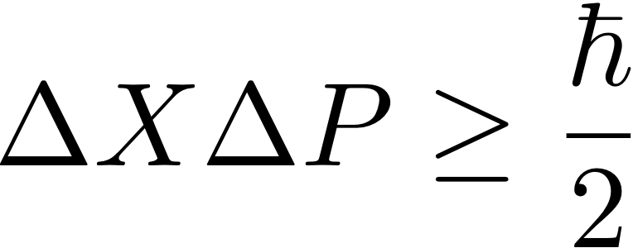
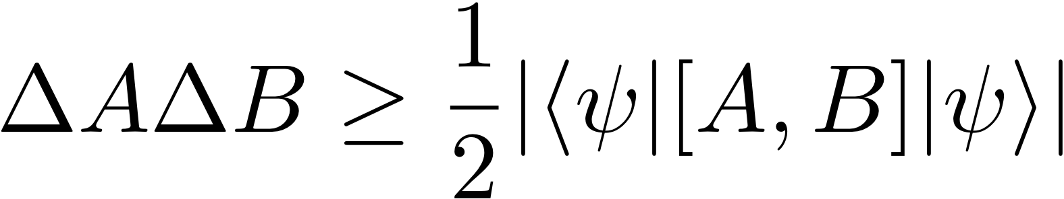
The Uncertainty Principle
Heisenberg [Zeitschrift fur Physik 43, 172 (1927)]:
Generalization by Robertson [Phys. Rev. 34, 163 (1929)] to any 2 arbitrary observables:
Drawbacks:
State dependence! Can be zero for non-commuting observables
Does not provide a quantitative description of the uncertainty principle

Slide 3
Entropic Uncertainty Relations
Deutsch [Phys. Rev. Lett. 50, 631 (1983)] addressed the problem by providing an entropic uncertainty relation, later improved by Maassen and Uffink [Phys. Rev. Lett. 60, 1103 (1988)] to:
where
and
Vast amount of work since then, see S. Wehner and A. Winter
[New J. Phys. 12, 025009 (2010)] and I. B. Birula and
L. Rudnicki [Statistical Complexity, Ed. K. D. Sen, Springer,
2011, Ch. 1] for two recent reviews

Slide 4
Entropic Uncertainty Relations
Deutsch [Phys. Rev. Lett. 50, 631 (1983)] addressed the problem by providing an entropic uncertainty relation, later improved by Maassen and Uffink [Phys. Rev. Lett. 60, 1103 (1988)] to:
where
and
Still not satisfactory: use particular entropy measures
(nice asymptotic properties), but no a priori reason to quantify
uncertainty by an entropy.

Slide 5



Entropic Uncertainty Relations
Alice’s Lab
Bob’s Lab
Alice choice of A or B
b
a
A or B
m
Entropic uncertainty relations provide lower bounds on Bob’s
resulting uncertainty about Alice’s outcome
M. Berta et al, Nature Phys. 6 659-662 (2010)

Slide 6
Entropic Uncertainty Relations
Alice’s Lab
Bob’s Lab
Alice choice of A or B
b
a
A or B
m
In the asymptotic limit of many copies of , the average
uncertainty of Bob about Alice’s outcome is:

Slide 7
How to quantify uncertainty?
Intuitively:
Main Requirement: The uncertainty of a random variable X
cannot decrease by mere relabeling .
A measure of uncertainty is a function of the probabilities
of X:

Slide 8
Random Relabeling
Figure: Uncertainty must increase under random relabeling. With probability r (obtained e.g. from a biased coin flip), Alice samples from a random variable (blue dice), and with probability 1 − r , Alice samples from its relabeling (red dice). The resulting probability distribution r p + (1 − r )πp is more uncertain than the initial one associated with the blue (red) dice p (πp) whenever Alice discards the result of the coin flip.

Slide 9
Monotonicity Under Random Relabeling

Slide 10
Monotonicity Under Random Relabeling
Birkoff's theorem: the convex hull of permutation matrices is the
class of doubly stochastic matrices (their components are
nonnegative real numbers, and each row and column sums to 1).
Random relabeling: is more uncertain than
if and only if the two are related by a doubly-stochastic matrix:

Slide 11
Monotonicity Under Random Relabeling
For
and
if and only if
:
Marshall and Olkin, “theory of majorization & its applications”, (2011).
R. Bhatia, Matrix analysis (Springer-Verlag, New York, 1997).

Slide 12
Monotonicity Under Random Relabeling
Conclusion: any reasonable measure of uncertainty must
preserve the partial order under majorization:
This is the class of Schur-concave functions.
Includes most entropy functions (Shannon, Renyi etc) but is not
restricted to them.
Measures of uncertainty are thus Schur-concave functions!

Slide 13
Our Setup
Figure:

Slide 14
Our Setup

Slide 15
Universal Uncertainty Relations

Slide 16
Comparisons

Slide 17
Computing ω

Slide 18
Computing ω

Slide 19
Computing ω
Lemma:
Look instead at:

Slide 20
Computing ω

Slide 21
The Most General Case
Not restricted to mutually unbiased bases (like most work before).
Non-trivial, better that summing pair-wise two-measurement uncertainty relations (consider e.g. a situation in which any two bases share a common eigenvector, for which the pair-wise bound gives a trivial bound of zero).

Slide 22
Example with 3 bases
Recall the MU entropic relation:
For any two measurements:
Trivial bound:

Slide 23
Example with 3 bases
Our UUR:

Slide 24
Summary and Conclusions
Discovered vector uncertainty relation
Fine grained, does not depend on a single number but on a majorization relation.
The partial order induced by majorization provides a natural way to quantify uncertainty.
Our relations are universal, capture the essence of uncertainty in quantum mechanics
Future work: uncertainty relations in the presence of quantum memory
Which bases are the most “uncertain”? Seem to be MUBs (strong numerical evidence).

Slide 25
Thank You!

