Slide 1

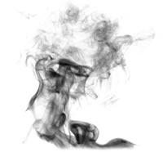
Quantum one-time programs
Anne Broadbent
Gus Gutoski
Douglas Stebila
extended abstract: Cryptology ePrint Archive, Report 2013/343
full version (old): arXiv:1211.1080 [quant-ph]
August 9, 2013, QCrypt, Waterloo

Slide 2
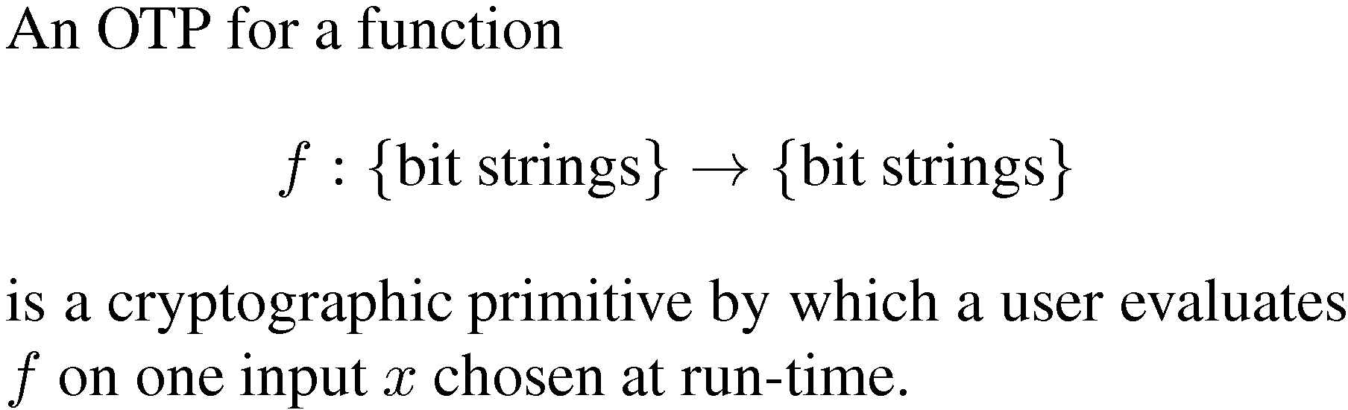





What is a one-time program?

Slide 3
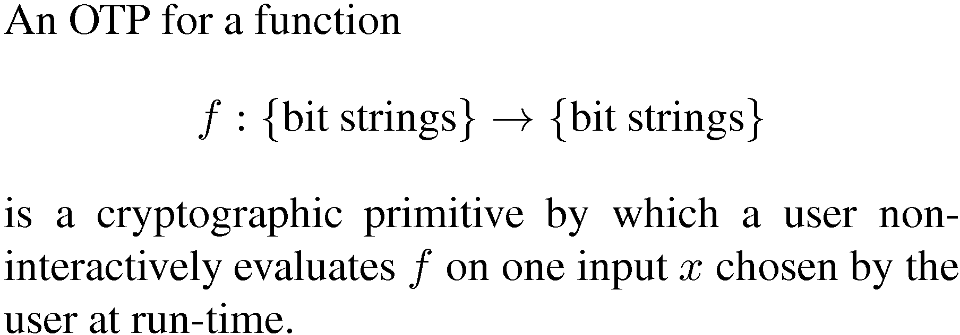


What is a one-time program?

Slide 4

What is a one-time program?

Slide 5
What is a one-time program?
BANG!

Slide 6
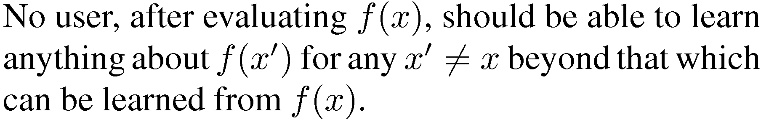
What is a one-time program?

Slide 7

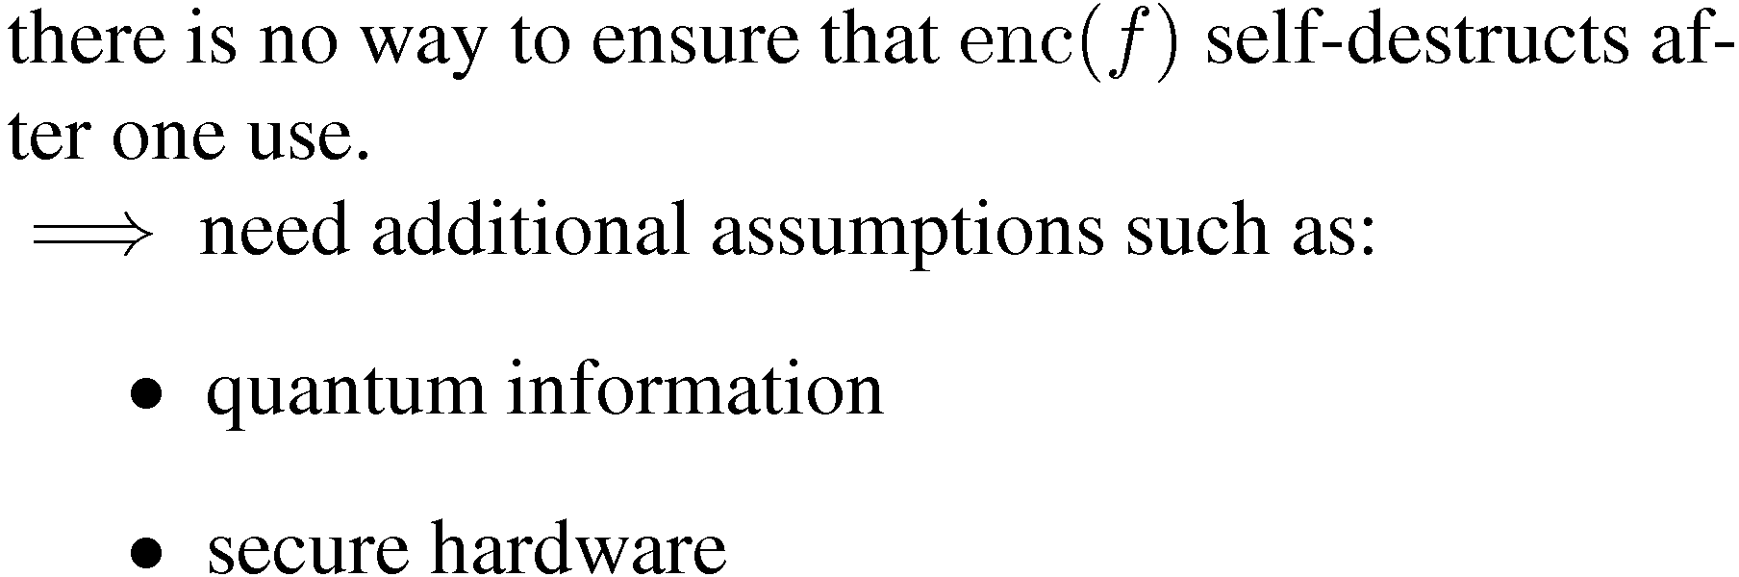
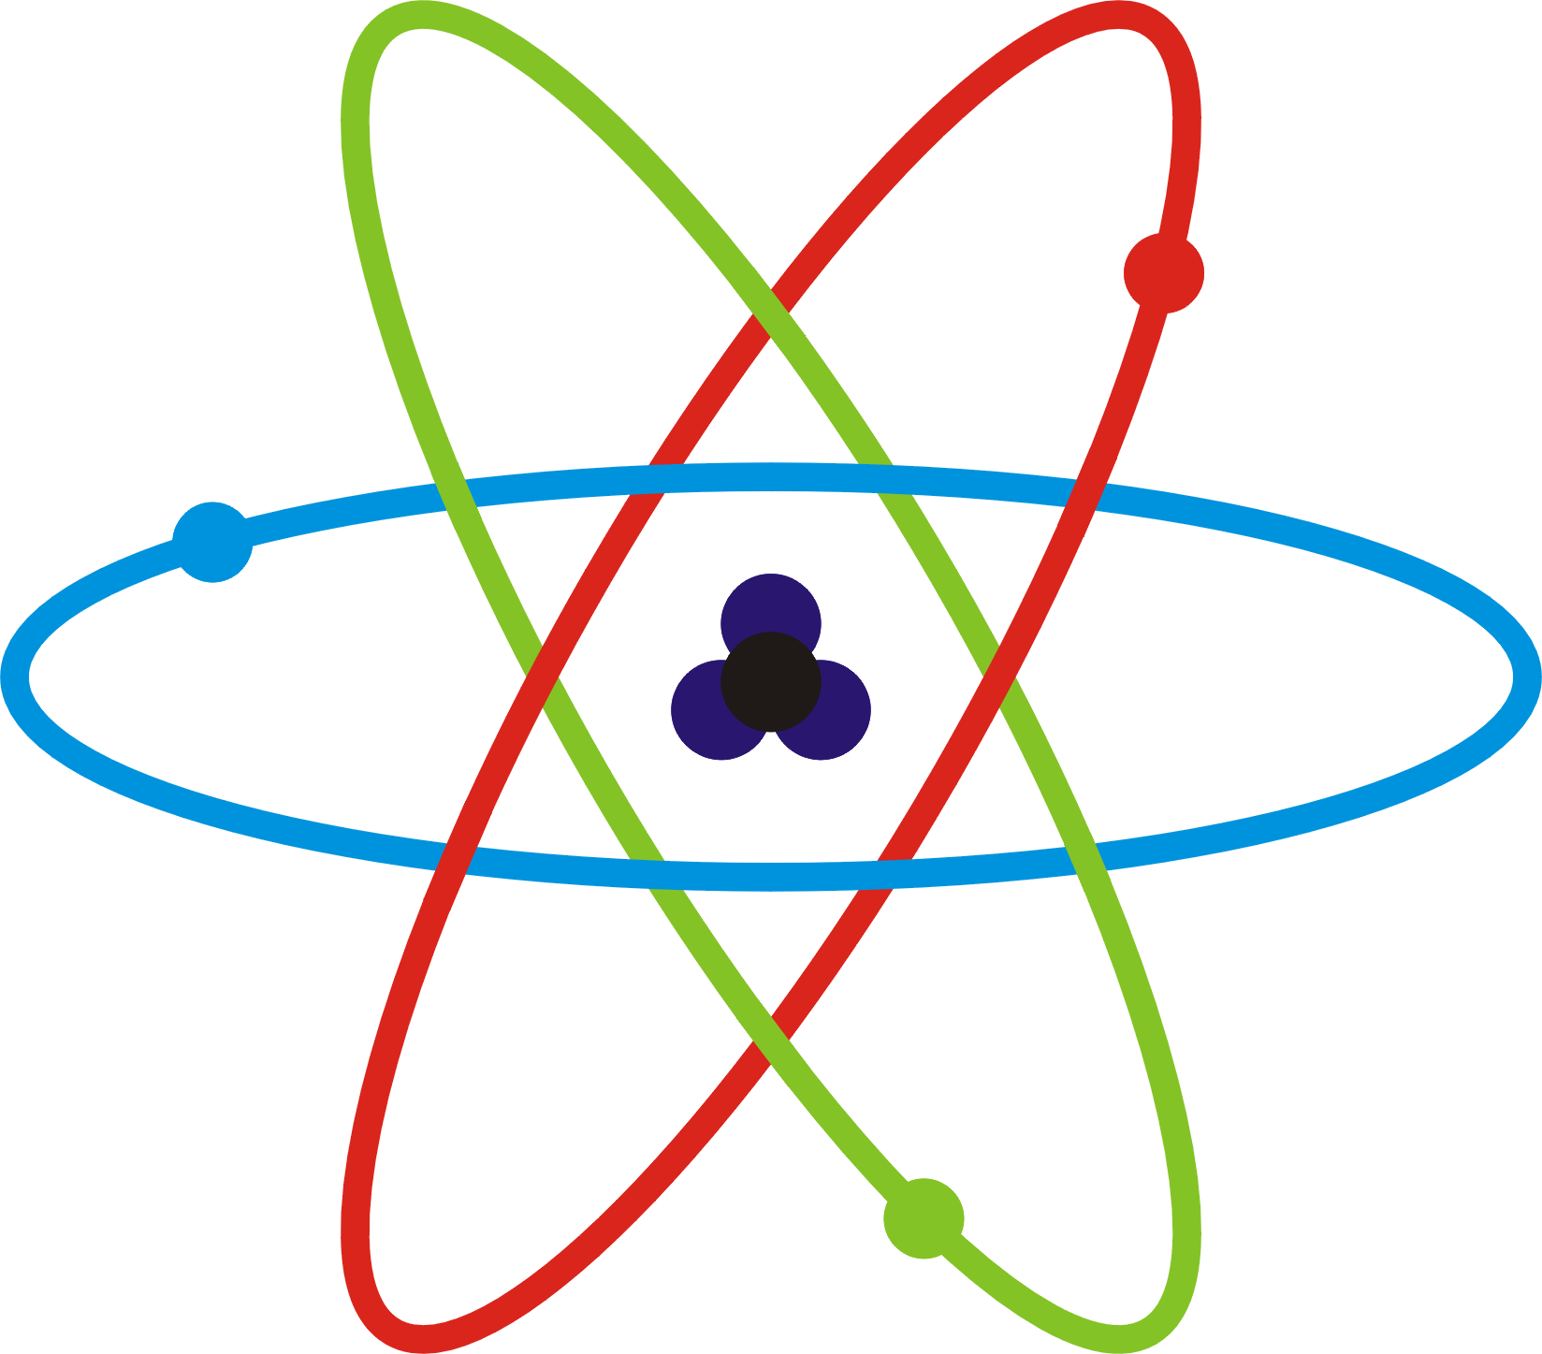
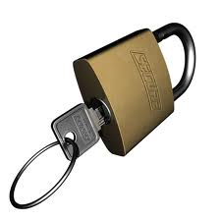
OTPs cannot be achieved by software

Slide 8
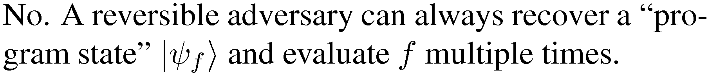






Does quantum information suffice?
U_{x}
U_{x}*

Slide 9
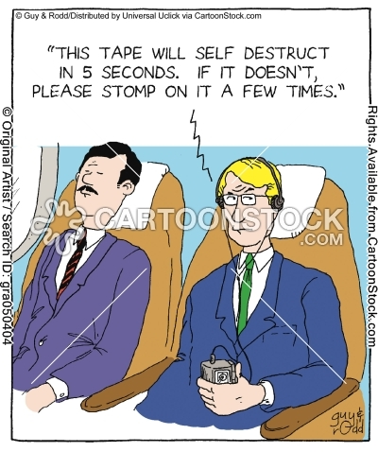
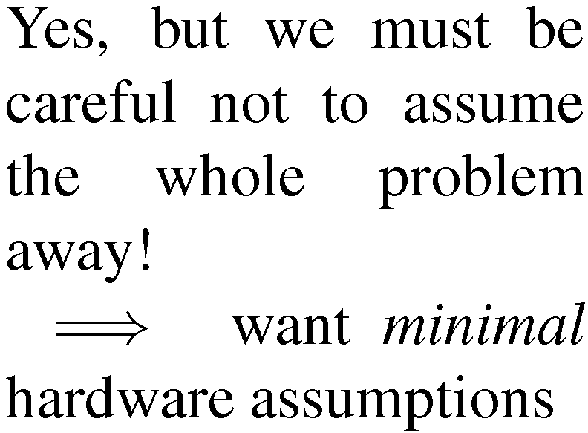
What about secure hardware?

Slide 10
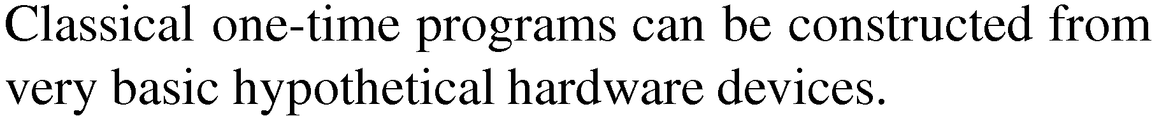




Secure hardware: one-time memory

Slide 11


Secure hardware: one-time memory

Slide 12
Secure hardware: one-time memory
BANG!

Slide 13
Secure hardware: one-time memory

Slide 14
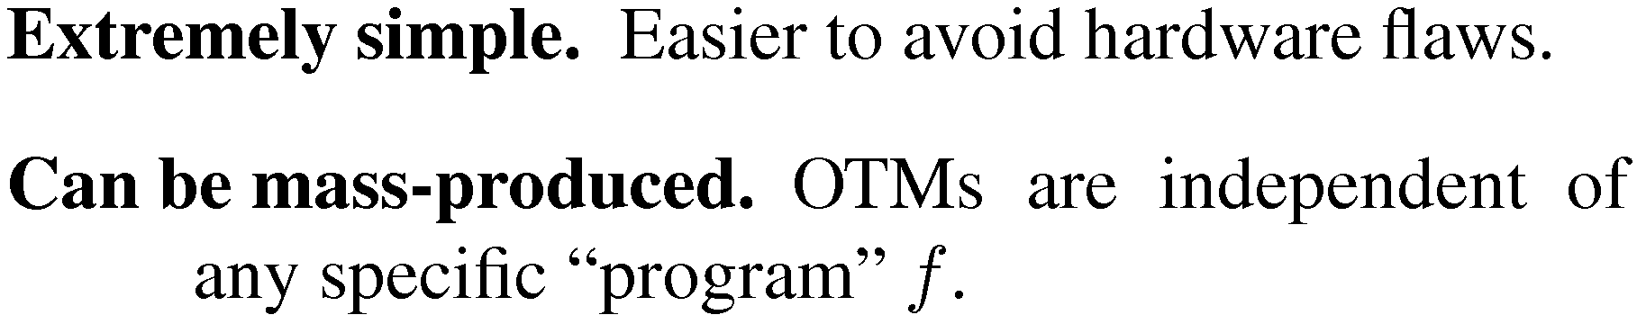

Advantages of one-time memories

Slide 15
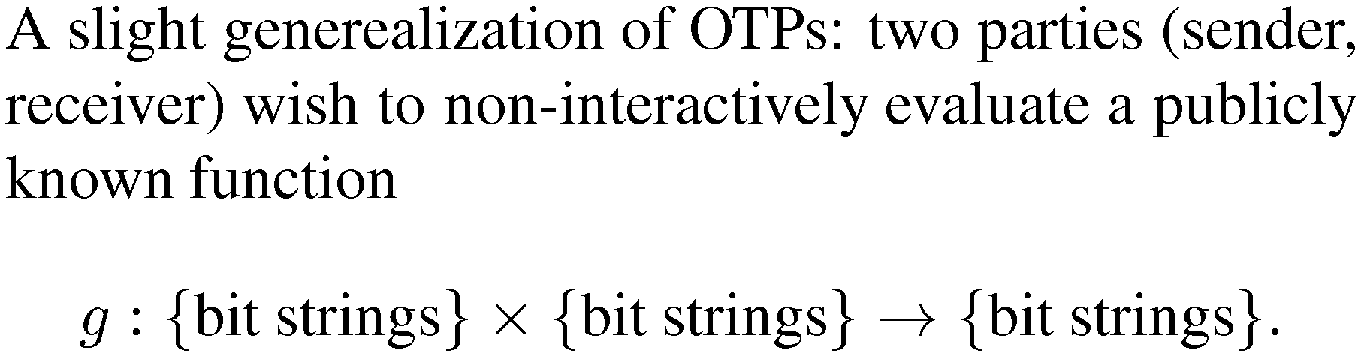



Non-interactive two-party computation
one-way
communication

Slide 16


Non-interactive two-party computation

Slide 17


Non-interactive two-party computation

Slide 18

Non-interactive two-party computation
BANG!

Slide 19
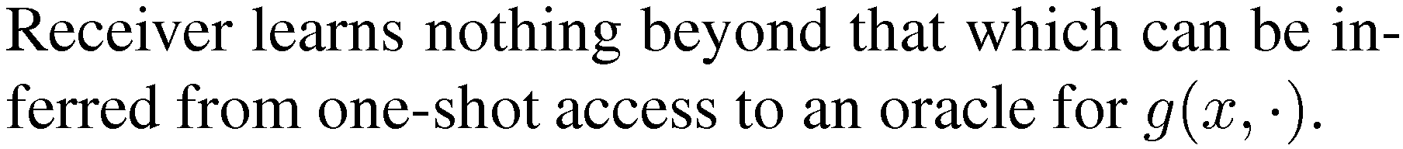
Non-interactive two-party computation

Slide 20
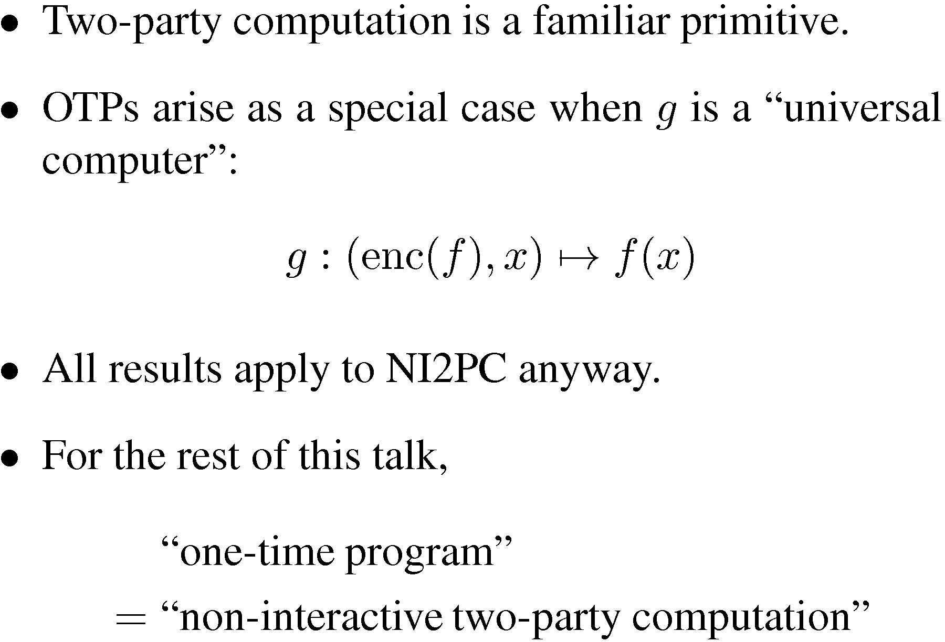
Why NI2PC?

Slide 21
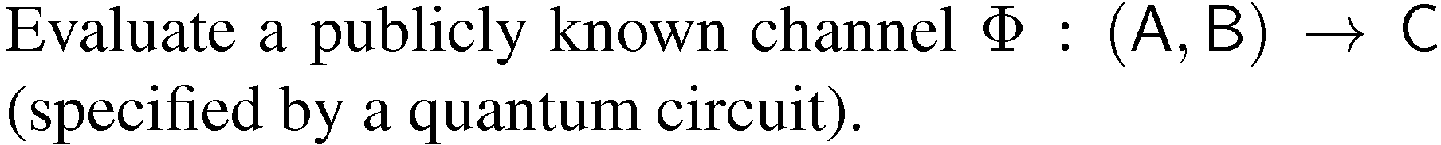





Quantum one-time programs
one-way
communication

Slide 22

Quantum one-time programs

Slide 23


Quantum one-time programs

Slide 24
Quantum one-time programs

Slide 25
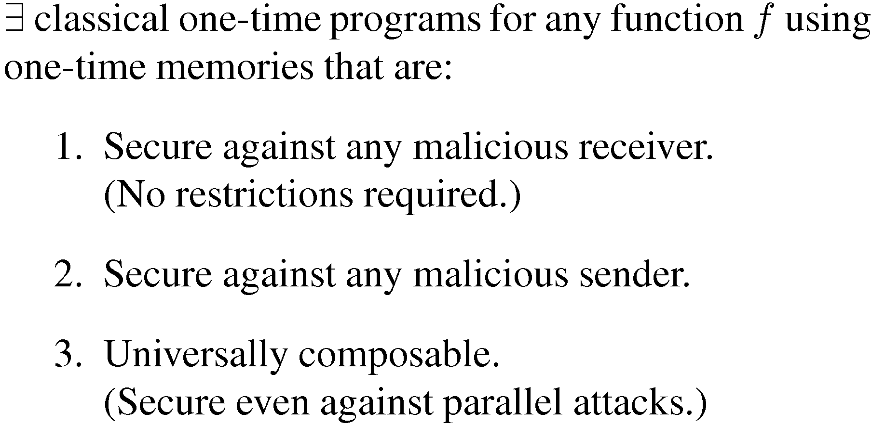
What’s known about classical OTPs

Slide 26


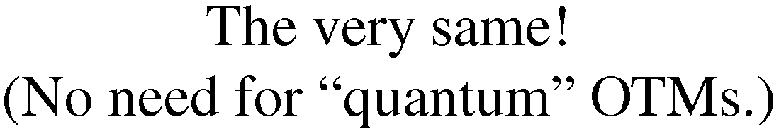
Our primary result:
quantum

Slide 27


Our primary result... in more detail
|φi
|ψi
|μi

Slide 28
Our primary result... in more detail
|φi
|ψi
|μi

Slide 29
Our primary result... in more detail
|φi
|ψi
B
|μi

Slide 30
Our primary result... in more detail
|φi
|ψi
|μi
B

Slide 31

Completeness requirement
C

Slide 32
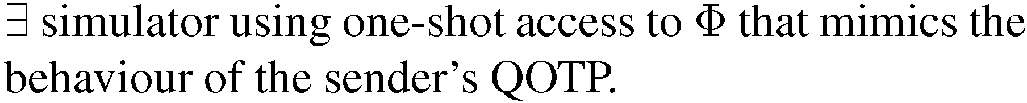


Security requirement
Φ
SIMULATOR

Slide 33
Security requirement
|φi
|ψi
|μi

Slide 34
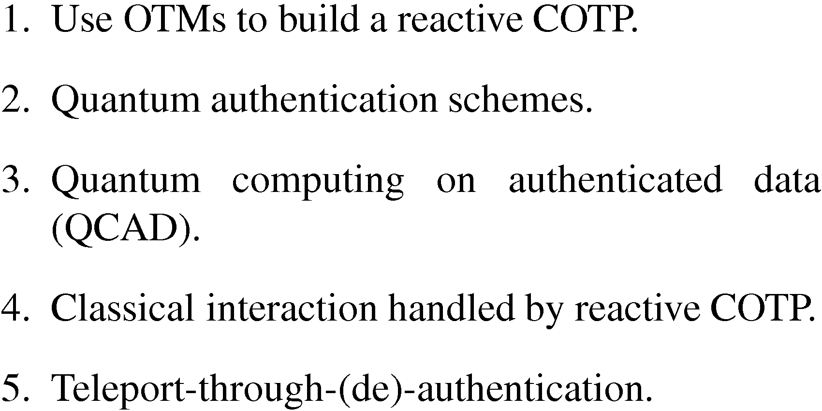
Overview: honest receiver

Slide 35
1. Use OTMs to build a reactive COTP
|φi
|ψi
|μi

Slide 36
From OTMs to COTPs...
|φi
|ψi
|μi

Slide 37
...and from COTPs to reactive COTPs
|φi
|ψi
|μi

Slide 38
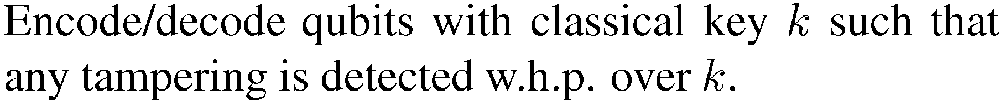




2. Quantum authentication schemes
TAMPERING

Slide 39
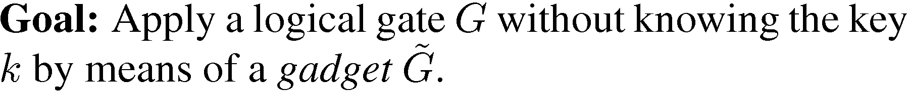





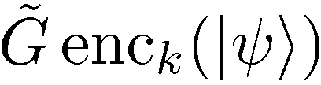


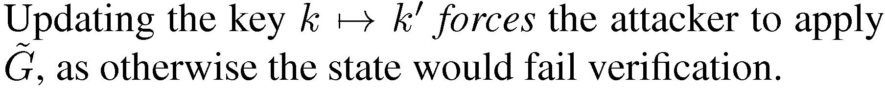
3. Quantum computing on authentica-ted data (QCAD)

Slide 40
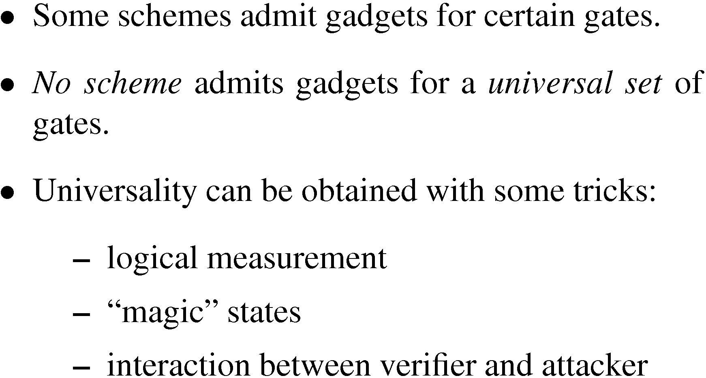
Life is not that easy

Slide 41
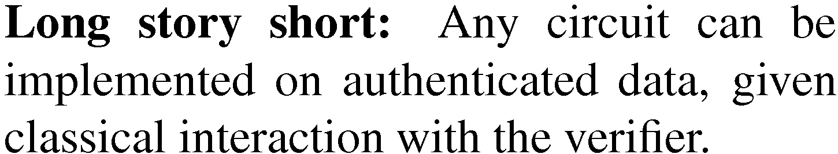
Life is not that easy

Slide 42
Life is not that easy
See Michael Ben-Or’s talk
from Wednesday

Slide 43
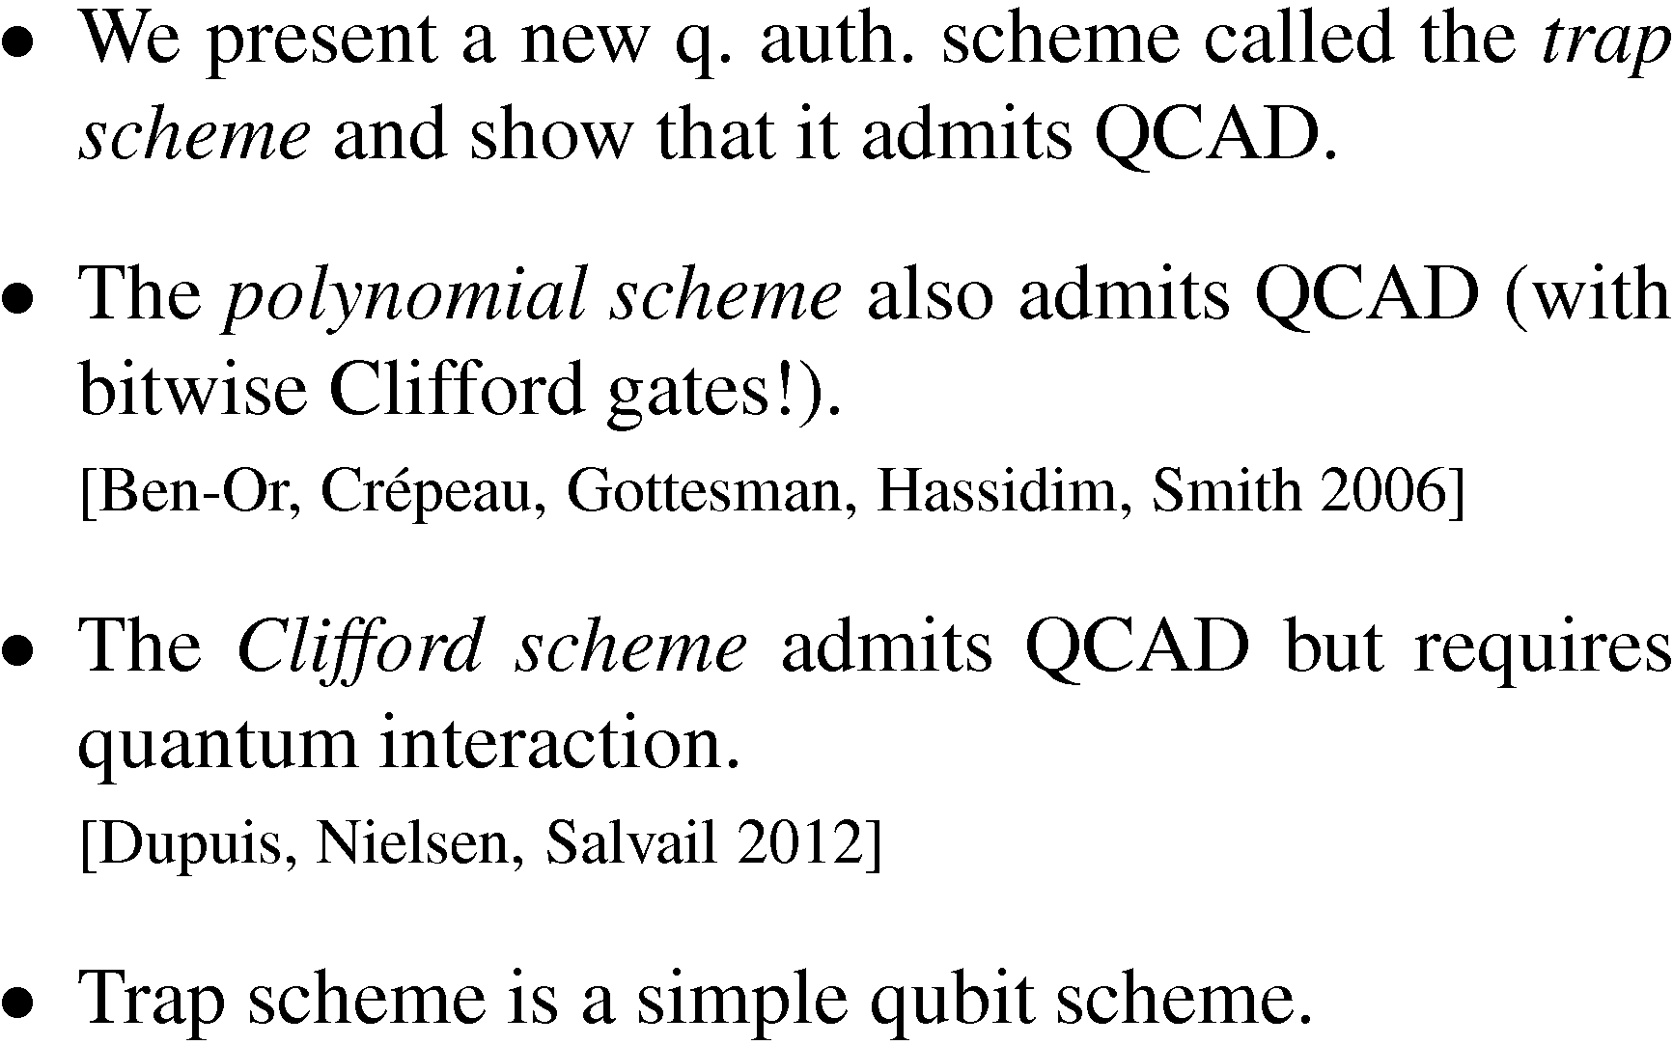
Schemes that admit QCAD

Slide 44
Schemes that admit QCAD
See Michael Ben-Or’s talk
from Wednesday

Slide 45
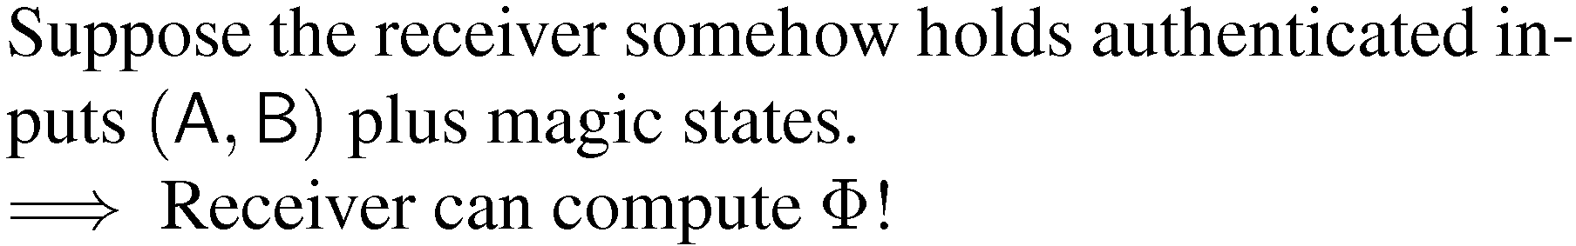





4. COTP for classical interaction
A
B
C

Slide 46
4. COTP for classical interaction
How does the receiver
non-interactively (de-)authenticate
his input without learning
the key??
A
B
C

Slide 47

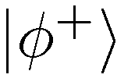

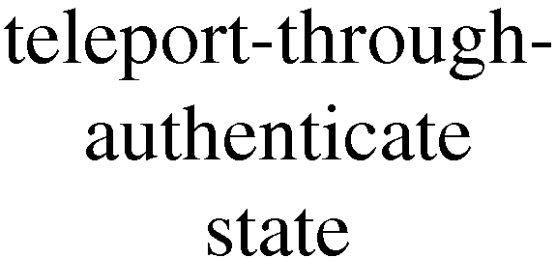

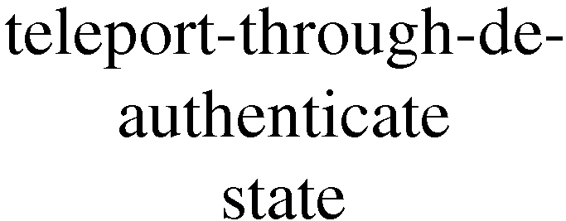
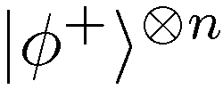


5. Teleport-through-(de)-authentication
trash

Slide 48
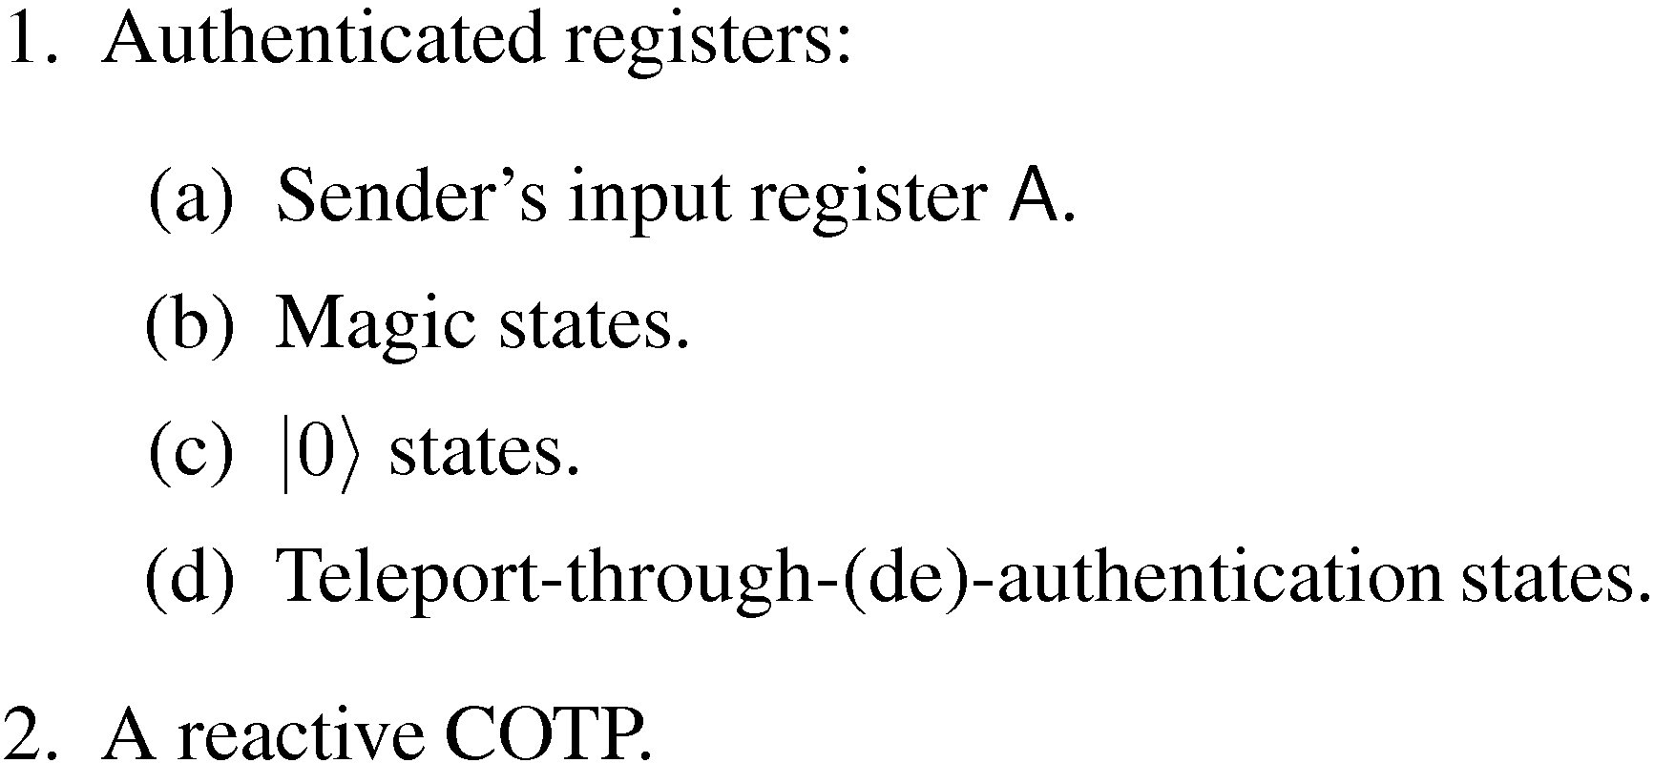
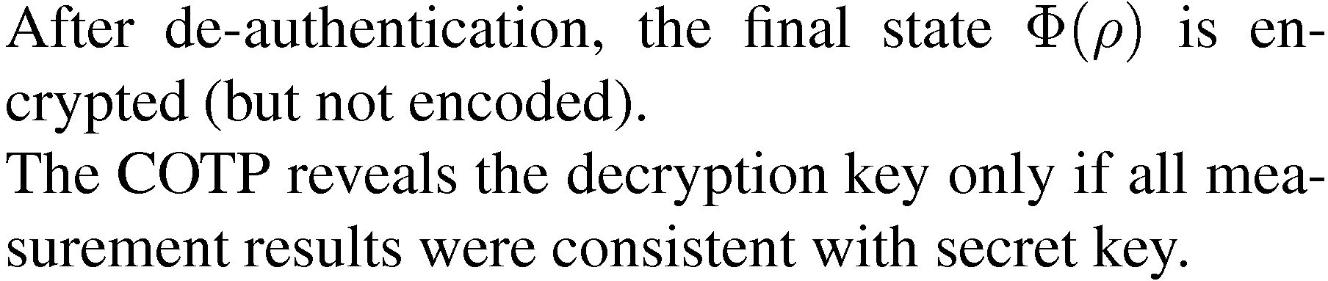
A QOTP consists of:
A
teleport
auth
|μi
|0i
teleport
de-auth

Slide 49
Security: a simulator for our QOTP
|ψi
|φi
|μi
Φ
SIMULATOR

Slide 50
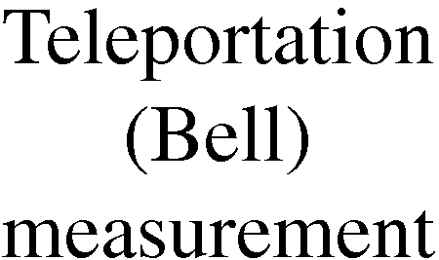



Simulator in pictures
A
Φ
|0i
|μi
|0i

Slide 51
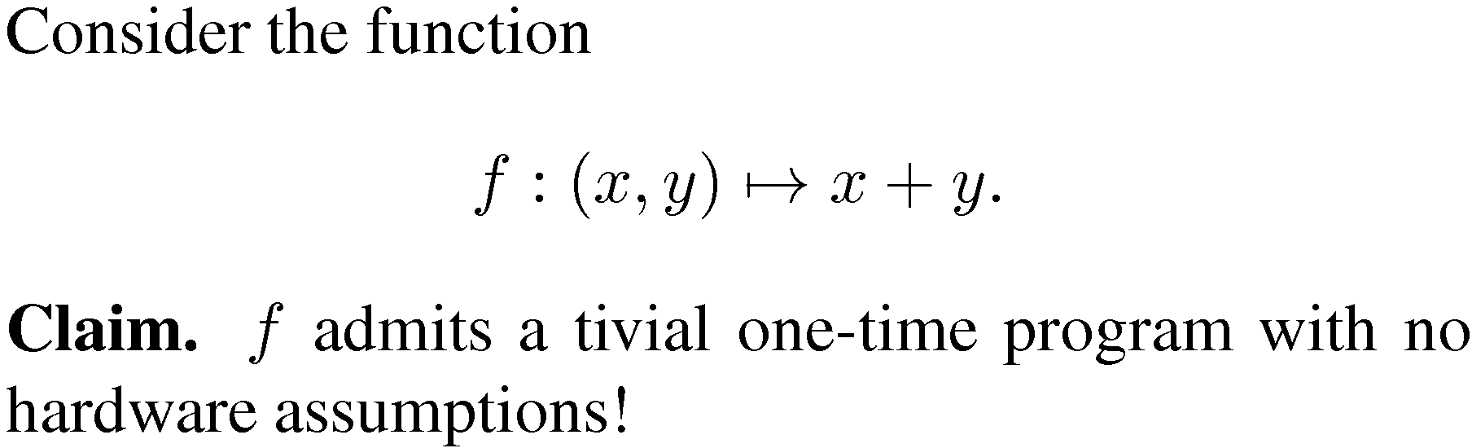

Trivial one-time programs

Slide 52
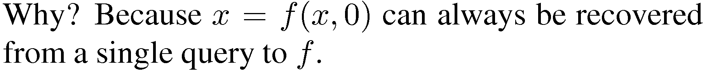


Trivial one-time programs
f

Slide 53
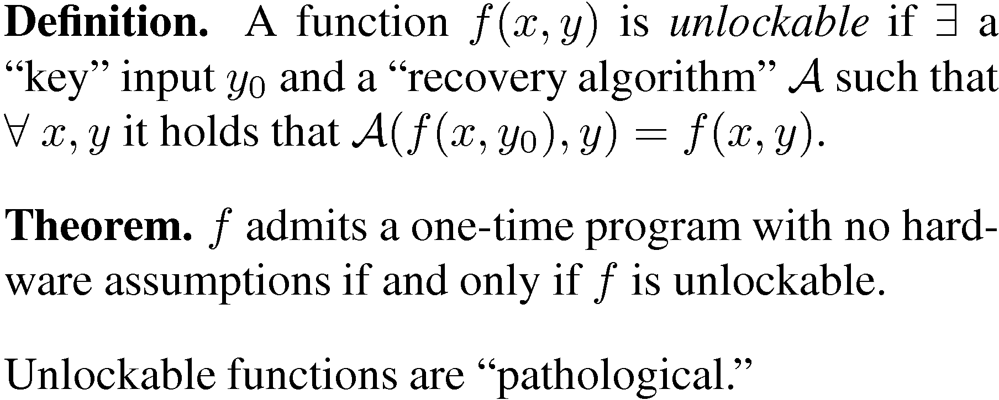
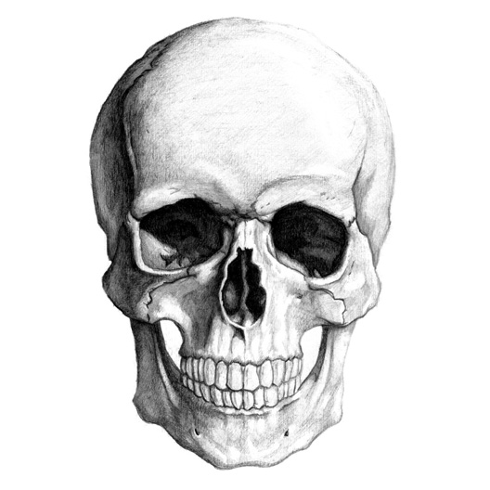
Unlockable classical functions

Slide 54
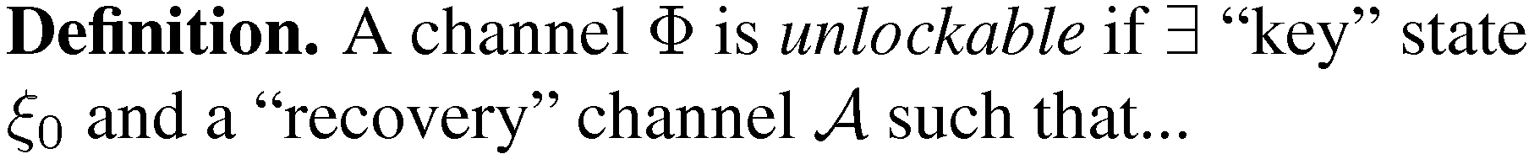
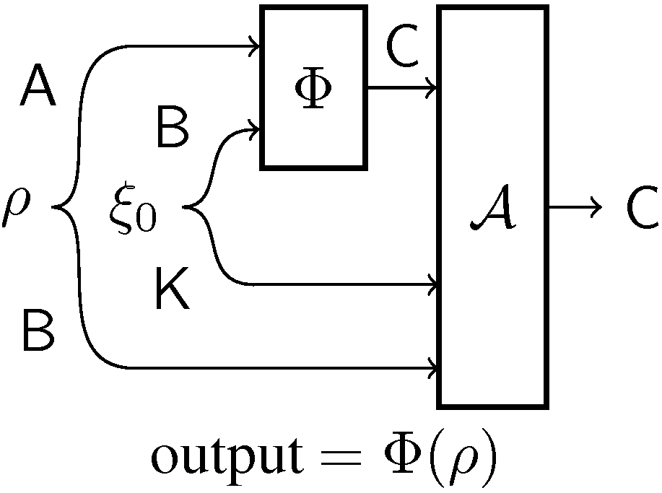
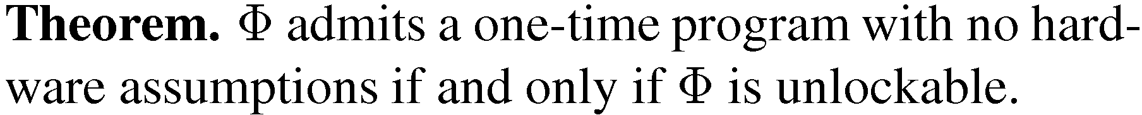
Unlockable quantum channels

Slide 55
The end
Thank you for your attention!
BANG!
extended abstract: Cryptology ePrint Archive, Report 2013/343
full version (old): arXiv:1211.1080 [quant-ph]

