Slide 1



Experimental demonstration of the coexistence of continuous-variable quantum key distribution with an intense DWDM classical channel
Rupesh Kumar
Joint work with
@ TelecomParisTech / CNRS
Hao Qin, Rupesh Kumar, Renaud Gabet, Eleni Diamanti and Romain Alléaume
@ SeQureNet
Paul Jouguet, Sébastien Kunz-Jacques

Slide 2
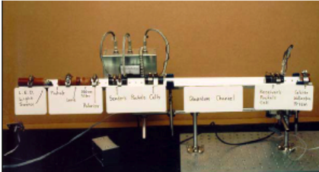




Motivations
QKD is a well understood part of quantum information
… but not yet widely adopted
ALICE
BOB
What does QKD need to become a successfull industrial technology ?

Slide 3
Main challenges for QKD development
- Performance (Rate, Distance)
Practical Security (Side-channel countermeasures)
Integration in existing infrastructures
+ Cost: transversal figure of merit
Example :
QKD Link (75 k$) deployed on a leased dark fiber (2000 $/ km / year)
Cost balance from 1 to 5 years
Fiber can be the highest operational cost in QKD network

Slide 4
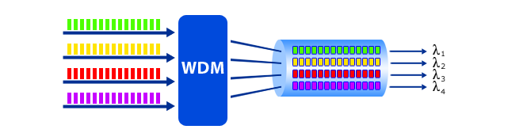
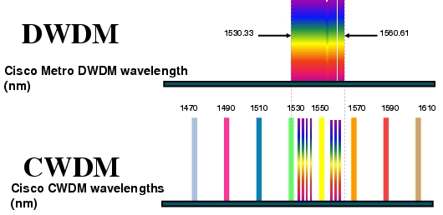
Sharing the fiber: Wavelength Division Multiplexing (WDM)
Multiplexing several optical channels in the same fiber
0.2nm – 0.8nm
300 ch
20nm
8-16 ch
What about QKD in WDM network?

Slide 5


Main noise sources in WDM context
Classical
channel
EDFA
Alice
Bob
MUX
DMUX
Due to finite channel isolation in WDM modules
Spontaneous emission at Lq from EDFA, or
Background emission from classical laser
Inelastic scattering due to
nonlinearity of optical fiber
Other noise sources: Four Wave Mixing and Rayleigh scattering

Slide 6
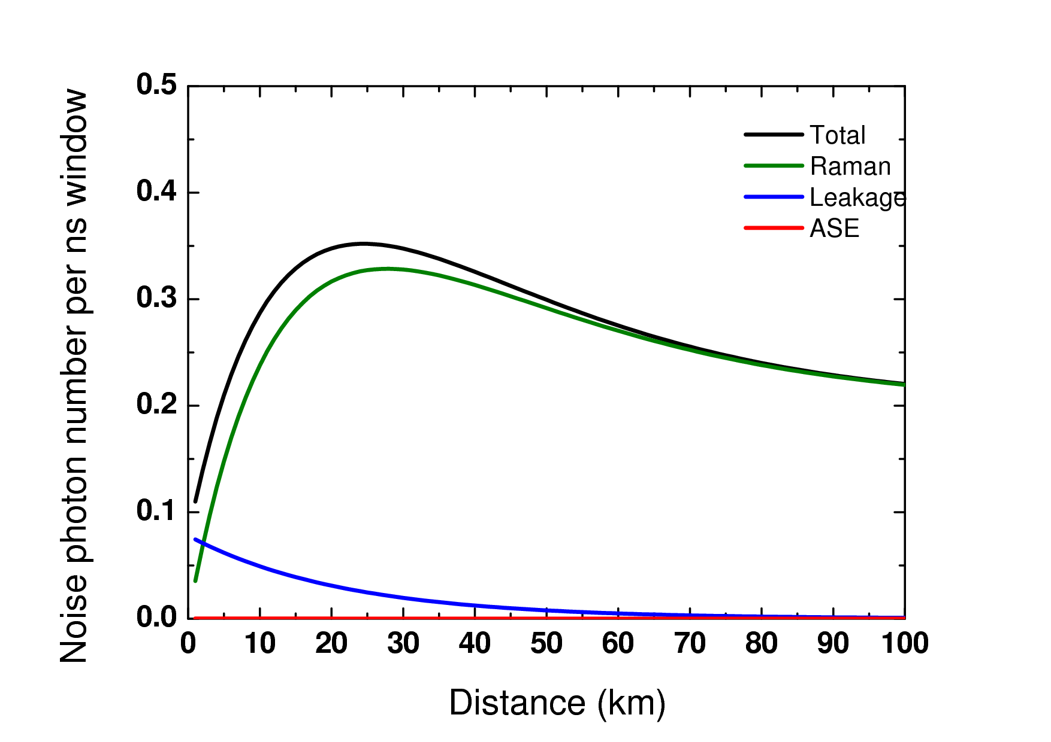
Typical amount of noise photons in WDM context
Number of photons per ns detection window received by single photon detector (after DEMUX 100 GHz)
Consider:
0 dBm (1 mW) classical channel power
100 GHz spacing (DWDM)
-80dB of isolation between channels
Insertion loss -0.5dB
Raman scattering is the main issue
With 1 mW launch power
➔ ~0.3 photons/ns
QKD impossible?

Slide 7

Previous works on QKD with WDM
Demonstration | Year | QKD Wavelength (nm) | Classical Wavelength (nm) | Distance | Ch power
Townsend et al (BT) | 1997 | 1310 | 1550 | 28 | ~ -18dBm
Chapuran et al (Telcordia) | 2009 | 1310 | 1550 | 25 | +2dBm
Lancho et al (Madrid) | 2010 | 1550 | 1310,1490 | 10 | --
Choi et al (Cork) | 2011 | 1310 | 1290,1550 | 10 | 0, -2.7dBm
Eraerds et al (Geneva) | 2010 | 1551.72 | 1555.33, 1555.75 | 50 | -15dBm
Patel et al (Toshiba) | 2012 | 1551.72 | 1555.33,1555.75 | 80 | -18.5dBm
Noise reductions techniques & Drawbacks
Narrow band filters : increases insertion loss.
Temporal filtering technique : strong constraint on detector jitter (SSPD).
Using classical channels out of the C band: not compatible with DWDM networks.
Unconventional classical power: component replacement in classical networks.
Is QKD incompatible with modern optical DWDM networks ?
Cisco DWDM SFP module, Pout = 4 dBm

Slide 8
Continuous Variable QKD: promising candidate for DWDM compatibility
Coherent detection (Homodyne detection) acts as a filter.
Bing Qi, Wen Zhu, Li Qian, Hoi-Kwong Lo, “Feasibility of quantum key distribution through dense wavelength division multiplexing network”, New Journal of Physics 12, 103042 (2010).
Only light coherent with local oscillator (LO) is effectively amplified
10⁸ photons in the LO ➔ 80 dB of isolation
Balanced Homodyne Detector
Strong advantage of CVQKD: intrinsic filtering of unmatched (noise) photons

Slide 9
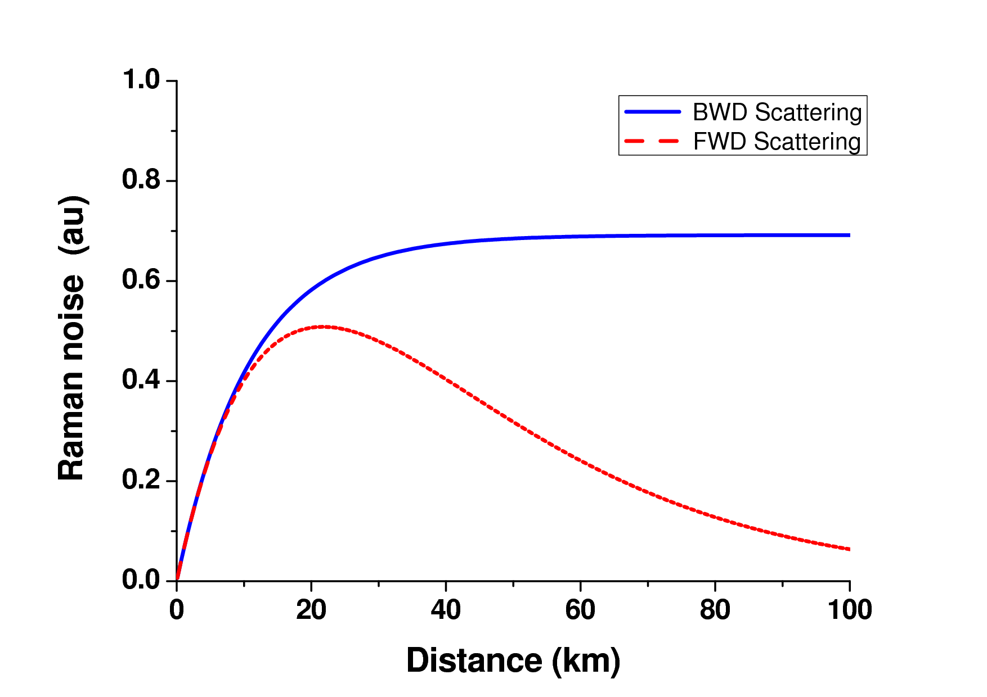
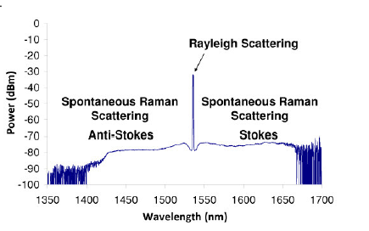
Main source of noise in CVQKD: Raman scattering
Out-band photons (leakage) => unmatched
In-band photons : only matched photons contribute
Raman scattering is the main source of noise for Dist > a few km
Raman anti-stokes forward scattering
Classical
channels
Classical
channels
Alice
Bob
Raman anti-stokes backward scattering
Classical
channels
Classical
channels
Alice
Bob

Slide 10
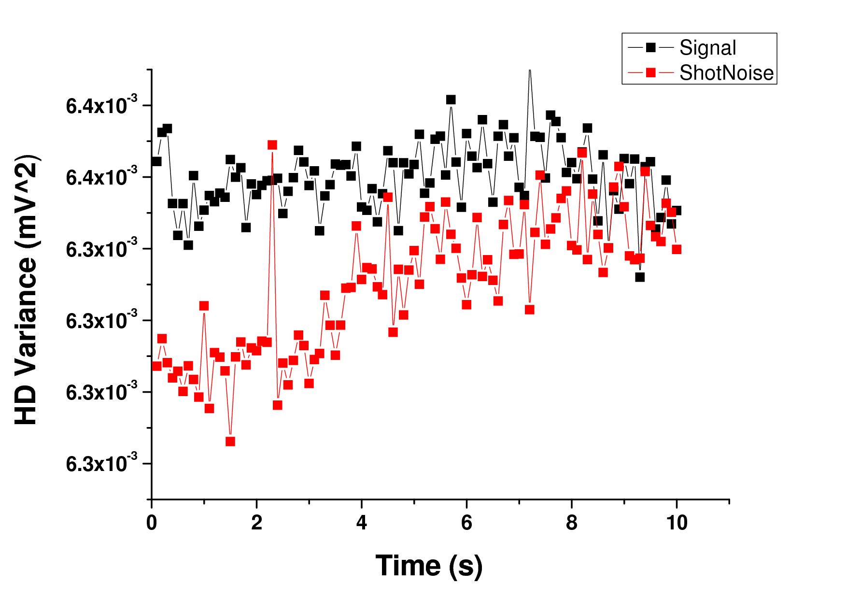
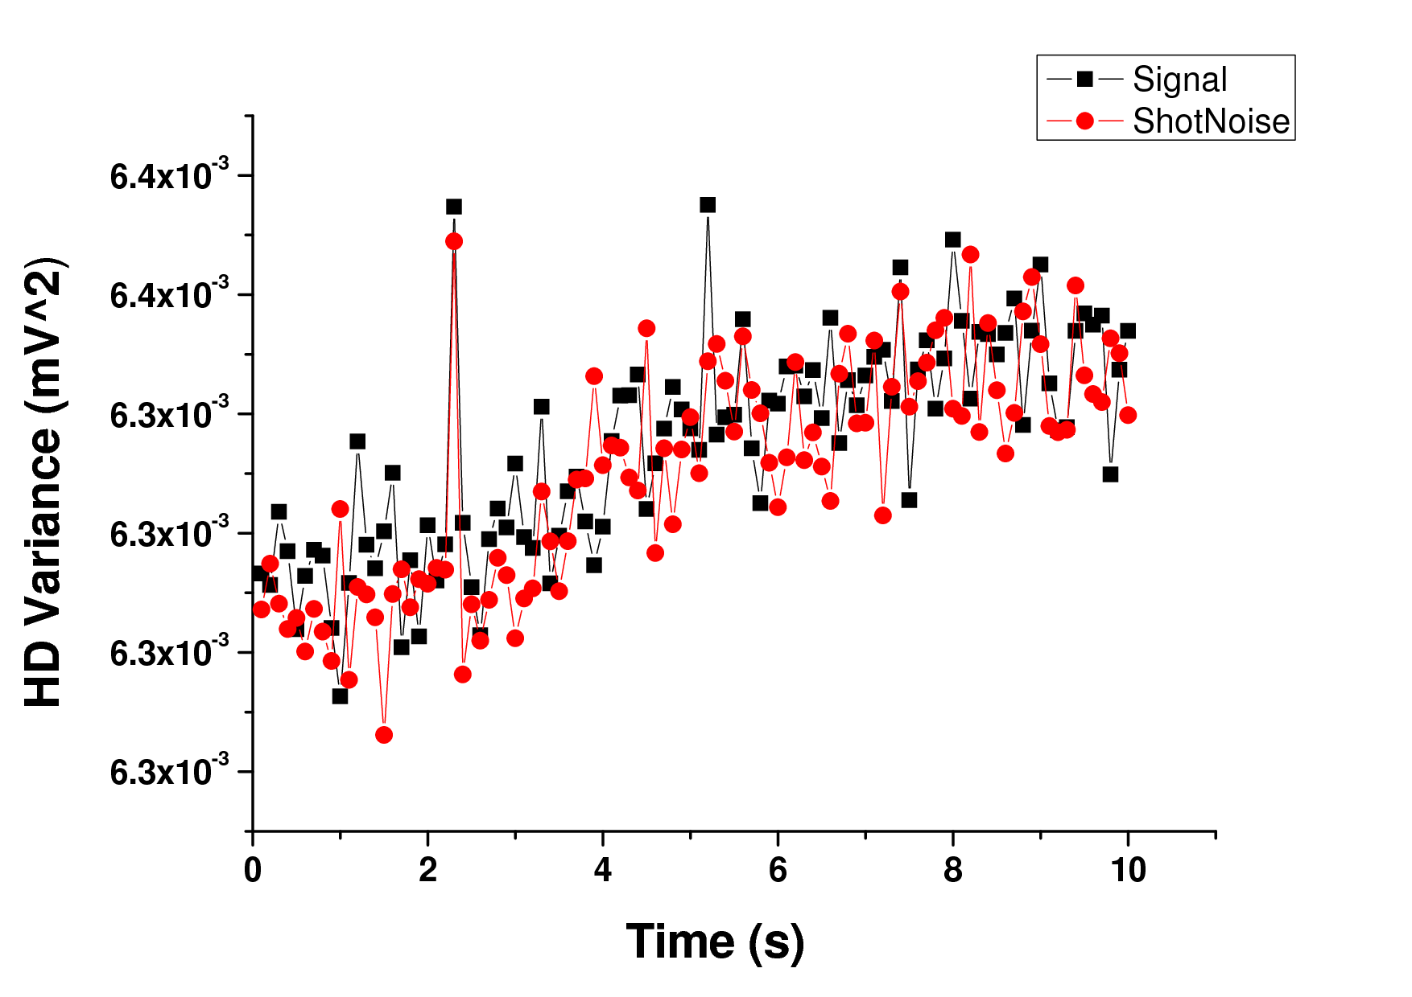
Calibrating Raman Scattering Noise on a Balanced Homodyne Detection
1554.89nm, 1556.56nm, 1557.2nm, 1558.97nm, 1559.79nm
Classical
channel
cw
Fiber spool
MUX
ADM
(Add Drop Module)
ADM
AM
Two sets to measurements :
Shot noise = N0
Total noise = N0 + N_{Raman}
1543.83nm
LO
Problem : Fluctuation of HD measurement variance with time
Solution :
Amplitude modulator to measure shot noise
(improves stability)

Slide 11
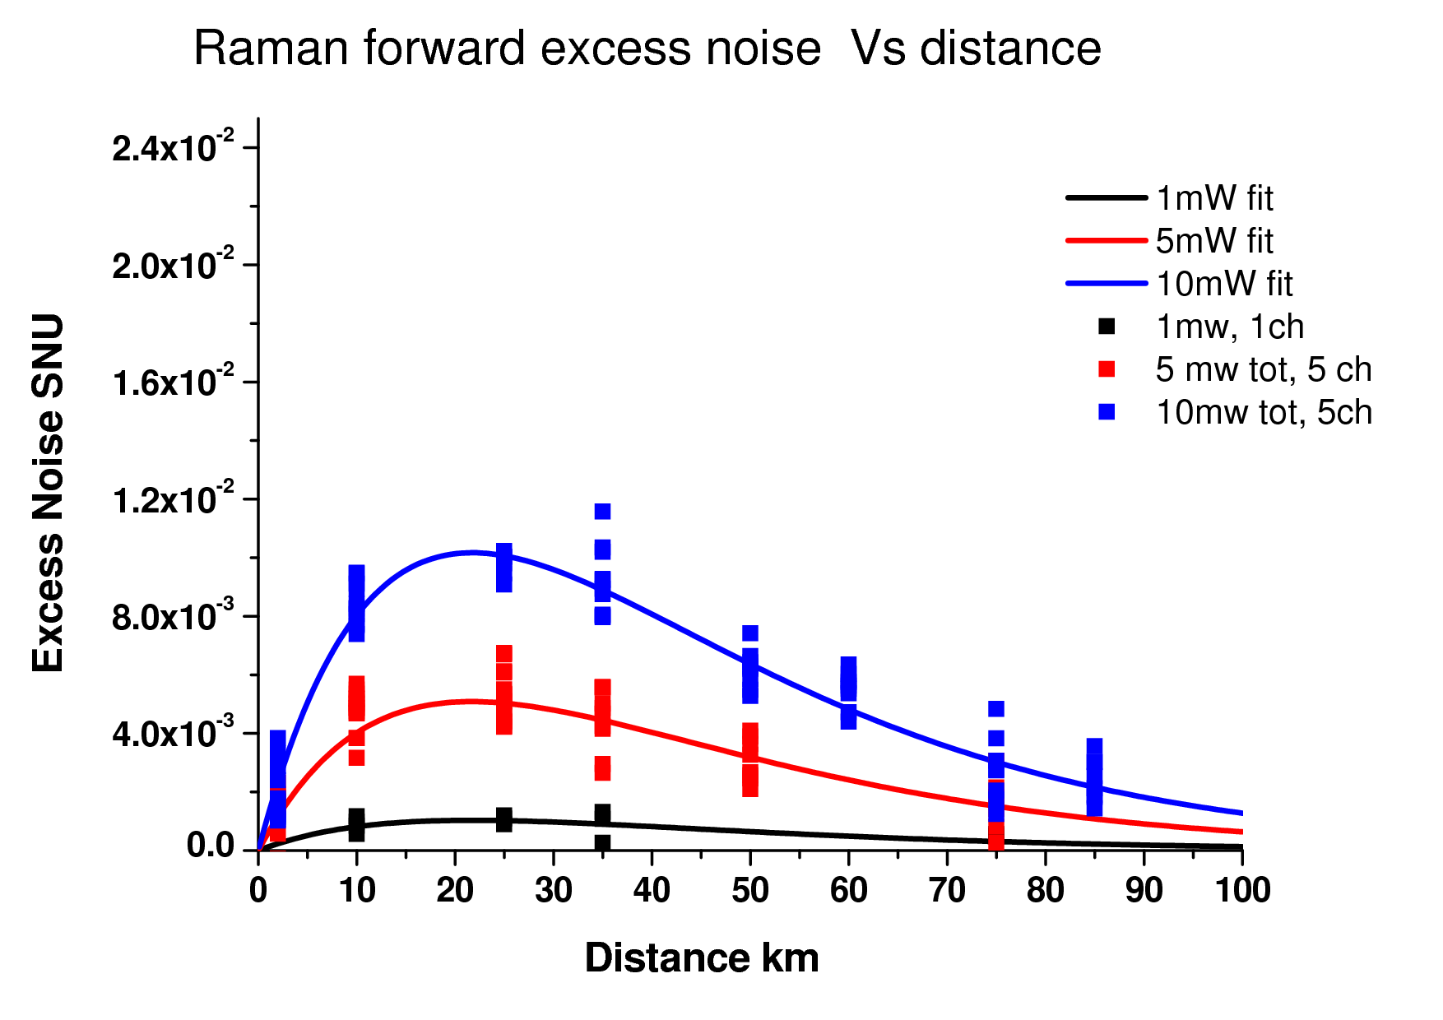
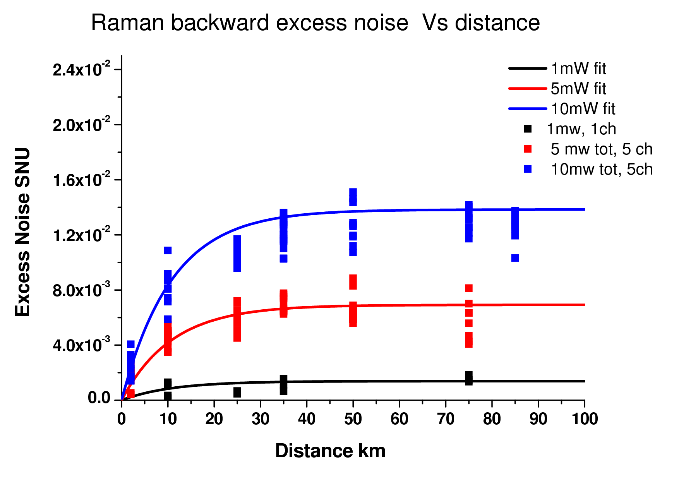
Raman scattering calibration measurements: Forward and Backward
η_{Bob}= 0.64 β_{Raman}= 3E-9/km.nm α_{ch} = 0.2 dB/km
On an homodyne detection, the excess noise at Alice, due to Raman scattering, is maximum around 25 km but is very low:
- 1mw (0dBm) ~ 0.001 N₀
- 10mw (10dBm) ~ 0.01 N₀

Slide 12
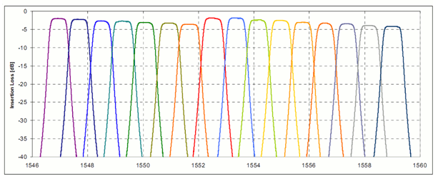
Full CVQKD + WDM deployment test
- 25 km of fiber
Real-time shot noise estimation
System excess noise ~ 7.10⁻²
ch34
ch33
ch29
DMUX
MUX
Ch 29
Ch 29
ADM
Ch 33
Ch 33
Fiber Spool
Ch 34
Ch 34
CVQKD
ALICE
CVQKD
BOB

Slide 13
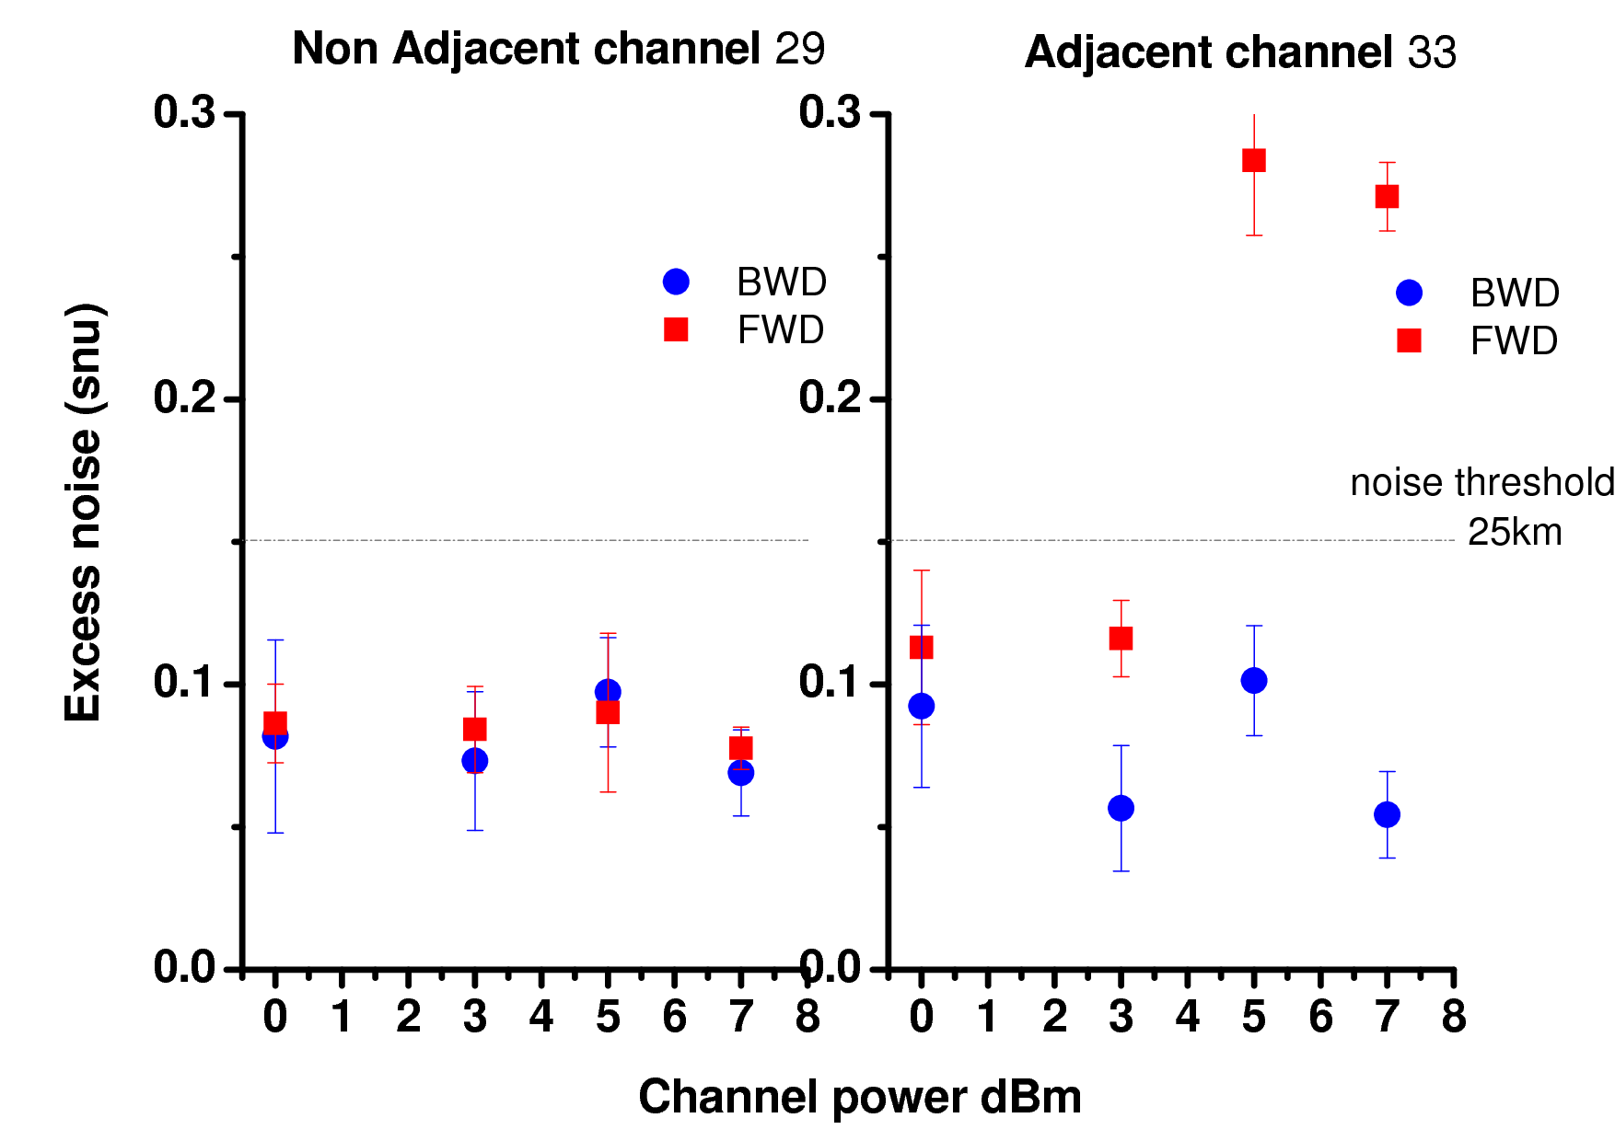
Experimental results: excess noise measurement
LO Channel (Ch34)
Classical Channel 33:
Leakage problem
=> Solvable (extra isolation)
Positive key rate (~3 kbit/s)
Successful CVQKD DWDM deployment test at 25 km in
coexistence with an intense (7 dBm) classical channel

Slide 14
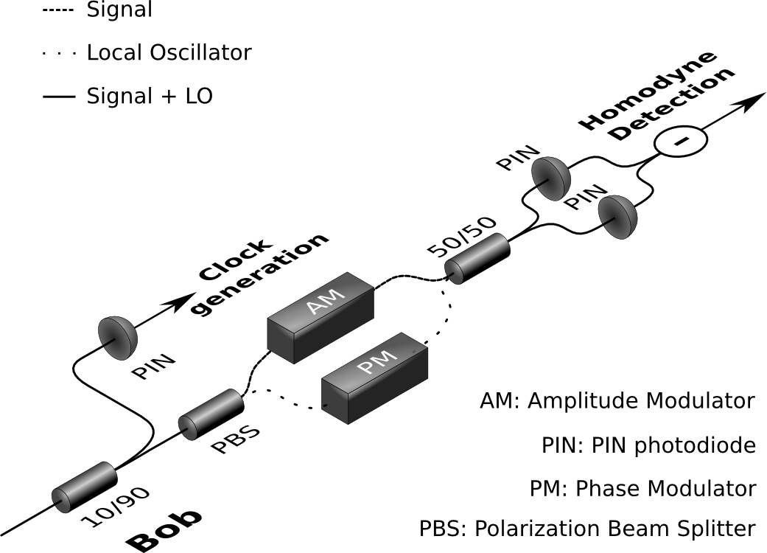
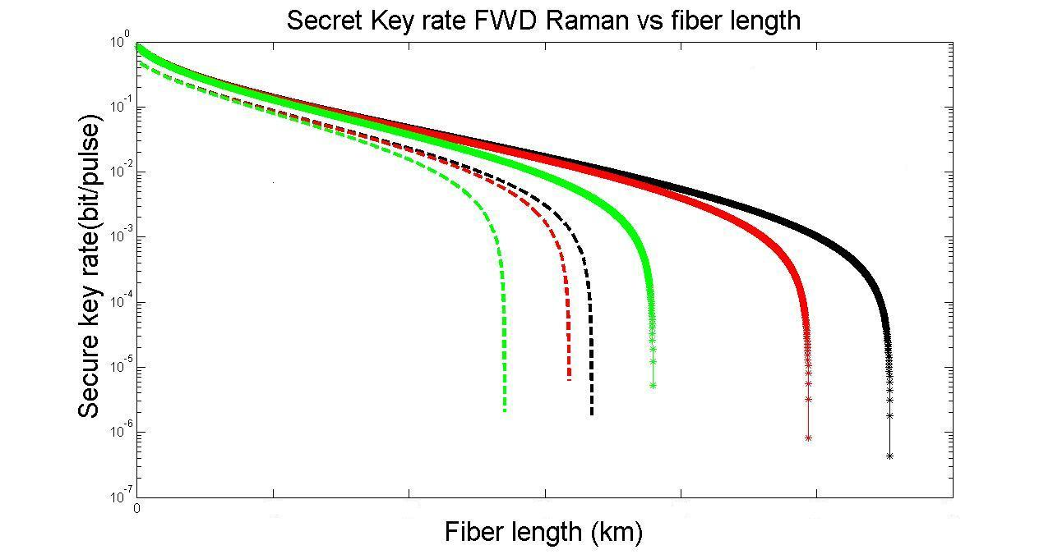
Analysis and Prospects
Current noise 0.07 N0
Demonstrated distance limit: > 25 km
- Due to system noise
- Not limited by DWDM channel power
Real shot-noise measurement
(see Poster Paul Jouguet et al.)
- Closes a security loophole (calibration attacks)
Higher losses and stability issues
No ch
0dBm
7dBm
Improving system stability
(to 0.02 N0 system noise)
=> ~ 50km, 0 dBm should be reachable
0.07N0
0.02N0
10
20
30
40
50

Slide 15
Conclusion and Perspectives
The strong noise filtering, intrinsic to its coherent detection, gives CVQKD a strong advantage in DWDM context
First demonstration of the coexistence, in the C band (DWDM),
of QKD with realistic (several dB) classical channels
Current measurements are compatible with 3 kbit/s at 25 km limited by system noise, not by Raman-induced noise.
Expected limit around 50 km for 0 dBm.

Slide 16
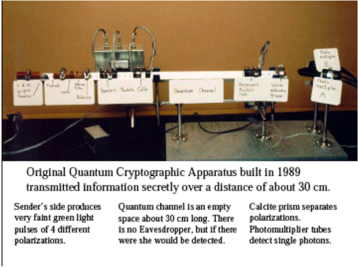
Thank you

