Slide 1


Experimental Demonstration of Polarization Encoding Measurement-Device-Independent Quantum Key Distribution
arXiv: 1306.6134
Zhiyuan Tang, Zhongfa Liao, Feihu Xu, Bing Qi, Li Qian, and Hoi-Kwong Lo
Centre of Quantum Information and Quantum Control
Department of Electrical and Computer Engineering
and Department of Physics
University of Toronto
ztang@physics.utoronto.ca
Qcrypt 2013
Waterloo, Ontario, Canada
August 8, 2013

Slide 2
Outline
Security of Practical QKD Systems
Quantum hacking and counter measures
Measurement-Device-Independent QKD (MDI-QKD)
Our Experiment
Future outlook

Slide 3
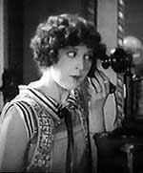


In theory , QKD is secure…
Eve
ALICE
Bob
? ? ? ? ? ? ?
Single photon source
Quantum
Channel
Perfect single
photon detector

Slide 4
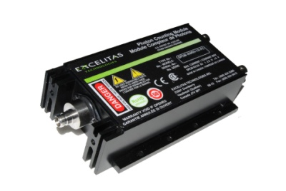
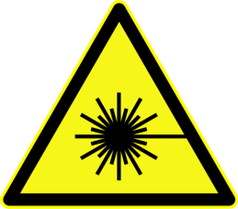
In practice …
Eve
ALICE
01100101…
Bob
Attack source
Attack detectors
Quantum
Channel
Coherent source
Imperfect single
photon detector

Slide 5
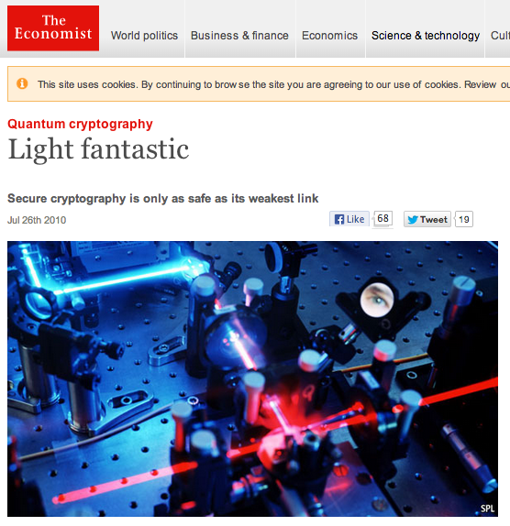
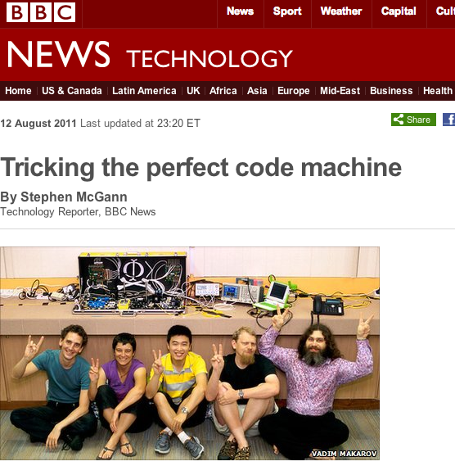
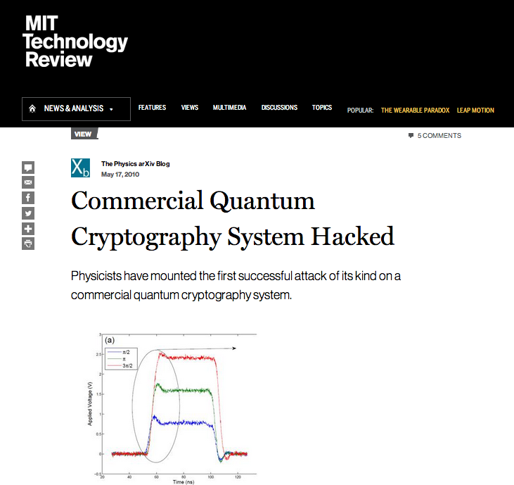
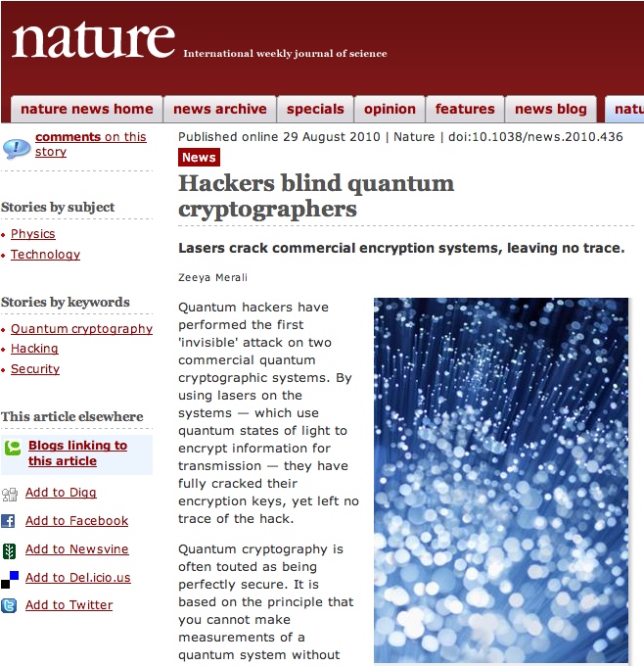
Quantum hacking

Slide 6
Quantum hacking
Photon number splitting attack Brassard et al., Phys. Rev. Lett. 85 1330 (2000).
Phase remapping attack Fung et al., Phys. Rev. a 78, 042333 (2007); Xu et al., New J. Phys. 12, 113026 (2010).
Time-shift attack Qi et al., Quant. Inf. Comput. 7, 073 (2007); Zhao et al., Phys. Rev. A 78, 042333 (2008).
Bright illumination attack Markarov, New J. Phys. 12, 113026 (2009); Lydersen et al., Nat. Photon. 4, 686 (2010); Lydersen et al., Opt. Express 18, 27938 (2010); Lydersen et al., Phys. Rev. A 84, 032320 (2011); Wiechers et al., New. J. Phys. 13, 013043 (2011).
Device calibration attack Jain et al., Phys. Rev. Lett. 197, 110501 (2011).
Attack by exploiting the dead time of SPD Weier et al., New. J. Phys. 13, 073024 (2011).
Attacks on sources
Photon detectors have turned out to be an Achilles’ heel for quantum key distribution (QKD), inadvertently opening the door to subtle side-channel attacks… - Charles Bennett
Attacks on detectors

Slide 7
Counter measures
Better models to understand imperfections in practical QKD systems e.g., T.F. da Silva et al., Opt. Express 20, 18911 (2012).
Hard to close all the security loopholes
Teleportation tricks
Lo and Chau, Science 283 2050 (1999).
Bob teleports incoming signal from outside to himself
still challenging today
Device-Independent QKD
Based on loophole-free Bell test
Requires detectors with near-unity quantum efficiency
Low key generation rate (~10⁻¹⁰ per pulse) Mayers and Yao, FOCS 1998; Acin et al., Phys. Rev. Lett. 98, 230501 (2007); Gisin et al., Phys. Rev. Lett. 105, 070501 (2010).

Slide 8


Is there a PRACTICAL solution to quantum hacking today?

Slide 9
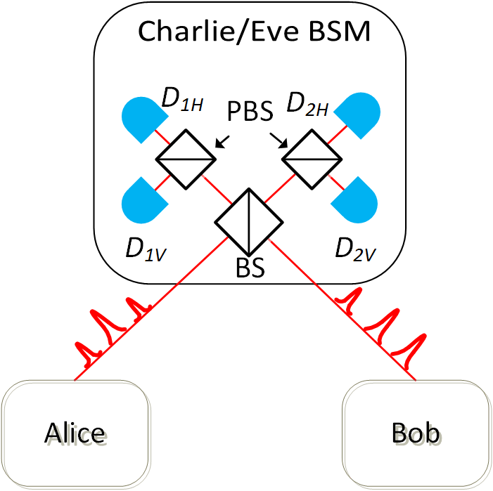
Measurement-Device-Independent QKD (MDI-QKD)
Built on time-reversed entanglement QKD
Biham et al., Phys. Rev. A 54, 2651 (1996);
Inamori, Algorithmica 34, 340 (2002).
Bell state measurement (BSM) by an untrusted third party
All detector side channels are removed
Assumption: sources are trusted
Finite basis dependent flaws can be tolerated
Tamaki et al., Phys. Rev. A 85, 042307 (2012)
Lo, Curty, and Qi, Phys. Rev. Lett. 108, 130503 (2012)

Slide 10
MDI-QKD Protocol
Alice & Bob encode key bits into polarization/time-bin/phase of weak coherent pulses with decoy states;
Alice & Bob send their pulses to Charlie/Eve;
Charlie performs Bell state measurements (BSM) on incoming pulses;
Charlie announces BSM results to Alice and Bob;
Alice and Bob announce basis selections over a public channel, and generate a sifted key;
Error correction and privacy amplification → secure key.

Slide 11


Measurement-Device-Independent QKD (MDI-QKD)
MADE IN
NORTH KOREA
Measurement devices can be manufactured by an untrusted party
No need to certify detection systems in QKD, thus simplifying standardization of QKD by ETSI.
Lo, Curty, and Qi, Phys. Rev. Lett. 108, 130503 (2012)

Slide 12
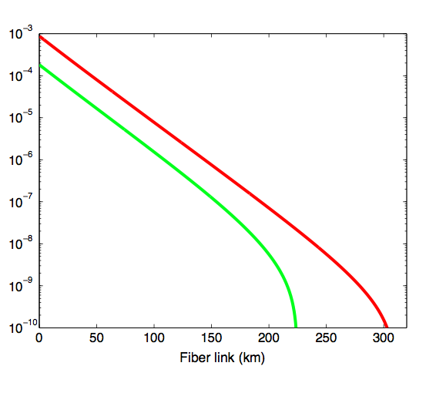
MDI-QKD Performance
Performance comparable to entanglement based QKD
Key rate much higher than that of a DI-QKD
The only feasible solution to the security problem of QKD today
Entanglement
based QKD
MDI-QKD
Reproduced from Phys. Rev. Lett. 108, 130503 (2012)

Slide 13
Previous experimental work
Proof-of-principle demonstrations:
Time-bin encoding
A. Rubenok et al., arXiv: 1304.2463
Polarization encoding
T. Ferreira da Silva et al., arXiv: 1207.6345
Time-bin phase encoding
Y. Liu et al., arXiv: 1209.6178, to be published in Phys. Rev. Lett.
Did not perform real QKD (e.g., random bit/basis selection); no finite key effect correction.

Slide 14
Our Experiment
arXiv: 1306.6134
The first demonstration of polarization encoding MDI-QKD over 10 km of telecom fibers.
We only use commercial off-the-shelf devices in our setup
Why polarization encoding?
Polarization qubits can be easily prepared / detected
Has been used in both fiber and free space
Polarization management still required in time-bin / phase encoding for efficient operation

Slide 15
Our Experiment
arXiv: 1306.6134
Optimized performance:
Signal state: µ = 0.3 photon per pulse
Two decoy states: ν = 0.1, ω = 0.01 photon per pulse
Correct for finite key effect
Xu et al., arXiv: 1305.6965
Ma et al., Phys. Rev. A 86 052305 (2012)

Slide 16
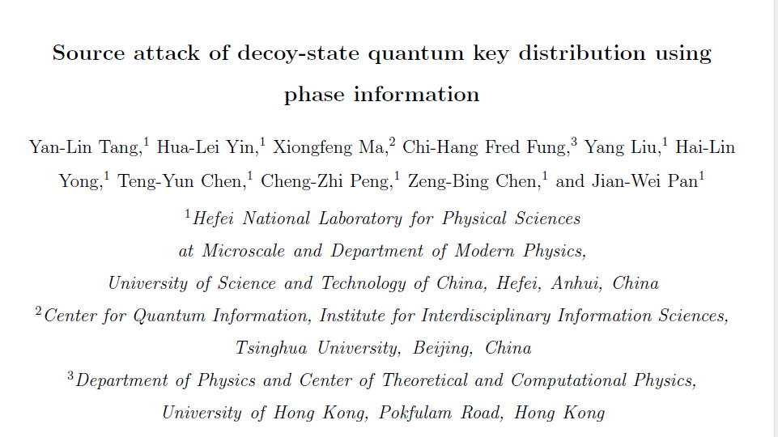
Our Experiment
Active phase randomization of weak coherent pulses is implemented to close this loophole
Y. Tang et al., arXiv: 1304.2541

Slide 17

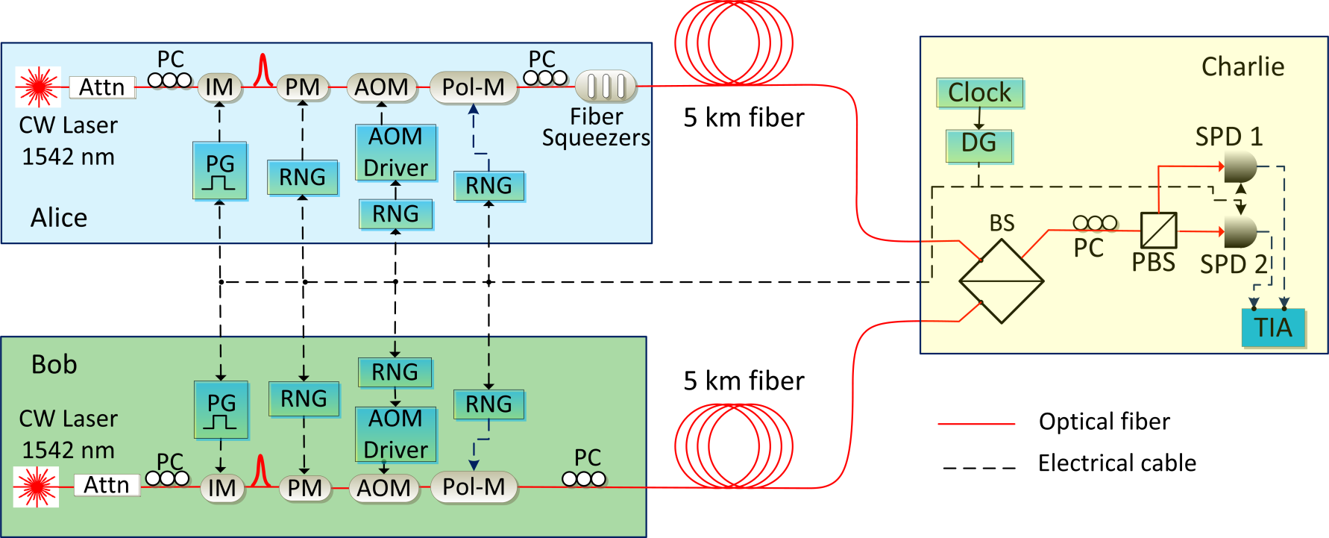
Experimental Setup
arXiv: 1306.6134
Active Phase
Randomization
Polarization
Encoding
1
0
1
Decoy states
0
rect
diag
500 KHz
5 km single
mode fiber
5 km single
mode fiber
Coincidence →
Projection into
Pulses: 1 ns FWHM

Slide 18
Experimental Setup
arXiv: 1306.6134
Challenges: Bell state measurements require photons be indistinguishable in
Arrival time
Independently controlled by a delay generator, difference < 100 ps
Spectrum
Mismatch < 10 MHz
(pulse BW ~ 1 GHz, sufficient spectral overlap)
500 KHz
5 km single
mode fiber
5 km single
mode fiber
Frequency locked lasers,
independently locked to a molecular
absorption line at ~1542 nm
Precise polarization alignment

Slide 19
Results
arXiv: 1306.6134
Key Rate Estimation
q : fraction of pulses used for key generation
Both Alice and Bob send signal states in rectilinear basis, q = 0.01
Measured from experiment
Gain , Error Rate
Estimated gain and error rate of single photon pulses using two decoy-state method
Gain , Error Rate
Privacy
amplification
Error correction
F. Xu et al., arXiv: 1305.6965

Slide 20
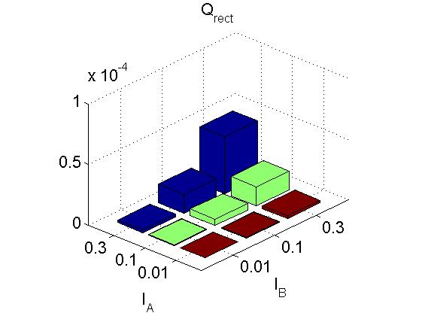
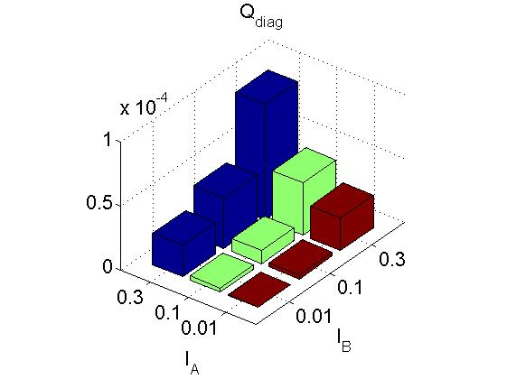
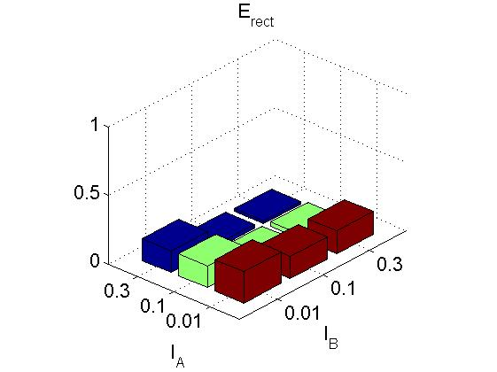
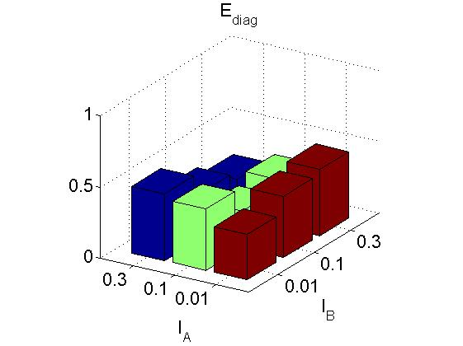
Results
arXiv: 1306.6134
Number of pulses sent out: 1.69×10¹¹

Slide 21
Results
arXiv: 1306.6134
Key Rate Estimation
q : fraction of pulses used for key generation
Both Alice and Bob send signal states in rectilinear basis, q = 0.01
Measured from experiment
Estimated using two decoy-state method, considering three standard deviations for statistical fluctuation analysis
Secure key rate
R = 1×10⁻⁸ bit per pulse , 1600 secure bits generated
Xu et al., arXiv: 1305.6965
Ma et al., Phys. Rev. A 86 052305 (2012)
Without finite key effect correction, R ~ 6.6×10⁻⁶

Slide 22
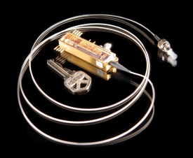
Future outlook
Detector side-channel free QKD network
Compact and low-cost devices
Alice
Bob
Hughes et al., arXiv 1305.0305
Untrusted service centre
(Bell state measurement)
Bob
Alice
Alice
Bob

Slide 23
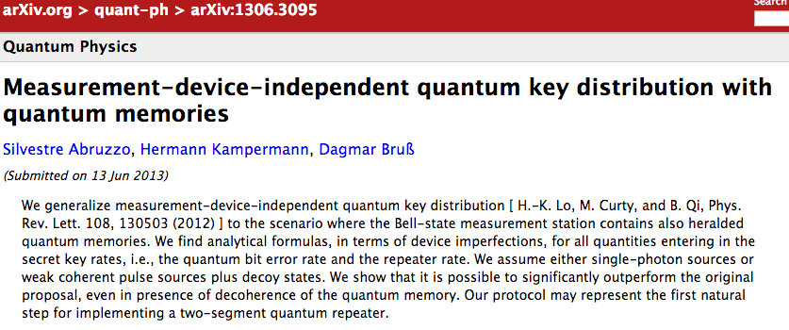
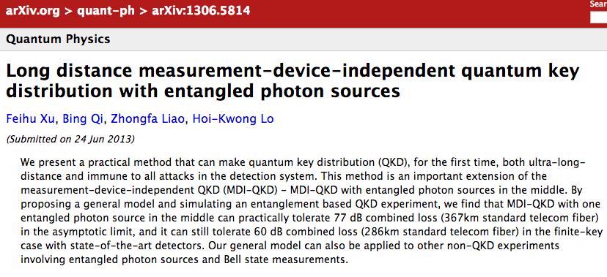
Future outlook Long distance MDI-QKD

Slide 24
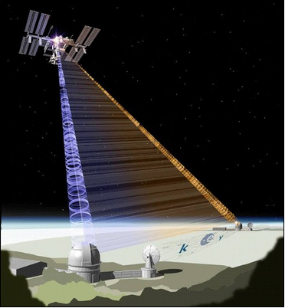
Future outlook
Ground-to-satellite QKD with an untrusted satellite
Untrusted
satellite
ALICE
BOB

Slide 25
Conclusion
We demonstrated the feasibility of polarization encoding MDI-QKD in telecom fibers
MDI-QKD is straight forward to implement with today’s commercial optoelectronic devices
MDI-QKD is highly compatible with quantum network
One step closer to quantum internet

Slide 26
Related work in MDI-QKD
Theory
X. Ma and M. Razavi, Phys. Rev. A 86, 062319 (2012);
X. Ma et al., Phys. Rev. A 86, 052305 (2012);
T. Song et al., Phys. Rev A 86, 022332 (2012);
X. –B. Wang, Phys. Rev. A 87, 012320 (2013);
S. –H. Sun et al., Phys. Rev. A 87, 052329 (2013);
S. Abruzzo et al., arXiv: 1306.3095.
Experiments
A. Rubenok et al., arXiv: 1304.2463;
T.F. da Silva et al., arXiv: 1207.6345;
Y. Liu et al., arXiv: 1209.6178.
Other related work
S. Braunstein and S. Pirandola, Phys. Rev. Lett. 108, 130502 (2012);
C. C. W. Lim et al., arXiv: 1208.0023.

Slide 27


Our group’s work on MDI-QKD
Proposing the idea of MDI-QKD:
H.-K. Lo, M. Curty, and B. Qi, Phys. Rev. Lett. 108, 130503 (2012).
Experiment (this talk):
Z. Tang et al., arXiv: 1306.6134
Finite key analysis:
M. Curty et al., arXiv: 1307.1081
Finite decoy state protocol; MDI-QKD with different channel losses
F. Xu et al., arXiv: 1305.6965; see POSTER SESSION
MDI-QKD with basis-dependent flaws
K. Tamaki et al., Phys. Rev. A 85, 042307 (2012)
Long distance MDI-QKD with entangled photons:
F. Xu et al., Appl. Phys. Lett. 103, 061101 (2013)
Quantum Random Number Generator
Industrial Exhibit session; F. Xu et al., Opt. Express 20, 12366 (2012).

