Slide 1
Industry Session Panel Discussion

Slide 2
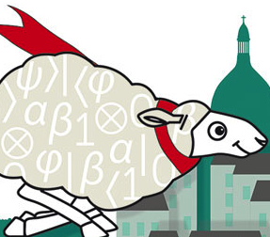
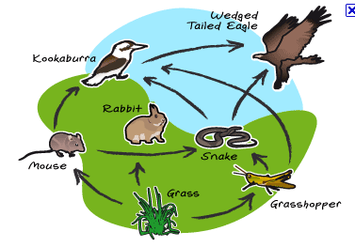
Industry Session Panel Discussion
QKD Ecosystem

Slide 3

Industry Session Panel Discussion
QKD Ecosystem
QKD and Security

Slide 4


QKD center of gravity
?
INDUSTRY
ACADEMIA
INDUSTRY
Where does QKD community stand today ?
What is the weight / importance of academia ?
Where is your institution positioned ?

Slide 5

Clients, Market
?
What is the primary market for QKD according to you ?
(high security / end user)
What are the main clients, now / in the future ?
What are their motivations, needs/ requirements ?

Slide 6
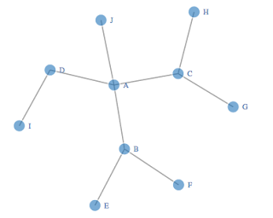
QKD Networks Business Model
What can be the typical Business Models for QKD networks ?
Type of service / Price / Number of users

Slide 7
Collaboration(s)
Do you see topics where global collaboration is particularly necessary ?
Within QKD ecosystem
With other ecosystems

Slide 8

If you could make 3 wishes
?
Consider you are free to change 3 main features (anything you want) of the QKD ecosystem,
➔ What would you change ?

Slide 9

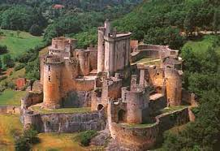
Trusted (?) Nodes
Acceptance ?
Can trust be mitigated ?
How can trust can be guaranteed ?

Slide 10
What about storage ?
Cryptographer: « The main challenge today it to secure data storage »
QKD is only used for « data in flight »
➔ What about the security of data storage ?

Slide 11
Certification
How important is QKD certification according to you ?
When do you think we can realistically achieve it ?

Slide 12
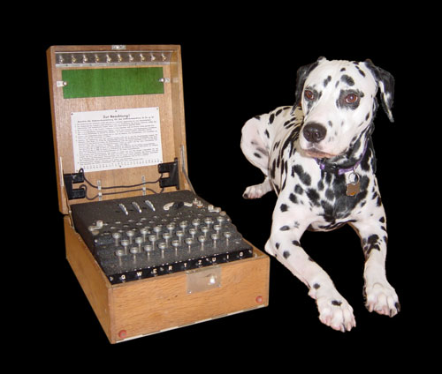
Hybrid security
Do you receive objections to QKD + AES ?
Are there hybrid (classical / quantum) associations you find promising ?

