Slide 1

Experimental Three-State Measurement-Device-Independent Quantum Key Distribution with Uncharacterized Sources
Speaker: Xingyu Zhou, Qin Wang
Nanjing University of Posts and Telecommunications
Email: qinw.njupt.edu.cn Website:http://quantum.njupt.edu.cn/
Paper Links:
arXiv:2002.04944
https://doi.org/10.1364/OL.398993
QCrypt2020-Online Conference:11 August

Slide 2
Outlines
1
Background
2
Protocol
3
Experiment
4
Conclusion

Slide 3
Practical QKD System
Ideal
Single Photon
Perfect Encoding
Lossy Channel
Qubit Detector
Imperfect Source
Lossy Encoding
Lossy and Noisy Channel
Threshold Detector
Practical
Untrusted Source
Phase Remapping Attack
Faked State Attack
Nonrandomized Phase
Time-Shift Attack
Modulation Error
Intensity Fluctuation
SPD Blind Attack
Multiple Lasers
Dead Time Attack
PNS Attack
····

Slide 4
Measurement-Device-Independent QKD （MDI-QKD）
Charlie
Bell State Measurement
Encoding
Encoding
Decoy State Method
Decoy State Method
Weak Coherent Source
Weak Coherent Source
Alice
Bob
Loss tolerant protocol : K. Tamaki, et al., Phys. Rev. A 90, 052314 (2014).
Uncharacterized Sources Protocol: Z. Q. Yin, et al., Phys. Rev. A 88, 062322 (2013).
Advancement：Immune to all possible detector side channel attacks ^{[1]}
Assumption：Perfect state preparation
[1] H. K. Lo, M. Curty, and B. Qi, "Measurement-device-independent quantum key distribution."Phys. Rev. Lett. 108.13, 130503 (2012)

Slide 5



Practical MDI-QKD with Uncharacterized Source
Tightened Bound: W.-Y. Hwang, et.al, Phys. Rev. A.95, 062313 (2017)
Alice
Bob
u
v
o
u
v
o
Z
X
Z
X
0
1
2
0
1
2
$$|φ_{0}〉$$
$$|φ_{1}〉$$
$$|φ_{2}〉$$
BSM
Charlie

Slide 6
Our Method——MDI-QKD with Uncharacterized Source
Difference
MDI-QKD
Assume almost perfect state preparation.
MDI-QKD with Uncharacterized Source
All the encoding{0,1,2} do not have to be ideal BB84 state，but assumed in two dimensional Hilbert space
Prepare four states in two bases
Alice/Bob will keep the successful events from matched bases
In X basis, only one state is prepared.
Alice/Bob will keep all the successful events (matched or mismatched bases).

Slide 7
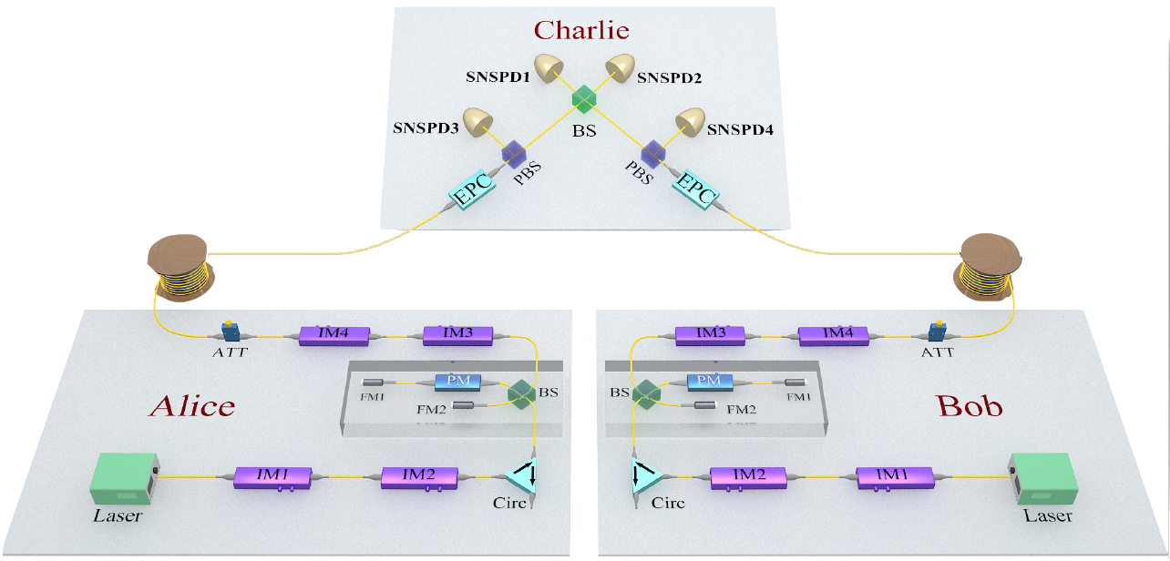
Experimental Setup
Laser: narrow linewidth continuous-wave laser
Time-bin phase encoding (Faraday-Michelson interferometer)
SNSPD: 85% efficiency & 60Hz dark counts
HOM visibility:47±0.5%
Misalignment in Z basis：0.15%,
Misalignment in X basis：1.5%

Slide 8
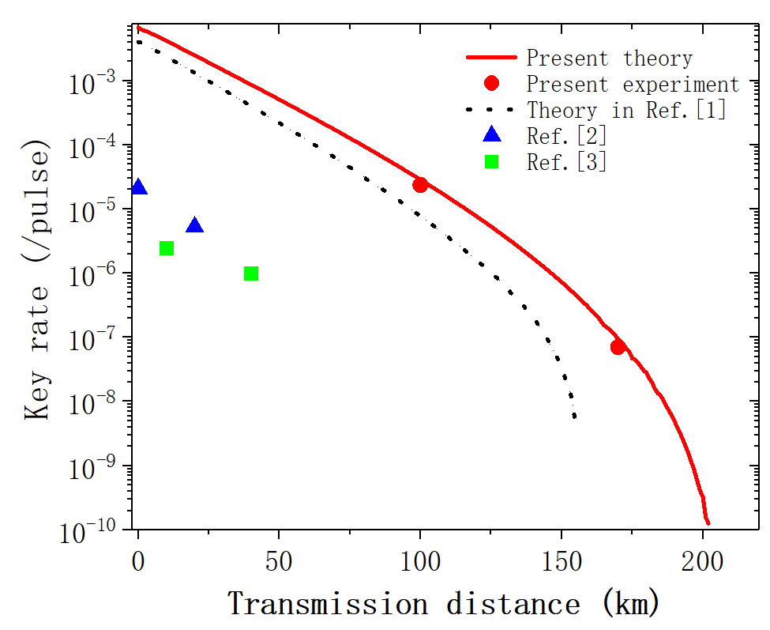
Experimental Result
[1] Z. Q. Yin, C. H. F. Fung, X. Ma, et. al, Phys. Rev. A 90,052319 (2014).
[2] C. Wang, S. Wang, Z. Q. Yin, et.al, Opt. Lett., 415596 (2016).
[3] Z. Tang, Z. Liao, F. Xu, B. Qi, L. Qian, and H. K. Lo, Rev. Lett. 112.190503 (2014).

Slide 9
Conclusion
Putting forward a practical scheme on decoy-state MDI-QKD with three uncharacterized states.
Realizing experimental demonstrations with a transmission distance up to 170 km.
Representing the longest transmission distance when considering source security.

Slide 10

Our team
(Website: http://quantum.njupt.edu.cn/)

Slide 11
Thank you very much!

