Slide 1
Post-quantum Zero Knowledge in Constant Rounds
Nir Bitansky
Omri Shmueli
Tel Aviv University

Slide 2

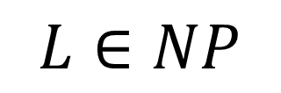


Zero-Knowledge Protocols [Goldwasser, Micali, Rackoff 85]
$$L∈NP$$
$$x\overset{?}{∈}L$$
$$P$$
$$V$$
.
.
.
Accept/Reject

Slide 3
This work:
ZK against quantum attacks

Slide 4



ZK against quantum attacks
Protocols are classical
$$x∈L$$
$$P(w)$$
$$V$$
.
.
.
Accept

Slide 5




ZK against quantum attacks
Soundness against efficient quantum provers
$$x∉L$$
.
.
.
$$P^{∗}$$
$$V$$
Reject

Slide 6
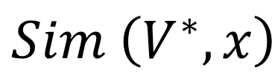





ZK against quantum attacks
$∃$ efficient quantum $Sim$ , $∀$ efficient quantum $V^{∗}$,
$$x∈L$$
.
.
.
$$P(w)$$
$$V^{∗}$$
$$\left|ψ\right\rangle$$
$$≈_{c}$$
$$Sim \left(V^{∗}, x\right)$$

Slide 7
The Round Complexity of ZK
Security Rounds | Classical | Quantum
Polynomial | GMW86 | Wat05
Constant | FS89, GK95 | ?
Note: Unknown even for quantum protocols.

Slide 8
Results
Assuming quantum FHE quantum LWE,
Theorem: There exist constant-round QZK arguments for NP.
Theorem: There exist quantumly-extractable classical commitments.
Corollary [+BJSW16]: There exist constant-round QZK quantum arguments for QMA.

Slide 9
Main Focus and Challenges

Slide 10
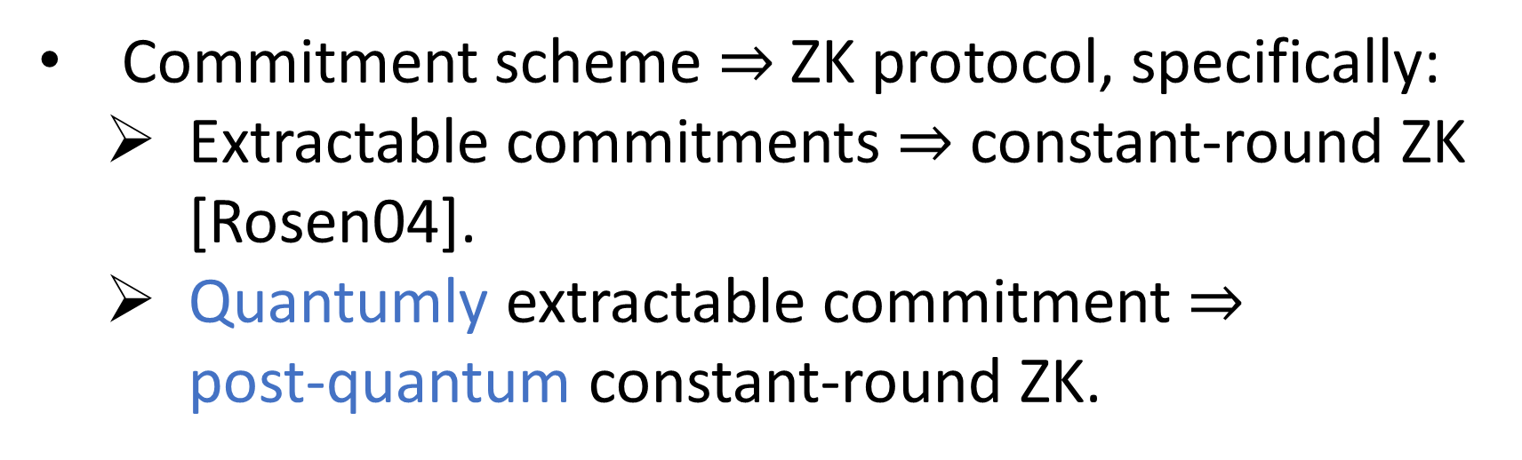
Main focus: Extractable Commitments
Commitment scheme $⇒$ZK protocol, specifically:
Extractable commitments $⇒$ constant-round ZK [Rosen04].
Quantumly extractable commitment $⇒$
post-quantum constant-round ZK.
Goal: quantumly-extractable commitment

Slide 11
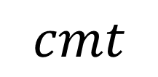


Quantumly-Extractable (Classical) Commitments
Protocol: ($Rec$, $Sen(m)$) , in constant rounds.
$$Rec$$
$$Sen(m)$$
.
.
.
$$cmt$$

Slide 12
Quantumly-Extractable (Classical) Commitments
(Perfect) Binding.
Quantum Computational Hiding.

Slide 13





Quantumly-Extractable (Classical) Commitments
$∃$ efficient quantum $Ext$ , $∀$ efficient quantum ${Sen}^{∗}$,
.
.
.
$$Rec$$
$${Sen}^{∗}$$
$$\left|ψ\right\rangle$$
$$cmt$$
$$m_{cmt}$$

Slide 14



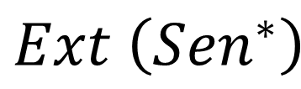

Quantumly-Extractable (Classical) Commitments
$∃$ efficient quantum $Ext$ , $∀$ efficient quantum ${Sen}^{∗}$,
.
.
.
$$Rec$$
$${Sen}^{∗}$$
$$\left|ψ\right\rangle$$
$$≈_{c}$$
$$Ext \left({Sen}^{∗}\right)$$
$$cmt$$
$$m_{cmt}$$

Slide 15
Traditional Extraction Techniques

Slide 16


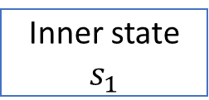

Traditional Extraction Techniques
$$Ext$$
$${Sen}^{∗}$$
$$⋮$$
Inner state $s_{1}$
The extractor copies the inner state.

Slide 17
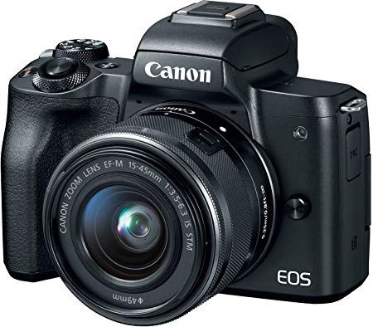
Traditional Extraction Techniques
1
$$Ext$$
$${Sen}^{∗}$$
$$⋮$$
Inner state $s_{1}$
The extractor copies the inner state.

Slide 18
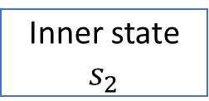


Traditional Extraction Techniques
$$Ext$$
$${Sen}^{∗}$$
$$⋮$$
$$α$$
$$β$$
2
Inner state $s_{2}$
continues interaction to obtain some sensitive information $β$..

Slide 19
Traditional Extraction Techniques
$$Ext$$
$${Sen}^{∗}$$
$$⋮$$
3
Inner state $s_{1}$
Using the copy from before, $Ext$ “rewinds” ${Sen}^{∗}$.

Slide 20

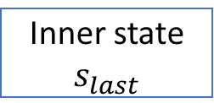


Traditional Extraction Techniques
$$Ext$$
$${Sen}^{∗}$$
$$⋮$$
$$α_{β}$$
4
$$⋮$$
Inner state $s_{last}$
Uses $β$ to extract more sensitive information.

Slide 21
The gap from classical techniques: Cloning
The previous extraction strategy fails in the quantum setting.

Slide 22

The gap from classical techniques: Cloning
No Cloning Theorem
$$Ext$$
$${Sen}^{∗}$$
$$⋮$$
Inner state ${|ψ}_{1}⟩$

Slide 23



The gap from classical techniques: Cloning
$$Ext$$
$${Sen}^{∗}$$
$$⋮$$
$$α$$
$$β$$
Inner state ${|ψ}_{2}⟩$

Slide 24
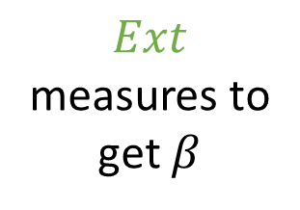
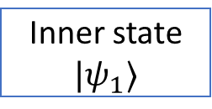
The gap from classical techniques: Cloning
$$Ext$$
$${Sen}^{∗}$$
$$⋮$$
Inner state ${|ψ}_{1}⟩$
$$α$$
$$β$$
Inner state ${|ψ}_{2}⟩$
$$Ext$$
measures to
get $β$

Slide 25
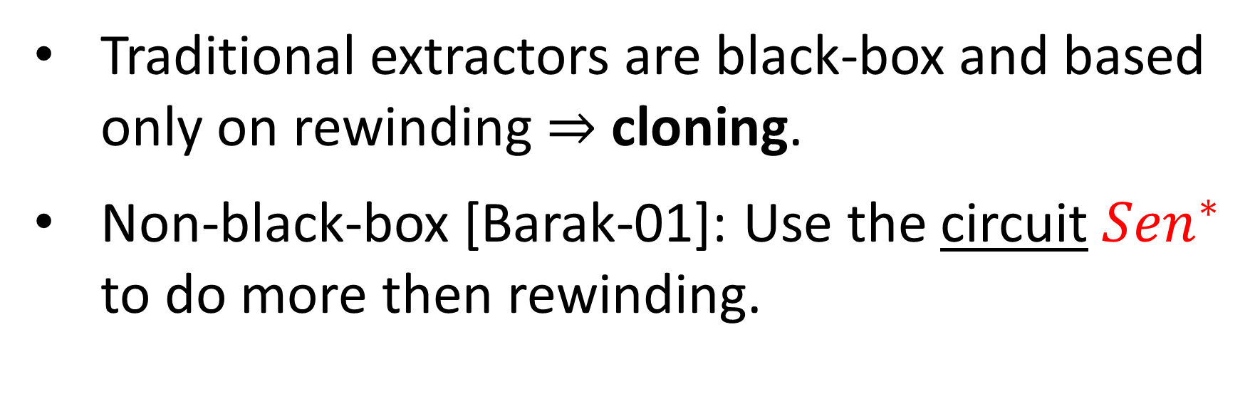
The gap from classical techniques: Cloning
Traditional extractors are black-box and based only on rewinding $⇒$ cloning.
Non-black-box [Barak-01]: Use the circuit ${Sen}^{∗}$ to do more then rewinding.

Slide 26
The gap from classical techniques: Cloning
So, what about non-BB techniques?
Don’t work, existing techniques either,
Use cloning.
Use tools not known for quantum computations (e.g. universal arguments).
Question: Can we use the circuit of the sender to extract without cloning?

Slide 27
Our Extractable Commitment

Slide 28
Tools: Quantum Fully-Homomorphic Encryption (QFHE) [Mahadev18, Brakerski18]
(QHE.Keygen, QHE.Enc, QHE.Dec, QHE.Eval) .
FHE that can evaluate quantum circuits.

Slide 29
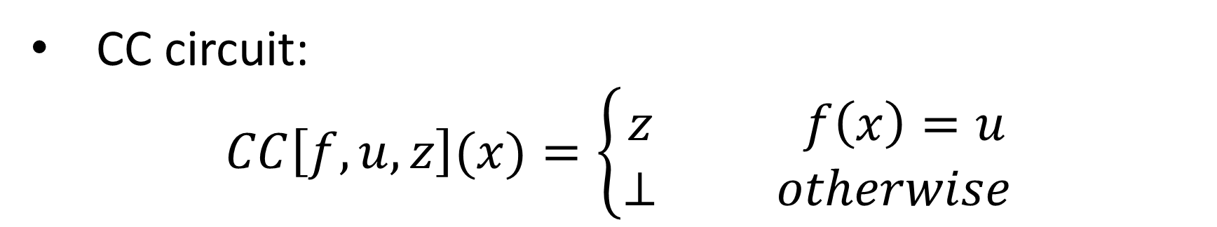
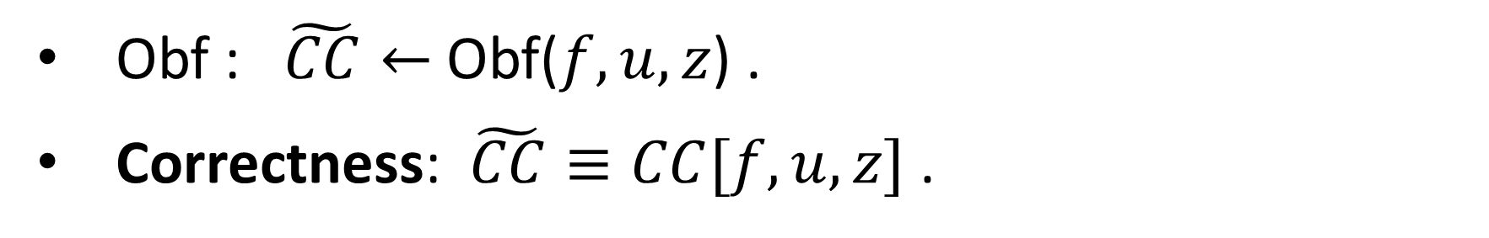
Tools: Compute-and-Compare (CC) Obfuscation
[Wichs-Zirdelis-17, Goyal-Koppula-Waters-17, Goyal-Koppula-Vusirikala-Waters-19]
CC circuit:
$$CC\left[f,u,z\right](x)=\left\{\begin{aligned}z f\left(x\right)=u \\ ⊥ otherwise\end{aligned}\right.$$
Obf : $\tilde{CC}←$Obf($f,u,z$) .
Correctness: $\tilde{CC}≡CC[f,u,z]$ .
Security: For a random $u←\{0,1\}^{λ}$, $\tilde{CC}$ hides $f,u, z$.

Slide 30
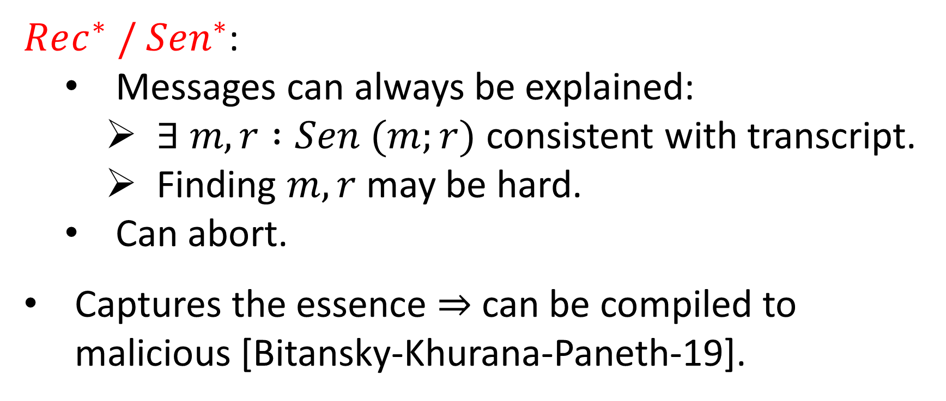
Simplification: Explainable Adversaries
$Rec^{∗} / Sen^{∗}$:
Messages can always be explained:
$∃ m, r :Sen (m;r)$ consistent with transcript.
Finding $m, r$may be hard.
Can abort.
Captures the essence $⇒$ can be compiled to malicious [Bitansky-Khurana-Paneth-19].

Slide 31
1st Try : No-Cloning Extraction
Inspired by
[Barak-Goldreich-Impagliazzo-Rudich-Sahai-Vadhan-Yang-01, Bitansky-Paneth-15, Bitansky-Khurana-Paneth-19]

Slide 32


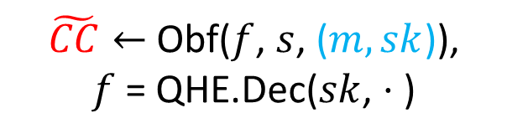
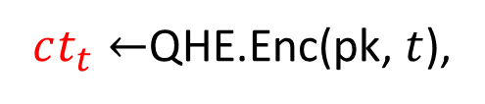
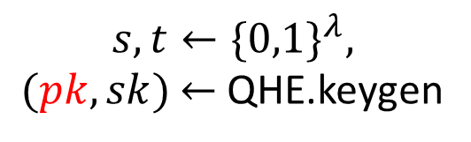
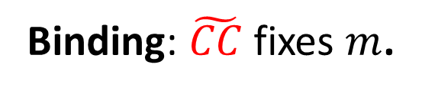
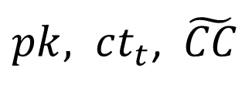

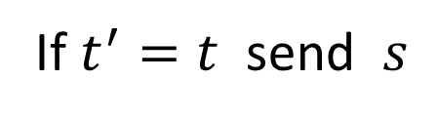

1st Try : No-Cloning Extraction
$$s,t←\{0,1\}^{λ},$$
$(pk,sk)$ $←$ QHE.keygen
$pk, ct_{t}$, $\tilde{CC}$
$$Rec$$
$$Sen(m)$$
$ct_{t}←$QHE.Enc(pk, $t$),
$$t′$$
$\tilde{CC}←$Obf($f$, $s$, ($m,sk$)),
$f$ = QHE.Dec($sk$, $⋅$ )
If $t^{′}=t$ send $s$
$$\tilde{CC}:ct_{s}→(m,sk)$$
Binding: $\tilde{CC}$ fixes $m$.

Slide 33

1st Try : No-Cloning Extraction
$$s,t←\{0,1\}^{λ},$$
$(pk,sk)$ $←$ QHE.keygen
$pk, ct_{t}$, $\tilde{CC}$
$$Rec$$
$$Sen(m)$$
$ct_{t}←$QHE.Enc(pk, $t$),
$$t′$$
$\tilde{CC}←$Obf($f$, $s$, ($m,sk$)),
$f$ = QHE.Dec($sk$, $⋅$ )
If $t^{′}=t$ send $s$
$$\tilde{CC}:ct_{s}→(m,sk)$$
Hiding: (1) $s$ is random thus $\tilde{CC}$ hides $s,f$, $(m,sk)$.
(2) $t$ is hidden by $ct_{t}$, hard to guess it and get $s$.

Slide 34
1st Try : No-Cloning Extraction
$$s,t←\{0,1\}^{λ},$$
$(pk,sk)$ $←$ QHE.keygen
$pk, ct_{t}$, $\tilde{CC}$
$$Rec$$
$$Sen(m)$$
$ct_{t}←$QHE.Enc(pk, $t$),
$$t′$$
$\tilde{CC}←$Obf($f$, $s$, ($m,sk$)),
$f$ = QHE.Dec($sk$, $⋅$ )
If $t^{′}=t$ send $s$
$$\tilde{CC}:ct_{s}→(m,sk)$$
Extraction?

Slide 35
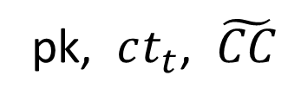


1st Try : No-Cloning Extraction
$$Ext$$
pk, $ct_{t}$, $\tilde{CC}$
$${Sen}^{∗}$$
Inner state ${|ψ}_{1}⟩$
Goal: Get an encryption of $s$.

Slide 36



1st Try : No-Cloning Extraction
$$t$$
$$Ext$$
$$=$$
$${Sen}^{∗}$$
pk, $ct_{t}$, $\tilde{CC}$
Inner state ${|ψ}_{1}⟩$
Observation 1: Under the encryption, $Ext$ have $t$

Slide 37

1st Try : No-Cloning Extraction
$$Ext$$
pk, $ct_{t}$, $\tilde{CC}$
$${Sen}^{∗}$$
Inner state ${|ψ}_{1}⟩$
$$t$$

Slide 38

1st Try : No-Cloning Extraction
$$Ext$$
pk, $ct_{t}$, $\tilde{CC}$
$${Sen}^{∗}$$
Inner state ${|ψ}_{1}⟩$
$$t$$
Observation 2: $Sen^{∗}$ returns $s$ for $t$

Slide 39
1st Try : No-Cloning Extraction
$$Ext$$
pk, $ct_{t}$, $\tilde{CC}$
$${Sen}^{∗}$$
Inner state ${|ψ}_{1}⟩$
$$t$$
Can we get an encrypted $s$? Yes, using the circuit $Sen^{∗}$ .

Slide 40
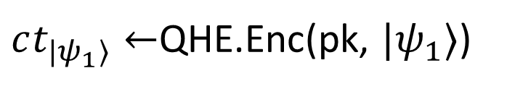
1st Try : No-Cloning Extraction
$$Ext$$
pk, $ct_{t}$, $\tilde{CC}$
$${Sen}^{∗}$$
Inner state ${|ψ}_{1}⟩$
$$t$$
$ct_{{|ψ}_{1}⟩}←$QHE.Enc(pk, ${|ψ}_{1}⟩$)

Slide 41

1st Try : No-Cloning Extraction
$$Ext$$
pk, $ct_{t}$, $\tilde{CC}$
$${Sen}^{∗}$$
Inner state ${|ψ}_{1}⟩$
$$t$$
This is exactly an input to $Sen^{∗}$ !

Slide 42

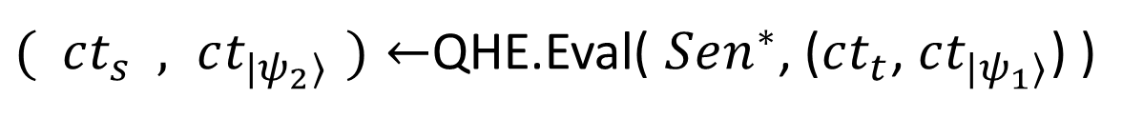
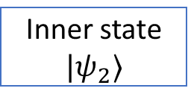

1st Try : No-Cloning Extraction
$$Ext$$
pk, $ct_{t}$, $\tilde{CC}$
$${Sen}^{∗}$$
$$t$$
$$s$$
Inner state ${|ψ}_{2}⟩$
$( ct_{s} , ct_{{|ψ}_{2}⟩ })←$QHE.Eval( $Sen^{∗}$, ($ct_{t}$, $ct_{|ψ_{1}⟩}$) )

Slide 43
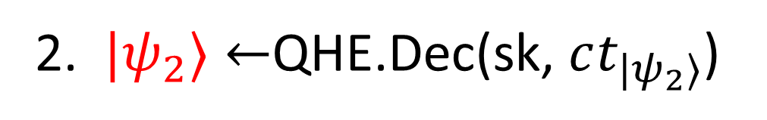
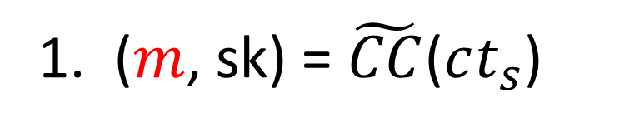
1st Try : No-Cloning Extraction
1. ($m$, sk) = $\tilde{CC}$($ct_{s}$)
Recall, inner state $|ψ_{2}⟩$ still under encryption.
2. $|ψ_{2}⟩←$QHE.Dec(sk, $ct_{|ψ_{2}⟩}$)
Done?

Slide 44






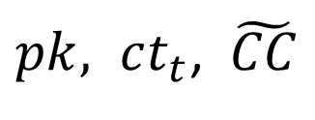
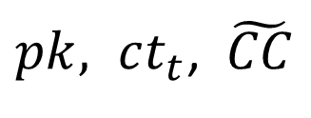



1st Try : No-Cloning Extraction
Problem: $Sen^{∗}$ view is easy to distinguish from real.
$pk, ct_{t}$, $\tilde{CC}$
$pk, ct_{t}$, $\tilde{CC}$
$$Rec$$
$${Sen}^{∗}$$
$$Ext$$
$${Sen}^{∗}$$
$$t′$$
$$t$$
$$⊥$$
$$s$$
We shouldn’t let $Sen^{∗}$ know what was sent.
Use two layers of homomorphic encryption.

Slide 45
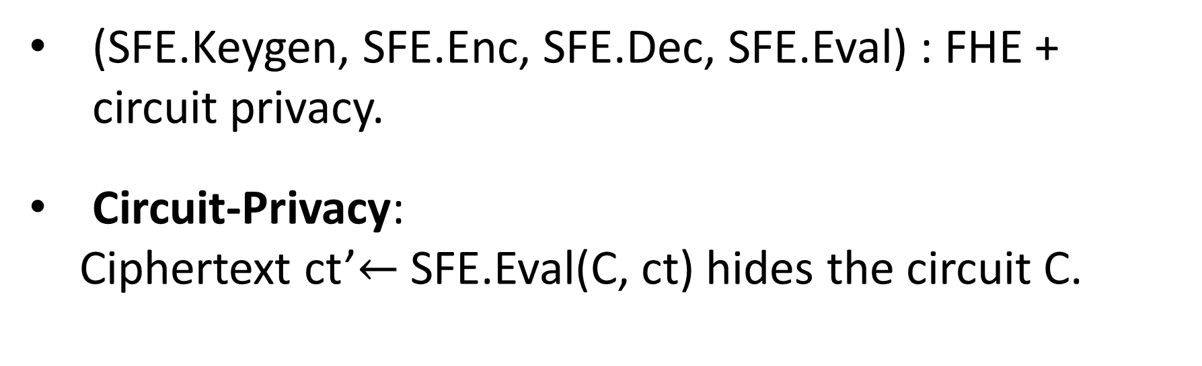
Tools: Circuit-Private FHE (SFE)
(SFE.Keygen, SFE.Enc, SFE.Dec, SFE.Eval) : FHE + circuit privacy.
Circuit-Privacy:
Ciphertext ct’$←$SFE.Eval(C, ct) hides the circuit C.

Slide 46
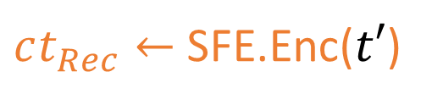


2nd Try : No-Cloning Extraction
$$s,t←\{0,1\}^{λ},$$
$(pk,sk)$ $←$ QHE.keygen
$pk, ct_{t}$, $\tilde{CC}$
$$Rec$$
$$Sen(m)$$
$ct_{t}←$QHE.Enc(pk, $t$),
$ct_{Rec}←$SFE.Enc($t′$)
$$\tilde{CC}:ct_{s}→(m,sk)$$
SFE.Eval($C_{s←t}$, $ct_{Rec}$)

Slide 47
2nd Try : No-Cloning Extraction
$$t$$
$$Ext$$
$$=$$
$${Sen}^{∗}$$
pk, $ct_{t}$, $\tilde{CC}$
Inner state ${|ψ}_{1}⟩$

Slide 48

2nd Try : No-Cloning Extraction
$$Ext$$
pk, $ct_{t}$, $\tilde{CC}$
$${Sen}^{∗}$$
Inner state ${|ψ}_{1}⟩$
$$t$$
This is not an input to $Sen^{∗}$ …

Slide 49
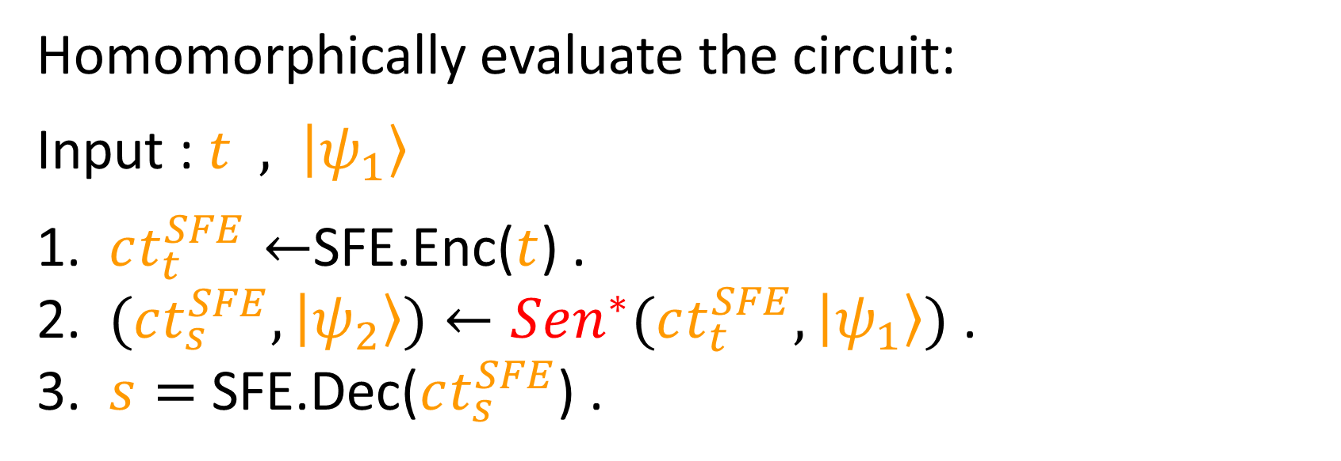
2nd Try : No-Cloning Extraction
Homomorphically evaluate the circuit:
Input : $t , \left|ψ_{1}\right\rangle$
1. $ct_{t}^{SFE}←$SFE.Enc($t$) .
2. $(ct_{s}^{SFE},\left|ψ_{2}\right\rangle )←Sen^{∗}(ct_{t}^{SFE},\left|ψ_{1}\right\rangle )$ .
3. $s=$ SFE.Dec($ct_{s}^{SFE}$) .

Slide 50
2nd Try : No-Cloning Extraction
$$Ext$$
pk, $ct_{t}$, $\tilde{CC}$
$${Sen}^{∗}$$
Inner state ${|ψ}_{1}⟩$
$$t$$

Slide 51

2nd Try : No-Cloning Extraction
$$Ext$$
pk, $ct_{t}$, $\tilde{CC}$
$${Sen}^{∗}$$
Inner state ${|ψ}_{1}⟩$
under SFE
$$t$$
Encrypt $t$ with SFE.

Slide 52
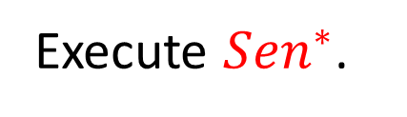
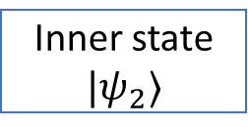
2nd Try : No-Cloning Extraction
$$Ext$$
pk, $ct_{t}$, $\tilde{CC}$
$${Sen}^{∗}$$
$$t$$
under SFE
$$s$$
Inner state ${|ψ}_{2}⟩$
Execute ${Sen}^{∗}$.

Slide 53

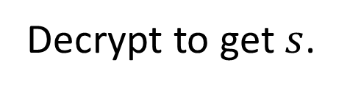
2nd Try : No-Cloning Extraction
$$Ext$$
pk, $ct_{t}$, $\tilde{CC}$
$${Sen}^{∗}$$
$$t$$
under SFE
$$s$$
Inner state ${|ψ}_{2}⟩$
Decrypt to get $s$.

Slide 54
2nd Try : No-Cloning Extraction
The scheme is extractable.
The scheme is binding.
What about hiding?

Slide 55

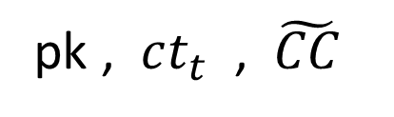






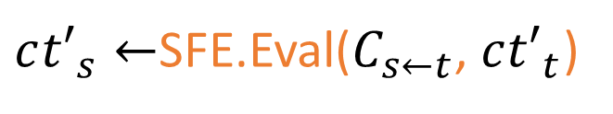
Problem: Malleability
Attack:
pk , $ct_{t}$ , $\tilde{CC}$
$$Rec^{∗}$$
$$Sen(m)$$
$$c{t′}_{t}$$
$c{t′}_{s}←$SFE.Eval($C_{s←t}$, $c{t′}_{t}$)
$$ct_{t}$$
$$c{t′}_{t}$$
$$c{t′}_{s}$$
$$ct_{s}$$
FHE
SFE
SFE
FHE

Slide 56




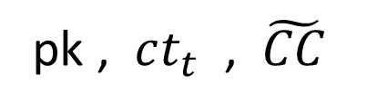
Problem: Malleability
In the attack: $Rec^{∗}$ did not know how to open $c{t′}_{t}$.
“Let it give an extractable commitment to SFE key”?
pk , $ct_{t}$ , $\tilde{CC}$
$$Rec^{∗}$$
$$Sen(m)$$
$$c{t′}_{t}$$

Slide 57
Problem: Malleability
Are we back to square one?
Observation 1: Hiding security reductions are existential.
Observation 2: Receiver SFE key is independent.

Slide 58
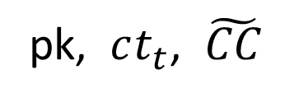
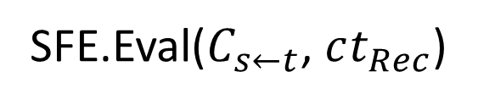
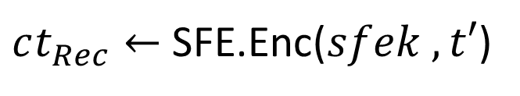


3rd (and last) Try : No-Cloning Extraction
$$Rec$$
$$Sen(m)$$
pk, $ct_{t}$, $\tilde{CC}$
$ct_{Rec}←$SFE.Enc($sfek , t′$)
SFE.Eval($C_{s←t}$, $ct_{Rec}$)

Slide 59
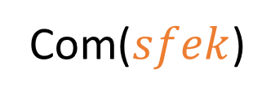
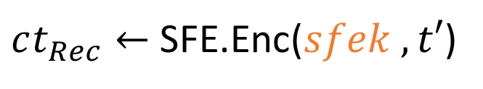
3rd (and last) Try : No-Cloning Extraction
Com($sfek$)
$$Rec$$
$$Sen(m)$$
pk, $ct_{t}$, $\tilde{CC}$
$ct_{Rec}←$SFE.Enc($sfek , t′$)
SFE.Eval($C_{s←t}$, $ct_{Rec}$)

Slide 60
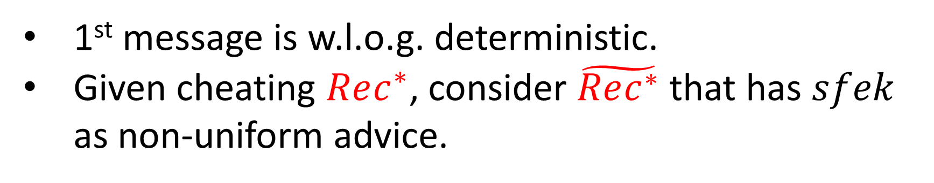


3rd (and last) Try : No-Cloning Extraction
Com($sfek$)
$$Rec^{∗}$$
$$Sen(m)$$
1st message is w.l.o.g. deterministic.
Given cheating $Rec^{∗}$, consider $\tilde{Rec^{∗}}$ that has $sfek$ as non-uniform advice.

Slide 61
Thanks for listening!

Slide 62
Additional Hurdles
$$Ext$$
pk, $ct_{t}$, $\tilde{CC}$
$${Sen}^{∗}$$
Inner state ${|ψ}_{1}⟩$
under SFE
$$t$$

Slide 63

Additional Hurdles
$$Ext$$
pk, $ct_{t}$, $\tilde{CC}$
$${Sen}^{∗}$$
$$t$$
under SFE
$$⊥$$
Inner state ${|ψ}_{2}⟩$

Slide 64



${Sen}^{∗}$ will (abort/not abort)
$$Ext$$
$${Sen}^{∗}$$

Slide 65













SFE hiding $⇒$ choice of ${Sen}^{∗}$ independent of $Ext$ guess.
pk, $ct_{t}$, $\tilde{CC}$
$$Ext$$
$${Sen}^{∗}$$
SFE.Enc$(0)$
$$⊥$$
${|ψ}_{2}⟩$
pk, $ct_{t}$, $\tilde{CC}$
$$Ext$$
$${Sen}^{∗}$$
$$t$$
$$s$$
${|ψ}_{2}⟩$

