Slide 1


Scalable Pseudorandom Quantum States
Zvika Brakerski
Omri Shmueli
Weizmann Institute of Science
Tel Aviv University

Slide 2
Efficiently Generating Quantum Randomness
Efficiently generating a truly random quantum state is impossible.
Space of states is too big.

Slide 3
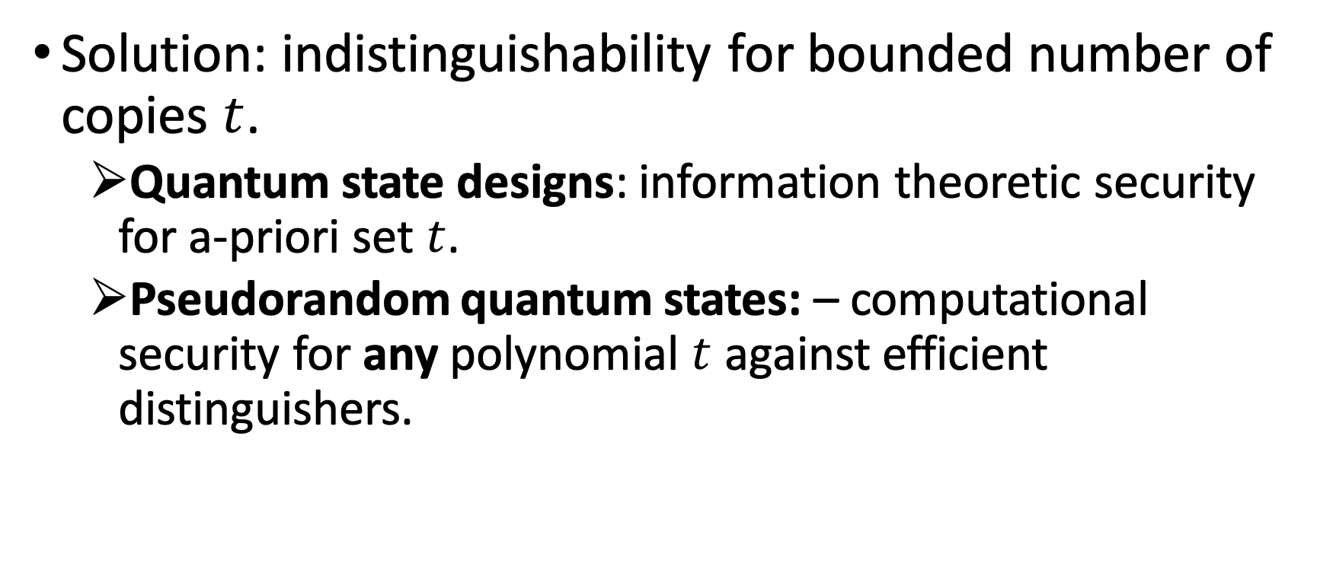
Efficiently Generating Quantum Randomness
Solution: indistinguishability for bounded number of copies $t$.
Quantum state designs: information theoretic security for a-priori set $t$.
Pseudorandom quantum states: – computational security for any polynomial $t$ against efficient distinguishers.

Slide 4
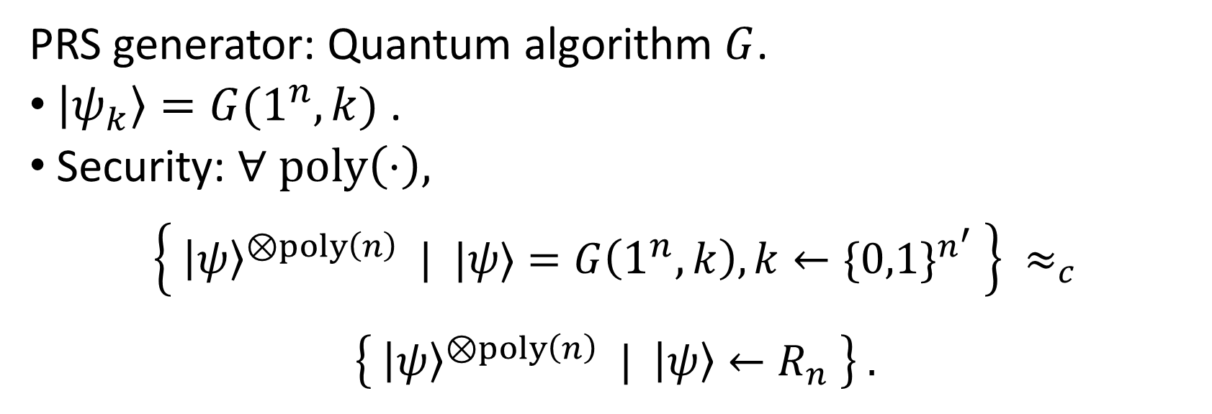
Pseudorandom Quantum States (PRS) [Ji, Liu, Song 2018]
PRS generator: Quantum algorithm $G$.
$\left|ψ_{k}\right\rangle =G(1^{n},k)$ .
Security: $∀ poly\left(⋅\right),$
$$\left\{ {\left|ψ\right\rangle }^{⊗poly\left(n\right)} | |ψ⟩=G\left(1^{n},k\right), k←\{0,1\}^{n^{′}} \right\} ≈_{c}$$
$$\left\{ {\left|ψ\right\rangle }^{⊗poly\left(n\right)} | \left|ψ\right\rangle ←R_{n} \right\} .$$

Slide 5
Pseudorandom Quantum States (PRS)
Applications include:
Simulating thermalized quantum states.
Quantum money.
Known to exist based on post-quantum one-way functions [Ji-Liu-Song-18, Brakerski-S-19].

Slide 6
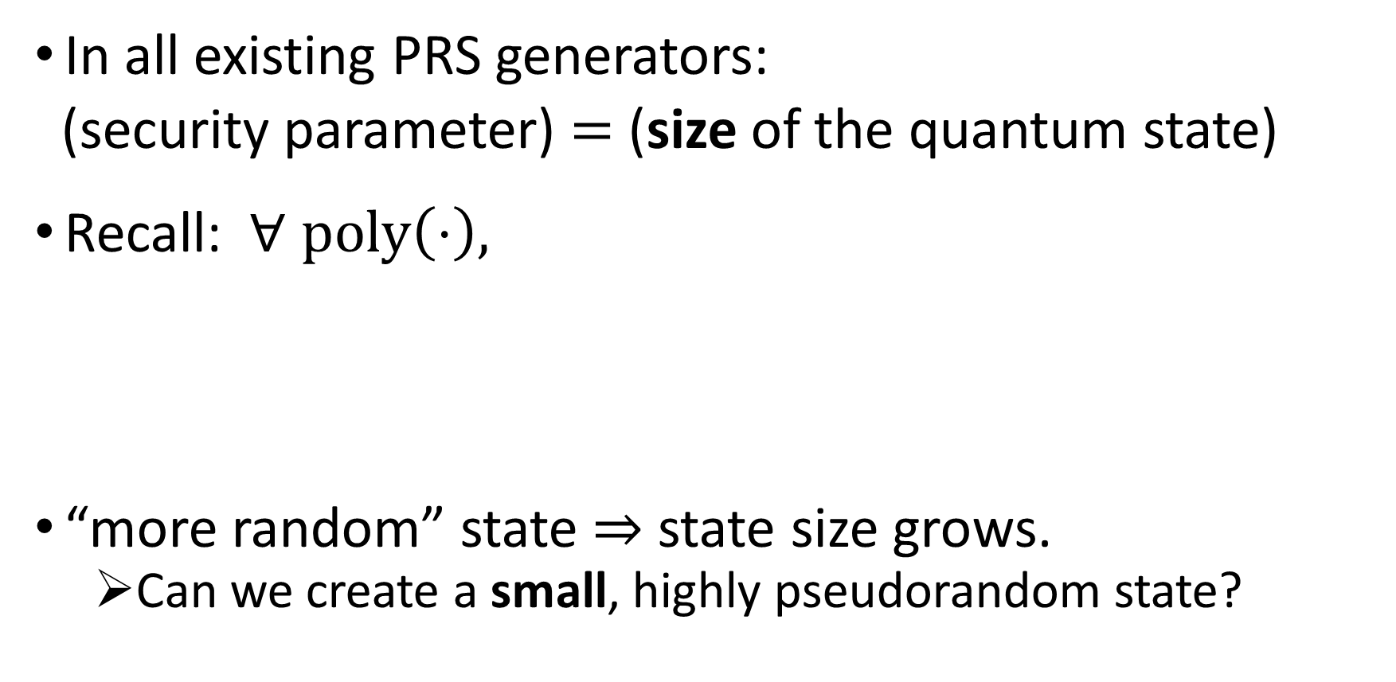
Pseudorandom Quantum States (PRS)
In all existing PRS generators:
(security parameter) $=$ (size of the quantum state)
Recall: $∀ poly\left(⋅\right),$
“more random” state $⇒$ state size grows.
Can we create a small, highly pseudorandom state?
$$\left\{ {\left|ψ\right\rangle }^{⊗poly(n)} | |ψ⟩=G\left(1^{n},k\right), k←\{0,1\}^{n^{′}} \right\}≈_{c, negl(n)}$$
$$\left\{ {\left|ψ\right\rangle }^{⊗poly(n)} | \left|ψ\right\rangle ←R_{n} \right\} .$$

Slide 7
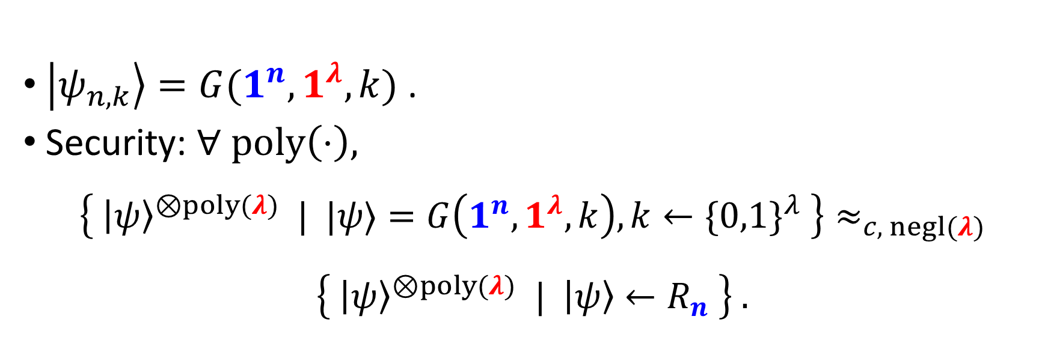
Scalable PRS Generator
$\left|ψ_{n,k}\right\rangle =G(1^{n},1^{λ},k)$ .
Security: $∀ poly\left(⋅\right),$
$$\left\{ {\left|ψ\right\rangle }^{⊗poly(λ)} | |ψ⟩=G\left(1^{n},1^{λ},k\right), k←\{0,1\}^{λ} \right\}≈_{c, negl(λ)}$$
$$\left\{ {\left|ψ\right\rangle }^{⊗poly(λ)} | \left|ψ\right\rangle ←R_{n} \right\} .$$

Slide 8
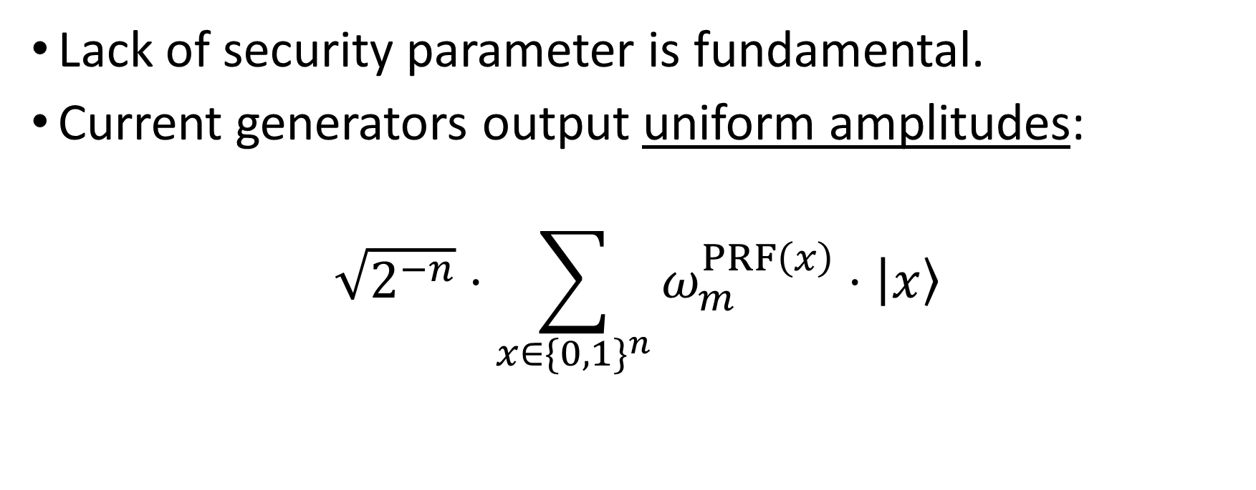
Known Constructions are not Scalable
Lack of security parameter is fundamental.
Current generators output uniform amplitudes:
$$\sqrt{2^{−n}}⋅\sum_{x∈\{0,1\}^{n}}{ω_{m}^{PRF\left(x\right)}⋅\left|x\right\rangle }$$
stationary amplitude
random phase

Slide 9
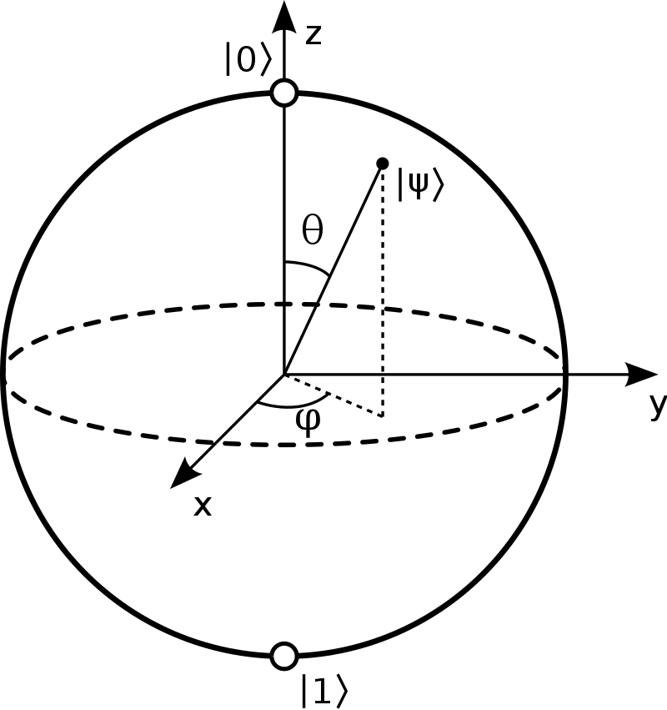
Known Constructions are not Scalable
What is the
performance
for 1 qubit?

Slide 10

Known Constructions are not Scalable
Covers at most a ring in the Bloch sphere.
Easy to distinguish from random state!
$$⇓$$

Slide 11
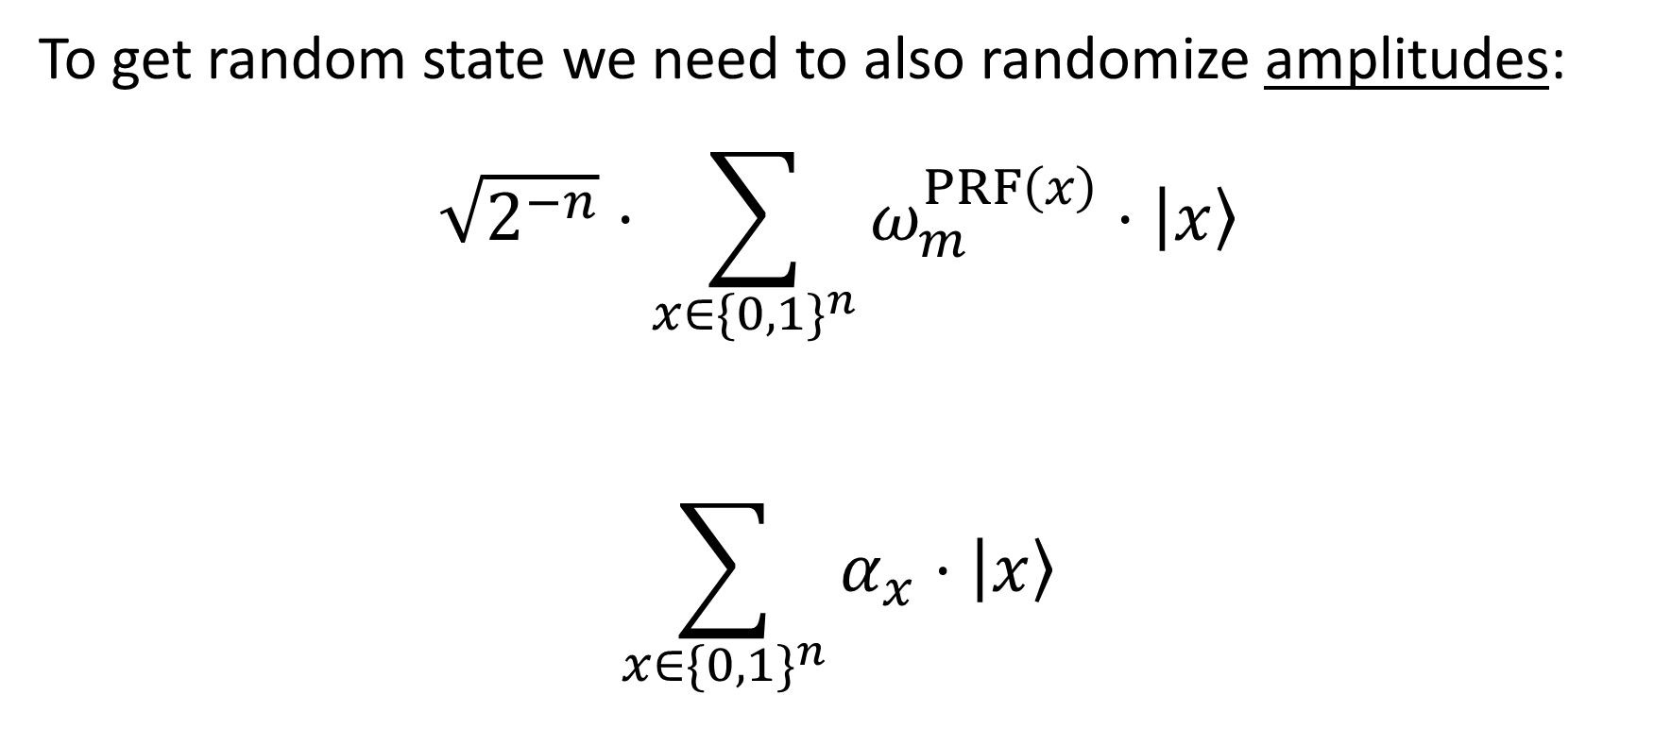
Known Constructions are not Scalable
To get random state we need to also randomize amplitudes:
$$\sqrt{2^{−n}}⋅\sum_{x∈\{0,1\}^{n}}{ω_{m}^{PRF\left(x\right)}⋅\left|x\right\rangle }$$
$$\sum_{x∈\{0,1\}^{n}}{α_{x}⋅\left|x\right\rangle }$$
stationary amplitude
random phase
random phase
and amplitude

Slide 12
Our Results

Slide 13
This Work
We define and explore the notion of scalability in random quantum state generation.
We show a framework for constructing scalable random quantum objects.

Slide 14
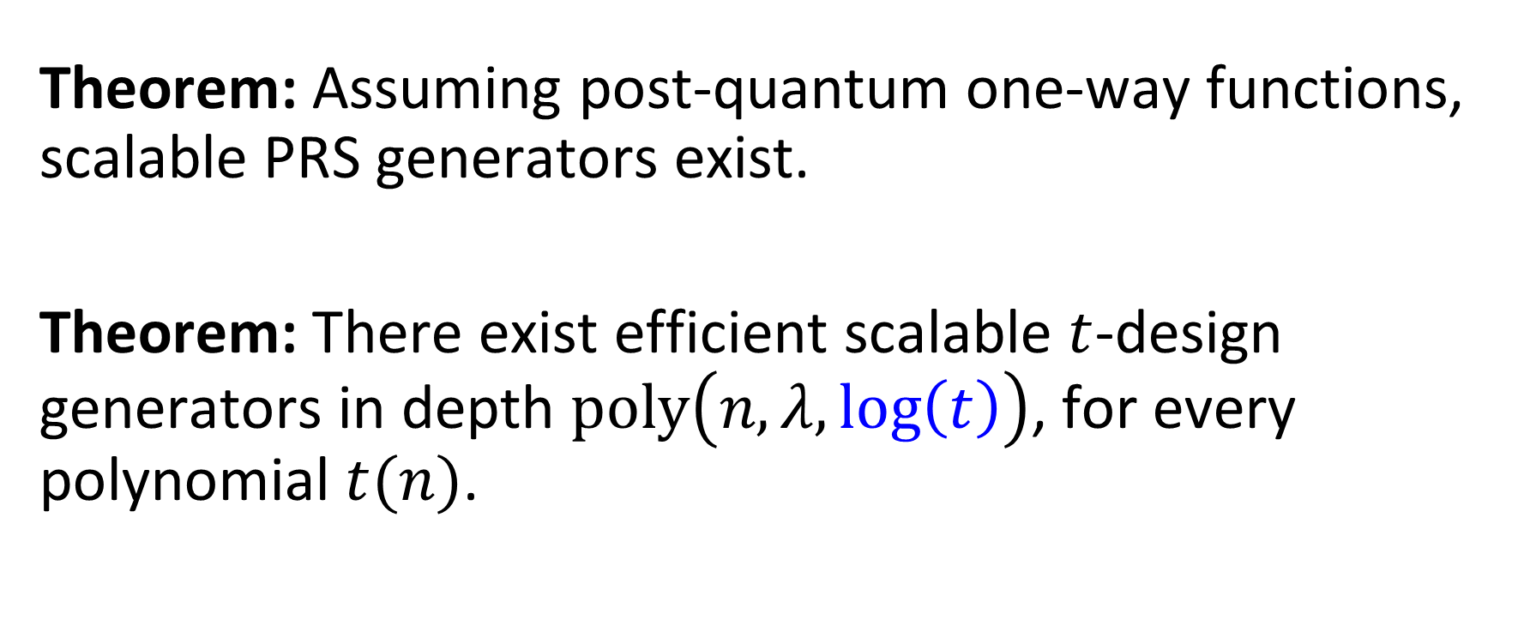
Main Theorems
Theorem: Assuming post-quantum one-way functions, scalable PRS generators exist.
Theorem: There exist efficient scalable $t$-design generators in depth $poly\left(n,λ,log\left(t\right)\right)$, for every polynomial $t(n)$.

Slide 15
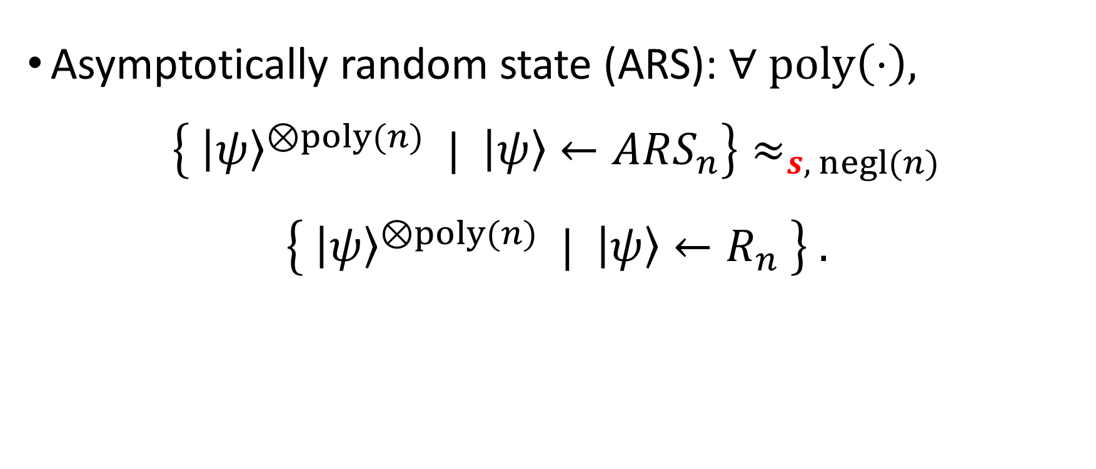
Asymptotically Random State Generator
Asymptotically random state (ARS): $∀ poly\left(⋅\right),$
$$\left\{ {\left|ψ\right\rangle }^{⊗poly(n)} | \left|ψ\right\rangle ←ARS_{n}\right\}≈_{s, negl(n)}$$
$$\left\{ {\left|ψ\right\rangle }^{⊗poly(n)} | \left|ψ\right\rangle ←R_{n} \right\} .$$

Slide 16
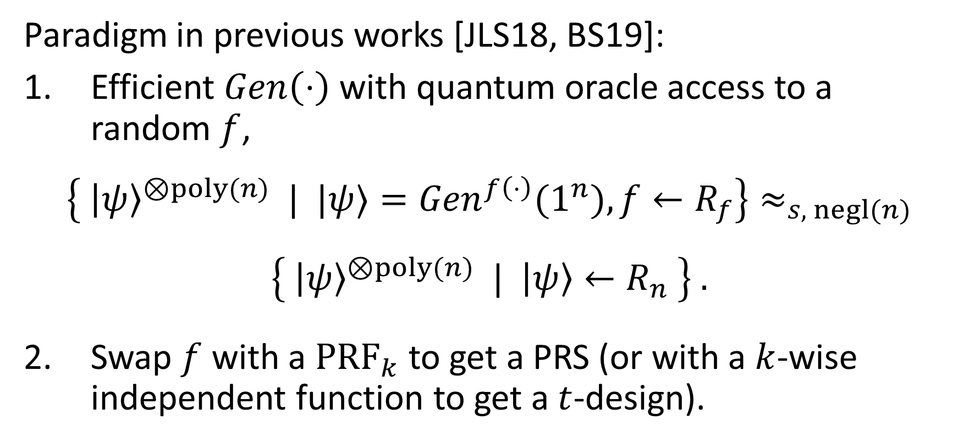
Asymptotically Random State Generator
Paradigm in previous works [JLS18, BS19]:
Efficient $Gen\left(⋅\right)$ with quantum oracle access to a random $f$,
$$\left\{ {\left|ψ\right\rangle }^{⊗poly(n)} | |ψ⟩={Gen}^{f\left(⋅\right)}(1^{n}), f←R_{f}\right\}≈_{s, negl(n)}$$
$$\left\{ {\left|ψ\right\rangle }^{⊗poly(n)} | \left|ψ\right\rangle ←R_{n} \right\} .$$
Swap $f$ with a ${PRF}_{k}$ to get a PRS (or with a $k$-wise independent function to get a $t$-design).

Slide 17
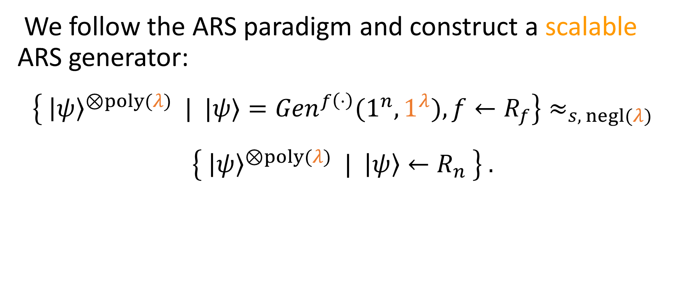
Scalable ARS Generator
We follow the ARS paradigm and construct a scalable ARS generator:
$$\left\{ {\left|ψ\right\rangle }^{⊗poly(λ)} | |ψ⟩={Gen}^{f\left(⋅\right)}(1^{n},1^{λ}), f←R_{f}\right\}≈_{s, negl(λ)}$$
$$\left\{ {\left|ψ\right\rangle }^{⊗poly(λ)} | \left|ψ\right\rangle ←R_{n} \right\} .$$

Slide 18
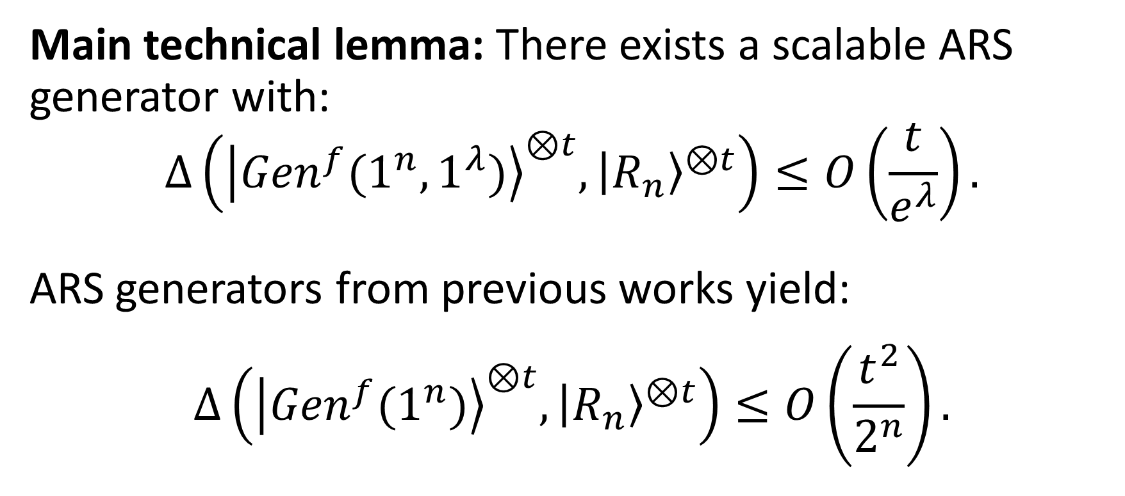


Our Scalable ARS Generator
Main technical lemma: There exists a scalable ARS generator with:
$$Δ\left({\left|{Gen}^{f}(1^{n},1^{λ})\right\rangle }^{⊗t},{\left|R_{n}\right\rangle }^{⊗t}\right)≤O\left(\frac{t}{e^{λ}}\right).$$
ARS generators from previous works yield:
$$Δ\left({\left|{Gen}^{f}(1^{n})\right\rangle }^{⊗t},{\left|R_{n}\right\rangle }^{⊗t}\right)≤O\left(\frac{t^{2}}{2^{n}}\right).$$
independent of $n$
depends on $n$

Slide 19
Our Scalable ARS Generator

Slide 20
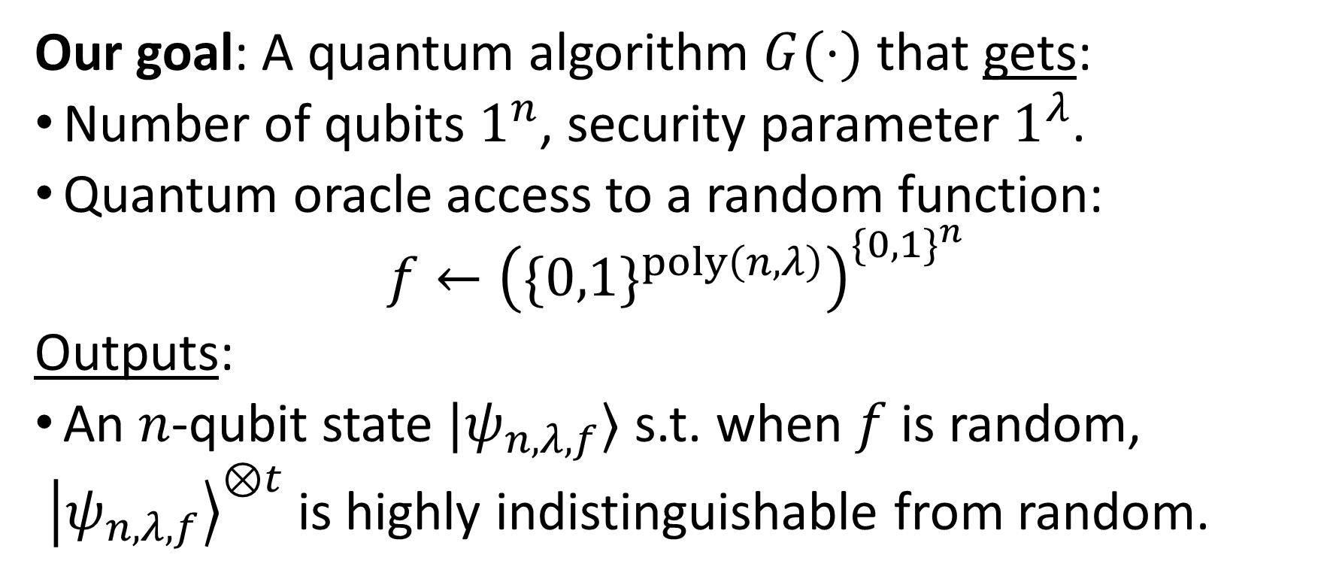
Scalable ARS Generator
Our goal: A quantum algorithm $G(⋅)$ that gets:
Number of qubits $1^{n}$, security parameter $1^{λ}$.
Quantum oracle access to a random function:
$$f←{\left(\{0,1\}^{poly\left(n,λ\right)}\right)}^{\{0,1\}^{n}}$$
Outputs:
An $n$-qubit state $|ψ_{n,λ,f}⟩$ s.t. when $f$ is random,
${\left|ψ_{n,λ,f}\right\rangle }^{⊗t}$ is highly indistinguishable from random.

Slide 21
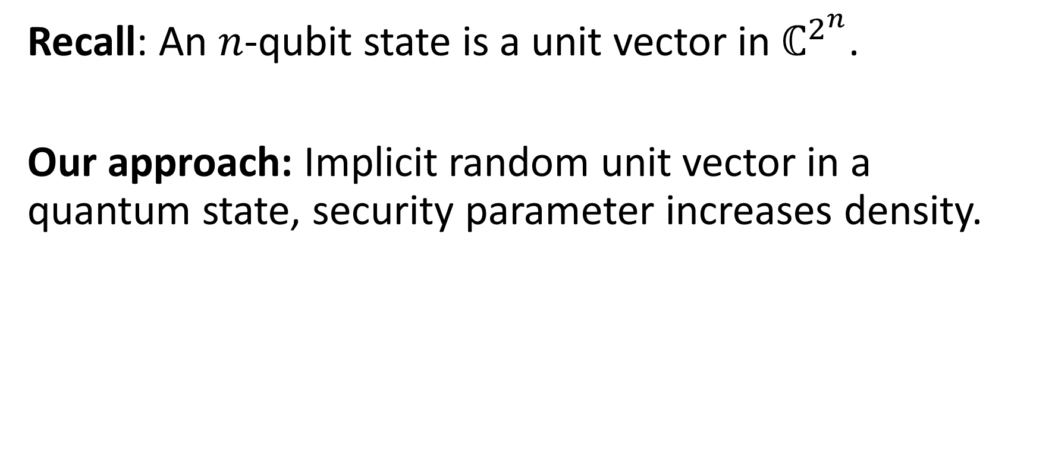
Scalable ARS Generator
Recall: An $n$-qubit state is a unit vector in $ℂ^{2^{n}}$.
Our approach: Implicit random unit vector in a quantum state, security parameter increases density.

Slide 22
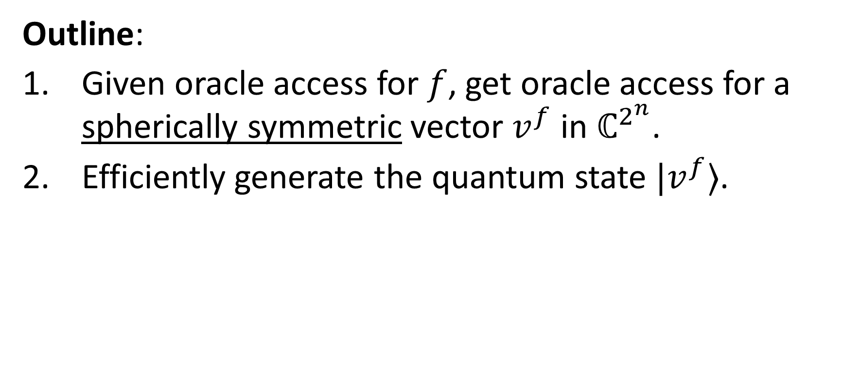
Scalable ARS Generator
Outline:
Given oracle access for $f$, get oracle access for a spherically symmetric vector $v^{f}$ in $ℂ^{2^{n}}$.
Efficiently generate the quantum state $|v^{f}⟩$.

Slide 23
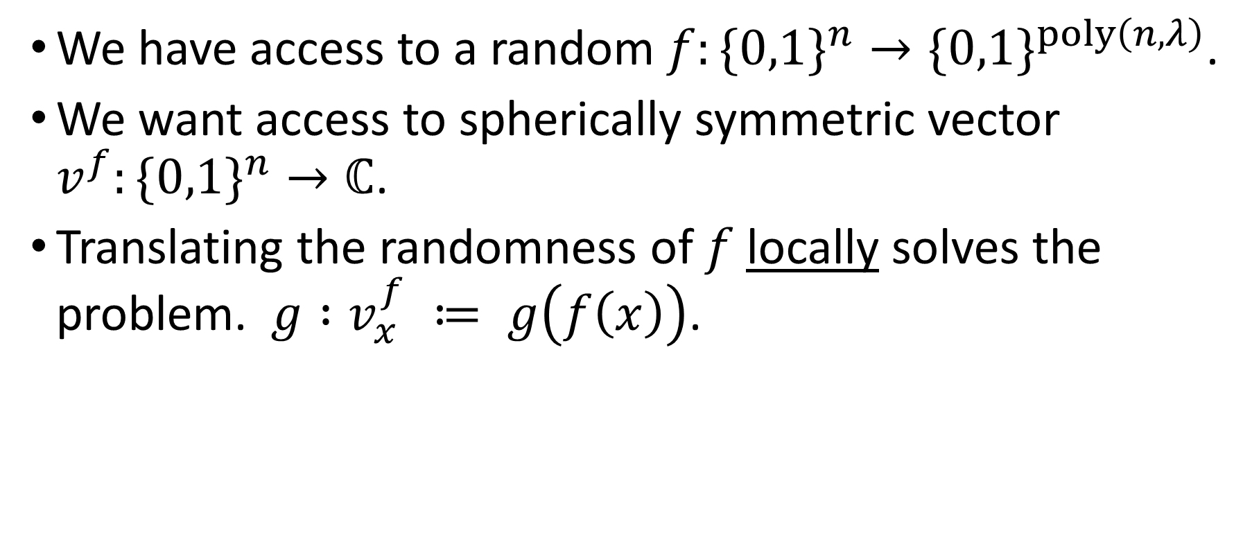
Oracle Access to a Spherically Symmetric Vector
We have access to a random $f:\{0,1\}^{n}→\{0,1\}^{poly\left(n,λ\right)}$.
We want access to spherically symmetric vector $v^{f}:\{0,1\}^{n}→ℂ$.
Translating the randomness of $f$ locally solves the problem. $g :v_{x}^{f} ≔ g\left(f\left(x\right)\right)$.

Slide 24
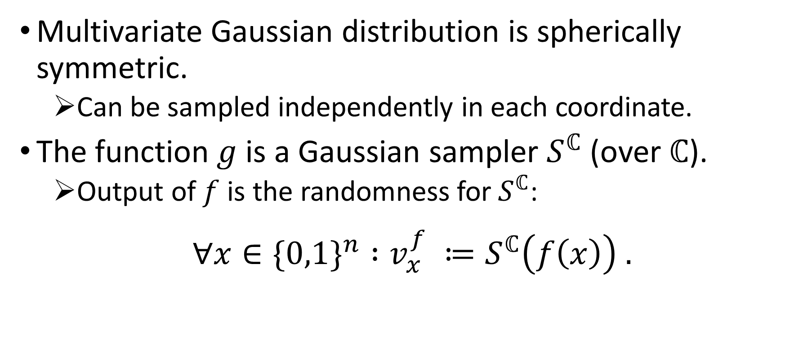



Oracle Access to a Spherically Symmetric Vector
Multivariate Gaussian distribution is spherically symmetric.
Can be sampled independently in each coordinate.
The function $g$ is a Gaussian sampler $S^{ℂ}$ (over $ℂ$).
Output of $f$ is the randomness for $S^{ℂ}$:
$$∀x∈\{0,1\}^{n} :v_{x}^{f} ≔S^{ℂ}\left(f\left(x\right)\right) .$$
$←$ known, very useful property
$$←$$
note that $S^{ℂ}$ samples from discrete distribution

Slide 25
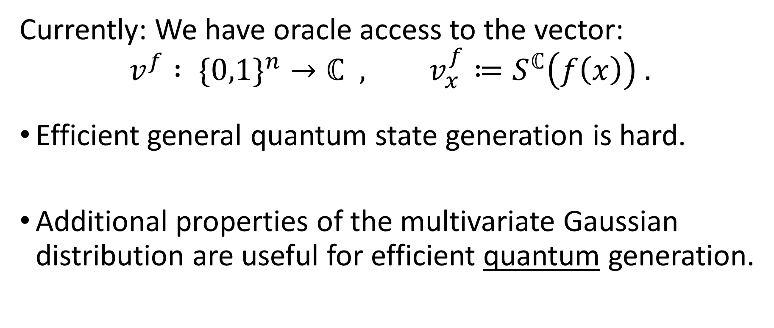
Gaussian State Generation
Currently: We have oracle access to the vector:
$$v^{f} : \{0,1\}^{n}→ℂ , v_{x}^{f}≔S^{ℂ}\left(f\left(x\right)\right) .$$
Efficient general quantum state generation is hard.
Additional properties of the multivariate Gaussian distribution are useful for efficient quantum generation.

Slide 26




Quantum Rejection Sampling
State generation tool we go for is quantum rejection sampling:
Given $F:\{0,1\}^{n}→ℂ$ that outputs $F\left(x\right)=\frac{1}{d }⋅\frac{β_{x}}{α_{x}}$ for some $d≥M$, can generate $|β⟩$ with probability $\frac{1}{d^{2} }$ .
$$M≔\max_{x}\left|\frac{β_{x}}{α_{x}}\right|$$
$$|α⟩$$
$$|β⟩$$

Slide 27
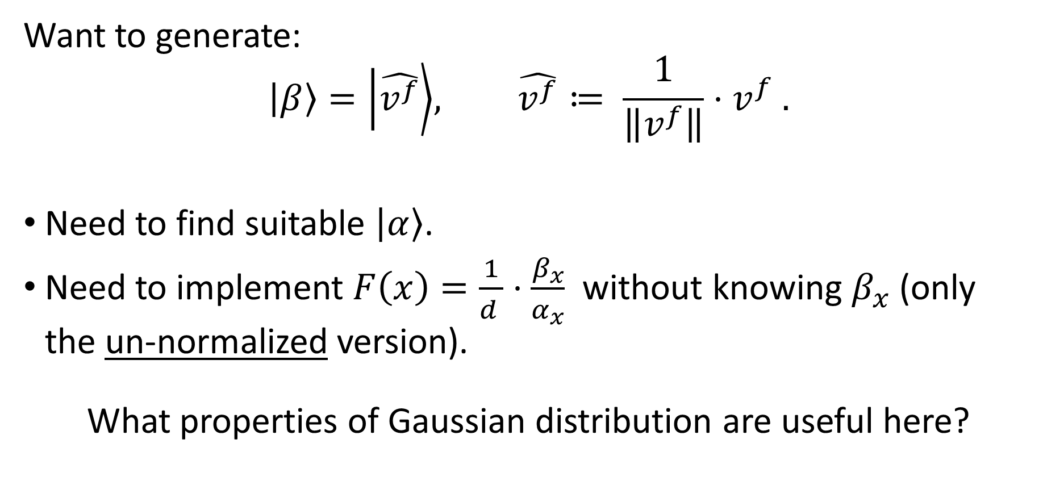
Gaussian State Generation
Want to generate:
$$\left|β\right\rangle =\left|\hat{v^{f}}\right\rangle , \hat{v^{f}}≔ \frac{1}{\left\|v^{f}\right\|}⋅v^{f} .$$
Need to find suitable $\left|α\right\rangle$.
Need to implement $F\left(x\right)=\frac{1}{d }⋅\frac{β_{x}}{α_{x}}$ without knowing $β_{x}$ (only the un-normalized version).
What properties of Gaussian distribution are useful here?

Slide 28
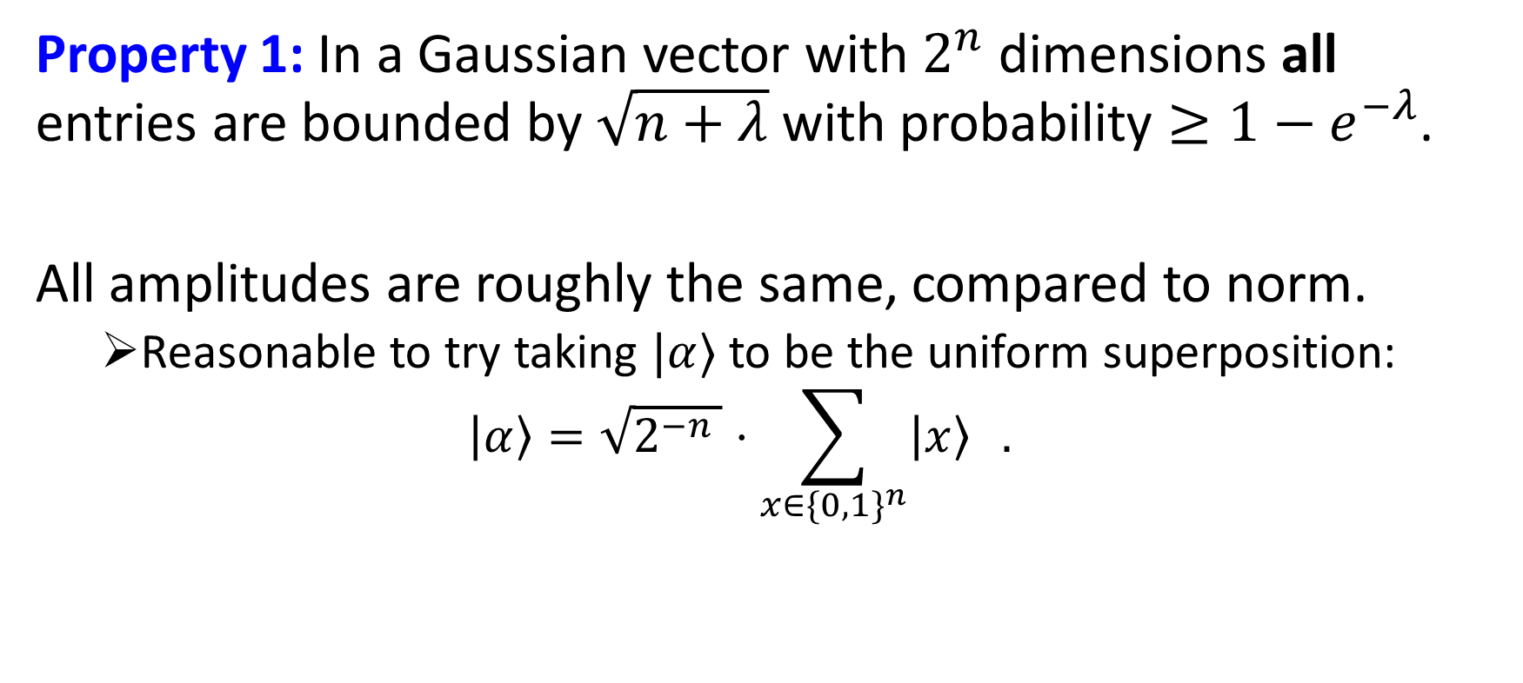
Gaussian State Generation
Property 1: In a Gaussian vector with $2^{n}$ dimensions all entries are bounded by $\sqrt{n+λ}$ with probability $≥1−e^{−λ}$.
All amplitudes are roughly the same, compared to norm.
Reasonable to try taking $|α⟩$ to be the uniform superposition:
$$\left|α\right\rangle =\sqrt{2^{−n }}⋅\sum_{x∈\{{0,1\}}^{n}}{\left|x\right\rangle } .$$

Slide 29
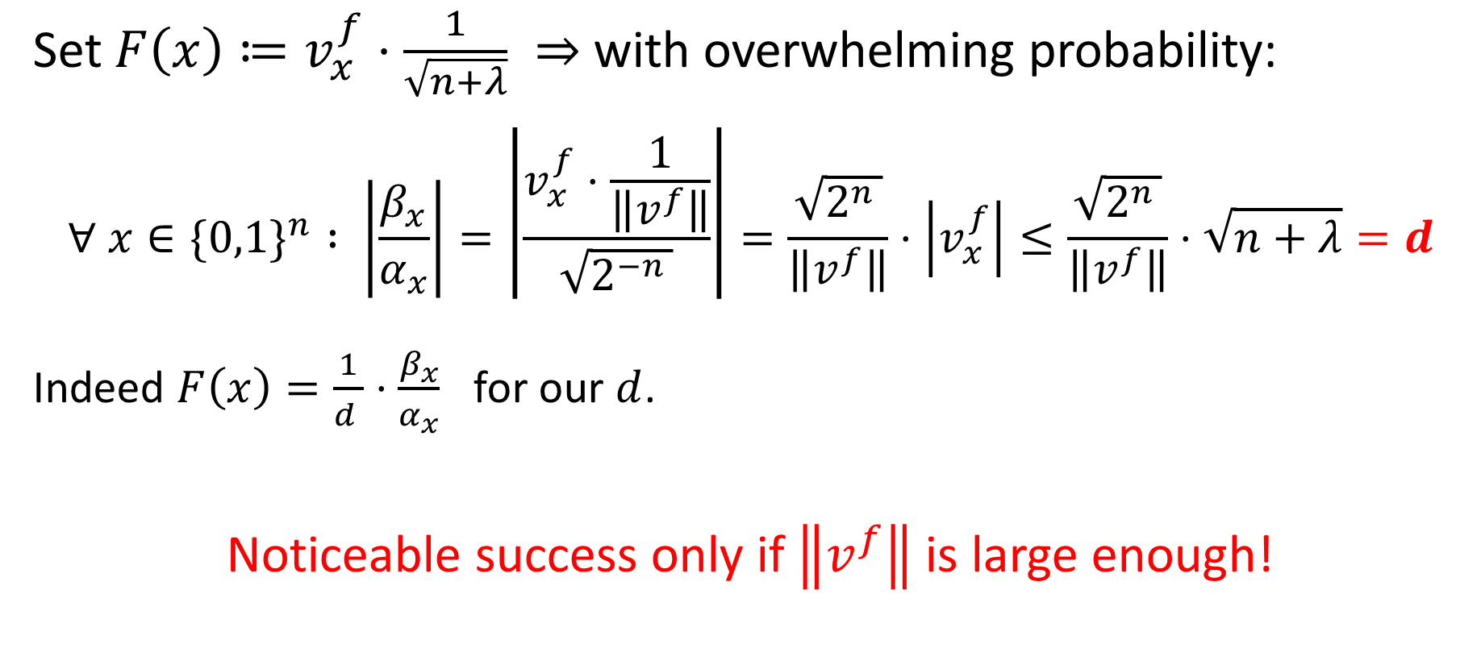
Gaussian State Generation
Set $F\left(x\right)≔v_{x}^{f}⋅\frac{1}{\sqrt{n+λ}} ⇒$ with overwhelming probability:
$$∀ x∈\{0,1\}^{n} : \left|\frac{β_{x}}{α_{x}}\right|=\left|\frac{v_{x}^{f}⋅\frac{1}{\left\|v^{f}\right\|}}{\sqrt{2^{−n }}}\right|=\frac{\sqrt{2^{n }}}{\left\|v^{f}\right\|}⋅\left|v_{x}^{f}\right|≤\frac{\sqrt{2^{n }}}{\left\|v^{f}\right\|}⋅\sqrt{n+λ}=d$$
Indeed $F\left(x\right)=\frac{1}{d }⋅\frac{β_{x}}{α_{x}}$ for our $d$.
Noticeable success only if $\left\|v^{f}\right\|$ is large enough!

Slide 30
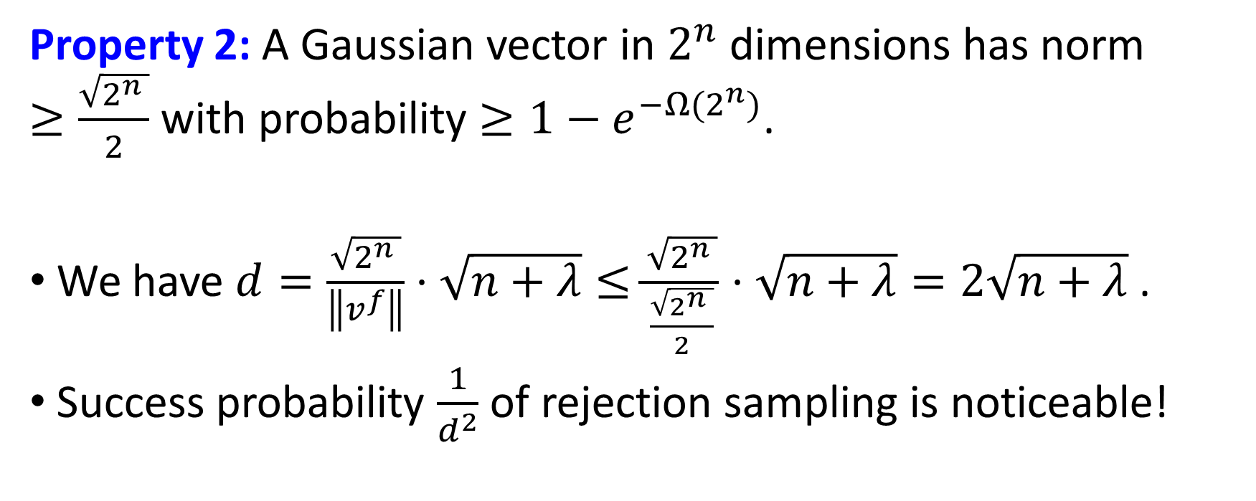
Gaussian State Generation
Property 2: A Gaussian vector in $2^{n}$ dimensions has norm $≥\frac{\sqrt{2^{n }}}{2}$ with probability $≥1−e^{{−Ω(2}^{n})}$.
We have $d=\frac{\sqrt{2^{n }}}{\left\|v^{f}\right\|}⋅\sqrt{n+λ}≤\frac{\sqrt{2^{n }}}{\frac{\sqrt{2^{n }}}{2}}⋅\sqrt{n+λ}=2\sqrt{n+λ}$ .
Success probability $\frac{1}{d^{2}}$of rejection sampling is noticeable!

Slide 31
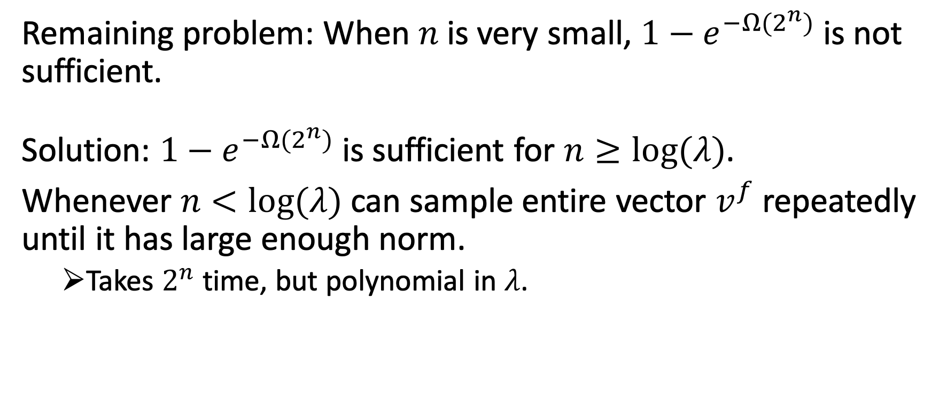
Gaussian State Generation
Remaining problem: When $n$ is very small, $1−e^{{−Ω(2}^{n})}$ is not sufficient.
Solution: $1−e^{{−Ω(2}^{n})}$ is sufficient for $n≥log(λ)$.
Whenever $n<log(λ)$ can sample entire vector $v^{f}$ repeatedly until it has large enough norm.
Takes $2^{n}$ time, but polynomial in $λ$.

Slide 32
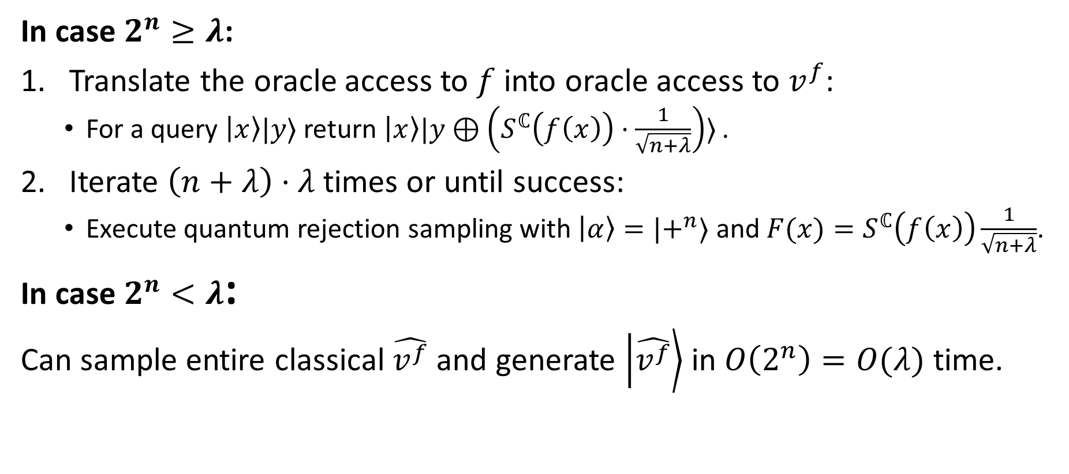
Scalable ARS Generator Algorithm
In case $2^{n}≥λ$:
Translate the oracle access to $f$ into oracle access to $v^{f}$:
For a query $\left|x\right\rangle |y⟩$ return $\left|x\right\rangle |y⊕\left(S^{ℂ}\left(f\left(x\right)\right)⋅\frac{1}{\sqrt{n+λ}}\right)⟩$ .
Iterate $\left(n+λ\right)⋅λ$times or until success:
Execute quantum rejection sampling with $\left|α\right\rangle =|+^{n}⟩$ and $F(x)=S^{ℂ}\left(f\left(x\right)\right)\frac{1}{\sqrt{n+λ}}$.
In case $2^{n}<λ$:
Can sample entire classical $\hat{v^{f}}$ and generate $\left|\hat{v^{f}}\right\rangle$ in $O\left(2^{n}\right)=O(λ)$ time.

Slide 33
Thanks for listening!

