Slide 1

Award Ceremony

Slide 2
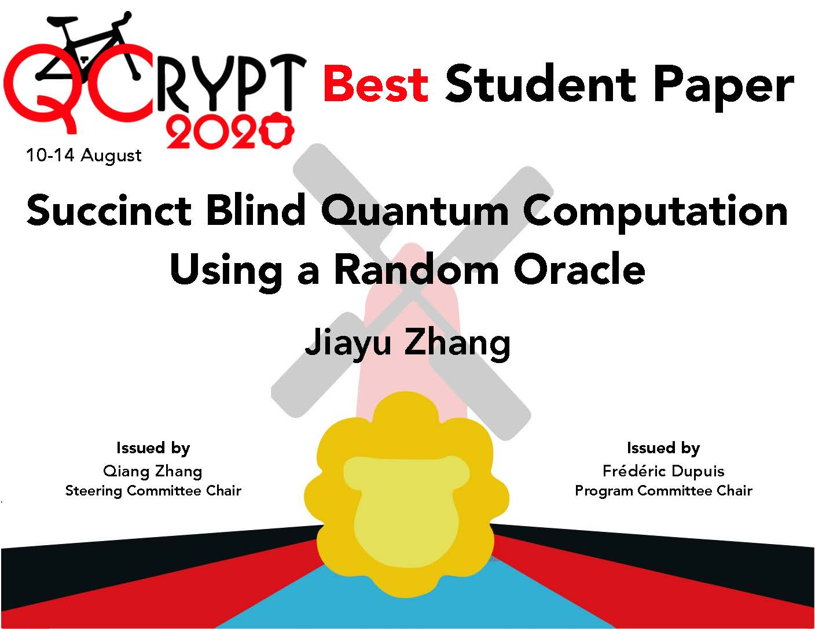
Best student paper award I

Slide 3

Best student paper award II

